Slide 2
Transverse MD subjects for 2018
V. Forte, M. Fraser, A. Huschauer
in collaboration with the PS MD users
LIU-PS Beam Dynamics Working Group, 17 May 2018

Slide 3
PSB-to-PS transfer line investigations
Investigation of BT-BTP calibration errors
  Kick response as a function of quadrupole gradients
Re-matching of BT-BTP transfer line to PS (dedicated MD )
  Correcting for measured calibration errors
  Requirements:
    Injection SEM grids (single pass and multi-turn)
    Cycle setup with low chromaticity (standardised MD cycle)
    Verification of SEM grid protection
  Use of quadrupolar pickup: analyse injection mismatch in collaboration with A. Oeftiger
  optics measurements: dispersion and kick response, emittance blow-up sensitivity studies to mismatch (dispersive and betatronic mismatch)
  BGI and emittance measurements: continued investigations (e.g. RF ON/OFF )

Slide 4
Analysis of emittance blow-up from PSB-to-PS
Analysis of LHC beams at different longitudinal emittances
  repeat with standard and then BCMS beam
  Understand extracted emittance coming from PSB
  WS, 3 SEM grids and k-scan on single SEM-grid in BTM (PSB MD)
  Backed up by simulations of emittance measurements including deconvolution algorithms
  Understanding of single-particle sources of emittance growth:
  Steering errors at injection
  Momentum errors at injection

Slide 5
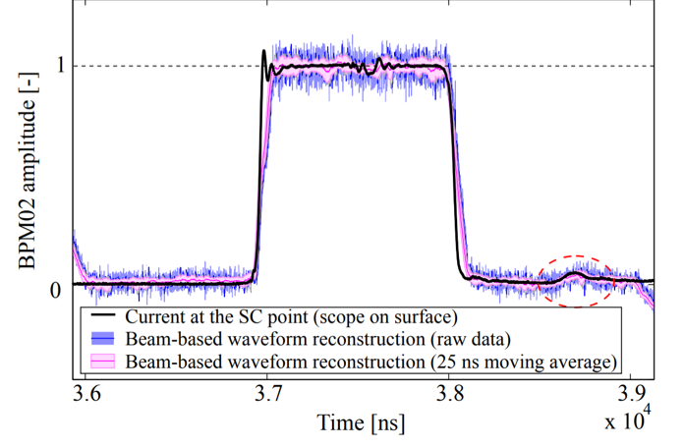
Analysis of post-pulse ripple amplitude of PS proton injection kicker KFA45
Non-scaling of post-pulse ripple with voltage reported by ABT-PPE
  verification with beam
Understand minimum voltage needed for KFA45 as optics kicker:
  overcome present control software limitations by ramping, kicking at higher voltage and scaling with rigidity

Slide 6
Studies in the ring
Cycle setup with low-chromaticity
  Standardised MD cycle for injection studies
  Follow-up of the working point optimization along the cycle
Chromaticity correction with new sextupoles (PR.XNO)
Injection bump studies
  Single particle contribution to emittance blow-up appears small
  Verification with optics measurements
  Check emittance blow-up at second instance of injection
  Including space charge contribution in simulations
Optics measurements
  Measurements of ring optics, coupling and RDTs
  Aim at an optics correction (e.g. localized coupling correction)
  Benefit from synergies between PSB and PS studies (TFB as AC dipole)

Slide 7
Studies in the ring
Tune diagram measurements
  Importance of remnant fields identified
  Contribution of the various non-linear elements being investigated
Measurements of amplitude detuning and benchmarking of the model
Space charge and resonance compensation studies
Improvement of the working point control
  Optimization on the LHC cycles
  PFW matrix measurement campaign
  Implementation/testing of LSA tools
Commissioning of the horizontal BGI
  Resonance crossing to observe blow-up under controlled conditions

Slide 8
THANK YOU FOR YOUR ATTENTION!

