Slide 1
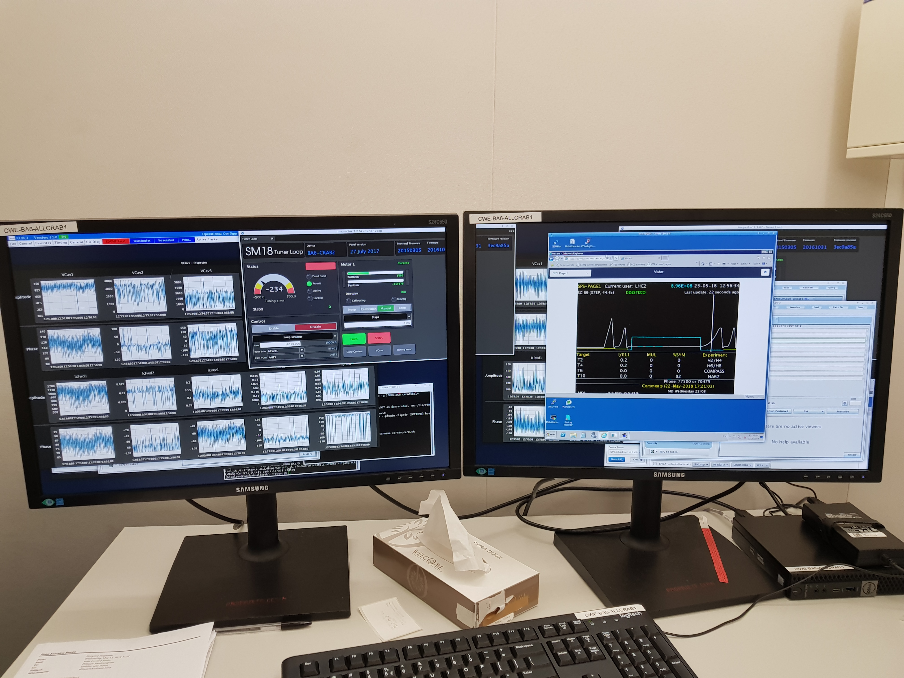
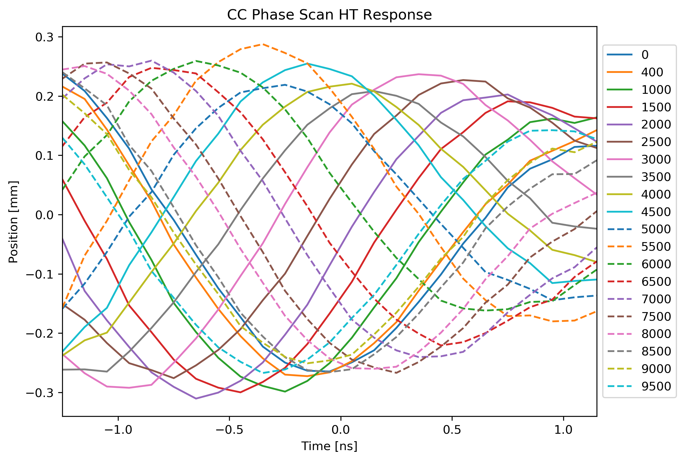
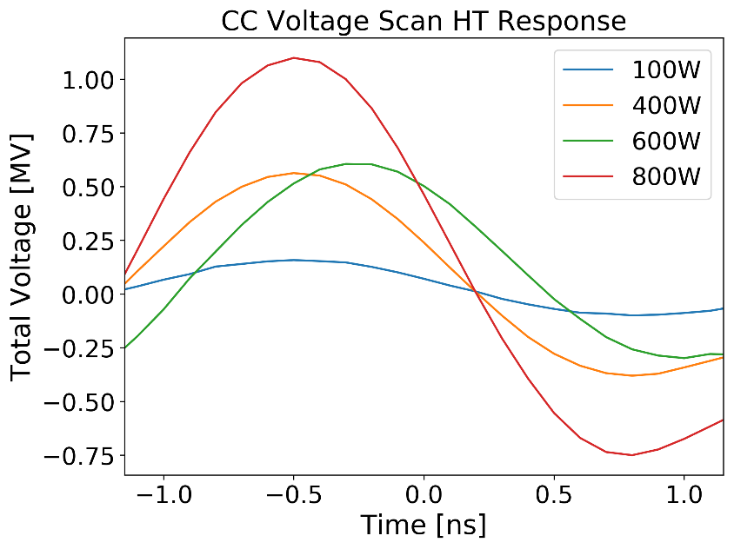
MD #1 – Protons meet Crabs
First injection – 12:55, May 23
Preliminary analysis (phase scan & voltage scan)
steps
Approx

Slide 2
Next Steps
Next MD on 30/05
  Move to ~1 MV/cavity (limited by 4.5K)
  Need to commission closed cavity loops, beam calibration and test 270 GeV
June: No MDs planned, 2-3 weeks of cryo re-commissioning to 2K approx. 20/06, RF conditioning
July: 2K & LLRF fully deployed → ~3 MV/cavity

