Slide 1
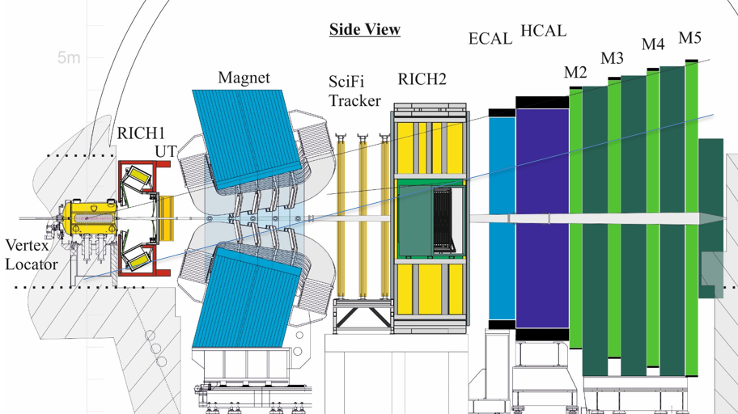
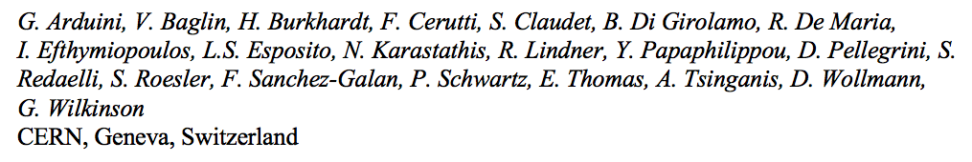

Implications for running LHCb with higher luminosity – quick view
Note editor Ilias Efthymiopoulos
50th HL-LHC TCC Meeting – 24 May 2018

Slide 2
Scope of the upgrade: up to LS4
Initial LHCb configuration, readout limited (1 MHz), allows to reach by LS2 an integrated luminosity of 8 fb⁻¹, at a
Major upgrade during LS2 for readout (every detector at 40 MHz) and few higher rate-capable detectors make the experiment to collect 50 fb⁻¹ at

Slide 3
Scope of the upgrade: starting from LS4
Further modifications to allow the experiment to collect 50 fb⁻¹ every year if able to work at
This implies adapting the beam optics as well as increasing the protections for both LHC elements and for the detectors

Slide 4
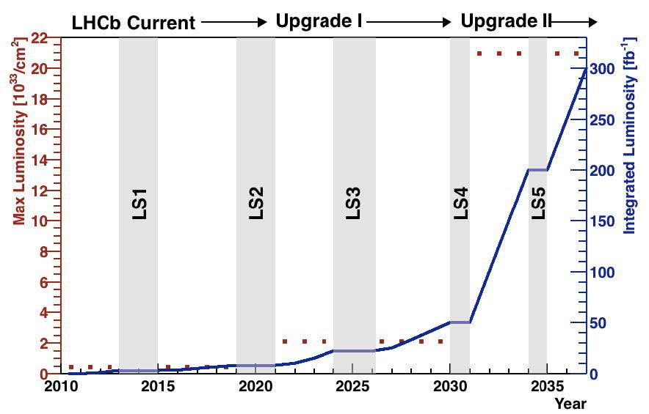
In summary

Slide 5
Deadlines and implications
The main deadline was triggered by LHCb for the LHCC meeting in June
  A letter of intent was produced and is being refined
  LHCb wants to show that there are no showstoppers
On our side we need to fix the details of the changes to have an initial estimation of the costs
The scope here is beyond HL-LHC budget, it will have to be absorbed by LHC and LHCb for the respective upgrades

Slide 6
Status of the studies
Note status: being corrected by Ilias with the latest comments to be addressed
  More studies needed for beam-beam effects and energy deposition
  Possible refinements in the mechanism of rotating the crossing plane during ramp
  More understanding on β* optimizations in IP1 and IP8, which are “ATS-inter-dependent”
Full costing not yet completed and need of reality check with integration studies
This is just a first look at the situation, a more refined talk will have to be done later

Slide 7
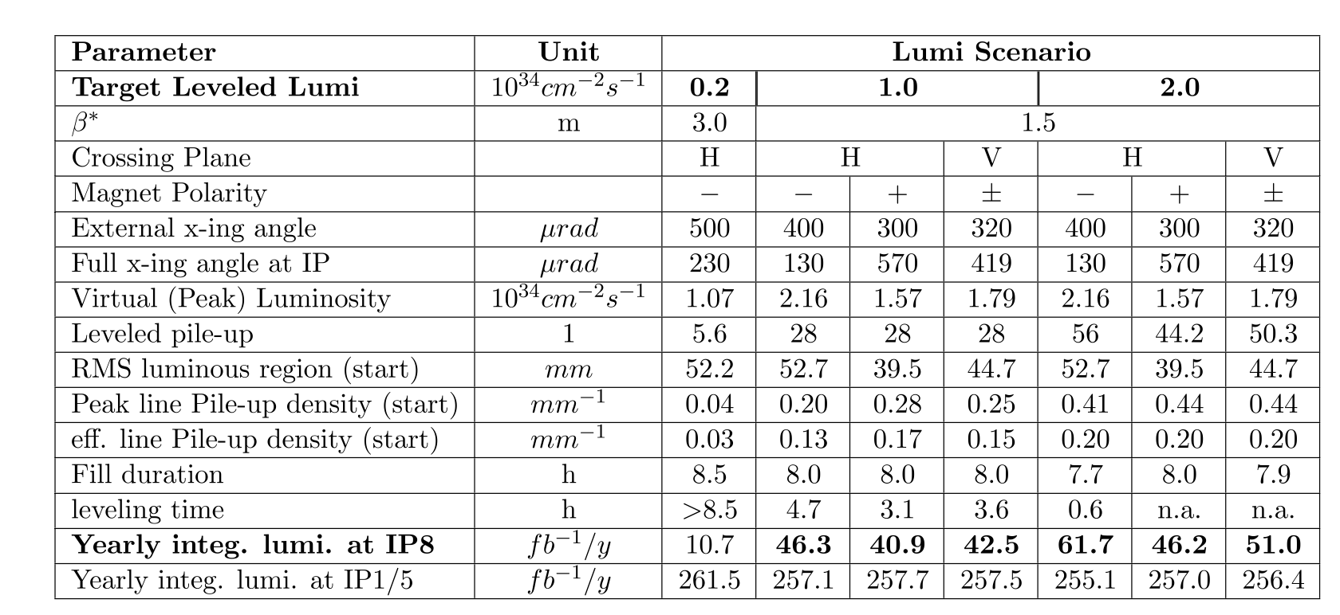
Can parameters be found to make the dream real? Yes
Unavoidable impact on ATLAS and CMS is limited to 2-3%

Slide 8
Mandatory machine elements
Protections that haven’t been considered before
  A TAS-like based on filling with tungsten bars the MBXWS magnets
  Possibly a longer TAN than currently planned to install during LS2 (44 cm tungsten)
  Prolongation of the shielding to Q1 interconnect (a reinforcement as in HL-LHC)
  TCL collimators for Q5 protection
Possible impact in cryogenics to be still evaluated
Impact in ventilation system, R2E needs, increasing wall thickness and density on one side
Vacuum equipment displacement from hot regions round TAS-like to be evaluated
Ageing of MBXWS and provision for substitution to be evaluated

Slide 9
Cost evaluation
Absorbers TAS and TAN: quite some amount of tungsten ~ 2 MCHF
Two collimators ~ 1 MCHF (all included, cables, controls)
All the rest is being evaluated in more detail, my guess 1-1.5 MCHF

Slide 10
What next
I think a more substantial presentation of the changes has to be done at a future TCC, this is a quick view
A more refined costing is being prepared. It won’t be very precise, but it could be with 100 kCHF error level instead of 1 MCHF
If the cost is seen as a showstopper we need to say
Integration studies need to be done.
  On the right side IP8 is complicated by beam 2 injection elements
  Space for TAN, TCL, other possible absorbers is very limited

