Slide 1
New Vacuum Pumping Ports in the ARCs linked to the 11T and TCLDs Installation
G.Bregliozzi & E. Page
TE-VSC

Slide 2
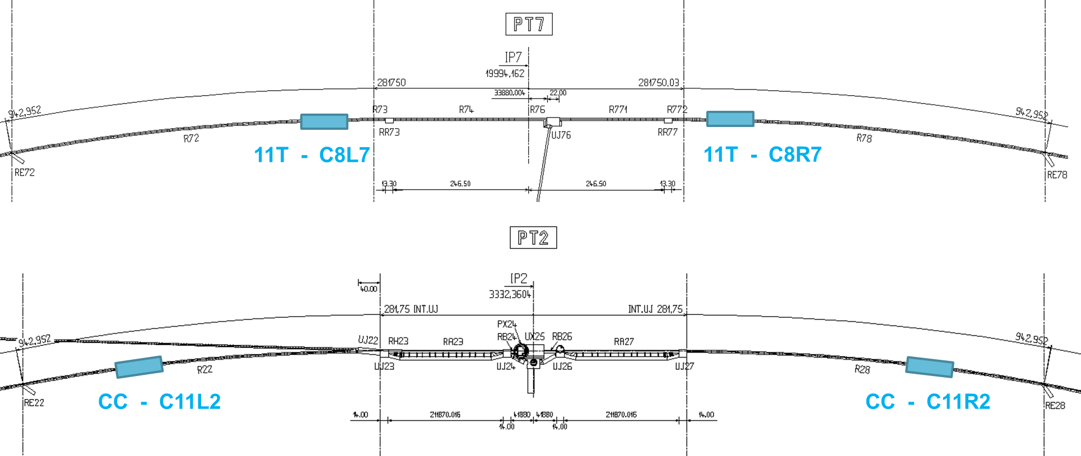
Existing situation: Point 2 & 7
ARC67
ARC78
LSS7
TI2
ARC12
ARC23
LSS2

Slide 3
Reason for Change
ARC12.B
LSS1
LSS2
ARC12.R
Need to add a new pumping port
ARC12.B
LSS1
LSS2
TCLD
ARC12.R - A
ARC12.R - B
ARC12.R - C

Slide 4
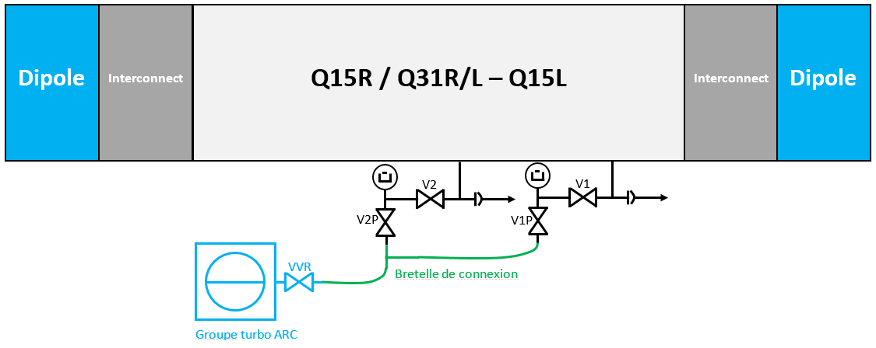
LHC ARCs: Locations for the pump down
Locations per ARC available
Q12L/Q15L/Q23L/Q31L
Q31R/Q23R/Q15R/Q12R
Point 7: No available pumping ports
Point 2: Available point ports but need of new cables for gauges installation

Slide 5
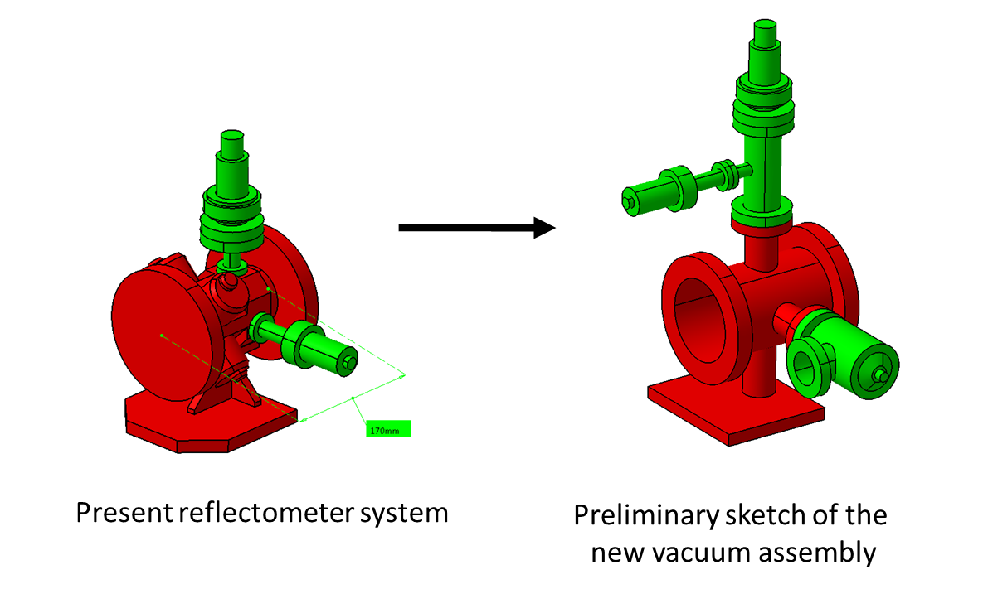
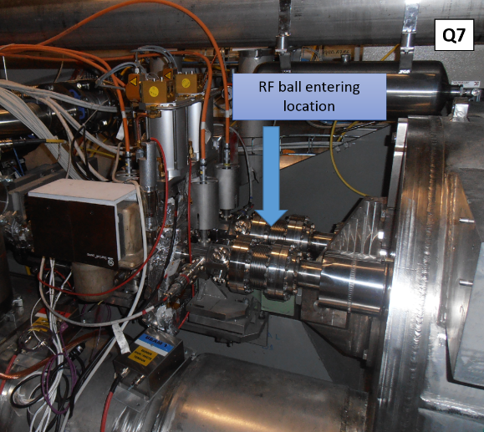
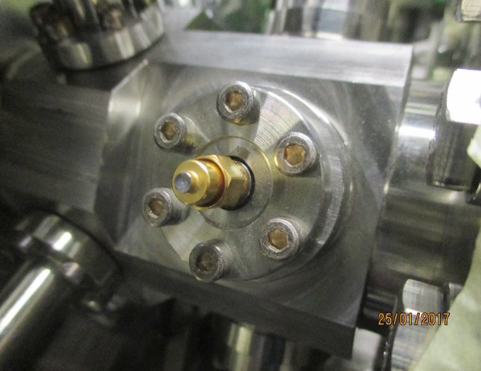
Proposed solution: Upgrade of existing modules in the Q7 magnets
Removal of RF pickup of the reflectometer system in the ARC of the LHC
This reflectometer assembly was used in the past in surface to allow checking the beam screen for obstacles during the construction phase of LHC.
No needs of additional mechanical works on cryostart
No need of new cabling
No aperture variation
No impedance variation
The hardware was installed but the system was was never put in place and never used.

