Slide 1
ECR for a Beam Gas Curtain (BGC) Demonstrator
Stage 1
Ray VENESS, Tom Dodington, Rhodri Jones, Stefano Mazzoni, Gerhard Schneider
With thanks to
E.Page, O.Santos, P.Santos Diaz / TE-VSC
G.Mazzacano, Benoit Salvant / BE-ABP
M. Gonzalez de la Aleja Cabana / ATS-DO

Slide 2
Introduction and motivation for the Demonstrator
Beam Gas Curtain (BGC) is the baseline instrument for on-line monitoring of the overlap between proton and electron beams in the hollow e-lens
BGC development in progress by funded by HL-LHC collaboration KN 2970 (Cockcroft Institute), with participation of GSI experts
Prototypes extensively tested with electron gun sources, but there are a number of performance criteria that can only be demonstrated by operation with 7 TeV coasting proton beams
  Operating scenarios in the LHC synchrotron light background
  Hadron shower noise background reduction due to reduction of length of the gas pressure bump
  Operations with VSC in the baked LHC vacuum environment
If this instrument is to be operational post- LS3, then some preliminary steps need to be taken in LS2
  This instrument should include a new vacuum sector and significant cabling, so it would be difficult to implement outside of a long shutdown

Slide 3
Staged installation strategy
Instrument development in-progress, so final designs not available before late 2018
  Full demonstrator will not be ready for installation before early 2020, depending on successful qualification on an e-gun test stand at CERN/Cockcroft
  CERN management request all ECRs for LS2 by mid-2018
Agreed with HL Integration team to propose a two-stage ECR process:
  Stage 1 (today), install one new sector valve, new shielded vacuum chamber, pull cables for the final system to new racks
  Stage 2, a second ECR for the full instrument to follow in late 2018
Completion of stage 1 would mean that no further vacuum or beam impedance changes to the machine should be required
  The remaining instrument components would be added behind vacuum valves
This staged approach proved successful for the BGV demonstrator, with new vacuum sector and special vacuum chamber installed in LS1 followed by gas injection and detectors during technical stops

Slide 4
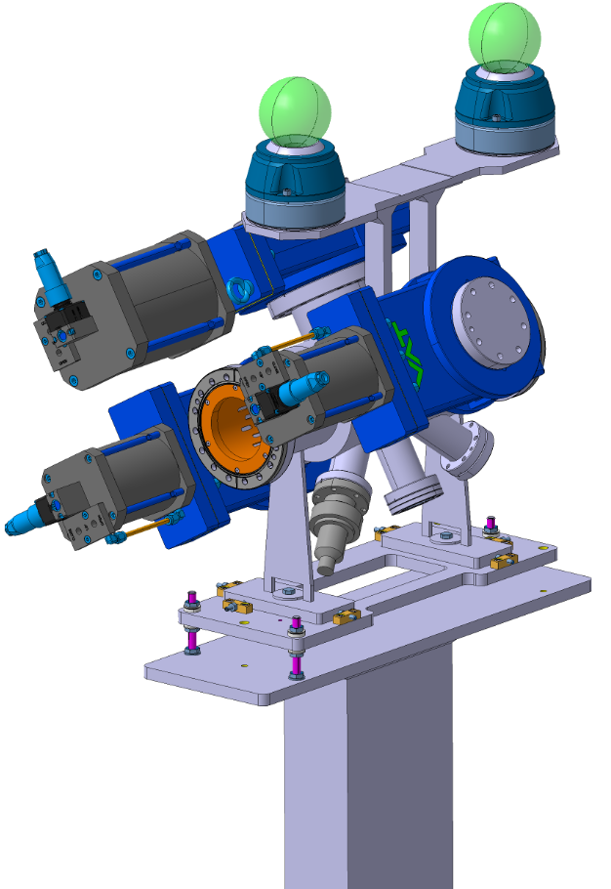
New BGC equipment for this ‘Stage 1’ ECR
Survey targets
New shielded vacuum chamber
3 x all-metal gate valves
Vacuum instrumentation and viewport

Slide 5
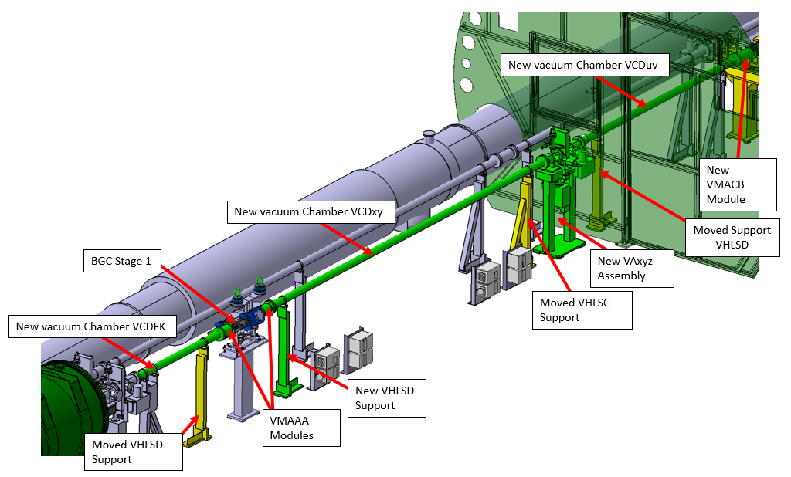
New beamline components for LS2

Slide 6
New LHC layout following this ‘Step 1’ ECR

Slide 7
Status of the approval and installation
Request has been in PLAN (#10834) since 2015, with resources approved by all contributing groups
  BE-ABP, EN-EL, EN-MME, TE-VSC, EN-ACE, EN-SMM
DIF and DIC submitted and in the LS2 baseline for full BGC demonstrator and vacuum instrumentation cables
  One last request for racks pending the circulation of this ECR
ECR ready for circulation
  TE-VSC contributed for new vacuum sector
  Joint working meetings ongoing with TE-VSC for pumping and machine vacuum aspects
Impedance Working Group #17 stated “…overall acceptable impedance if compared with the budget.”
Safety assessment made, documented in EDMS 1936384

Slide 8
WP13 therefore requests that the TCC:
Support the proposal for a BGC demonstrator for installation in the LHC
Approve circulation for comment of the ECR “Installation of a Beam Gas Curtain (BGC) Demonstrator – Stage 1”
  This would then proceed for standard LHC circulation process, followed by approval in the LMC
  The ECR for ‘Stage 2’ will follow toward the end of 2018, when final designs are available

Slide 9
Reserve slides

Slide 10
Beam-Gas Curtain: Instrument Components
Note: This shows a potential integration of a laboratory prototype (v2), NOT an instrument designed for the LHC
Gas exhaust system and diagnostics
Beam-gas interaction chamber, with gate valves to isolate beam vacuum from other components (in blue)
Gas jet generator, consisting of gas bottle, high-pressure nozzle, molecular flow skimmers and vacuum pumps
Optical acquisition system, separated from beam vacuum by a viewport

Slide 11
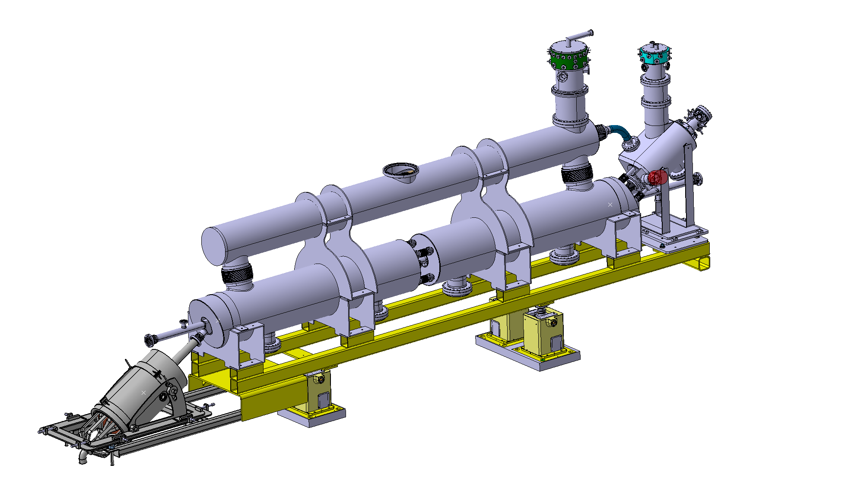
E-gun solenoid
HL-LHC protons
~ 3000 mm
Main solenoids
Beam position instrumentation
Collector
Slide from D.Perini – this meeting

Slide 14
