Slide 1

Resolver issue mitigation
Issue identified with larger resolver (PSB & PS type) and the vacuum barrel
1) Analog signals filtering (Patrik)
Provides stable position – tested in the PS
Ready for motion with Dspace (during technical stop?)
2) RDC Phase lock and amplitude adaptation
Implemented in the new electronics (VFC based)
Provides very stable position when adjusted (see next slide)
Requires modification of circuits – ready for starting new version
3) Influence of the membrane type (2D or 3D forged)
4) Installation of a PSB type resolver in the PS

Slide 2
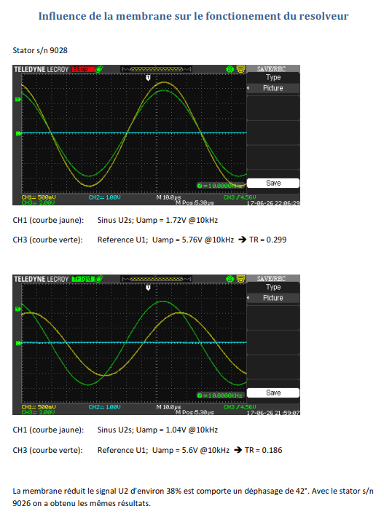
Admotec Precision AG report

Slide 3
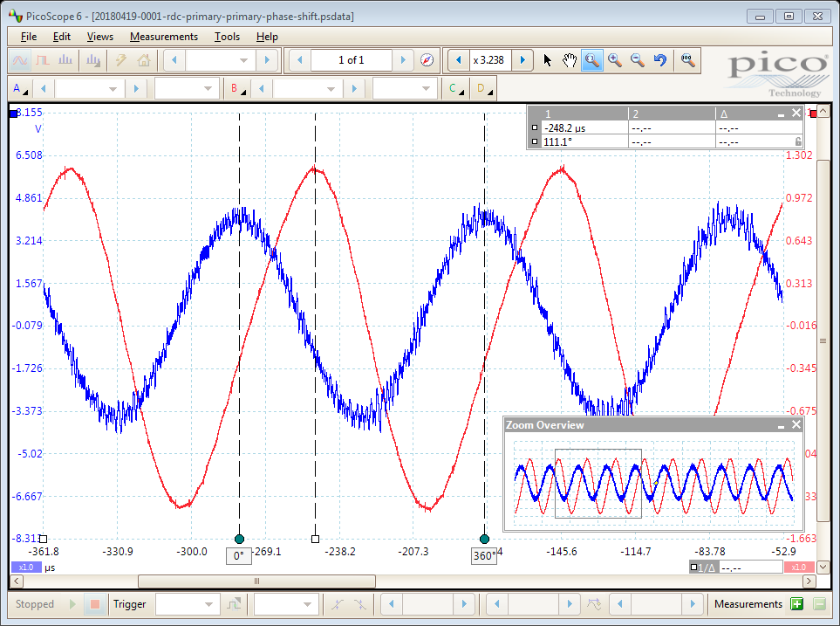
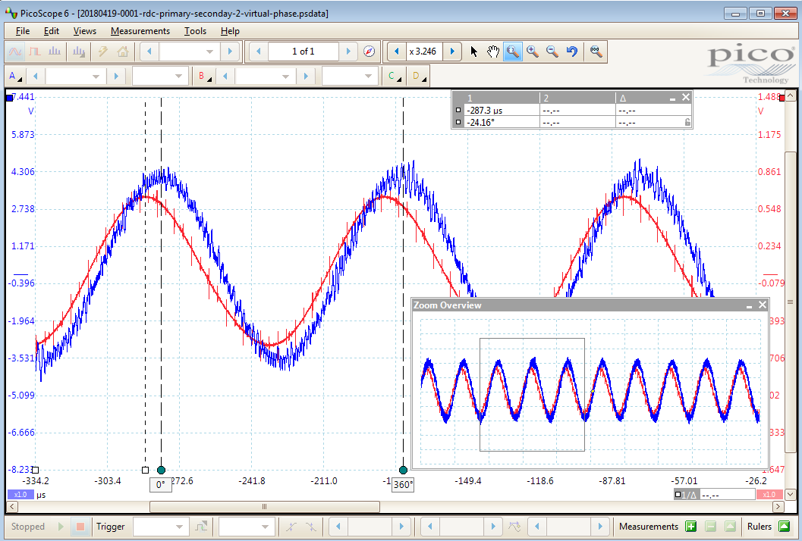
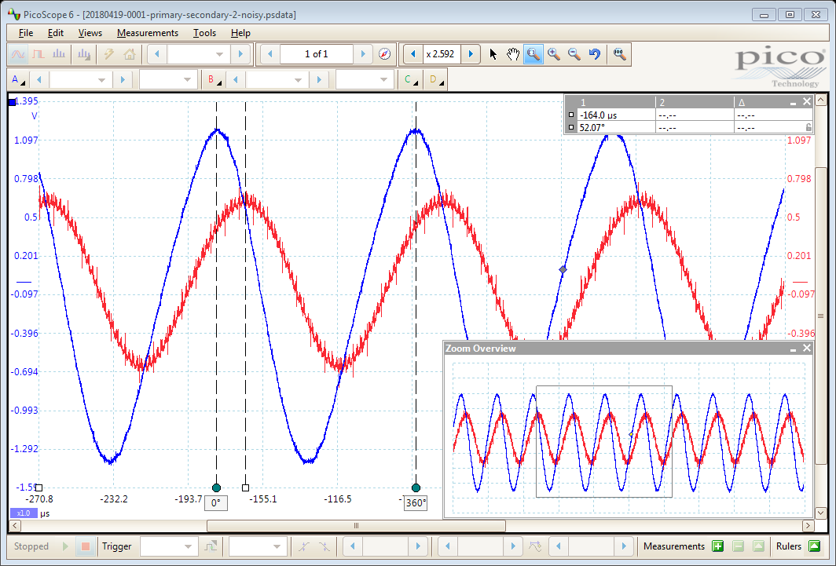
Phase alignment principle using FPGA
RDC stimulation (blue)
Reconstructed stimulation with defined phase
~ +111 deg
Phase introduced by the resolver & cable
Primary (blue)
Secondary (red)
Phase +52 deg
Primary to secondary phase seen by the RDC: -24 deg

Slide 4
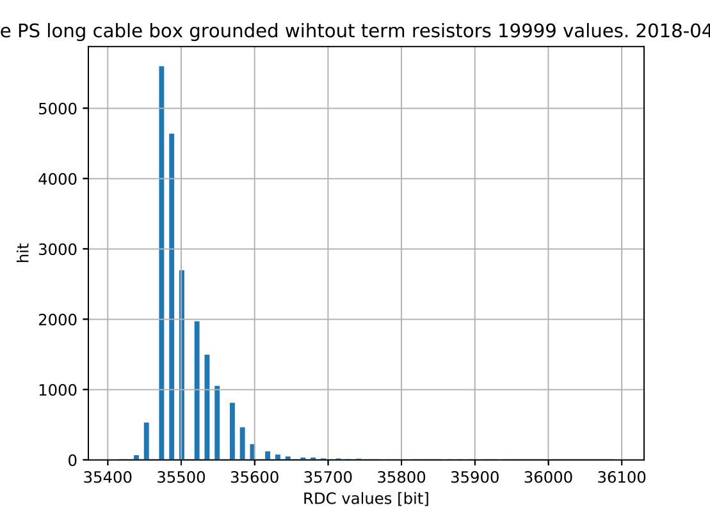
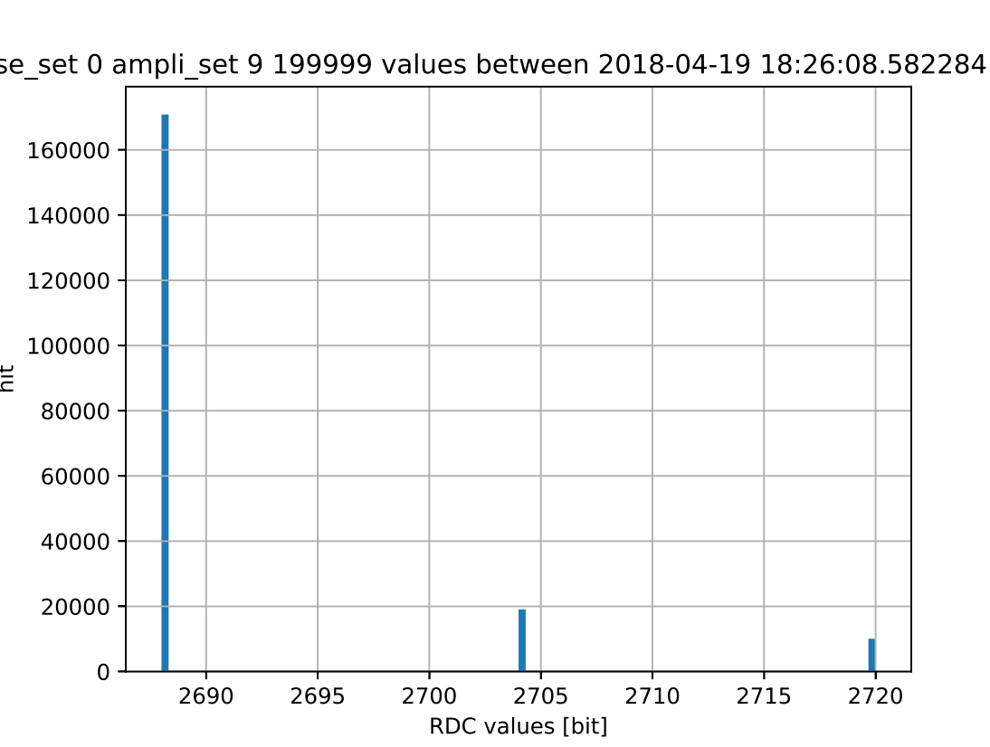
Measures in the PS with the resolver
WITHOUT PHASE ALIGNMENT
20k values (~every 2.5ms)
35750 – 35430 = 320 => 80 values (14 bits resolution)
Effective resolution: ~8 bits
WITH PHASE ALIGNMENT
200k values (~every 2.5ms)
Systematic small shit at defined USER (sychro with the machine)
2720-2688=32 (16 bits) => 8 bits shift (14 bits)
Effective resolution (long term) 14-3 = 11 bits! (short term is 14 bits)
Transition between values (small shit)
to be recorded with Firmware update

Slide 5
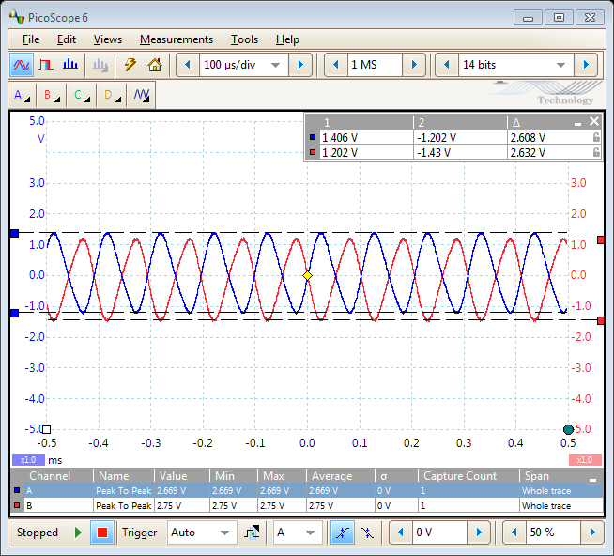
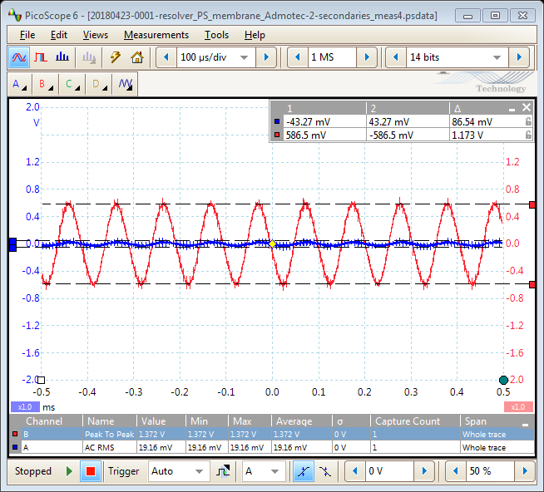
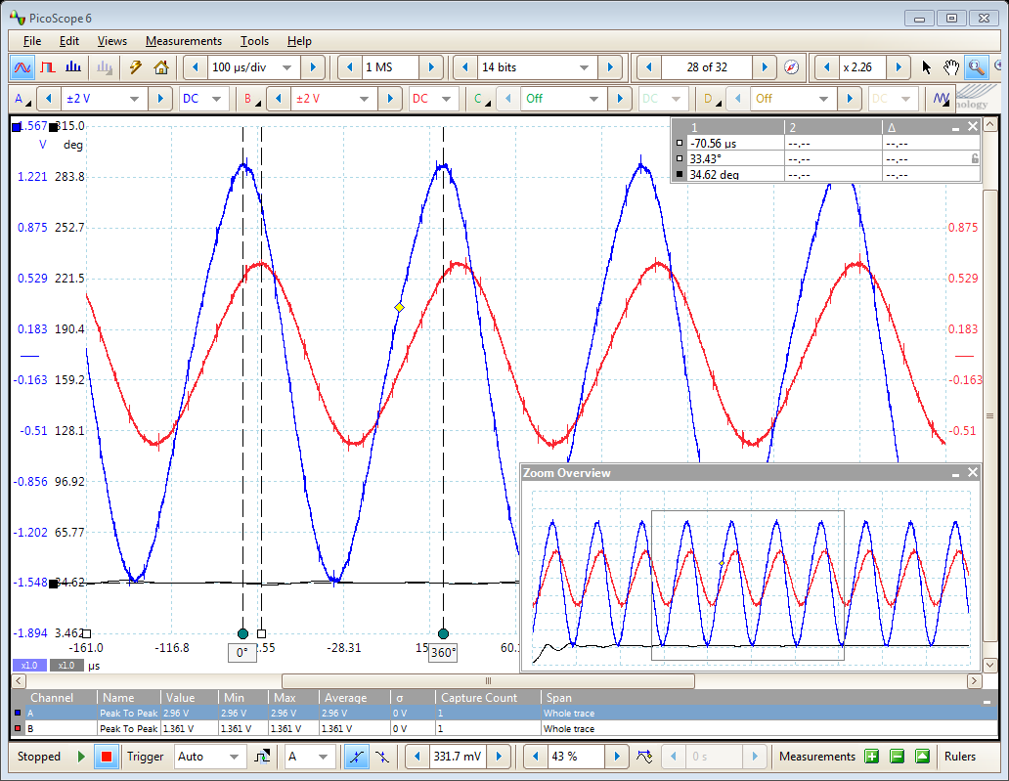
Influence of the membrane type – 25.04.2018
Position | Admotec (2D) | Production (3D) | difference [%]
32784 | 0.463 | 0.482 | -4.1
16400 | 0.481 | 0.48 | 0.2
7810 | 0.789 | 0.595 | 24.6
0 | 0.569 | 0.437 | 23.2
Phase | Admotec (2D) | Production (3D) | difference [%]
min | 29.86 | 31 | -3.8
max | 32.45 | 36 | -10.9

Slide 6
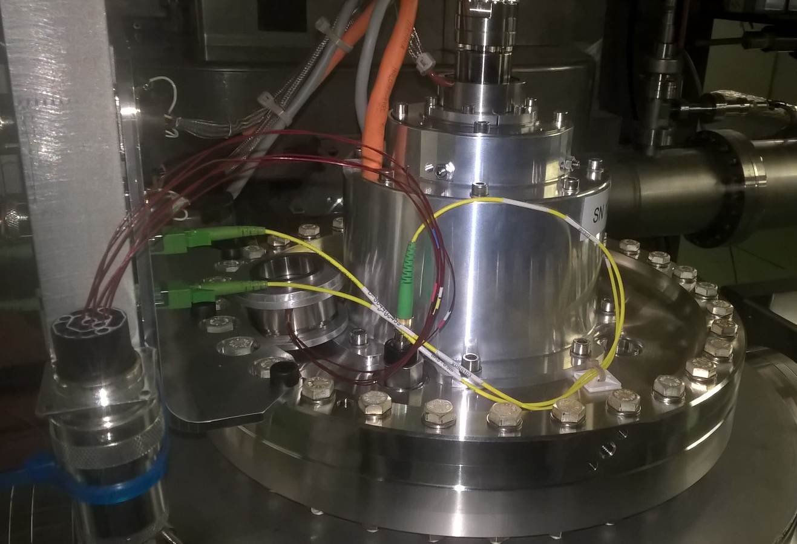
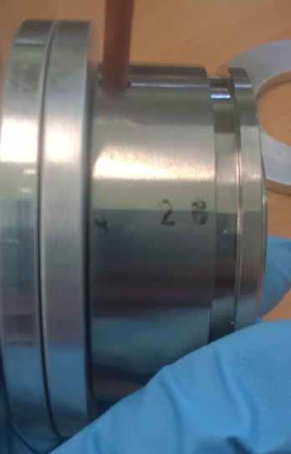
Compare resolvers in PS environments
PS type
PSB type

Slide 7
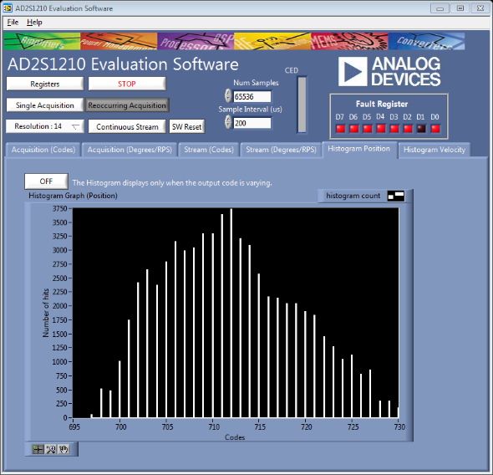
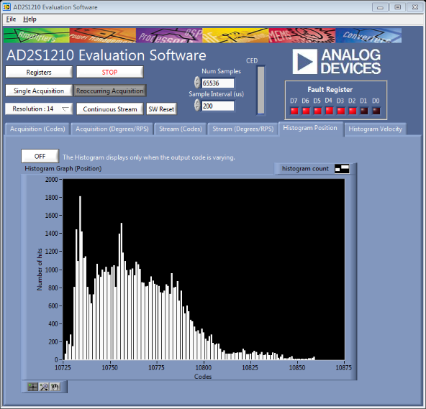
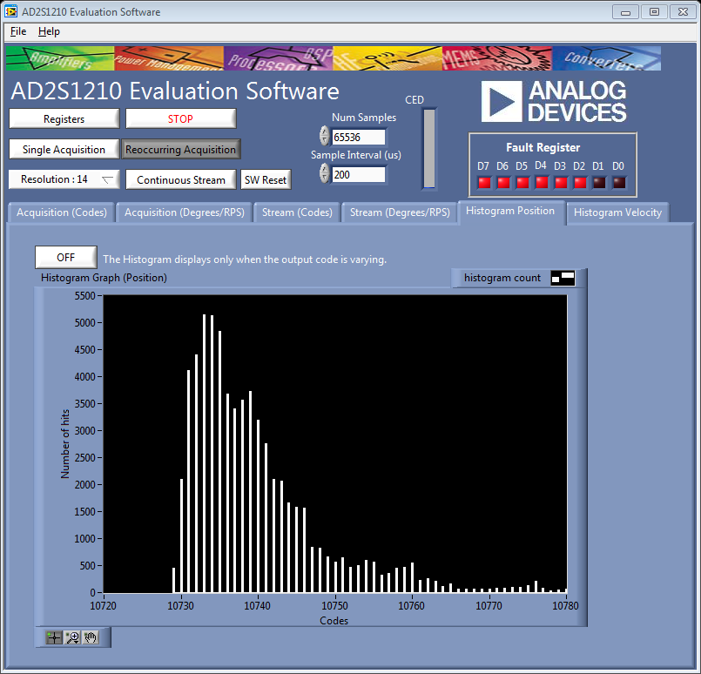
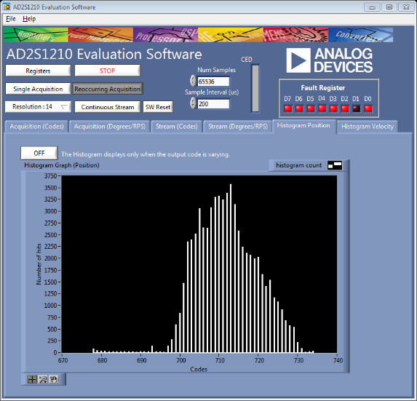
Compare resolvers in PS environments 30.04.2018
PSB resolver
Highest setting stimulation
Noise: 114, 126, 135
With Lowest setting:
63, 48, 51 (230mV, 330mV)
PS resolver
Lowest settings stimulation
Noise: 33, 35, 56 (280mV, 1.2V)

Slide 8
Conclusions for the resolver investigation
The type of membrane does not influence the signal significantly
The sensitivity to noise between the PS and PSB type is similar.
When phase and amplitude is adjusted and the RDC works in +_ 44 deg max, the position is very stable
Small shift observed, synchro with the machine (one particular user)
No evidence that PS resolver is worst that PSB type.
We can continue with PS resolver type, using the mitigation proposed
During the TS1 in June: test motion with Dspace & analog filtering
Start operating the PS scanner after TS1

Slide 9
BWS Drive system - Bill of Material
01/ BWSIDC - Intelligent Drive Crate - EDA-03634
(Assembly)
OP 01
02/ BWSMCU
Motion Control Unit
EDA-03697
(Assembly)
03/ BWSMIB
Motor Inverter Board
EDA-03519
(PCB)
04/ Firmware
EDA-03519
(Production)
05/ BWSCPC
Capacitor Power Charger EDA-03592
(PCB)
06/ Electrical parts & cablings
07/ Mechanics & connectors
OP 02
07/ VFC-HD - EDA-03133
(PU)
08/ BWSAIF
Analog Interface FMC
EDA-03096
(PCB)
09/ Firmware
(Production)
10/ BWSFHE
FMC height extender
EDA-03624 (PCB)
11/ BWSVPA
VME Power Adapter
EDA-03698 (PCB)
12/ Optical parts & cablings
13/ Mechanics & connectors

Slide 10
BWS PMT assembly - Bill of Material
01/ BWS PMT (Assembly)
OP 01
02/ BWSPSA
EDA-03764
(PCB)
03/ Mechanics box & shielding
(Produced)
04/ Mechanics
Filter wheel
(assembly)
05/ Scintillator
(PU)
OP 02
06/ Mechanics box
(Produced)
07/ filters
(PU)
08/ Motor
(PU)
09/ Cabling & connectors

