Slide 1



Beam-Beam Considerations for possible baseline scenario
C. Tambasco, J. Barranco and T. Pieloni
Work supported by the Swiss State Secretariat for Education, Research and Innovation SERI

Slide 2
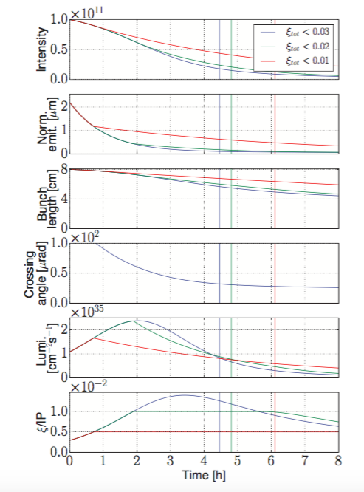
Possible Cycle
Due to strong radiation damping we have quite some different regimes from beam-beam point of view:
LHC/HL-LHC beam-beam dynamics ξ_{bb} = 0.06→0.01
  LHC experience and long-range effects
  Baseline
Head-on driven dynamics with beam-beam parameter ξ_{bb} = 0.01→ 0.02 plus 2 low luminosity IPs
  LHC experience with HL-LHC MDs
Mixed status, radiation damping and possible operational scenarios
Need new developments in models
3
2
1
X. Buffat

Slide 3
Round Optics baseline: IPA and IPG
FCC New Lattice L* 40 m 2.2 μm emittances
Q’ = 2 units
TCP Collimators aperture 7.2 σ
Q’ = 20 units
d=17 σ
Crossing angle of 200 μrad at IPA and IPG gives LR separations of around 17 σ (DA = 6 σ) Total HO tune shift 0.007 for IPA and IPG
→ Still to be added some margins for:
→ Landau Octupoles
→ Magnets imperfections
→ Tunability and low luminosity experiments

Slide 4
Round Optics baseline after 1 h
FCC New Lattice L* 40 m 2.2 μm emittances
Q’ = 2 units
TCP Collimators aperture 7.2 σ
Q’ = 20 units
d=17 σ
Crossing angle of 140 μrad at IPA and IPG gives equivalent separations in LR but HO larger 0.01 total might need slightly larger separations due to HO → Still to be added some margins for:
→ Landau Octupoles
→ Magnets imperfections
→ Tunability and low luminosity experiments

Slide 5
Low Luminosity Experiments: IPL and IPP
The long-range effects of IPL and B will impact bunches differently (no passive compensation)
To have them not perturbing the high luminosity experiments should have angles > 90 μrad
Long-range: to keep effects weak larger angles needed →larger than 80 μrad
Head-on ok for baseline but has to apply sep levelling to keep HO tune shift smaller than 0.02 total.

Slide 6
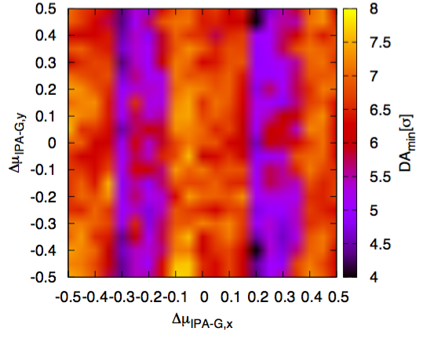
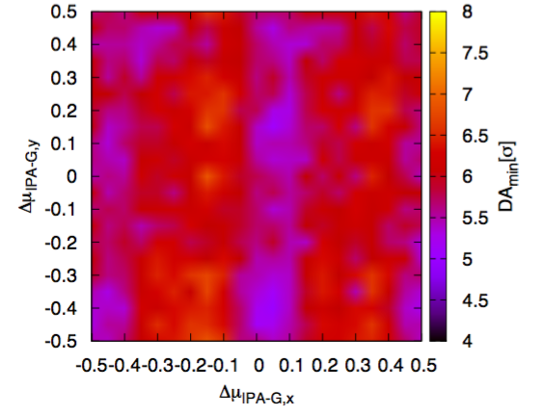
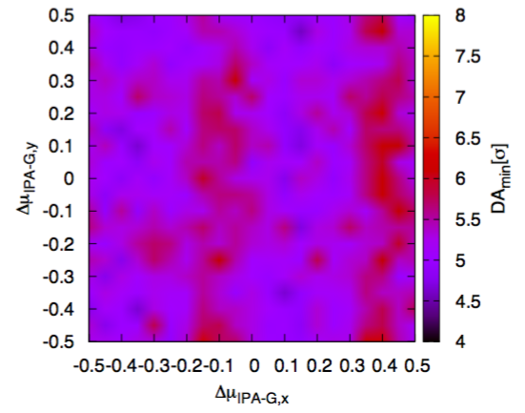
Landau Octupoles and beam-beam compensation
- Landau Octupoles
Beam-Beam Effects
+ Landau Octupoles
We choose to have negative octupole polarity (compensates the long-range beam-beam effects):
→ provides larger stability for single beam (see C. Tambasco talk)
→allows for larger DA with optimized phase advance thanks to compensation
(CERN-ACC-NOTE-2017-036)
Different Phase advances at different stages of the operational cycle to have maximum Dynamic Aperture and maintain compensation
NEGATIVE PREFERENCE also because of stability…

Slide 7
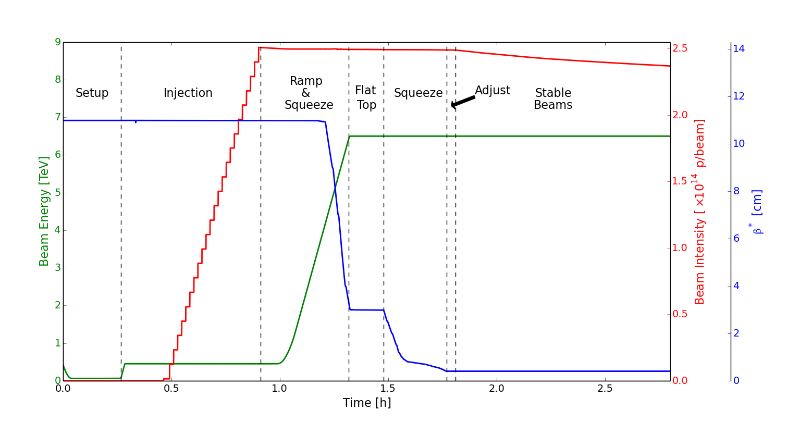
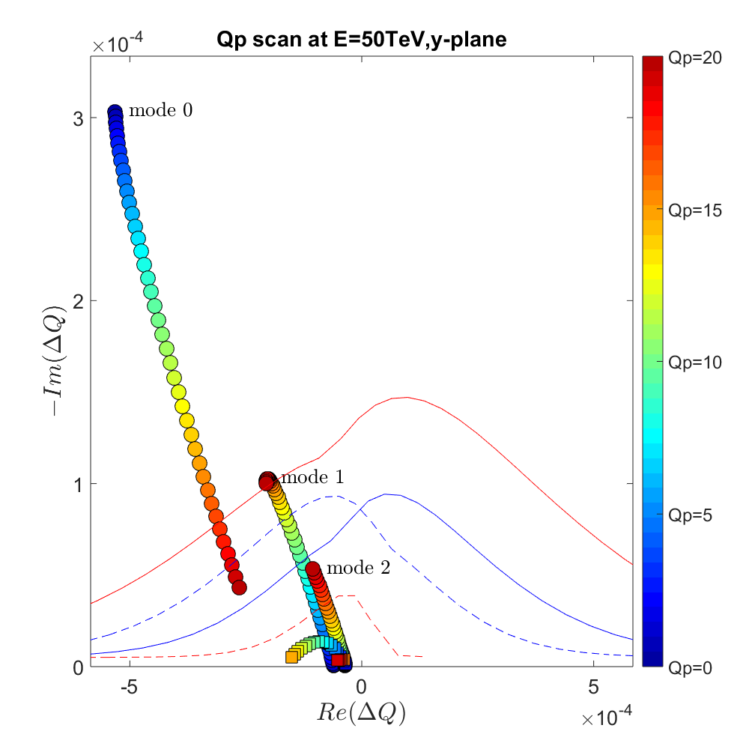
Stability
new modes with transvers feedback included
from S. Arsenyev and N. Klinkenberg
Negative polarity:
Larger DA, and tunability
Larger Stability single beam

Slide 8
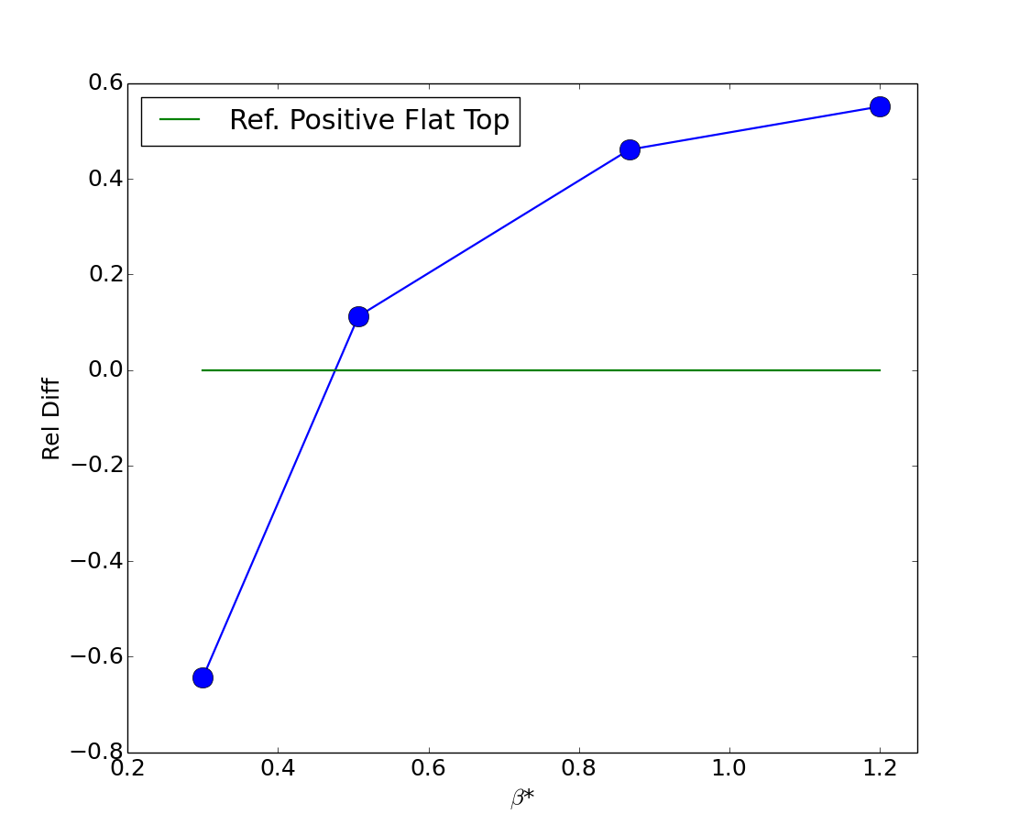
Stability
POSITIVE OCT reference
Beta * at injection 4.6 m (Roman)
Ramp and Squeeze to 1.2 m
Collide and squeeze at reduced angle
Ways to avoid reduction → collide and Squeeze →
Angle can be further reduced to 100 μrad total reducing to half crab cavity voltage etc…

