Slide 1


Arts & Science Across Italy
Master Programme

Slide 2

Agenda
Your programme agenda:
https://indico.cern.ch/e/ArtsScience
Please browse frequently – agenda subject to change!

Slide 3
Important phone numbers
Your programme coordinator at CERN
Pierluigi
The Educational team
Ines Knapper (Programme Manager): +41 75 411 22 97 (or 16 22 97)
Our office: 33/R-020

Slide 4

In case of emergency
Emergencies at CERN:
Use the fixed phones located all over CERN
Fire brigade/Medical emergencies: 74444
Emergencies in Switzerland:
Ambulance: 144
Fire Brigade: 118
Police: 117
European SOS: 112

Slide 5


Meal vouchers
RESTAURANT 1 ONLY!
 | Opening Hours | Breakfast | Lunch | Dinner
Monday - Friday | 6h00 - 24h00 | 6h30 - 10h30 | 11h30 - 14h15 | 18h00 - 21h30
Weekend & bank holidays | 7h00 - 22h00 | 7h00 - 10h00 | 11h30 - 14h00 | 18h00 - 20h00

Slide 6
Navigate on the CERN campus
Campus maps:
Printed CERN map
https://maps.cern.ch/
Mobile version of CERN map available
Shuttle Service: http://smb-dep.web.cern.ch/en/ShuttleService
No 2: Prévessin
CERN Entrance gates:
Gate B: open 24h/24h

Slide 7

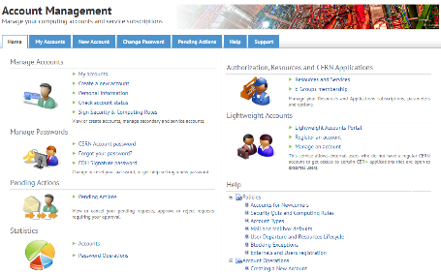
Login for the first time
cern.ch/account

Slide 8




Visits at CERN

Slide 9
Enjoy the programme!
The Educational team

