Slide 1
Status and plans of the CLOUD experiment
Urs Baltensperger
Laboratory of Atmospheric Chemistry, Paul Scherrer Institute
Villigen, Switzerland
For the CLOUD Collaboration
SPSC
Cern, 7 June 2018

Slide 2
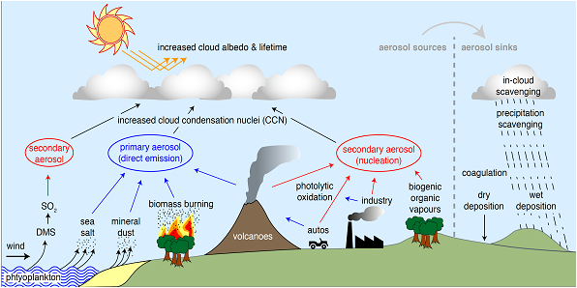
Atmospheric aerosol particles:
Solid or liquid particles suspended in the atmosphere
Primary: direct emission into the atmosphere
Secondary: Formation in the atmosphere after oxidation of gaseous precursors
Courtesy: J. Kirkby
atmospheric

Slide 3
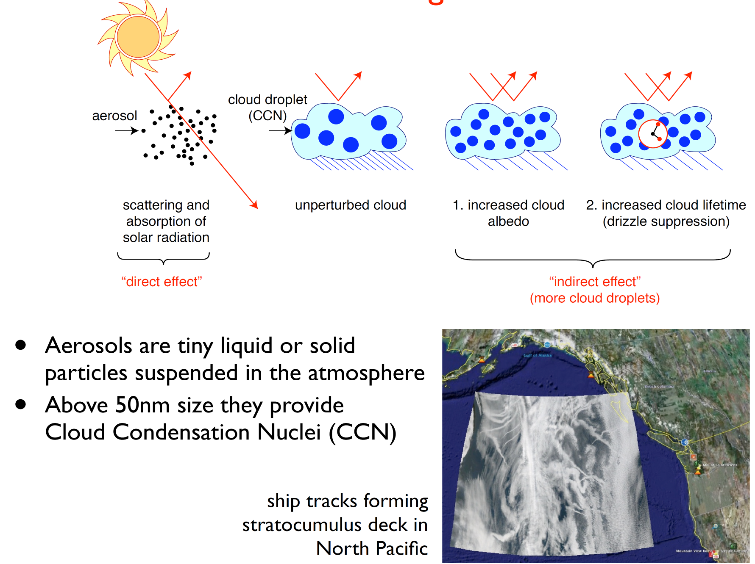
The radiative forcing of aerosols
New terminology:
Aerosol-Radiation Interaction Aerosol-Cloud Interaction
Courtesy: Jasper Kirkby, CERN

Slide 4
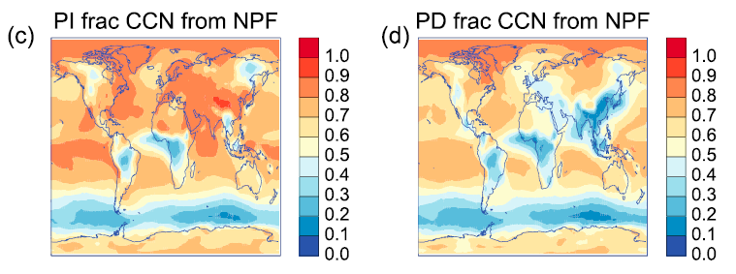
More than 50% of the cloud condensation nuclei (CCN) are formed in the atmosphere via new particle formation (NPF), rather than being directly emitted
PI: Preindustrial PD: Present Day
Gordon et al., JGR 2017
Notes:
CCN concentrations at 0.2% supersaturation (CCN0.2%) at low cloud level (approximately 460–1100 m
altitude), and fractions from NPF. The (a) present-day and (b) preindustrial annual mean concentrations;
and (c, d) the fractions of these particles that originate from NPF.

Slide 5
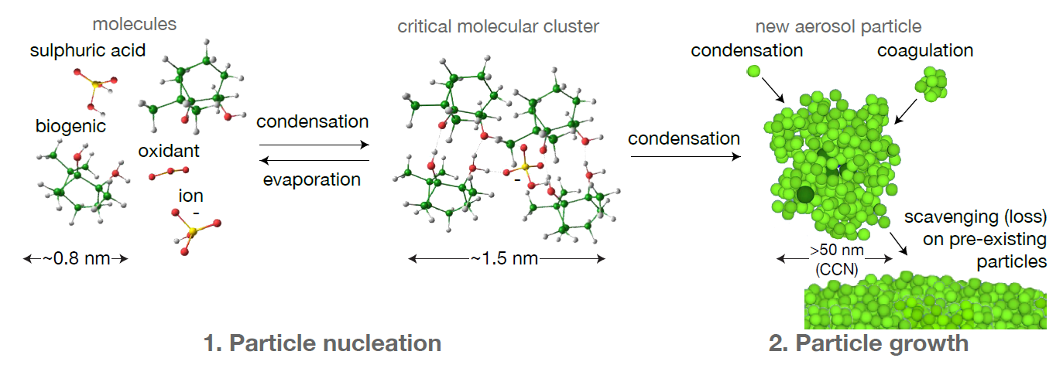
New particle formation (NPF) and growth to cloud condensation nuclei (CCN)
Questions:
How do the molecules from different sources as well as ions influence the formation rate of new particles (in our case: particles with a size of 1.7 nm)?
And how do they influence the growth rate of newly formed particles?
➔ Both is important for the formation of CCN

Slide 6
A possible mechanism for a link
between galactic cosmic rays and clouds
Solar variability
GCR
Ion concentration
LOSU
High
Nucleation
Medium
Climate variability
Growth
Low
Cloud cover
CCN
LOSU: Level of Scientific Understanding
Notes:
corrlation with cosmic rays, nucleate and eventually go to CCN, FOCUS on the possble microphysical link! (nucleation)

Slide 7
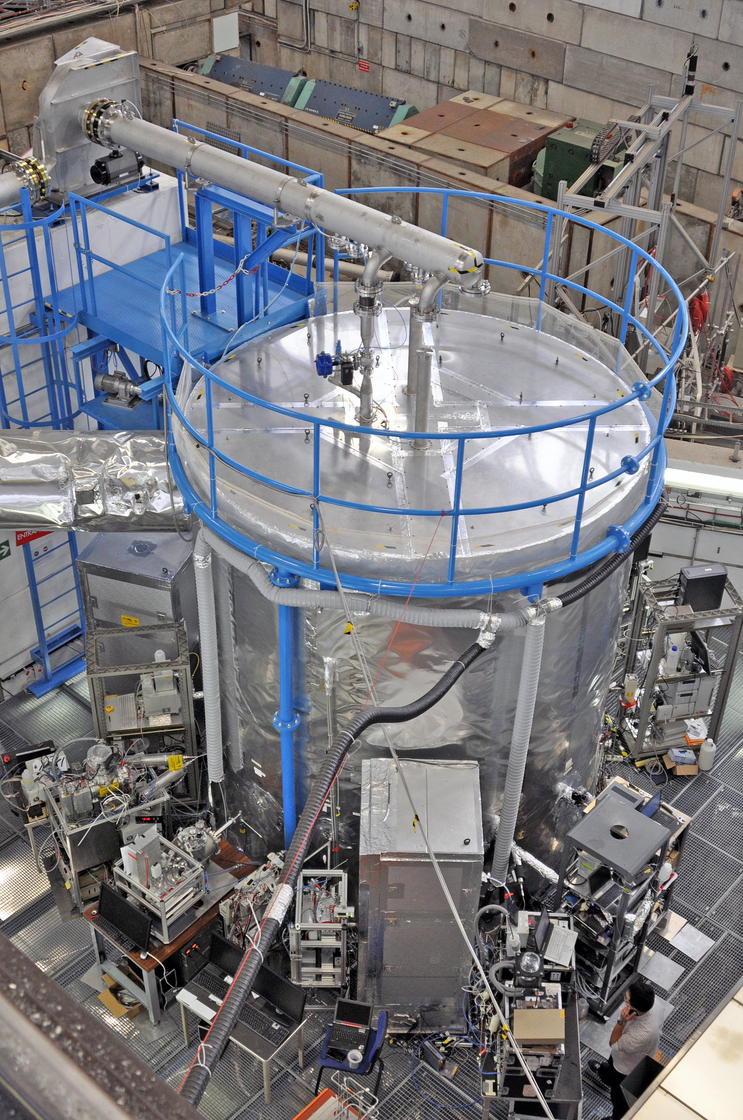
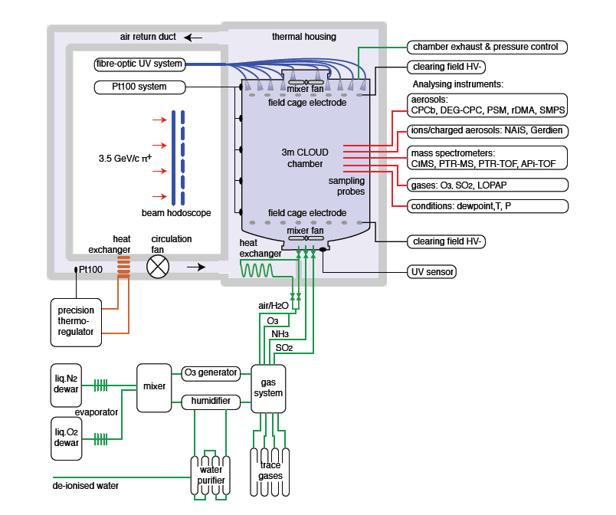
CLOUD was designed to
answer these questions
OH from photolysis of ozone
H₂SO₄ from reaction of SO₂ with OH
T11 PS 3.5 GeV/c π⁺
Kirkby et al., Nature 2011
Almeida et al., Nature 2013
Schobesberger et al., PNAS 2013
Kürten et al., PNAS, 2014
Riccobono et al., Science 2014
Kirkby et al., Nature 2016
Tröstl et al., Nature 2016
Lehtipalo et al., Nature Comm. 2016
Gordon et al., PNAS 2016
Dunne et al., Science 2016
up to 5000 ion pairs per cm³

Slide 8
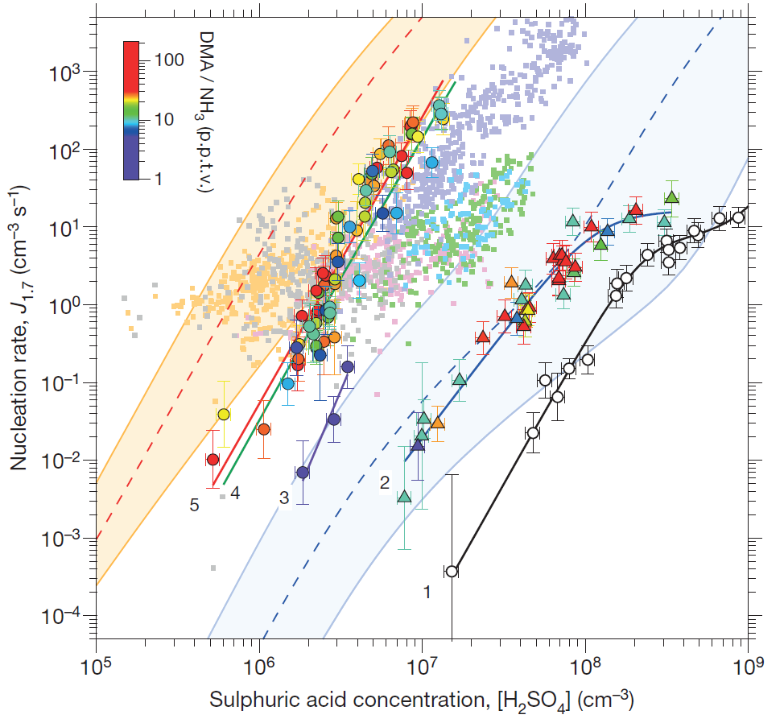
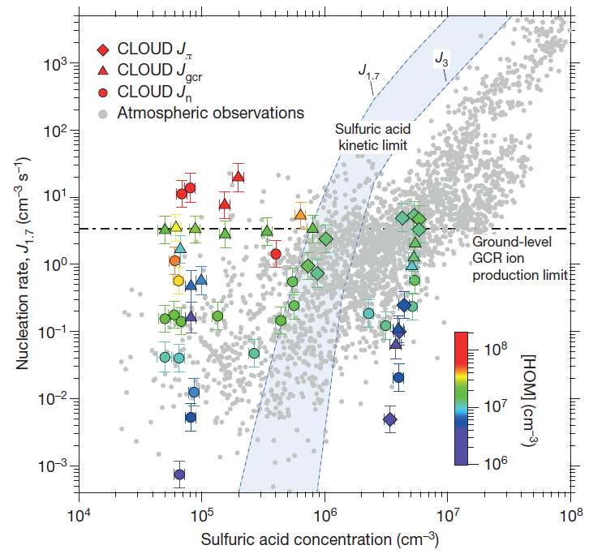
The big discovery in 2016:
Highly oxygenated organic molecules (HOMs) are able to trigger new particle formation on their own, without the help of sulfuric acid ➔ Implications for the preindustrial time
Sulfuric acid with either NH₃ or dimethylamine (DMA) With HOMs
Almeida et al., Nature 2013 Kirkby et al., Nature 2016

Slide 9
Feedback loops between laboratory and field experiments as reality check: Is there agreement concerning NPF rate, growth rate, and cluster molecular composition?
Boreal
forest
Urban
environments
Marine
environment
Lower free
troposphere
Upper free troposphere

Slide 10
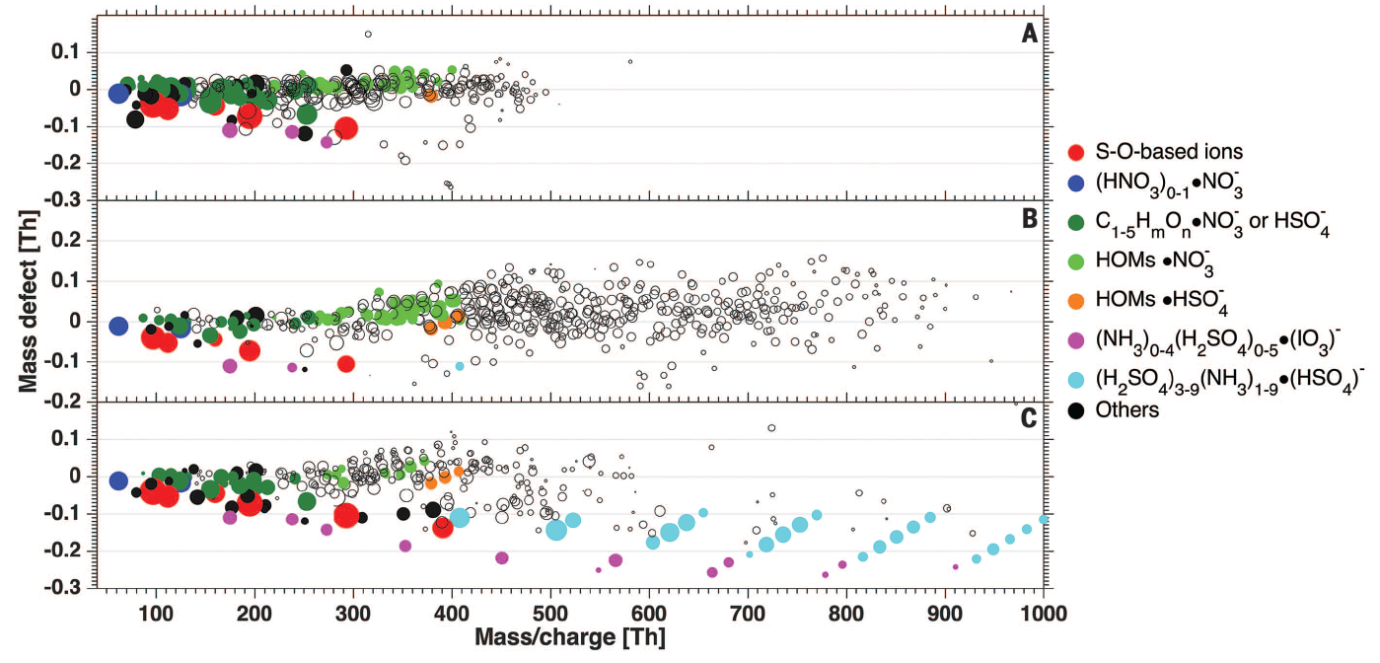
Reality check in the lower free troposphere:
Yes, also at the Jungraujoch (3580 m asl) importance of highly oxygenated organic molecules (HOMs) and in other cases sulfuric acid confirmed
No nucleation
Nucleation with HOMs
Nucleation with H₂SO₄/NH₃
Every dot is a species with a different molecular weight and chemical composition
Bianchi et al., Science 2016

Slide 11
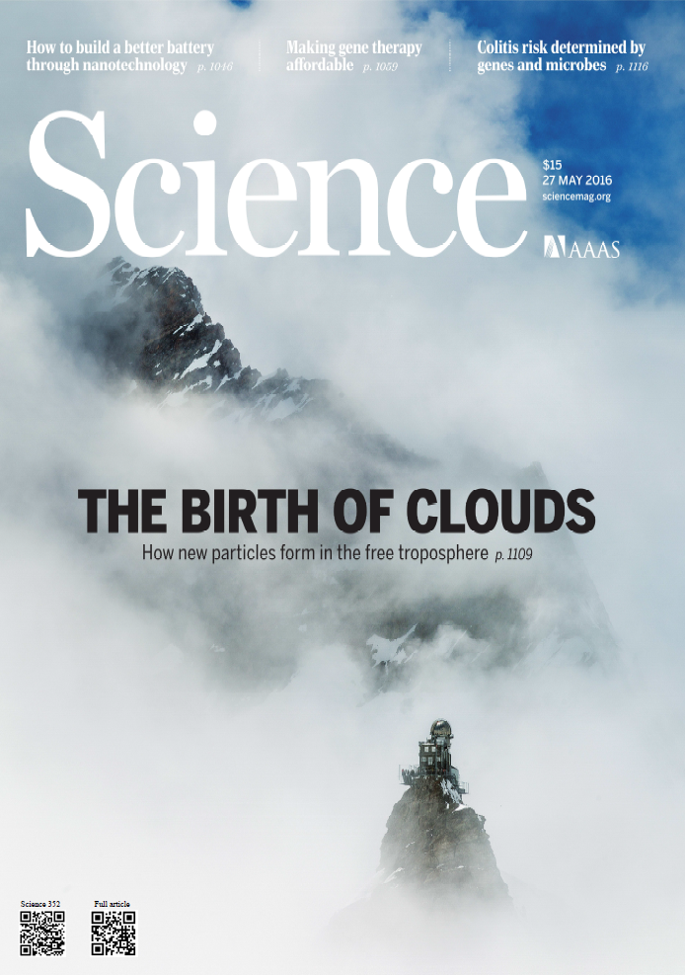
➔ 2 papers in Nature and
1 in Science, coordinated by Nature and Science appeared simultaneously on 26 May 2016:
CLOUD experiment:
- Kirkby et al., Nature 2016
- Tröstl et al., Nature 2016
Field experiment at the Jungfraujoch:
- Bianchi et al., Science 2016
(including cover)

Slide 12
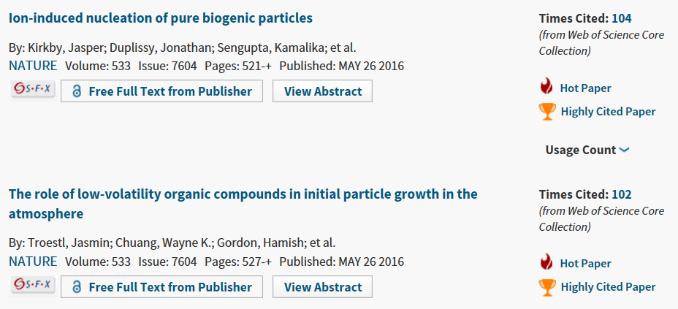
CLOUD results are highly cited
Hot Papers: ranked in the top 0.1% highly cited papers in geoscience for their age
Notes:
UB is ranked No 9 in terms of highly cited papers in the field of Geosciences, with 27 highly cited papers

Slide 13
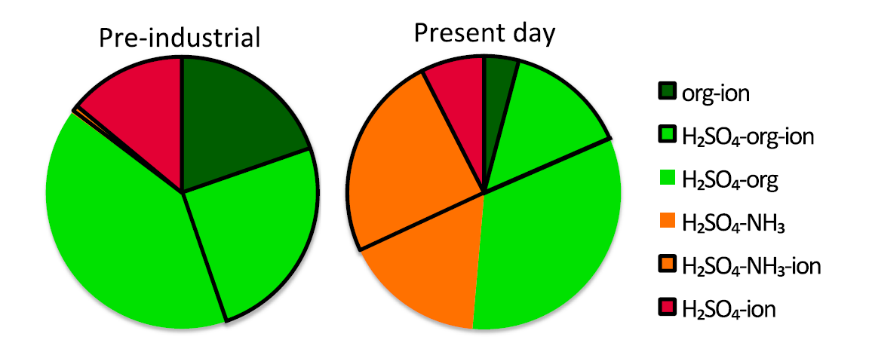
The ultimate answers come from model calculations: Fractions of NPF and in preindustrial and present-day atmospheres
Fractions of NPF
NPF below 5.8 km altitude
50% in present day atmosphere and 59% in pre-industrial atmosphere involve ions
CCN (0.2% SS) from ion-induced NPF:
27% in present-day atmosphere and 40% in preindustrial atmosphere
Solar cycle variations of ion concentration:
max. 1% variation of CCN (0.2% SS) Gordon et al., JGR 2017
Notes:
We quote fractions below 5.8 km (the top of the fourteenth model level from the surface) because we assume most activation of CCN takes place at these altitudes

Slide 14
CLOUD has answered a first important question
The fluctuations of the 11-year cycle have a negligible impact on climate via the ion – new particle – CCN mechanism

Slide 15
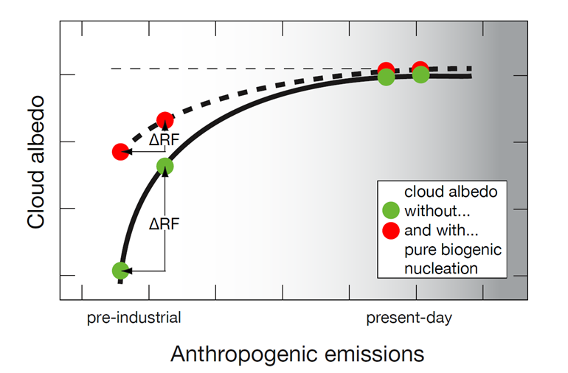
Important questions remain:
How about the pre-industrial period?
The pre-industrial aerosol is one of the biggest uncertinties in the calculation of climate forcing.
Important uncertainties in our parametrization remain
Courtesy: K. Carslaw, Leeds

Slide 16
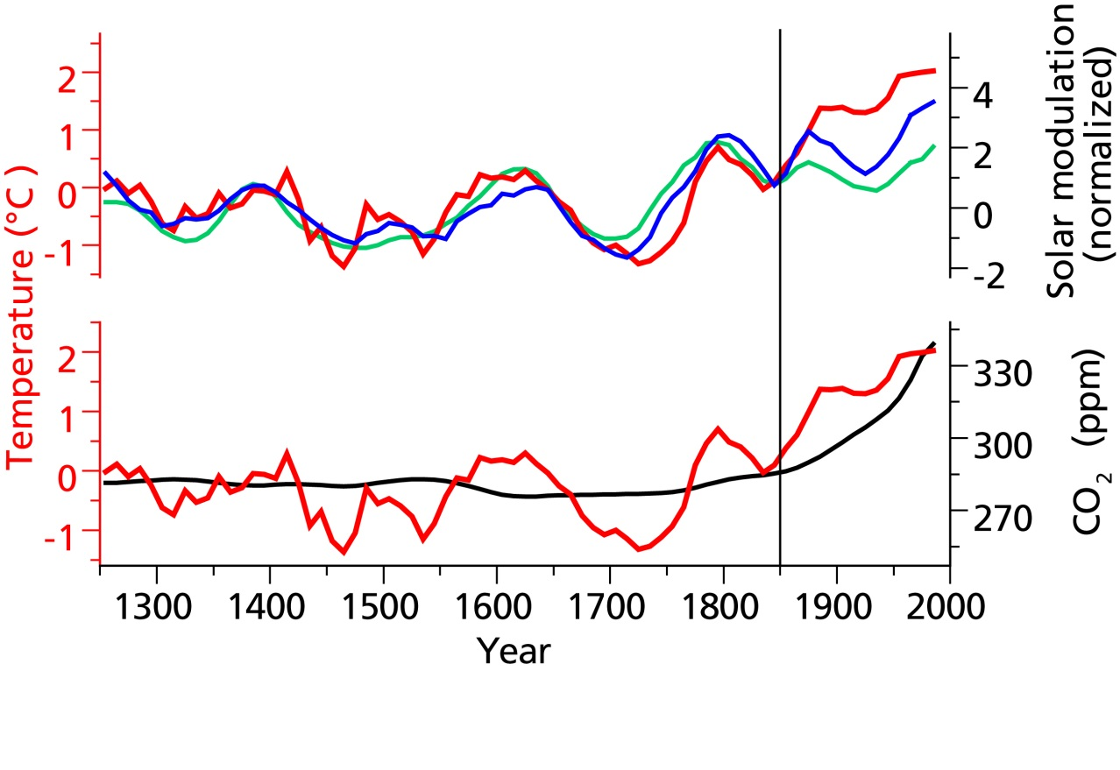
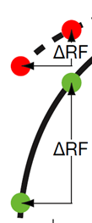
Not answered yet: Is there an effect of GCR on climate in the preindustrial time?
Eichler et al. GRL 36 (2009)
¹⁰Be
¹⁴C
Temperature proxy: ice core oxygen isotope

Slide 17
➔ Important uncertainties remain
Also: CLOUD has evolved answering fundamental research questions of high relevance
➔ Further evolution of CLOUD required
Constant improvement of facility
➔ New light sources (next slide)
Constant improvement / addition of instrumentation:
➔ New mass spectrometers (in CLOUD12, 2017:
around 45 analysing instruments, including 12 mass spectrometers)
Constant replenishment of the young scientists
➔ CLOUD has been awarded an unprecedented third Marie Curie Innovative Training Network grant,
(CLOUD-MOTION, 15 PhD students, start 1 Sept 2017)

Slide 18
Extension of light sources
Fibre optic Hg-Xe system (250-570 nm): O₃ photolysis to OH radical, and broad spectrum photolysis
Fibre optic UV excimer laser (248 nm, adjustable):
O₃ photolysis to OH radical
50W UV sabre 1 (254 nm, not adjustable): diiodomethane photolysis to I radical
400W UV sabre 3 (385 nm): NO₂ photolysis to NO, and HONO photolysis to OH radical
150W light sabre 4 (528 nm): I₂ photolysis to I radical

Slide 19
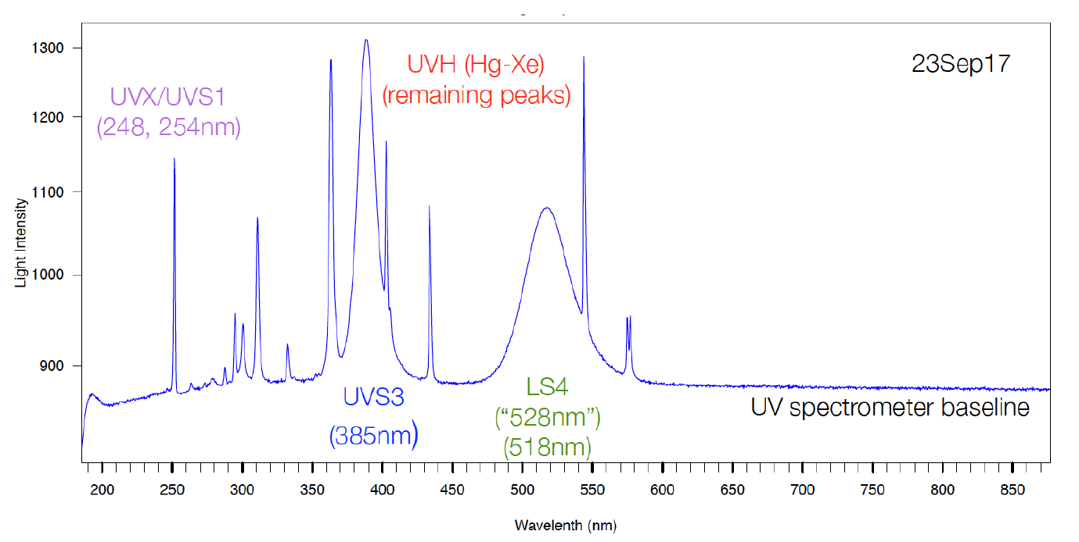
CLOUD12 light spectrum from the 5 sources in operation

Slide 20
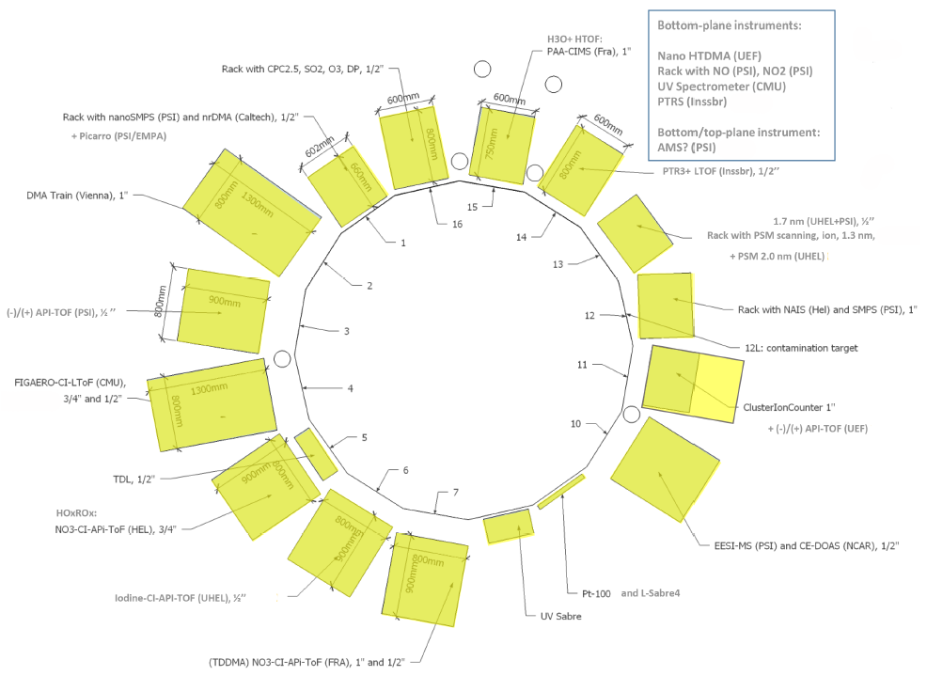
Layout of the analysing instruments around the chamber during CLOUD12

Slide 21
CLOUD12 scientific programme
(18 September – 27 November 2017)
Marine nucleation and growth involving iodine compounds (2 wk)
(new in CLOUD, observed in coastal regions with exposed seaweed
Growth rates of pure sulphuric acid particles at small sizes (3 d)
(test new instrumentation, compare to theory)
Multi-component aerosol particle nucleation and growth (4 wk)
(Extension of the H₂SO₄-NH₃-HOM-H₂O parameter space,
extension of temperature range to upper free troposphere, for a refined parameterization (HOM = Highly Oxygenated Molecules)
Anthropogenic aerosol particle nucleation and growth (2 wk)
(frequently observed in urban environments, typical aromatic compounds w’/w’out sulphuric acid, ammonia, dimethylamine, and high concentrations of NOx, ozone, and hydroxyl radicals (OH)

Slide 22
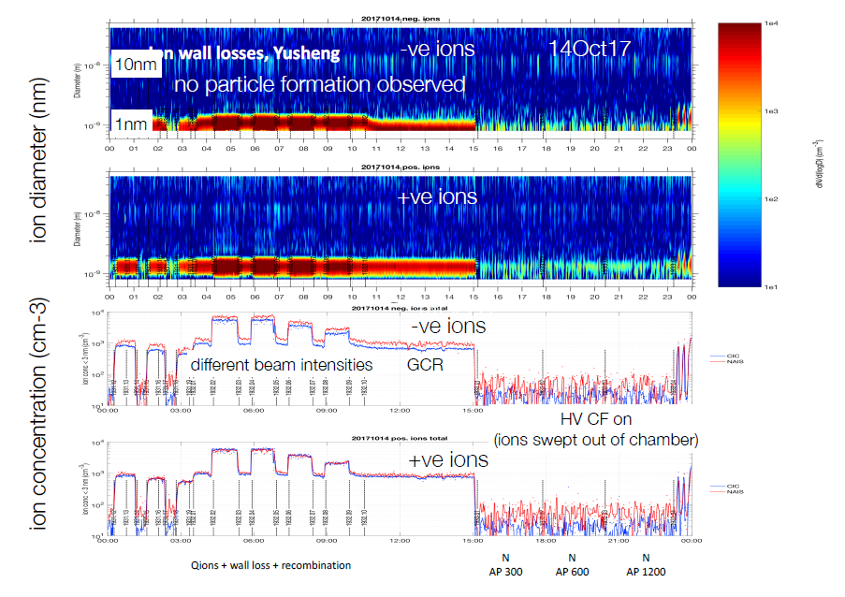
Variation of ion concentrations in the CLOUD chamber during CLOUD12

Slide 23
Beam requests 2018
CLOUD13T beam request, 11 June – 6 July 2018
Ion production and loss rates
Ion non-uniformities in the CLOUD chamber
CLOUD13 beam request, 17 September – 26 November 2018
Marine nucleation and growth involving iodine compounds and dimethylsulphide (3 wk): DMS from phytoplankton to be studied for the first time
Multi-component aerosol particle nucleation and growth (3 wk):
Completion of experiments for parameterization up to 12 km, inclusion of nitric acid (produced with new generator)
Anthropogenic aerosol particle nucleation and growth (3 wk):
Extension of CLOUD12, addition of new compound (cresol), understanding of nucleation in Chinese megacities; adding one more aromatic compound, w’/w’out sulphuric acid, ammonia, dimethylamine, varying NOx, ozone, OH, surface area of pre-existing aerosols

Slide 24
CLOUD requests
Permanent CLOUD open office/meeting room
CLOUD needs a dedicated 50 m² open office space and meeting room.
This is needed for its daily run coordination meetings and for use by CLOUD experimenters at CERN (25–30 scientists during runs at the PS)
From 2015 to 2017, a temporary meeting room in bat. 510 was provided by EP, but this will become unavailable.
The room needs to be close to the T11 experimental zone
CLOUD operation during LS2 East Area Renovation, 2019–2020
CLOUD requests to run with cosmic rays (without beam) during the fall 2019 and fall 2020 periods
Urgency to continue with CLOUD data collection in view of the important impact of CLOUD on the understanding of aerosols on climate change.
Also we have just hired 15 PhD students in the new H2020 Marie Curie Initial Training Network (CLOUD-MOTION) who will rely on CLOUD data collected during the 2018–2020 period

Slide 25
Summary
CLOUD is the ‘gold standard’ for new particle formation experiments worldwide
CLOUD has made a paradigm change on how aerosols are represented in global climate models
Unprecedented combination of wide variety of models (theoretical, empirical, mechanistic, global) with laboratory data, complemented by permanent reality check in the field
An ambitious research programme ahead: marine environments, more complex multi-component systems, polluted urban environments

Slide 26

Acknowledgments
We would like to thank CERN EP-DT,
EN-MME,
Lau Gatignon,
Henrik Wilkens (PS Coordinator), and
the CERN PS machine team for their support of CLOUD
Thank you for your attention

