Slide 1
Cu + Acid Passivation + Etching (43)
Kazue Yokoyama

Slide 2
overview
Spot1 (z=4.05) : No reliable data (I found broken cables in a circuit.)
Spot2 (z=4.15) : Measured beta & BD Field
Spot3 (z=4.25) : Measured beta & BD Field
Spot4 (z=4.35) : Measured spectrums by Jan
Spot5 (z=4.45) : Measured beta & BD Field
Spot6 (z=4.55) : Measured beta & BD Field

Slide 3
Spot1 (z=4.05) : No data because of broken cables in a circuit
> Beta values couldn’t be measured.

Slide 4
I couldn’t say Local field = 10.8 GV/m (= beta * breakdown field).
It looks higher than 10.8 GV/m.

Slide 5
BD at high field (~450 MV/m)
by Jan
666.5 MV/m
No BD, but pressure is changed a bit.

Slide 6
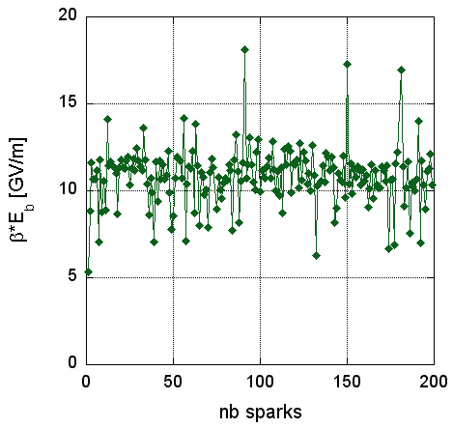
Notes: Antoine Descoeudres’s data
β · E_{b} = 10.8 GV/m
(± 16%)
Local field = cst = 10.8 GV/m for Cu
I couldn’t say Local field = 10.8 GV/m (= beta * breakdown field).
It looks higher than 10.8 GV/m.

Slide 8
After many BDs, Local field reached 10.5 GV/m (= beta * breakdown field).

Slide 9
I could say Local field is around 10 GV/m (= beta * breakdown field).

Slide 10
Beta measurements
beta wouldn’t be changed drastically by gap measurements.

Slide 11
Beta measurements
A break for a couple of hours
-> beta value grew downward.
Material surface could be changed as time advances.

Slide 13
2E-11 [A]
< current < 1E-9 [A]
After BD, higher voltage is required for beta measurements as time advances.
beta value is changed by using the method in the current program.
: Few data and unsuitable region for fitting

Slide 14
Beta~90
Beta~50
After BD in a while, it seems that data shows several slopes.

Slide 15
Summary of Cu + Acid Passivation + Etching (43)
Average of Initial beta (before breakdown) and beta * BD Field:
spot2 ~ 49, beta*BD Field ~ 12.6 GV/m
spot3 ~ 29, beta*BD Field ~ 13.4 GV/m
spot4 ~ 30, beta*BD Field ~ 14.2 GV/m
spot5 ~ 30, beta*BD Field ~ 13.5 -> 10.2 GV/m
spot6 ~ 20, beta*BD Field ~ 10.6 GV/m

Slide 16
example of waveform from PMT (Photomultiplier Tube)
Two peaks can be seen in a waveform.

Slide 17
summary
Just after BD, material surface could be un stable. It might be caused by outgas or ions under vacuum… β might indicate this condition.
Local field = β_{(befor BD)} * BD Field_{(after beta measurement)}
But E_{m} = β * E_{M}
β : field enhancement factor ← constant; Material characteristic and average value under stable surface.
Em : micro , EM :macroscopic field
The β value after BD could not indicate the state β.
I’d like to test some coppers like a fine grain or large grain.
Beta value could be depend on a crystal structure.

Slide 18
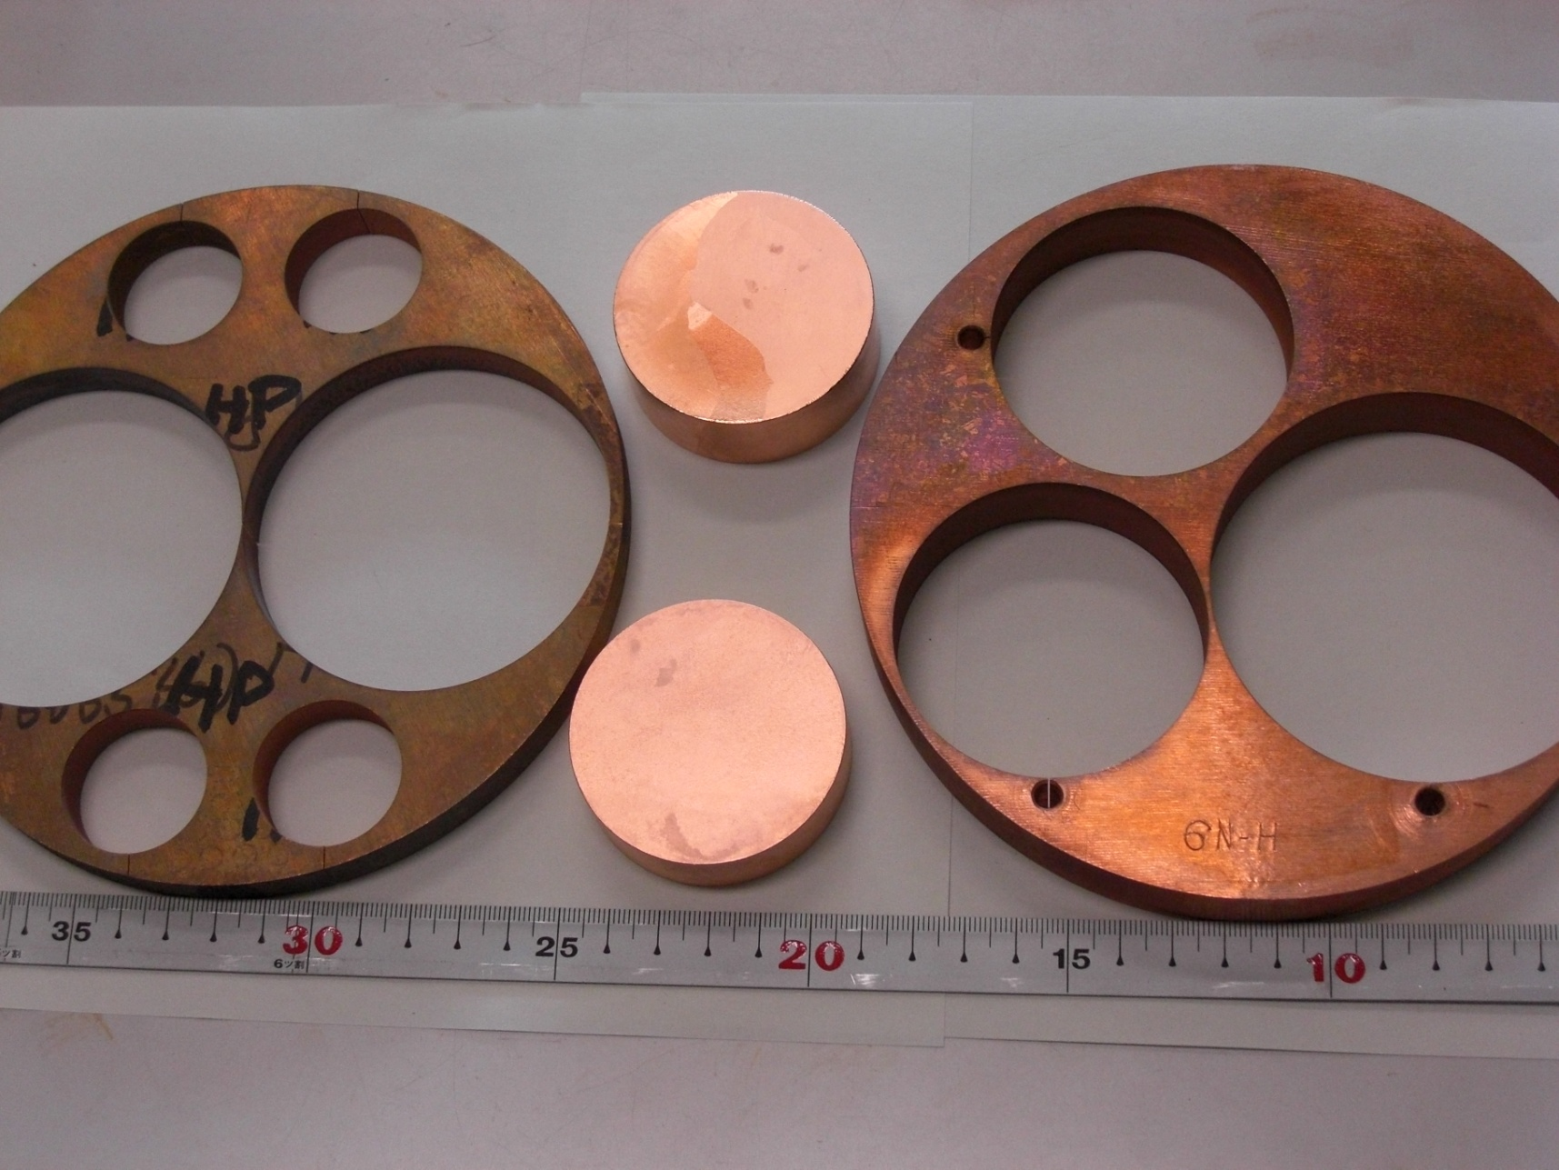
DC Breakdown samples 091022 Y. Higashi
7N Large Grain
6N HIP (hard material)
6N Fine Grain
7N Fine Grain

