Slide 1

COSMIC RAYS
&
SPARK CHAMBER

Slide 2
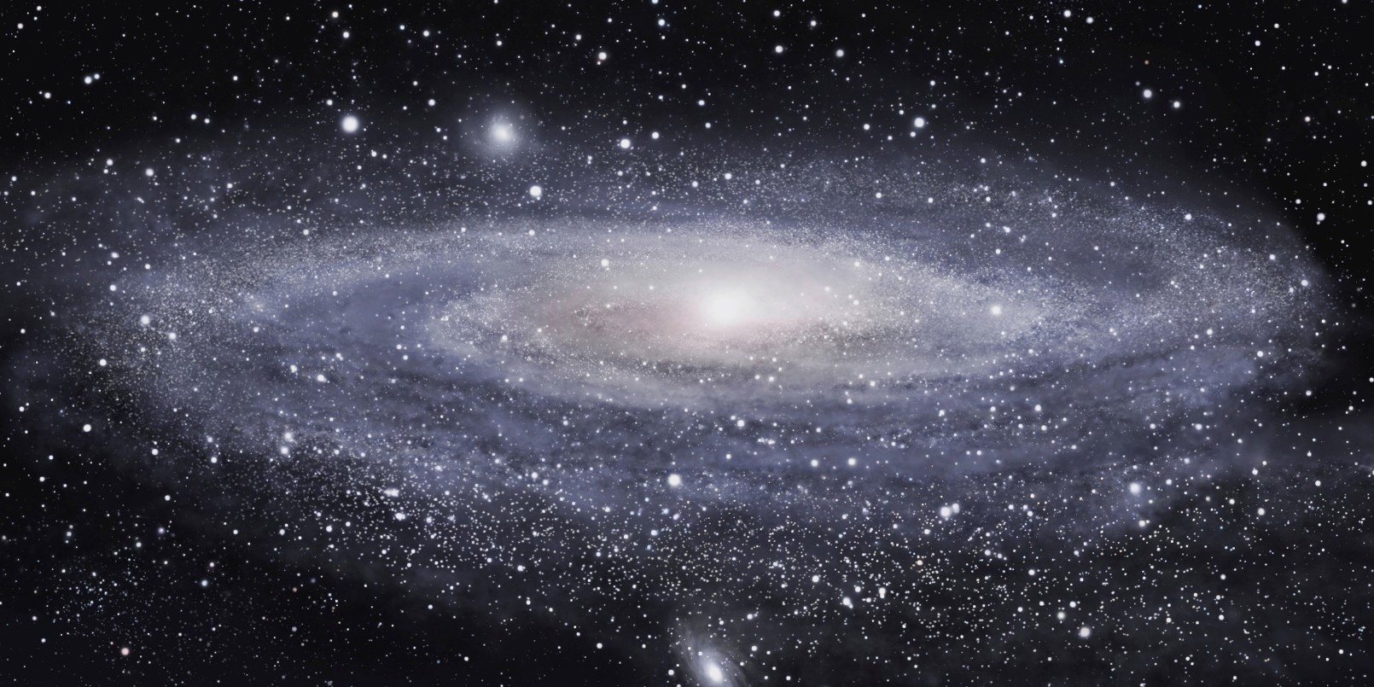


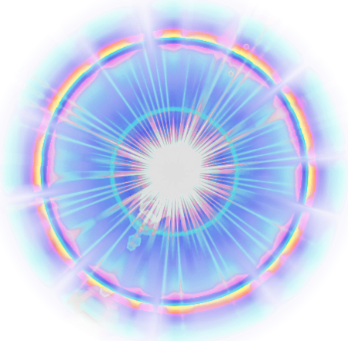
WHAT ARE COSMIC RAYS?
THEY ARE HIGH ENERGY PARTICLES (USUALLY PROTONS), PRODUCED IN ENERGETIC EVENTS SUCH AS SUPERNOVAS THAT TRAVEL ACROSS THE GALAXY…
SOME OF THOSE PARTICLES ARRIVE TO THE EARTH AND COLLIDE WITH IONIZED ATOMS AT THE ATMOSPHERE, THUS DECAYING AND PRODUCING A SHOWER OF PARTICLES

Slide 3
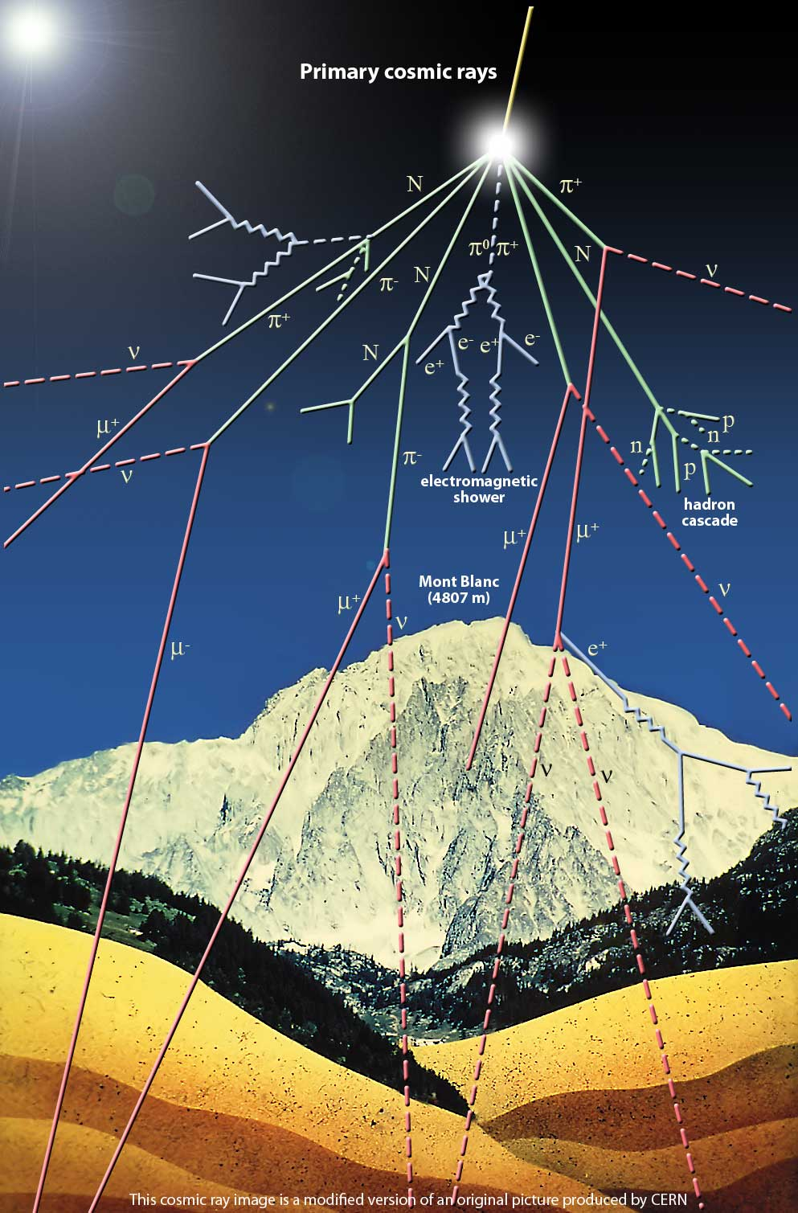
WHAT ARE COSMIC RAYS?
THEY ARE HIGH ENERGY PARTICLES (USUALLY PROTONS), PRODUCED IN ENERGETIC EVENTS SUCH AS SUPERNOVAS THAT TRAVEL ACROSS THE GALAXY…
SOME OF THOSE PARTICLES ARRIVE TO THE EARTH AND COLLIDE WITH IONIZED ATOMS AT THE ATMOSPHERE, THUS DECAYING AND PRODUCING A SHOWER OF PARTICLES

Slide 4
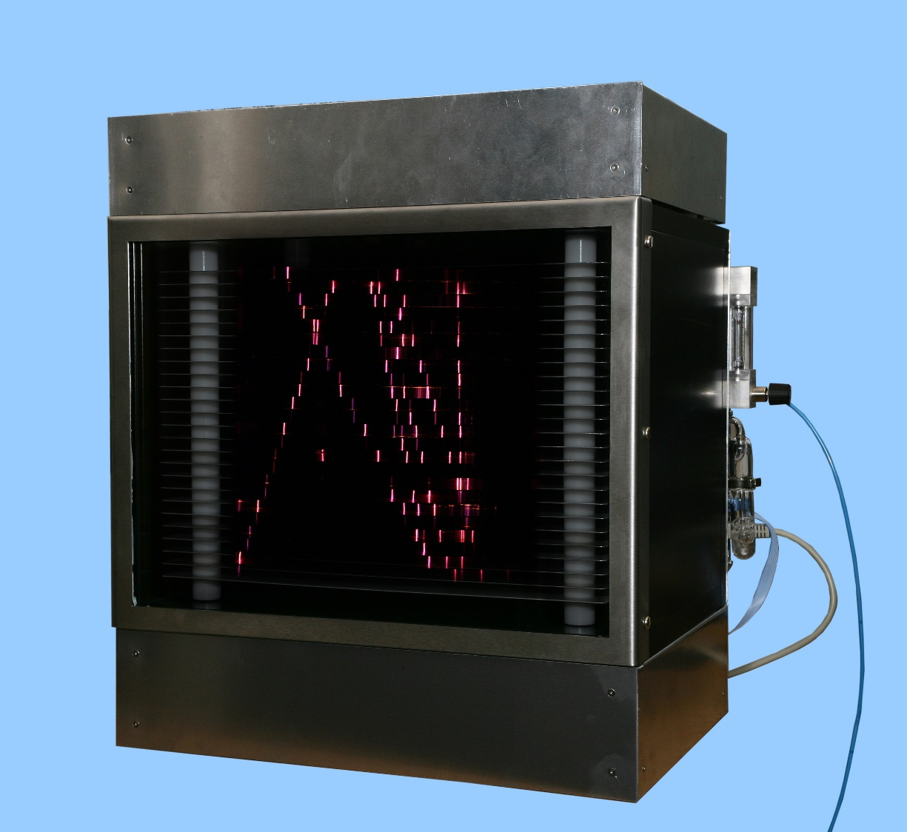
SPARK CHAMBER
THEY ARE HIGH ENERGY PARTICLES (USUALLY PROTONS), PRODUCED IN ENERGETIC EVENTS SUCH AS SUPERNOVAS THAT TRAVEL ACROSS THE GALAXY…
SOME OF THOSE PARTICLES ARRIVE TO THE EARTH AND COLLIDE WITH IONIZED ATOMS AT THE ATMOSPHERE, THUS DECAYING AND PRODUCING A SHOWER OF PARTICLES

Slide 5
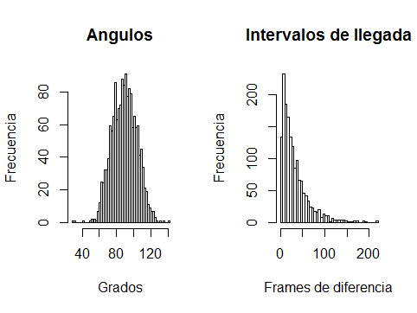
DATA ANALYSIS
THEY ARE HIGH ENERGY PARTICLES (USUALLY PROTONS), PRODUCED IN ENERGETIC EVENTS SUCH AS SUPERNOVAS THAT TRAVEL ACROSS THE GALAXY…
SOME OF THOSE PARTICLES ARRIVE TO THE EARTH AND COLLIDE WITH IONIZED ATOMS AT THE ATMOSPHERE, THUS DECAYING AND PRODUCING A SHOWER OF PARTICLES

Slide 6
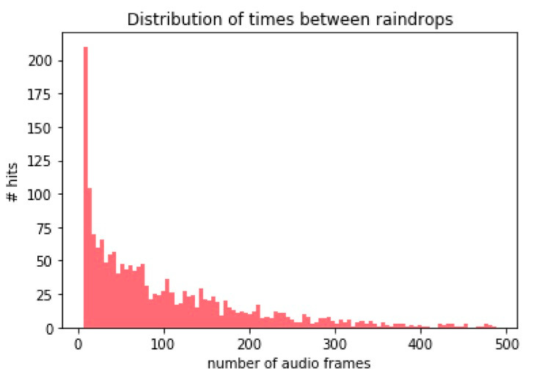
RAIN DROPS FREQUENCY
THEY ARE HIGH ENERGY PARTICLES (USUALLY PROTONS), PRODUCED IN ENERGETIC EVENTS SUCH AS SUPERNOVAS THAT TRAVEL ACROSS THE GALAXY…
SOME OF THOSE PARTICLES ARRIVE TO THE EARTH AND COLLIDE WITH IONIZED ATOMS AT THE ATMOSPHERE, THUS DECAYING AND PRODUCING A SHOWER OF PARTICLES

Slide 7
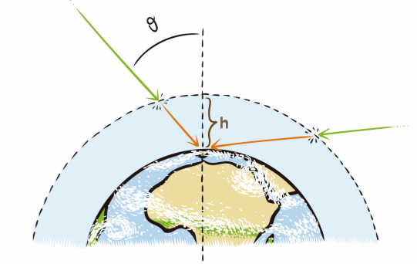
COSMIC RAYS
THEY ARE HIGH ENERGY PARTICLES (USUALLY PROTONS), PRODUCED IN ENERGETIC EVENTS SUCH AS SUPERNOVAS THAT TRAVEL ACROSS THE GALAXY…
SOME OF THOSE PARTICLES ARRIVE TO THE EARTH AND COLLIDE WITH IONIZED ATOMS AT THE ATMOSPHERE, THUS DECAYING AND PRODUCING A SHOWER OF PARTICLES

Slide 8
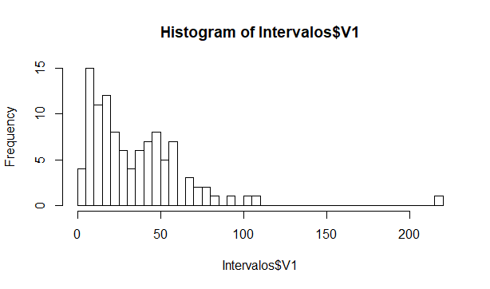
DATA ANALYSIS
THEY ARE HIGH ENERGY PARTICLES (USUALLY PROTONS), PRODUCED IN ENERGETIC EVENTS SUCH AS SUPERNOVAS THAT TRAVEL ACROSS THE GALAXY…
SOME OF THOSE PARTICLES ARRIVE TO THE EARTH AND COLLIDE WITH IONIZED ATOMS AT THE ATMOSPHERE, THUS DECAYING AND PRODUCING A SHOWER OF PARTICLES

Slide 9
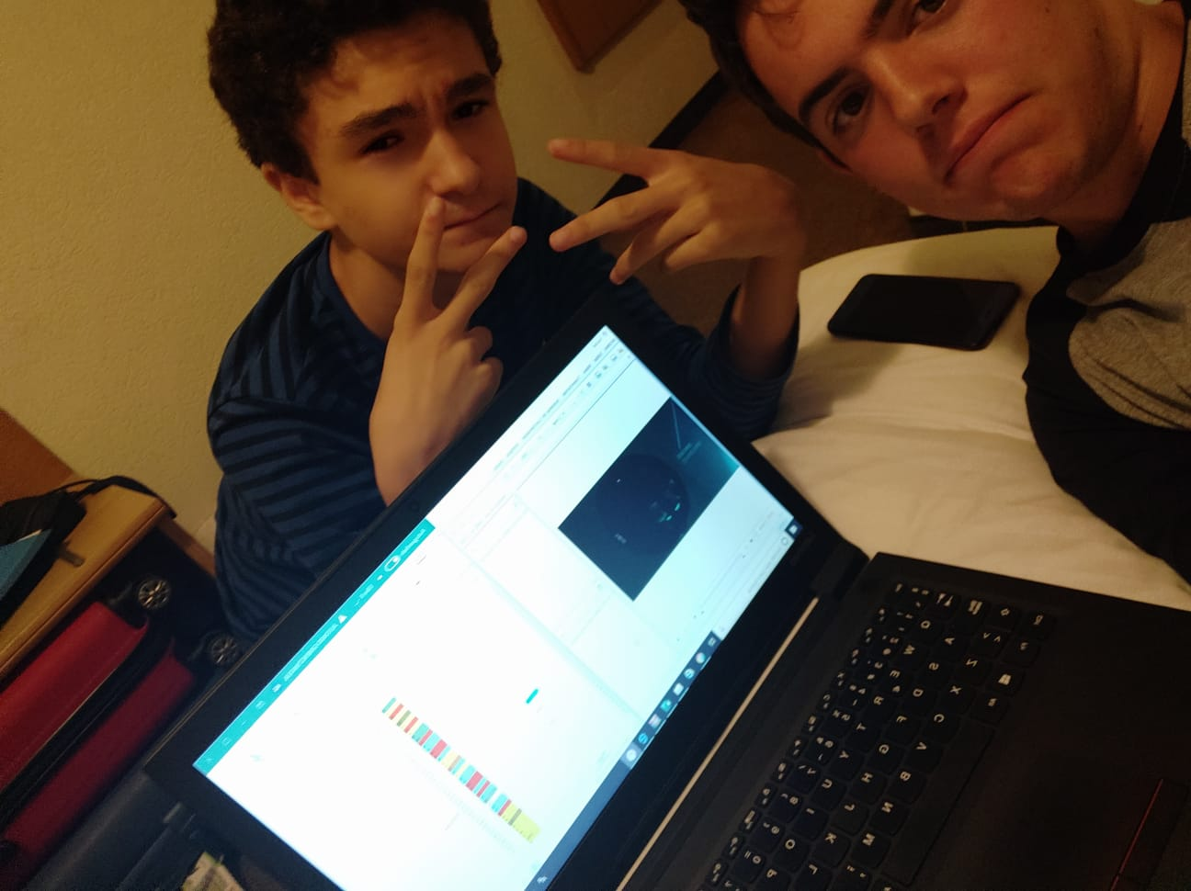
THEY ARE HIGH ENERGY PARTICLES (USUALLY PROTONS), PRODUCED IN ENERGETIC EVENTS SUCH AS SUPERNOVAS THAT TRAVEL ACROSS THE GALAXY…
SOME OF THOSE PARTICLES ARRIVE TO THE EARTH AND COLLIDE WITH IONIZED ATOMS AT THE ATMOSPHERE, THUS DECAYING AND PRODUCING A SHOWER OF PARTICLES

