Slide 1
Convolutional Layer
Implementation & Testing

Slide 2
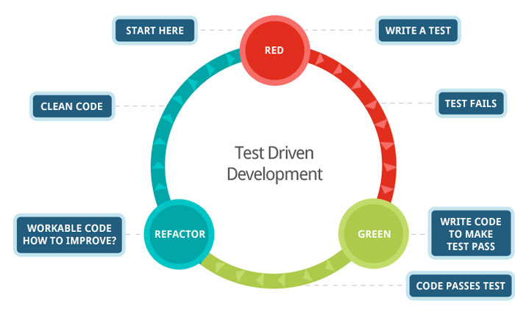
Overview
Convolutional Layer
Unit testing
Integration testing
Future Work

Slide 3
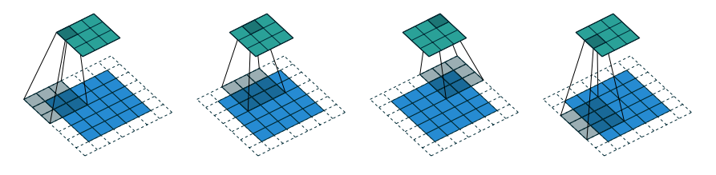
Convolutional Layer
Convolving a 3x3 kernel over a 5x5 input, using s = 2 and p = 1
Extra Considerations
Both the input volume and kernel are generally 3D.
Each layer includes more than one kernel.
Stride and padding values do not need to be equal in the two dimensions.
The kernel and input tensors are not necessarily square.

Slide 4
Unit testing
Testing a single operation in isolation
Test cases
Different strides and padding.
Non square kernels.
Depth > 1.
166 | 212 | 213
150 | 114 | 119
109 | 115 | 101
212 | 213
150 | 119
The same testing strategy was employed for forward and backward propagation in all supported layer types.
Fun fact: Doing that for convolutional layer back-prop took me more time than implementing it!

Slide 5

Integration testing
Great! Each piece works, therefore the system works! Right…?
Hint: Wrong
Generally a system is more than the sum of its pieces.

Slide 6
Integration Testing – Approach 1
We could use the same strategy as in unit testing:
Create an input.
Create kernels for each layer.
Compute the output of each layer on paper.
Compute the gradients for every layer on paper.
I was actually stubborn enough to do that.
This would probably take me a month to compute and would include about 5 to 10 mistakes.

Slide 7
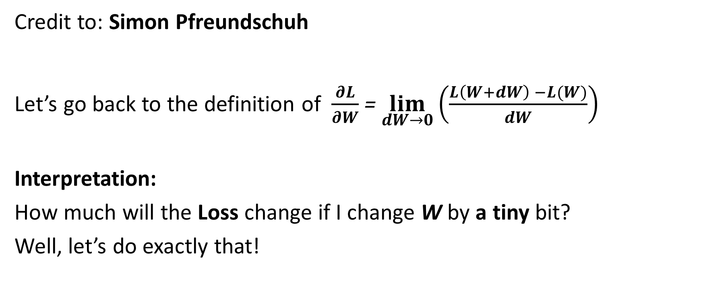
Enter finite difference computation!
Credit to: Simon Pfreundschuh
Let’s go back to the definition of $\frac{∂L}{∂W}$ = $\lim_{dW→0}{{\left(\frac{L\left(W+dW\right) −L(W)}{dW}\right)}^{}}$
Interpretation:
How much will the Loss change if I change W by a tiny bit?
Well, let’s do exactly that!

Slide 8
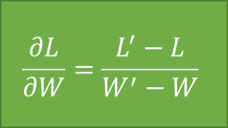
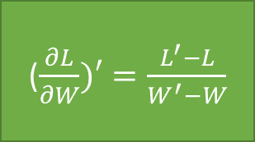
Finite difference comparison
Backward propagation
$$\frac{∂L}{∂W}=\frac{L^{′}−L}{W^{′}−W}$$
W
Forward propagation
L
($\frac{∂L}{∂W})′=\frac{L^{′}−L}{W^{′}−W}$
Assert
Equality!
Input Image
Forward propagation
L’
Change by a tiny bit
W’
Operation
Computed value
Arbitrary input Value

Slide 9


Results & Future Work
My implementation recently passed this test! Hurray!
Since its (supposedly) correct, it’s now time to make it fast!

