Slide 1
Activities on accelerators in Spain
Francis Perez
ALBA Accelerator’s Head
on behalf of
CONECTA: Spanish Coordination on Accelerator’s Science and Technology

Slide 2

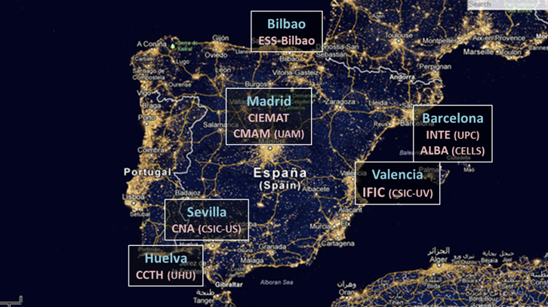
CONECTA
Spanish Accelerator Facilities and Groups
IFIC Accelerator Group - CSIC-UV - Valencia
CIEMAT Accelerator Group - Madrid
ALBA - 3rd Generation Light Source - Barcelona
CCTH - Centro Científico Tecnológico Huelva – UHU - Huelva
CNA - Centro Nacional de Aceleradores – US - Sevilla
CMAM - Centro de Microanálisis de Materiales – UAM - Madrid
ESS Bilbao - Bilbao
INTE - Institute of Energy Technologies – UPC - Barcelona

Slide 3

CONECTA
Coordination of the activities of the Accelerator community in Spain
Contribute to the implementation of R&D Plans
Provide technical consultancy
Provide support to education and training
Help to coordinate the rationalization of the available resources
Help to consolidate and recognize professional careers
Serve as consultant to the industry, in coordination with official bodies
Provide knowledge and support to the Spanish participation in international collaborations
Gather the needs on accelerator technologies on different scientific fields
SCOPE

Slide 4





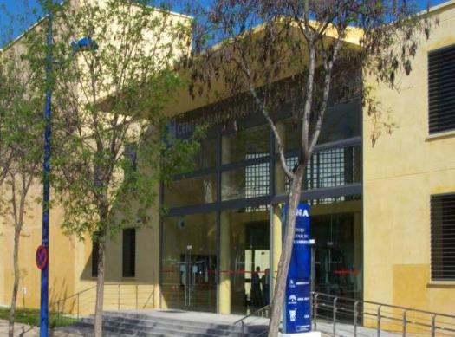
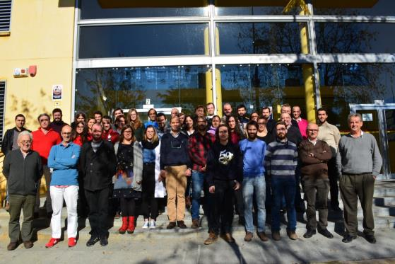
MINISTERIO
DE EDUCACION Y CIENCIA
Parque Tecnológico Cartuja’93, Avda.Thomas Alva Edison nº 7, E-41092 – Sevilla. Spain
Phone: +34.95.4460553, Fax: +34.95.4460145 cna@us.es
Joaquin Gomez - CNA
The CNA Team
We are today ~58
Notes:
Centro mixto U.Sevilla-J.Andalucia-CSIC
Instalaciones principales: 4 aceleradores, 1 irradiador, 1 Tomógrafo PET-CT.
ICTS: Instalación orientada a usuarios. Más de 100 solicitudes de uso al año. Comité científico regula el acceso al centro.
Personal: 48 trabajadores.
19 fijos. 20 temporales. 9 en formación.
13 doctores de plantilla (12 US, 1 CSIC),
10 doctores contratados (2 R&C, 8 postdocs).
Financiación externa por empresas: SAS, IBA, ALTER, ENRESA …además de proyectos autonómicos, nacionales y europeos, y facturación por el uso de las instalaciones.

Slide 5
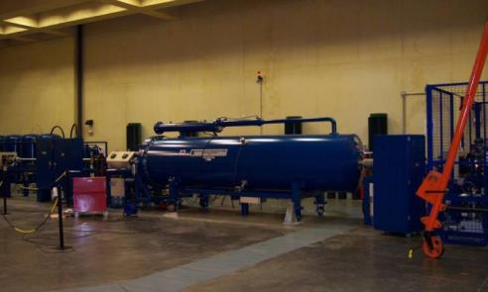
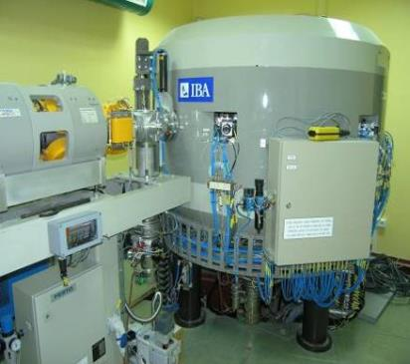
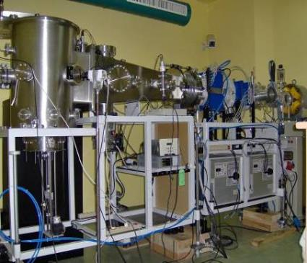
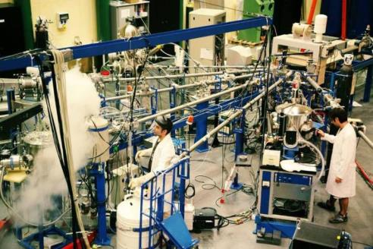
3MV Tandem accelerator
Cyclotron
18 MeV (p), 9 MeV (d)
Nuclear physics and Instrumentation (Nuclear and Particle Physics)
IBA techniques (Material Science)
Irradiation (Space technology
Radiopharmaceutical production (Molecular Imaging)

Slide 6

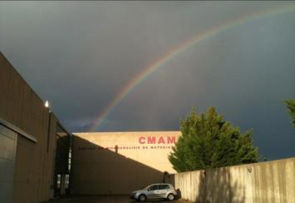
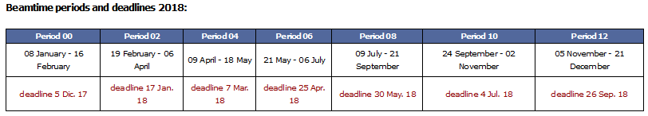
Belonging to UAM
Located in the Cantoblanco Campus
In operation since March 2003
11 M€ of technological investment
CMAM Research Fields
Archaeometry
Biophysics
Energy Related Materials
Ion-Solid Interactions
Nuclear Physics
Photonics
Open facility with competitive access

Slide 7

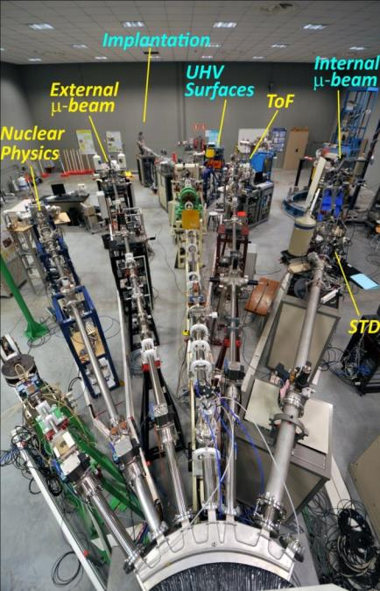
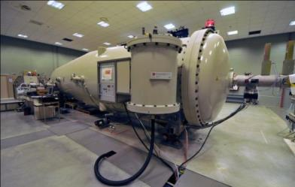
Accelerator & Beamlines
Tandem accelerator, 5MV, HVEE.
The first, High Current, Tandetron Accelerator using the Coaxial Cockcroft-Walton power supply system to reach 5MV.
Experimental stations.
Four beamlines with seven experimental stations, including two micro-beams.)

Slide 8

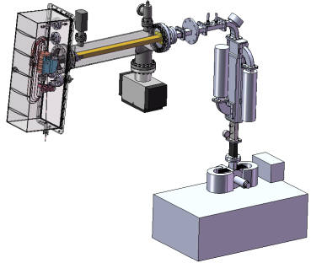
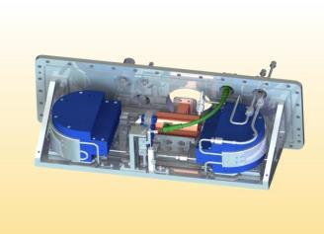
Yuri Koubychine - UPC
Microtron project at the INTE-UPC
Design and construction of an electron accelerator with beam recirculation of the race-track microtron (RTM) type.
Quite compact machine: the accelerator head dimensions are 60 x 20 x 12 cm approximately.
Experiments on material irradiation with electron beam, industrial radiography, cargo inspection
Main characteristics
Beam energies | 6, 8, 10, 12 MeV
Energy gain per turn | 2 MeV
Injection energy | 25 keV
Operating frequency | 5712 MHz
Pulse duration | 3 µs
Pulse repetition frequency | 1 – 200 Hz
Pulse beam corrent | 5 mA
Permanent magnets (NdFeB) in-vacuum
Energy switch by change of the extraction orbit
On-axis E-gun with off-axis cathode
3D image of the interior of the accelerator
head / vacuum chamber

Slide 9
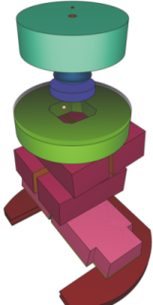
PRIMO - Advanced tool for linac simulation
PRIMO is a software tool for the Monte Carlo simulation of most Varian models of clinical linacs.
The dose distribution in voxelized patients, or homogeneous phantoms, is also determined. Tools to perform the analysis of these distributions (e.g., dose volume histograms, gamma index) are included.
It includes a graphical user interface similar to those found in commercial treatment planning systems.
In collaboration with Universitätsklinikum, Essen
Freely available at
http://www.primoproject.net

Slide 10

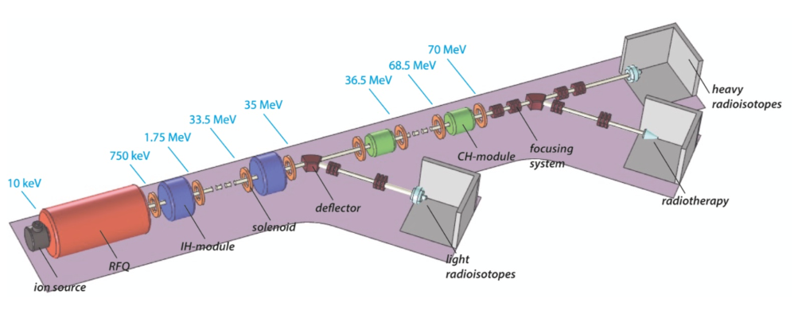
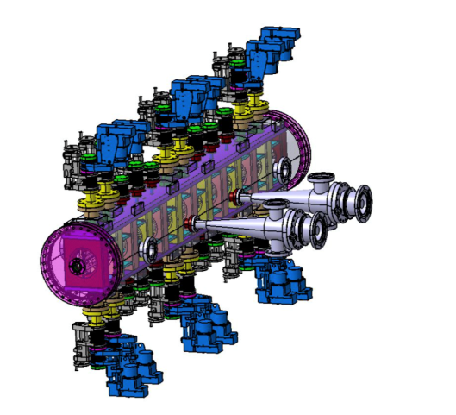
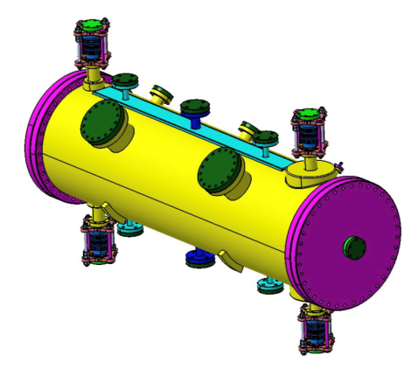
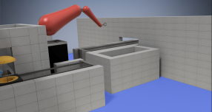
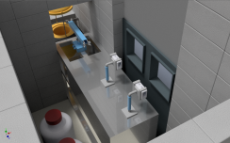
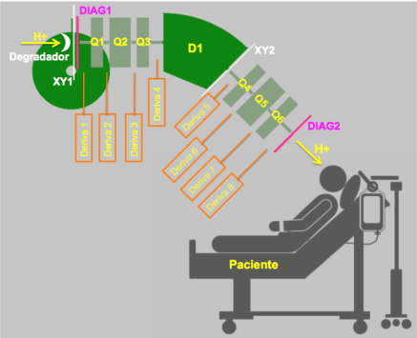
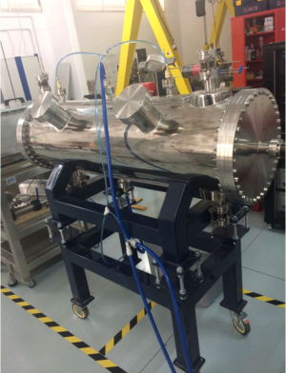
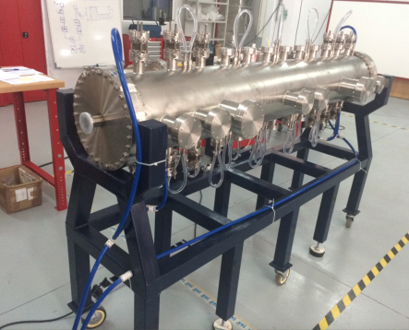
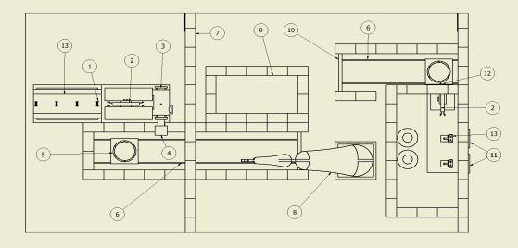
Ismael Martel
Proyecto ICH15 (CDTI, ITC-20151186)
Design of a 70 MeV IH+CH CW proton linac for radioisotope production and therapy (uveal tumour). Freq.= 200 MHz.
I= 5 mA , E= 30 MeV & 70 MeV production beam lines
I = 1 uA, E= 70 MeV radiotherapy beam line
ICH15 – Facility layout
IH Linac
4-rod RFQ
30 & 70 MeV radioisotope
production
70 MeV radiotherapy
RFQ & IH prototypes being tested at CCTH – Huelva

Slide 11


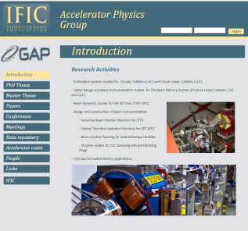
Accelerator R&D, IFIC
http://gap.ific.uv.es/
COLLABORATIONS
  ERDF funds to construct HG-RF laboratory and purchase equipment.
  Marie Curie – IF (H2020) : D. Esperante, grant to develop the system and upgrade it.
  Marie Curie – ITN-OMA (H2020) : A. Vnuchenko. Optimization of Medical Accelerators.
  CompactLight-XLS INFRADEV (H2020): Use of high-gradient for “Free Electron Laser” facilities
  New CLIC-KE contract: Val HG-RF lab power upgrade, commissioning, first operations and XBOXs support.
Notes:
11
The Accelerator group at IFIC
IFIC participation in CLIC starts in 2002 with the collimation studies for the BDS; in 2004 the group initiates the collaboration with the CTF3 facility. In 2006 IFIC in collaboration with the Universitat Politecnica de Catalunya (UPC) and CERN, undertook the design, construction and performance tests of a series of 16 Beam Inductive Position Monitors (BPM) for the CTF3. The BPMs are installed in the TBL of CTF3 and working successfully since October 2009 .
These studies have been extended with the BPMs studies for the Drive Beam of CTF3, and are being made under the Spanish Programme of European Large Infrastructures. The work started in June 2011 and it is being made in collaboration with the Beam Instrumentation Group of CERN. The first prototype of a stripline BPM has been designed constructed and tested at the CERN labs.
Since October 2010 in the framework of the DR Working Group of CLIC, the IFIC and CIEMAT groups are developing a first prototype of a stripline kicker for the DR kickers in close collaboration with CLIC group at CERN, under the Spanish Research Programme of the Centro de Desarrollo Tecnologico e Industrial (CDTI) in collaboration with the company G&P Vacuum projects. The first prototype is being designed and constructed and it will be tested at CERN labs at the beginning of 2014. This prototype will also be tested with beam and with the corresponding power supply, an inductive Adder type being constructed by CERN, in ATF2 test facility. Yesterday the prototype has arrived at CERN!!!!!
The measured vertical emittance in the EXT of ATF was larger than expected . This motivated the study of the possible sources of emittance growth; IFIC started a collaboration with KEK in 2007, jointly with Laboratoire de l’Accelerateur Lineaire (LAL), the Science & Technology Facilities Council (STFC), in order to carry out this study.
This study has permitted the presentation of a proposal in combination with the accelerator group of SLAC in June 2009 for constructing a multi-Optical Transition Radiation (mOTR) system, consisting of four monitors, in the EXT line of ATF2. This system is being used routinely since 2011 and has demonstrated to be a reliable and stable diagnostic tool for fast beam size measurement and emittance reconstruction. Similar mOTR system can be deployed at FLC and linac-based synchrotron light sources. For instance, we have studied the feasibility of using mOTR systems in diagnostic sections of the Ring to Main Linac (RTML) of FLC.
In April 2013 jointly with LAL, we have started the study of the halo collimation in ATF2. Preliminary studies has been made in collaboration with LAL and this studies will be the starting point for making a proposal in collaboration with LAL, for the design, construction and implementation of a retracting halo collimator system in ATF2.

Slide 12

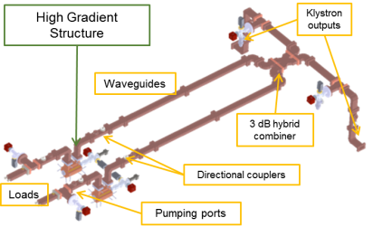
High-Gradient RF laboratory
Lab main elements:
The bunker (1)
the crane (2) and the
Supporting structure (3)
Waveguides (4)
Rack vacuum components (5)
Modulator + Klystron connected (6)
2
3
4
5
1
6
High-power S-Band (3 GHz)
Aim: High-gradient research topics at 3 GHz => RF testing, breakdown studies and dependencies, structures RF conditioning, studies of High-Power performance, Surface field emission, development of alternative diagnostics and analysis techniquesDesign and development of RF components and technology
Prospects for Val HG-RF facility:
R&D High-gradient accelerators for hadrontherapy applications:
  Testing and conditioning of HG cavities and high-gradient phenomena studies
  Design and development of HG cavities for hadrontherapy linacs
  High-energy proton imaging in hadron-therapy
Other applications: Very High Energy Electron (VHEE) linacs for radiotherapy, cargo-scanning, FELs, compton sources…

Slide 13

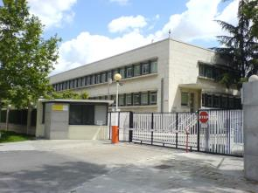
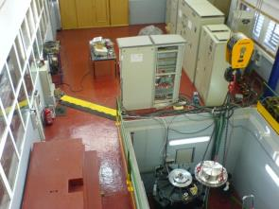
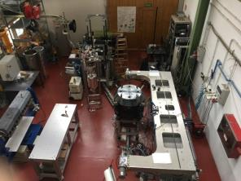
The Electrical Engineering Division at CIEMAT
Accelerator R&D activities: CIEMAT
Luis García-Tabarés - CIEMAT
STRUCTURE
ELECTRIC ENGINEERING DIVISION (33 people)
ACCELERATOR
TECHNOLOGY UNIT (16 people)
ELECTROMECHANICAL TECHNOLOGY
UNIT (9 people)
POWER SYSTEMS
UNIT (6 people)
FACILITIES
Main Offices Energy & Superconductivity Assembly Hall

Slide 14
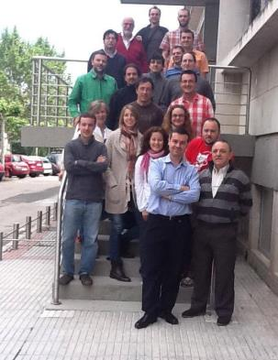
Electrical Engineering Division: Areas, Projects and Collaborations
Accelerator R&D activities: CIEMAT
ACCELERATORS | POWER SYSTEMS
Large Facilities ↓ | Storage ↓
E-XFEL | SH2
FAIR
LHC Hi-Lumi (CERN)
CTF3/CLIC (CERN)
FCC (CERN) & EuroCirCol
ILC
IFMIF | Generation ↓
TIARA | UNDIGEN+
Small Accelerators ↓ | SEA-TITAN
AMIT CYCLOTRON

Slide 15
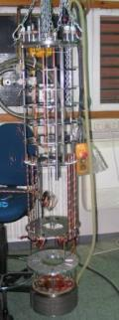
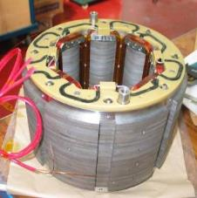
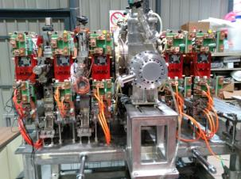
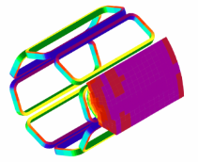
Accelerator R&D activities: CIEMAT
Accelerator Technology Unit: Activities & Capabilities
Calculations: Electromagnetic, thermal and mechanical analysis and beam dynamics simulations.
Engineering design: 3-D modeling, fabrication techniques, drawings.
Prototyping: Fabrication and assembly of magnets, RF structures and other accelerator components, including complete compact accelerators.
Testing: Two vertical cryostats, one cryocooler and low power RF measurements.

Slide 16
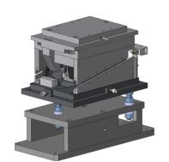
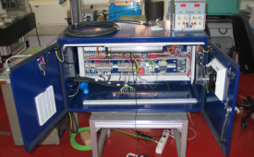
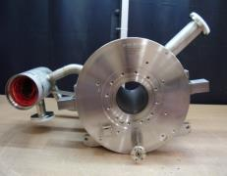
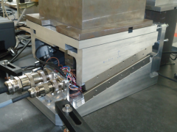
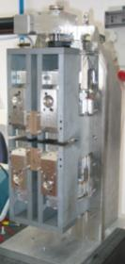
Accelerator R&D activities: CIEMAT
Accelerator Technology Unit: Relevant Projects (I)
CONTRIBUTION TO THE E-XFEL PROJECT (European Free Electron Laser):
101 Electronic Control Racks
103 Combined Superconducting Magnets
101 Moving Tables
3 Phase Shifters

Slide 17
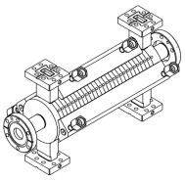
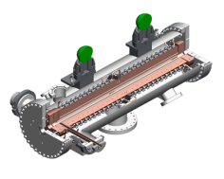
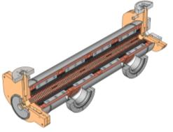
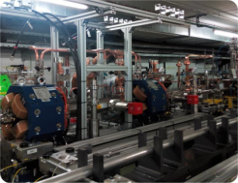
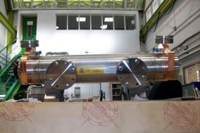
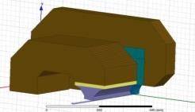
Accelerator R&D activities: CIEMAT
Accelerator Technology Unit: Relevant Projects (II)
CONTRIBUTION TO THE CLIC PROJECT (Compact LInear Collider):
1 Accelerating Sructure
12 Power Extraction Transfer Structures for CTF3
1 Double Length Power Extraction Transfer Structure
1 Damping Ring Gradient Dipole

Slide 18
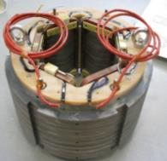
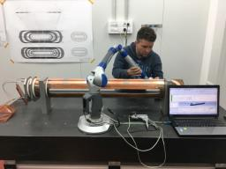
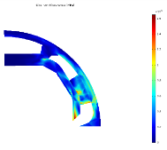
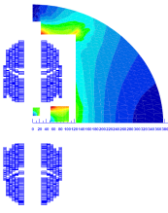
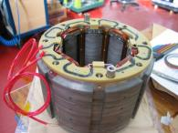
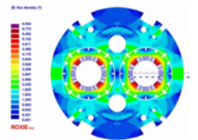
Accelerator R&D activities: CIEMAT
Accelerator Technology Unit: Relevant Projects (III)
CONTRIBUTION TO THE LHC-HiLumi & FCC (Future Circular Collider) PROJECTS:
Participation in the FCC Vacuum Beam Screen Design
Radiation resistant high aperture SC Sextupole
Combined Corrector Dipole for LHC-HL
Analysis of the Common-Coil option for the FCC main Dipoles
Radiation resistant high aperture SC Octupole
Participation in the development of 2 Quadrupoles for LHC-HL

Slide 19





Accelerator R&D activities: CIEMAT
Accelerator Technology Unit: Relevant Projects (IV)
CONTRIBUTION TO THE IFMIF (International Fusion Irradiation Facility) PROJECT:
2 RF Buncher Cavities
2 Collimation Scrapers
Integration activities in the MEBT
13 Combined Resistive Magnets
Beam Position Monitors

Slide 20


Accelerator R&D activities: CIEMAT
Accelerator Technology Unit: Relevant Projects (V)
THE AMIT PROJECT: A Compact Superconducting Cyclotron for Radioisotope Production
GENERAL
Cyclotron Type | Classical
Energy | >8.5 MeV
Current | >10 μA
MAGNET
Type | Low Tc Superconductor
Configuration | Warm Iron
Superconductor | NbTi
Central Field | 4 T
Focusing type | Radially decreasing (1.5%@extraction radius)
RF SYSTEM
Configuration | One 180º Dee
Peak Voltage | 60 kV
RF frequency | ∼ 60 MHz
ION SOURCE
Type | Internal
Ions | H⁻
EXTRACTION
Extraction | Stripping foil at 110 mm
Target | Nitrogen gas (¹¹C) , ¹⁸O enriched water (¹⁸F)
Position | External
He
RECONDENSER
MAGNET
RF
RESONATOR
General lay out of the accelerator (up) and complete superconducting magnet (down)

Slide 21









ESS-Bilbao
The Spanish Contribution to the ESS
Public consortium of Central and Basque Governments; bringing knowledge and added value in particle accelerators and neutron scattering science and technologies; by leveraging its in-kind contribution to the European Spallation Neutron Source, in Lund (Sweden).
Mario Pérez, ESS-Bilbao
52 employees
Qualification
age average: 40
27% PhD
29% women
71% men
13% Post Graduate Degree
44% Master’s Degree
8% Bachellor
8% Technician
Headquarters
R&D Center
AWF
Madrid Satellite
Poligono Ugaldeguren III
Zamudio (Bilbao)
Parque Tecnológico
Zamudio (Bilbao)
Polígono Industrial Júndiz
Vitoria-Gasteiz
Instituto de Fusión Nuclear
Madrid

Slide 22










In-Kind Contributions to ESS
TARGET
MEBT
RF Systems
RF chains: 1 for RFQ and 5 for DTL. Composed by klystrons, modulators, loads, waveguides, interlocks and LLRF
Accelerating element: complete subsystem that goes after the RFQ and integrates: design, manufacturing, diagnostics, control, assembly and testing.
4
5
3
The spallation process takes place when the accelerated proton beam hits the Tungsten bricks of the 11-tonne target wheel. This will produce neutron brightness for scientific experiments across multiple disciplines.
MIRACLES INSTRUMENT
Time-of-Flight backscattering instrument for polymer science, energy materials, and magnetism studies.
Prime contractors: design, manufacturing, assembly &cold commissioning

Slide 23

In-Kind Contribution - MEBT

Slide 24




In-Kind Contribution – RF Systems
Klystrons
Modulators
Marx Generator – Direct Modulator mixed topology
Pulses feature outstanding rise/fall time and flatness characteristics

Slide 25






ESS-Bilbao In-House Projects
ECR: H+ source; 45 KeV; 50 mA
LEBT: Low Energy Beam Transport
Focusing and beam diagnostics
RFQ: Radio Frequency Quadrupole
Four-vane, 3 MeV, 3.2 m long, at 352 MHz
RFTX: RF Test Stand

Slide 26





ALBA,
Synchrotron Light Source
The ALBA Team
We are today ~200
Source: Javier Sanchez Rios
Francis Perez - ALBA

Slide 27

ALBA
Accelerators
Parameter | Value
Energy | 3 GeV
Circumference | 268.8 m
Emittance | 4.5 nm·rad
Current | 250 mA
RF frequency | 500 MHz
# cavities | 6
Long straights | 4 (8 m)
Medium straights | 12 (4 m)
LINAC
100 MeV
BOOSTER
100 MeV -> 3 GeV
STORAGE RING
3 GeV

Slide 28



ALBA
Accelerators
Linac
Accelerate electrons from rest to 100 MeV RF cavities 3 GHz
Repetition rate of 3 Hz
Booster
Accelerate e- from 100 MeV to 3 GeV
1 x RF cavity at 500 MHz
Repetition rate of 3 Hz
Storage Ring
Keep electrons at 3.0 GeV
Magnets and correctors to keep the orbit (sub-μm)
Vacuum Pumps (10⁻¹⁰ mbar)
6 x RF cavities at 500 MHz
Circulating current: 250 mA

Slide 29


ALBA BEAMLINES
In operation (8)
In construction (3)
BL29: BOREAS
EU71– (0.08-3 keV)
REsonant Absorption
and Scattering
Bending: e⁻ Diagnostics
BL01: MIRAS
Bending – (0.4-100 µm)
IR Spectroscopy
BL24: CIRCE
EU62– (0.1-2 keV)
Photoemission
spectroscopies
BL04: MSPD
SCW31 – (8-50 keV)
HP/HR
Powder Diffraction
BL06: XAIRA
IVUXX (~5-25 keV)
Macromolecular Cristallography
Spectral range: from UV (80 eV) to hard x-rays (50 keV)
High brilliance: 10²⁰ at 2 keV
BL22: CLÆSS
MPW80– (2-63 keV)
Absorption &
Emission Spectroscopies
BL09: MISTRAL
Bending– (0.27-2.6 keV)
X ray Microscopy
BL20: LOREA
EUXX– (10-450 eV)
ARPES
BL11: NCD
IVU21– (6-13 keV)
Non Cristalline Diffraction
SAXS/WAXS
BL16: NOTOS
Bending)
XAS-PD-Metrology
BL13: XALOC
IVU21 – (5-22 keV)
Macromolecular Cristallography

Slide 30




ALBA BEAMLINES
Some pictures
Xaloc
Mistral
NCD
CLAESS

Slide 31




ALBA BEAMLINES
Some pictures
CIRCE
BOREAS
MIRAS
MSPD

Slide 32


ALBA Operation
24/24h 7/7days
Average Availability in the last 5 years = 97,5%

Slide 33







Active International Collaborations
H2020 – XLS - CompactLight
1st Annual Meeting hosted by ALBA, Dec 2018
Post Doc
KE contract FCC-CERN – HTS-BS-FCC
→ PhD student
EU H2020 Project EuroCirCol
Leader WP4 – FCC Vacuum chamber
PhD student
KE contract CLIC-CERN
→ Pulsed Magnets, RF, Diagnostics, Beam dynamics
H2020 - ARIES – Advanced Diagnostics for Accelerators
    Fast Feed Back Workshop hosted by ALBA, Nov 2018

Slide 34



ALBA-CLIC Collaboration
WP1: Test with beam of the CLIC DR Stripline
The main objective of this project is to test the stability of the proposed stripline kicker and its pulser in a real accelerator with beam. For that, these elements shall be installed in the ALBA storage ring.

Slide 35


ALBA-CLIC Collaboration
WP1: Test with beam of the CLIC DR Stripline

Slide 36





Slide 37



FCC - Vacuum Beam Screen Design
Synchrotron Radiation
as a Light Source

Slide 38




Active contracts (Collaborations)
ESRF - EBS – BPM tool
Map
Error
Standard ESRF BPM response with one electrode (right-top) retracted by 300 um
SIRIUS - Digital LLRF
ALBA DLLRF
installed at SIRIUS

Slide 39


ALBA Magnetic Lab
  CIEMAT – IFMIF magnets
  CIEMAT - SC Cyclotron
  Magnet measurements for several companies

Slide 40




ALBA RF Lab
  LLRF and Controls racks
  HVPS
  IOT cabinet
  RF transmitter
CIEMAT
IFMIF Buncher cavity
at ALBA RF lab for High Power Conditioning
  ALBA Cavity inside the Bunker

Slide 41


CONECTA
As summary, Spanish groups on accelerators have consolidated and are contributing to the development of accelerators in Spain as well as to the new international projects (CLIC, FCC, XFEL, ESS, …).

Slide 42

Thanks for your attention

