Slide 1
United Kingdom mid-term ECFA report
102nd PECFA meeting, Alba Synchrotron, Spain
Prof Stewart Boogert (Royal Holloway, University of London)

Slide 2
Introduction
UK particle physics (inc particle astro) experimental programme (uneven selection, RED not shown)
LHC experiments
  ATLAS, CMS, LHC-b, ALICE
Neutrino physics
  SBND, MicroBooNE, NOvA, T2K, DUNE, Hyper-K
Flavor physics
  NA62, BES-III
Dark matter
  LUX, LZ, DEAP-3600, Darkside
Astroparticle
  CTA, LIGO
Precision low energy
  g-2, Mu2e, Mu3e, Comet, (n,e,p)EDM, SNO+, SuperNemo
Hidden sector
  SHiP
Country profile
HEP in the UK
UK large scale (HEP related) infrastructure
Community and organisation
STFC funding
CERN industrial return
Physics higher education
UK Research and innovation
HEP and Brexit
Major events since last RECFA visit to UK
Theory
Computing
Accelerators (HL-LHC, ILC/CLIC, FCC, PWA)
Detector R&D

Slide 3

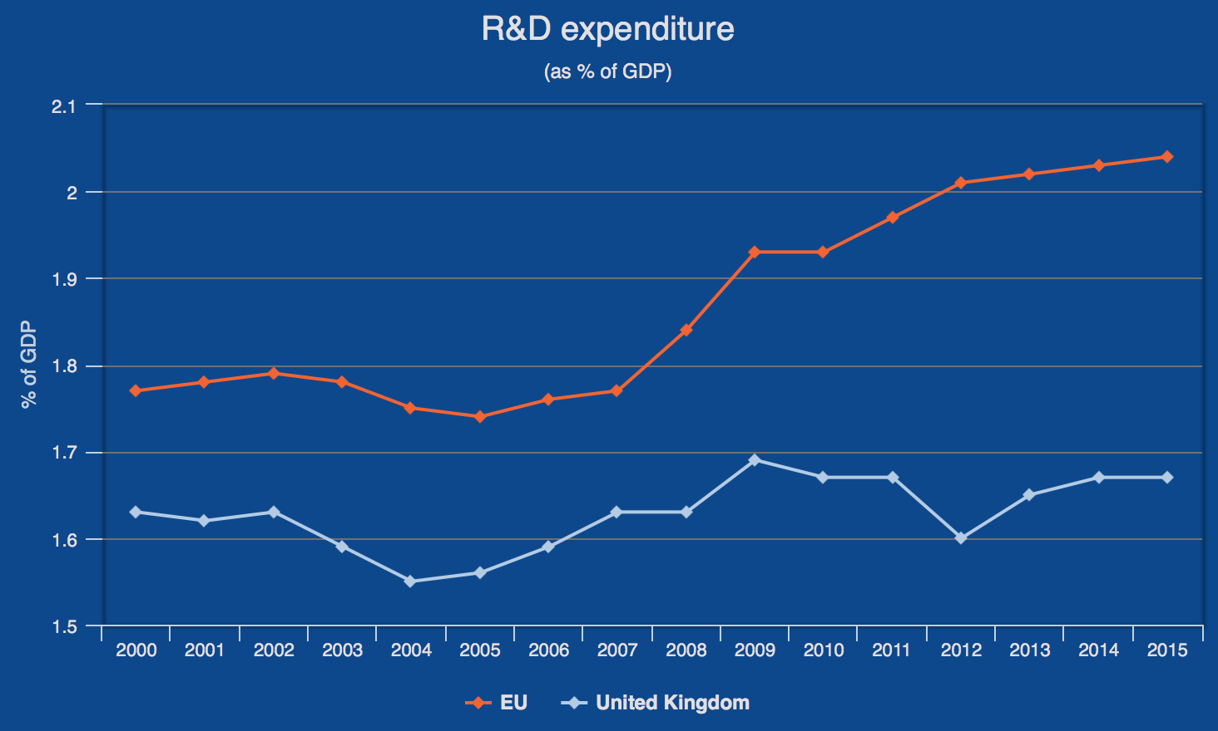
Country profile
Population : 66.2 M
Area : 242,495 km²
GDP/capita : 33.8 k€
R&D/GDP (2016): 1.69 %
CERN annual contribution (2018):
  177.9 MCHF
  Second largest contributor

Slide 4
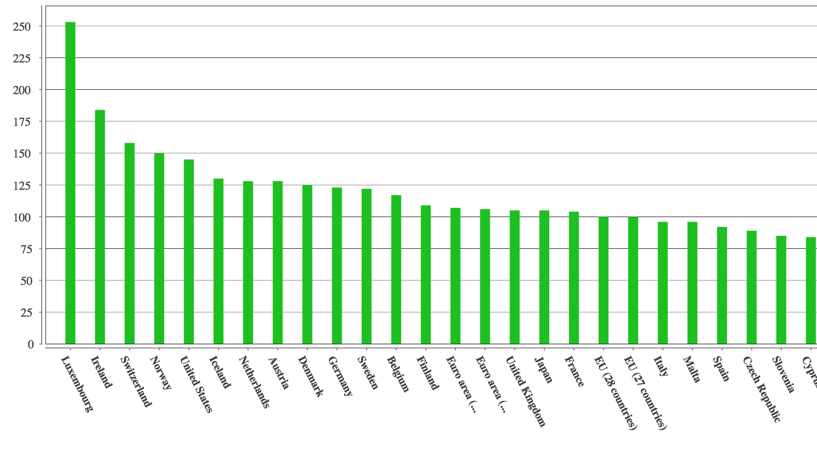
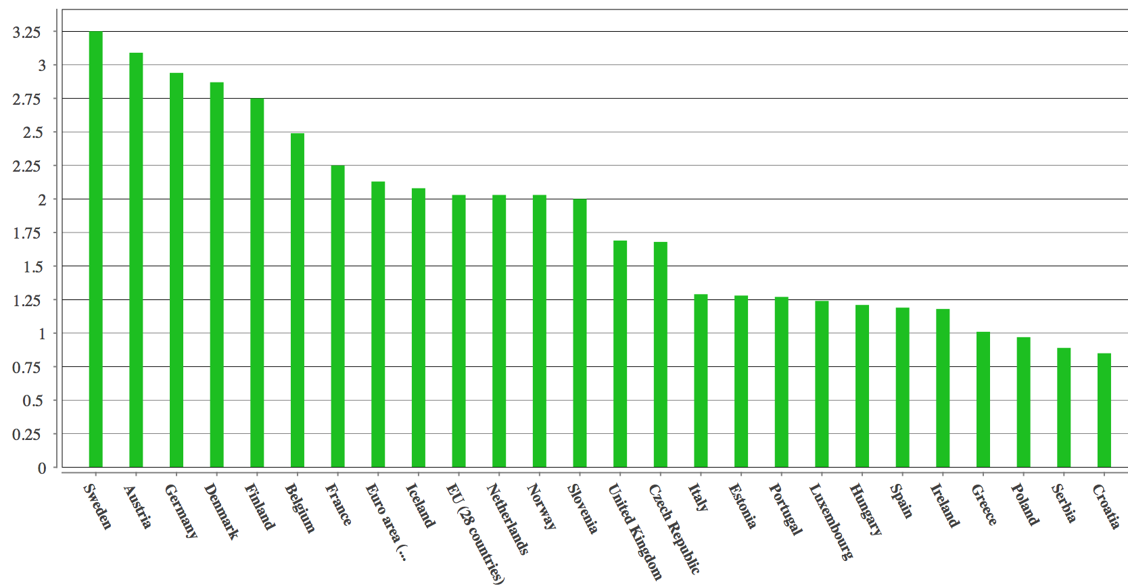
Country profile (GDP and R&D)
GDP
  Units are PPE
  13th in the EU
  Inline with EU28 average
R&D
  1.69%
  12th in the EU
  Below EU 28 average

Slide 5










UK University experimental HEP groups

Slide 6

UK University theoretical HEP groups

Slide 7
UK large scale HEP related infrastructure
Daresbury Laboratory
Boulby underground lab
Diamond light source
CLARA
ISIS neutron and muon source
ASTeC/Engineering technology centre
Central laser facility

Slide 8
HEP in the UK
16/22 (experimental/theoretical) University groups
National laboratories
  Rutherford Appleton Laboratory, Daresbury Laboratory, Boulby underground laboratory
Experimental (16)
  Birmingham, Bristol, Cambridge, Edinburgh, Glasgow, Imperial, Lancaster, Liverpool, Manchester, Oxford, Queen Mary, Royal Holloway, Sheffield, Sussex, UCL, Warwick
Theoretical (22)
  Cambridge, City, Durham, Edinburgh, Glasgow, Herriot-Watt, Imperial, Kings, Lancaster, Liverpool, Manchester, Nottingham, Oxford, Plymouth, Queen Mary, Royal Holloway, Sheffield, Southampton, Surrey, Sussex, Swansea, UCL
Funded by Science and Technology Research Council (STFC)
  National facilities, High energy Physics, Astronomy, Particle Astrophysics, Nuclear, Theory, Computing

Slide 9
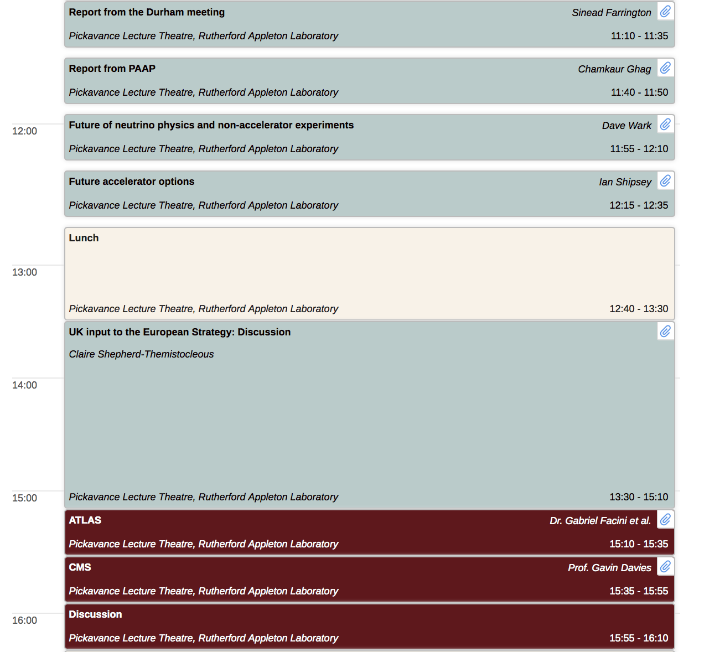
Community and organisation
Particle physics community
meeting 16-17th July 2018
Community well organised
  STFC Advisory boards
  Institute of Physics (IoP)
  UK components of large collaborations
  Community meetings
    PPAP 16-17th July 2018
  European Strategy Update Workshop
    IPPP 16-18th April 2018
https://conference.ippp.dur.ac.uk/event/729/overview
https://conference.ippp.dur.ac.uk/event/661/overview
Notes:
Science board
Accelerator Strategy Board (ASB)
Particle Physics, Astronomy and Nuclear Physics (PPAN)
Particle Physics Grants Panel (PPGP)
Projects Peer Review Panel (PPRP)
Computing Advisory Panel (CAP
Education, Training and Careers Committee (ETCC)
Advisory Panel for Public Engagement (APPE)
Public Engagement Grants Panel

Slide 10
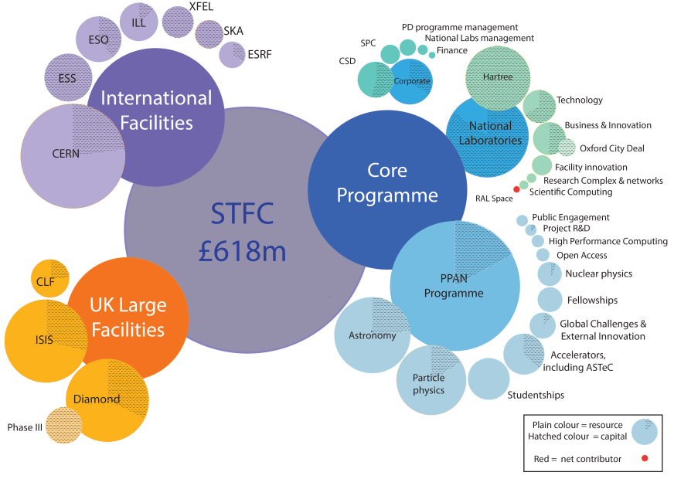
STFC Funding breakdown

Slide 11
Funding
Primary funding from STFC (Science and Technology Facilities Council)
  Subscriptions (CERN, ESO, ILL, ESRF, European XFEL, ESS, etc)
  National Laboratories
  University groups typically funded by 3 year ``consolidated grants’’
  Specific project funding from STFC
    LHC experiment upgrades
    Capital investment in detector construction
UK universities hidden funder
  Higher education in the UK effectively student fee funded
  Faculty staff costs
European Union
  FP6, FP7, ERC, MCSA, H2020

Slide 12
Funding
Particle Physics, Astronomy and Nuclear (PPAN)
  2017/18 : £107M
  Particle physics 40%
  Astronomy 43%
  Accelerators 6%
  Nuclear 5%
  Particle Astro 3%
Maintained flat funding
  2014-2022
  Constant erosion due to inflation and exchange rate changes

Slide 13
CERN industrial return
http://procurement.web.cern.ch/en/
2017
  Contracts in supplies
    15.6 MCHF
  Contracts in services
    9.7 MCHF
  Industrial return index
    Supplies 0.45 (poorly balanced)
    Services 0.46 (well balanced)
LH-LHC could help to improve supplies
Notes:
http://procurement.web.cern.ch/en/procurement-report-contents#table-1

Slide 14
Physics education
https://www.hesa.ac.uk
Pre-university (16-18) education in UK focused on 3-4 subjects
Applications for Physics subjects at university
  2012/13 : 4762
  2013/14 : 5304
  2014/15 : 5454
64 Universities teach physics at BSc (3 year), MSci/MPhys (4 year)
STFC funded PhD places
  Total expt, theory, nuclear, astro : 220 p.a
  Experiment : approx. 80 p.a
  Total larger (project funded, EU, university scholarships), full census needed before next RECFA visit (including diversity data)

Slide 15
UK Research and innovation (UKRI)
https://www.ukri.org
Restructured all government funding agencies under a coherent new entity (April 2018)
  UK Research and Innovation (UKRI)

Slide 16
New opportunities from UKRI
Industrial Strategy Challenge Fund (ISCF) – Wave 2 challenges launched, open call for Wave 3 ideas
Global Challenges Research Fund (GCRF) – up to £200 million of the £1.5 billion total collective fund unallocated
Strategic Priorities Fund (SPF) – £755 million over three years, bids from any BEIS-funded research and development organisation
Talent Fund – £300 million over three years
Commercialisation Fund – £108 million
Strength in Places Fund – £115 million over three years for collaborative bids between research organisations and business to support regional growth
Fund for International Collaboration – £110 million over three years

Slide 17
HEP funding and Brexit
Potential overall reduction in HEP funding in the UK
  Significant problems anticipated if UK government does not step in
  Pressure on whole research programme in the UK (not just HEP) might have a knock-on effect on HEP
Other important effects
  UK has significant internationalised community
  Potential brain drain from UK universities and laboratories
  UK could be seen as less attractive to researchers

Slide 18
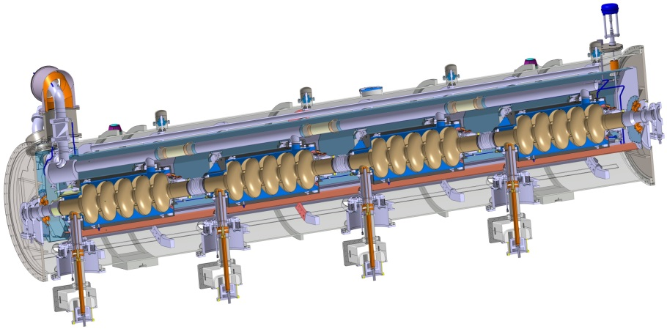
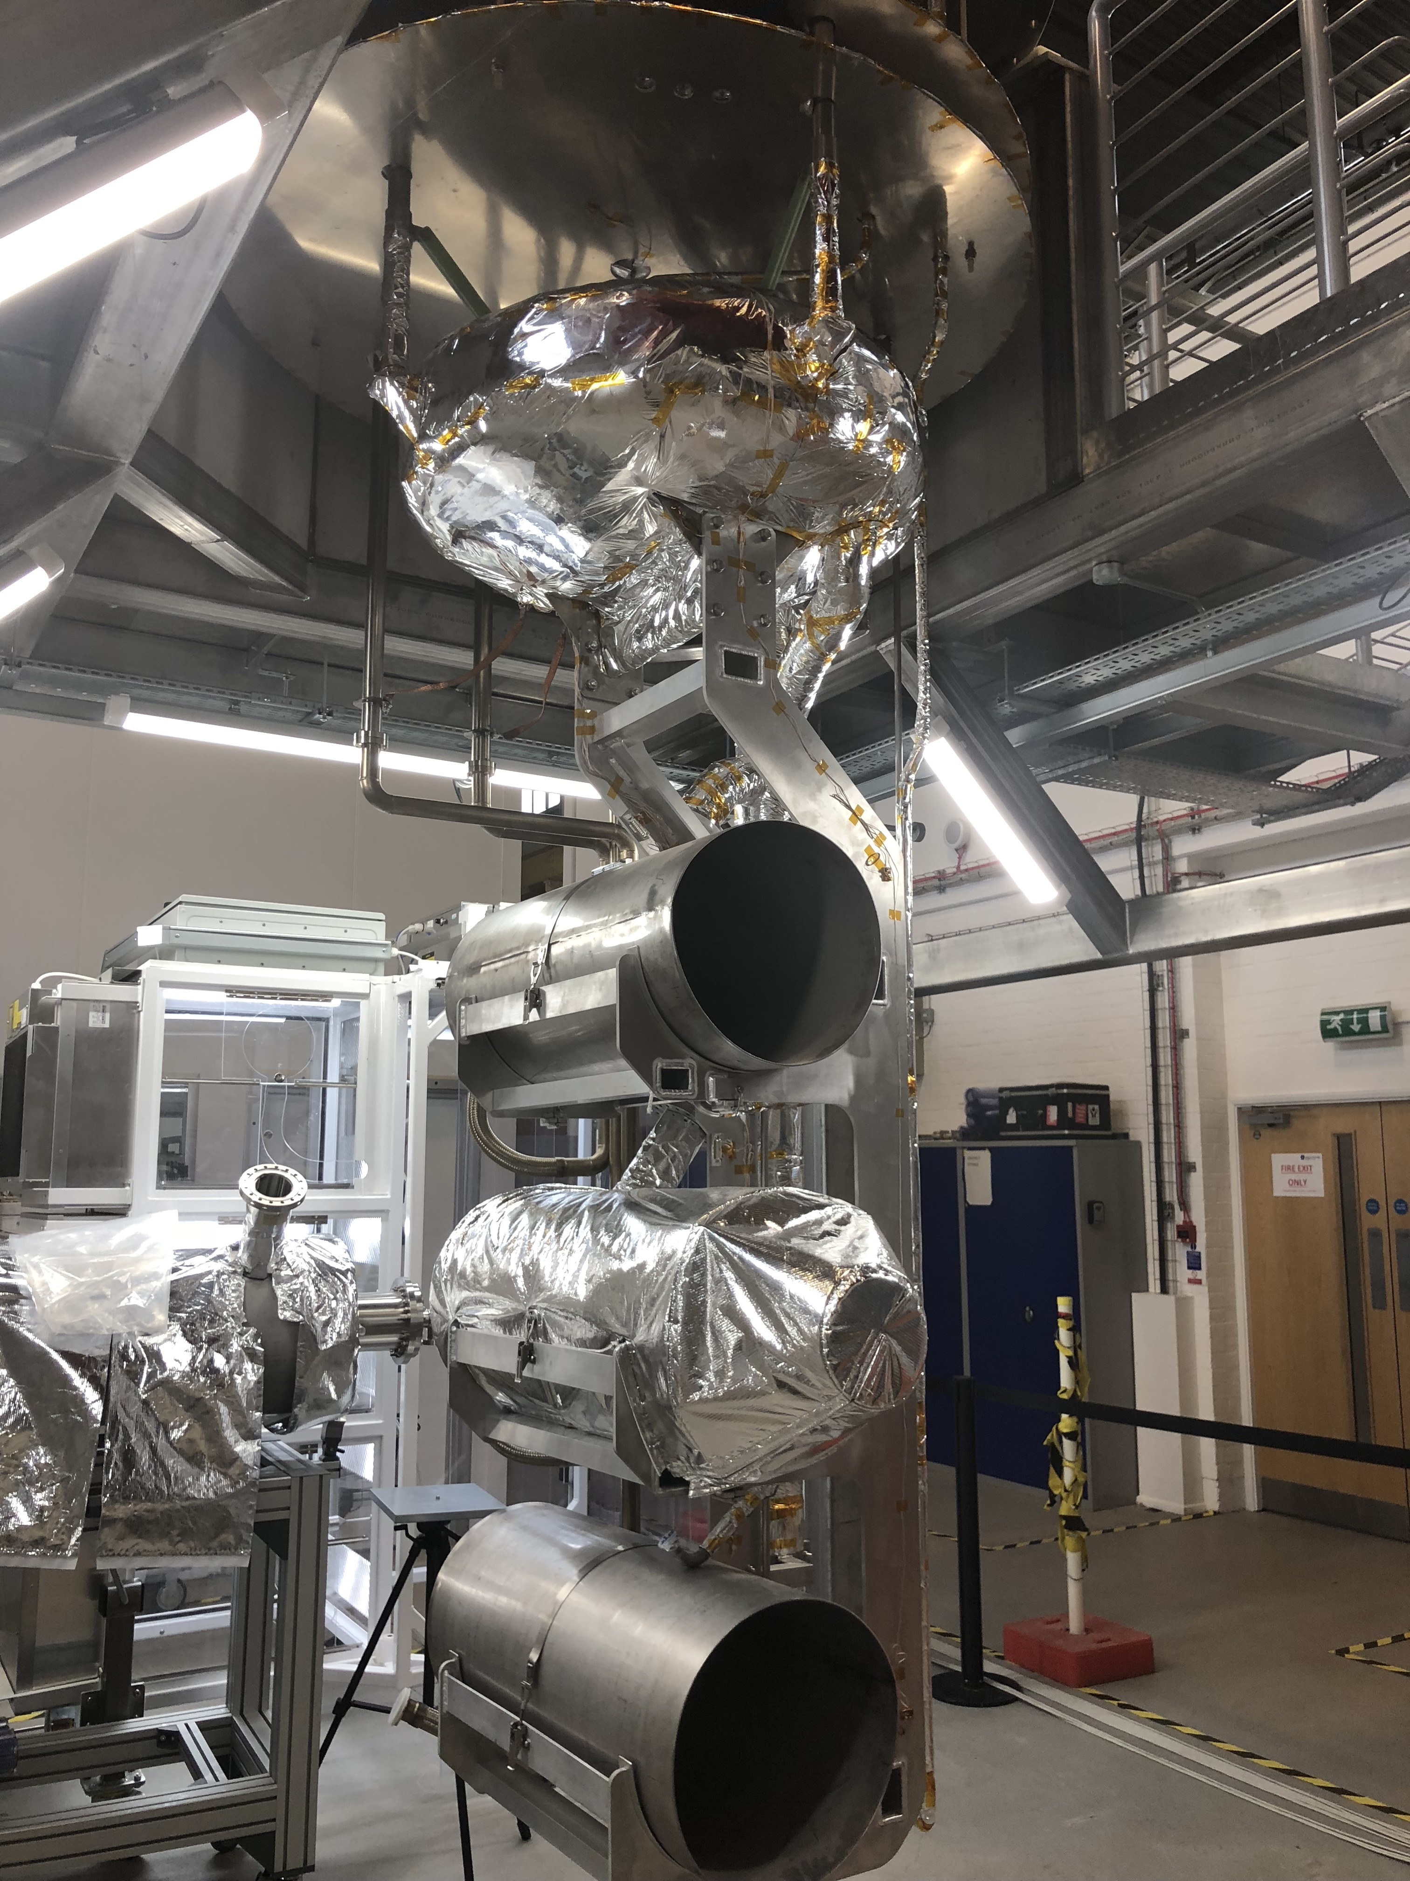
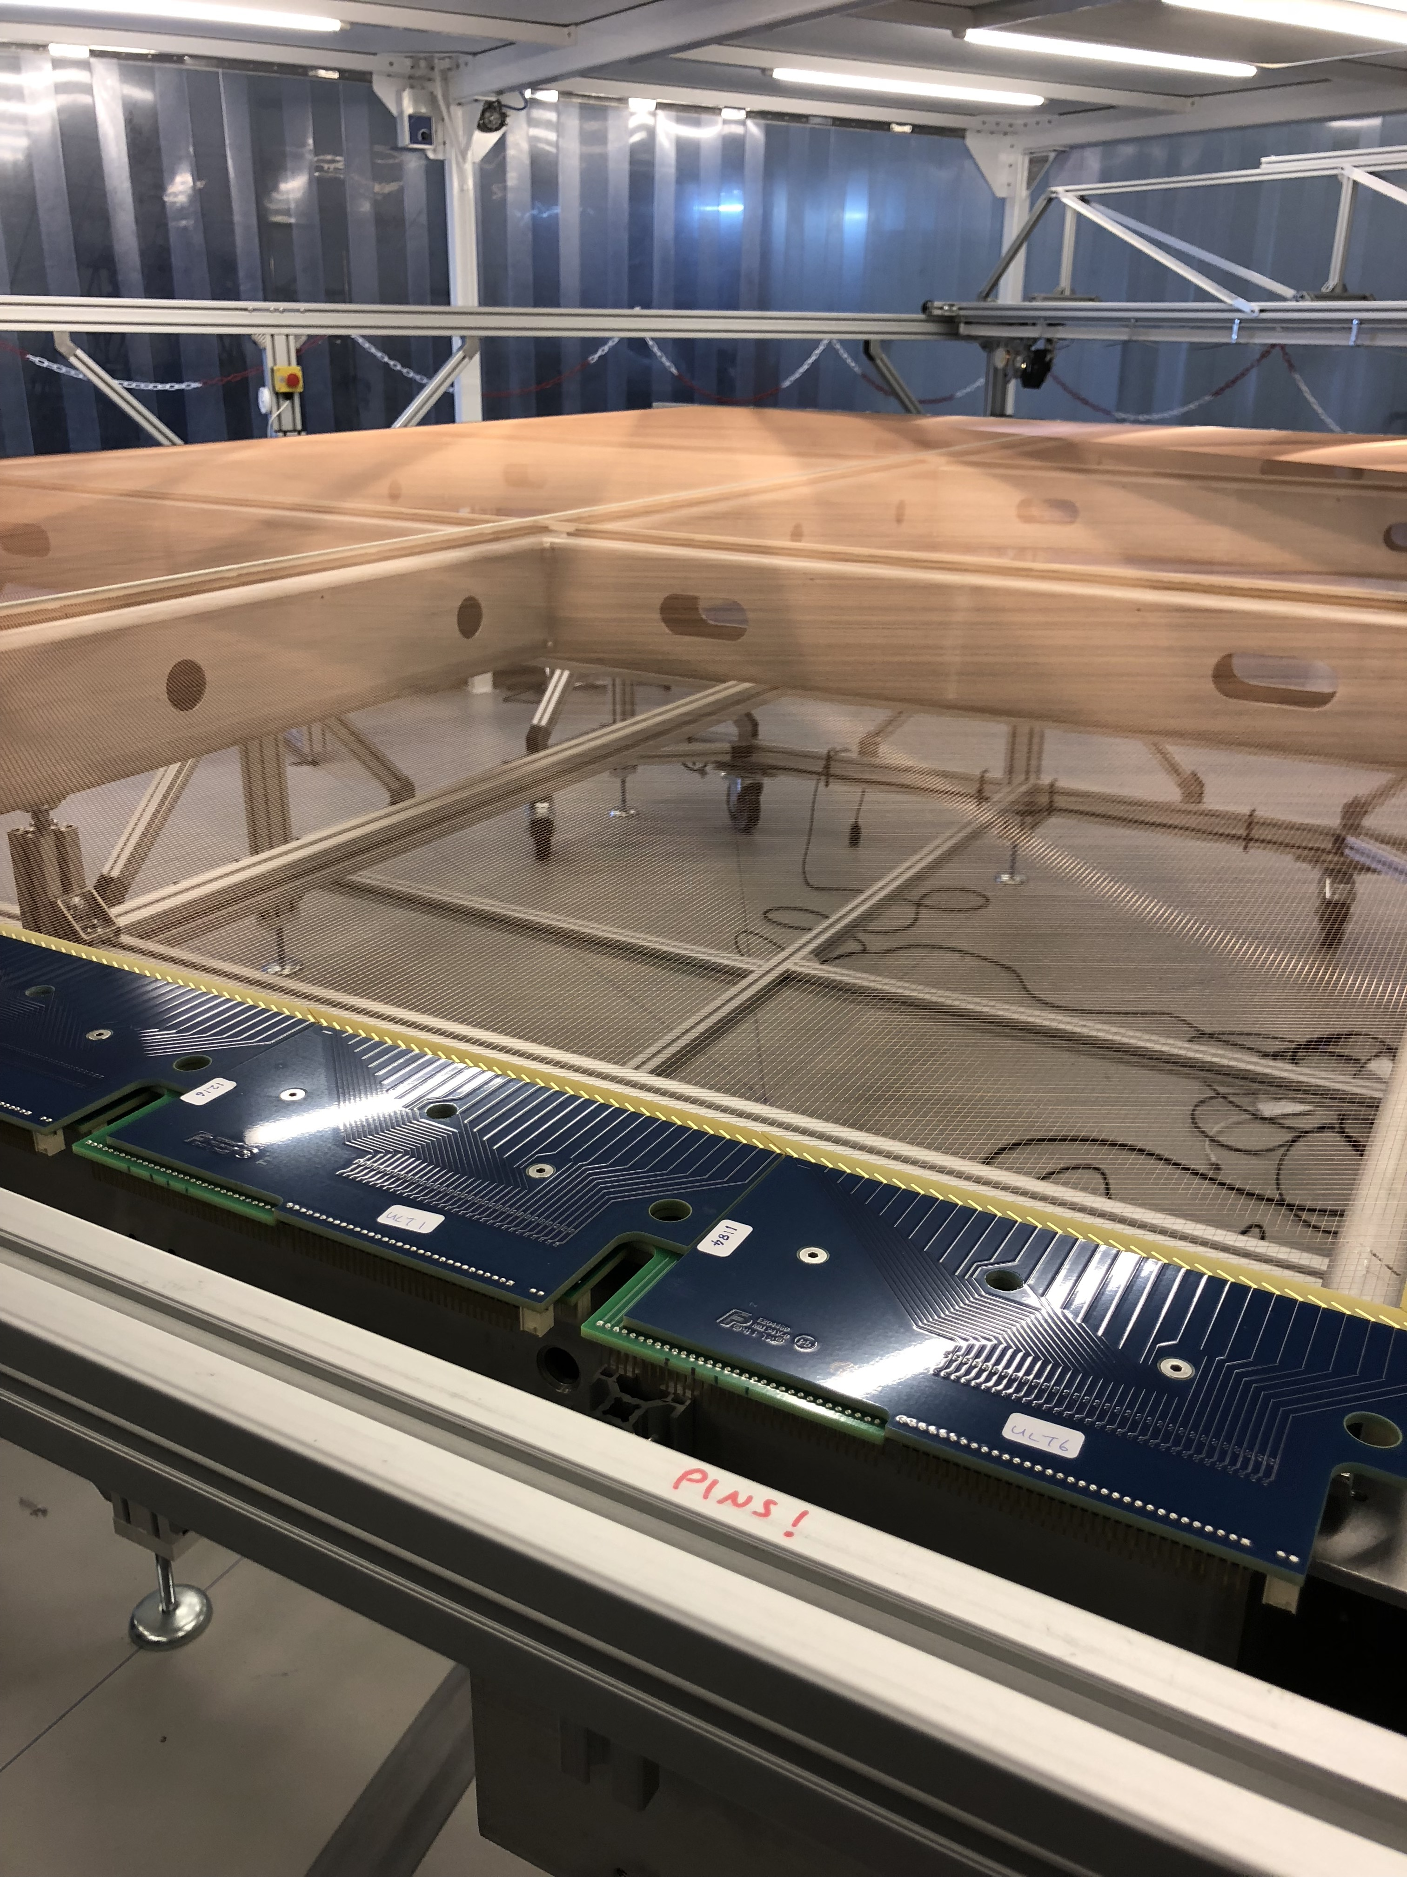
Events since last RECFA visit to the UK
European Spallation Source
  Officially joined 30/06/2016
  10% of 1.8 B€ project
  165 M£ contribution
  Instruments, cryomodules, engineering
European XFEL
  Officially joined 19th March 2018
  26 M€, 2% of construction cost
  2% of operation budget
  Mainly X-ray instruments
LBNF/DUNE
  Announced 21 September 2017
  65 M£ capital investment
  DUNE, proton target, PIP-II

Slide 19
Theory
World leading activity based on long and history
Lattice field theory
  LHCb, NA62, muon g-2, QCD parameters (quark masses and coupling)
Phenomenology
  PDFs, MC generators, precision QCD, Higgs (SM and BSM), neutrino phyiscs (SM and BSM), dark matter
QFT
  Amplitude calculations; exact solutions (SUSY); integrability; applications of AdS/CFT correspondence; solitons; speculative ideas such as Lorentz-violating theories.
Cosmology
Strings
Particle physics theory funding
  £6.6M/p.a
  32 post-docs awarded in 2016
Subject areas
  Cosmology 17%
  Lattice 16%
  Phenomenology 30%
  QFT 21%
  Strings 17%
Clear need to improve and support the numbers of post-docs

Slide 20
Accelerators
ATF2 prototype ILC/CLIC final focus system
ILC/CLIC
  Long standing (>10 year involvement)
  Focus on beam delivery system
LH-LHC (STFC-CERN funded)
  More recent (~5 years), collimation, crab-cavities, beam diagnostics
EuroCircCol EU design project
  Machine detector integration
  IR design
  Inner triplet
Crab cavity test system installed in the SPS

Slide 21
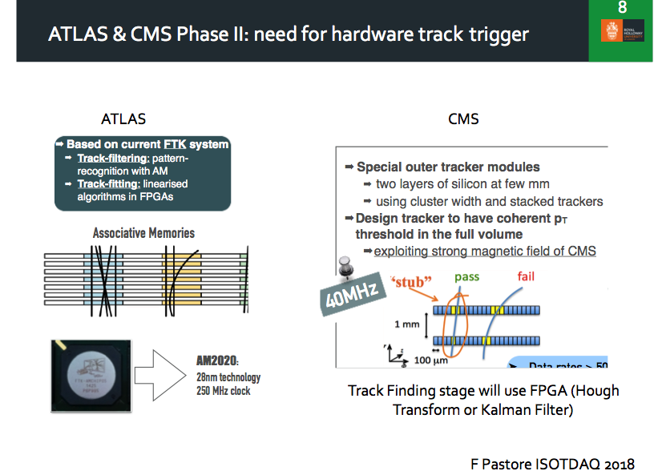
Detector R&D
Established strengths
  Silicon detectors
  Readout and DAQ
  Trigger system
Developing strengths
  Neutrino detectors
  Large scale LAr DUNE
  LArTPC
  HPTPC

Slide 22
Summary
UK maintains a diverse and balanced programme
  Well aligned with the current European Strategy for Particle Physics
    Maximise scientific return from CERN/LHC
  Positioned well for potential discoveries
  Well evolved discussions in the UK regarding strategy update
  Strong involvement with LHC experiments (and upgrades)
  Large investment in future long base line neutrino programme (DUNE, perhaps HK)
  Focused direct dark matter programme (LZ)
  Range of low-energy precision non-collider experiments (g-2, mu2e, mu3e, COMET, nEDM)
Issues for the next visit to the UK
  Changes to the funding landscape (UKRI)
  Effect of Brexit!
  Erosion of programme due to flat cash
  Level of investment in theory and particle astrophysics

