Slide 1
POPS-B project follow-up
LIU-PSB Meeting 217 03 July 2018
Fulvio Boattini TE/EPC

Slide 2
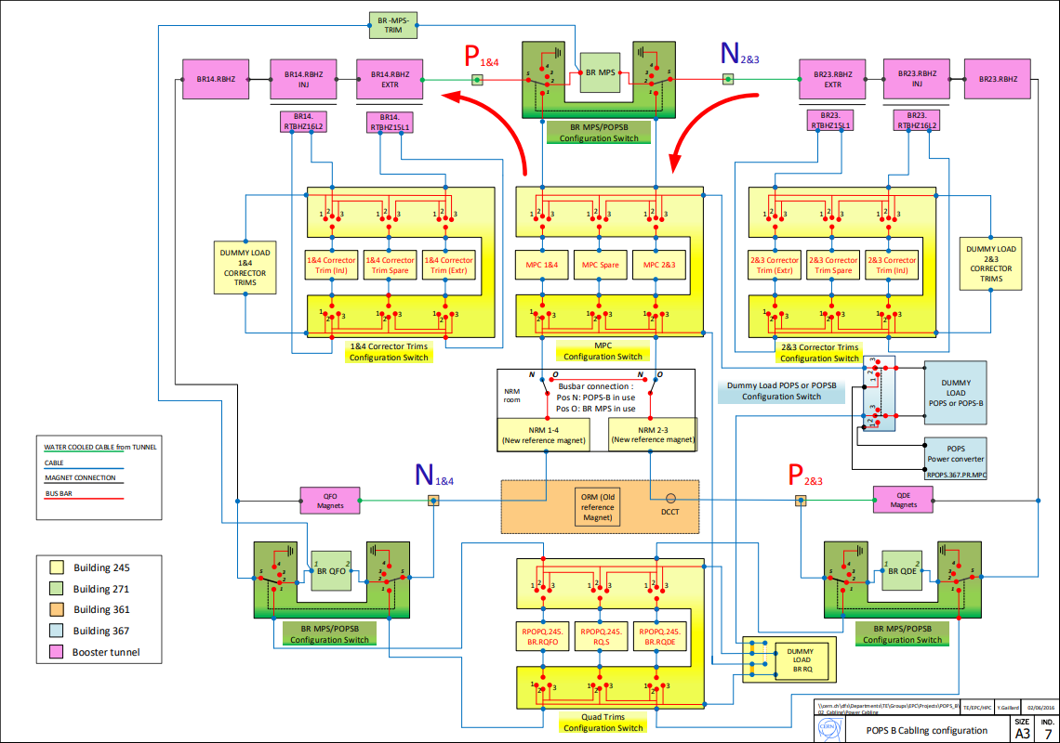
POPS B
Main Power Converters

Slide 3
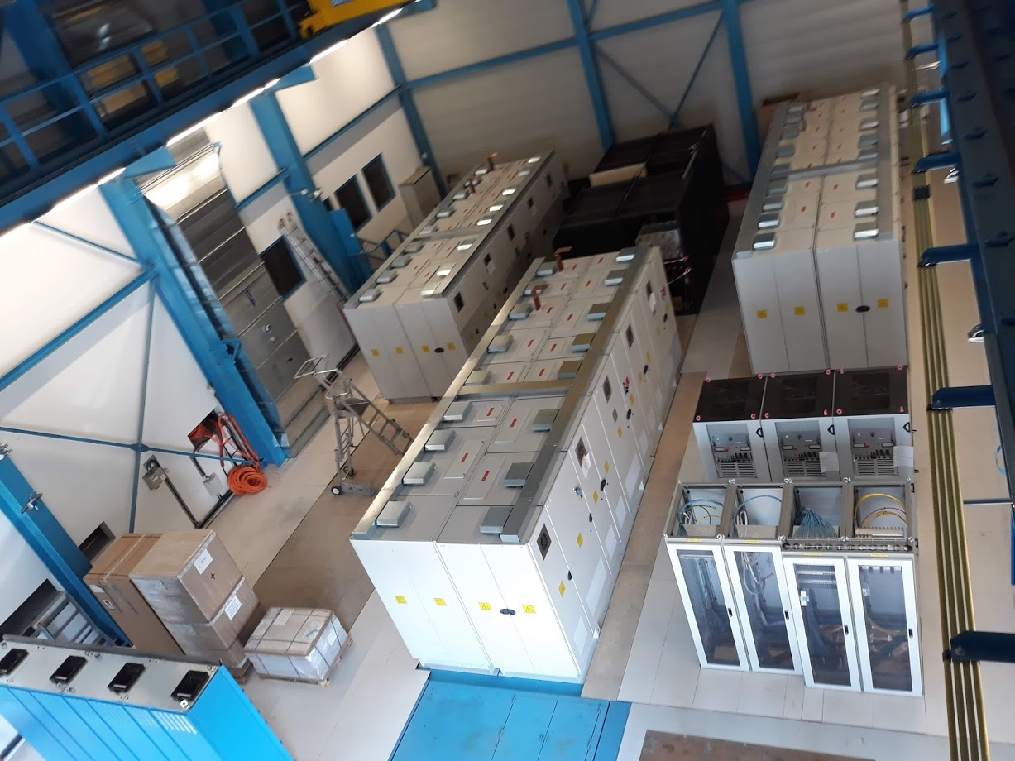
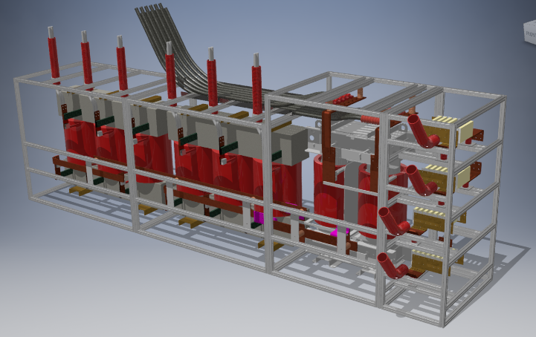
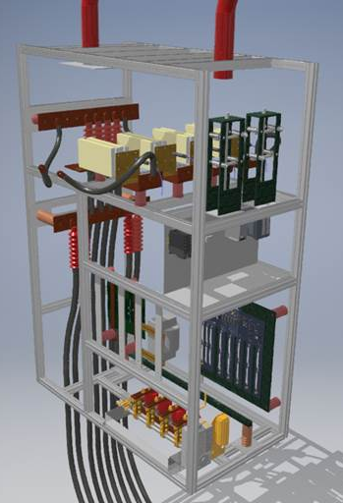
Main Power Converters
MPC control electronics installation → end July
(FGC, DCCT, DIVPAM, PLC…)
Cooling pipes connections → end July
LV Switchgears and cabling → end July
MV cables and cable heads → end August
Power transformers → end August
Magnetic and capacitor structures → end July
Dummy load → mid July

Slide 4
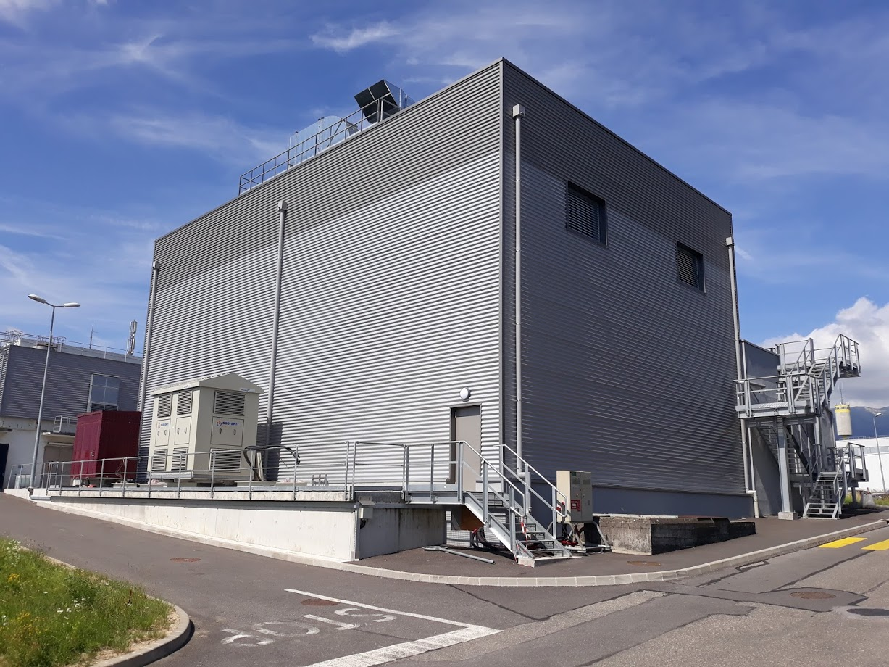
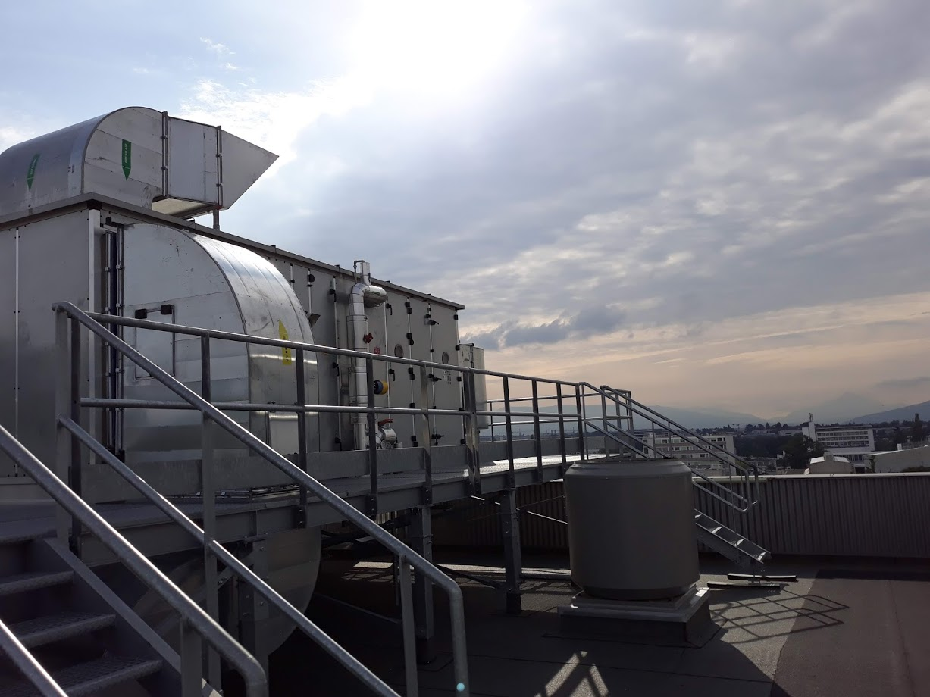
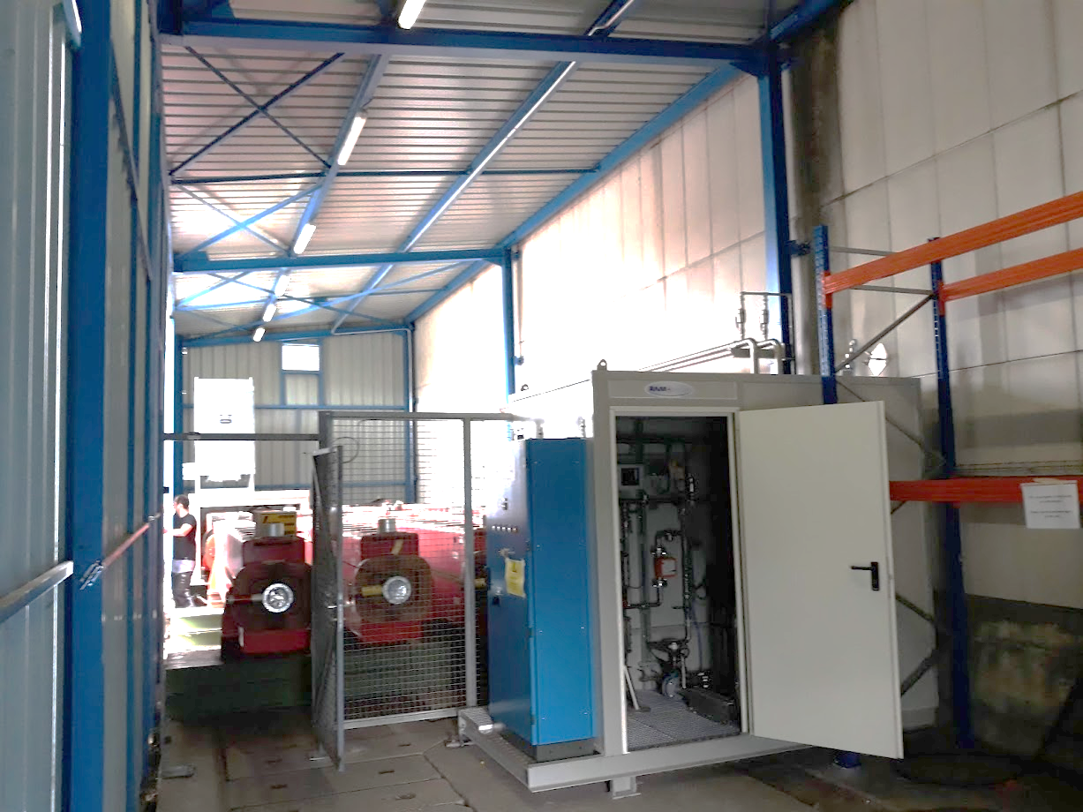
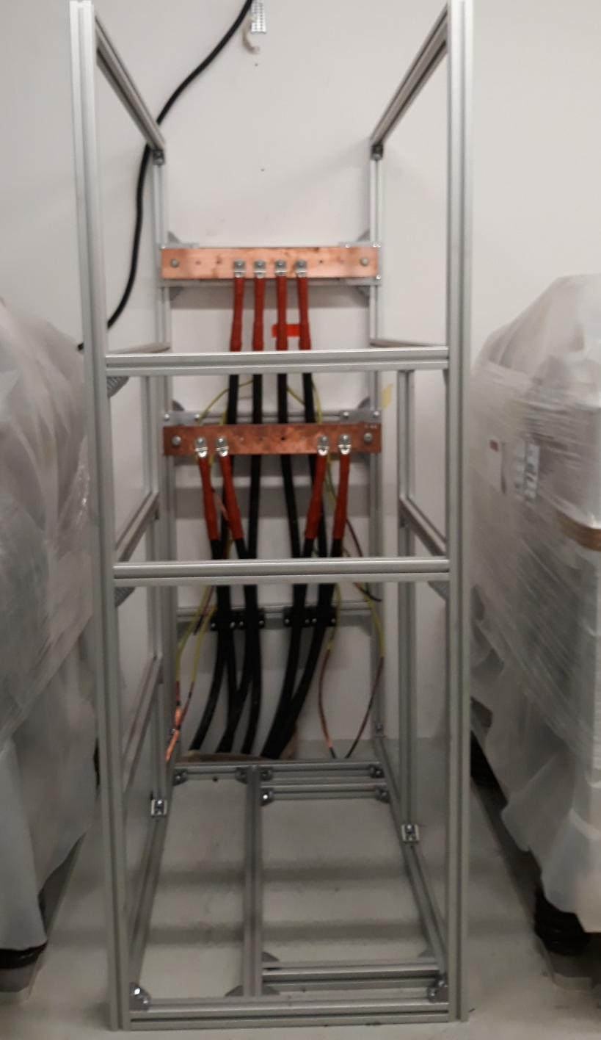
Main Power Converters

Slide 5
POPS B
QTRIM Converters

Slide 6
QTRIM Converters
PANDORA
First Prototype → October 2018
Tests → December 2018
Series production → September 2019
Commissioning → December 2019 (on full load)

Slide 7
POPS B
Trims 14 Converters
Trims 23 Converters

Slide 8
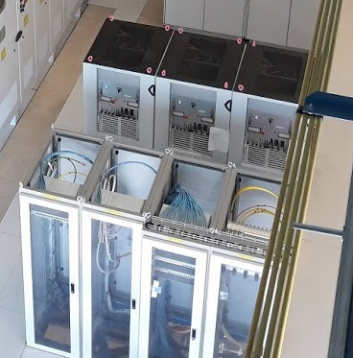
TRIMS 14 and 23 Converters
COMET
Trims 14 → installed
Trims 23 → tests in December 2018 installation in February 2019

Slide 9
POPSB remaining activities
EN-CV: realization of water treatment unit and routing of chilled water to the roof
EN/CV: installation of air intake grids and modification of firebrigade cabinet
EN/EL: completion of LV power and auxiliary cabling and testing of the installation and installation of lights in ctrl room
SMB/SE: Installation of explosion vents
SMB/SE: Installation of blast doors
SMB/SE: Steel door for capa room S401
SMB/SE: Modification of floor plates in converter hall
SMB/SE: Completion of CTRL room
BE/ICS: Installation of smoke pipes on top of converters.
TE/EPC: Commissioning of the power converters
TE/EPC: Tests of fuses protection
TE/MSC: replacement of dumping resistors
LS2 / end 2018
Mid August 2018
End of August 2018
BC 76805 → ~30kCHF probably missing
End of July 2018
Sept-Dec 2018
LS2
End November

