Slide 1


Materials
What are things made from?
Notes:
CPD:
Hi, we’re Elizabeth and Jo and we work for STFC – the Science and Technology Facilities Council. We’re the government body that funds particle physics (and nuclear physics and astronomy) at Universities in the UK, we run big experimental facilities in the UK, and we also fund the UK’s contribution to big international collaborations, like CERN.
This session ties the things you’ve been seeing and learning here at CERN to the properties of materials, and the states of matter.

Slide 2
Contents
Applications of Particle Physics: The ISIS Neutron and Muon Source
Spider webs
Imaging
Materials and microscopes
Rock hunt
Notes:
CPD:
We’ll start off with talking about some of the applications of particle accelerators, and in particular one of our particle accelerators, ISIS. Then we’ll run through a set of activities based around ISIS that we’ve run in outdoor sessions: it’s a nice way to get the children outside too.

Slide 3
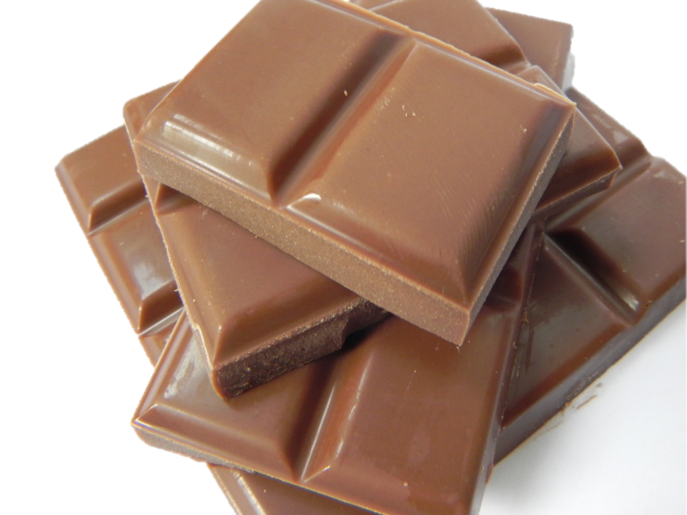
Particle Accelerators: Applications
As well as trying to answer fundamental questions about our Universe, particle accelerators have many practical applications.
Medical imaging
Medical treatment
Making electrical circuits
Studying stars
Cleaning water
Security
Studying chocolate
Notes:
Particle accelerators don’t just study the really fundamental, blue skies questions: they also have many practical applications …
For more information, see Applications of particle accelerators in Europe: http://apae.ific.uv.es/apae/

Slide 4
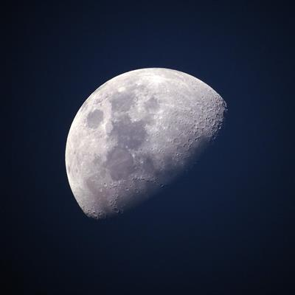
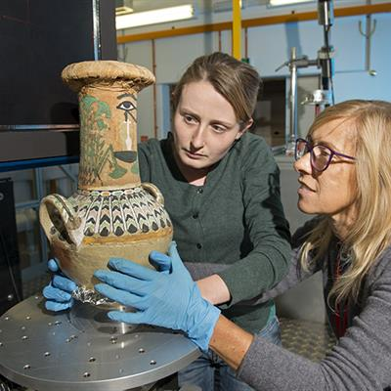
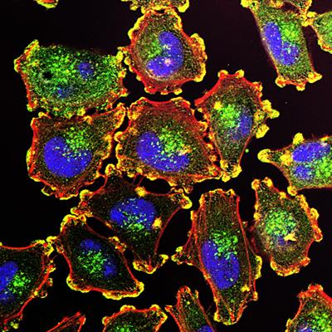
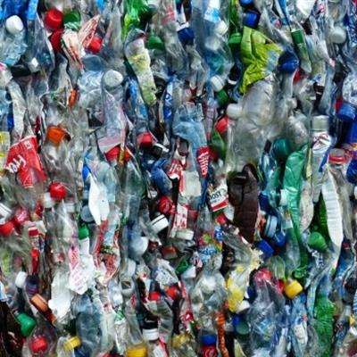
ISIS Neutron and Muon Source
We use ISIS to:
Work out how to protect astronauts on the moon
Look inside vases from Ancient Egypt
Deliver medicine to fight cancer
Understand new, environmentally-friendly, plastic
Notes:
CPD:
To give you some background, and ideas about the breadth of research we can use particle accelerators for …
At our site in Oxfordshire, the Rutherford Appleton Laboratory, we have two particle accelerators, that we use as giant microscopes. They’re used to study all kinds of things: from planes to Samurai swords. One of those accelerators is called the ISIS Neutron and Muon Source. (ISIS is the local name for the Thames. ISIS also re-uses parts from a previous experiment on site, Nimrod, and the goddess ISIS is associated with reincarnation.)
ISIS uses neutrons to look deep inside materials, to look at the atoms that make them up. If we can understand how the atoms fit together, and move around, we can begin to understand the material’s properties.
Just recently, ISIS has:
Looked at lunar soil analogues to figure out whether we could use them to protect astronauts living on the moon
[CLICK] Looked inside Ancient Egyptian vases, from the tomb of Kha and Merit
[CLICK] Looked at ways to deliver drugs that fight cancer to the right part of the body, so that the drugs only fight the cancer and not the healthy bits
[CLICK] Looked at a new type of plastic based on sugar – that could replace normal plastic bottles
These stories, and other recent science highlights from ISIS can be found online: https://www.isis.stfc.ac.uk/Pages/Science-Highlights.aspx

Slide 5
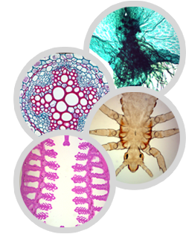
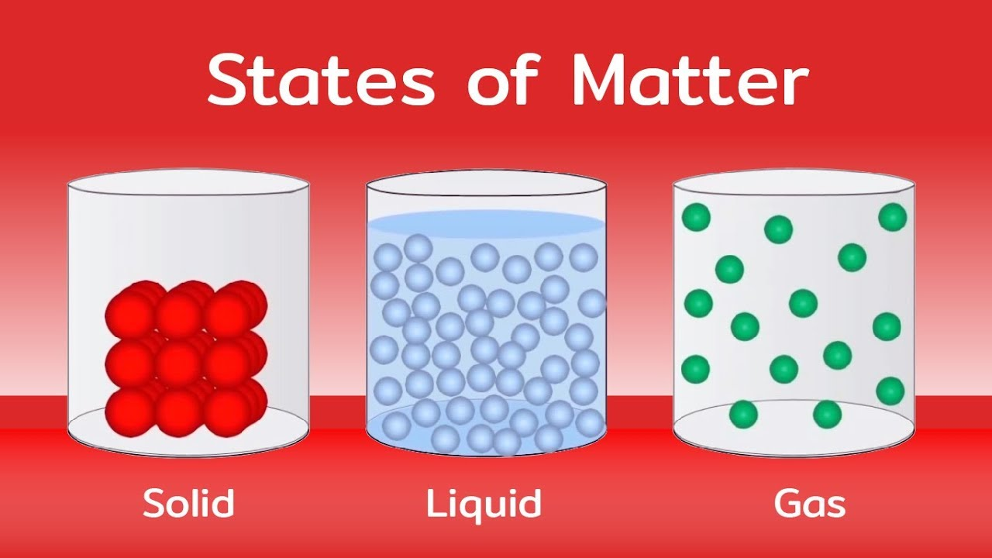
Microscopes
We use microscopes to look at things which are too small for our eyes to see
Notes:
CPD:
We first talk about atoms – which many children have heard about, linking it back to the curriculum content of states of matter: solid, liquids and gases. We do this by talking about microscopes.
SCHOOL:
Who has ever looked through a microscope? What did you see? Did you learn more about whatever it was you were looking at? Did you see things you couldn’t see just by looking with your eyes?
[Discussion of looking through a microscope]
Our microscopes are so powerful that we can look right down inside things, to see the things that make them up: the atoms. Has anybody heard of atoms?
[Discussion about atoms]
[CLICK] Atoms behave differently in solids, liquids and gases. Let’s think about water – a liquid. What happens to water when it gets cold?
[It freezes into ice]
What happens to water when it gets hot?
[It boils into steam]
Let’s think about what the atoms are doing. As a solid the atoms are all fixed, just wobbling around one point. As a liquid, the atoms move around a bit, waving here and there. As a gas, the atoms are whizzing around all over the place.
[Atom dance ☺]

Slide 6
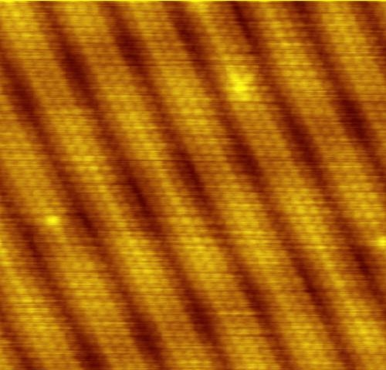
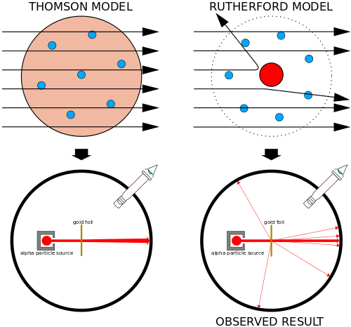

Hidden shape: Rutherford Scattering
Most of the alpha particles went straight through the foil.
Notes:
CPD:
To demonstrate how ISIS works we can do the ‘hidden shape’ activity – which is also a great ‘how science works’ activity.
SCHOOL:
To find out where the atoms are in a material, we can do the same experiment that Rutherford and his team did to find out what atoms are made of, more than 100 years ago.
Rutherford and his team fired alpha particles from a radioactive source at a thin gold foil. They saw most of the particles went straight through the foil.
To take measurements they set up a screen around the equipment that flashed when it was hit by a particle and the students took it in turns to spend hours watching for flashes.

Slide 7
Hidden shape: Rutherford Scattering
But some were reflected back!
Like firing a gun at a piece of tissue paper and getting hit yourself!
Notes:
SCHOOLS:
But occasionally something strange happened. A particle was reflected almost straight back at the source. This was very unexpected at the time, they expected all the particles to go straight through. Rutherford compared it to firing a weapon like a gun at a sheet of tissue paper and getting hit yourself!
Rutherford and his team worked out what was inside an atom by looking at how the tiny alpha particles bounced off atoms.

Slide 8
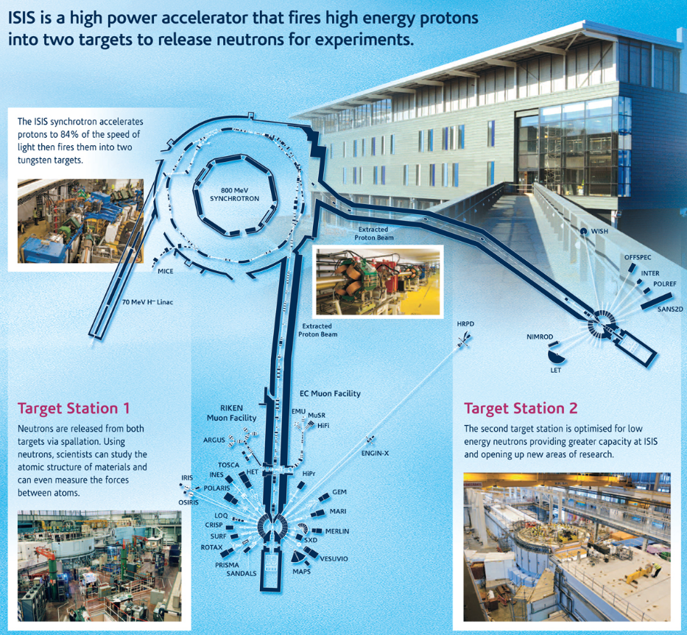
ISIS Neutron and Muon Source
Notes:
CPD:
At ISIS we do the same thing that Rutherford did – we shoot particles (neutrons) at our materials (meteorites or train wheels), and watch how they bounce off.
[Hidden Shape Activity]
ISIS starts with a little bottle of hydrogen. We turn the hydrogen atoms into negative hydrogen ions and then accelerate it through the linear accelerator, to roughly one third of the speed of light.
Once the hydrogen ions arrive here, the electrons are stripped and the remaining proton enters the synchrotron, which accelerates the protons to about 84% of the speed of light. This takes about 10,000 revolutions of our ring – which is just a baby compared to CERN, at about 163 m circumference. The protons then shoot off along the proton beamlines and hit a target – a lump of tungsten – which creates a shower of neutrons. The neutrons fly off in all directions (unless stopped by shielding), down to many different instruments, where whatever the object we’re looking at is placed.
For more information on how ISIS works, see https://www.isis.stfc.ac.uk/Pages/What-does-ISIS-Neutron-Muon-Source-do.aspx

Slide 9
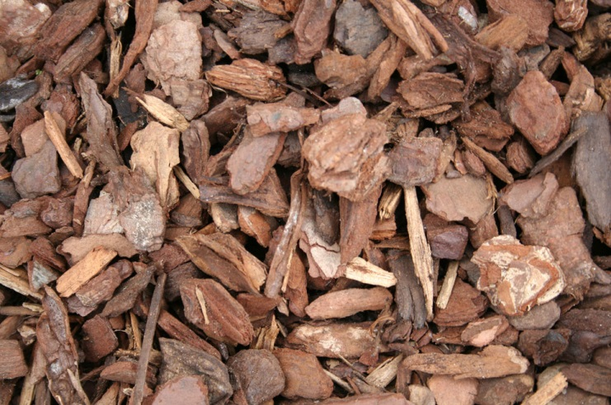
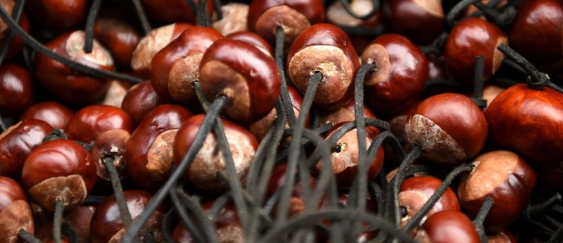
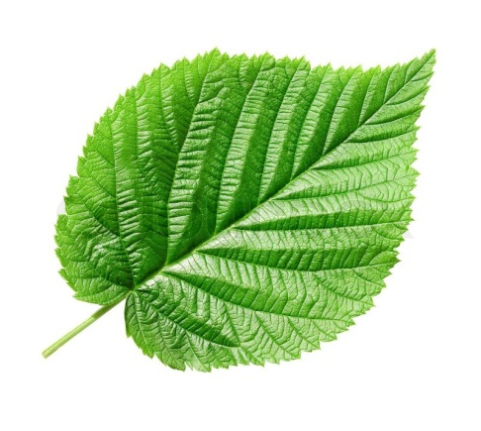

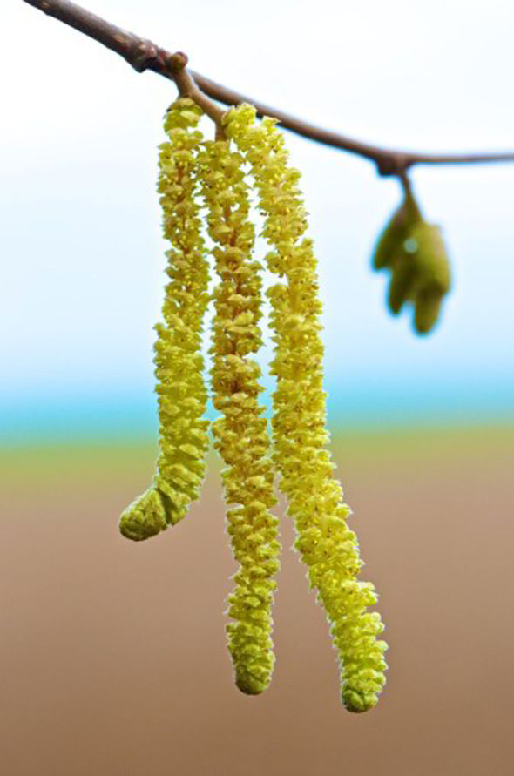
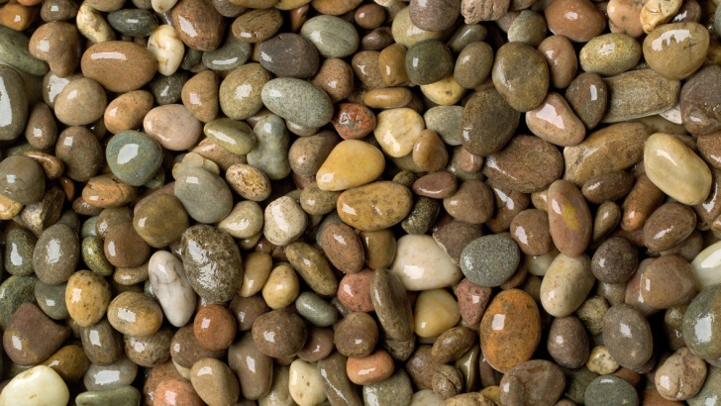
Materials and microscopes
Notes:
CPD:
Classifying materials according to their properties is part of the KS2 curriculum. This first activity allows this to be introduced or reinforced using natural materials, chosen by the children – giving them some agency in the work.
SCHOOL:
As scientists, we try to understand the world around us. We look at lots of different types of materials and try to learn about their properties. What kind of materials can you think of?
[metal, wood, plastic …]
What kind of properties do those materials have?
[hard/soft, opaque/transparent …]
We’re going to investigate the different materials we can find right here in the park. What we want you to do is to find TWO different materials, and bring them back here. You can go anywhere in [THIS] area. Don’t pick up anything sharp, or that looks nasty or too dirty – if you’re not sure, ask a grown up. You’ve got TWO minutes to find your materials.
[Finding materials]
Now you’ve all got your materials, we want you to think about their properties.
[Hand out worksheets]
Fill out the first six empty columns on your worksheet – draw your object, find out about its properties, and write what you think it’s made from. Remember to label your drawings!

Slide 10
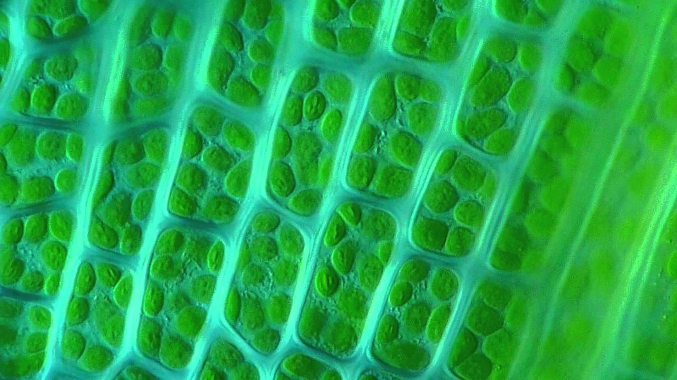
Materials and microscopes
We can learn more by looking at materials – like this leaf – through microscopes
Notes:
CPD:
We next extend the investigation of natural materials to include properties that aren’t obvious at first sight – using tools (conducting experiments) to learn more about a material.
SCHOOL:
At RAL, we use our giant microscope to look more closely at materials. Why might we want to do that?
[To see things that are so small we can’t see them with our eyes]
Our microscope, which is called ISIS, is so big that we couldn’t fit them in the [space – ISIS is the size of several football pitches] – so we can’t use that now. Instead, we can use these magnifying glasses. Look again at your objects through the lenses. Do you see anything new?
[Hand out lenses]
Now we want you to draw what you can see through the lenses – and write down anything extra you can see using the lenses.
[Draw]
[if-time] Does anyone want to tell the group about one of their materials?
[Show-and-tell: if time] There are all kinds of different materials around us. We use super microscopes so that we can learn more about them and their properties – so that we can build stronger aeroplanes and better medicines. Materials are all around you. Keep your worksheets, and next time you spot an interesting material, fill out its properties here.

Slide 11
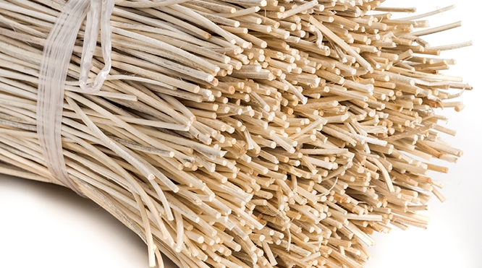
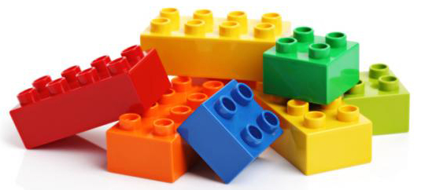
Spider silk: Types of materials
Natural materials are those that are found around us.
Man made materials are ones we have altered or added together
Notes:
CPD:
Once atoms and ISIS have been introduced, we come back to the properties and changes of materials curriculum topic – looking at man-made and natural materials.
SCHOOL:
There are lots of different types of material in the world, and we use them for different things. Some materials are natural and some are man-made. Who can give me some examples of natural materials?
[stone, wood …]
Natural materials are those that are found around us. We may have to dig them out of the ground, grow them or take them from living things.
Who can give me some examples of man-made materials?
[plastic, steel …]
Why do we make our own materials? Why don’t we just use natural ones?
[because they have properties that we need – they’re strong / cheap / flexible etc.]

Slide 12
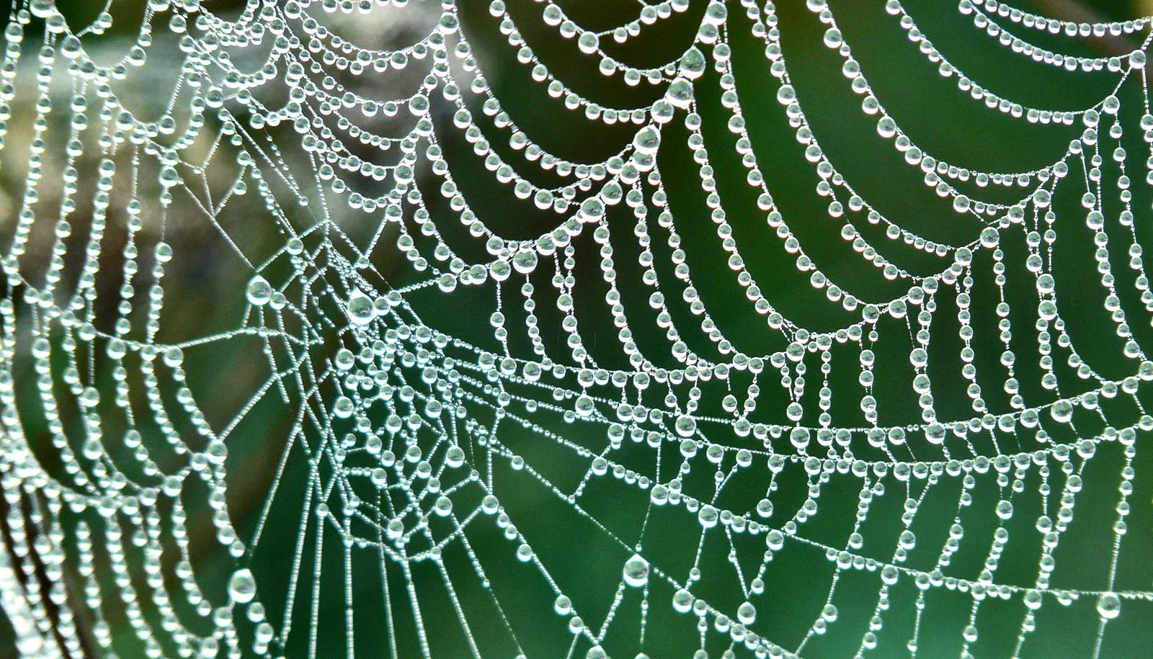
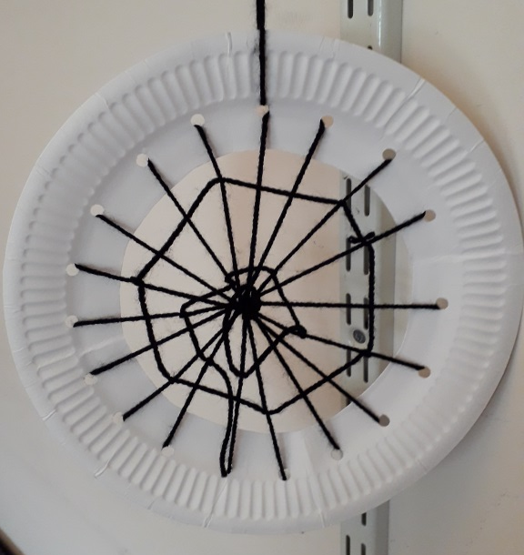
Spider silk: Types of materials
Spider silk is incredibly strong – an inch-thick rope could hold up a jumbo jet!
Notes:
CPD:
We talk about a specific example of some of ISIS’ work, which the children will be able to relate to directly. It has a nice craft activity associated with it, so you can link to patterns and art.
SCHOOL:
At the ISIS Neutron and Muon Source – one of our giant microscopes – we try to understand materials so we can make better materials, which do exactly what we need them to do. One material we’re trying to understand is cobwebs.
Who likes cobwebs? They can be really pretty. Who can tell me what they’re made from?
[spider silk]
It turns out that spider silk is really amazing. We can break cobwebs made from spider silk up because they’re really small and thin – but spider silk is actually very very strong. So strong, that if you made a rope from it – just one inch thick – you could use that rope to hold up a jumbo jet! We can’t make anything that strong.
[CLICK]
At ISIS, we’re trying to understand what makes spider silk so strong – because if we understand it, we can maybe use that to make new materials – that are strong like spider silk.
[CLICK]
What we want you to do is to make your own cobwebs. We don’t have a spider farm, so we’re going to use wool to make them. Everyone needs to collect a rim, and then you need to thread the wool through the holes to make a beautiful spider’s web.

Slide 13

Properties of materials
We can learn about properties of materials by using our sense of touch
Notes:
CPD:
The final activity is about our other senses – linking back to other areas of the curriculum.
SCHOOL:
So, we’ve seen that we can tell all kinds of things about a material just by looking at it. But how else could we learn about a material’s properties? What if you were wearing a blindfold?
[Click]
[other senses – smell, hear, touch]
[Click]
We can learn about materials by touching them – is it rough or smooth? Say we wanted to investigate this [piece of bark / leaf / coin]. What could we tell about it?
[if it’s rough or smooth, its temperature, patterns on the surface]

Slide 14
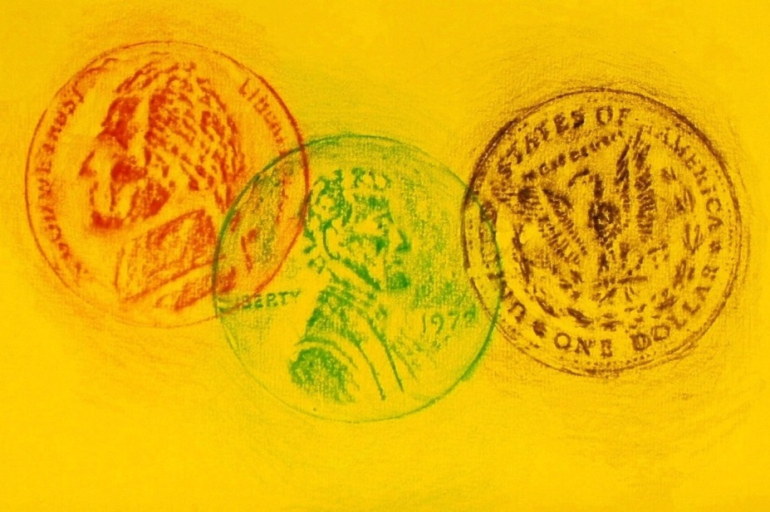
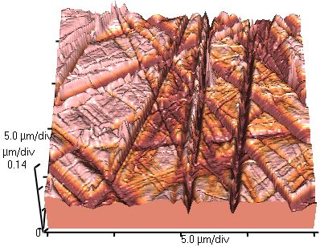
Properties of materials
We can make a record of how a material feels by taking a rubbing of the material
This is a picture of glass, taking by an Atomic Force Microscope ‘rubbing’ its surface
Notes:
CPD:
The final activity can be a nice activity too –It extends the material properties theme by asking the pupils to think about how we can record our results, and different ways of communicating those results. It can be easily extended into a whole-class project, making a collage of different materials.
SCHOOL:
So we’ve found out all about our material by touching it.
How would we share what we’d learned? We could write it down in words, but that could be quite tricky to capture everything about all the different patterns we’d felt. We could make a picture of how it felt though, by doing a rubbing of it.
[CLICK]
We do this at our lab as well – we have special microscopes called Atomic Force Microscopes. They rub over the surface of a material, and find all the tiny lumps and bumps – which are much too small to see with our eyes, or even with a normal microscope!
[CLICK]
You’ve got ten minutes to do two bark or leaf rubbings – try to get different trees and leaves.
[hand out worksheets]
Now we’d like you to spend a few minutes writing what you can tell from the rubbing you took. Can you see the veins on the leaves?
[Write notes]
Who would like to show us their rubbings?
[Show-and-tell]
Can anybody guess which tree [child] did the rubbing from?

Slide 15
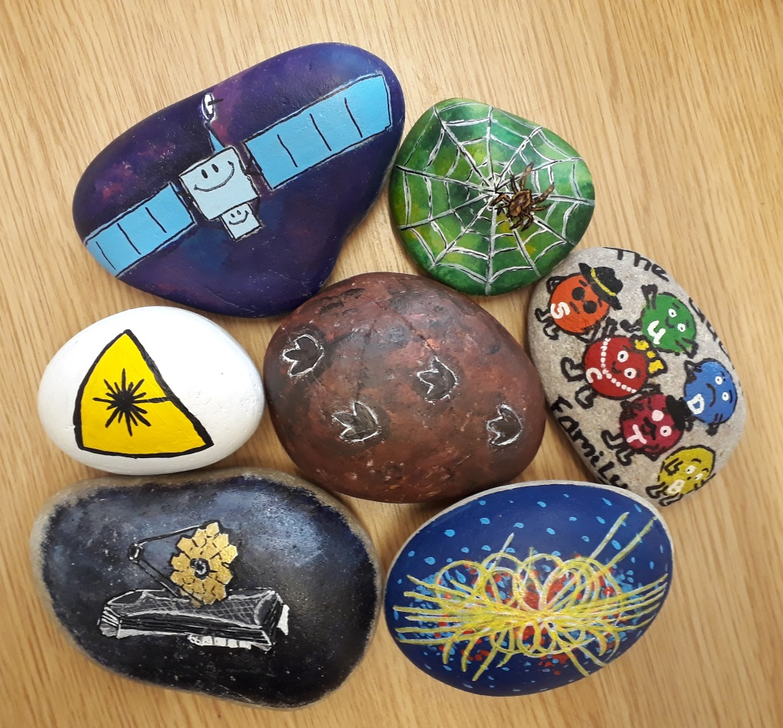
Looking for clues
Scientists learn about different properties by doing different experiments, and piecing together all of the clues
Notes:
CPD:
We wrap up with a discussion about how we can use different experiments to learn different things about materials –only by putting everything together can we see the whole picture.
Natural materials have extraordinary properties, and by studying them we can learn how they work – so we can make even better materials to help us solve problems.
We can learn about materials by studying them with microscopes.
We can record the results of our experiments in lots of different ways.
SCHOOL:
Scientists have to do lots of different experiments to find all the different clues if we want to understand a material. Hidden around the park are some special rocks – see if you can find them all to spell out the hidden message!

Slide 16
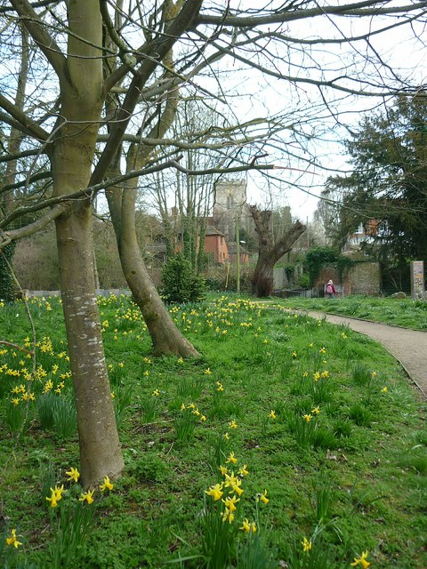
Acrostic poem
Seeing the trees and the plants in the park
Creating a spider web, looking for bark
Inspecting materials, looking for clues
Eyes can see little, microscopes we choose
Natural science, a subject we study
Climbing on logs, getting all muddy
Exploring the park to find rocks with a letter
Invisible rays, to see space better
Nothing is safe from our inquisitive eyes
Thinking up poems, in hope of a prize
Hunting for clues, we are looking for rocks
Earwigs and earthworms and maybe a fox
Parks are here for much more than playing
Art and for science and even for praying
Remember to visit when you want some fresh air
Keep your eyes open wide when visiting there

