Slide 1


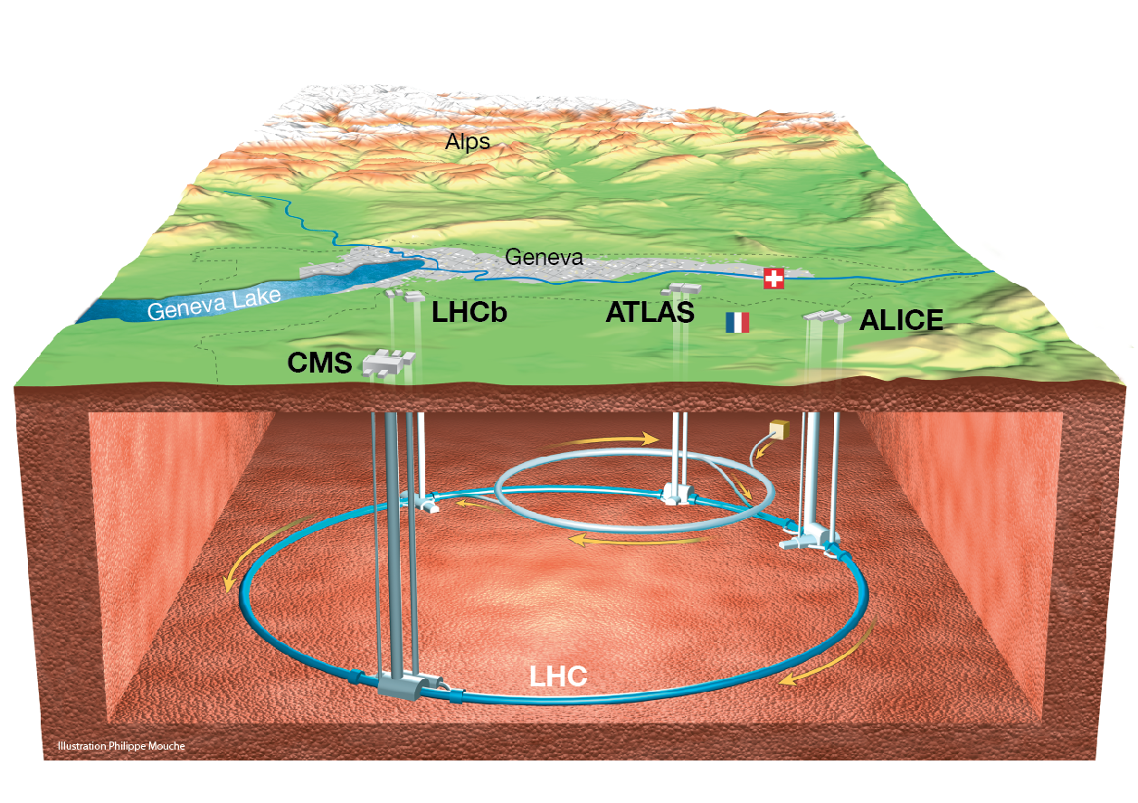
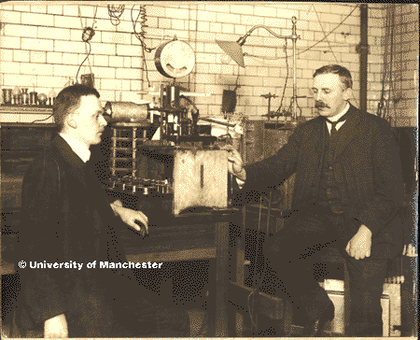
Accelerators and Detectors
– Working Scientifically
Amanda Poole
Jenny Watson
Jackie Flaherty

Slide 2
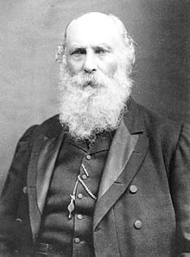
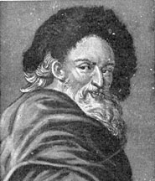
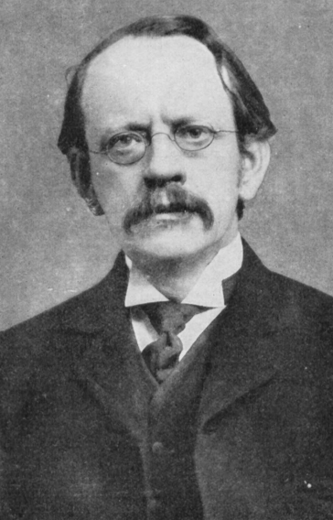
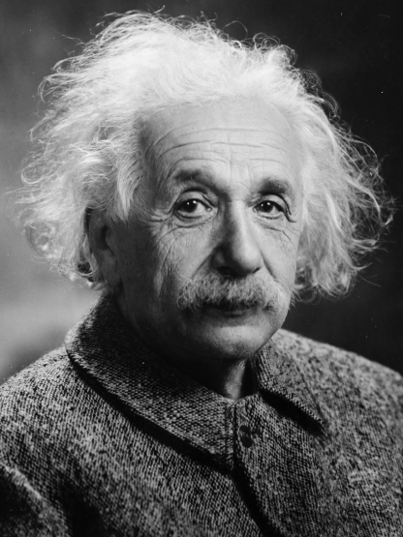
Changing Scientific Ideas Over Time
Ask a Question
Do Background Research
Make predictions
Think!
Try again
Democritus
460 -370 BC
George Stoney
1874
Plan and carry out a Test
Analyse Results Draw Conclusions
Hypothesis is True
Hypothesis is False or Partially True
J J Thomson
1898
Albert Einstein
1905
Report Results

Slide 3
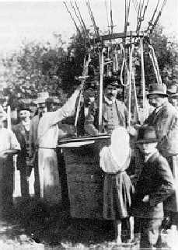
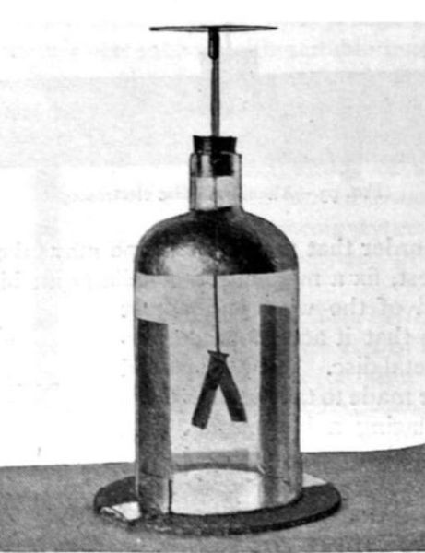
Early Detectors
The Discovery of Cosmic Radiation
Victor Hess, 1912 took charge-measuring equipment up in a hot air balloon.
Does this strange radiation really get weaker at higher altitudes?
What would happen to the electroscope if I could take it to higher altitudes?

Slide 4
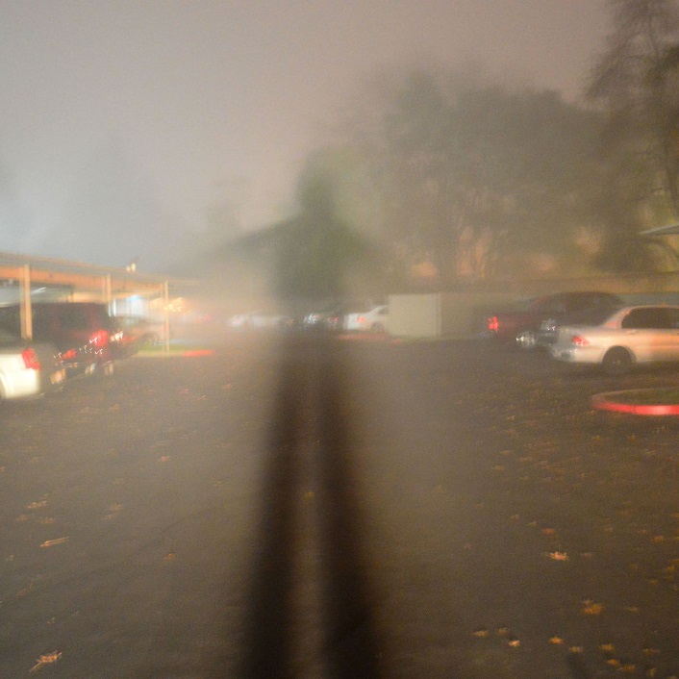
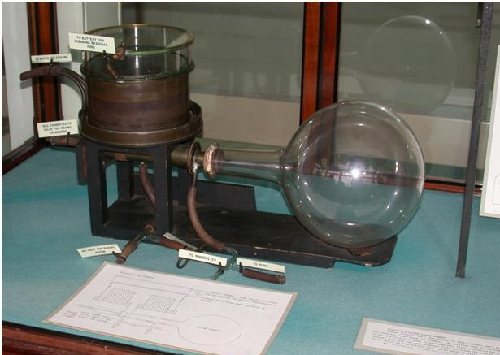
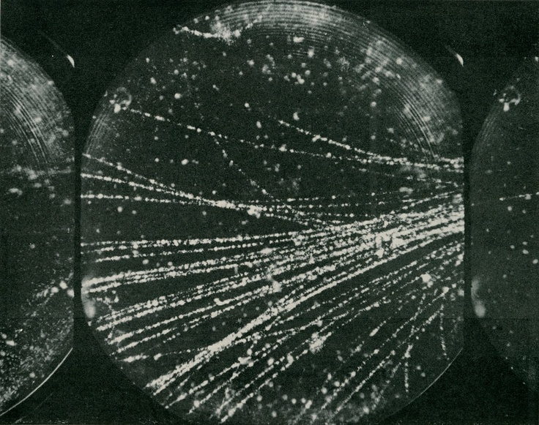
Invention of the Cloud Chamber
Early Detectors
Charles Wilson, 1894 was inspired by sightings of the Brocken spectre (large foggy shadows) seen while working on the summit of Ben Nevis.
What is happening here?
How could I make use of this?

Slide 5
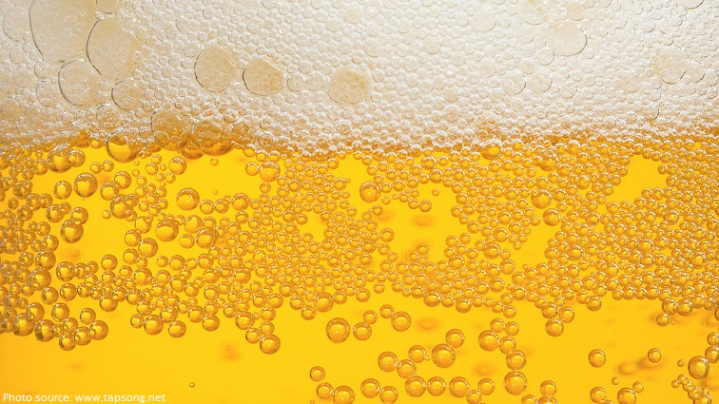
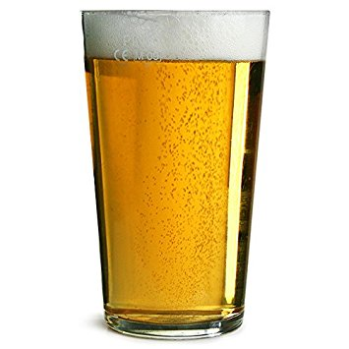
What has beer got to do with elementary particles?

Slide 6
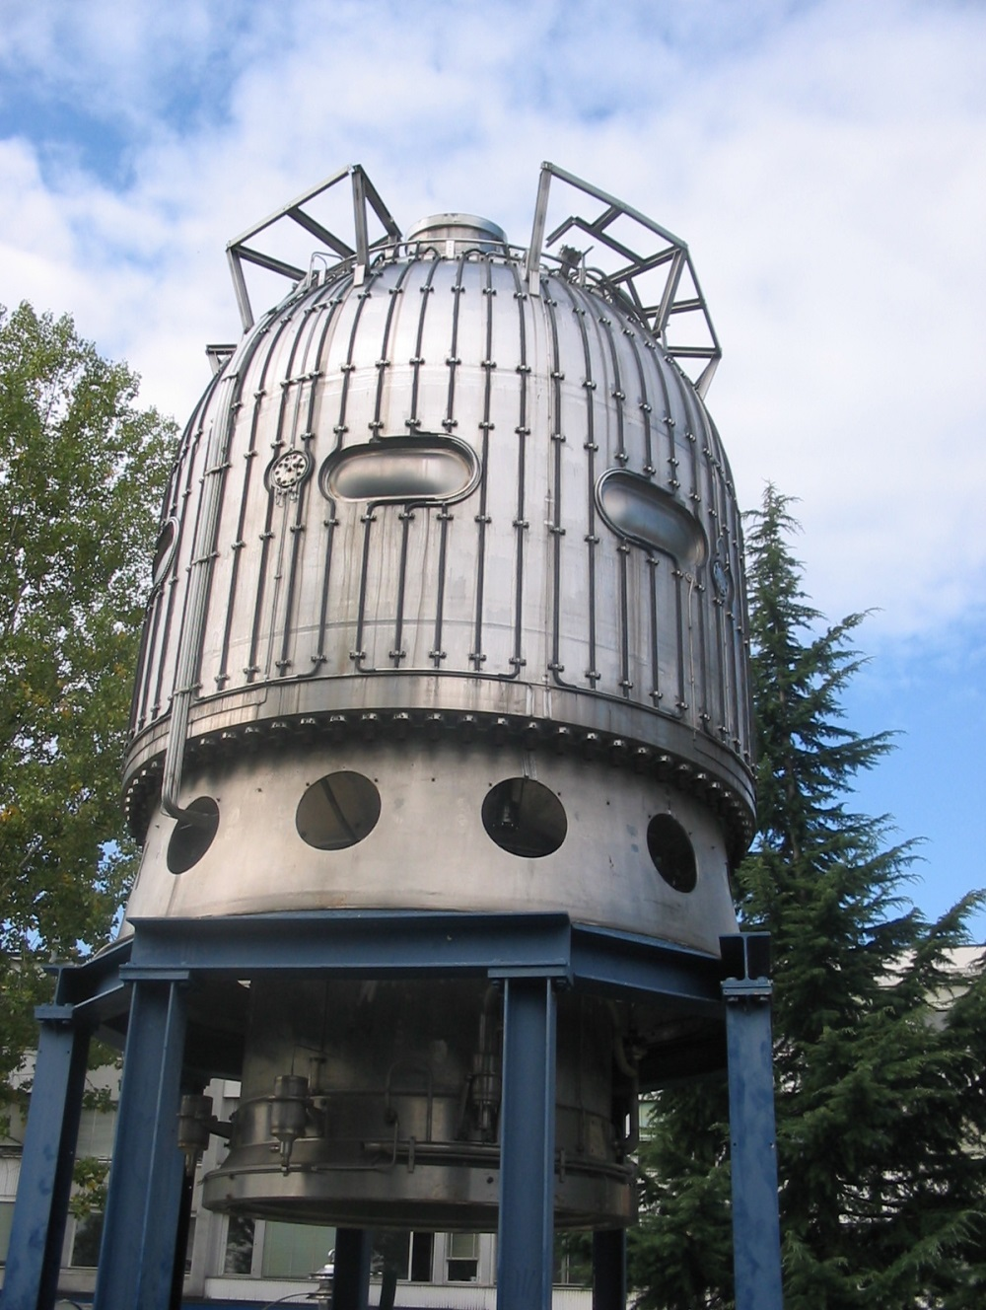
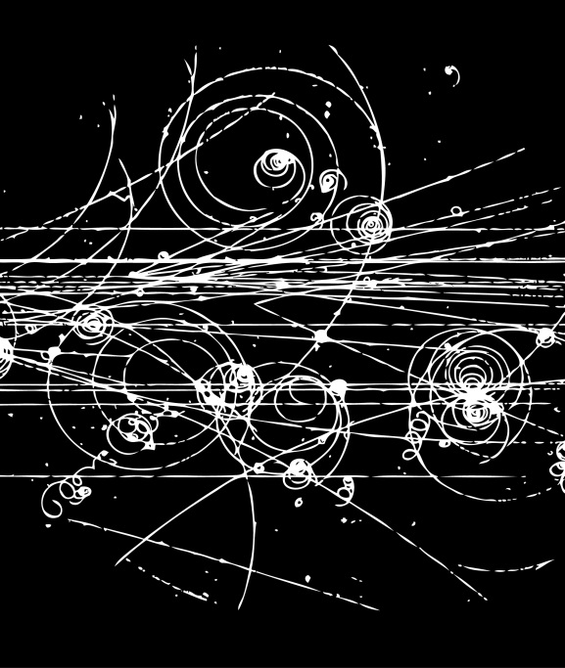
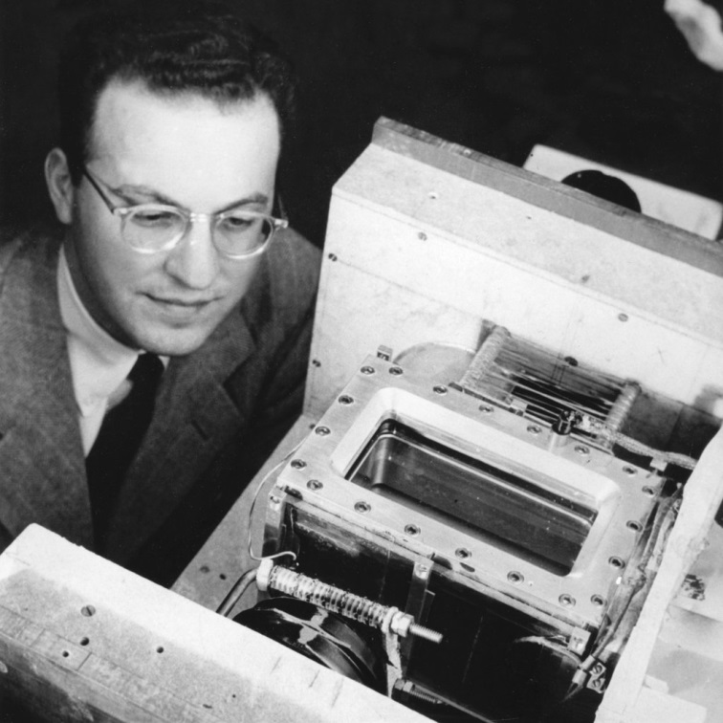
Invention of the Bubble Chamber
How could this be useful when learning about elementary particles?
Donald Glaser, 1952 used beer in some of his early bubble chamber prototypes.
Early Detectors
How do superheated liquids behave?

Slide 7
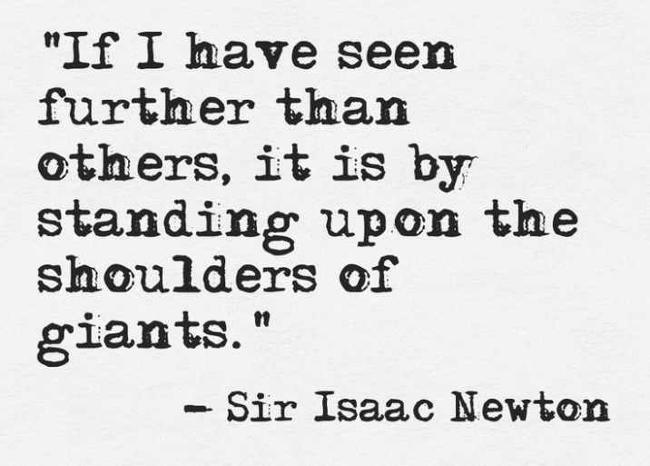
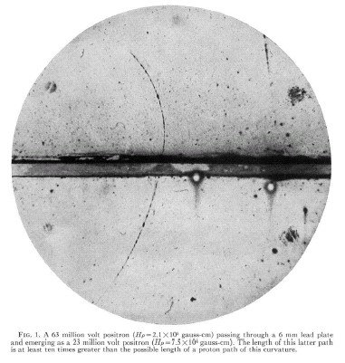
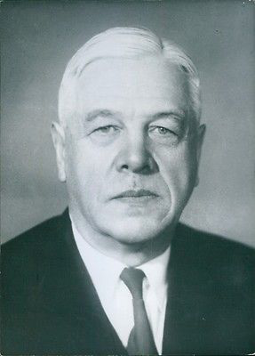
Discovery
Dmitri Skobeltsyn, 1929, observed electron-like particles which curved the ‘wrong ‘ way in a magnetic field.
What is going on here?
Why is this happening?

Slide 8
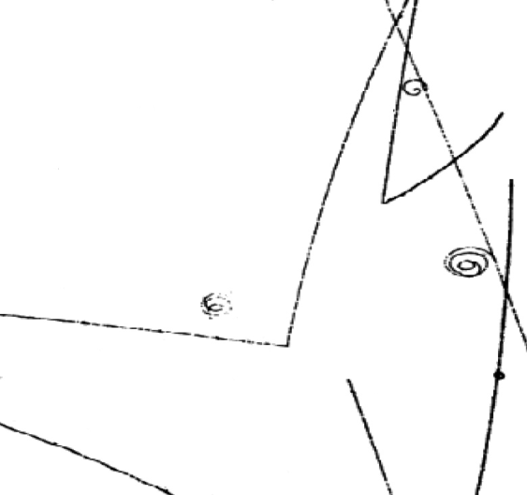
How do we identify elementary particles?
By their:
charge
mass
lifetime
decay modes
(what they change into)
Magnetic simulation
Notes:
Magnetic simulation – Tray with iron filings on, roll marbles underneath and look at ‘tracks’ - use glass marble, metal ball, magnetic marble, collide various underneath.
then draw out similarities – detects magnetic materials – leaves track, but can postulate presence of un-magnetised object dues to disjointed tracks

Slide 9
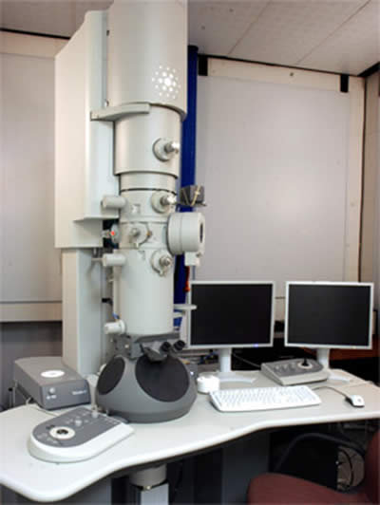
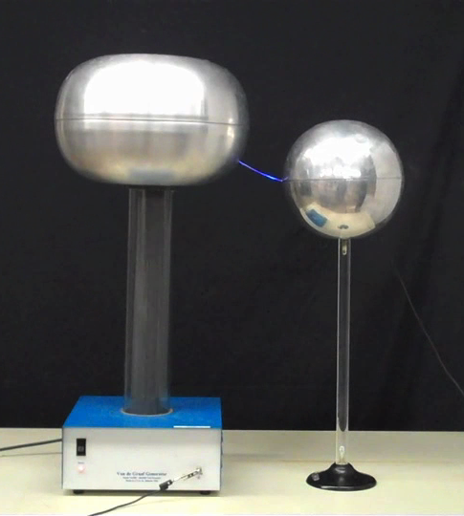
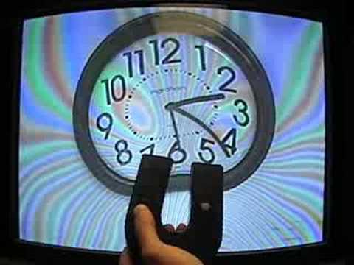
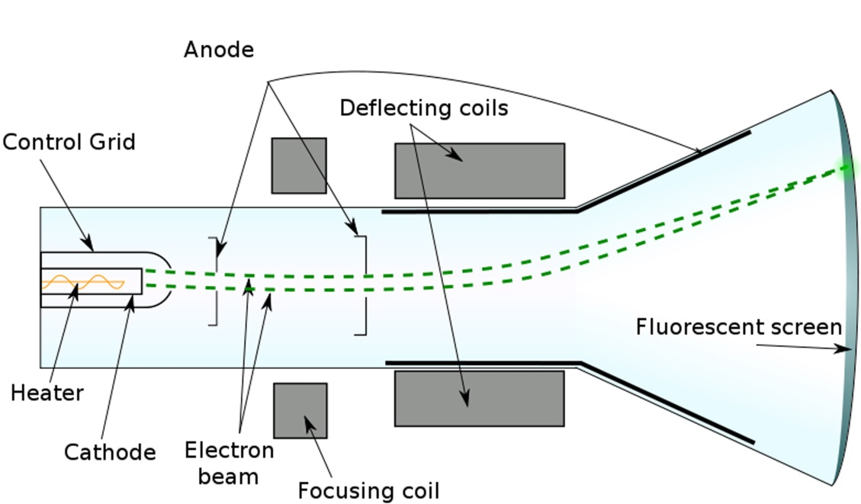
Particle Accelerators
Van de Graaffs
CRT TVs
Electron microscopes
Balloon & ES demo
Notes:
Balloon and electrostatics demo – charged particles accelerate in an electrostatic field (due to charged targets)

Slide 10
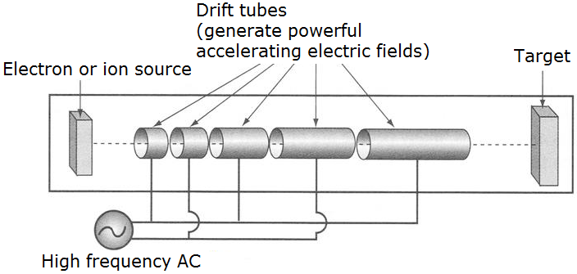
Linear Accelerators
Beachball accelerator: Oxford sheet
gauss gun
Notes:
Consider a positive ion (positively charged particle) given off by source.
If the first drift tube is negatively charged then the +ve ion is attracted to it and moves towards it.
When it gets inside the first drift tube, if this goes negative (due to the high frequency AC current) and the next one positive, an the ion now accelerates towards the second tube.
This again changes charge when the ion enters it.
Each time the charge on the alternately-charged tubes changes, the ion accelerates towards the next.
As it progresses the ion gets faster and faster,

Slide 11
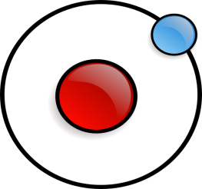
Particle Accelerators
−
−
−
+
−
+
+
+
+
1. A Hydrogen Atom is ionised i.e. has its electron removed, leaving a charged proton.
2. Charged protons start to move, attracted by an electric field.
3. The protons accelerate towards electrically-charged rings (RF cavities) which alternate charge, so they go faster and faster.
Introduce Pizza box LHC: Labels 1-5 on inside lid

Slide 12
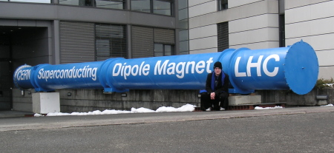
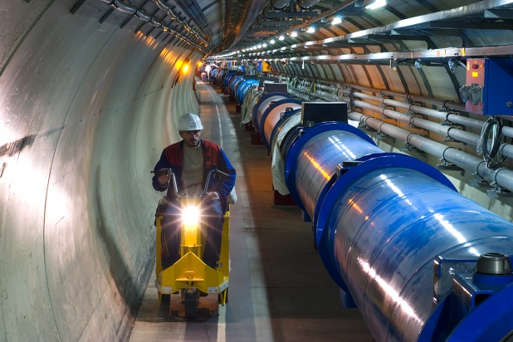
Circular Accelerators
4. To keep the protons contained, magnets are used, which make charged particles move in curved paths - round in circles!
+
Direction – marble on slope & label 6
Notes:
Roll a steel ball down a slope which has magnets behind it to deflect the ball…

Slide 13
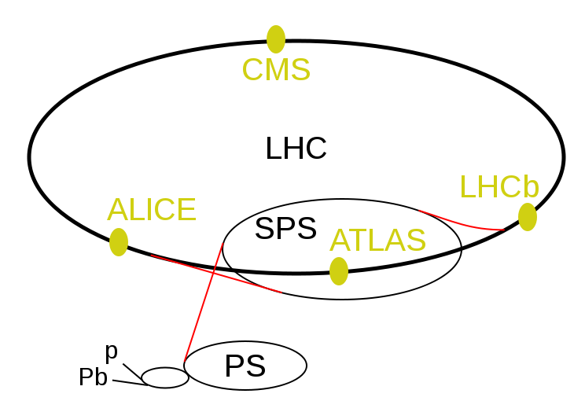
Larger rings mean you can reach higher energies
5. These very fast protons are then injected from one ring into another larger ring. Bigger accelerators mean higher energies.
RF cavity
RF cavity
6. Protons in the SPS have energies of 450GeV, and travel at 99.9998% of the speed of light. They are then injected into the LHC ring which works at 6.5TeV and 99.9999991% of the speed of light.
Labels 7, 8, draw 12cm rad LHC, 5cm SPS & 0.8cm PS circles & label 9

Slide 14
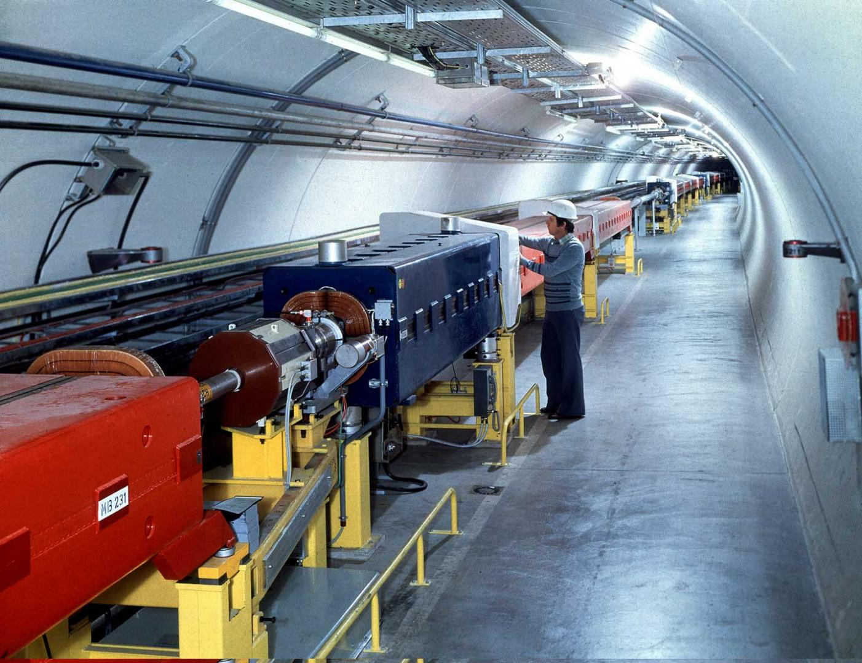
SPS Beam Pipes & Magnets
7. The LHC protons have to travel in a vacuum (very empty space) to stop them hitting things and changing direction.
Label 10, 11, 12. Make & place SPS magnets & RF cavity

Slide 15
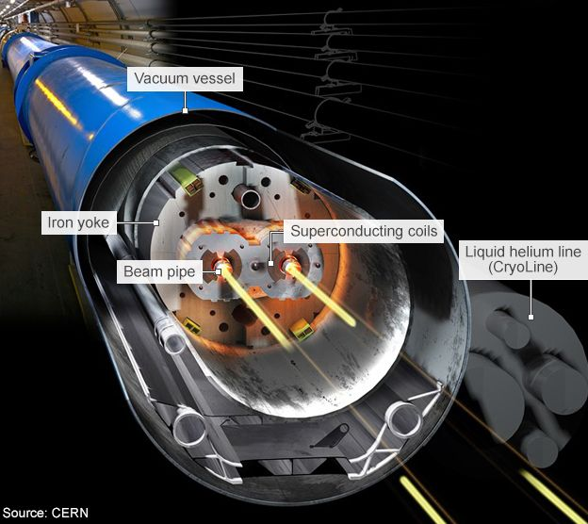
LHC Beam pipes & Superconducting magnets
8. The LHC uses 1,600 (very cold) superconducting magnets spaced around the ring to make the protons travel in a circle. These work at a temperature of -271°C (1.9K), i.e. just above absolute zero.
9. The LHC has two vacuum tubes
in which protons travel - one for a ‘clockwise’ and another for an ‘anticlockwise’ beam, so that the
protons can collide head-on!
Label 13, 14, 15 & 16
Make LHC magnets/beam pipes & place these

Slide 16
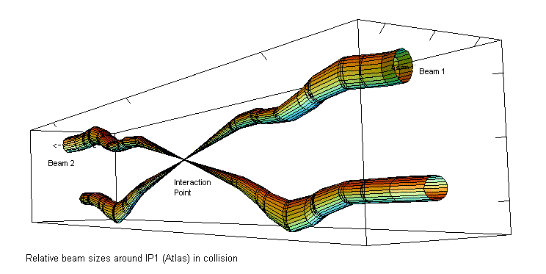
LHC Detectors
10. The two proton beams are brought together at a few ‘crossing points’ in the LHC ring – which is where the main experiments take place – at the CMS, ATLAS, ALICE
and LHCb detectors.
Labels 17 & 18

Slide 17
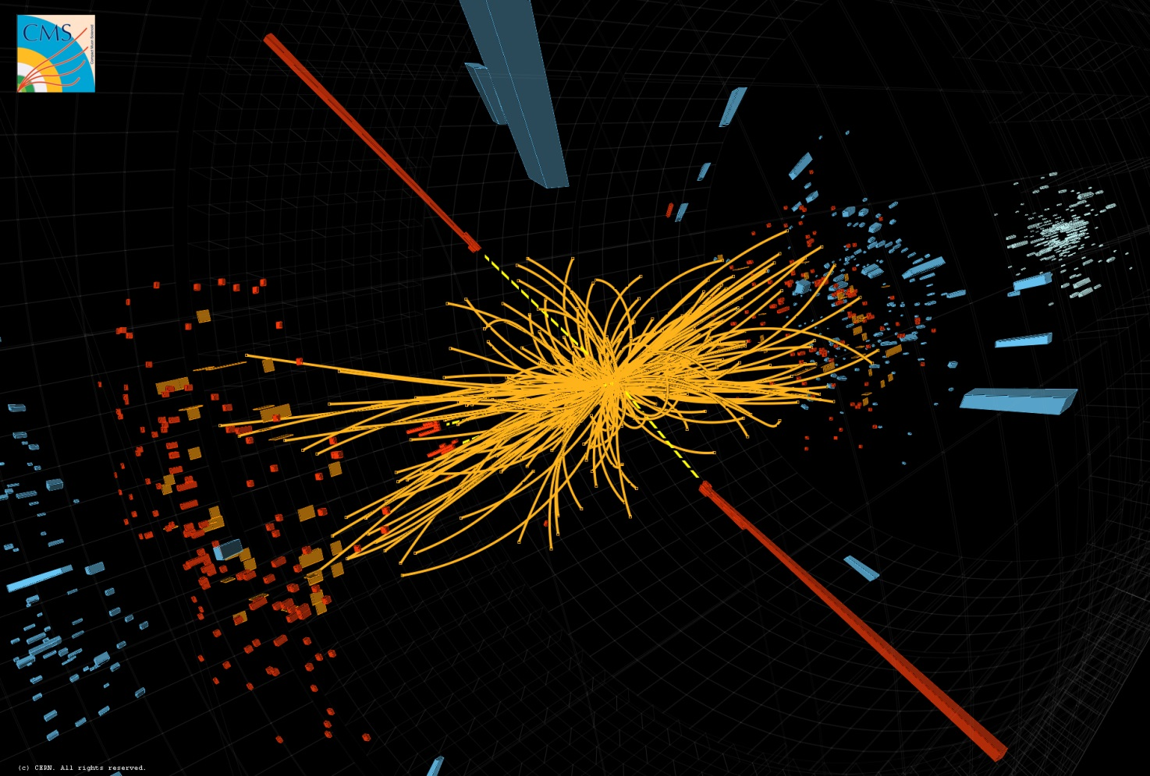
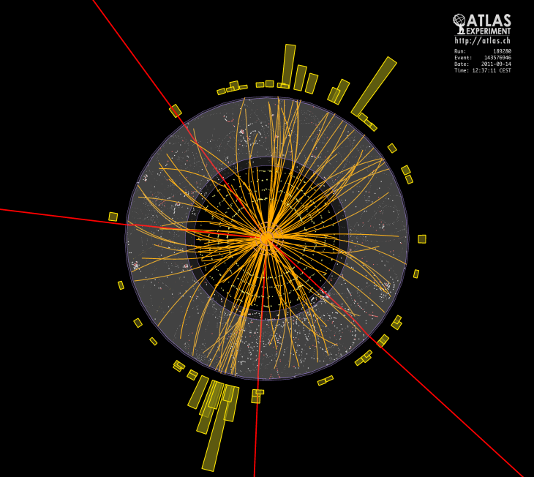
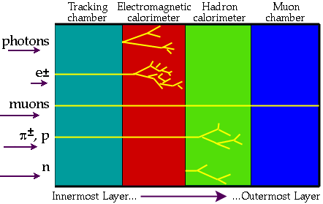
New Particles....
11. When the protons collide, new particles are formed with distinctive tracks in the detector sub-systems.
Labels 17 & 18 or 19
Demo splash-balls colliding: Oxford sheet

Slide 18
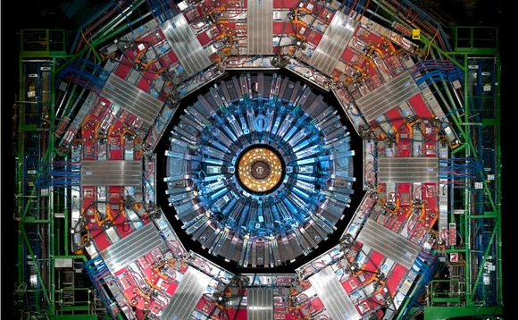

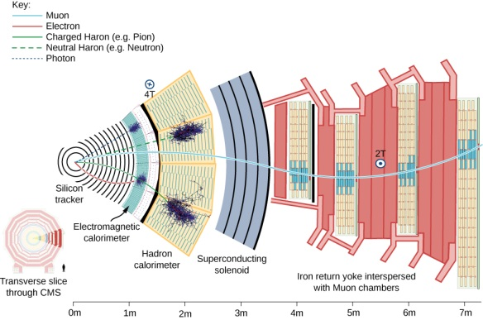
Modern detectors – working scientifically
Modern detectors have several layers of different types of detector – for example using semiconductors, charge-sensing wires and calorimeters (which absorb energy).

Slide 19
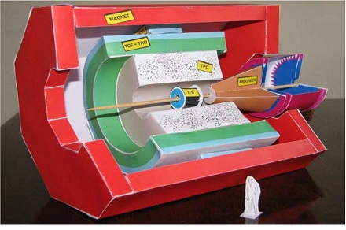
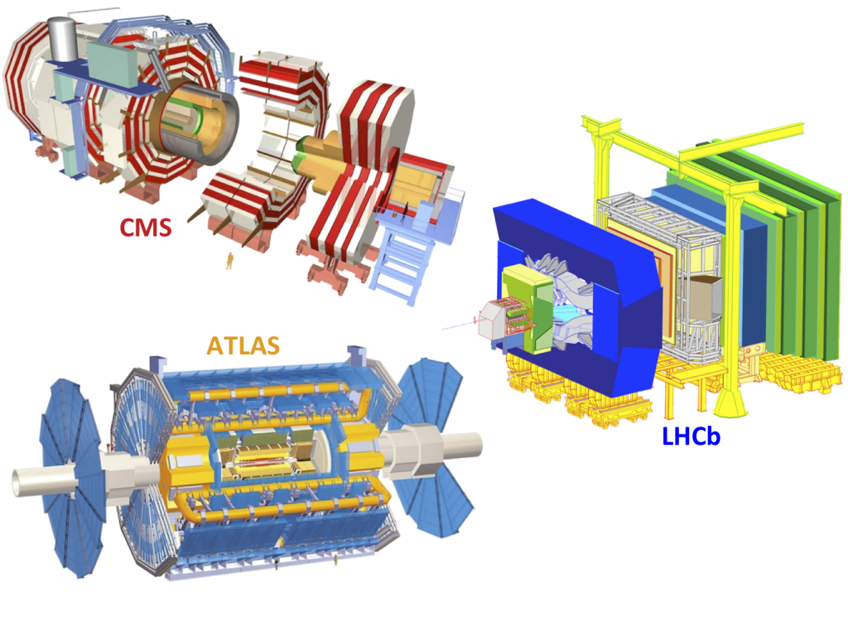
LHC Particle detectors
ALICE
Make detectors & glue into Pizza box

Slide 20

How do we identify elementary particles?
By their:
charge
mass
lifetime
decay modes
(what they change into)
Classifying activity, time permitting
Notes:
Classifying activity with magnet, ruler, balloon, scales, beaker of water? (Sorting ping-ping, polystyrene & bouncy balls, glass, magnetic & metal marbles, plastic & polystyrene beads)

Slide 21
Accelerators and Detectors
Amanda Poole
Jenny Watson
Jackie Flaherty

