Slide 2
Design for Reliability
On the example of the FGClite
Jochen Schwenk

Slide 3
Content
Current status of the FGClite‘s reliability
Design for Reliability
  Theory
  Process of the FGClite
  Possible improvements

Slide 4
FGClite in the LHC
Radiation tolerant controller for LHC power converters
754 devices installed since YETS2016
300 more to be installed during LS2
8 failures since deployment
  6 in LHC, only 1 affected operations
  2 in A7
6 failures on analogue board → under investigation

Slide 5
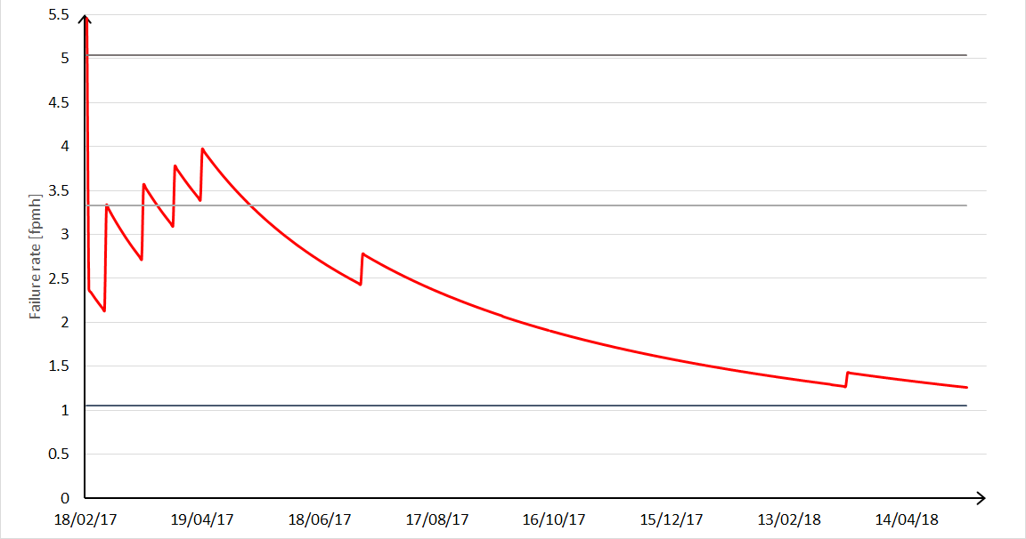
Development of Failure Rate
Prediction : 5,04fpmh
FMEA : 3,33fpmh
Required: 1fpmh

Slide 6
Achievement of reliability goals
Best case
  No more failures
  1 fpmh is proven at the end of September 2018
Realistic case
  Uses average accumulated hours
  1 fpmh is reached in January 2019
FGC2 reliability was even higher (0.74 fpmh)
  Proof after LS2

Slide 7
Content
Current Status of the FGClite‘s reliability
Design for reliability
  Theory
  Process of the FGClite
  Possible improvements

Slide 8
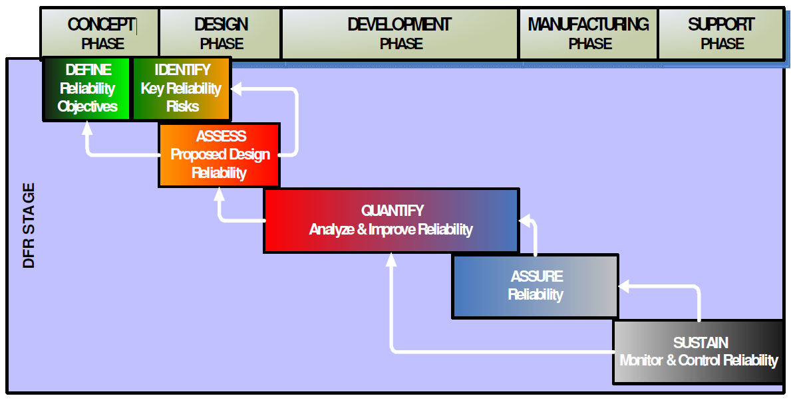
Theoretical Design for Reliabilty Process

Slide 9
Basis for reliability engineering in EPC
Most of the time no new designs with unknown technology
Very controlled environment
In-house developments
  Data from predecessor
  Tracking of devices throughout their life
  No censored data

Slide 10
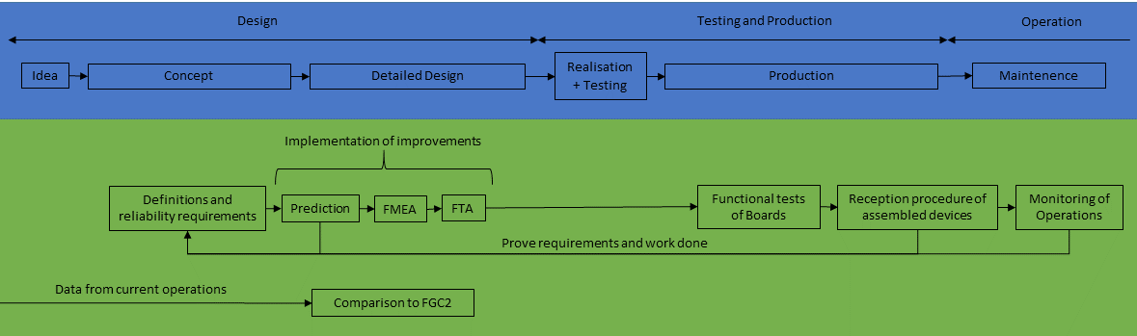
Design for Reliability of the FGClite

Slide 11
Improvements - Requirements
Ensuring consistency in the course of the project → establish reliability specifications
Example outline:
  Nomenclature and units
  Definition of the system under investigation
  Environment
  Reliability goals
  Way of calculating and proofing the reliability

Slide 12
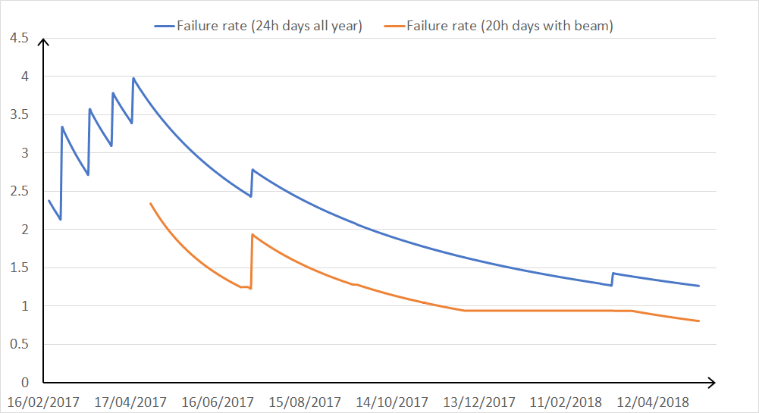
Improvements – Requirements/Analysis
Calculation of reliability parameters based on different assumption during project
  Powered time (24h, 365 days per year)
  Operational time (20h per day, only days with beam)
Failure causes of electronics are mostly dependent on powering and temperature not on switching
FGClite doesn’t have a standby mode
Failures occur in times without beam

Slide 13
Improvements - Testing
No testing for electrical reliability has been done
Re-use of prototype infrastructure and boards for long run reliability tests before production
Testing on subsystem levels
Highly accelerated testing

Slide 14
Improvements – Feedback from Operations
Failure Reporting, Analysis and Corrective Action System (FRACAS)
  Must be easy to handle and maintain
  Data already available but spread throughout multiple databases and not always precise
  Example of input into database:
    Date and Time of Event:
    Device (HCR code):
    Failure message:
    Classification:
    Failure cause:
    Repaired parts:
    Links to other events:
  Analyse data to prevent failures in future projects
To complete by reporter of failure
To complete when analysed and repaired

Slide 15
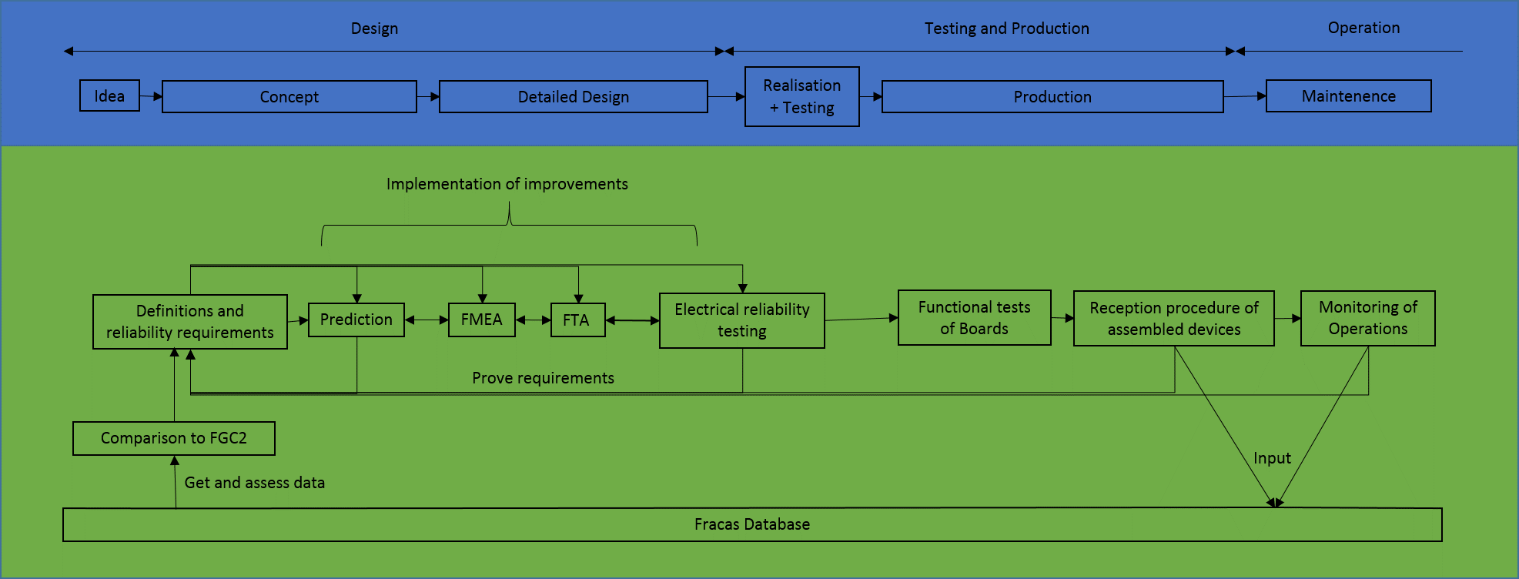
Improved Design for Reliability of the FGClite

