Slide 1
Common Input Format and OpenMars
Modelling, simulation and results
O. Rey Orozco
RASWG meeting

Slide 2
Input format for availability modelling
Common Input format:
Set of tables that fully defines an availability model
An intermediate translator generates the correct input files for the target simulation software (AvailSim)
Developed at CERN
OpenMars:
Open modelling approach for availability, reliability and production models
Tabular format
Developed at CERN in collaboration with Ramentor company

Slide 3
Use case: Linac4 simplified model
Input data (from Linac4 Reliability Run):
Assumptions:
Series configuration
Repairs at the moment of failure
Operation: 2850h
Simulations: 1000
System | MTTF data set 1 [h] | MTTR data set 1 [h]
Accelerator Controls | 1289.607 | 1.54361111
Access Management | 859.738 | 3.61666667
Beam Losses | 31.45383 | 0.32954946
Cooling and Ventilation | 2579.214 | 1.23333333
Electrical Network | 2579.214 | 0.81666667
Machine Interlock System | 2579.214 | 0.16666667
Operation | 515.8428 | 0.82983333
Other | 644.8035 | 0.4125
Power Converters | 21.85775 | 0.74169962
Pre-Chopper | 198.4011 | 2.09702991
Radio Frequency | 19.39259 | 0.95190058
Source | 28.97993 | 0.46364232

Slide 4
Modelling: Linac4 in the Common Input Format
System hardware and failure logic definition (positive logic)
Linac4
AND
Controls
OP
Source
Failure modes definition

Slide 5
Modelling: Linac4 in the Common Input Format
Failure mode assignments
Phase definition
Facility | Phase | Duration | PhaseType | PhaseGroup | Parent OP Phase | DownRepairPolicy | Description
Linac4 | Operation | 2580 | Operation |  |  | 1
Simulation parameters

Slide 6
Modelling: Linac4 in Open Mars
System fault tree definition (negative logic)
Linac4
Linac4OR
Linac4 fault
Source fault
Linac4
Connections definition
Linac4OR
Linac4 fault
Source fault

Slide 7
Modelling: Linac4 in Open Mars
Parameters definition

Slide 8
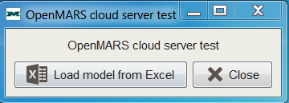
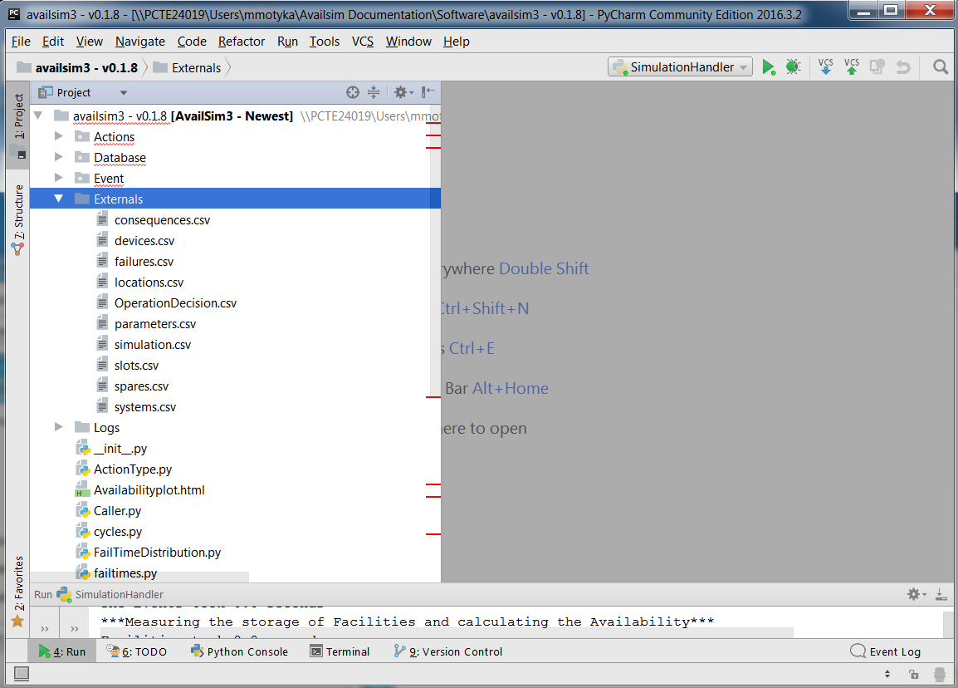
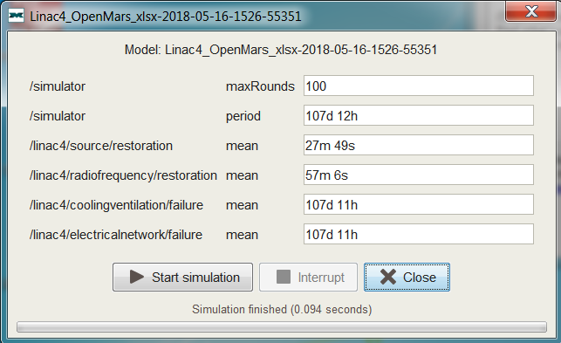
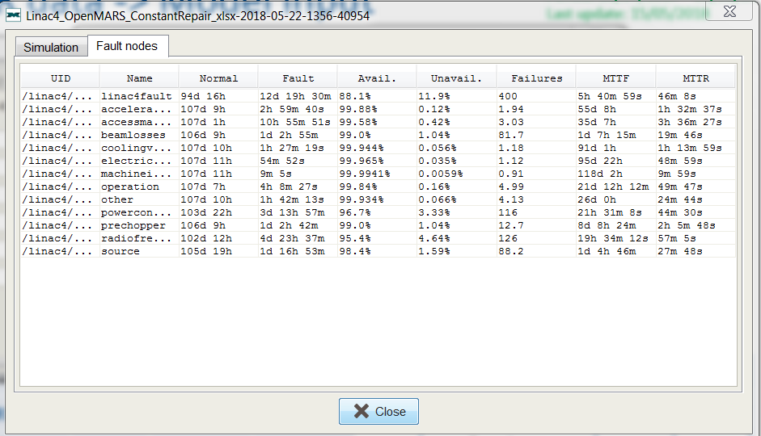
Simulation: Linac4
OpenMars
Load model
Define simulation parameters
Run
Common Input format and AvailSim
Run translator and generate input files for AvailSim
Copy generated files into AvilSim Externals folder
Run
Results.xlsx

Slide 9
Results: Linac4
Simulation Software | Input Format | Simulations | Simulation time (100 runs) | Availability | Fault Count | Downtime | MTTR
AvailSim | CIF | 1000 | 15 min | 88.6% | 401 | 294.3h | ~46 min
ELMAS | OpenMars | 1000 | 0.1s | 88.6% | 400 | 293.03h | ~44 min
Fault count
MTTR
System / Simulation Software | AvailSim | ELMAS | AvailSim | ELMAS | Input
Accelerator Controls | 1.873 | 1.74 | 1.543611 | 1.542778 | 1.54361111
Access Management | 3.067 | 2.63 | 3.616667 | 3.614167 | 3.61666667
Beam Losses | 81.035 | 72.8 | 0.329525 | 0.329444 | 0.32954946
Cooling and Ventilation | 0.895 | 0.86 | 1.233333 | 1.233056 | 1.23333333
Electrical Network | 0.892 | 0.87 | 0.816667 | 0.816389 | 0.81666667
Machine Interlock System | 1.096 | 0.89 | 0.166667 | 0.166389 | 0.16666667
Operation | 5.172 | 4.33 | 0.829833 | 0.829722 | 0.82983333
Other | 4.1 | 3.41 | 0.4125 | 0.412222 | 0.4125
Power Converters | 114.747 | 105 | 0.741571 | 0.741389 | 0.74169962
Pre-Chopper | 12.814 | 11.3 | 2.09703 | 2.096111 | 2.09702991
Radio Frequency | 127.149 | 118 | 0.951563 | 0.951389 | 0.95190058
Source | 87.988 | 78.4 | 0.463598 | 0.463333 | 0.46364232

Slide 10
Conclusions
Simulation Software | Input Format | Simulations | Simulation time (100 runs) | Availability | Fault Count | Downtime | MTTR
AvailSim | CIF | 1000 | 15 min | 88.6% | 401 | 294.3h | ~46 min
ELMAS | OpenMars | 1000 | 0.1s | 88.1% | 398 | 307h | ~44 min
Functionality / Simulation Software | CIF / AvailSim | OpenMars / ELMAS
Simulation time | 15 min | 0.1s
Modelling input / language | Excel / User oriented | Excel / Developer oriented
Modelling technique | Availability models | Availability models and more
Complex repair assumptions | Yes | Under development
Failure dependant phases | Under development | Yes
The two software packages show similar (almost the same) results.
ELMAS simulation engine much faster than AvailSim.
Both modelling languages/ approaches presented: AvailSim – user oriented, ELMAS – developer oriented.
The CIF is used only to define Availability models, the OpenMars support fault trees, Markov models, etc.
Simple availability models easy to model in both languages.
While the CIF contains the columns to define more complex assumptions, new elements (not–predefined) need to be defined in OpenMars.
Failure dependant phases can be modelled in OpenMars and the CIF, but for the moment only simulated in ELMAS. This functionality currently under development in AvailSim.

