Slide 1
Container orchestration as key to the evolution of CERN Web Services
Alex Lossent
CERN - IT-CDA

Slide 2
Abstract
Introduced in 2016, the "PaaS for Web Applications" service aims at providing CERN users with a modern environment for web application hosting, following the Platform-as-a-Service paradigm. The service leverages the Openshift (now OKD) container orchestrator.
We will provide a quick overview of the project, its use cases and how it evolved over its more than two years of production phase. Then we will focus on integration of Openshift with the CERN environment, and in particular how integration with GitLab allowed to significantly simplify and automate application deployment. We will conclude with the prospects the platform offers for the evolution of CERN Web Services.

Slide 3
Outline
Overview of the "PaaS for Web Applications" service
Use cases
Project history and evolution
Integration with the CERN environment
Automation of web application deployment
Prospects for the evolution of CERN Web Services

Slide 4
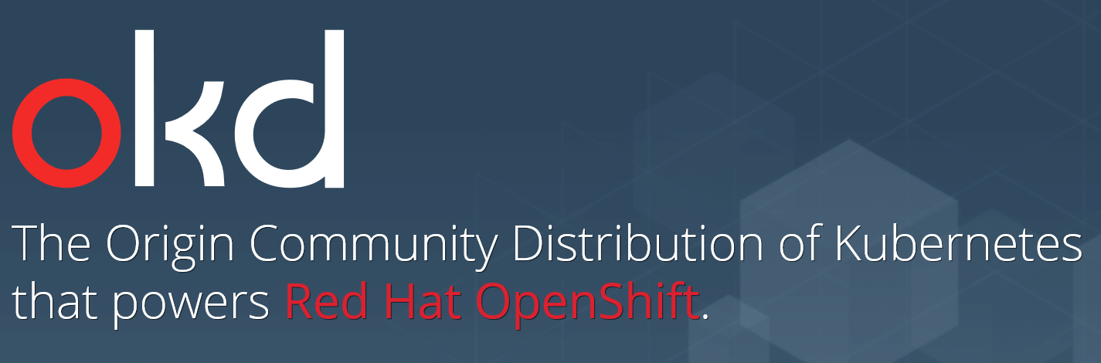
PaaS for Web Applications
A central hosting service for user web applications
Leverage OKD, a.k.a. Openshift
  Kubernetes + application lifecycle management and DevOps tools
High level of service
  HA, app monitoring, data backup, scaling, TLS cert, DNS…
High level of integration with CERN environment
  Storage, Authentication/Authorization, GitLab…

Slide 5
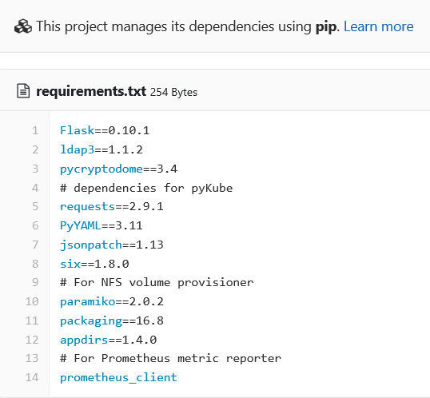






Use case: arbitrary user applications
Offer greater flexibility than “shared” web hosting
  Containers enable each application can use its own combination of libraries and development stacks
  Better isolation between sites
Reduce the need for
application owners to run
their own web servers
Native support for a range of
programming languages

Slide 6

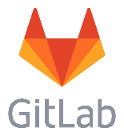
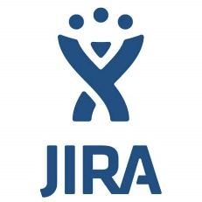



Use case: 3rd party applications
Provide an environment to deploy 3rd party applications
  Reduce the need to operate dedicated servers
  Simpler and faster deployment
  Leverage availability of Docker images for many applications

Slide 7



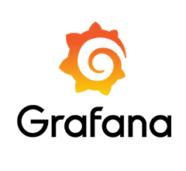

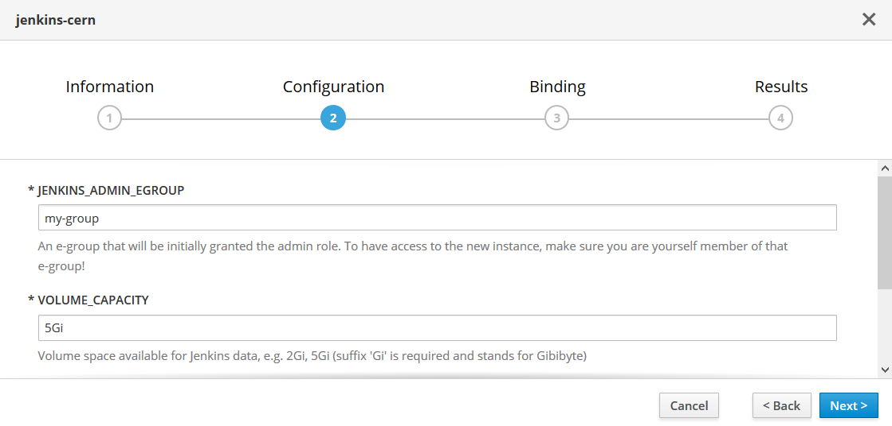
Use case: application templates
Some IT services involve multiple application instances
Application templates in OKD combine:
  An application definition that can be centrally maintained
  Isolated application instances for each tenant
  Self-service instance provisioning
  for users of the service
  Full delegation of admin rights
  to application owner
Strategic change in how
some services are offered

Slide 8
Project history
2014: evaluate PaaS solutions for Jenkins instances
2015: first Openshift “v3” release based on Kubernetes
2016: production deployment
  Regular in-place updates, running 3.9 as of October 2018

Slide 9
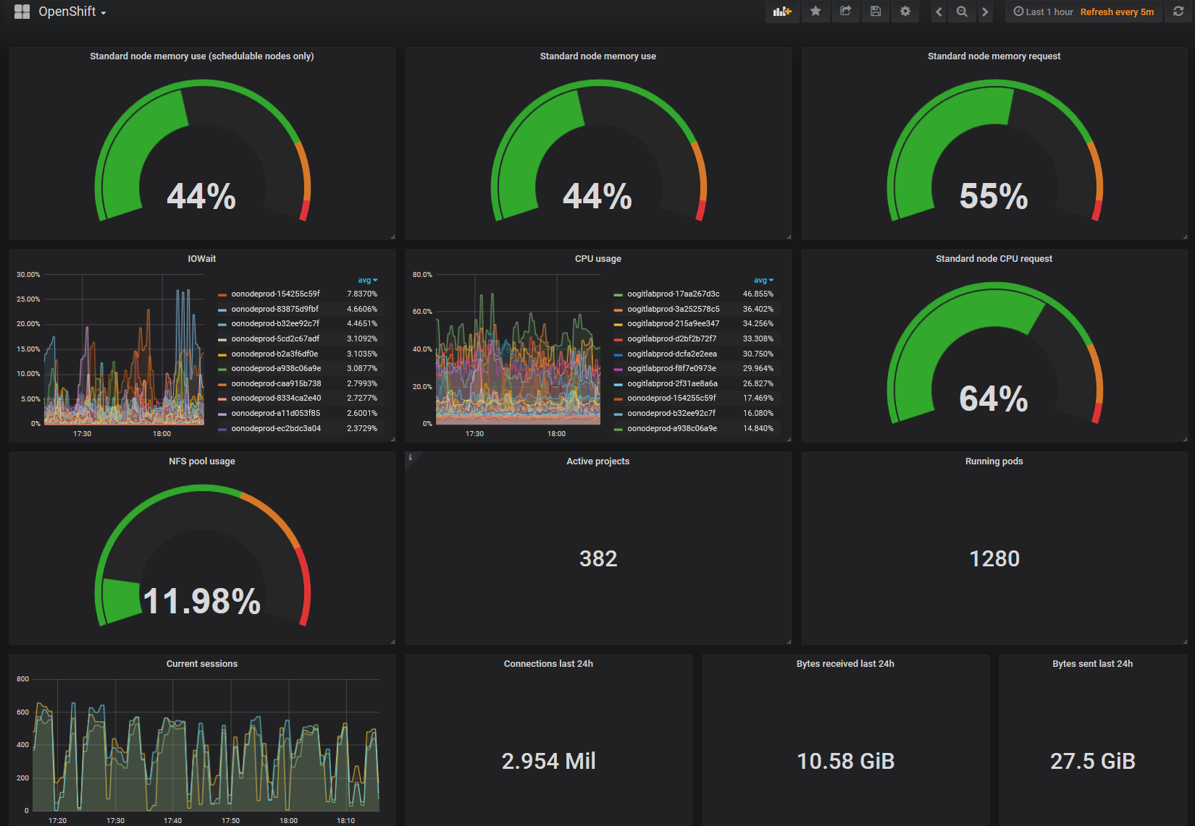
Production cluster status
~400 apps
~1200 pods
24 worker nodes
  30GB RAM
  10 cores
Avg per app
(avail.)
  0.5CPU
  1GB
Avg per app (used)
  0.1 CPU
  0.5GB

Slide 10
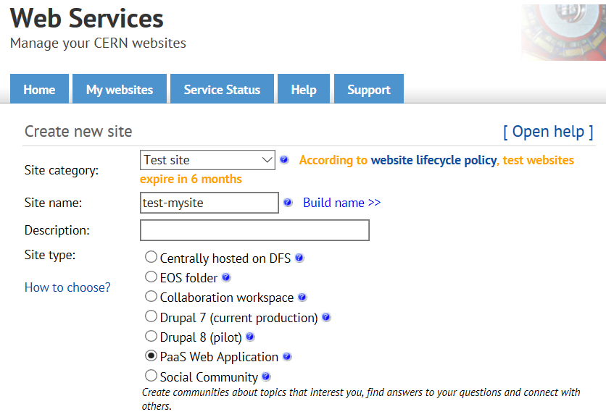
Integration with the CERN environment
Authentication and authorization:
  SSO and e-group support
  Application template for an authenticating proxy
CERN Web Services portal for application lifecycle

Slide 11
Integration: extending Openshift
Leveraging Openshift/Kubernetes API
  Watching and reacting to events in the Openshift cluster
Storage:
  Dynamic persistent volume provisioning from NFS Filer service
  CERN network filesystems: CVMFS, EOS
  Work in progress: CephFS
Application visibility
  Intranet / Internet / CERN Technical Network

Slide 12
Automation of web application deployment
Goals:
  Deploy an application in minutes
  Automate application redeployment on changes
Leverage:
  GitLab for application source code
  Openshift deployments
    Rollback, redeploy, retry…

Slide 13
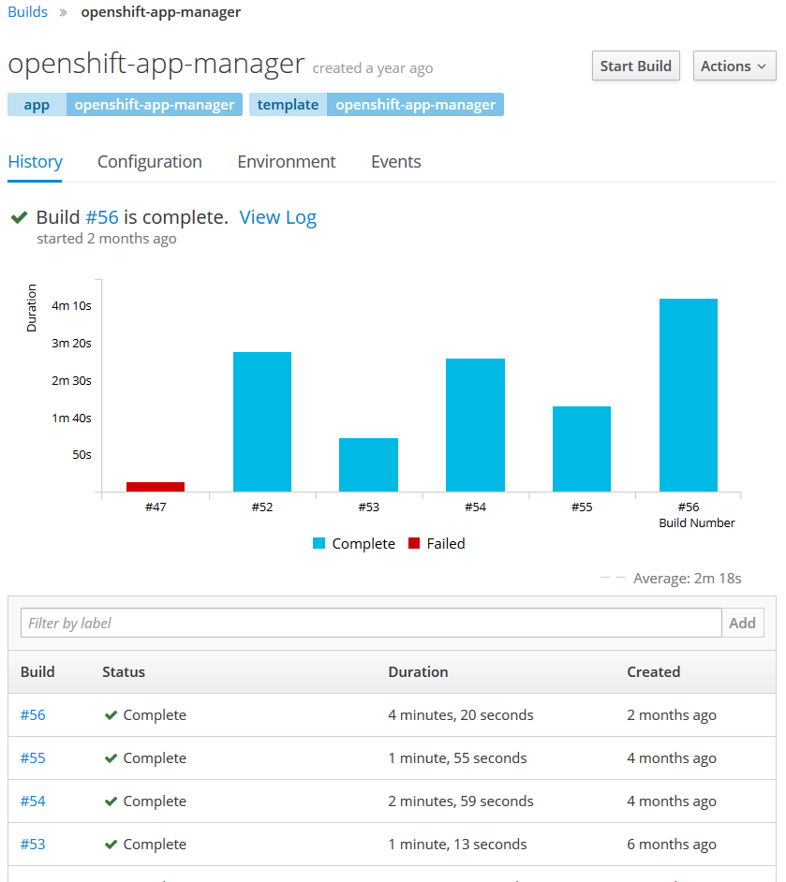
Automation of web application deployment: S2I
Openshift Source-to-Image for simpler use cases
  Automates building Docker images
  From Git URL to application source code
  Web hooks to automatically rebuild/redeploy on code changes
  Automatically rebuild and redeploy all apps on updates to base image

Slide 14
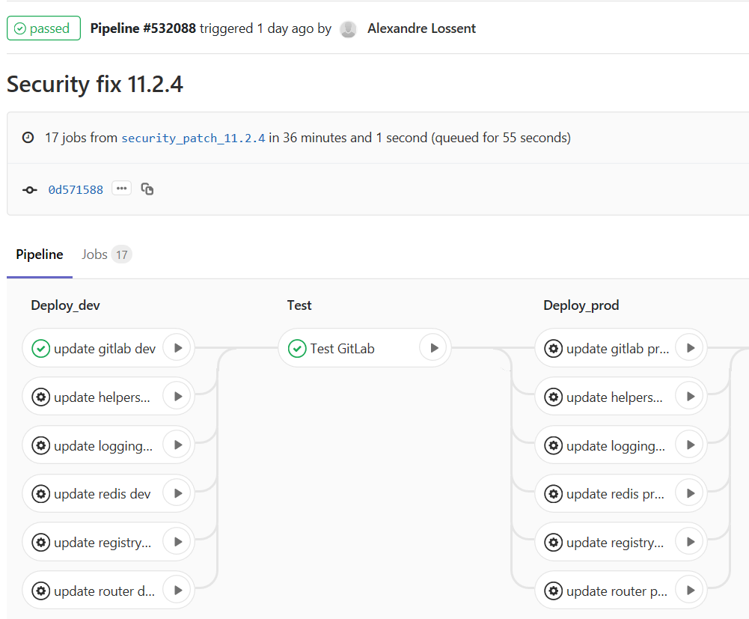
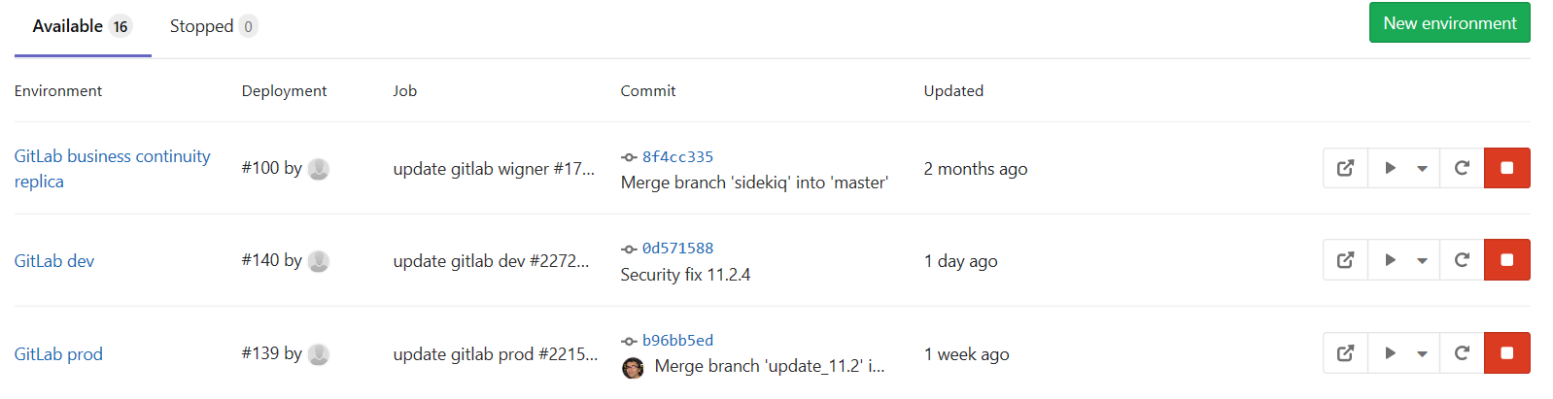
Automation of web application deployment: GitLab CI/CD
Complete control on build and deployment pipeline
  Build arbitrary Docker images
  Primitives for deploying to Openshift
GitLab Environments
  Test, staging, production, “review apps”
  Keeps track of what is deployed where

Slide 15
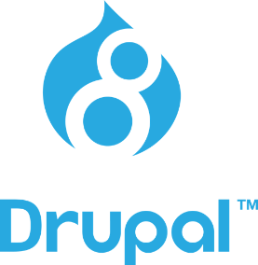

Prospects for the evolution of CERN Web Services
Migrate “traditional” web hosting to containers
  Static + CGI sites from network filesystems
  Content Management Systems
  Leverage app deployment process for static CMS: Jekyll, Hugo…
Benefits:
  Consolidate all web hosting on common infrastructure
  Facilitates providing multiple environments (staging, dev)
  Flexibility: advanced users can extend the base Docker image for specific needs

Slide 16
Evolution of CERN Web Services
Move “web infrastructure” itself to containers
  Various components for management, monitoring, log processing…
  Goal: simplify and standardize
  Leverage Openshift native functionality

Slide 17
Conclusion
Container orchestration
  Enables hosting a much larger range of web applications within CERN Web Services
  Simplifies and streamlines application deployment
  Leverages standardized cloud technologies and skill set
  Enables more efficient usage of computing resources
Opportunity to consolidate all web hosting services on a common infrastructure

