Slide 2
Too much BEER and the kubernetes dance
Ben Jones
Markus Schulz [BEER]
Luis Fernandez Alvarez [k8s]
Olga Datskova [k8s]

Slide 3
Background
Demands on compute not diminishing
No new datacenter & exiting Wigner
Budgets are very tight

Slide 4
Problems to solve
Can we use spare compute capacity within CERN Computer Centre in the batch service?
Can we get more out of the resources we already have?
How do we best take advantage of public cloud resources?

Slide 5
How do containers help?
Eliminate the need to share OS / libraries / Apps with Host machine
Reduce the amount of things we need to configure on Host machines
CGroups ensure that we can control resource usage of jobs

Slide 6
Condor + Containers on EOS
Cores reserved for EOS
Cores integrated in Condor running jobs at low priority, memory and scratch space restricted by cgroups,
EOS
cores
Monitored by:
cadvisor/collectd
memory
cgroups
Condor
job
job
job
job
container
Local disk

Slide 7
Limits to protect EOS
Memory limit
  is set as a parameter in /etc/systemd/system/condor.service and systemd uses the setting when setting up the cgroup for the condor service: 48GB
  But does not limit swap usage
  Modified condor.service to also set memsw limit (ram + swap) to 96GB
Add condor to another cgroup using cpuset
    cpus 2-7,10-15,18-23,26-31
      leaves 4 physical cores entirely excluded covering both sockets
    Later only number of cpus has been limited.
Condor configured to offer 24 job slots and 96GB ram
blkio is used to control the I/O scheduling
  blkio.weight == 50
Network traffic limits can be set via iptables on the docker level, but are currently not used.

Slide 8
BEER Preproduction on Production Nodes
Started with 70 nodes with 40 cores just before CHEP 2018
Disk Servers from ATLAS Production
  Initial loads from ATLAS
    Later will become part of CERN prod resources
LHCb joined a month later
  Same as above

Slide 9
Experience so far
ATLAS is using 2568 cores
  Mix of job types (grid jobs)
LHCb runs 1300 jobs
  MC production
The EOS team treats the nodes just like any other storage node
Batch treats it like a grid enabled resource
  CE + Condor queue

Slide 10
LHCb
2.6 % overall

Slide 11
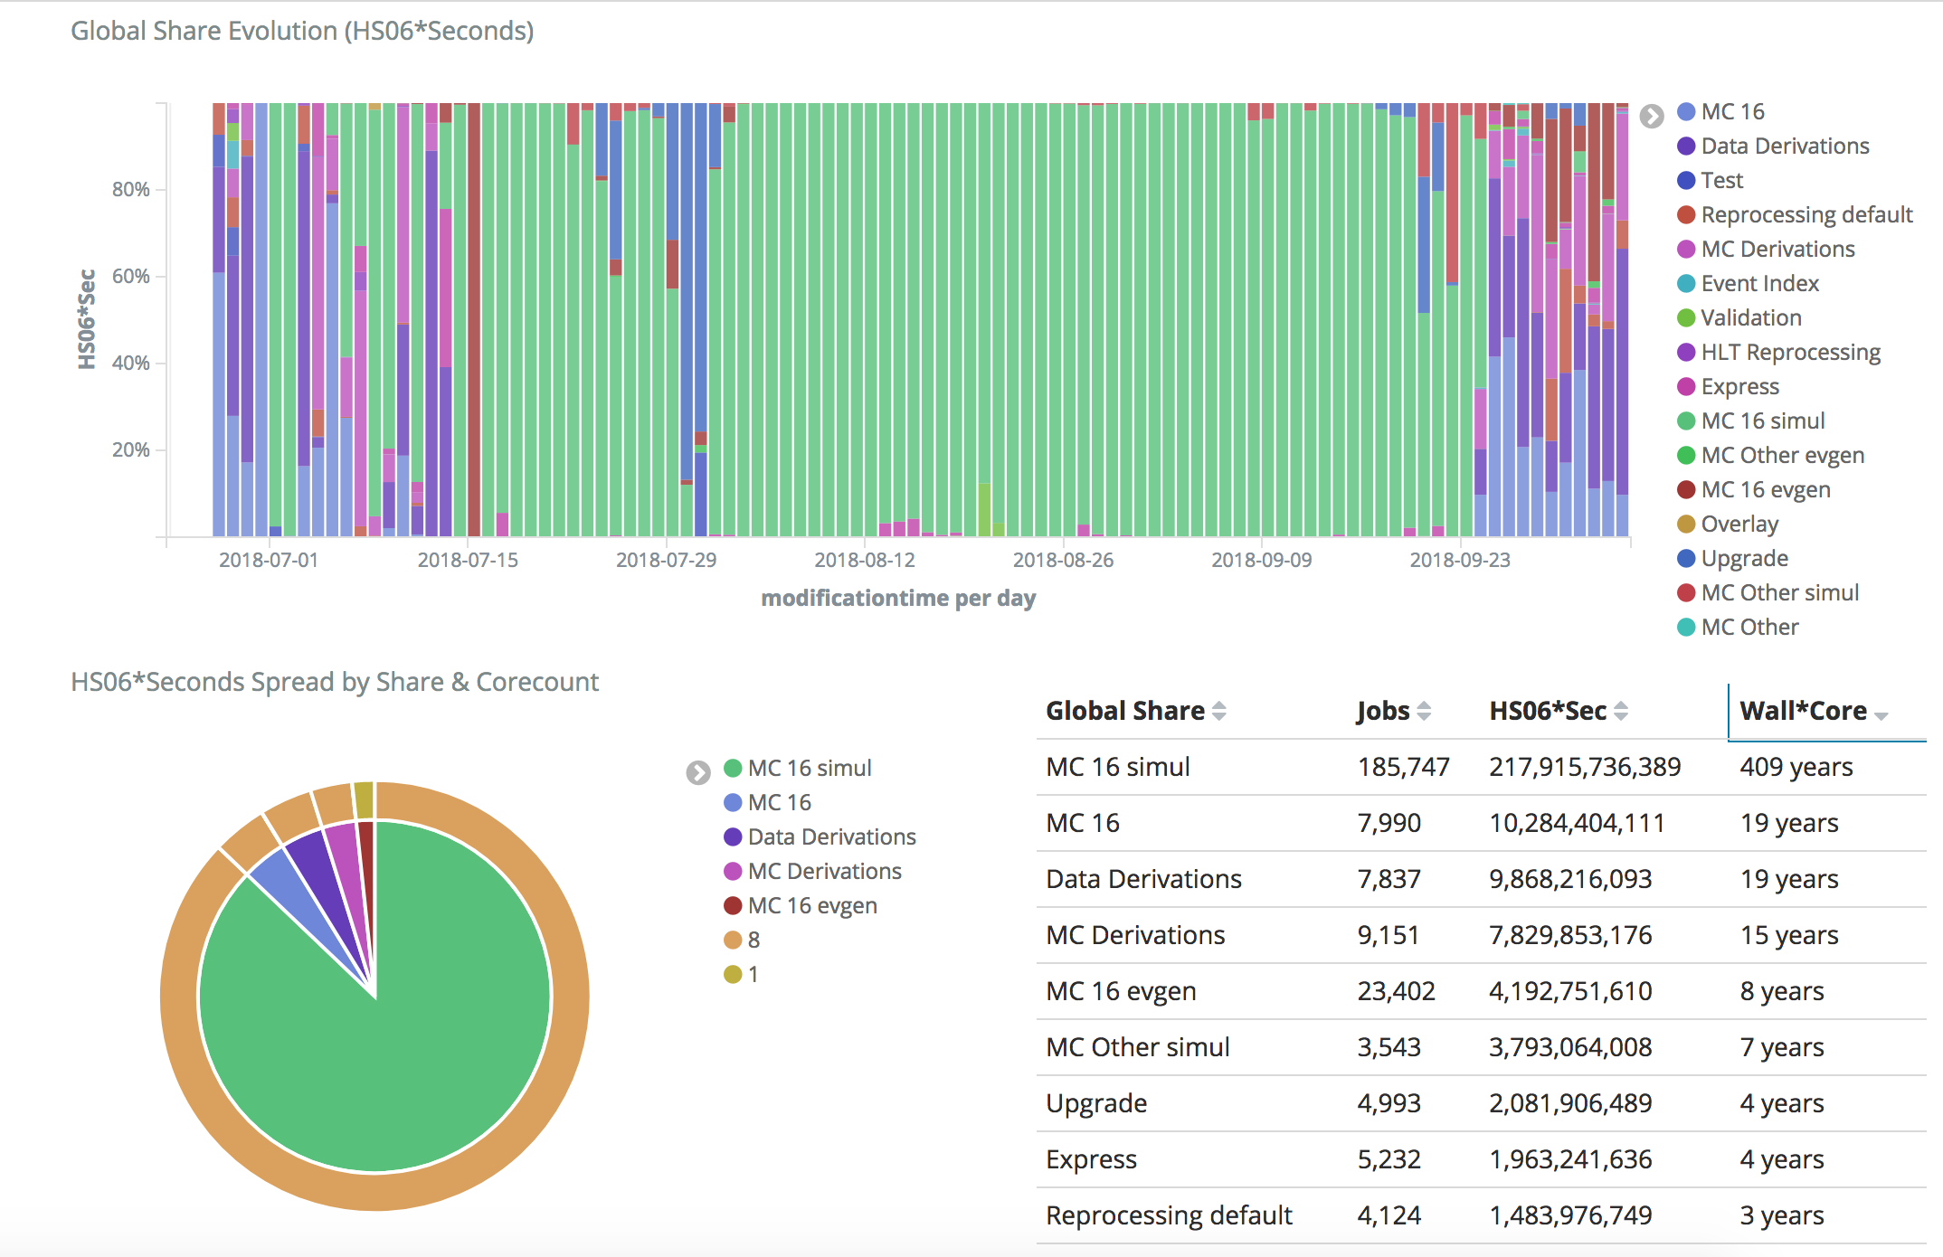
ATLAS job types
(ht: Ivan Glushkov)
Mostly simulation, 8-core

Slide 12
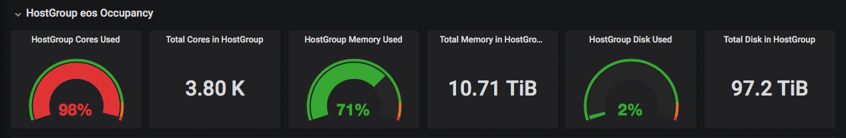
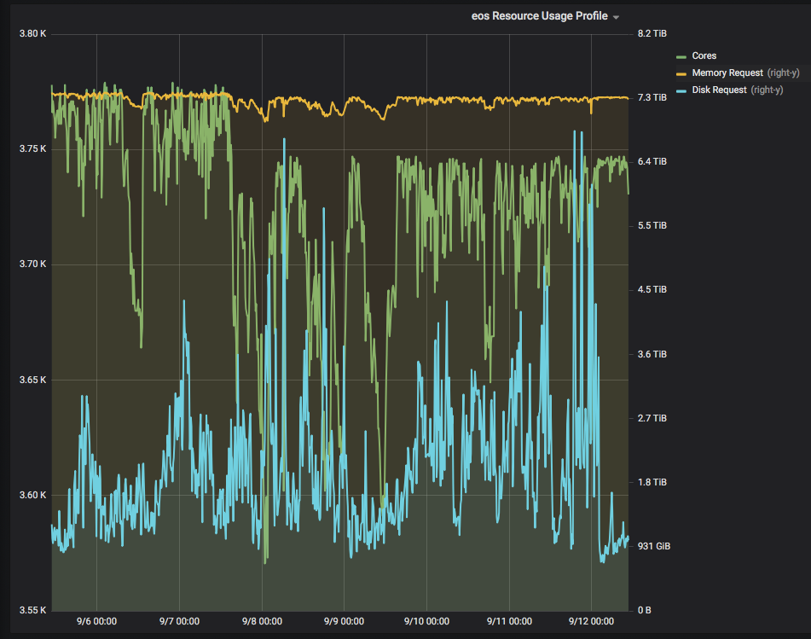
Plots from monitoring: production
Last week

Slide 13
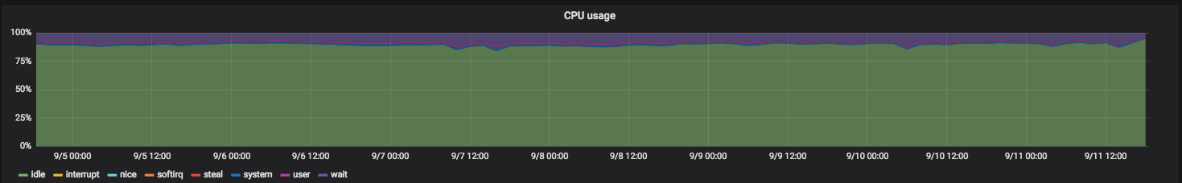
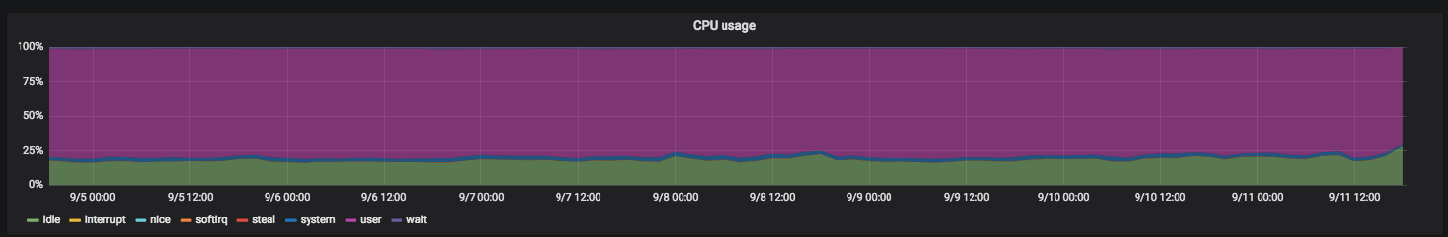
ATLAS with and without BEER
idle
without
user
with

Slide 14
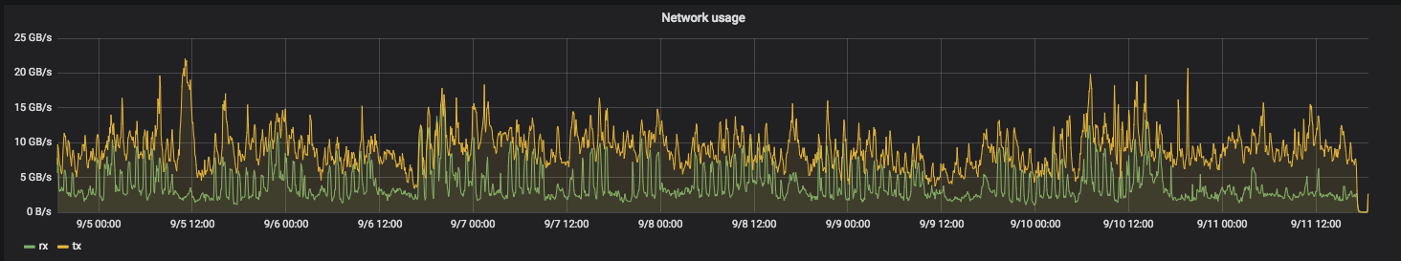
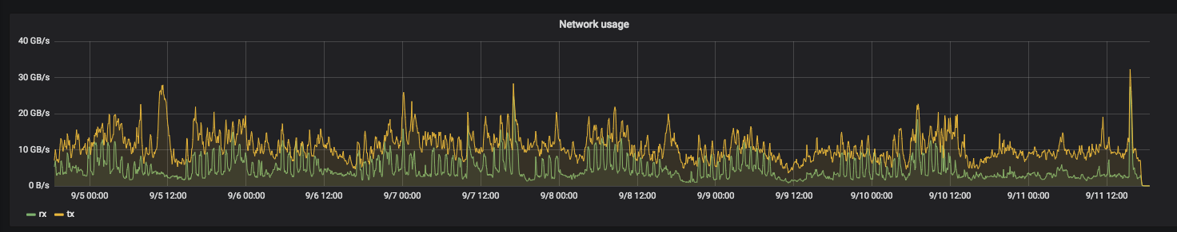
ATLAS with and without BEER
20GB/s
260 nodes
without
85 nodes
20GB/s
with

Slide 15
Next Steps
Adding support for Singularity
  Required by CMS
Adding limits for I/O and networks
Scaling up
  Significant increase after the Heavy Ion run
  Potentially ~11K additional cores
KBAC - Kurchatov's BEER Adaptation for Ceph
  20 Nodes
    16X8TB drives, 24 cores, 256GB RAM
  Slurm with a “Ceph queue”
  Tests will start soon

Slide 16
BEER Contributors
IT-CM
  Tim Bell, Ben Jones, Domenico Giordano,
  Gavin McCance, Jaroslava Schovancova, Havard Tollefsen
IT-ST
  Dirk Duellmann, Massimo Lamanna, Herve Rousseau
IT-DI
  Markus Schulz, Andrea Sciaba, Andrea Valassi, David Smith
Petersburg Nuclear Physics Institute
  Andrey Kirianov
ATLAS and LHCb for using the resource

Slide 17
Kubernetes & Public Cloud
Initial model was to deploy VMs, and configure them using standard CERN workflows as HTCondor worker nodes
Cloud providers now offering container engine services
  Reduced effort and time to provision condor worker processes
Kubernetes federation allows for clusters that span public & private clouds

Slide 18
Kubernetes & Private Cloud
We like Cloud semantics for managing worker nodes
  One team to manage hardware lifecycle (crucially, not us)
  Current provisioning / break fix recovery is to fill-up tenants with VMs until creation fails
  Kubernetes with condor deployed as a daemonset means all machines in a cluster will automatically be deployed
Kubernetes on bare metal servers means we may get best of both worlds
  (and a few extra slots)
Ecosystem includes orchestration, monitoring, multicloud

Slide 19
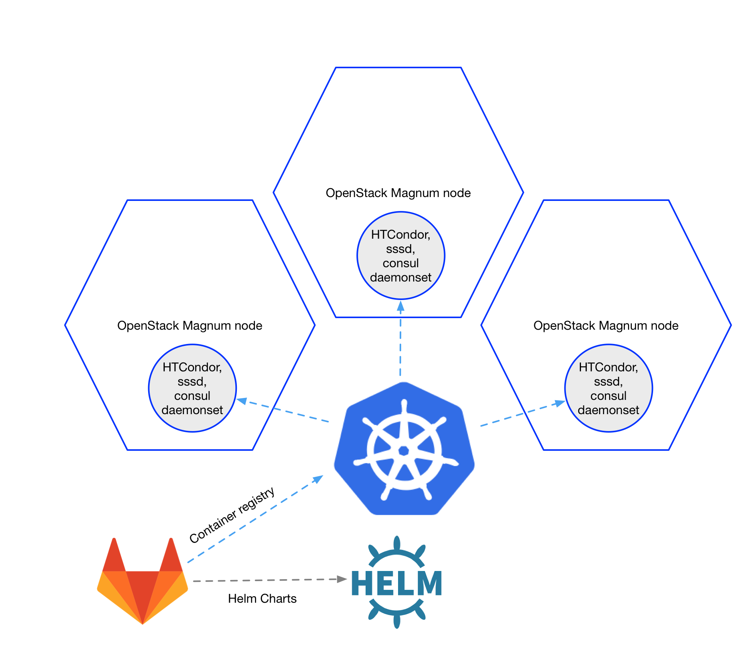
Kubernetes HTCondor
OpenStack Magnum provides nodes with grid certs available
Helm charts to package various k8s objects, and separate code / data
GitLab container registry & helm repo. Exploring gitlab-ci to automate deployments
CVMFS volume driver
Consul explored for registration to feed data to htcondor infra

Slide 20
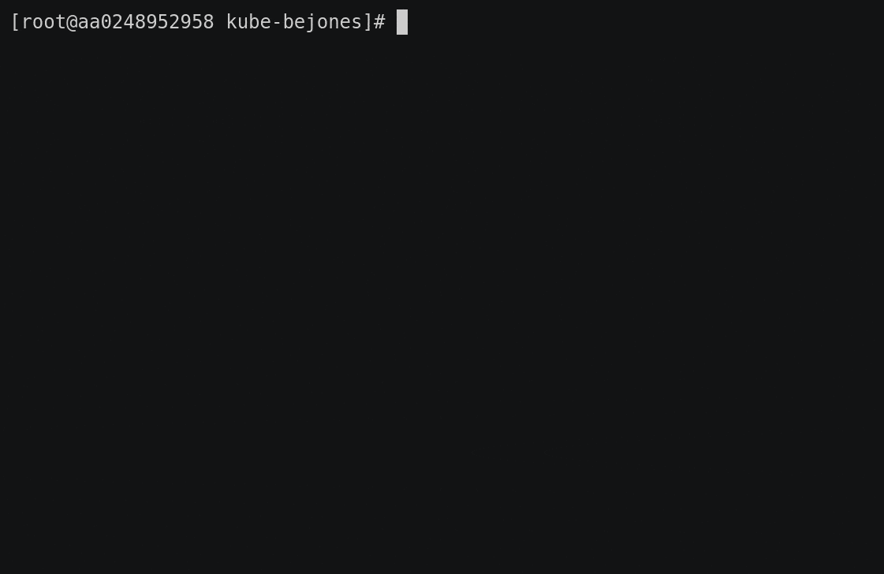
“demo”

Slide 21


Slide 22
Questions?

Slide 23
backup

Slide 24
I/O OFF
job ON
I/O ON
job ON
I/O ON
job OFF
Phase 1
Phase 2
Phase 3
Out = load + replication
No difference in I/O performance!
Proof of Concept III

Slide 25
Production I/O loads/stress tests
Production peak on the ATLAS cluster during a week ≈ 300MB/sec
Test with xrdstress saturated at ≈ 600MB/sec

Slide 26
Security?
Data on the node is protected by UNIX ownership
Separation between users is done by CONDOR
In addition jobs are run in containers
  EOS data disks not visible within container

