Slide 1
Report on the Workshop on Central Computing Support for Photon Sciences
Oct. 10, 2018

Slide 2
Background
Several new Light Source facilities in recent years
Many operate on sites where legacy HENP facilities co-exist with a strong (often closely-coupled) computing support
Computing support models for HENP facilities developed over ~50 years of experience, from early days of fixed-target, low-data rate experiments to high-data rate large colliders
  Inter-connected, outward-looking and collaborative community
  Well-established discussion forums (ie, HEPIX, OSG, etc)
Light Sources are now developing own computing support models—some very different from HEPN, and Central Computing facilities are tasked with supporting them
  Islands of smaller, self-reliant communities
  Fewer forums to foster inter-disciplinary collaborative efforts
Convened a workshop to discuss challenges associated to computing support for Photon Sciences (Light Sources in particular), with an emphasis on facilities at sites with a strong tradition in HEPN

Slide 3
Participating Organizations
U.K.
  Diamond
  STFC
Germany
  DESY
U.S.
  BNL (SDCC, NSLS-II, CFN)
  SLAC (LCLS)
  LBL (NERSC)
  Argonne

Slide 4
Topics
Computing & Storage Challenges
Authorization & Authentication Infrastructure (AAI)
Archival Tape Storage
Access to/from Wide Area Network
Software Support

Slide 5
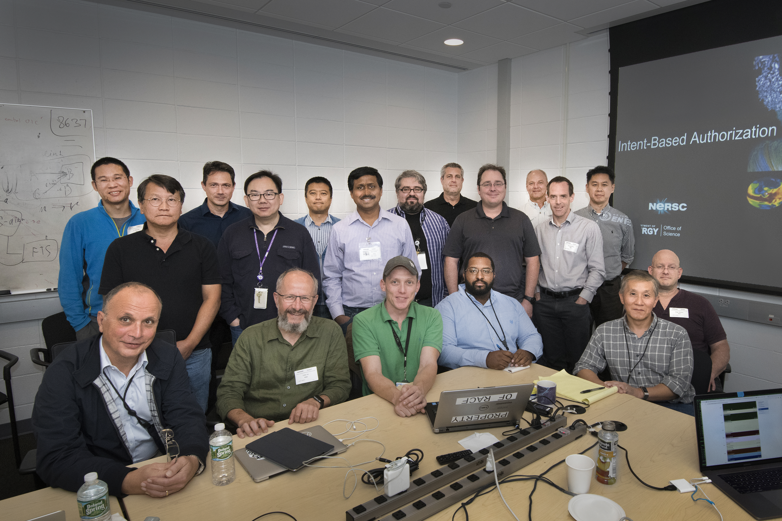
Participants

Slide 6
Diamond & STFC
Diamond (presented by Andrew Richards)
  Operating since 2007 (24 x 6)
  Support for life, physical and environmental sciences
  ~5000 hours of beam time to 30 beamlines
  Upgrade to Diamond-II underway (2025)
STFC (presented by Ian Collier)
  Data storage support
  Data Analysis as a Service (DAaaS)
  Leverage SCD expertise and infrastructure to support Diamond

Slide 7
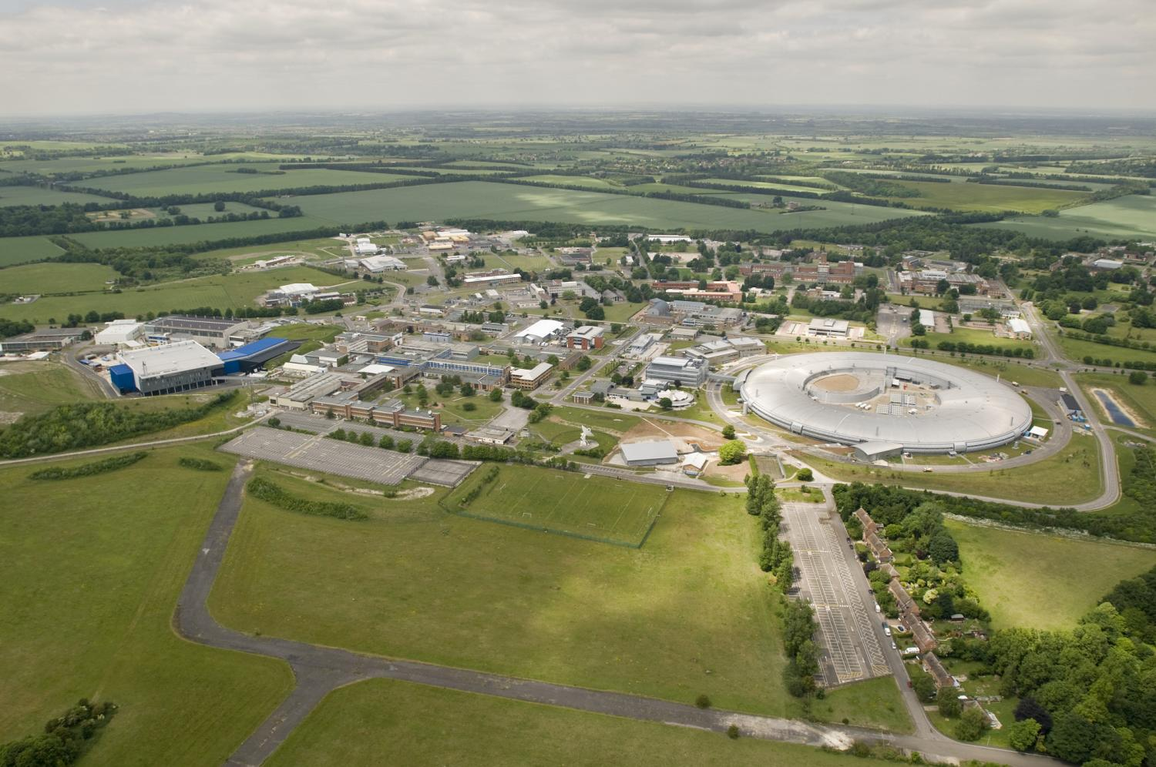
Harwell Science and Innovation Campus
LHC Tier 1 computing
ISIS (Spallation Neutron Source)
Central Laser Facility
Research Complex (for users of Diamond, ISIS and CLF)
Diamond Light Source

Slide 8
Current Developments
Several challenges
  Rapidly increasing I/O rates with advances in detector technologies
  Archival storage (how long to keep data? Who pays?)
  Re-processing competing for limited resources—create new resources and separate online vs. offline computing?
  Data movement – need scalable, high-performance file system and transfer mechanisms
Projects underway
    Several use cases of cloud computing
    Leveraging existing software (mostly used in HEPN)
    Complement archival storage with open data repository (where feasible)

Slide 9
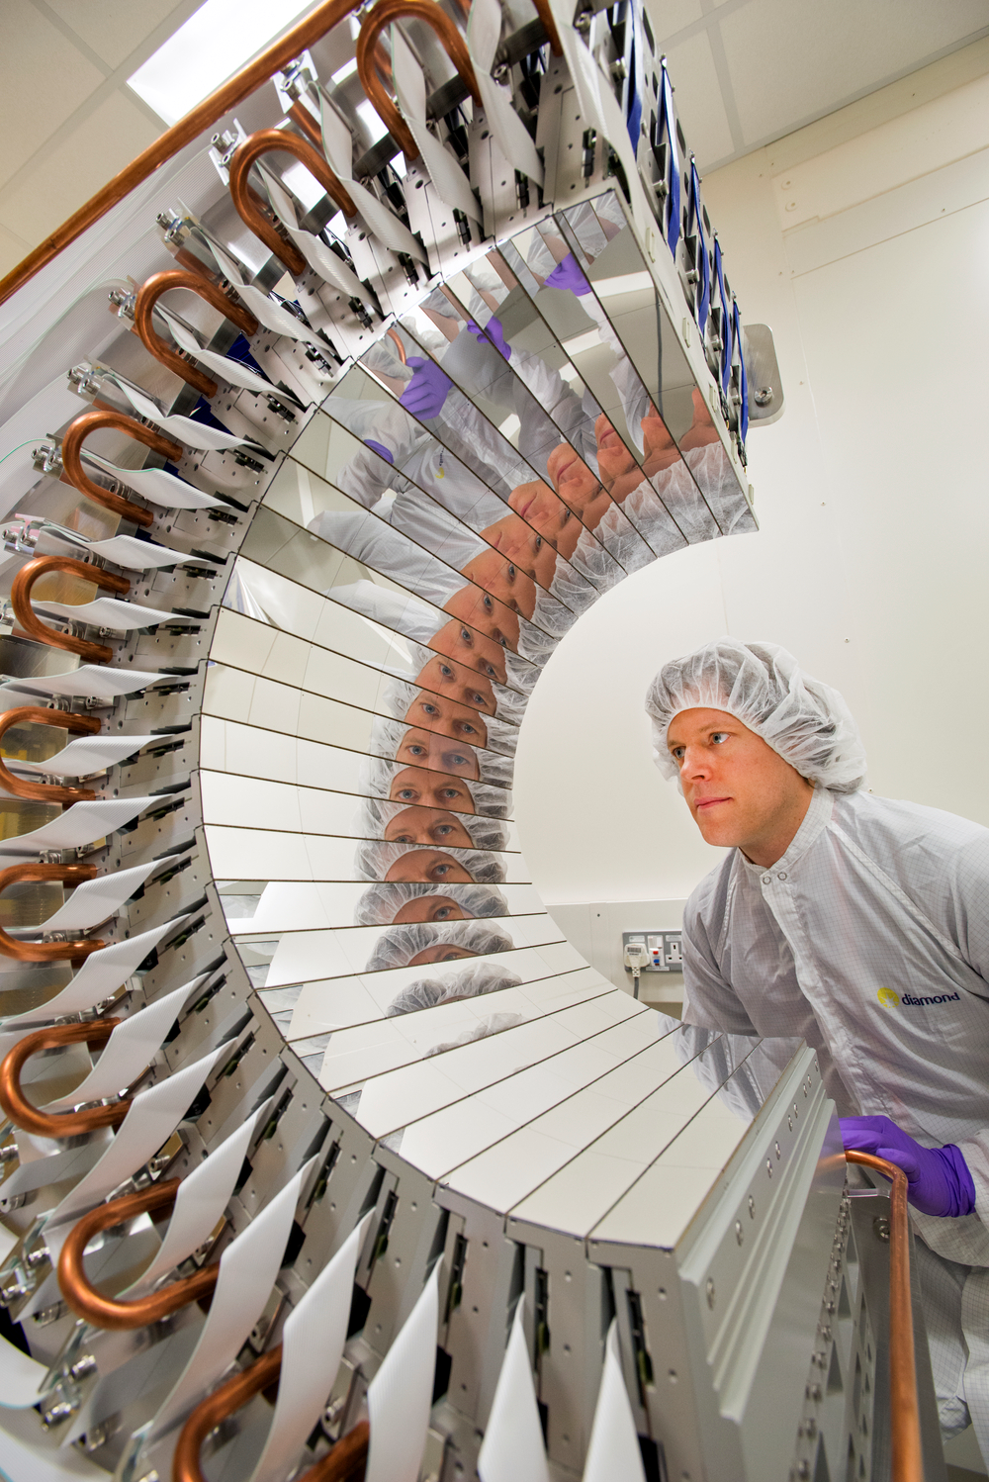
Data Rates
Doubling time = 7.5 months
2007 No detector faster than ~10 MB/sec
2009 Pilatus 6M system 60 MB/s
2011 25Hz Pilatus 6M 150 MB/s
2013 100Hz Pilatus 6M 600 MB/sec
2013 ~10 beamlines with 10 GbE detectors (mainly Pilatus and PCO Edge)
2016 Percival detector 6GB/sec

Slide 10
Technology
In house exploration of commercial clouds (Amazon AWS, Microsoft Azure, Google).
Containerisation: Using Docker for trial deployment of in-house applications.
Evaluation of Singularity for more secure application deployment instead of Docker.
Used Univa Grid Engine NavOps framework for remote cloud VM control.
Testing of Kubernetes in-house for Container management.
Production deployment of Openstack / OpenShift in Verne Global (Iceland) HPC Direct service for LabXChem fragment screening production pipeline. (Frank von Delft)

Slide 11
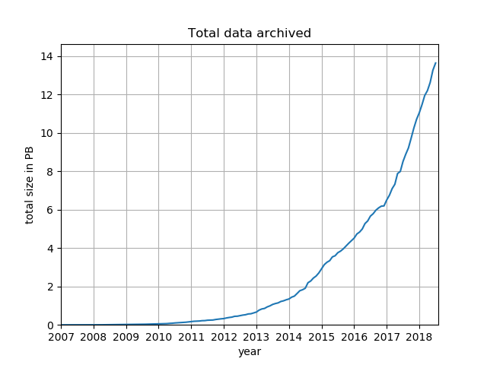
DLS Data archived by SCD
Nearly 14PB - 8PB a year ago

Slide 12
SCD Aims
Improving the scientific output of the facilities
  Decrease time to publication
  Increase experiment to publication conversion rate
Simplify the deployment of new workflows
Simplify the development of new innovations
Simplify data analysis process for users and developers

Slide 13
LCLS @ SLAC
LCLS flagship facility at SLAC after the de-commissioning of SLC in 1998
Presented by Amedeo Perazzo
Computational challenges
  Real time feedback during data taking
  Timely access to storage for data analysis
  Archival data retrieval and re-processing
  Dedicated local facilities for data reduction/compression before sending over ESNET
LCLS-II upgrade (3x higher data throughput) by 2025

Slide 14
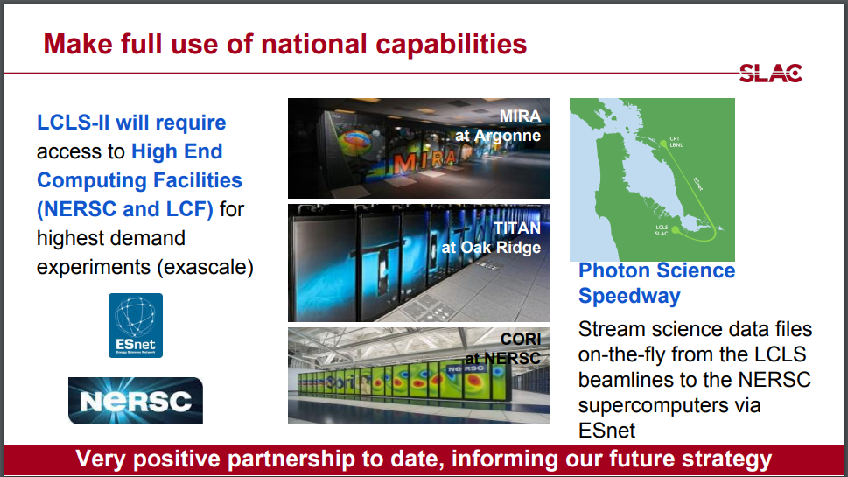
LCLS-NERSC Partnership

Slide 15
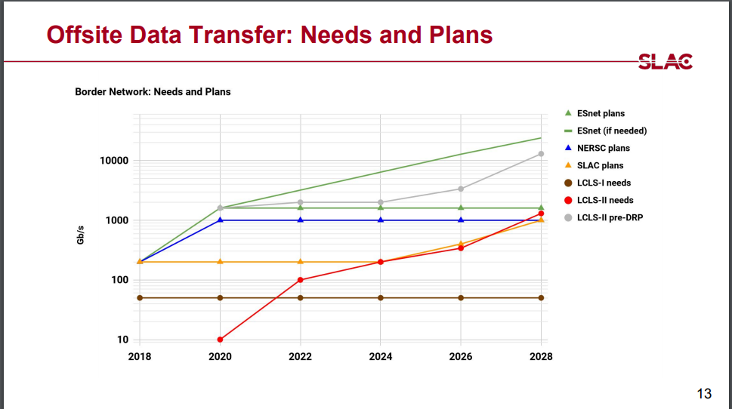

Slide 16
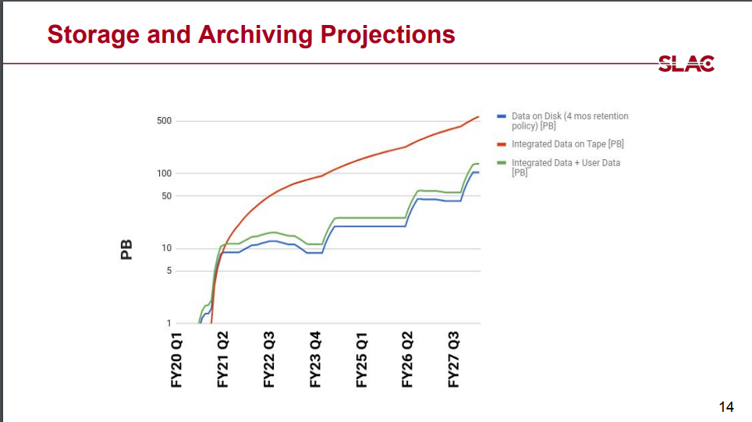

Slide 17
DESY
Presented by Martin Gasthuber
Three facilities in operation sharing a common computing infrastructure and supported by central IT + teams at each facility:
  Petra 3
  FLASH
  EuXFEL
Central IT support for:
  Workflow (beamtime proposal) software system
  Online and Offline dCache filesystem + storage
  Data management and movement

Slide 18
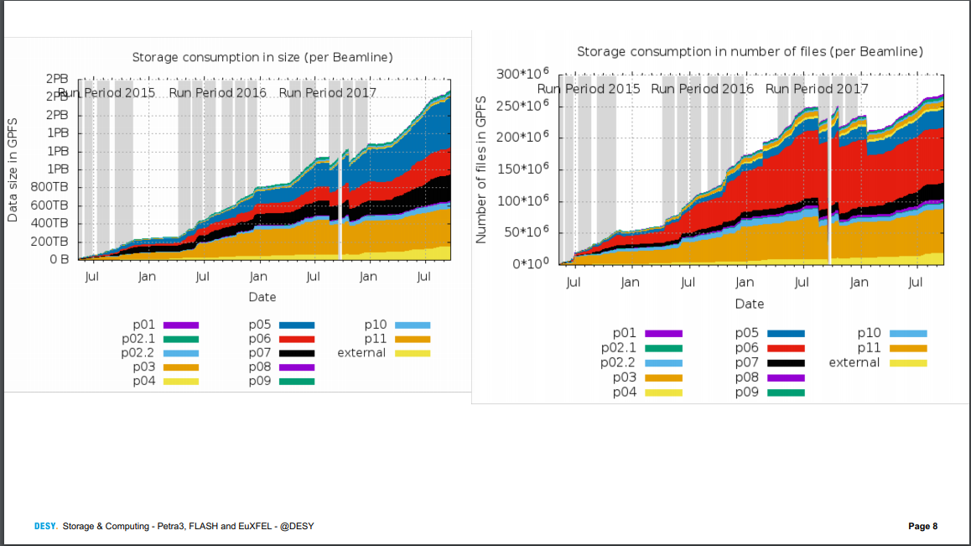
Storage Statistics @ DESY

Slide 19
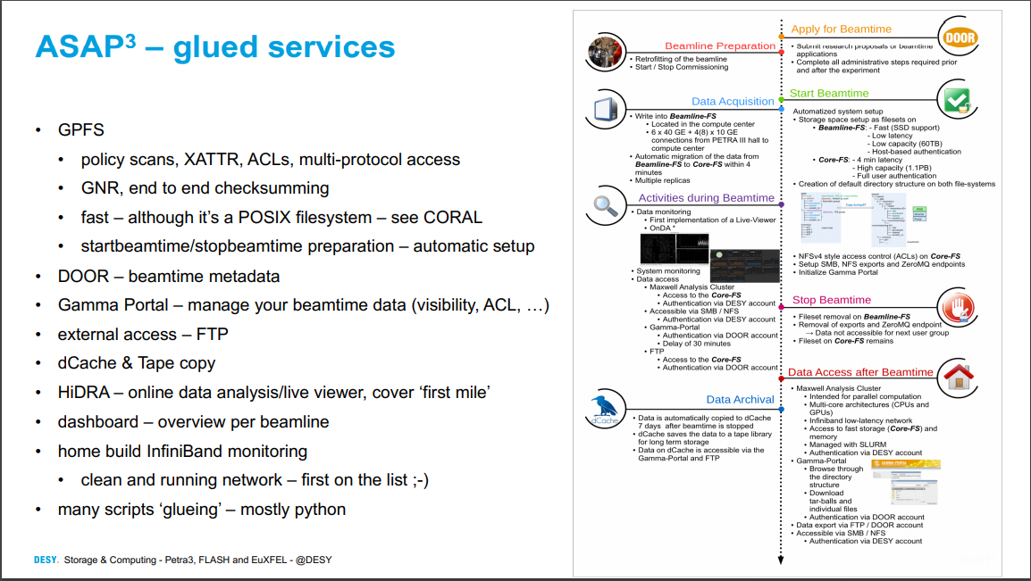
IT Support During Experimental Lifecycle

Slide 20
Some Observations
Detector improvements outpacing Moore’s Law
Getting data out of detector and bandwidth from beamline to storage increasingly challenging
Real-time analysis challenge
Increasing load on filesystem—scalability concerns
Lack of forums (HEPIX, CHEP, etc) to leverage expertise, discuss best practices/developments, standardization, etc
Data reduction techniques more critical
PETRA 4 (~10³ higher data rate) coming
Trust between beamlines and central IT—a critical component of successful operations—built over years

Slide 21
NSLS-II @ BNL
Presented by Richard Farnsworth
Commissioned in 2015–28(?) beamlines operating today—plan to ramp up to ~58 in the future
Several challenges with new facility
  Online cluster instabilities
  Real time feedback during data taking
  Post-experiment data analysis needs
  SSO and remote user access
  Data retention policy
Data Acquisition, Management and Analysis (DAMA) group
  Support for a common language across beamline experiments using diverse proprietary detector software
  Bluesky—visualization and data management
  Bluesky evolving with contributions from APS (Argonne) and LCLS (SLAC)

Slide 22
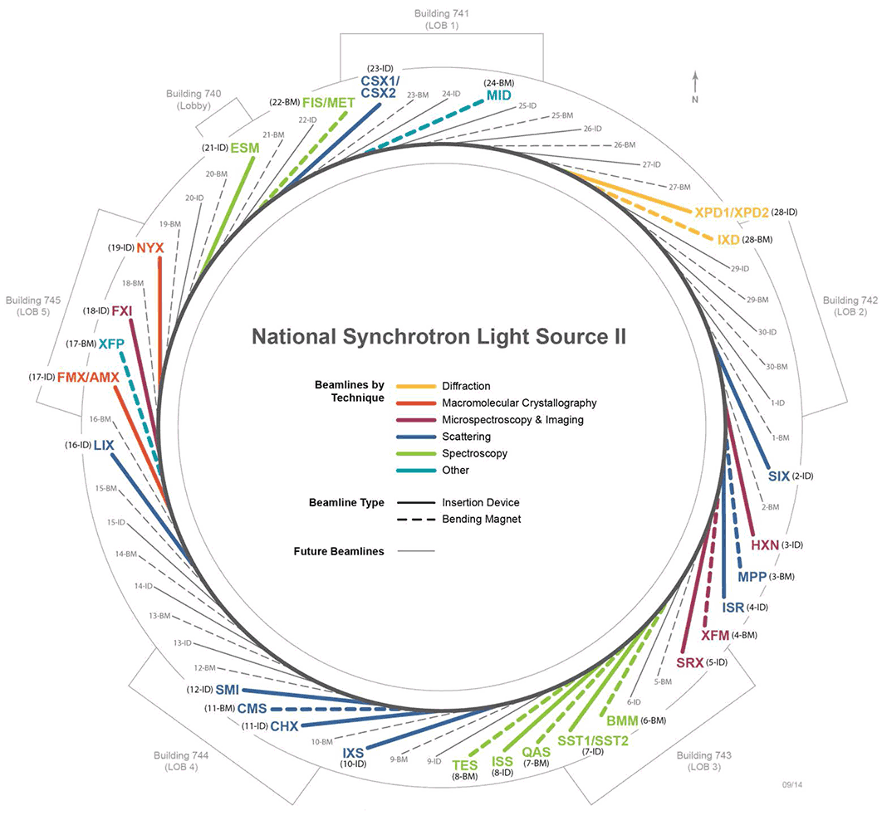
Beamlines - Introduction

Slide 23
Estimated Data Rates for NSLS-II

Slide 24
SDCC
Presentations by staff on various topics of interest to Photon Sciences
  ESNET and High-Throughput Scientific Network (HTSN)
  SSO
  BNLBox
  HTC/HPC resources
  Archival Storage

Slide 25
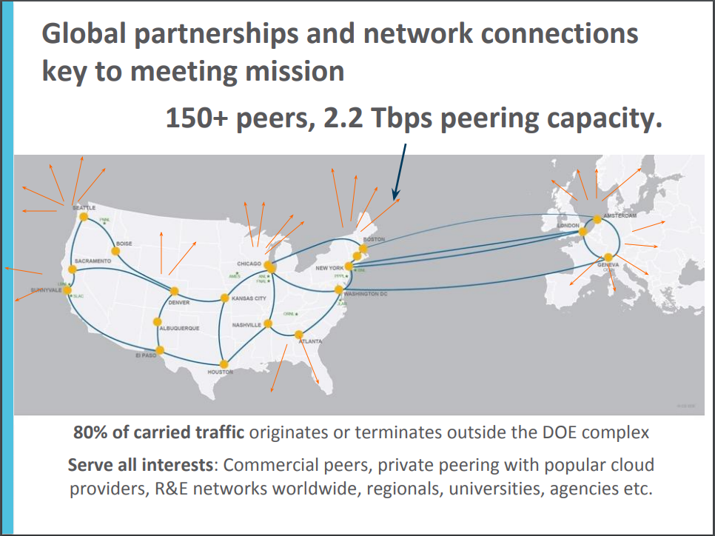
ESNET WAN Service & Support

Slide 26
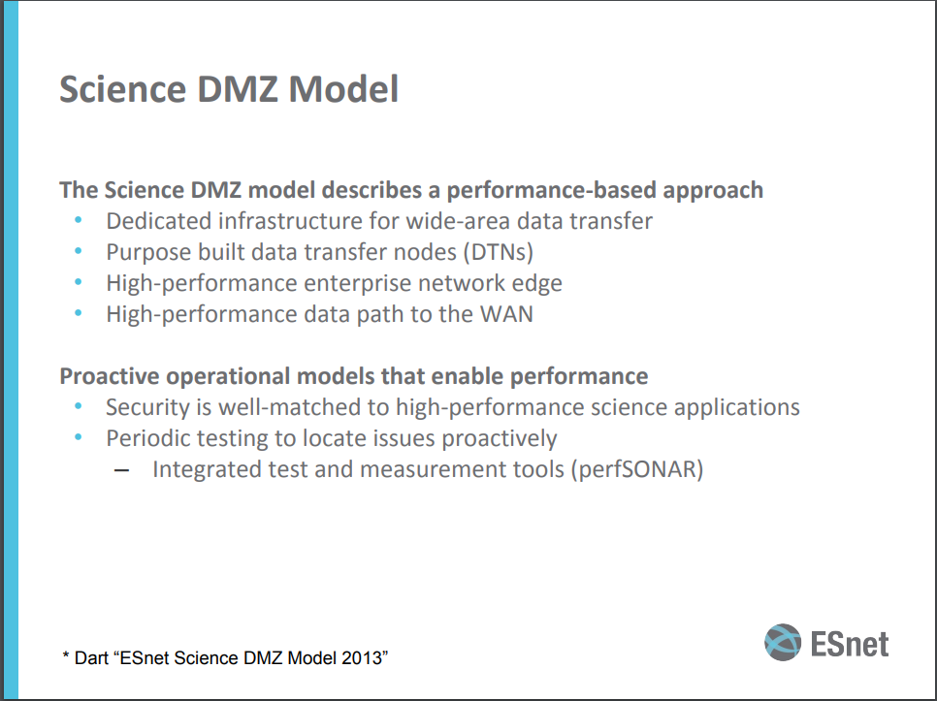

Slide 27
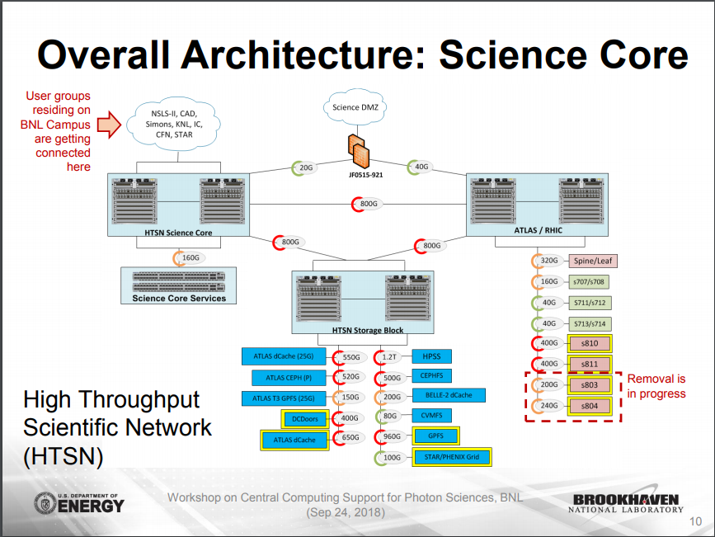

Slide 28
Single Sign-On (SSO) @ BNL
Reduce number of accounts/passwords per user
Simplify staff administrative burden
  Replace LDAP, Kerberos and Shibboleth with FreeIPA and KeyCloak
Enable support for various applications of interest to SDCC
Plan to roll out IPA-based system by mid-December 2018 (before next RHIC run)

Slide 29
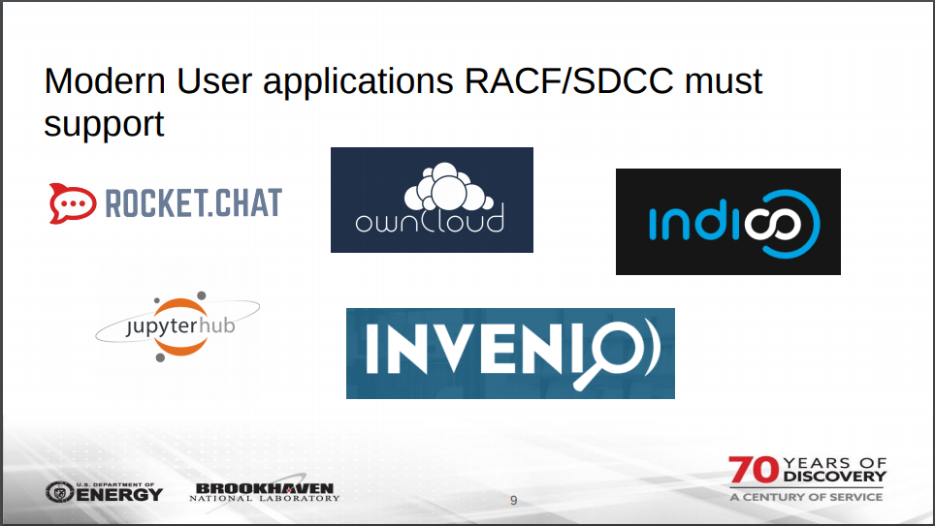

Slide 30
BNL Tape Storage System (HPSS)
HPSS ideally positioned for archival storage and data retrieval for NSLS-II re-processing
Many years of experience with RHIC and ATLAS data
Cost-effective alternative to high-availability disk storage systems

Slide 31


Tape Storage Usage
In 2017
Archived to tape:
  19,412,702 files – Average 53,185 files/day
  20.8 PB – Average 58.4 TB / day
20.8 PB
Restored from tape:
  11,693,141 files - Average 32,036 files/day,
  24.8 PB - Average 69.5 TB/day
24.8 PB

Slide 32
BNLBox
Based on Owncloud
Provide users with ability to store and access their data anywhere via easy-to-use applications on various platforms
Share data with anyone with automated data replication
HPSS data archival option

Slide 33
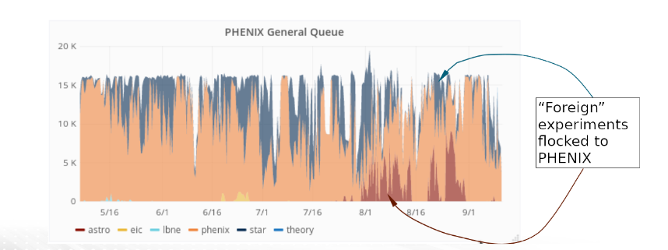
BNL
HTC/HPC cross-work
  HTCondor suitable for HTC workloads—not ideal for multi-core or multi-node applications
  Photon Sciences can leverage shared resources managed by HTCondor
  Slurm-based HPC resources for multi-node or multi-node applications

Slide 34
Summary
To my knowledge, first organized meeting to discuss Photon Science support with Central Computing facilities with various labs
  Many desire to follow-up
  Lack of sufficient forums to share experiences and collaborate
Common themes at Light Source Facilities
  Real time data analysis needs
  Re-processing campaigns
  Data retention (archival) policy
  Detector advances outpacing Moore’s Law—need data reduction to trim I/O rates to storage

Slide 35
Next Steps
Create a mailing list to allow people to bring up issues relevant to IT support for Photon Sciences
Promote the creation of a forum to share experiences, discuss best practices and leverage expertise
  Similar to HEPIX’s stated goals
  Co-locate future meeting with a shared session?

