Slide 1
LHeC IR design recap
E. Cruz-Alaniz
16th May, 2018

Slide 2
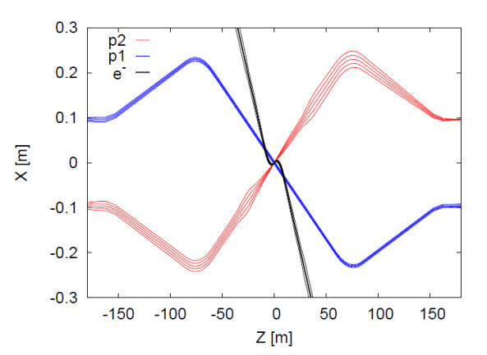
LHeC IR
Aim of the design: Focus one of the proton beams and collide it with the electron beam while the other proton beam bypasses the interaction.
Installation on IR2: Original design β*=10 m and L*=23 m.
In order to reach Luminosity reach:
  10³³ cm⁻²s⁻¹ , β*=10 cm (LHeC CDR)
  10³⁴ cm⁻²s⁻¹ , β*=5 cm (Post LHeC CDR)
Move L* to 10 m to improve chromaticity correction

Slide 3
LHeC IR
Aim of the design: Focus one of the proton beams and collide it with the electron beam while the other proton beam bypasses the interaction.
Installation on IR2: Original design β*=10 m and L*=23 m.
In order to reach Luminosity reach:
  10³³ cm⁻²s⁻¹ , β*=10 cm (LHeC CDR)
  10³⁴ cm⁻²s⁻¹ , β*=5 cm (Post LHeC CDR)
Move L* to 10 m to improve chromaticity correction

Slide 4
LHeC IR
Aim of the design: Focus one of the proton beams and collide it with the electron beam while the other proton beam bypasses the interaction.
Installation on IR2: Original design β*=10 m and L*=23 m.
In order to reach Luminosity reach:
  10³³ cm⁻²s⁻¹ , β*=10 cm (LHeC CDR)
  10³⁴ cm⁻²s⁻¹ , β*=5 cm (Post LHeC CDR)
Move L* to 10 m to improve chromaticity correction

Slide 5
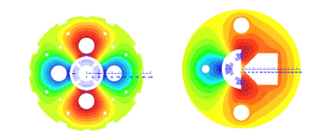
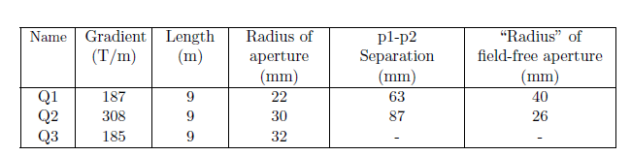
LHeC IR
Changes to the IR
Installation of new quadrupoles of IT: Free-field regions for the non-colliding proton beam and the electron beam.
Change dipole strength to direct beams to corresponding apertures.
LHeC CDR design S. Russenschuck
Limits on strengths of the quads and chromaticity correction.
Following example of HL-LHC. Extend ATS scheme into IR2.
  Pre-squeeze: β*=30 cm
  Squeeze: β*=10 cm

Slide 6
LHeC IR
Changes to the IR
Installation of new quadrupoles of IT: Free-field regions for the non-colliding proton beam and the electron beam.
Change dipole strength to direct beams to corresponding apertures.
LHeC CDR design S. Russenschuck
Limits on strengths of the quads and chromaticity correction.
Following example of HL-LHC. Extend ATS scheme into IR2.
  Pre-squeeze: β*=30 cm
  Squeeze: β*=10 cm

Slide 7
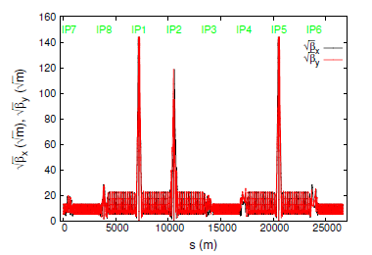
LHeC IR
Changes to the IR
Installation of new quadrupoles of IT: Free-field regions for the non-colliding proton beam and the electron beam.
Change dipole strength to direct beams to corresponding apertures.
LHeC CDR design S. Russenschuck
Limits on strengths of the quads and chromaticity correction.
Following example of HL-LHC. Extend ATS scheme into IR2.
  Pre-squeeze: β*=30 cm
  Squeeze: β*=10 cm

Slide 8
Flexibility of the design
Explore flexibility of the design:
Increase L*
  Advantages: Minimize synchrotron radiation
  Disadvantages: Increase chromatic aberrations
  Cases: L*=10-20 m and β* fixed at 10 cm.
Minimize β*
  Advantages: Increase Luminosity (in particular β*=5 cm)
  Disadvantages: Increase chromatic aberrations
  Cases: L*=5-10, 20 cm and L* fixed at 10 m.
Optics works ok, study which cases are feasible in terms of chromaticity, SR and Dynamic Aperture

Slide 9
Flexibility of the design
Explore flexibility of the design:
Increase L*
  Advantages: Minimize synchrotron radiation
  Disadvantages: Increase chromatic aberrations
  Cases: L*=10-20 m and β* fixed at 10 cm.
Minimize β*
  Advantages: Increase Luminosity (in particular β*=5 cm)
  Disadvantages: Increase chromatic aberrations
  Cases: L*=5-10, 20 cm and L* fixed at 10 m.
Optics works ok, study which cases are feasible in terms of chromaticity, SR and Dynamic Aperture

Slide 10
Flexibility of the design
Explore flexibility of the design:
Increase L*
  Advantages: Minimize synchrotron radiation
  Disadvantages: Increase chromatic aberrations
  Cases: L*=10-20 m and β* fixed at 10 cm.
Minimize β*
  Advantages: Increase Luminosity (in particular β*=5 cm)
  Disadvantages: Increase chromatic aberrations
  Cases: L*=5-10, 20 cm and L* fixed at 10 m.
Optics works ok, study which cases are feasible in terms of chromaticity, SR and Dynamic Aperture

Slide 11
Further Studies
Chromaticity correction.
  Tried three different schemes: LHC-like (all families varying the same), LHeC-like (families varying independently), HL-LHC-like (strong/weak families).
  LHeC-like works the best, but has limit in L*=19 m and β*=8 cm.
  TO DO: Exploring again the HL-LHC like. So far I have a better result. Test it for different cases to see if DA improves.

Slide 12
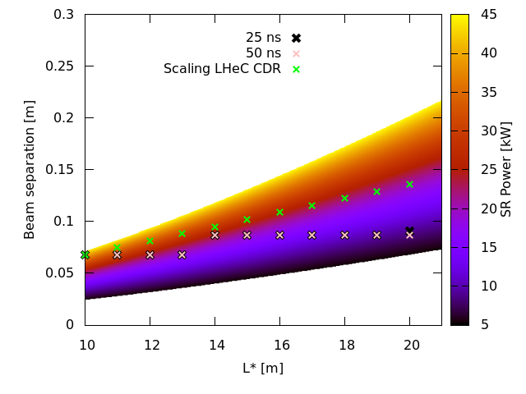
Further Studies
Chromaticity correction.
  Tried three different schemes: LHC-like (all families varying the same), LHeC-like (families varying independently), HL-LHC-like (strong/weak families).
  LHeC-like works the best, but has limit in L*=19 m and β*=8 cm.
  TO DO: Exploring again the HL-LHC like. So far I have a better result. Test it for different cases to see if DA improves.
Synchrotron radiation:
  Original design with L*=10 m, β*=10 cm -> 49 kW
  Increasing L* -> 25 kW
  Minimizing aperture in quads -> 9 kW

Slide 13
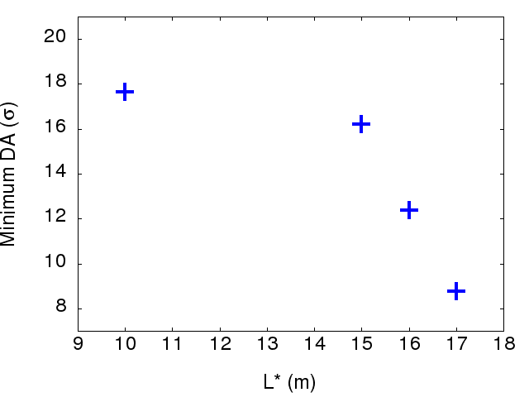
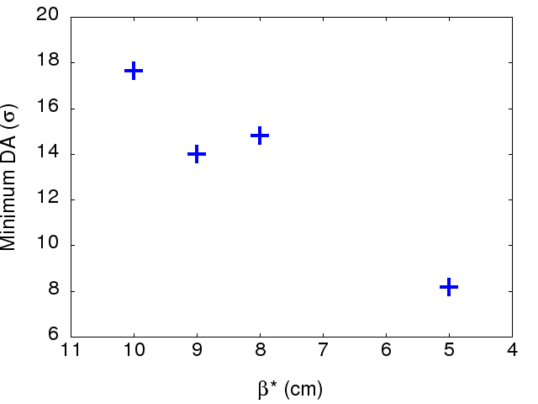
Dynamic Aperture
DA studies: 10⁵ turns, 60 seeds, 5 angles.
Errors in the arcs but NOT in the new IRs: IR1, IR5 and IR2. (Error tables for IR1 and IR5 were on-going work at the time)
DA looks good with L* up to 15 m, very similar than for 10 m. For minimizing β* DA decays more rapidly.
Case for β*=5 cm looks challenging. Try with new chromatic correction.
Up until now : β*=10 cm L*=15 m looks the most feasible.
TO DO: Repeat with error tables, start with IR1 and IR5. To give more complete information about feasible designs.

Slide 14
Dynamic Aperture
DA studies: 10⁵ turns, 60 seeds, 5 angles.
Errors in the arcs but NOT in the new IRs: IR1, IR5 and IR2. (Error tables for IR1 and IR5 were on-going work at the time)
DA looks good with L* up to 15 m, very similar than for 10 m. For minimizing β* DA decays more rapidly.
Case for β*=5 cm looks challenging. Try with new chromatic correction.
Up until now : β*=10 cm L*=15 m looks the most feasible.
TO DO: Repeat with error tables, start with IR1 and IR5. To give more complete information about feasible designs.
No chrom correction

Slide 15
Dynamic Aperture
DA studies: 10⁵ turns, 60 seeds, 5 angles.
Errors in the arcs but NOT in the new IRs: IR1, IR5 and IR2. (Error tables for IR1 and IR5 were on-going work at the time)
DA looks good with L* up to 15 m, very similar than for 10 m. For minimizing β* DA decays more rapidly.
Case for β*=5 cm looks challenging. Try with new chromatic correction.
Up until now : β*=10 cm L*=15 m looks the most feasible.
TO DO: Repeat with error tables, start with IR1 and IR5. To give more complete information about feasible designs.
No chrom correction

Slide 16
Dynamic Aperture
DA studies: 10⁵ turns, 60 seeds, 5 angles.
Errors in the arcs but NOT in the new IRs: IR1, IR5 and IR2. (Error tables for IR1 and IR5 were on-going work at the time)
DA looks good with L* up to 15 m, very similar than for 10 m. For minimizing β* DA decays more rapidly.
Case for β*=5 cm looks challenging. Try with new chromatic correction.
Up until now : β*=10 cm L*=15 m looks the most feasible.
TO DO: Repeat with error tables, start with IR1 and IR5. To give more complete information about feasible designs.
No chrom correction

Slide 17
Dynamic Aperture
DA studies: 10⁵ turns, 60 seeds, 5 angles.
Errors in the arcs but NOT in the new IRs: IR1, IR5 and IR2. (Error tables for IR1 and IR5 were on-going work at the time)
DA looks good with L* up to 15 m, very similar than for 10 m. For minimizing β* DA decays more rapidly.
Case for β*=5 cm looks challenging. Try with new chromatic correction.
Up until now : β*=10 cm L*=15 m looks the most feasible.
TO DO: Repeat with error tables, start with IR1 and IR5. To give more complete information about feasible designs.
No chrom correction

Slide 18
Dynamic Aperture
DA studies: 10⁵ turns, 60 seeds, 5 angles.
Errors in the arcs but NOT in the new IRs: IR1, IR5 and IR2. (Error tables for IR1 and IR5 were on-going work at the time)
DA looks good with L* up to 15 m, very similar than for 10 m. For minimizing β* DA decays more rapidly.
Case for β*=5 cm looks challenging. Try with new chromatic correction.
Up until now : β*=10 cm L*=15 m looks the most feasible.
TO DO: Repeat with error tables, start with IR1 and IR5. To give more complete information about feasible designs.
No chrom correction

Slide 19
Magnet Input
SR load-limits and distance between apertures
  1. Define minimum L*
  2. Once L* is defined, choose β*
  3. Get optics (if there’s not one yet)
  4. Run DA (errortables for magnets?)
  If optics/DA looks ok , lower β*
  If it doesn’t, higher β*

Slide 20
Magnet Input
SR load-limits and distance between apertures
  1. Define minimum L*
  2. Once L* is defined, choose β*
  3. Get optics (if there’s not one yet)
  4. Run DA (errortables for magnets?)
  If optics/DA looks ok , lower β*
  If it doesn’t, higher β*

Slide 21
Magnet Input
SR load-limits and distance between apertures
  1. Define minimum L*
  2. Once L* is defined, choose β*
  3. Get optics (if there’s not one yet)
  4. Run DA (errortables for magnets?)
  If optics/DA looks ok , lower β*
  If it doesn’t, higher β*
Get min β* for that L*
Achievable in terms of SR/magnet design,
optics and DA

Slide 22
Magnet Input
SR load-limits and distance between apertures
  1. Define minimum L*
  2. Once L* is defined, choose β*
  3. Get optics (if there’s not one yet)
  4. Run DA (errortables for magnets?)
  If optics/DA looks ok , lower β*
  If it doesn’t, higher β*
Get min β* for that L*
Achievable in terms of SR/magnet design,
optics and DA
Suggestions?
In the mid time. Work for workshop:
  DA with IT errors in HL IRs (IR1 and IR5)
  Explore new chromaticity correction
  Give more defined limits for L*, β* options.

Slide 23
Magnet Input
SR load-limits and distance between apertures
  1. Define minimum L*
  2. Once L* is defined, choose β*
  3. Get new optics (in progress)
  4. Run DA (errortables for magnets?)
Start with L*=15 m
Start with β* =10 cm
Start with current design -> necessary apertures
Magnet design (Brett)
Back to optics -> Fulfil necessary apertures?
In the mid time. Work for workshop:
  DA with IT errors in HL IRs (IR1 and IR5)
  Explore new chromaticity correction
  Give more defined limits for L*, β* options.

Slide 24
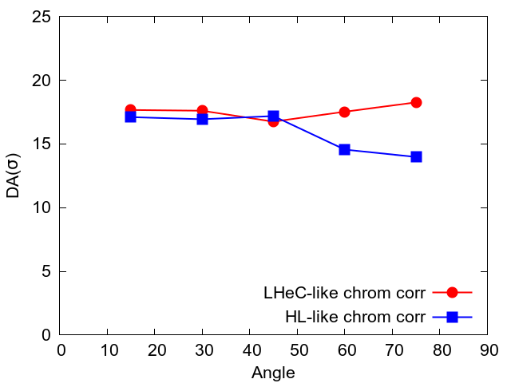
DA studies
  New chromaticity correction.
  Works for more cases (matched for β*=5 cm)
  DA for baseline case L*=10m and β*=10 cm looks worst
Min DA 16.7σ vs 14σ
- Check both options for each case.
- Useful for cases when LHeC correction non-possible

Slide 25
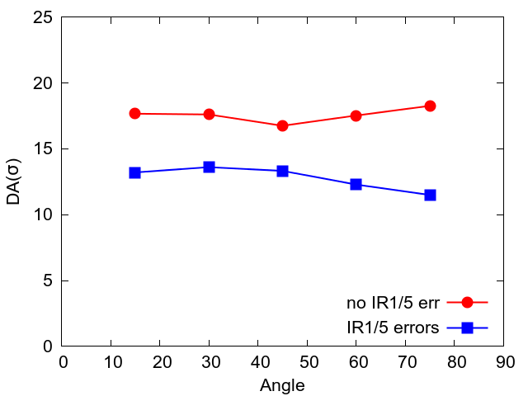
DA studies
  Errors in IR1 and IR5
  Using non-linear correctors in IR1 and IR5.
Min DA 16.7σ vs 11.5σ
Get new values with updated optics.
See how it impacts on L*=15 m. (non-error case) loss of around 1.5σ
Fixing L*=15 m to get results-> This will get updated with new triplet

Slide 26
DA studies
Work for June
- Updated DA for colliding beam 2 L*=15 m, β*=10 cm
- Errors on the triplet IR1/IR5
- Effect of non-linear correctors on DA
- DA for non-colliding beam?
- Alternative options?

