Slide 1
MIXMAX & other RNGs for GeantV
J. Apostolakis (CERN) & S.Y. Jun (Fermilab)
3 July 2018
Conference and Workshop of the MIXMAX Consortium, NCSR Demokritos, 3-4 July 2018
https://indico.cern.ch/event/731433/

Slide 2
HEP experiment simulation
Use Radiation Transport simulation (“Detector Simulation”) for
  design,
  calibration and
  analysis of experiments
Simulation of LHC experiments are large user of computing resources
  ~ 50% of total experiment CPU time (which use 100,000 CPU cores .)
Geant4 is the simulation engine in most recent HEP experiments
  Including ATLAS, CMS and LHCb at LHC
The GeantV Vector prototype investigating potential of computing speed gains using vectorisation & improved use of CPU cache
  GeantV requires vectorised versions of good PRNG engines

Slide 3
Transport Monte Carlo & PRNGs
PRNGs are a key part of Radiation Transport Monte Carlo
For each secondary particle, its properties are sampled from distributions using PRNG outputs (‘variates’)
Typically O(10) variates used for every electromagnetic (EM) physics interaction. More for hadronic interactions.
PRNGs take 2-3% of CPU time, and the goal is to reduce it below 2.0% while using a PRNG with the best statistical properties
The use of PRNGs is relatively ‘robust’ - few of the values are critical
Use of high quality PRNG (within CPU cost ceiling) is necessary to avoid correlations between events, and to avoid very costly re-simulation
Notes:
Robust = many output values are used, with only the ones involving the original or longest lived particles have a very significant impact on the final results of the simulation (the distribution of deposits in different locations / volumes. )

Slide 4
VecRNG and Simulation
Double_v lambda = ..
Double_v step= lamda * Uniform();
Uniform()
A vector PRNG object can be used with vector physics models (or other classes)
In the simple (non-reproducible) mode, a per-thread object is used.
In order to be reproducible, the PRNG state must be owned by a track, and it must be used only for the simulation of that track.
Note: VecRNG is part of VecMath library - based on VecCore vector library
VecMath git repository at https://github.com/root-project/vecmath
States of different instances
of ‘scalar’ generator
Notes:
Double_v energy = tracks.GetEnergy();
Double_v lambda = Lambda( tracks.Get(Energy));
Double_v step= lamda * Uniform();

Slide 5
Geant Vector Prototype & PRNGs
GeantV requires both scalar and vector PRNGs
Some simulation is done in ‘scalar’ mode
Most simulation is done in ‘vector’ mode, with one track in each lane of a (hardware) vector
  E.g. X-coordinate (x0, x1, x2, x3) or energy (e0, e1, e2, e3) of tracks 0, 1, 2 & 3
Needs: ( see full requirements in talk at GeantV community meeting, Oct 2016 )
Create an interface to extend sequential RNGs for vector use
VecRNG is our draft vector PRNG interface
Static polymorphism: methods are not virtual
Multiple outputs expected (one per lane) - from different ‘streams’

Slide 6
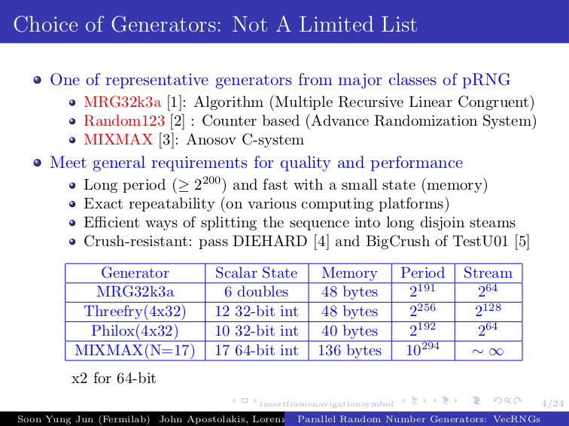

Slide 7
Generators in VecRNG
Implemented already:
MRG32k3a ( 137 ns scalar, 58 ns AVX per output value )
Random123’s ThreeFry ( 74 ns scalar, 43 ns AVX per ouptut value )
Random123’s Philox ( 55 ns scalar, 77 ns AVX per output value )
Underway / planned:
MIXMAX N=17 (and potentially N=8)
Ranlux
Benchmark for 10⁶ values on Intel(R) Xeon(R) CPU E5-2650 v2 @ 2.60GHz (Ivy Bridge). The word size (W) and round (R) used for Random-123 were W4x32 R20 for Threefry and W4x32 R10 for Philox

Slide 8
Needs of “per-track state”
5
3
1
0
2
2
GeantV reproducible mode means per-track ‘owned’ PRNG object/state
Requirement(s) / constraints
  Keep the same interface when moving to reproducible mode (as much as possible.)
  Ensure that after its use, the per-track PRNG’s state is correctly updated
Constraints
  Speed - as low overhead as possible compared with ‘simpler’ VectorRNG use
  Each PRNG state will be at a different offset/location in its output (eg MIXMAX, RANLUX) because its track had a different history, and number of variates used.
  Avoid copying of significant amount of data
11
15
RNG offset in state
Track slot

Slide 9
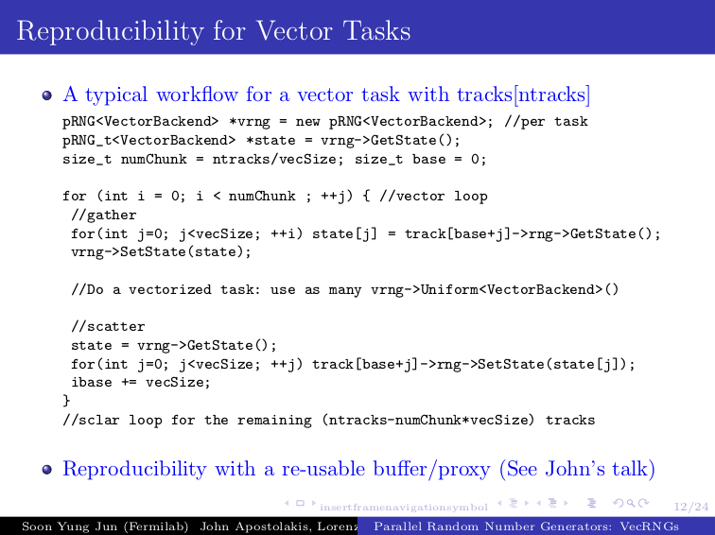

Slide 10
VecRNG Proxy Design/Interface
New approach: create a ‘proxy’ object that appears like a vector-RNG object
  The proxy will provide all the methods of VecRNG object
Constructor VecRNGproxy( prngState* trackPrng[VecLen], numVariatesExpected ) takes
  a set of RNG states (corresponding to the tracks in the lanes)
  the expected number of outputs (variates)
Destructor ensures that per-track RNG objects are correctly updated
Its implementation will hide the complexity of the previous page code into the proxy RNG class

Slide 11
Newest results / ongoing
First Proxy implementation ‘JoiningProxyMRG32k3a” copying state of MRG32k3a
Initial benchmarks:
overhead of copying requires about 10 output values per stream to compensate cost of copying state (in and out) of proxy
Investigating vectorisation of ‘partial sum’ operation
Key operation for MIXMAX generator

Slide 12
Summary / next steps
Design of vector RNG interface
First t of vector RNGs using MRG32k3a and Random123
Per-track state of generator will be used for reproducible simulation.
First implementation to adapt VecRNG generators
Next steps:
Full performance evaluation, used with vectorised EM physics models.
Vector extension to MIXMAX
Investigation of ‘pinning’ events to threads - can be fully repeatable with simple RNG state (1 vector + 1 scalar) and thus reproducible without per-track state.

Slide 13
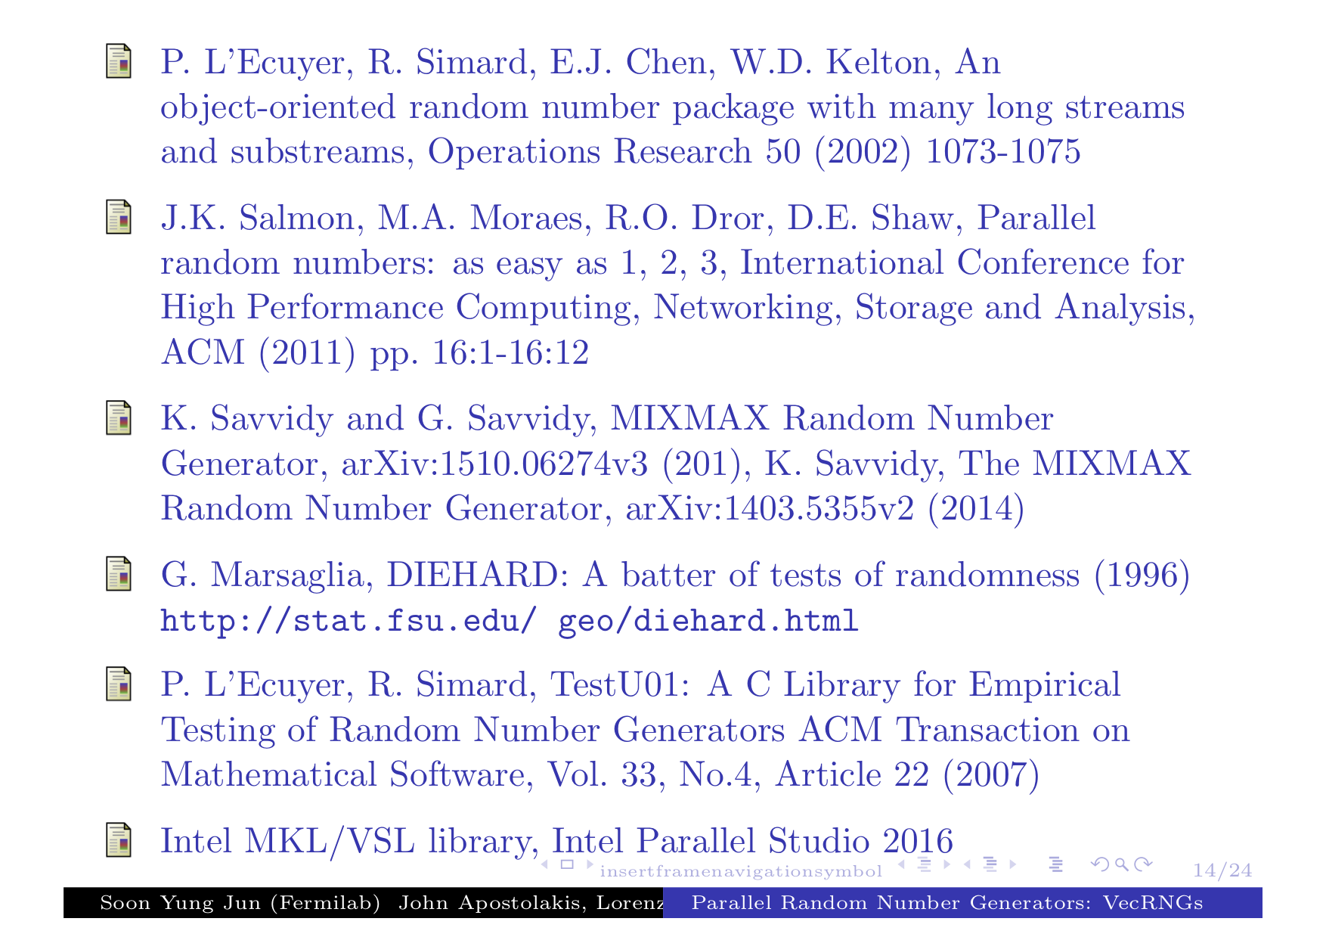
References
1.
2.
3.
4.
5.

Slide 14
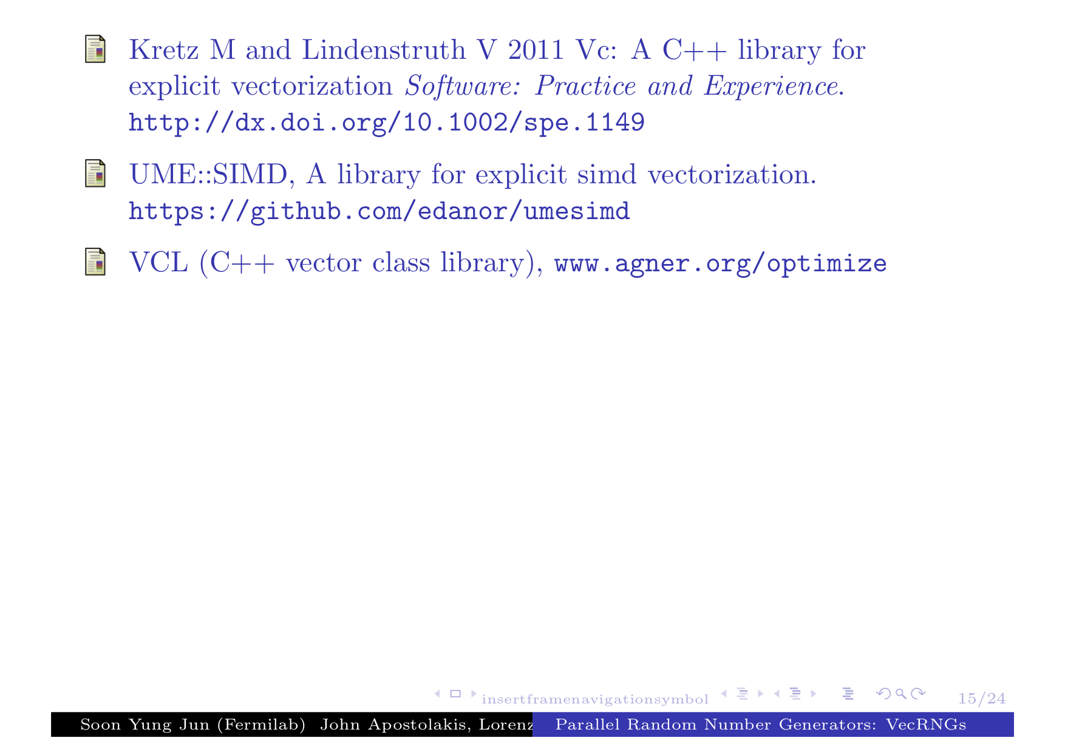
6.
7.
8.

Slide 15
Reproducibility & use of RNG
To ensure reproducibility the number of PRNG output values (variates) consumed in a method must be constant.
It must NOT depend on whether scalar or vector call is made,
It must NOT depend on what happens to tracks in other vector lanes.
All algorithms that consume PRNG variates must ensure that the number of variates consumed depends only on the values of the track itself and the PRNG output values.
So if there are variations in ‘consumption’, it seems that one of two strategies must be used:
To consume exactly as many as necessary for every track.
To “normalize” the number of PRNG variates to be the equal to a fixed maximum (potentially wasteful.)

