Slide 1
Overview of the modular DAQ hardware designed for beam tests of the HGCAL prototype
Rajdeep M Chatterjee
University of Minnesota, USA
On behalf of the CMS collaboration
7th Beam Telescopes and Test Beams Workshop, CERN, Geneva
14-18 January 2019

Slide 2
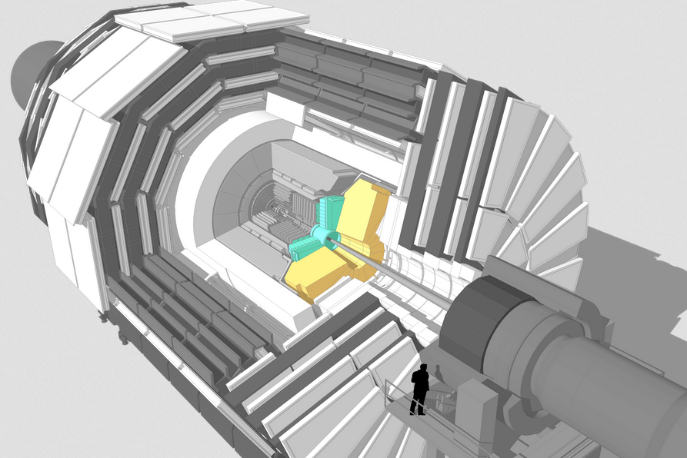
Upgrades to CMS calorimeters for HL-LHC
Barrel EM calorimeter
Replace FE/BE electronics
Lower operating temperature(8ºC)
Replace endcap calorimeters
Radiation tolerant – high granularity
Mitigate pileup – 3D tracking , timing
The endcap calorimeters need replacement as they will not
support the doses and fluences at the HL-LHC.

Slide 3
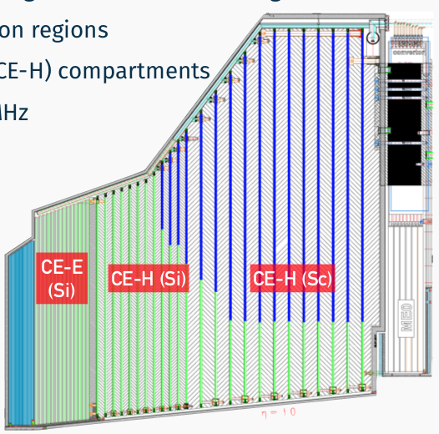
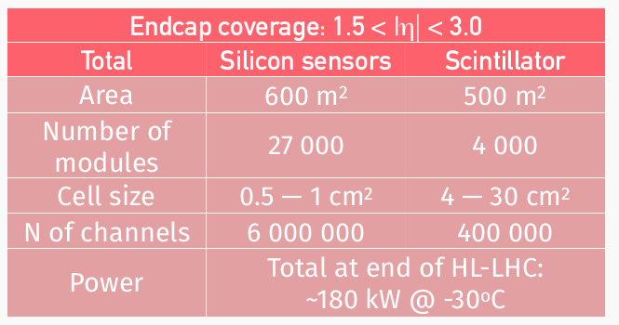
The CMS upgrade endcap calorimeter: Design
  The current endcap calorimeters will be replaced with a new High Granularity Calorimeter(HGCAL) for operations at the HL-LHC
  Active Elements:
  Silicon(Scintillator) detectors in the high(low) radiation regions.
  “Cassettes”: multiple modules mounted on cooling plates with electronics and absorbers.
  28 layers in the ECAL (CE-E) + 24 layers in the HCAL (CE-H) compartments.
Key Parameters:
    See F. Simon’s slides for details.

Slide 4
BEAM TESTS

Slide 5
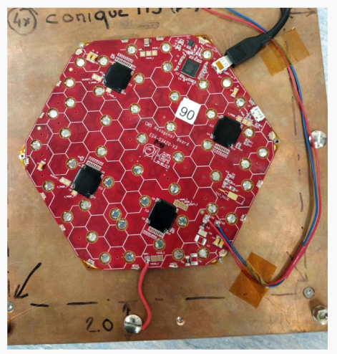
Why beam tests
Several beam tests performed since 2016 with the following goals:-
Test the proof of concept of the baseline design with a closely spaced stack-up of modules.
Validate the design of compact detector modules.
First experience with a FE ASIC including the 3 basic components of the future HGROC.
  An ADC(with two gains) for small pulses.
  A ToT for large pulses.
  A precise measurement of the pulse timing ( target ~ 50 ps for large S/N).
Calorimetric performance of electromagnetic and hadronic sections.
Validation of MC simulation.
6’’ Si prototype Module

Slide 6
History of HGCAL beam tests
  2016(CERN/Fermilab)
  Silicon: Up to 16 modules in CE-E layers.
    Results summarized in the publication JINST 13(2018) P10023 .
2017(CERN)
  Silicon: 20 modules in CE-E & CE-H layers with Skiroc2-CMS* ASIC | Scintillator: CALICE AHCAL.
    New beam test DAQ.
  March 2018(DESY)
  Silicon: Studies of single module response
  June 2018(CERN)
  Silicon: Full CE-E depth prototype with 28 modules.
  October 2018(CERN)
  Silicon: Up to 94 modules| Scintillator: CALICE AHCAL
    Final major beam test before LS2.
  * a special adaptation of a CALICE-developed chip to CMS read-out, in non-rad-hard technology

Slide 7
The data to be readout
6’’ Si prototype Module
Each prototype module has 256 channels readout by 4 ASICs(Skiroc2-CMS).
Per trigger the ASIC generates 1924 16-bit words.
  For each channel 11 time samples in High and Low gain ADC. Additionally ToT and ToA.
The local readout of these ASICs was controlled by a MAX10(Altera) FPGA.
Signals from the MAX10 FPGAs were transmitted to a modular off-detector DAQ.
MAX10
ASIC
ASIC
ASIC
ASIC
HEXABOARD

Slide 8
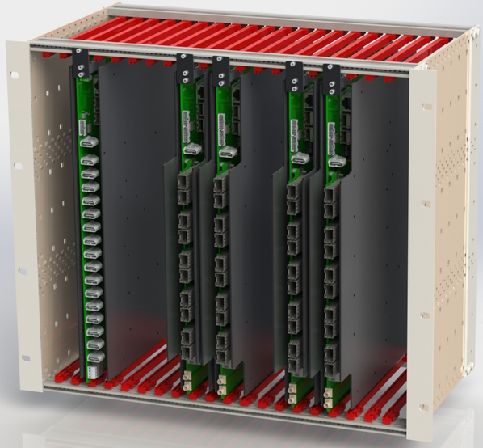
DAQ system for HGCAL protoype: Overview
DAQ CRATE
HGCAL Modules
…
HDMI cable ~2m (signal & LV)
AWG28 or 26
Cable Interposers
…
Cable Interposers
…
The DAQ was designed to be scalable, using readily available components, mounted on custom PCBs:-
The basic repeating unit of the DAQ is a RDOUT Board(4 shown).
  Each RDOUT board can read/control up to 8 detector modules.
A SYNCH board(extreme left) ensures we have a synchronized readout from the multiple RDOUT boards.
  Enables interfacing the HGCAL prototype with other detectors.
A system host(PC) running EUDAQ controls the overall DAQ operations.
Ethernet cables
Ethernet cables
…
Network
Switch
To other RDOUT Boards, AHCAL, …
RAID
For temporary data storage
PC
To EOS
10 Gbps
DQM

Slide 9
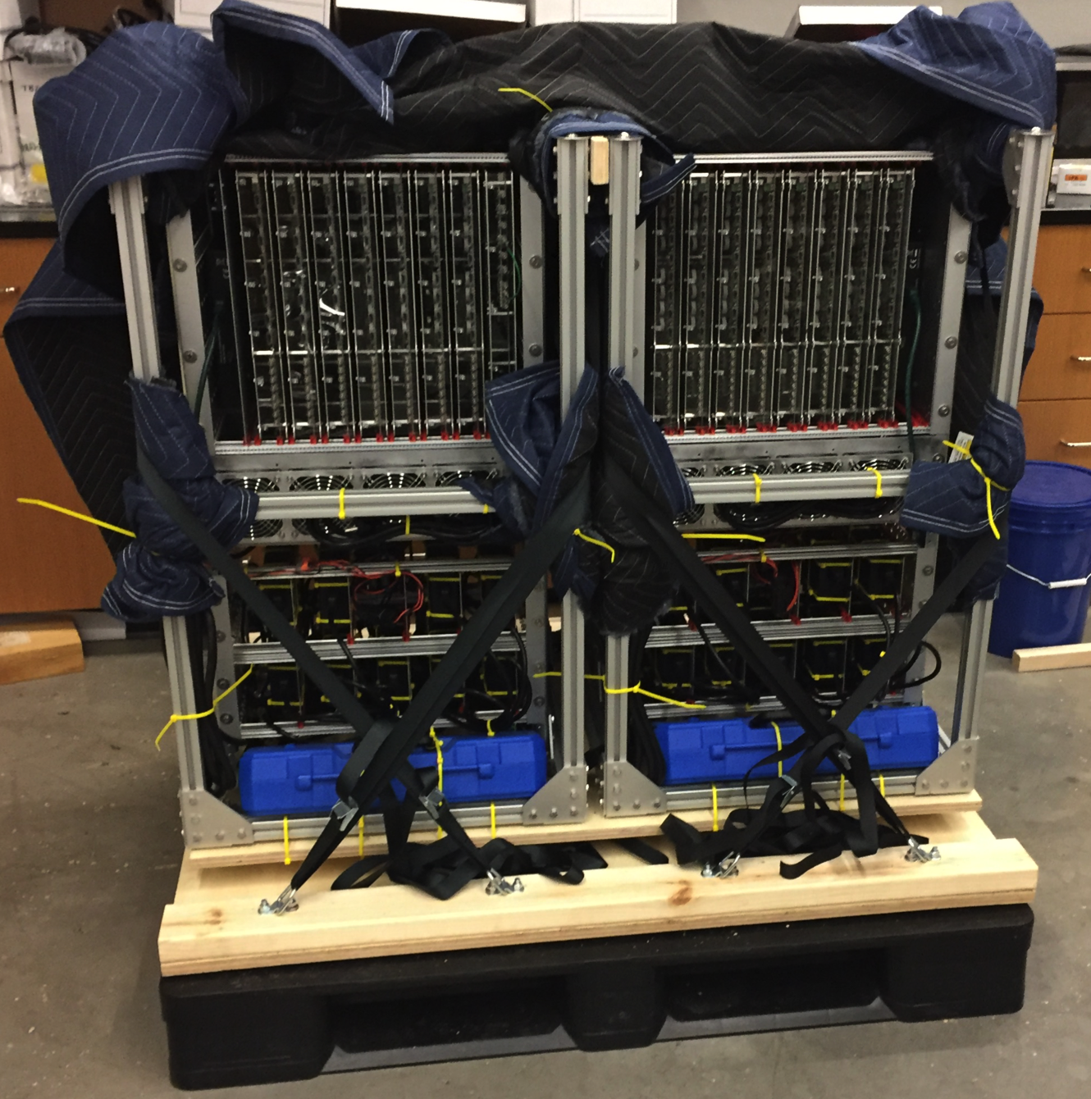
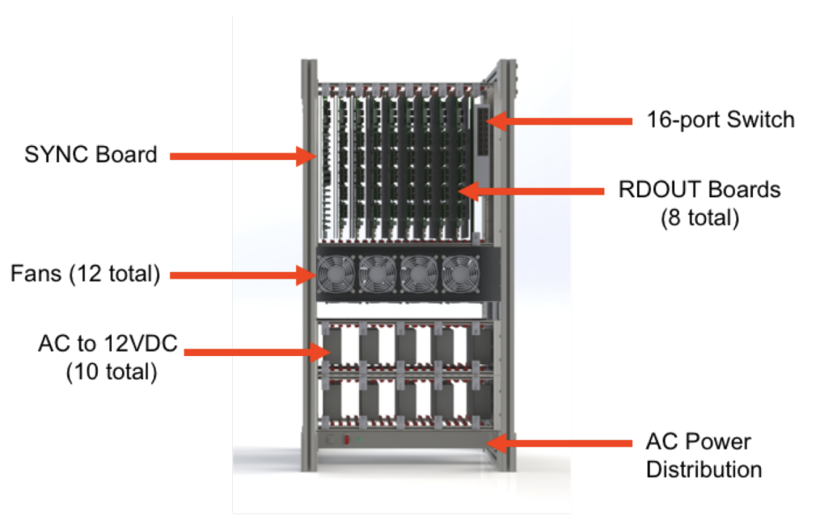
DAQ system for HGCAL protoype: Mechanics
The DAQ mechanics is modular and scalable.
For the October, 2018 beam tests the DAQ comprised of 2 crates.
  14 RDOUT boards and 1 SYNCH board.

Slide 10
Key components of the DAQ

Slide 11
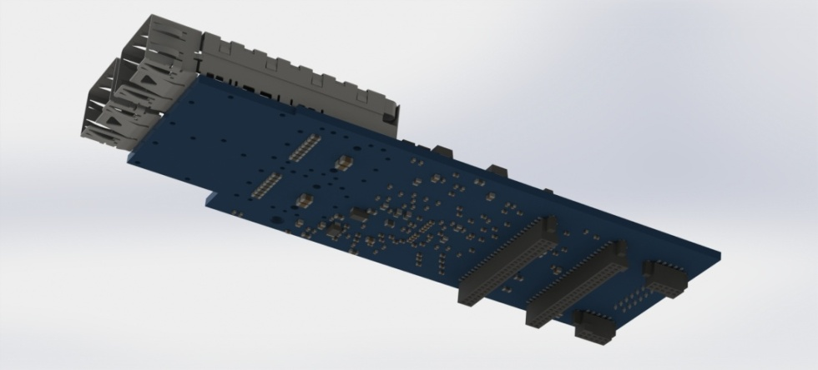
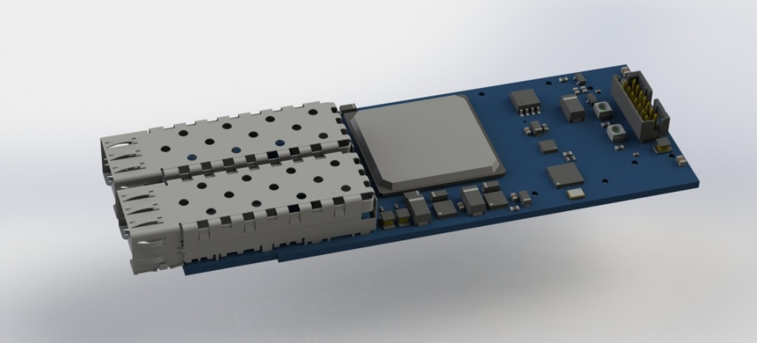
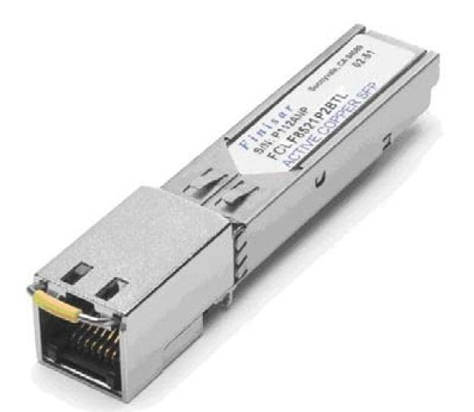
CMS optical Readout Module(oRM)
A common FPGA, “Optical Receiver Module”(oRM), was used in both the RDOUT and the SYNCH boards. These were previously used in the CMS trigger and had outlived their lifetime. Hence they were available at no cost!
Xilinx Kintex-7 XC7K70T-1FBG676C
  4.8 Mbits of block RAM
  Two 6.6 Gbps bidirectional serial ports
  128Mbit FLASH memory for configuration
The relevant firmware was written in Verilog.
SFP to RJ-45 Adapter for direct connection from FPGA to GbE Switch.

Slide 12
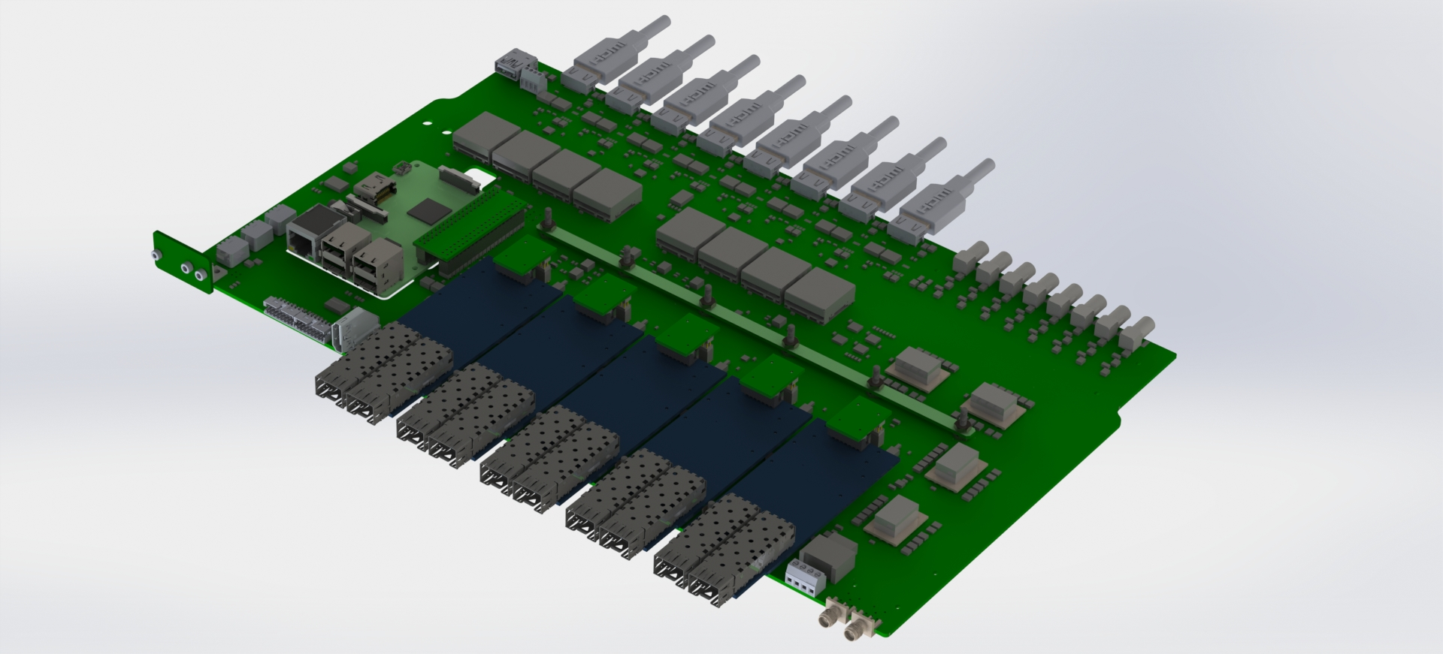
RDOUT Board layout
HDMI Cables to 8 Hexaboards
9U x 220mm PCB form factor
8 High Voltage Fanout
Connectors with filters
to 8 Hexaboards
Raspberry
Pi3 CPU
HDMI connector to
SYNC_ORM board
oRM mezzanine for
control and interface
4 oRM mezzanines
Replaceable fuse
Low Voltage Input
2 High Voltage
Input connectors

Slide 13
RDOUT Board
Each readout board hosts 5 oRMs.
  4 “Data” oRMs read the data from up to 8 detector modules.
  The 5th oRM controls the readout sequence, and “packs” the data from the Data oRMs
    It is interfaced to the system host using the IPBUS protocol.
A RPi, connected to the system host via ethernet, configures the ASICs on the HGCAL modules and also performs the slow control.
  On completion of the readout after receiving a trigger a “readout done” signal is sent to the SYNCH board by the RPi.
  The RPi can optionally perform the full readout operation at a slow rate(~ 1 Hz).
The RDOUT board also distributes the low and bias voltages to the detector modules connected to it.
100 MbE
Ras. Pi3
SPI
TRIG, CLK
SYNC
8 GPIO
CTL oRM
GbE
Data oRM
HDMI_0 … HDMI_7
4
Data oRM
4
Data oRM
4
Data oRM
Bias Voltage FANOUT
Bias Voltage IN
4

Slide 14
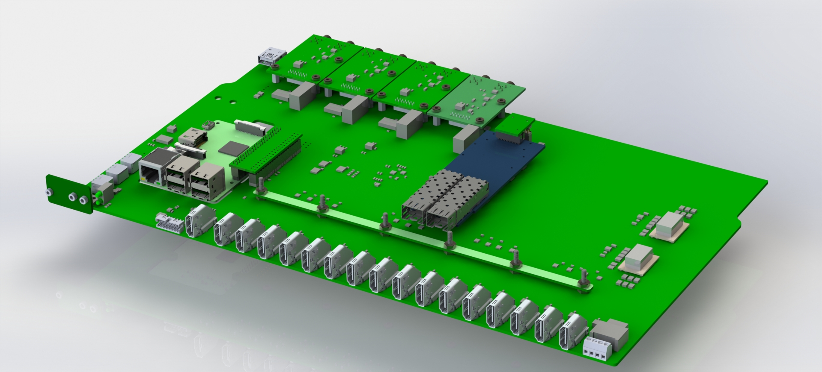
SYNCH Board layout
3 generic Input / Output
connector mezzanines
9U x 220mm PCB form factor
Mezzanine receives
CLEAR and TRIGGER.
Generates 40MHz.
Raspberry
Pi3 CPU
HDMI connector to
SYNC_ORM board
16 HDMI connectors to
the RDOUT_ORM boards
oRM mezzanine for
synchronization logic
Low Voltage input
Replaceable fuse

Slide 15
SYNCH Board
Multiple RDOUT boards are operated in synchronization with the help of the SYNCH board, which hosts one RPi and one oRM.
The SYNCH board forwards a copy of the trigger to all sub-detectors that are being operated together(RDOUT boards, DWCs and AHCAL).
The SYNCH board distributes the 40 MHz system clock to the RDOUT boards.
It receives a “readout done” signal from each of the RDOUT boards.
While operating jointly with the AHCAL it received a veto from it.
100 MbE
Ras Pi3
SPI
CTL oRM
MISC_IN_A
MISC_OUT_A
MISC_IN_B
MISC_OUT_B
Fanout
ENABLE
BUSY
16 HDMI Connectors to
16 RDOUT_ORM Boards
CLEAR
TRIGGER
40MHz
40MHz

Slide 16
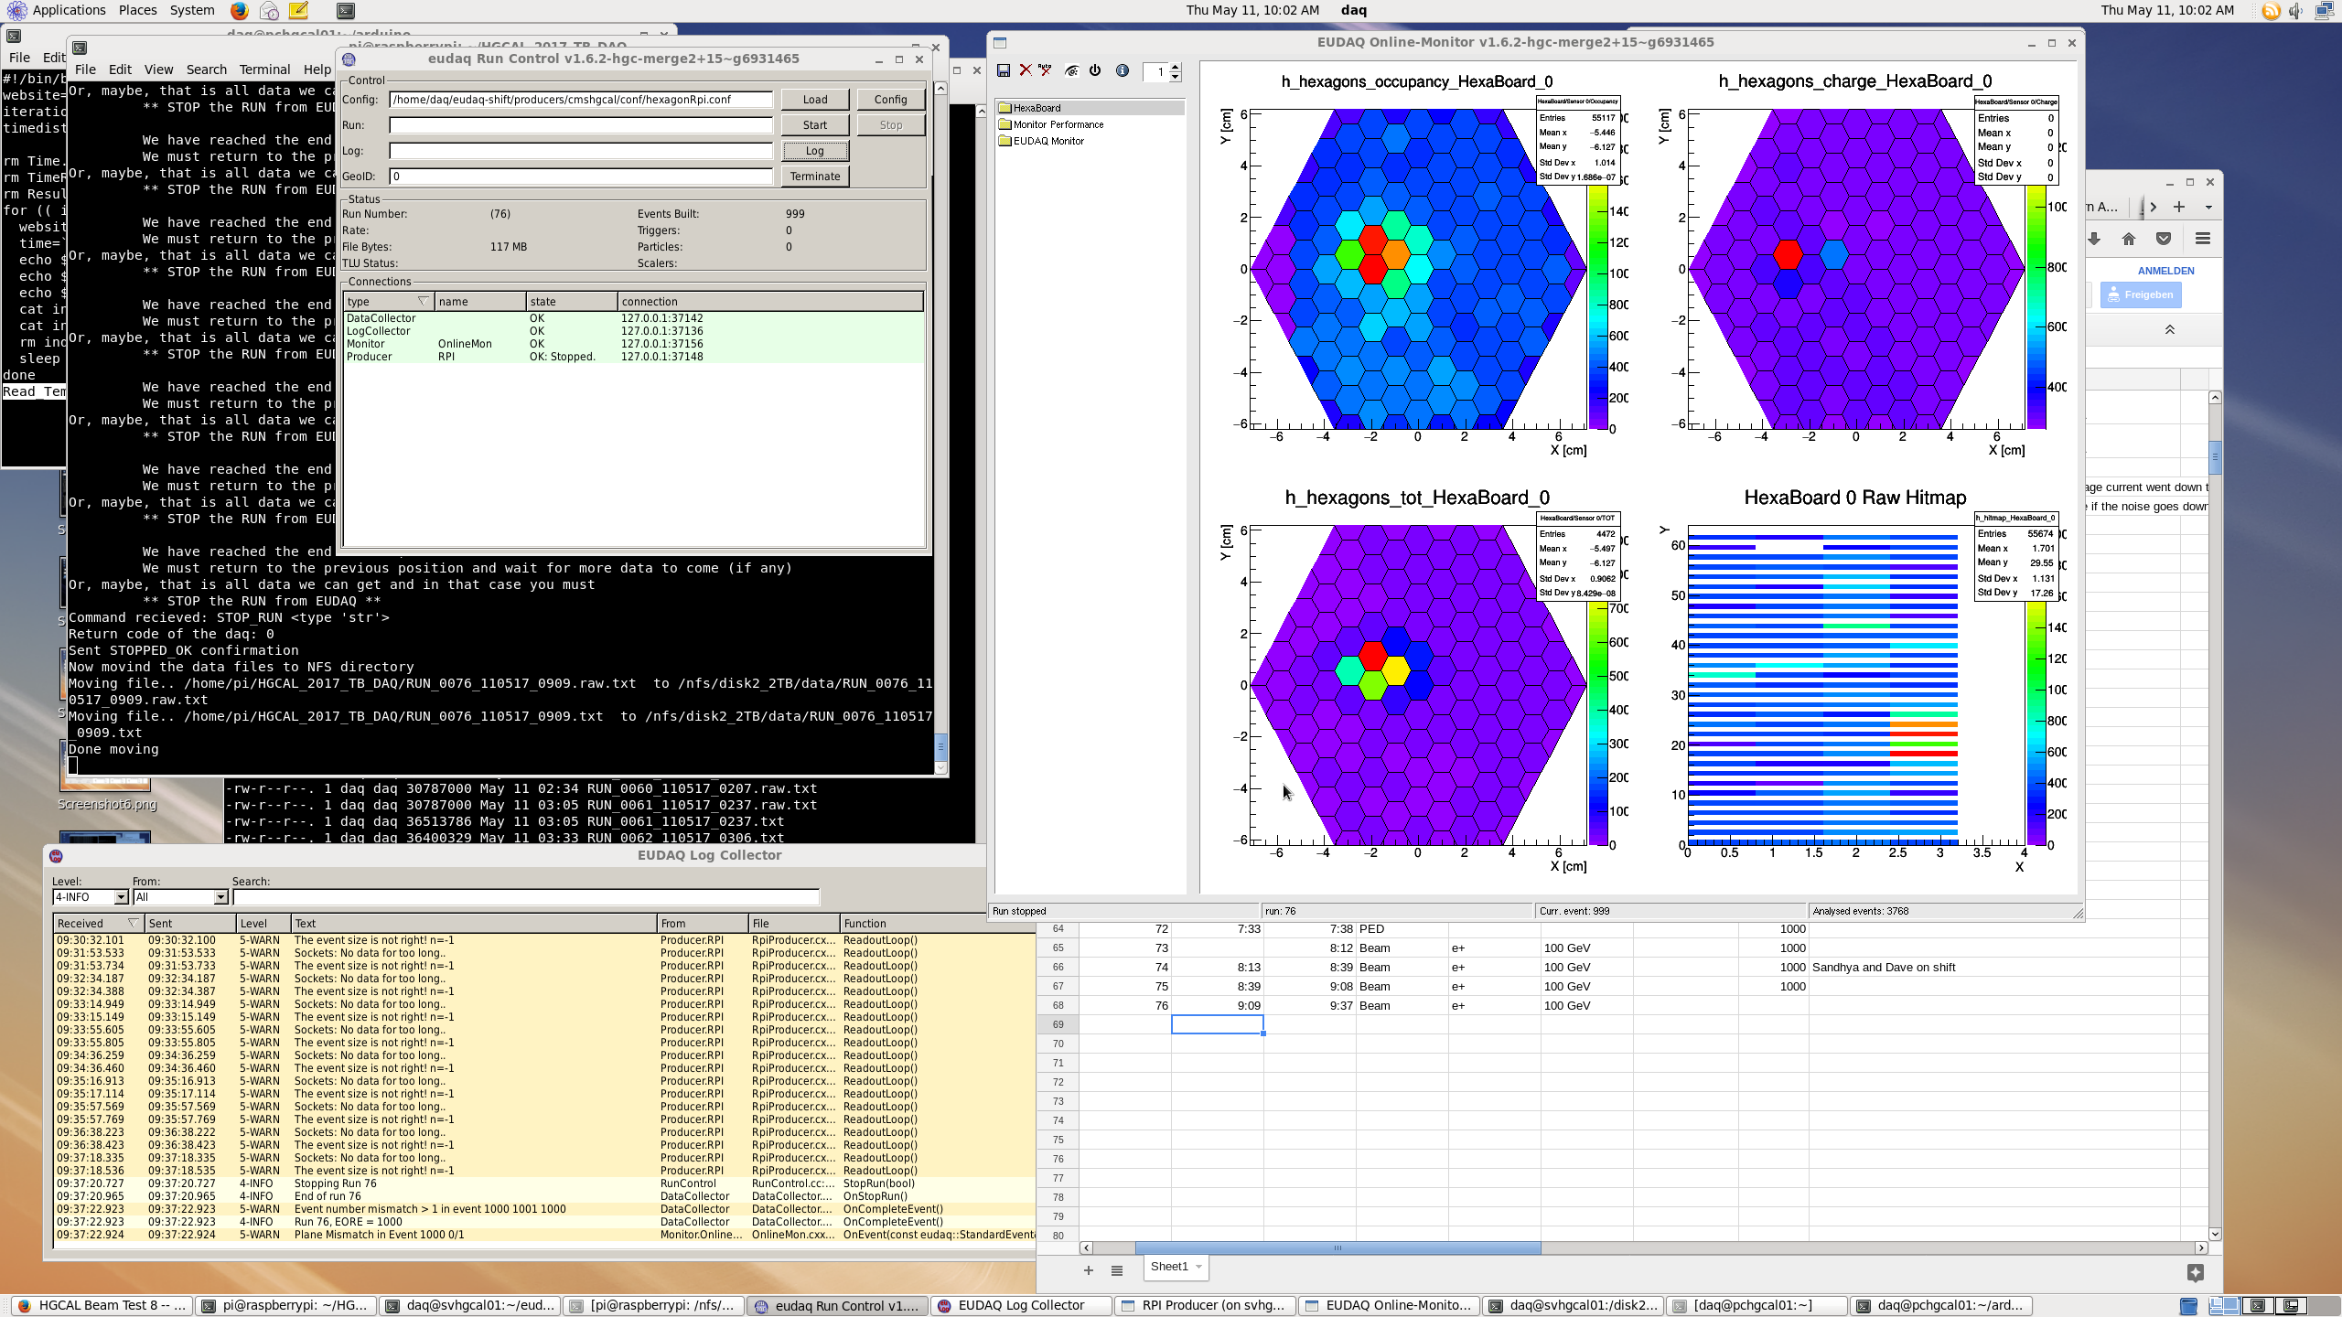
System host and DAQ software
The system host performs the overall run control, data readout, data storage and DQM.
The HGCAL DAQ software was developed in the EUDAQ framework.
  Ensures all DAQ software(AHCAL DAQ, HGCAL with IPBUS, VME modules and their optical readout) are centralized in the same framework.
  Enables a common DQM.

Slide 17
DAQ operations: scalability, throughput
The DAQ is easily scalable.
  Operated with 1 detector module(256 channels) in DESY to 94 detector modules(24k channels) readout by 14 RDOUT boards in CERN!
The DAQ design allows for up to 12 groups of RDOUT boards, each under the control of one SYNCH board, to be controlled by a master SYNCH board.
The SYNCH board enables other detectors to be interfaced for joint data taking.
  The HGCAL prototype has been operated jointly with delay wire chambers, a beam telescope, MCPs, Cerenkov detectors and the CALICE AHCAL(See T. Quast’s slides for more details).
The DAQ was operated at readout rate of 40 Hz.
  Possible to improve it further to ~100 Hz.
At this rate the amount of data readout for a typical 5 sec SPS spill for the HGCAL(EE+FH) was 300 Mb.
  ~16 Kb per module per trigger; ~ 1.5 Mb for 94 modules per trigger.
In future the use of this DAQ can be extended for any system with the order of 20k channels, where the signal from on-detector modules are transmitted on HDMI cables and the readout rate is < 100 Hz.

Slide 18
Data collected
  6 million events accumulated in multiple detector configurations over 2 weeks.
    Wide range of energies for electrons and pions from 20-300 GeV.

Slide 19
Summary
The current DAQ for the HGCAL beam test prototype has been operational since 2017.
In the latest beam tests held in CERN in October 2018, a total of 94 detector modules were readout.
Other detectors can be interfaced with this DAQ for joint data taking.
In future the use of this DAQ can be extended to readout any system where the on-detector signal can be transmitted via HDMI.

Slide 20
BACKUP

Slide 21
The HGCAL consists of a Si sampling calorimeter
WHY Silicon ?
Extensive R&D, for the Tracker and Pixel detectors over the last 20 years have led to the development of Si sensors that can sustain the high radiation levels of the HL-LHC
  Fluence at |η| = 3 in HGCAL ~ same as inner pixel layer in CMS during HL-LHC.
  Radiation effects are well understood and reproducible. Can be mitigated by low T operation.
Fast signal collection(< 10ns) and fast timing capability(~15 ps).
High granularity with fast timing, enables 3D tracking which helps mitigate pileup effects(<pileup> ~140 at a luminosity of 5*10³⁴ Hz/cm²).
Affordable cost.
Electronics in 130/65 nm allows low noise and low power readout Front-End(10-15 mW per channel).

Slide 22
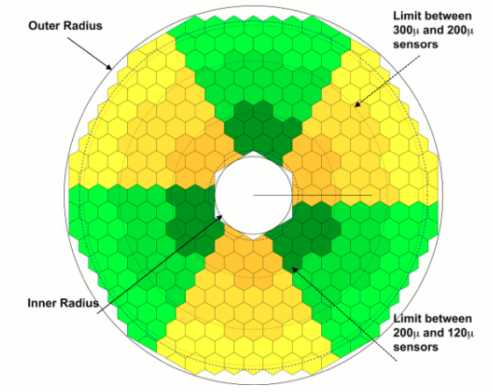
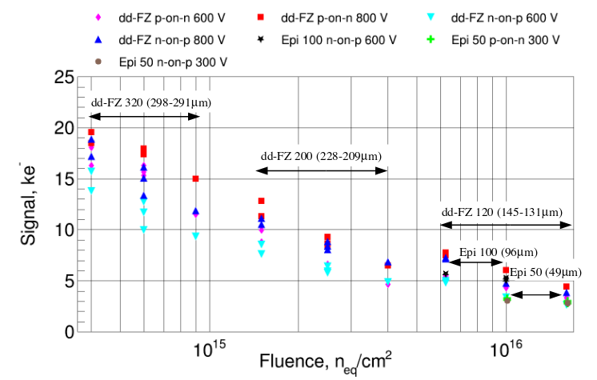
Si sensors for HGCAL
8’’ hexagonal silicon sensors p/n-type | 192/432 cells .
At higher radiation levels its beneficial to use thinner sensors. E-field higher for the same bias.
Higher η region: Sensors with 120 μm depletion depth.
Lower η region: 200 μm & 300 μm
Cell size ~ 1 cm² for 200 μm & 300 μm depletion sensors.
~ 0.5 cm² for 120 μm depletion sensors.
Cell size reduction to maintain moderate capacitance(< 50 pF).

Slide 23
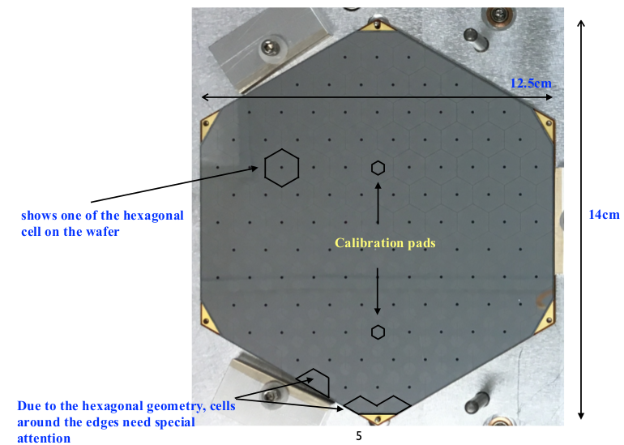
128 channel Si sensor for beam tests
“p-on-n” with 200/300 μm depletion thickness, made from 6” wafers, Cell size ~ 1 cm²

Slide 24
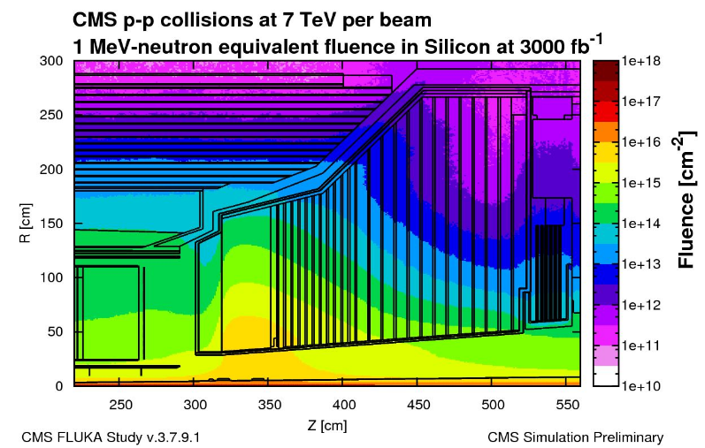
HL-LHC radiation environment
Si sensors in the higher
radiation parts of CE-E and CE-H
Scintillator in the lower
radiation parts of CE-H
CE-H
CE-E
10¹⁶ n/cm²

Slide 25
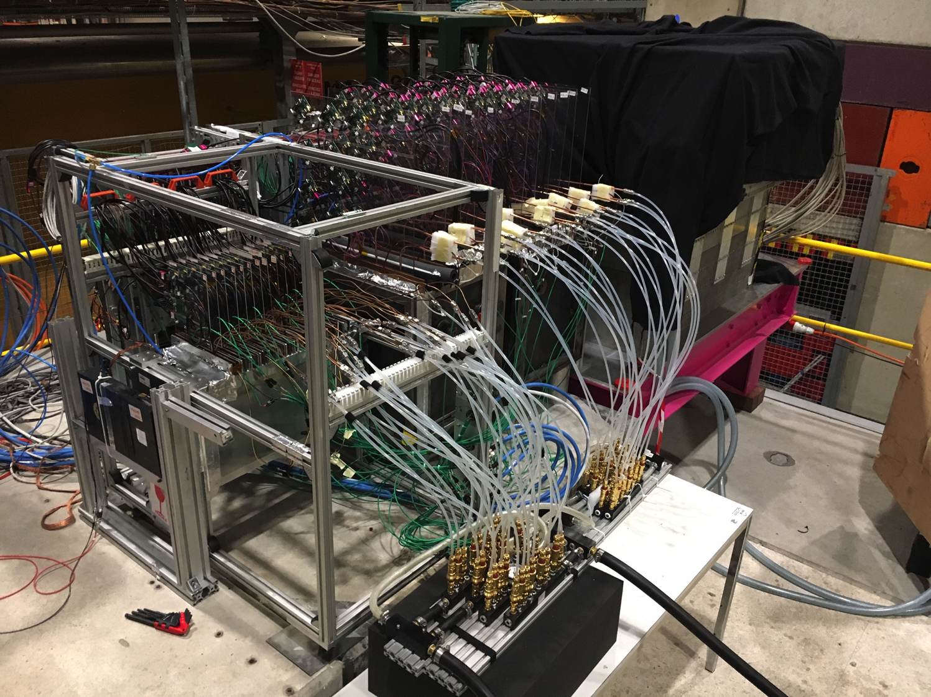
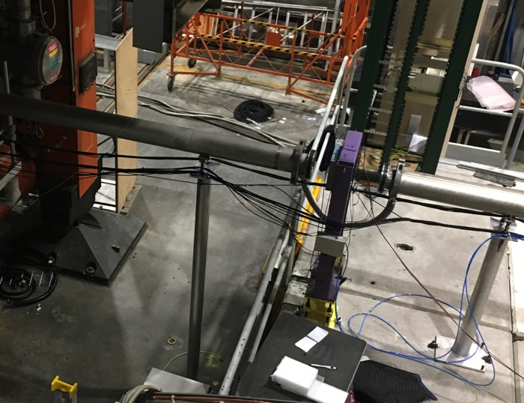
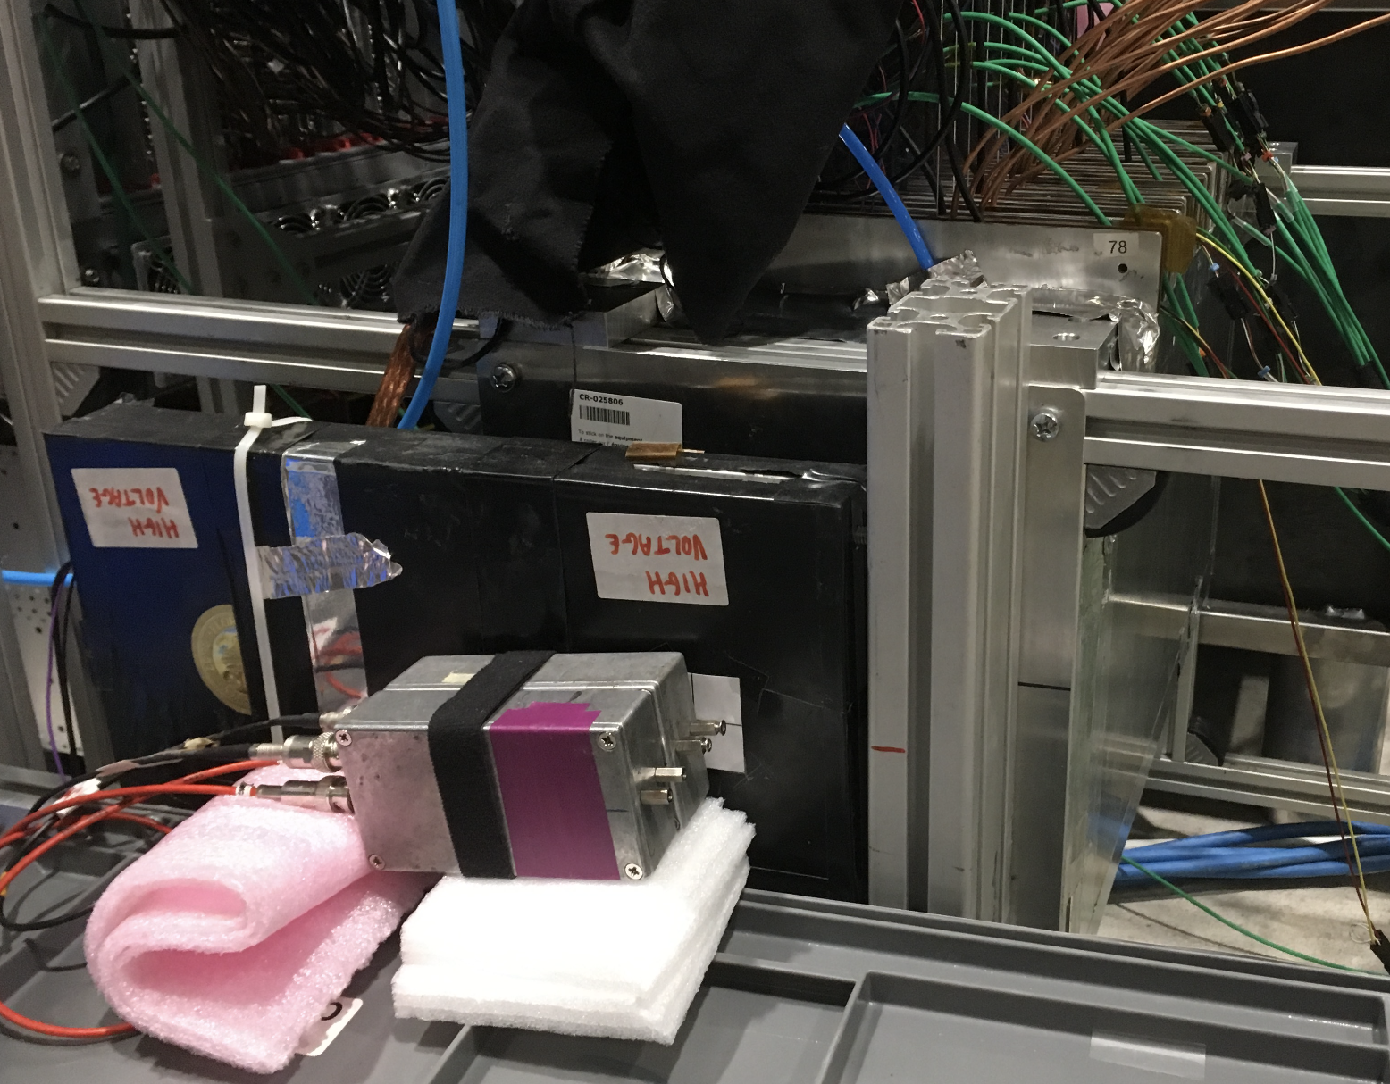
HGCAL October, 2018 beam test setup
CE-E CE-H AHCAL
HGCAL: silicon CE-(E) and CE-(H) with 94 modules, up to 40 layers.
AHCAL: SiPM-on-scintillator tile in 39 layers.
Delay wire chambers for tracking.
Cerenkov counters for π/p ID.
MCP-PMT: Timing ref. (σ ~ 30ps).
DWC
2 MCP-PMT

Slide 26
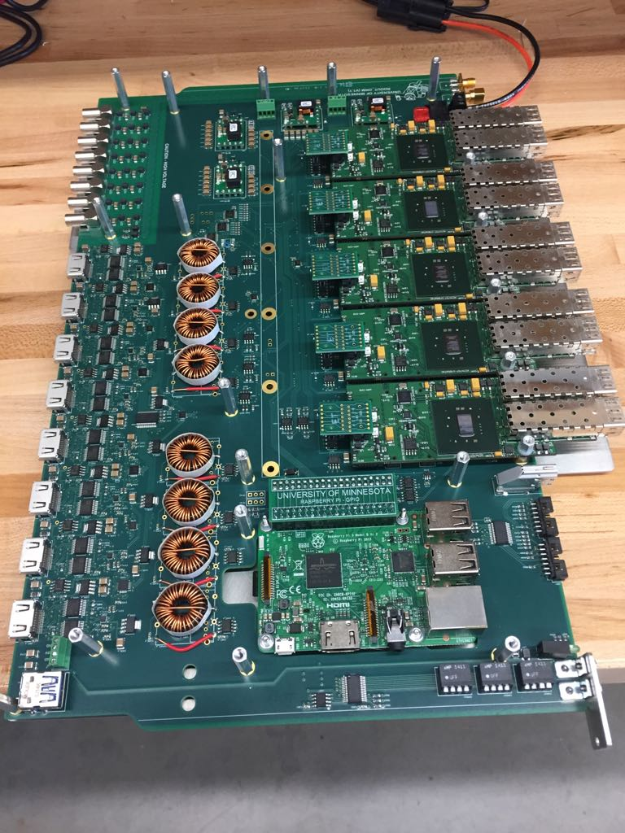
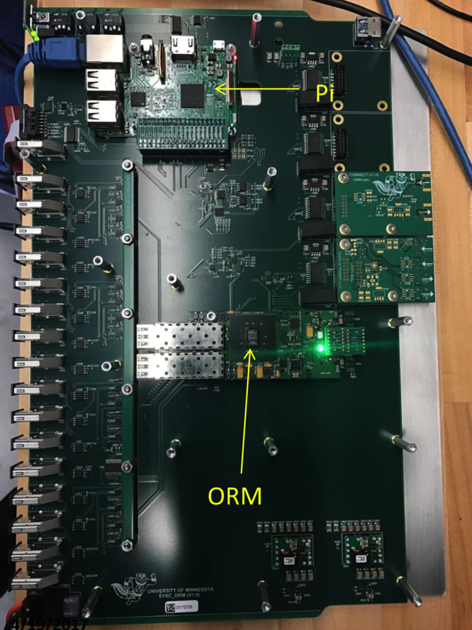
RDOUT and SYNCH Board
Pi
Control
oRM
Data
oRMs

