Slide 1



Microwave undulator
Liang Zhang, Wenlong He and Adrian Cross
Department of Physics, SUPA, University of Strathclyde,
Glasgow, UK
27 June 2018, University of Strathclyde
ABP

Slide 2
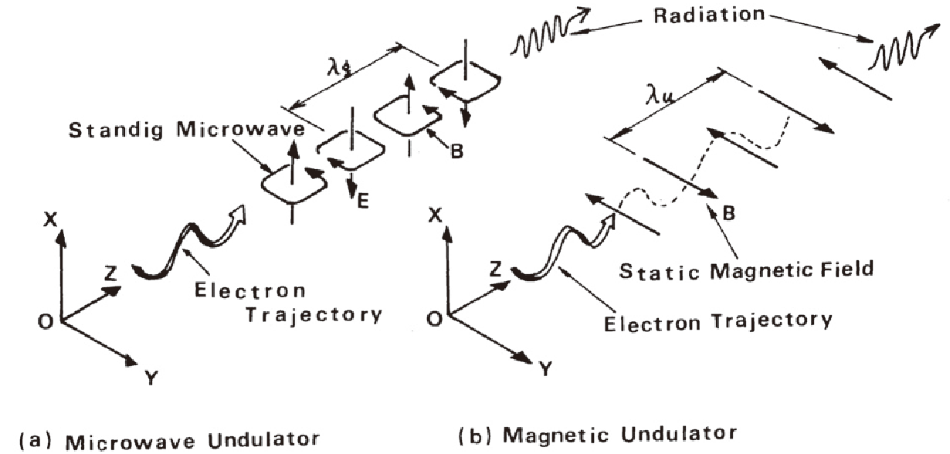

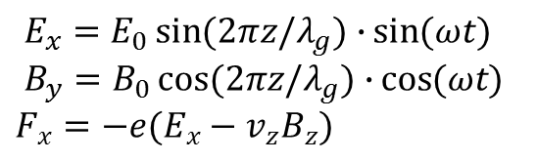
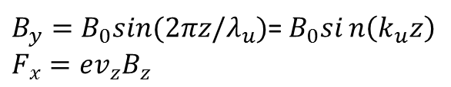
Microwave undulator
$E_{x}=E_{0}\sin{(2πz/λ_{g})∙}\sin{(ωt)}$
$B_{y}=B_{0}\cos{(2πz/λ_{g})∙}\cos{(ωt)}$
$F_{x}=−e(E_{x}−v_{z}B_{z})$
$B_{y}=B_{0}sin⁡(2πz/λ_{u})$=$B_{0}sin\left(k_{u}z\right)$
$F_{x}=ev_{z}B_{z}$
In microwave undulator, the electron bunch see both the electric field and magnetic field.
Figure source: T. Shintake, Development of Microwave Undulator, 1983

Slide 3

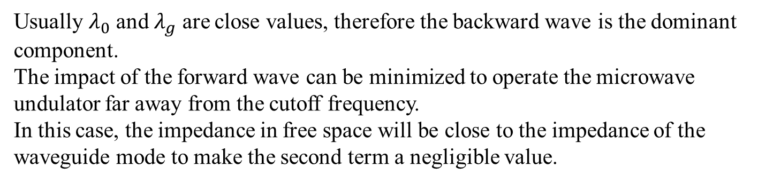
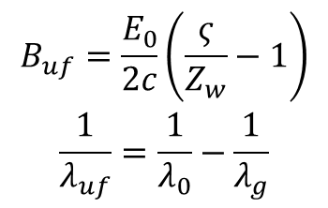
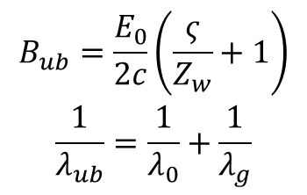
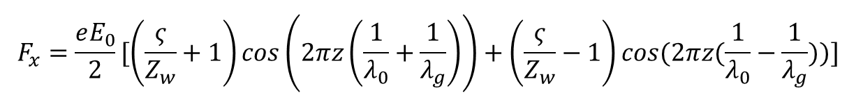
Principle
Rewrite the force in microwave undulator as
$$F_{x}=\frac{eE_{0}}{2}[\left(\frac{ς}{Z_{w}}+1\right)\cos\left(2πz\left(\frac{1}{λ_{0}}+\frac{1}{λ_{g}}\right)\right)+\left(\frac{ς}{Z_{w}}−1\right)\cos{(2πz(\frac{1}{λ_{0}}−\frac{1}{λ_{g}})})]$$
And compare its form for the case of a magnet undulator
$$F_{x}=ecB_{u}cos(2πz/λ_{u})$$
$$\begin{matrix}B_{ub}=\frac{E_{0}}{2c}\left(\frac{ς}{Z_{w}}+1\right) \\ \frac{1}{λ_{ub}}=\frac{1}{λ_{0}}+\frac{1}{λ_{g}}\end{matrix}$$
$$\begin{matrix}B_{uf}=\frac{E_{0}}{2c}\left(\frac{ς}{Z_{w}}−1\right) \\ \frac{1}{λ_{uf}}=\frac{1}{λ_{0}}−\frac{1}{λ_{g}}\end{matrix}$$
Can achieve short wavelength.
Usually $λ_{0}$ and $λ_{g}$ are close values, therefore the backward wave is the dominant component.
The impact of the forward wave can be minimized to operate the microwave undulator far away from the cutoff frequency.
In this case, the impedance in free space will be close to the impedance of the waveguide mode to make the second term a negligible value.

Slide 4
Advantages
Desire features
  Fast dynamic control of polarization
  Easy to control the field strength by adjusting the input power
  Short wavelength
  Large aperture (cm vs mm)
  Less possibility of damage by radiation as compared with the use of permanent magnets

Slide 5
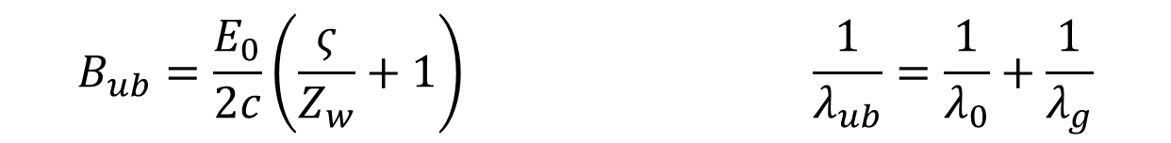
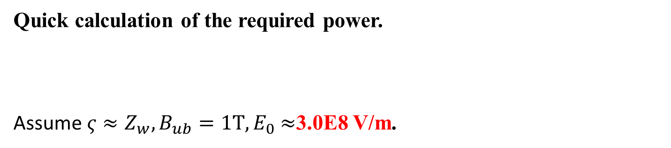
Disadvantage
Quick calculation of the required power.
Assume ${ς≈Z_{w}, B}_{ub}=1T, E_{0}$ $≈$3.0E8 V/m.
$$B_{ub}=\frac{E_{0}}{2c}\left(\frac{ς}{Z_{w}}+1\right) \frac{1}{λ_{ub}}=\frac{1}{λ_{0}}+\frac{1}{λ_{g}}$$
In a standard rectangular waveguide with a TE10 mode, the required power flow at different operating frequencies are:
Waveguide type | Operating frequency | Required power
WR62 (15.799 mm * 7.899 mm) | 12 GHz | 4.5 GW
WR28 (7.112 mm * 3.556 mm) | 36 GHz | 1.22 GW
WR10 (2.54 mm * 1.27 mm) | 96 GHz | 0.152 GW
Need very large microwave power.

Slide 6
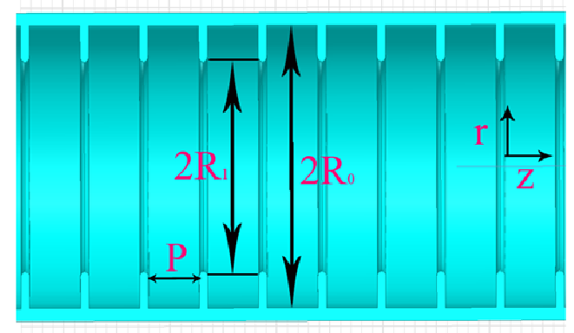
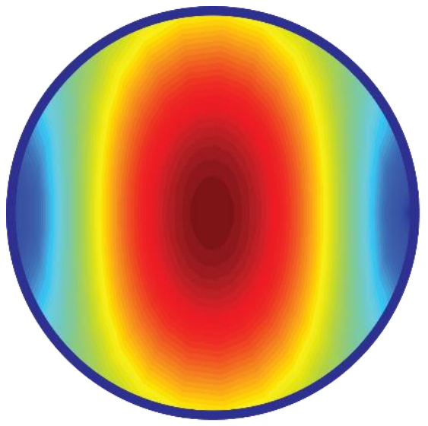
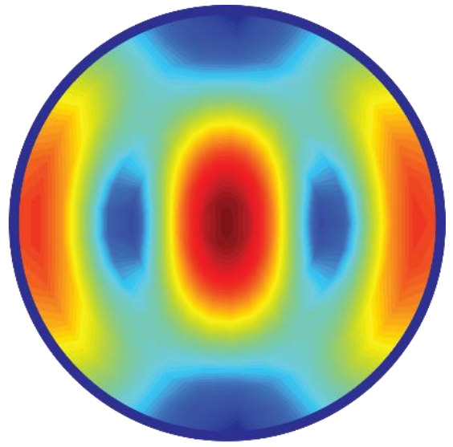
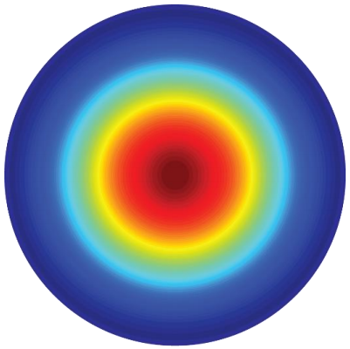
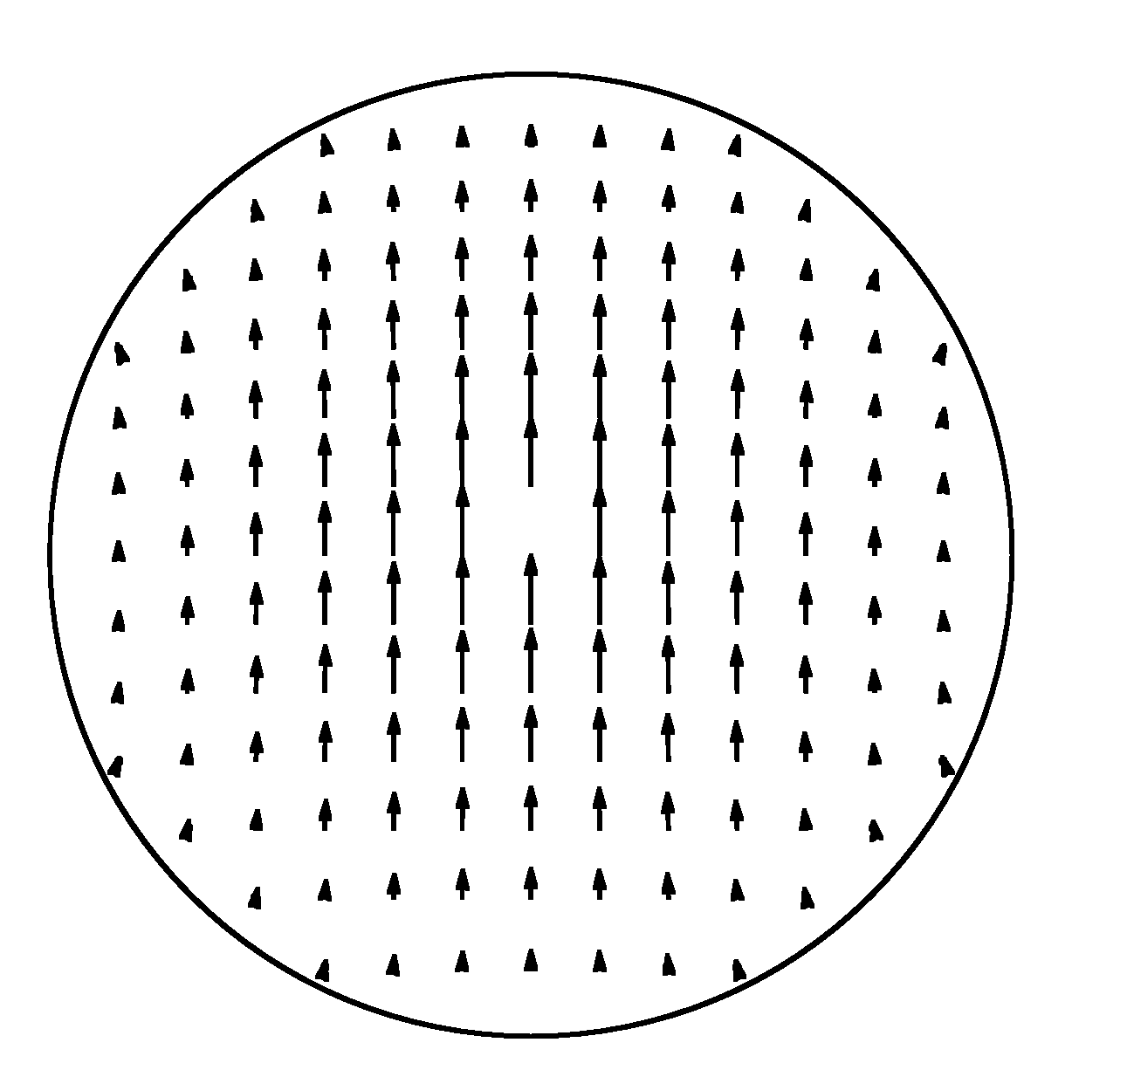
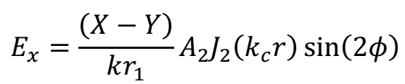
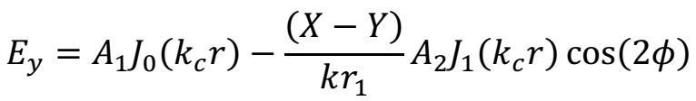
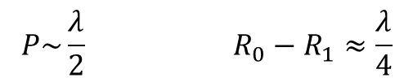
Hybrid modes – HEn modes
A corrugated waveguide has interesting feature of being able to generate a quasi-optical mode, which has very low loss. They have been widely used as mode converter horns or as transmission lines for high power gyrotron driven systems
TE11
+
TM11
$$P\sim \frac{λ}{2} R_{0}−R_{1}≈\frac{λ}{4}$$
The dominant mode is the HE11, its field is:
HE11
In the balanced hybrid condition: X = Y

Slide 7

What we proposed?
Possible improvements:
Evaluate the possibility to operate at Ka-band, to achieve a smaller wavelength.
Possible to further improve the corrugated waveguide, and further reduce the field at the wall.
 | Conventional undulator | Record breaking undulator | Dream Undulator
Period (mm) | 13.9 | 13.9 | 4.4
Beam Aperture (mm) | 5.0 | 5.0 | 5.0
Peak B Field (T) | 0.92 | 1.62 | 2.0
K Parameter | 1.2 | 2.1 | 0.82
Length (m) | 4.0 | 1.0 - 4.0 | 1.0 – 4.0
Operating frequency (GHz) | 11.424 | 11.424 | 36
Required microwave power (MW) | 152 | 185 - 464 | 108 - 272
Required pulse length (us) | 5.8 | 1.4 - 5.7 | 0.8 - 3.2
$P∝L^{2/3}$ $T∝L$

Slide 8
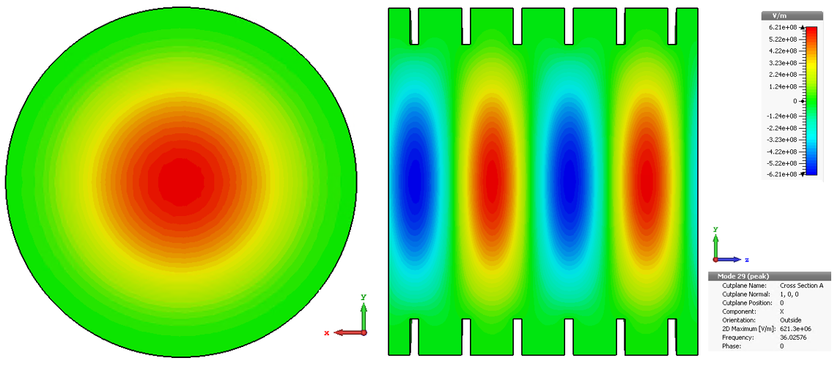
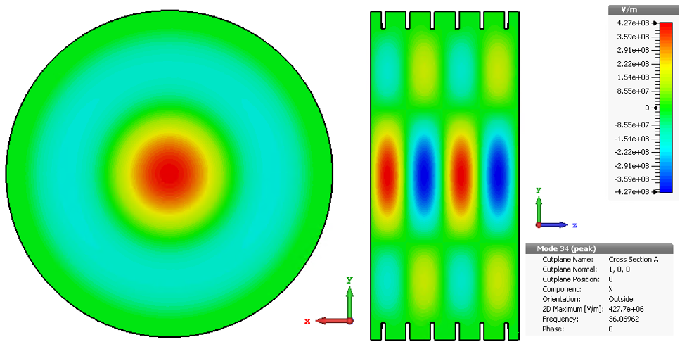
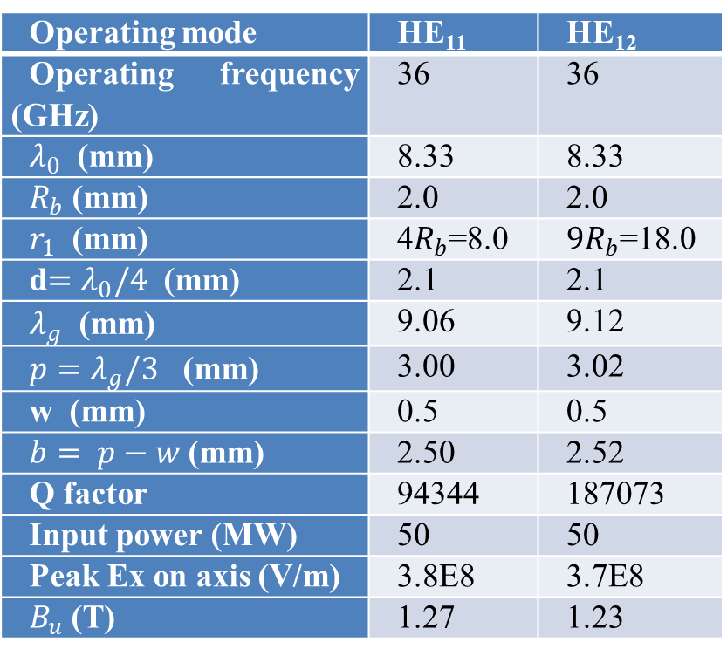
Corrugated waveguide design
Operating mode | HE₁₁ | HE₁₂
Operating frequency (GHz) | 36 | 36
$λ_{0}$ (mm) | 8.33 | 8.33
$R_{b}$ (mm) | 2.0 | 2.0
$r_{1}$ (mm) | 4$R_{b}$=8.0 | $9R_{b}$=18.0
d$=λ_{0}/4$ (mm) | 2.1 | 2.1
$λ_{g}$ (mm) | 9.06 | 9.12
${p=λ}_{g}/3$ (mm) | 3.00 | 3.02
w (mm) | 0.5 | 0.5
$b= p−w$ (mm) | 2.50 | 2.52
Q factor | 94344 | 187073
Input power (MW) | 50 | 50
Peak Ex on axis (V/m) | 3.8E8 | 3.7E8
$B_{u}$ (T) | 1.27 | 1.23
HE11 mode
HE12 mode
Dimensions estimated from theoretical calculation

Slide 9
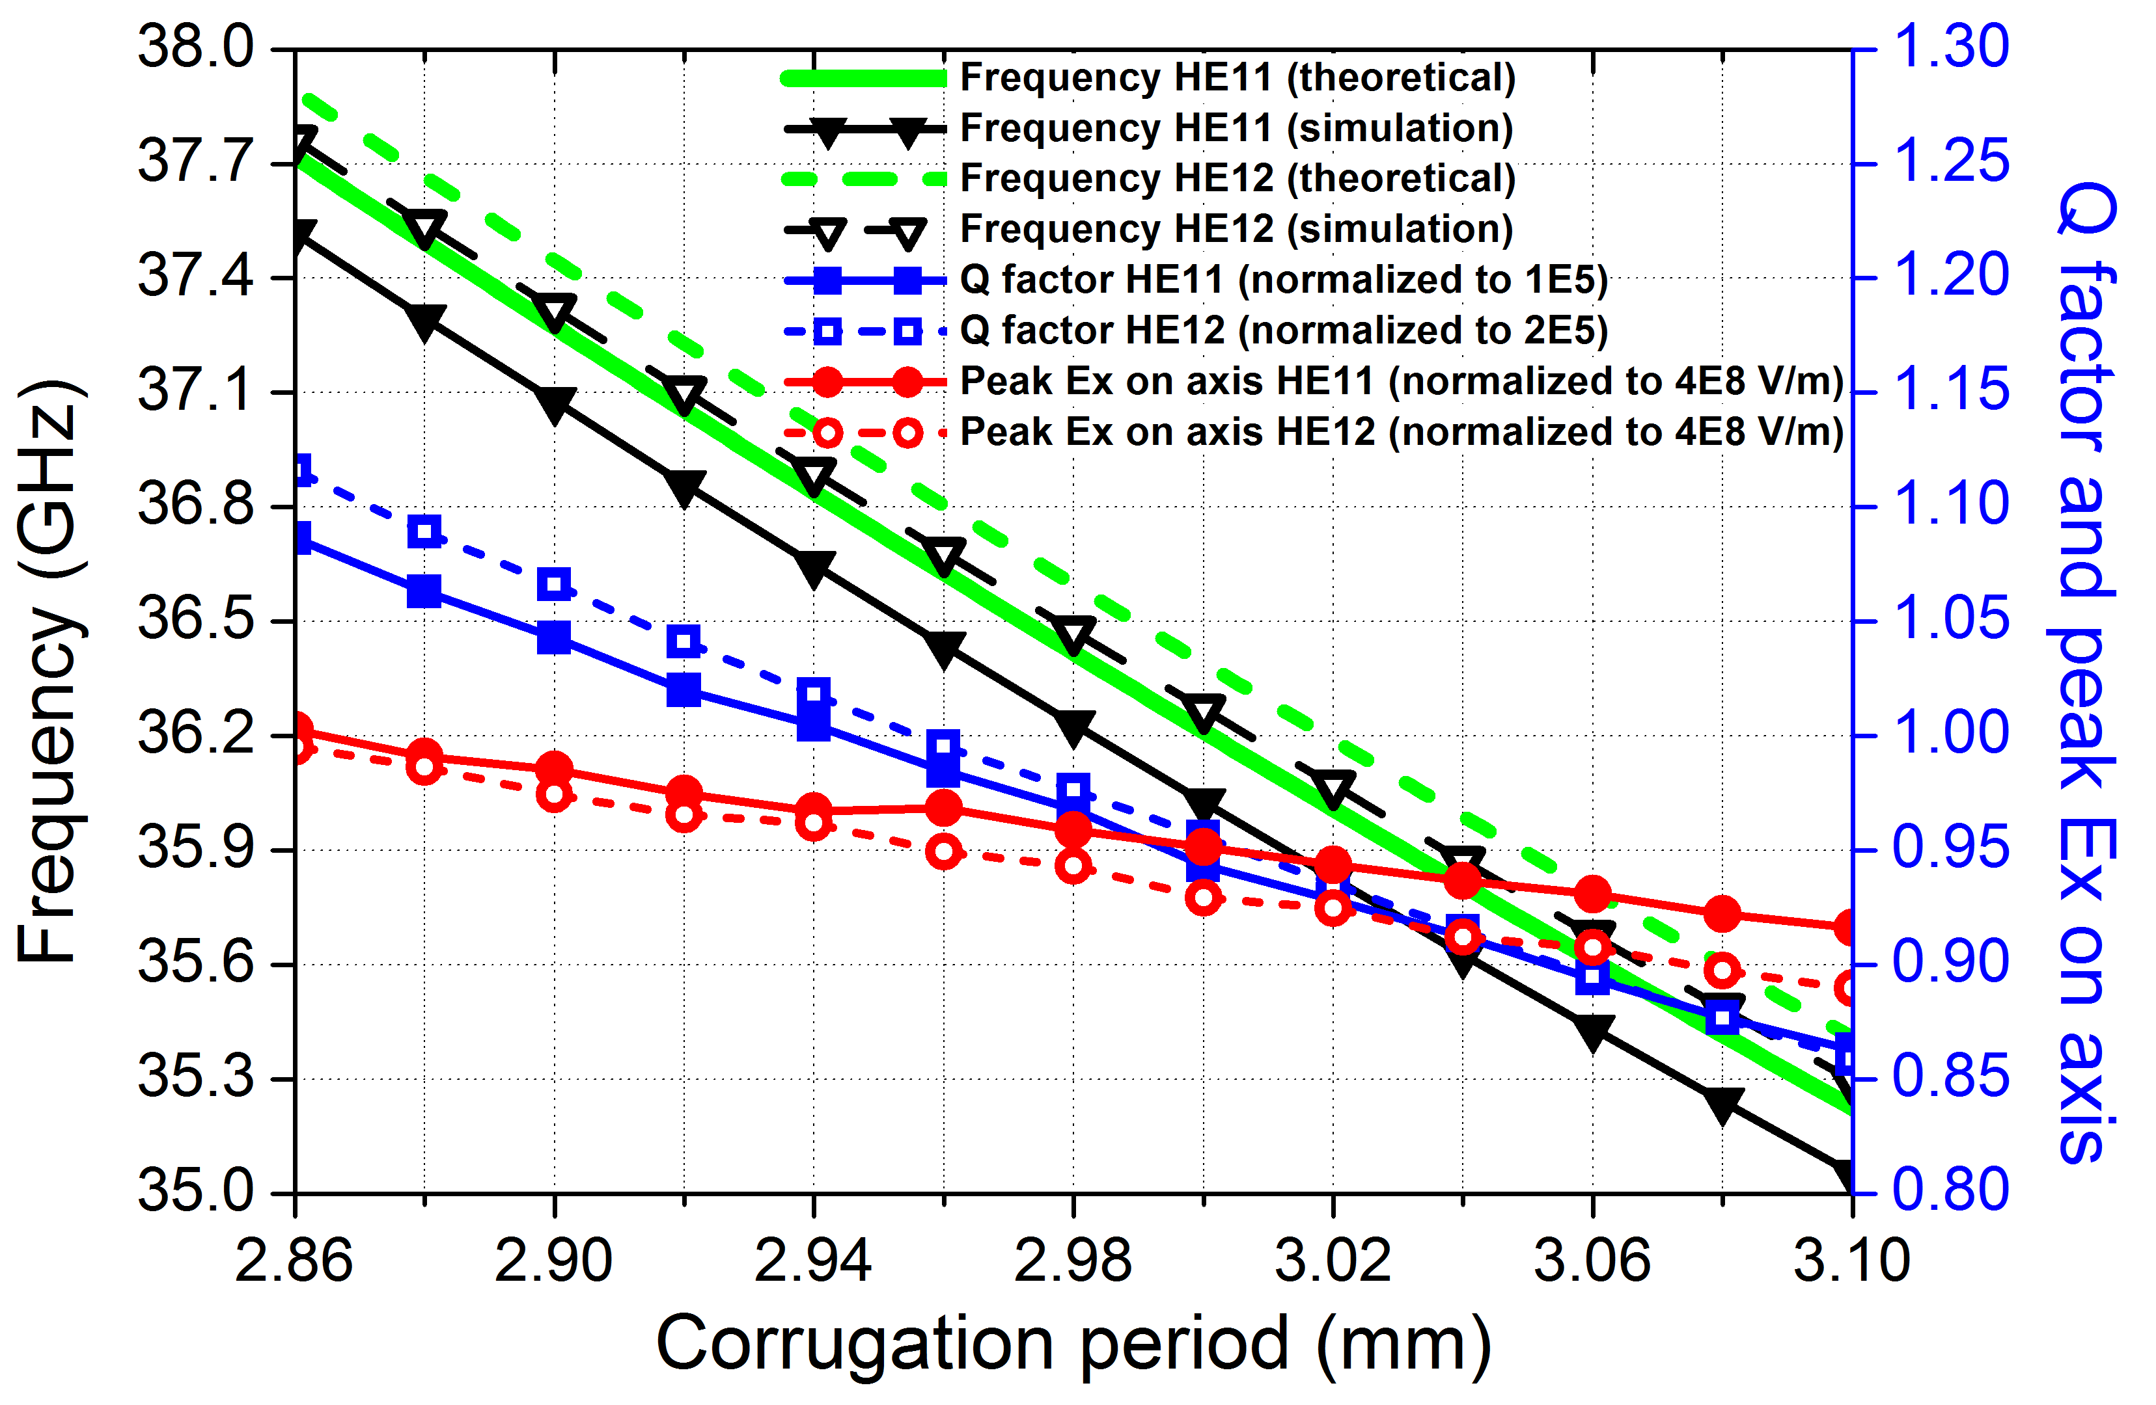
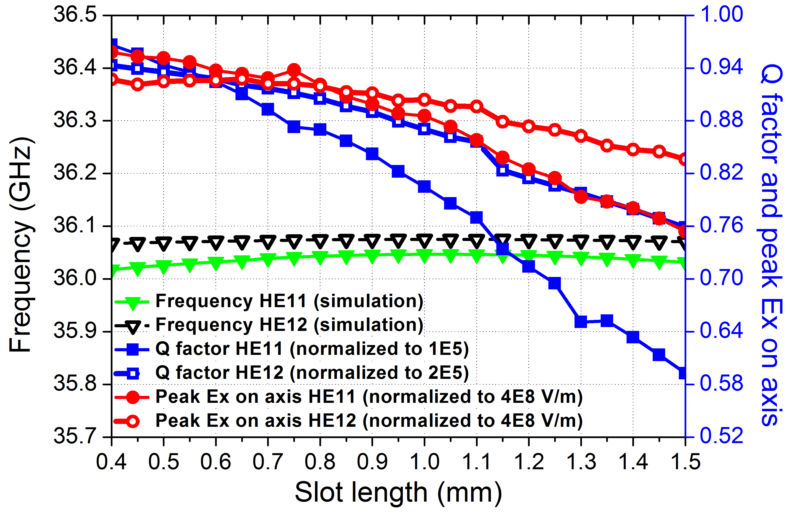
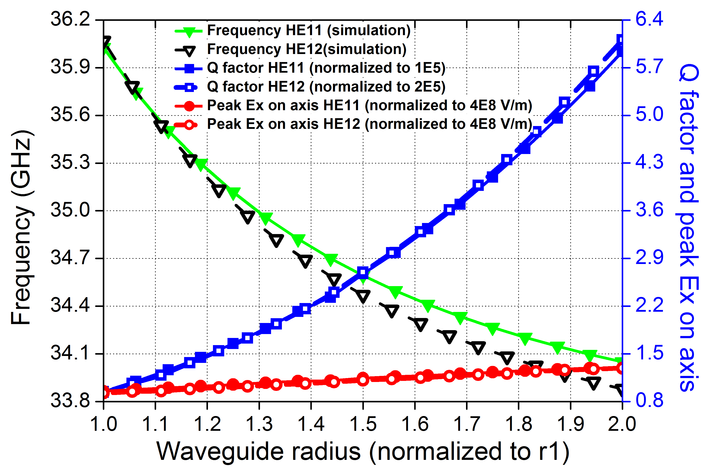
Parameter sweeping results
Simulated by CST microwave studio
Q factor is not very sensitive to the corrugation period.
Not very sensitive to the slot length.
Larger waveguide radius, higher Q factor can be achieved. The eigenfrequency drops.

Slide 10
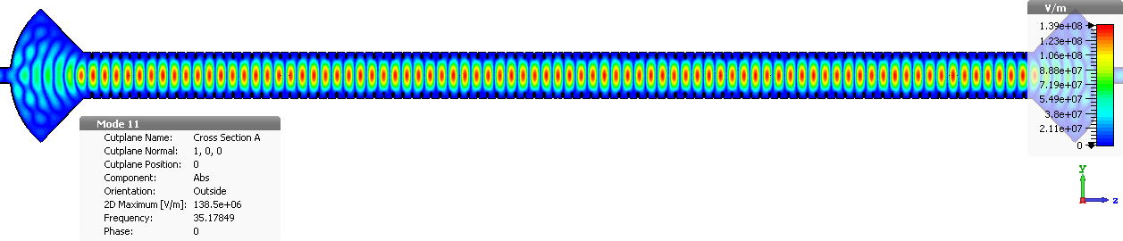
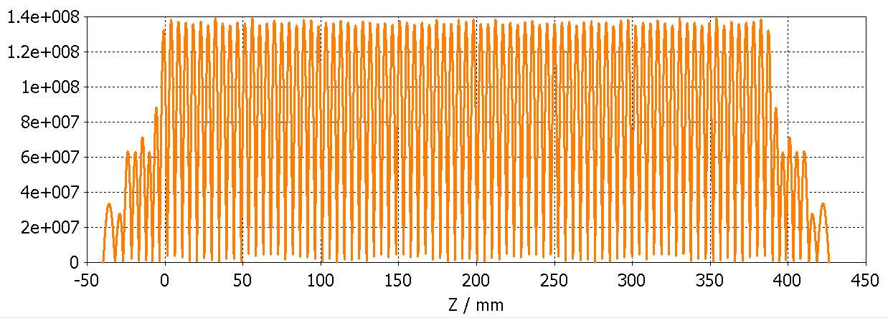
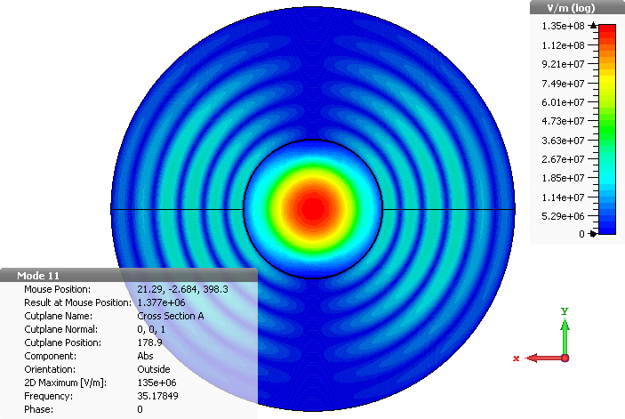
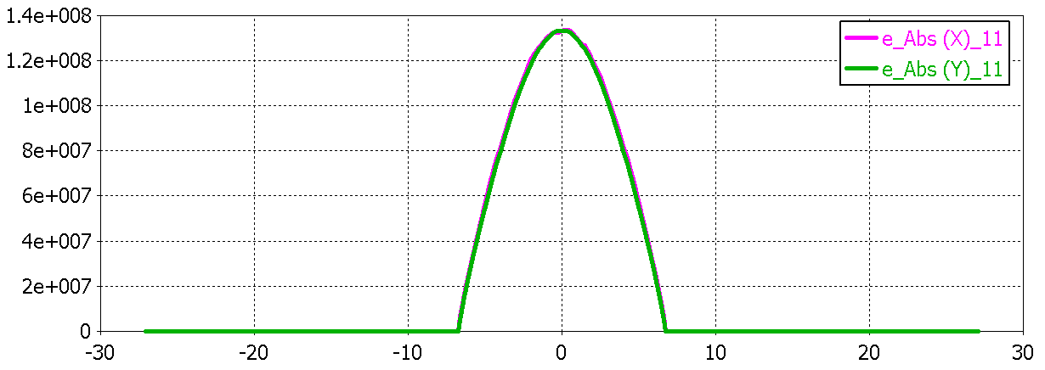
36 GHz corrugated cavity
100 period
Initial geometry parameters:
Radius of the waveguide: 9.13 mm Period of the corrugation: 3.83 mm
Corrugation depth: 2.37 mm Corrugation slot: 0.56 mm
Coupler radius: 35.55 mm

Slide 11
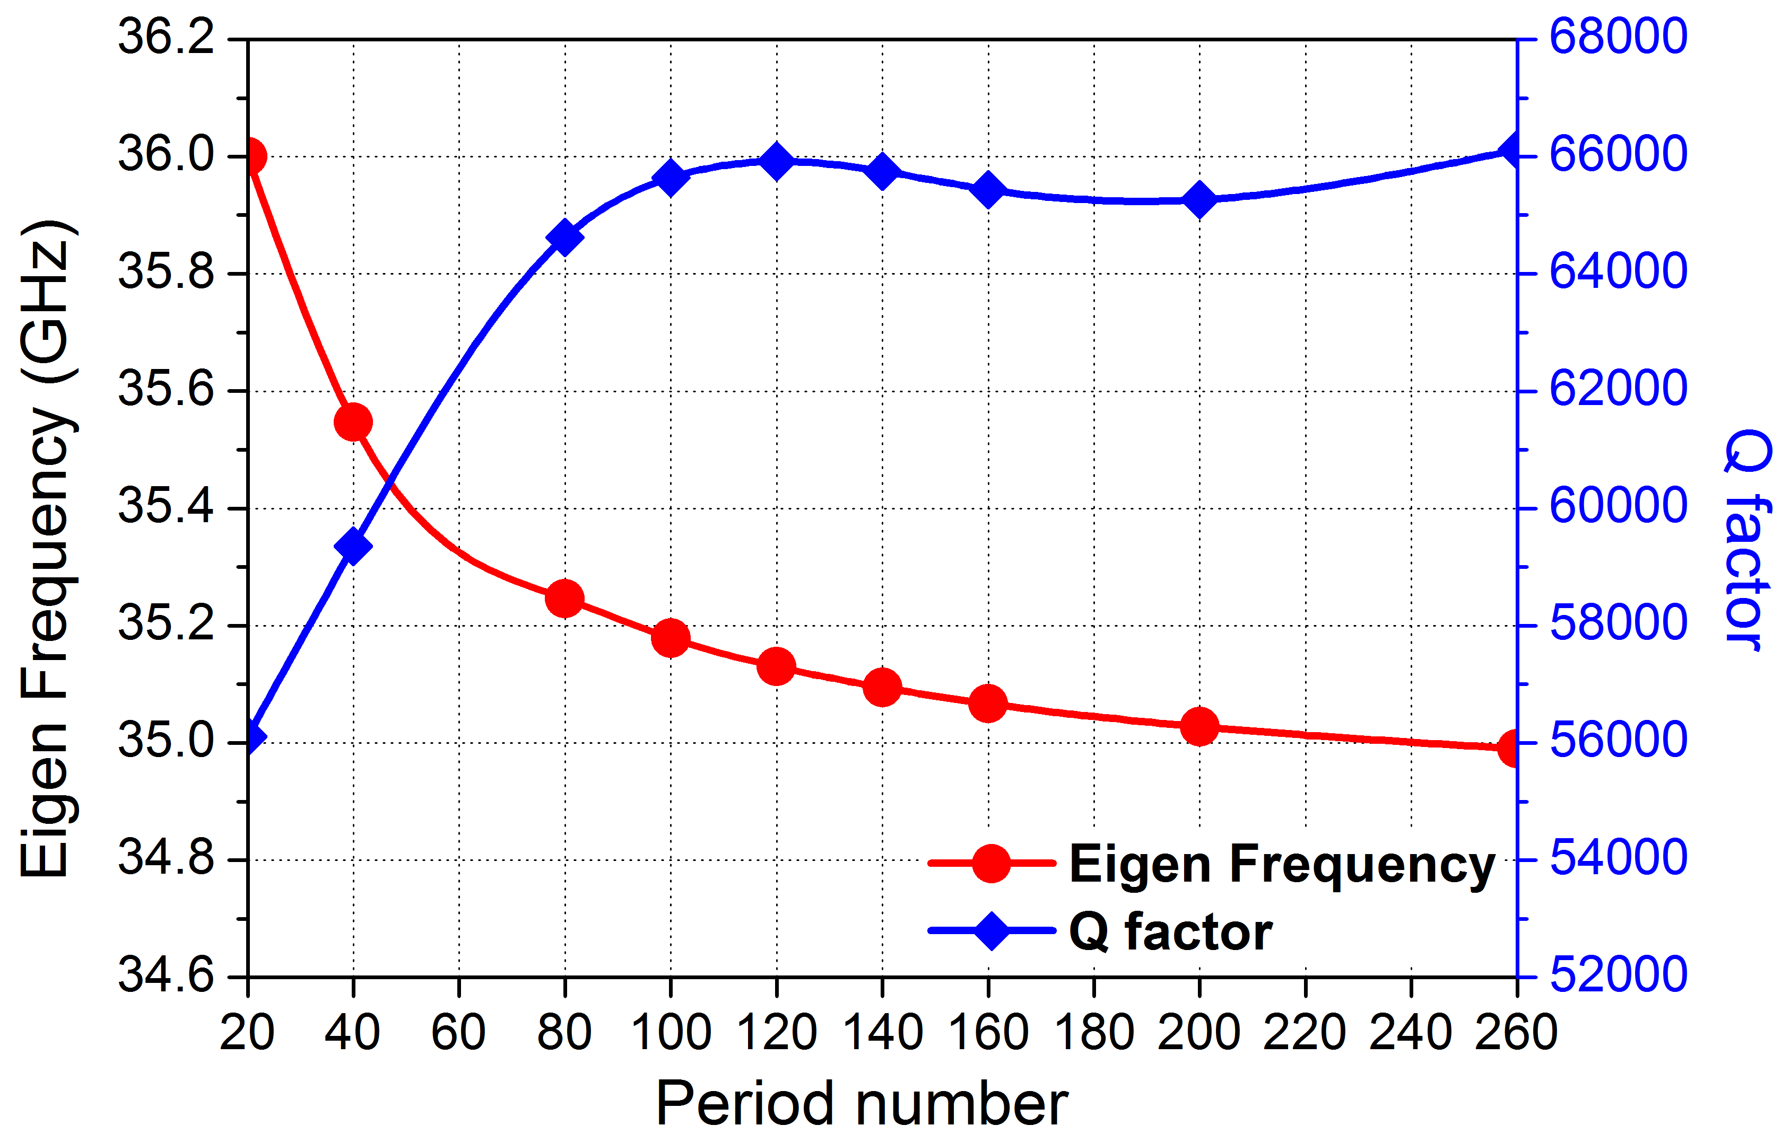
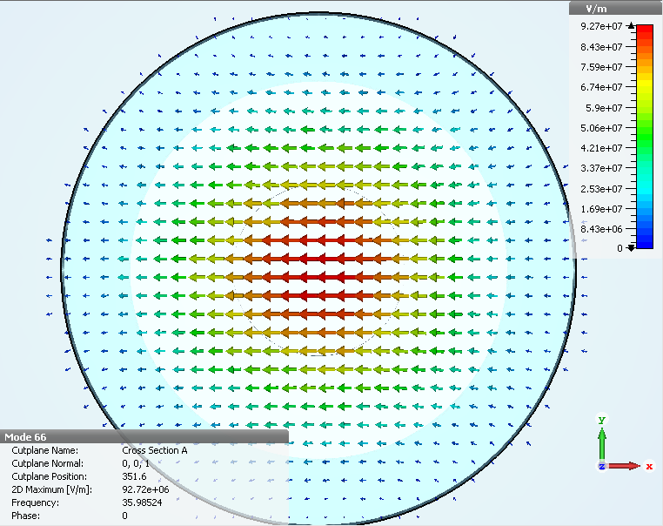
36 GHz corrugated cavity
Final parameters:
Radius of the waveguide: 8.88 mm
Period of the corrugation: 3.73 mm
Corrugation depth: 2.31 mm Corrugation slot: 0.55 mm
Coupler radius: 34.56 mm
Period number: 270 Uniform field length: 1 meter
Resonance frequency: 35.99 GHz
Q factor: 64398.7
Shunt impedance: 2.36E5
Peak field at the center: 0.926E8 V/m
@ input power of 55.9 MW
The Q factors and eigenfrequencies changes with the period number (cavity length).
However large period number leads to a long computing time and large memory requirements.
Parameter scans were used to determine the final dimensions.

Slide 12
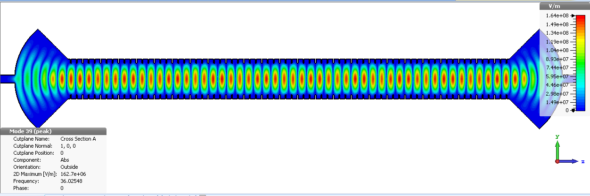
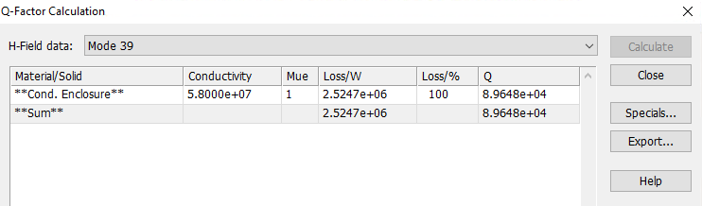
Further improvement
To achieve higher Q factor. Parameter scanning of the coupler dimensions. It requires a lot of computing time as the structure is relatively large.
The Q factor was improved from 64400 to 89650.
Nearly 40% improvement.

Slide 13
Future Work
  To manufacture a short section of the 35.99GHz RF undulator in copper
  Measure its reflection, transmission and losses using a Vector Network Analyser
Acknowledgements
  The support of the STFC Cockcroft Core Grant is gratefully acknowledged

