Slide 2
5th STEAM Collaboration Meeting - Intro
28.05.2016, CERN
B. Auchmann, S. Ayadi, L. Bortot, A. Liakopoulou,
M. Maciejewski, M. Mentink, M. Prioli, E. Ravaioli,
E. Stubberud, A. Verweij

Slide 3
Previous STEAM Meetings
18.-19. Aug. 2014 @ TEMF
13.-14. Jan. 2016 @ CERN
29.-30. Nov. 2016 @ PSI
21.-22. Sep. 2017 @ TEMF
28. Oct. 2018 @ CERN
http://indico.cern.ch/e/steam#
# … number of collaboration meeting.

Slide 4
What is STEAM?
The STEAM project is driven by accelerator-specific needs.
We harness the power of co-simulation with waveform relaxation to provide a new level of flexibility in tackling complex interdependent problems.
Workflows are built in the frontend and on-site GUIs, encoding best modeling practices for respective backends.
The framework is used in the analysis of LHC operation data, the design of the HL-LHC upgrade, and the Future Circular Collider study.
Meta Methods
(parameter sweep, optimization, cosimulation, etc.)
Frontend Adapter
Backend Adapter
Modif.
Exec.
Data
ROXIE parser
Frontends
(SIGMA, SING)
Backends
(COMSOL, QLASA,ROXIE, PSpice,LEDET, Cryosoft, LTSpice, PSIM, ANSYS, Opera, etc.)
Model
On-site GUIs

Slide 5

STEAM Developers and Users
 | Code development | Running applications
TE-MPE | Framework, tool adaptors, magnet and circuit generators | LHC, HL-LHC, FCC
TE-MSC | Quench heaters | SM18 tests
TE-EPC |  | HL-LHC
PSI | ANSYS 2D to SIGMA | FCC
TU Darmstadt | Co-simulation, performance
Tampere Univ. | Coodi, CoHDA, MASTO | FCC
INFN Milano | QLASA | HL-LHC
INFN Genova | SIGMA (COMSOL) | HL-LHC, FCC
FNAL |  | HL-LHC
LBNL | SIGMA, ANSYS 2D plugin | MDP
CIEMAT |  | Foreseen (HL-LHC/FCC)
NHMFL |  | Foreseen (HTS)

Slide 6
CERN Use Cases
 | Part | Study
LHC | RB circuit | Transients during Fast Power Abort and earth failures. Inter-turn shorts. Effect of unbalanced dipoles. Optimisation of transmission-line damping.
LHC | RB circuit + control | Operation of the power converter controller
LHC | 600 A circuits | Protection studies (quench-back, need of EE). Earth fault analysis/localisation.
LHC & HL-LHC | Triplet and RB | Effect of spurious QH or CLIQ firing on the beam.
HL-LHC | Triplet | Protection studies.
HL-LHC | 11 T | Protection studies and mechanical response proof-of-concept.
HL-LHC | QXF | Inter-turn short investigation based on FTF
HL-LHC | Triplet beam screen | Coupling currents and forces during a quench.
HL-LHC | RB+11 T | Protection studies, CLIQ. Functioning of trim PC.
TE-MSC | BH test magnet | QLASA+PSpice protection study
FCC | SC magnet | Use of quench absorption coils.
FCC | 16 T dipole designs | Quench protection (incl. CLIQ). Mechanical response
FCC | Circuit design | Transmission-line effects and unbalanced coils.
SM-18 | FRESCA2 | Quench, MIIts, hot spot, field errors during ramp.

Slide 7
Where to go from here … Autumn 2017 List
Applications: new in HL-LHC: electron-lense solenoids, short correctors.
Tools: add QLASA, release COMSOL 2D and 1D, add ANSYS, GetDP, TUT materials, TUT tools, TEMF electro-thermal FEM, CERN ”quench”, improved detection, HW in the loop, …
Model generators: more numerous tool alternatives call for stream-lined input.
User experience: GUI for standard workflows, documentation,
Validation: improve modeling through continuous comparison with measurements.
Performance computing: parallelization in algorithms, space, time, phys. domains
Theory: automatic window size, execution order, and coupling algorithm; graphical bond-graph representation, improved hierarchical modeling, enabling in-iteration model switch, in-time-window state change, …
Users: extend user base in- and outside CERN (CERN TE-MSC, CIEMAT, …)
Funding: continue to apply for funding for participating univ. institutes.

Slide 8
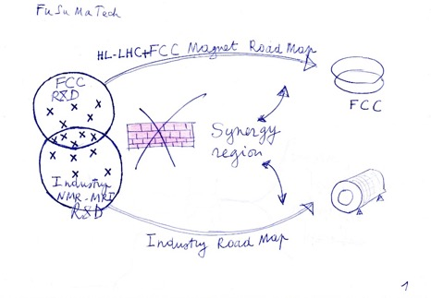
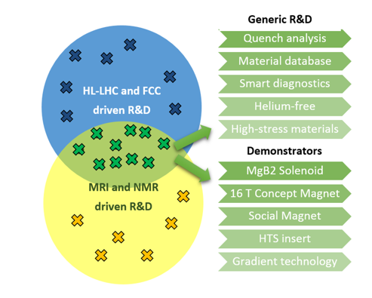
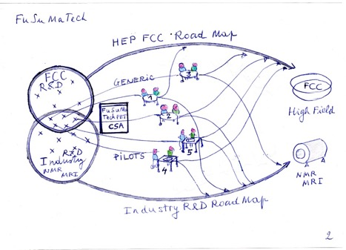
FuSuMaTech
Goal: European Cluster of Applied Superconductivity
Method: Clusterization by Nucleation

Slide 9
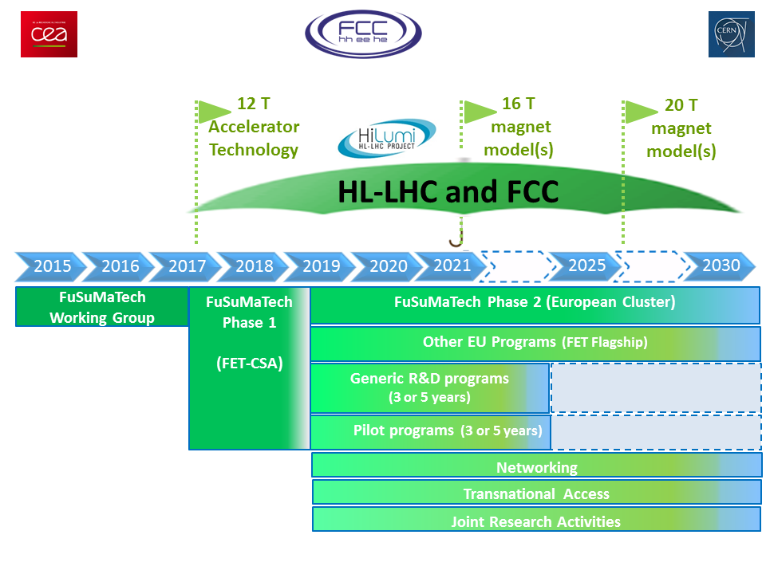
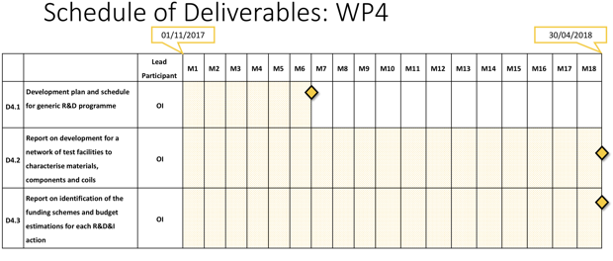
FuSuMaTech

Slide 10






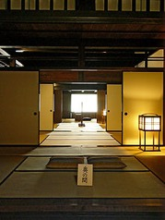








FuSuMaTech
FuSuMaTech

Slide 11

FuSuMaTech Task 4.1
Meta Methods
(parameter sweep, optimization, cosimulation, etc.)
Frontend
(CERN, KIT, PSI)
Backend R&D
(TEMF, Elytt)
Visualization
(CERN, ?)
Meta-Methods
(TEMF, CERN)
HPC Infrastructure
(CERN, Elytt)
Validation Community
(CERN, KIT)
Frontend Adapter
Backend Adapter
Modif
Exec.
Data
ROXIE parser
Frontends
(SIGMA, SING)
Backends
(COMSOL, QLASA,ROXIE, PSpice,LEDET, Cryosoft, LTSpice, PSIM, ANSYS, Opera, etc.)
Model
On-site GUIs
Funct.
Backend R&D
MASTO

Slide 12
FuSuMaTech Task 4.1 Description/Nomenclature
Backend: a software tool, commercial or other, that can be used to solve initial-value problems
occurring in the context of quench simulation. These may be commercial general-purpose Multiphysics tools (e.g., ANSYS, COMSOL, Opera, Cryosoft), commercial limited-purpose tools (PSpice, PSim), in-house solvers owned by institutes or companies (QLASA, ROXIE), or open software (OpenFoam).
Frontend: operates like a macro that will generate models of a quench problem in the UI language of a selected backend. Multiple backends can be supported for the same type of simulation. Best practices found in the community are implemented in the macros to serve the entire community.
Meta-Methods: are algorithms that combine one ore more backends and/or frontends in order to execute a complex task. For examples we mention optimization, sensitivity analysis, sweeps, collaborative simulation (co-simulation) of multiple backends. Meta-methods must encapsulate backends and frontends in standardized interfaces or adapters.
On-site GUI: Particular repetitive workflows can be rendered more efficient by dedicated GUIs. These by no means supersede the sophisticated GUIs of some of the backends (ANSYS, COMSOL). They are intended to bring validated models and methods to magnet experts, who need not be experts with the particular numerical challenges and backend tools.
HPC infrastructure: Cluster or mathematics co-processors, made available to FuSuMaTech members with pre-configured backends for computationally demanding simulation tasks.
Validation community: is organized around an open series of meetings, attached to conferences (ASC, MT), in which the community discusses benchmark experiments, their instrumentation and results, as well as simulation efforts, challenges and results with different simulation approaches.

Slide 13
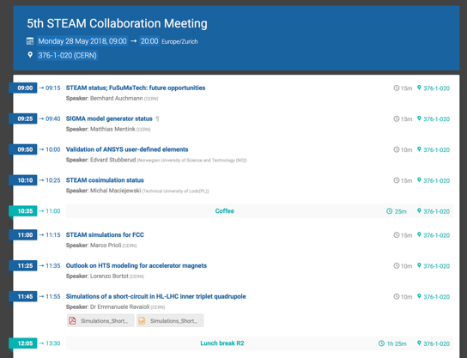
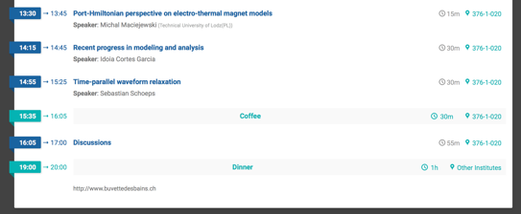
Program
Discussion topics:
Cosim time-window size
IFCC modeling
Error estimators
Usefulness of PH modeling
  Future directions?
Open multi-physics FE soft
FuSuMaTech
  Goals
  Partners

