Slide 1





STEAM Cosimulation Status
Notes:
Good afternoon ladies and gentlemen and thank you for coming.
My name is Michał Maciejewski and I have a great pleasure to share with you my adventure on co-simulation of transient effects in superconducting accelerator magnets.
The adventure has been started three years ago as a masters student and then transitioned to a PhD student at Łódź University of Technology who I am today.
I would like to acknowledge colleagues from several institute who have contributed to the obtained results.
In the next fifteen minutes I will go through each of the terms in the title stressing their importance as well as relevant aspects of co-simulation of transient effects in superconducting accelerator magnets.

Slide 2
Presentation outline
Algorithms
(One-way coupling, weak coupling, strong coupling, waveform relaxation)
Architecture
(Supported tool adapters, release status)
Applications
(voltage-driven field/circuit coupling)
Model-Based System Engineering – industrial language
(Qualities of good models, single source of truth/input, querying outputs)
Conclusion
Notes:
My talk is structured as follows:
I’ll begin with an introduction to superconducting accelerator magnets, which will allow us to understand several challanges in their simulation.
Then, I’ll move to a practical example presenting an application of hierarchical co-smulation framework to a standalone magnet.
I’ll conclude my talk with an outlook and a summary of results.

Slide 3
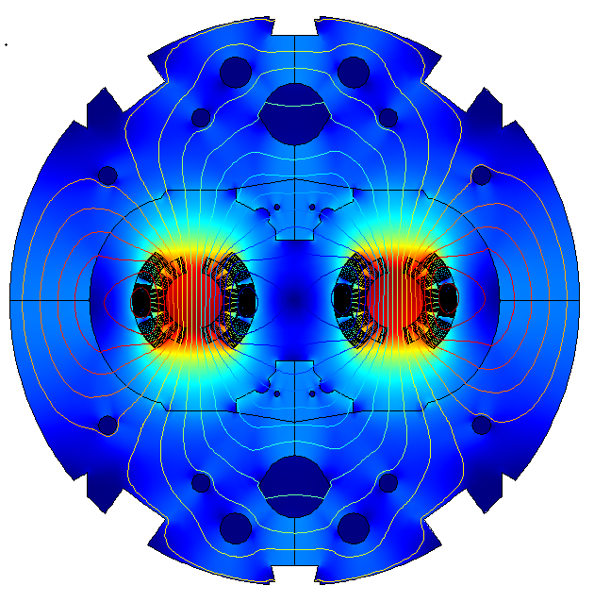




Superconducting accelerator circuits – motivation for coupling
Superconducting Magnet
Generate high magnetic field
Operate at 1.9 K
Highly non-linear materials and
physical laws (magnetic, thermal,
mechanical)
~us (quench) - ~10 ms (losses)
~mm (strands) - ~10m (coils)
$$\vec{B }$$
Power Converter Controller
$$\vec{F }$$
Controls circuit current
Fixed operating frequency
Digital system
+
$$\vec{v }$$
I_{ref}
+
PID
M2
M154
-
Superconducting Circuit
U
SC Magnet powering and protection
Operate at 1.9 – 300 K
Non-linear switches
~ms (switch) - ~minutes (discharge)
~10 cm (diodes) - ~km (circuit)
A
Multi-domain, Multi-physics, Multi-rate, Multi-scale Problem
Notes:
The same principle is applied in reality.
We develop sophisticated magnets as precise as swiss watches. The ratio between dipole and its first multipole is 10^-5
Swiss watches of 20 tonnes weight and 15 meters length.
We need to provide electric current and control its value in order to guide particles travelling at nearly the speed of light.
For that we need 12000 A which is equivalent to 600 households.
This physics is anything but trivial and researchers in the field of SC and SF received several Nobel prizes for their discoveries.
Here we can already see several subdomains making up a coupled problem we are studying.

Slide 4

Models coupling in the time domain
One-way Coupling/Parameter Extraction
„Strong” Coupling
S1
S1
t
t_{end}
t
t_{end}
S2
S2
„Weak” Coupling
Waveform Relaxation
S1
S1
t
t_{end}
t
t_{end}
S2
S2
STEAM Cosim supports all four coupling methods
Coupling methods can be switched during the execution of a co-simulation scenario
Fixed time window assignment
Only lumped signals can be exchanged
How can we determine the execution order?
How can we estimate the coupling strength?
Courtesy S. Schöps
Notes:
No free lunch theorem

Slide 5
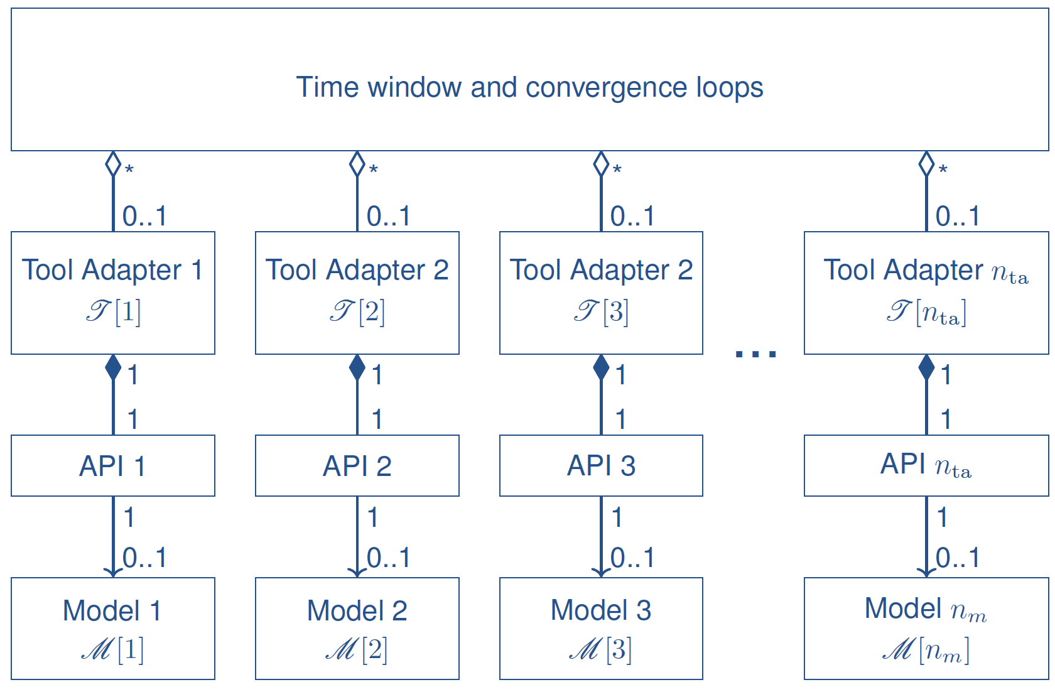
Architecture – SysML diagram of tool adapters
For more details on the STEAM Cosim architecture please refer to
„STEAM Architecture” presentation available at https://indico.cern.ch/e/steam4

Slide 6
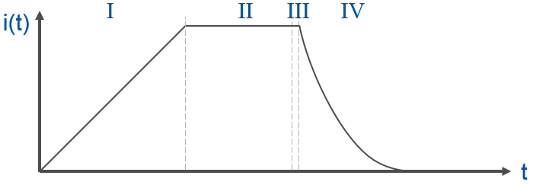
Release status of tool adapters
 | Power Converter Controller | Superconducting Circuit | Superconducting Magnet
Equation type | Differential-algebraic | Differential-algebraic | Differential-algebraic Partial-differential
Time-stepping | fixed | adaptive | adaptive
# DOF | ~10 | ~10-10k | ~1k-10k
Dimension | 0D | 0D | 0D, 1D, 2D
Physical Domains | - | Electric | Magnetoquasistatic Thermal Mechanical
Status
Developed and released
QLASA
Developed and tested, not released yet
To be developed
LEDET
We use validated, problem-specific models
Notes:
The same principle is applied in reality.
We develop sophisticated magnets as precise as swiss watches. The ratio between dipole and its first multipole is 10^-5
Swiss watches of 20 tonnes weight and 15 meters length.
We need to provide electric current and control its value in order to guide particles travelling at nearly the speed of light.
For that we need 12000 A which is equivalent to 600 households.
This physics is anything but trivial and researchers in the field of SC and SF received several Nobel prizes for their discoveries.
Here we can already see several subdomains making up a coupled problem we are studying.

Slide 7
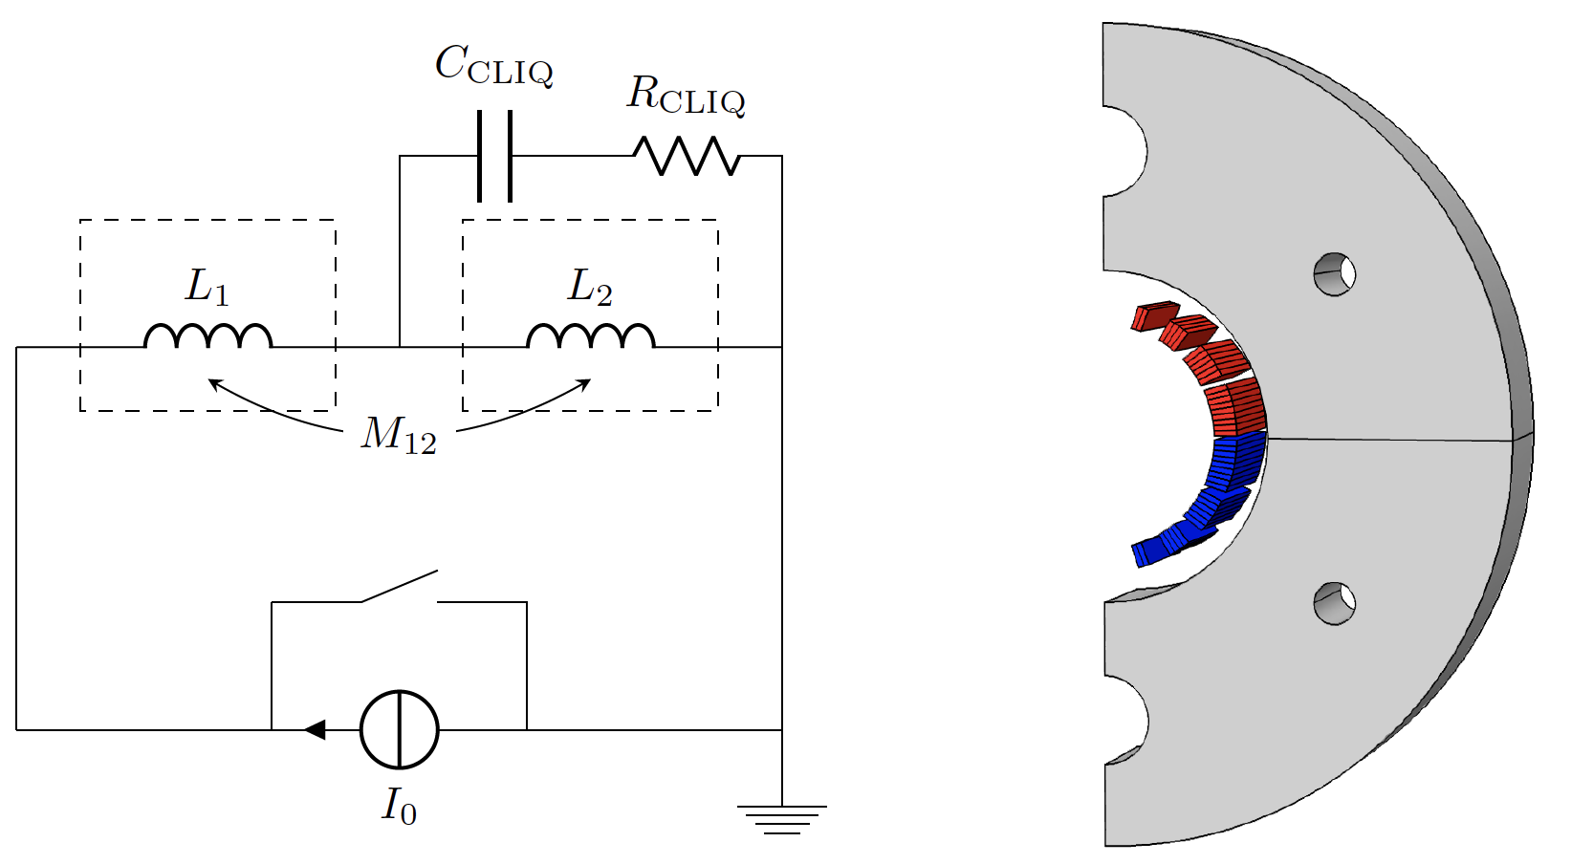



Field/circuit coupling – field equivalent model on the circuit side
We employ Gauss-Seidel-type waveform
relaxation algorithm
Field and circuit models are coupled through
lumped variables (current, voltage, resistance)
The derivation of the field equivalent model
on the circuit side is non-trivial
$$I_{s}$$
$$U_{mag}$$
$$R$$
I. Garcia et al, “Optimized Field/Circuit Coupling for the Simulation of Quenches in Superconducting Magnets”, IEEE Journal on Multiscale and Multiphysics Computational Techniques

Slide 8
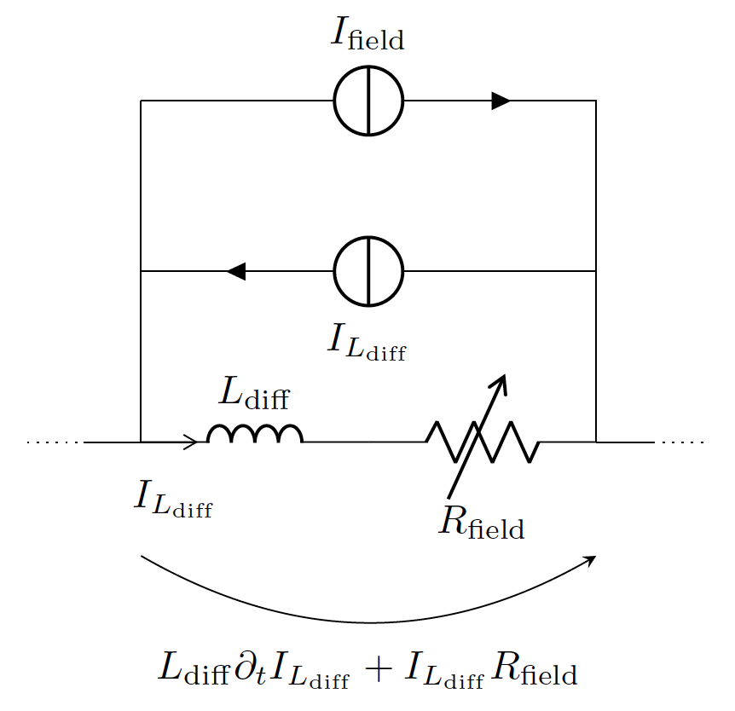
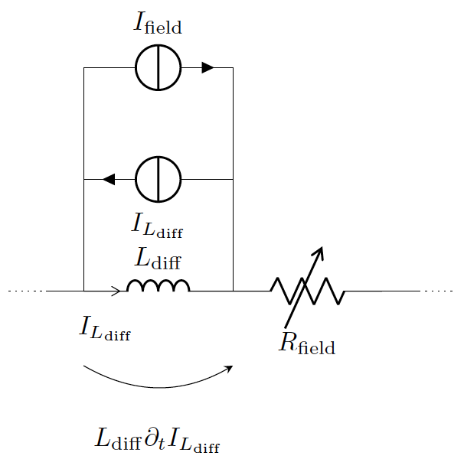
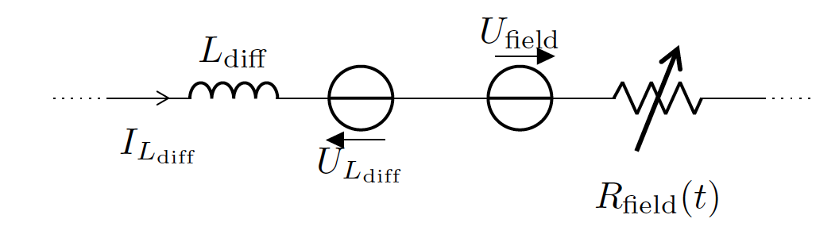
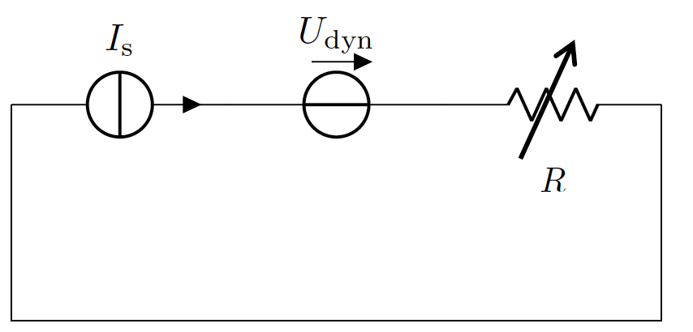
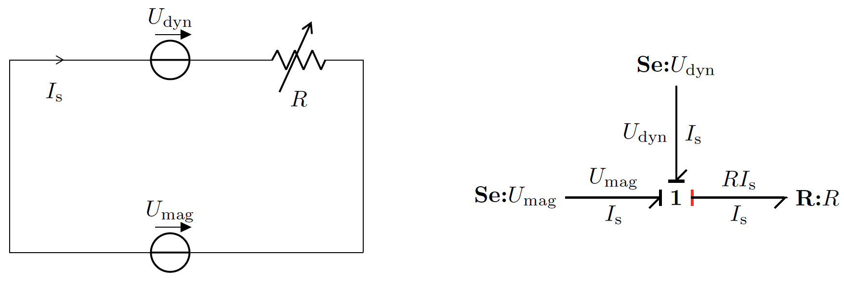
Field/circuit coupling – voltage- and current-driven field model
Current-driven mode
Voltage-driven mode
Circuit model
?
Field model

Slide 9
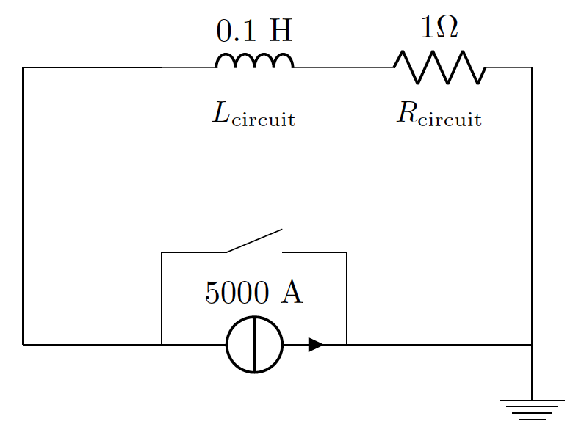
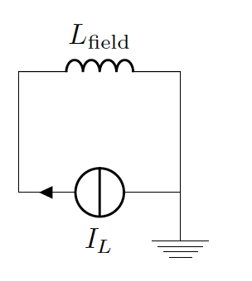
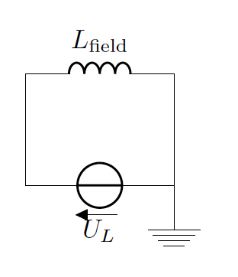
„Field”/circuit coupling – lumped case
We consider an RL circuit with initial current of 5000 A and a crowbar that closes at t=0s.
Circuit model
„Field” models
Field model is represented as a circuit with inductance L_{field} of 0.09 H (R_{field}=0)
connected in parallel with either a current (1) or a voltage (2) source.
Convergence criterion is based on the relative error equal to 1e-6 or the absolute error equal to 1 mA.
Co-simulation is solved for T=[0, 0.1, 0.2, 0.3, 0.4] s.
Maximum time step is equal to 100 us.
For the converged solution we expect a current discharge on the circuit side with time constant L_{field}/R_{circuit}.

Slide 10
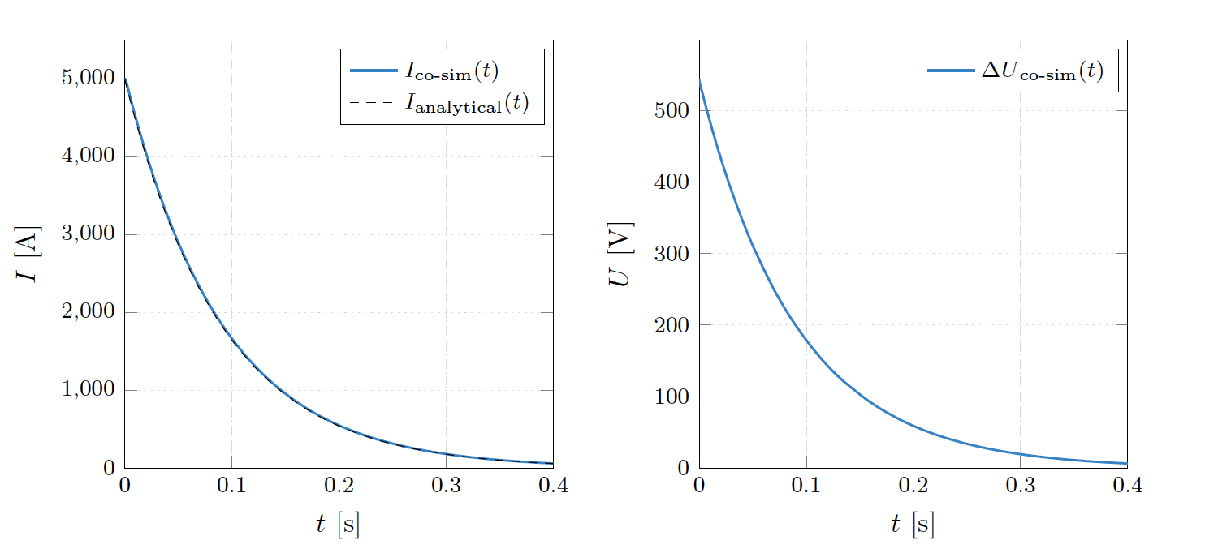
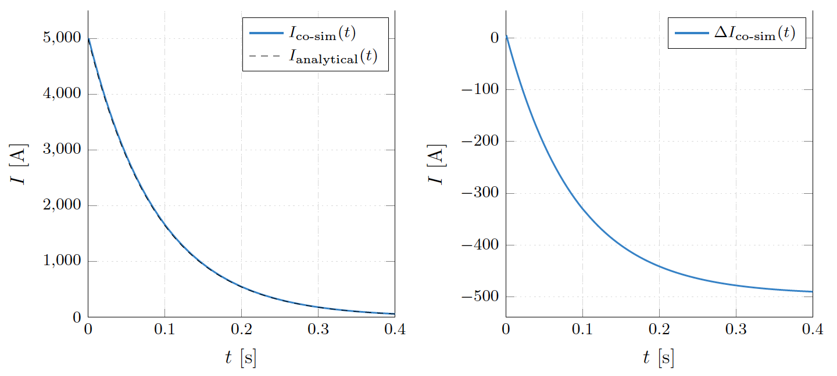
”Field”/circuit coupling – results
Current-driven mode
Voltage-driven mode
Both modes converged to the analytical solution with the requested accuracy

Slide 11
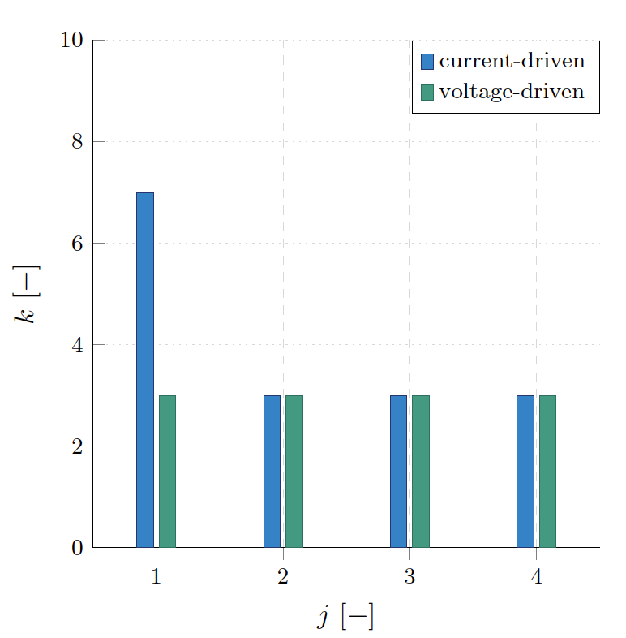
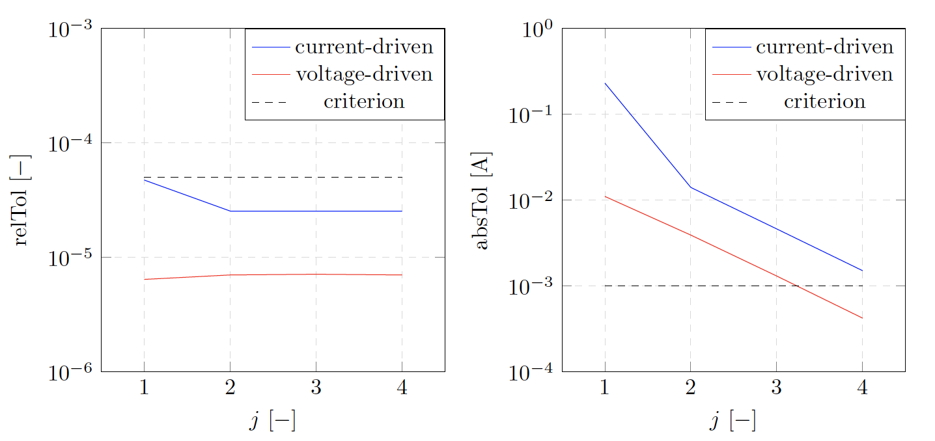
”Field”/circuit coupling – comparison
Number of iterations
Relative and absolute tolerance
Voltage-drive mode is numerically more stable than the current-driven one

Slide 12
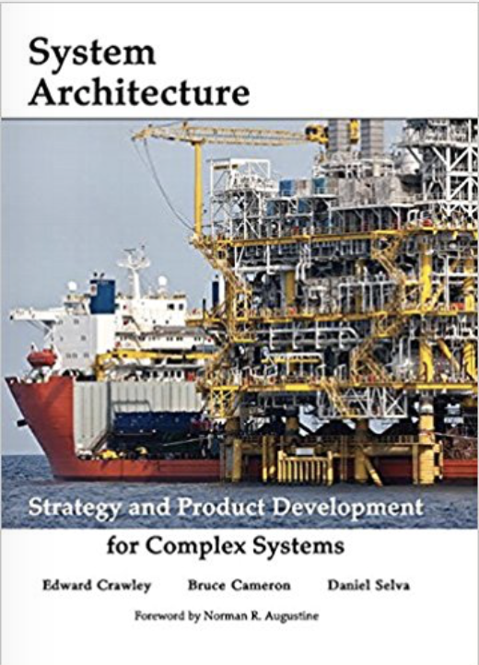
Presentation outline
Algorithms
(One-way coupling, weak coupling, strong coupling, waveform relaxation)
Architecture
(Supported tool adapters, release plan)
Applications
(voltage-driven field/circuit coupling)
Model-Based System Engineering – industry language
(Qualities of good models, single source of truth/input, automated workflows, querying outputs)
Conclusion
E. Crawley, B. Cameron, D. Selva: System Architecture: Strategy and Product Development for Complex Systems
Notes:
My talk is structured as follows:
I’ll begin with an introduction to superconducting accelerator magnets, which will allow us to understand several challanges in their simulation.
Then, I’ll move to a practical example presenting an application of hierarchical co-smulation framework to a standalone magnet.
I’ll conclude my talk with an outlook and a summary of results.

Slide 13
Qualities of good models – subjective comparison of magnet models
 | COODI (TU Tampere) | QLASA (INFN) | LEDET (LBNL, CERN) | COMSOL (CERN) | ANSYS (LBNL, CERN)
Model type | numerical | analytical | numerical (network) | numerical (FEM) | numerical (FEM)
Computational time | seconds | tens of seconds | minutes | tens of minutes | tens of minutes
License | free to use | free to use | free to use | commercial | commercial
…
AC losses | no | very approximated | approximated | accurate | accurate
Iron yoke saturation | no (linear model) | no (linear model) | no (linear model) | yes | yes
Eddy currents in wedges | no | no | no | yes | yes
…
Available API | no | co-sim | co-sim | co-sim + Java API | no
Input generation | manual | manual | manual (to be automated) | automated (SIGMA) | manual / ROXIE
Test coverage | ? | ? | ? | yes | yes
…
Very important for our visitors and collaborators (e.g. Lorenzo Mauro)

Slide 14
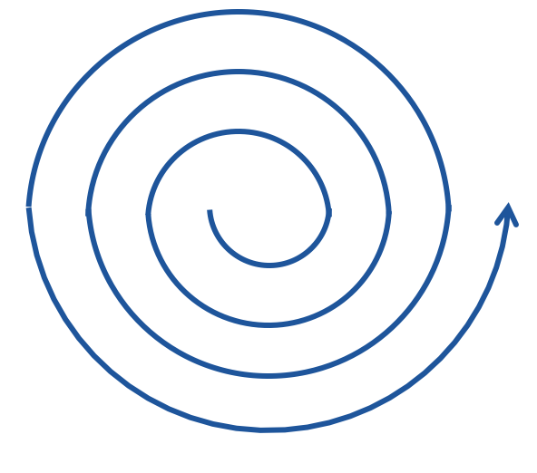
Model fidelity and credibility
Fidelity
HIGH
Model
fidelity
COODI
QLASA
LOW
LEDET
COMSOL
ANSYS
Credibility
LOW
HIGH

Slide 15
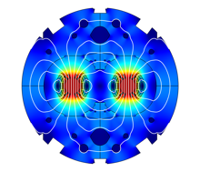





Single source of truth (input) – scripts for model generation
The design of majority of magnets starts with ROXIE. Compatibility with its input/outputs would expand our reach.
ROXIE input and output
BH curve
iron yoke geometry
coil geometry
cable parameters
SIGMA* API
BH curve parser**
Iron yoke geometry parser**
input Java code from ROXIE
input Java code from ROXIE
COMSOL
LEDET
ANSYS
QLASA
…
LHC – MB
Hi-Lumi – MQXF
FCC – Cos$θ$
FCC – Block coil
FCC – Common coil
Test station – FRESCA2
*STEAM Integrated Generator of Magnets for Accelerators
**Task of Soufiane Ayadi

Slide 16
Automated workflows –scripts for co-sim, circuit analysis**, etc.
STEAM APIs involved (some several times)
Pseudo-code of a script in e.g. MATLAB, python, java script, etc.
\\ build magnet model from ROXIE
\\ extract differential inductance
\\ build subcircuit with equivalent field model
\\ build circuit model
\\ prepare circuit stimula
\\ run co-simulation study
\\ post-process results
(Query models – models as repositories of data)
steam-sigma
steam-comsol-extractor
steam-sing*
steam-pspice-library
steam-sing*
steam-pspice-manager
steam-cosim
steam-cosim-viewer
steam-pspice-manager
*STEAM Integrated Network Generator
Versioning of workflows
**Task of Akrivi Liakopoulou

Slide 17
Conclusion
STEAM CoSim supports four main coupling algorithms in a hierarchical fashion
We achieved a lot, however still several relevant, open avenues of research
STEAM officially supports three tool adapters, additional four in the pipeline
Voltage-driven field/circuit coupling promises to improve convergence (stay tuned!)
MBSE provides a new/old perspective on modelling

Slide 18


