Slide 1

Impact of quench heater firing on the circulating beam – status and results of experimental and simulation studies
D. Wollmann, L. Bortot, M. Mentink, E. Ravaiolli,
E. Stubberud, M. Valette
122nd HiLumi WP2 Meeting – 29.05.2018

Slide 2
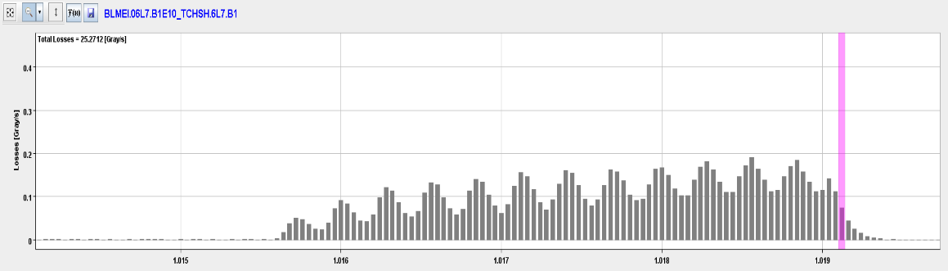
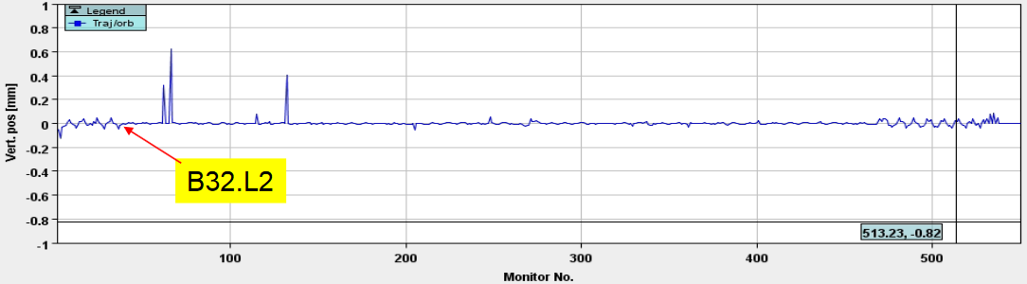
Beam induced quench causing periodic losses in IR7
  Periodic losses during beam induced quench (~3ms) before beam dump
  Traced back to small orbit oscillation from skew dipole field (kick of ~14.3 m*0.7 mT) → quench heater firing

Slide 3
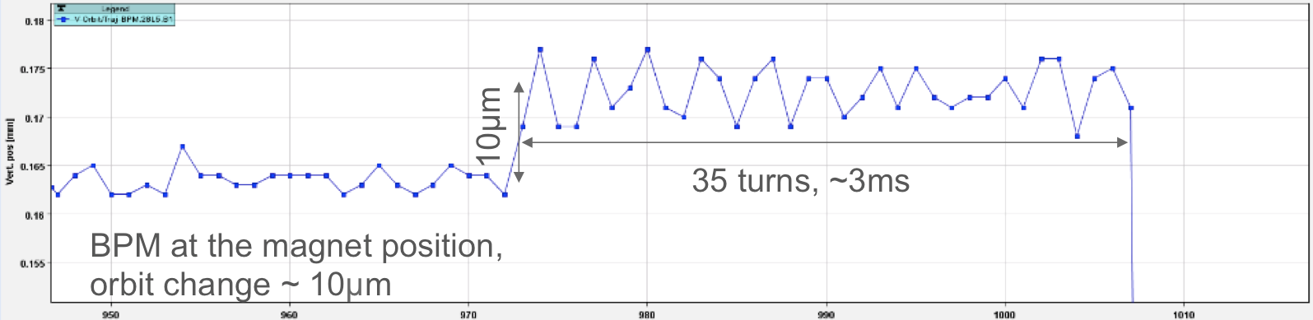
Effect of magnet protection on beam
Quench heaters (QH) impact the circulating beam, if not dumped before triggering → observed and verified for LHC main dipoles
Stronger effect in HL-LHC than in LHC due to:
  more QH (11 T, triplet, D1, D2), inner layer QH (triplet), QH + CLIQ (triplet)
  larger beta functions → Triplet (~8 km → ~21 km), D1 (~5 km → ~19 km) D2 (~1.7 → ~6.4 km)
Ultra fast effect, QH reaching full current/field after ~35 us (1/2 turn), CLIQ reaching peak field after ~12 ms.
Spurious triggering of one QH unit cannot be excluded.

Slide 4
Expected kicks from HiLumi magnets
Optimize QH connection scheme → reduced kick and/or quadrupole field
Issue beam dump before triggering QH discharge
Issue beam dump on CLIQ discharge
Ultra fast kicks need to be kept < 1.2 sigma to avoid dangerous losses (> 1 MJ) in the collimation system
Magnet (all QH) | LHC kick (sigma) | → | HL-LHC kick (sigma)
MB | 0.3 | → | 0.5
D1 | 1.4 | → | 2.0
D2 | 1.2 | → | 2.4
11 T - dipole | 0.4 | → | 0.4
Triplet | 2.5 | → | 29 (OL)
 |  |  | 52 (IL+OL)
Expected kick strength verified experimentally in LHC (firing of quench heaters @ 450 GeV)

Slide 5
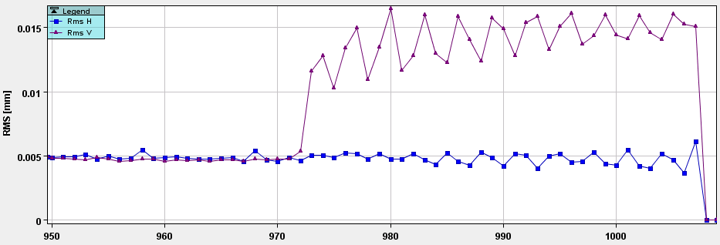
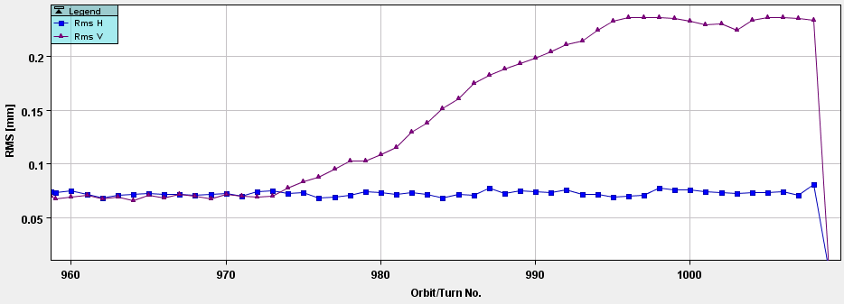
Heater firing with circulating beam @ 6.5 TeV versus 450 GeV
6.5 TeV: reaching full kick within 2-3 turns
450 GeV: reaching full kick within ~20 turns

Slide 6
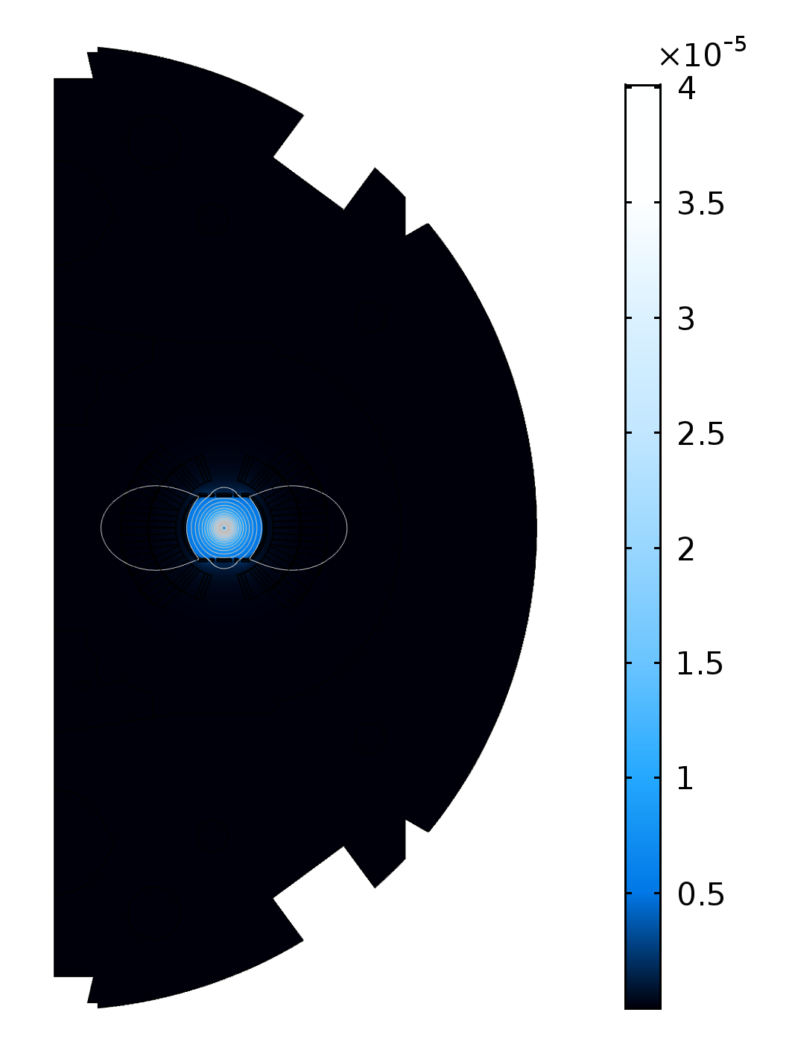
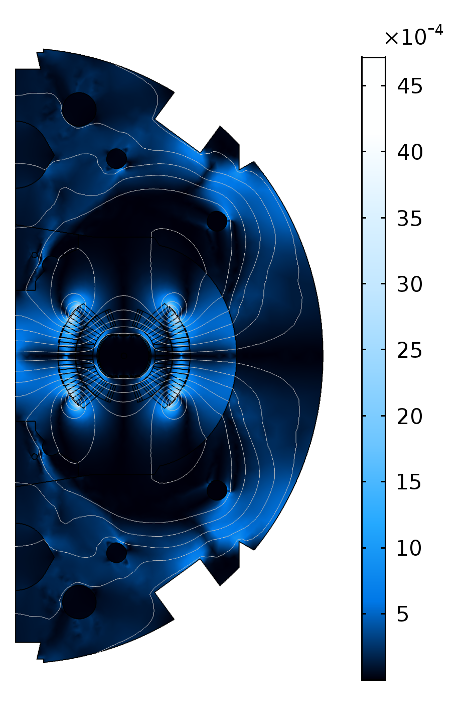
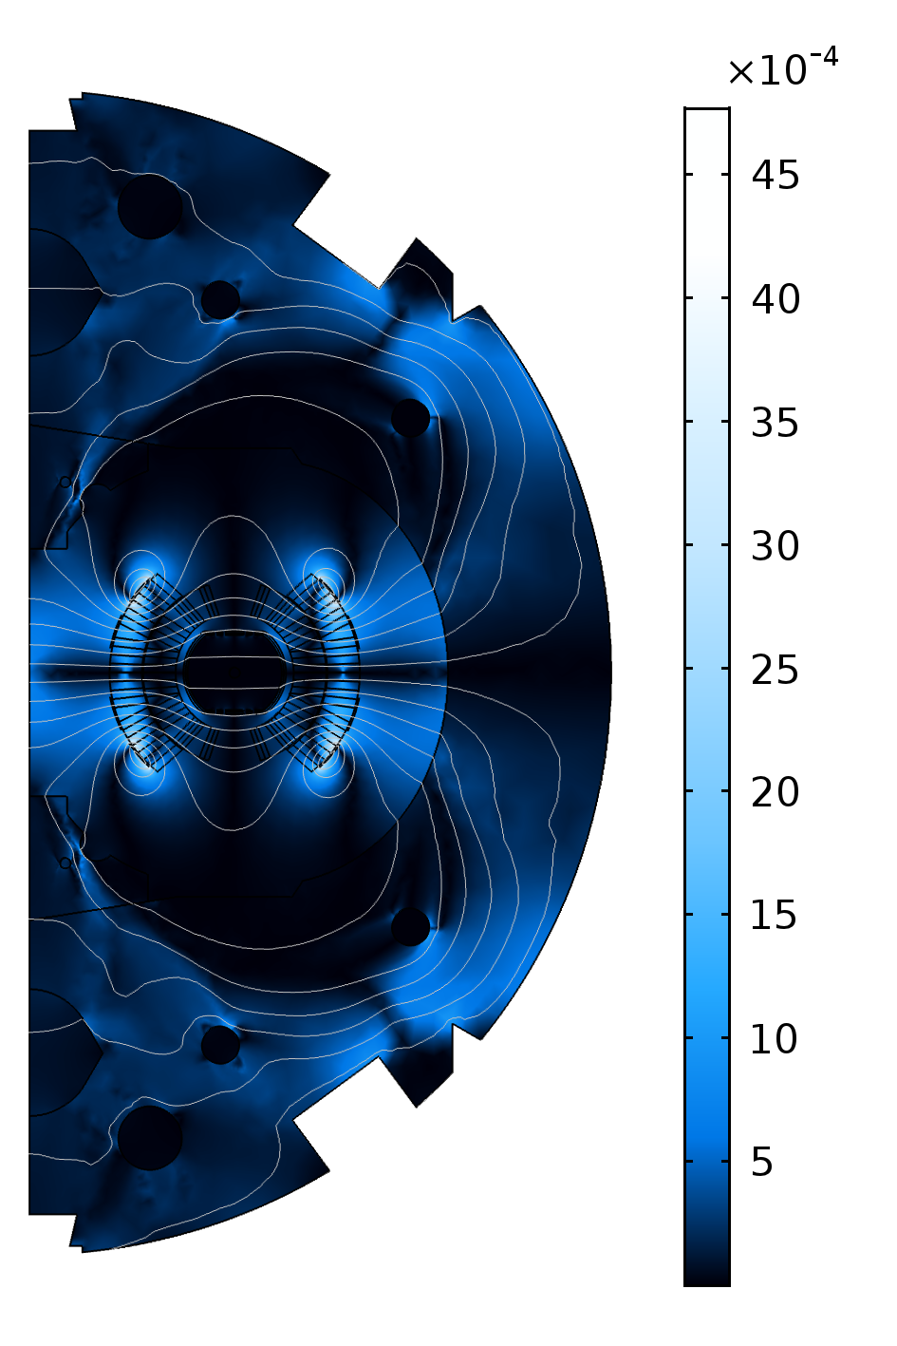
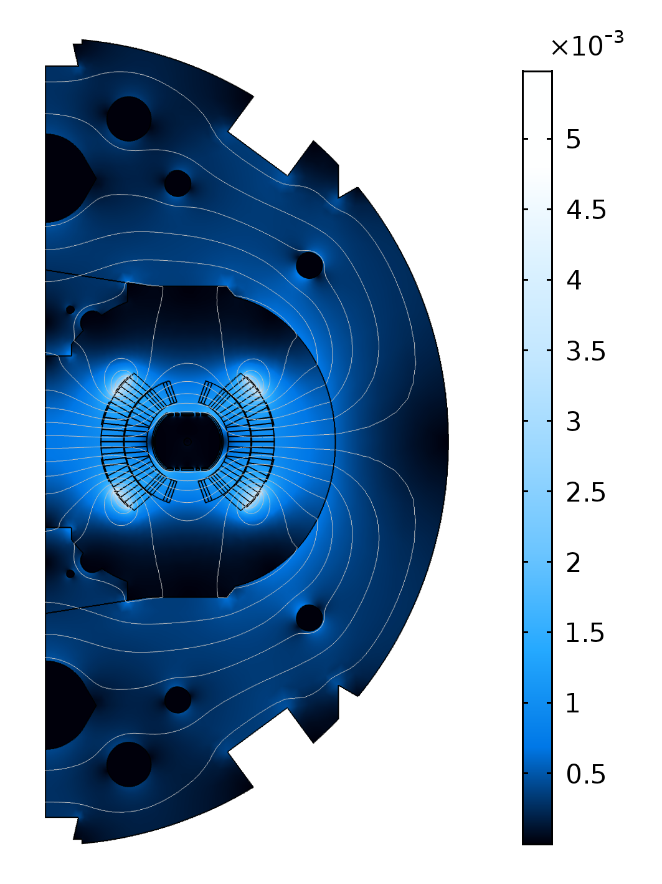
Simulations model
2D COMSOL model of LHC main dipole with quench heaters, main coils and beam screen to the study the effect of:
  Eddy currents in the beam screen (RRR=100)
  Inter-filament and Inter-strand coupling currents in the superconducting coil and copper matrix
  Magneto resistivity of the main coil @ 11.85 kA
on the magnetic field in the beam plane caused by the discharge of the quench heaters.
0 us
100 us
1000 us
[T]
[T]
[T]
T = 0 us: only beam and the image currents in beam screen, triggering of quench heater discharge
T = 100 us: Quench heaters at full field, beam screen is repelling the magnetic flux from the quench heater discharge.
T = 1000 us: Magnetic flux penetrating into beam plane

Slide 7
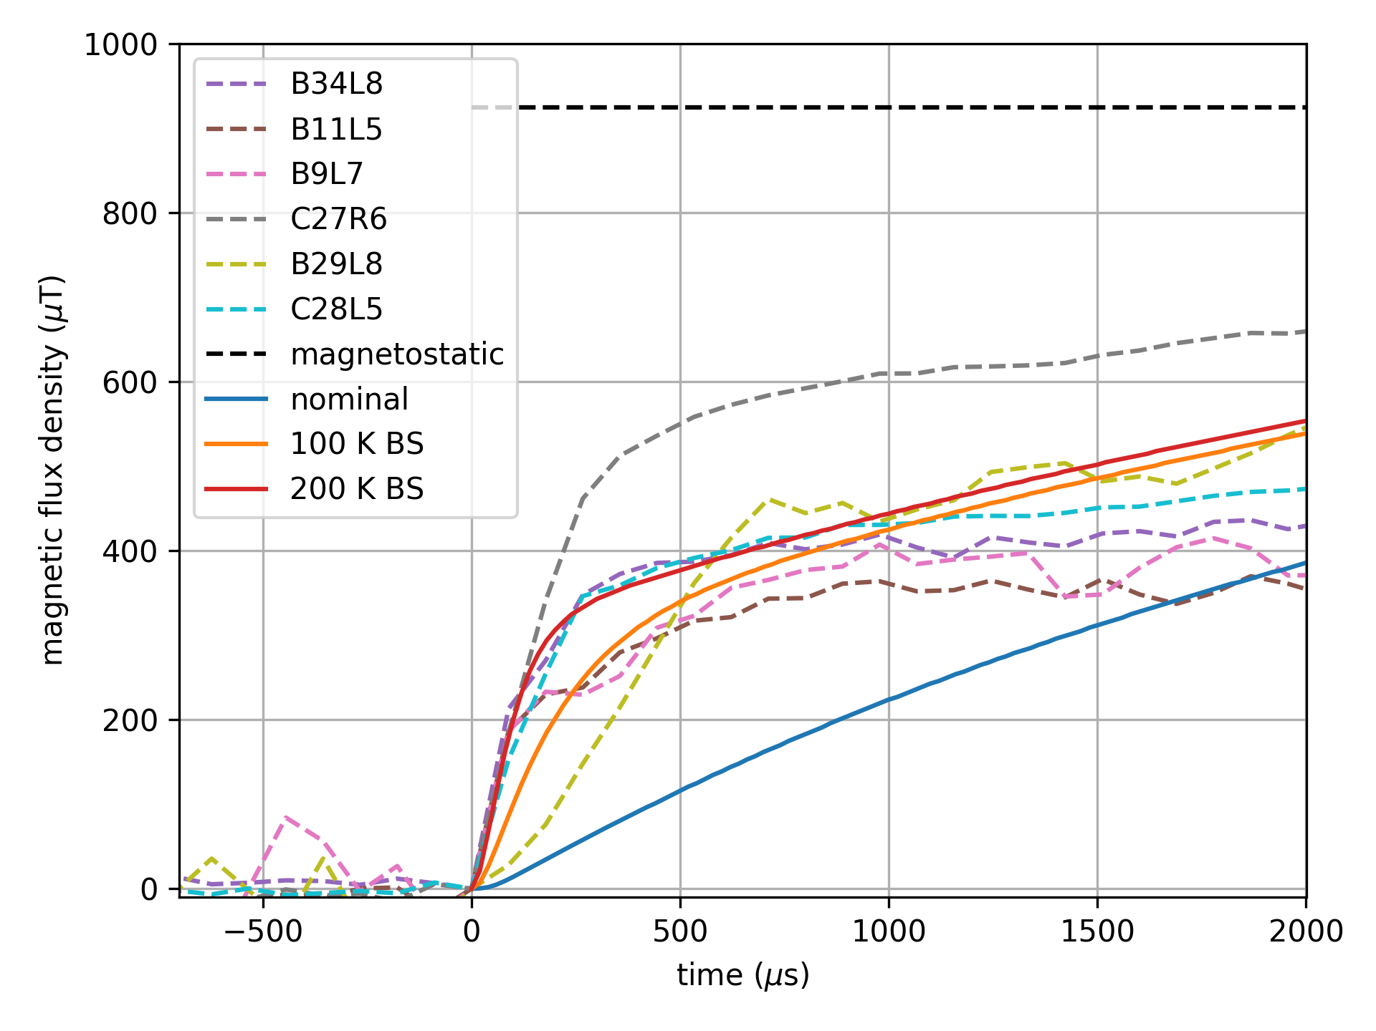
Simulations versus beam measurements
Measurements at
6.5 TeV (quenches):
Fast onset of kick <5 turns)
40-60% of kick strength expected by magneto-static simulations
Simulations:
Nominal beam screen parameters should lead to 4 times slower onset
Increased beam screen resistance leads to comparable behavior as measurements

Slide 8
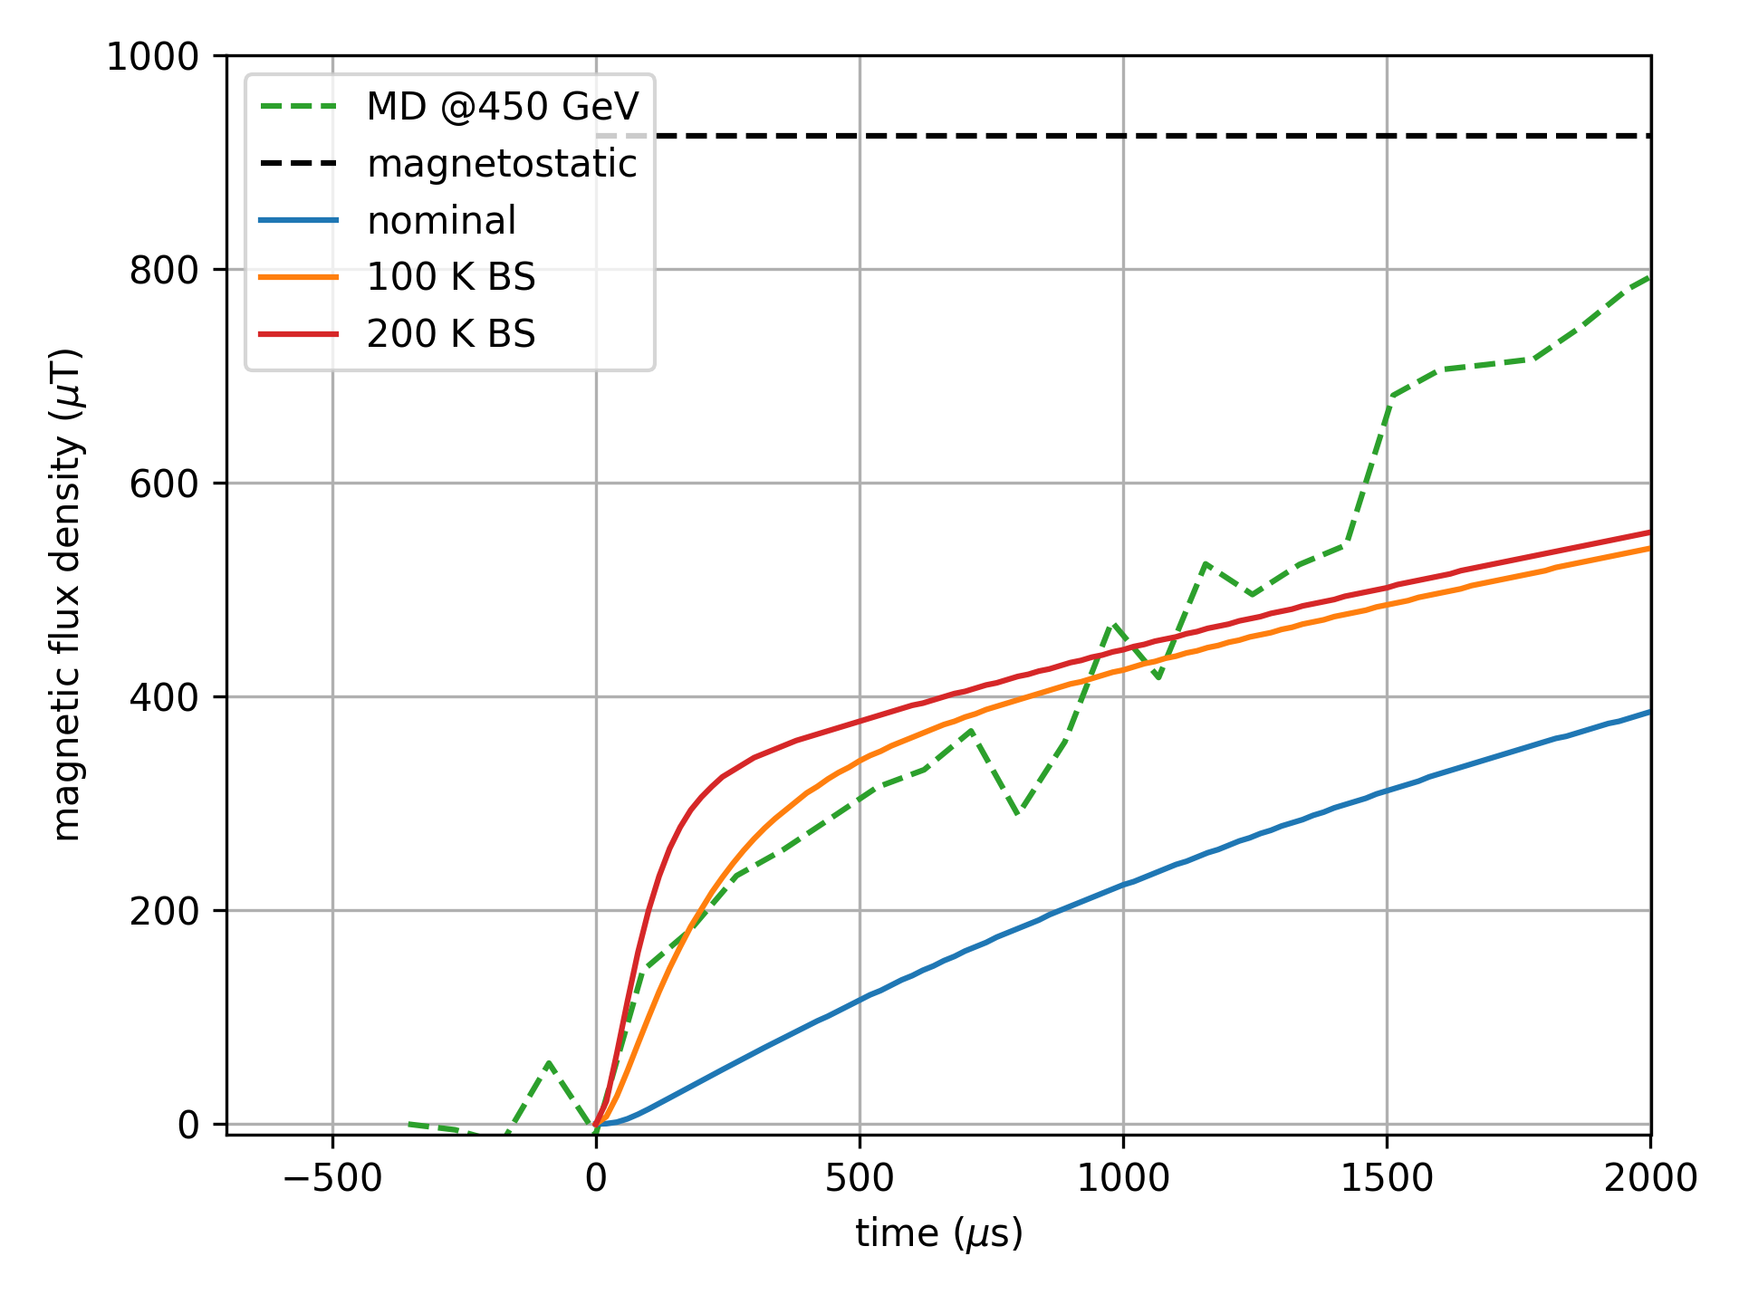
Summary of Simulation results
Simulations can reproduce the measured results
Beam screen plays the major role.
Significantly increased beam screen resistance of 8.5 x 10⁻⁹ Ωm would be required:
    Strongly degraded RRR?
    Heating of beam screen due to quench?

Slide 9
Conclusion & Outlook
Circulating beam experiences very fast kick from quench heaters: non-critical in LHC; critical for HL-LHC (triplets IP1/5, D1, D2)
Interlocking of quench heater discharge mandatory for new HL-LHC circuits and improved connection schemes for QH to reduce skew dipole kicks
Fast onset of quench heater kick reproducible in simulations with strongly increased beam screen resistance
Further experiments with beam (LHC, 6.5 TeV) and in magnet test station (SM18) required to further study shielding effect of beam screen

Slide 10
References
Impact of Superconducting Magnet Protection Equipment on the Circulating Beam in HL-LHC, IPAC’18, Vancouver
Polarities Connection for the MQXF magnets’ QHs/CLIQ for Voltage to Ground and Beam-Kick Optimisation, HL-MCF Meeting # 25
CLIQ and quench heater firing effect on the beam, HILumi Collaboration Meeting 2017

