Slide 1

HL-LHC
WP3 - D2 14 m long shells manufacturing solution
51st HL-LHC TCC meeting - 07.06.2018
Arnaud Foussat, TE-MSC

Slide 2
Summary
Scope of D2 recombination dipole procurement
LMBRD cold mass 2017 baseline
Issues with long shell procurement
Alternative manufacture route: orbital butt welding
Impacts from new 2018 baseline
Conclusions.

Slide 3
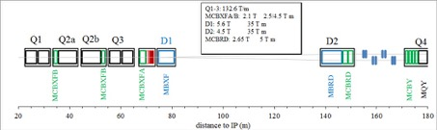
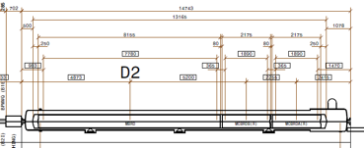
Scope of D2 cold mass procurement
New HL-LHC Nb-Ti D2 recombination Dipole to be built for IR1 and IR5
Short Model under construction at ASG, 1 unit, AP 105 mm, 4.5 T, 1.6 m long, planned for cold test at SM18 from 10/2018.
Prototype MBRD (D2): 1 unit, AP 105 mm, 4.5 T, 35 T.m, 7.8 m
Series MBRD (D2): 4 units + 2 spares, AP 105 mm, 4.5 T, 7.8 m
Double aperture correctors MCBRD: 8 + 2 spares, 105 mm, 2.2 T, 1.9 m
Integrated LMBRD cold mass length: 13 165 mm

Slide 4
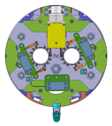
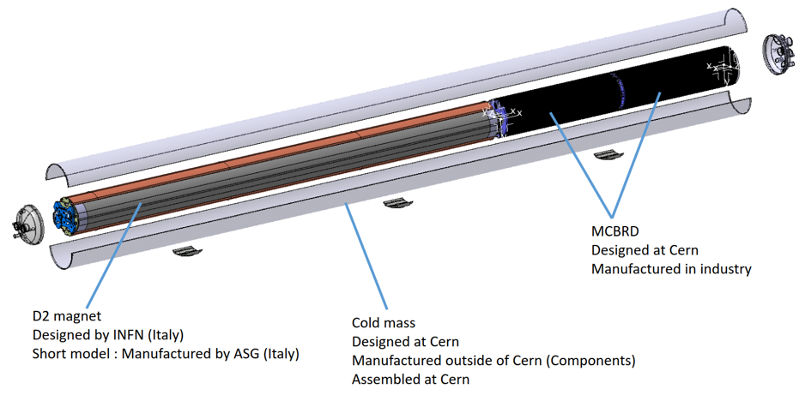
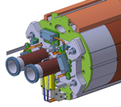
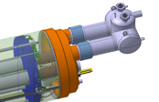
D2 cold mass 2017-2018 baseline
First CM version with entire 14 m long half shell pieces
(1.4429 stainless steel material AISI 316 LN, edms /1690902/1)
Half SS 316LN shell
( CCT coils)

Slide 5
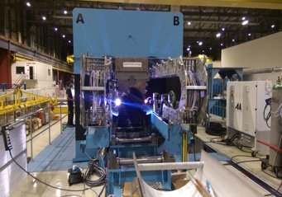
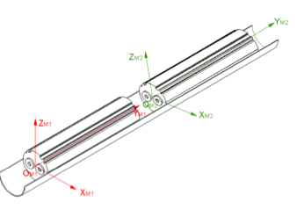
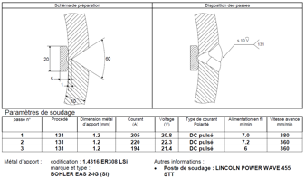

Common cold mass welding assembly
Pre alignment of CM(s) in craddles to set yaw, roll angles using dedicated tooling ( maximum local twist of 3 mrad with respect to V1-V2 fitted plane)
D2 half shells longitudinally MIG welded under press based on past MB cold mass with limited preload ( 30 bars under press, low shrinkage )
Similar shell bevel to LHCLMQ design

Slide 6
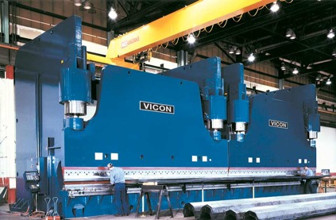
LHe containment shell technical requirements
316LN material, 8 mm thick shells, 14 m long.
Tight tolerance requirements on concentricity (1/1000 mm) , edge planarity (0.3/1000 m) and circumference [+0.5,-0.3 mm]
For small HL-LHC series production, use of industrial brake press tool for shaping. ( against past continuous rolling)

Slide 7
Issues with long SS shell procurement route
Raw stainless steel plates procurement: Recent outcome of market survey on raw 316LN long rolled flat plates (>14 m) (April 2018) resulted in only one supplier offer, at a cost five times higher than usual practise cost (30 euros/kg against mean 6 euros/kg) due to Electro Slag Remelting (ESR) heat treatment.
- This offer was disgarded by the company a month later.
Procurement of SS316LN 14 m long half shells (22 off) through press brake route:
  Early 2017 market survey (MS-4358) amongst 8 supplier companies resulted in only one positive response.
This last offer with long delivery time would have resulted in an overall material extra cost of 650 KEUR and further 140 kEUR extra cost in shell development.

Slide 8
Alternative manufacture route : butt welding
Proposed choice of butt welding between semi finished CM cylinders ( < 10 m) by automatic orbital TIG;
Manufacture sequence is affected and requires further developments:
  Assembly of LMBRD cold mass now in three steps ( 2 longitudinal welds and 1 orbital welding ) using short shells (< 10 m), first long D2 prototype planned in Jan 2020.
  The insertion of busbars, fixed point, wires are done after butt welding. New CAD design of bus fixed point and its location, weld geometry with metal protection strip under completion
  Dedicated NDT qualification tests on the orbital weld joint to be performed (EN-MME);

Slide 9
Automatic orbital TIG welding (1/2)
Last trial on TIG orbital welding back up assembly solution ( Nov 2017), using 5 passes on U-bevel joint shown good results ( maxi transverse deviation 0.3 mrad ) on worst-case free tubes assembly. -2.5 mm axial shrinkage.
The tooling is compatible with an on-line repair of weld bead and corrections to allow further passes to be applied.
  New orbital Weld Qualification (QMOS) approved by third party to be developed; UT inspection per quality level B ISO 5817.
Fig.2 a) TIG orbitasl automatic torch
Web video link
Fig.1 Polycar 60 TIG torch installed on OD 508 mm clamped rails guide
Fig.2 b) Last weld pass finish view

Slide 10
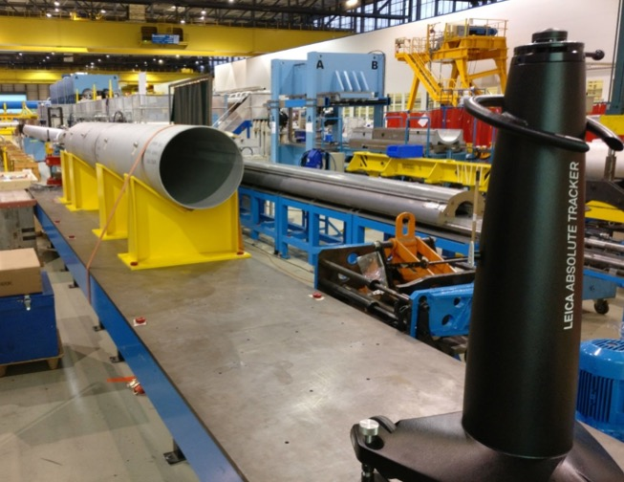
Automatic orbital TIG welding (2/2)
z
x
y
Fig 3. Use of Leica laser tracker to survey fiducial marks on both cylinder sections

Slide 11
Impacts from new assembly baseline
Orbital welding development and qualification (see TCC EDMS form for details on extra cost of 455 kEUR):
Trials of orbital welding on two mock ups shells assembly with rented equipment to evaluate parameters for welding qualification, provide weld qualification samples (QMOS), check deformations benchmarking;
Investment by LMF in an orbital TIG welding equipment tool, its power supply, and training of personnel;
Extra CM support tooling, dedicated alignment tool (LMF);
UT NDT qualification of orbital welding, test procedure with EN-MME;
Resources, manpower dedicated to extra welding, stand preparation steps : ∼ 1.4 FTE.year.
Schedule update with 1.5 months per cold mass to include extra welds preparation steps.

Slide 12
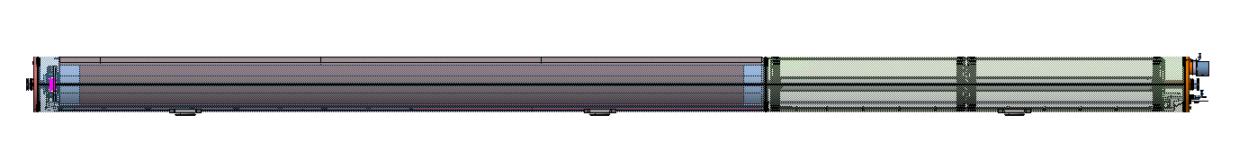
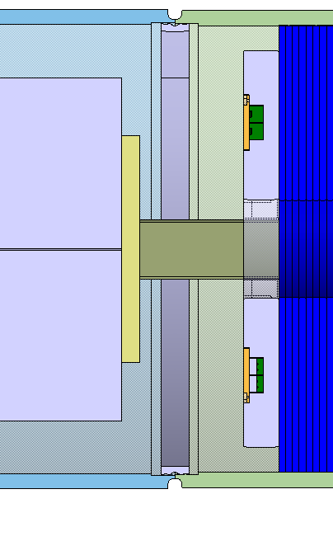
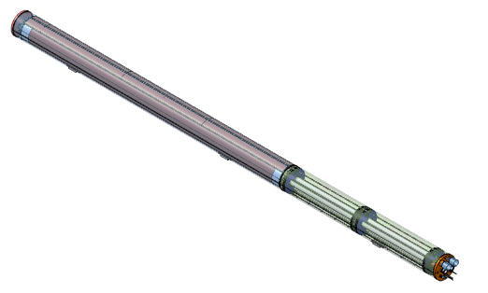
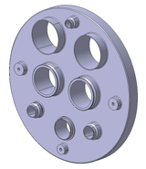
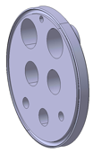
New cold mass model ( April 2018 baseline)
Updated CAD model version ready with orbital butt-weld at D2/correctors junction.
U-bevel joint
End cover design harmonised per NDT requirement, stress management.

Slide 13
Next steps
Preparation of Butt welding trials on going to set assembly procedures and weld qualification, (QMOS) and welds specimens tests (06/2018-09/2018).
Procurement of Orbital automatic welding torch, bevel machining followed by qualification of welders on final equipment by 04/2019.
Design of assembly tooling (alignment jig, clamping, survey) to be completed by 03/2019.

Slide 14
Conclusions
A technical alternative to long shell procurement has been proof tried based on orbital butt welding of semi finished D2 cold mass. The method when optimised shall be compliant with specifications;
Although requiring more development, the assembly method appears the least risky in terms of delays. NDT UT has to be qualified as no access for volumetric inspection from inside vessel.
Note that for long shell on future HFM long term needs, some friction stirring welding (FSW) joining is under investigation between half shells sections.

Slide 15
Thank you for your attention

