Slide 1
Enhancing Nuclear Security: Leveraging Non-Negative Matrix Factorization for High Sensitivity Threat Detection with Small Volume Gamma Detectors
S. Fearn, E. Connolly and P. Martin
UK Ministry of Defence © Crown owned copyright 2023/AWE

Slide 2
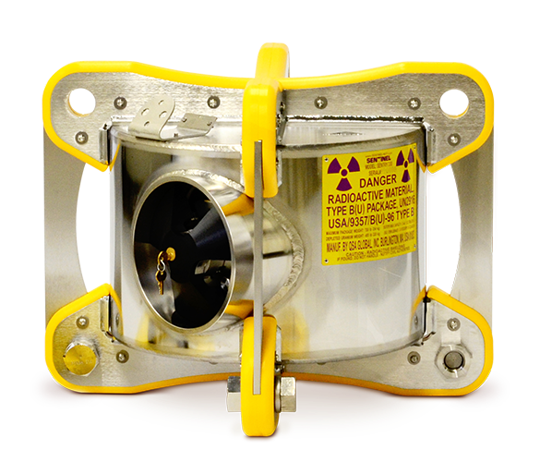
The Threat
Radioactive sources used for industrial and medical purposes
  Ranges of activities in 10s of GBq to a few TBq
Proliferated material could be used to fabricate radiological dispersal devices or ‘dirty bombs’
SENTINEL SENTRY Series Gamma Radiography Camera | QSA Global, Inc. - Up to 12 TBq of Co-60
UK Ministry of Defence © Crown owned copyright 2023/AWE

Slide 3

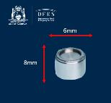

The Threat
Uranium: Man arrested over find at Heathrow airport – BBC News
Tiny radioactive capsule goes missing in Western Australia – BBC News
UK Ministry of Defence © Crown owned copyright 2023/AWE

Slide 4

The Problem
Ideally, want to be able to detect threats in transit for scenarios where material has been proliferated
Protect strategic targets and people from harm caused by dirty bombs
Screen personnel passively in high throughput areas or around ‘high value’ sites
UK Ministry of Defence © Crown owned copyright 2023/AWE

Slide 5
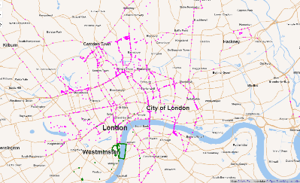
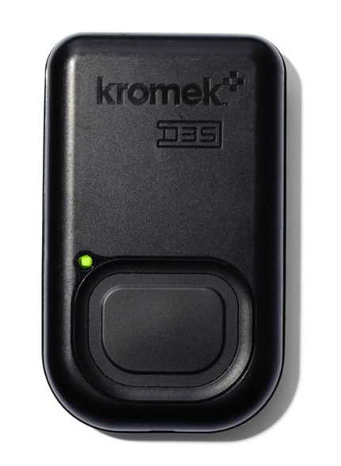
A Potential Solution
Distributed detectors:
  Portable D3S detectors - 2” x 1” x 0.5” CsI(Tl) – cheaper but lower sensitivity
    Some handheld, some static
  Larger static detectors – 2” x 4” x 16” NaI(Tl)
Data streamed every second via IoT devices to the cloud and stored
5.08 cm
2.54 cm
1.27 cm
UK Ministry of Defence © Crown owned copyright 2023/AWE

Slide 6
SIGMA Data Challenge
Make use of the obtained data, including finding and identifying any radioactive sources
Optimising the ability to identify and/or locate a threat while ignoring non-threat spectra
Looking at characterising the data in terms of what it shows and its quality
  Is it possible to apply filtering, such as rejecting data which are clearly anomalous?
However, we don’t know what is in the data!
UK Ministry of Defence © Crown owned copyright 2023/AWE

Slide 7

Machine Learning
Big data set, great for training ML models
No ground truth makes it difficult to do supervised learning
Potential for unsupervised methods - hard to know how well they are performing if sources unknown
Supervised Learning: Learns from labelled data and has a known desired output or target value. Generally used to get mapping function that can predict output for new inputs.
Unsupervised Learning: No labels. Algorithms exploit patterns, structures, or relationships within the data without any predefined target values. The goal of unsupervised learning is to discover hidden patterns, groupings, or representations in the data.
UK Ministry of Defence © Crown owned copyright 2023/AWE

Slide 8
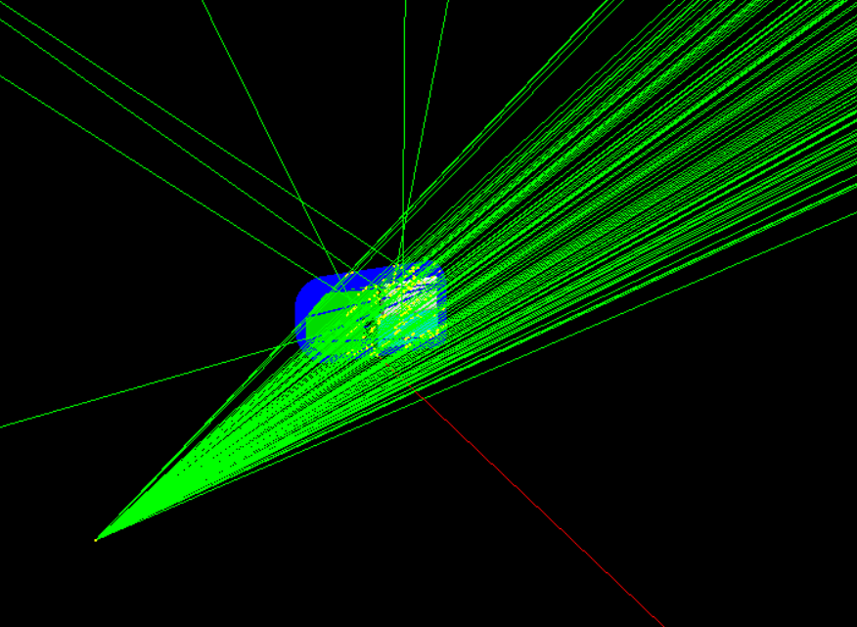
Simulating Threats
We have a very sparse real dataset, most of the spectra will be background
Possible to simulate radioactive sources and put the spectra from these into the dataset as “true” threats
UK Ministry of Defence © Crown owned copyright 2023/AWE

Slide 9
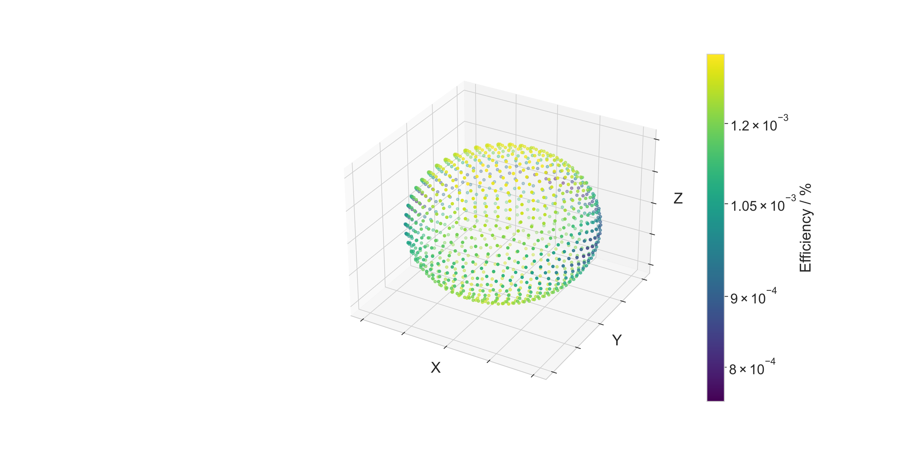
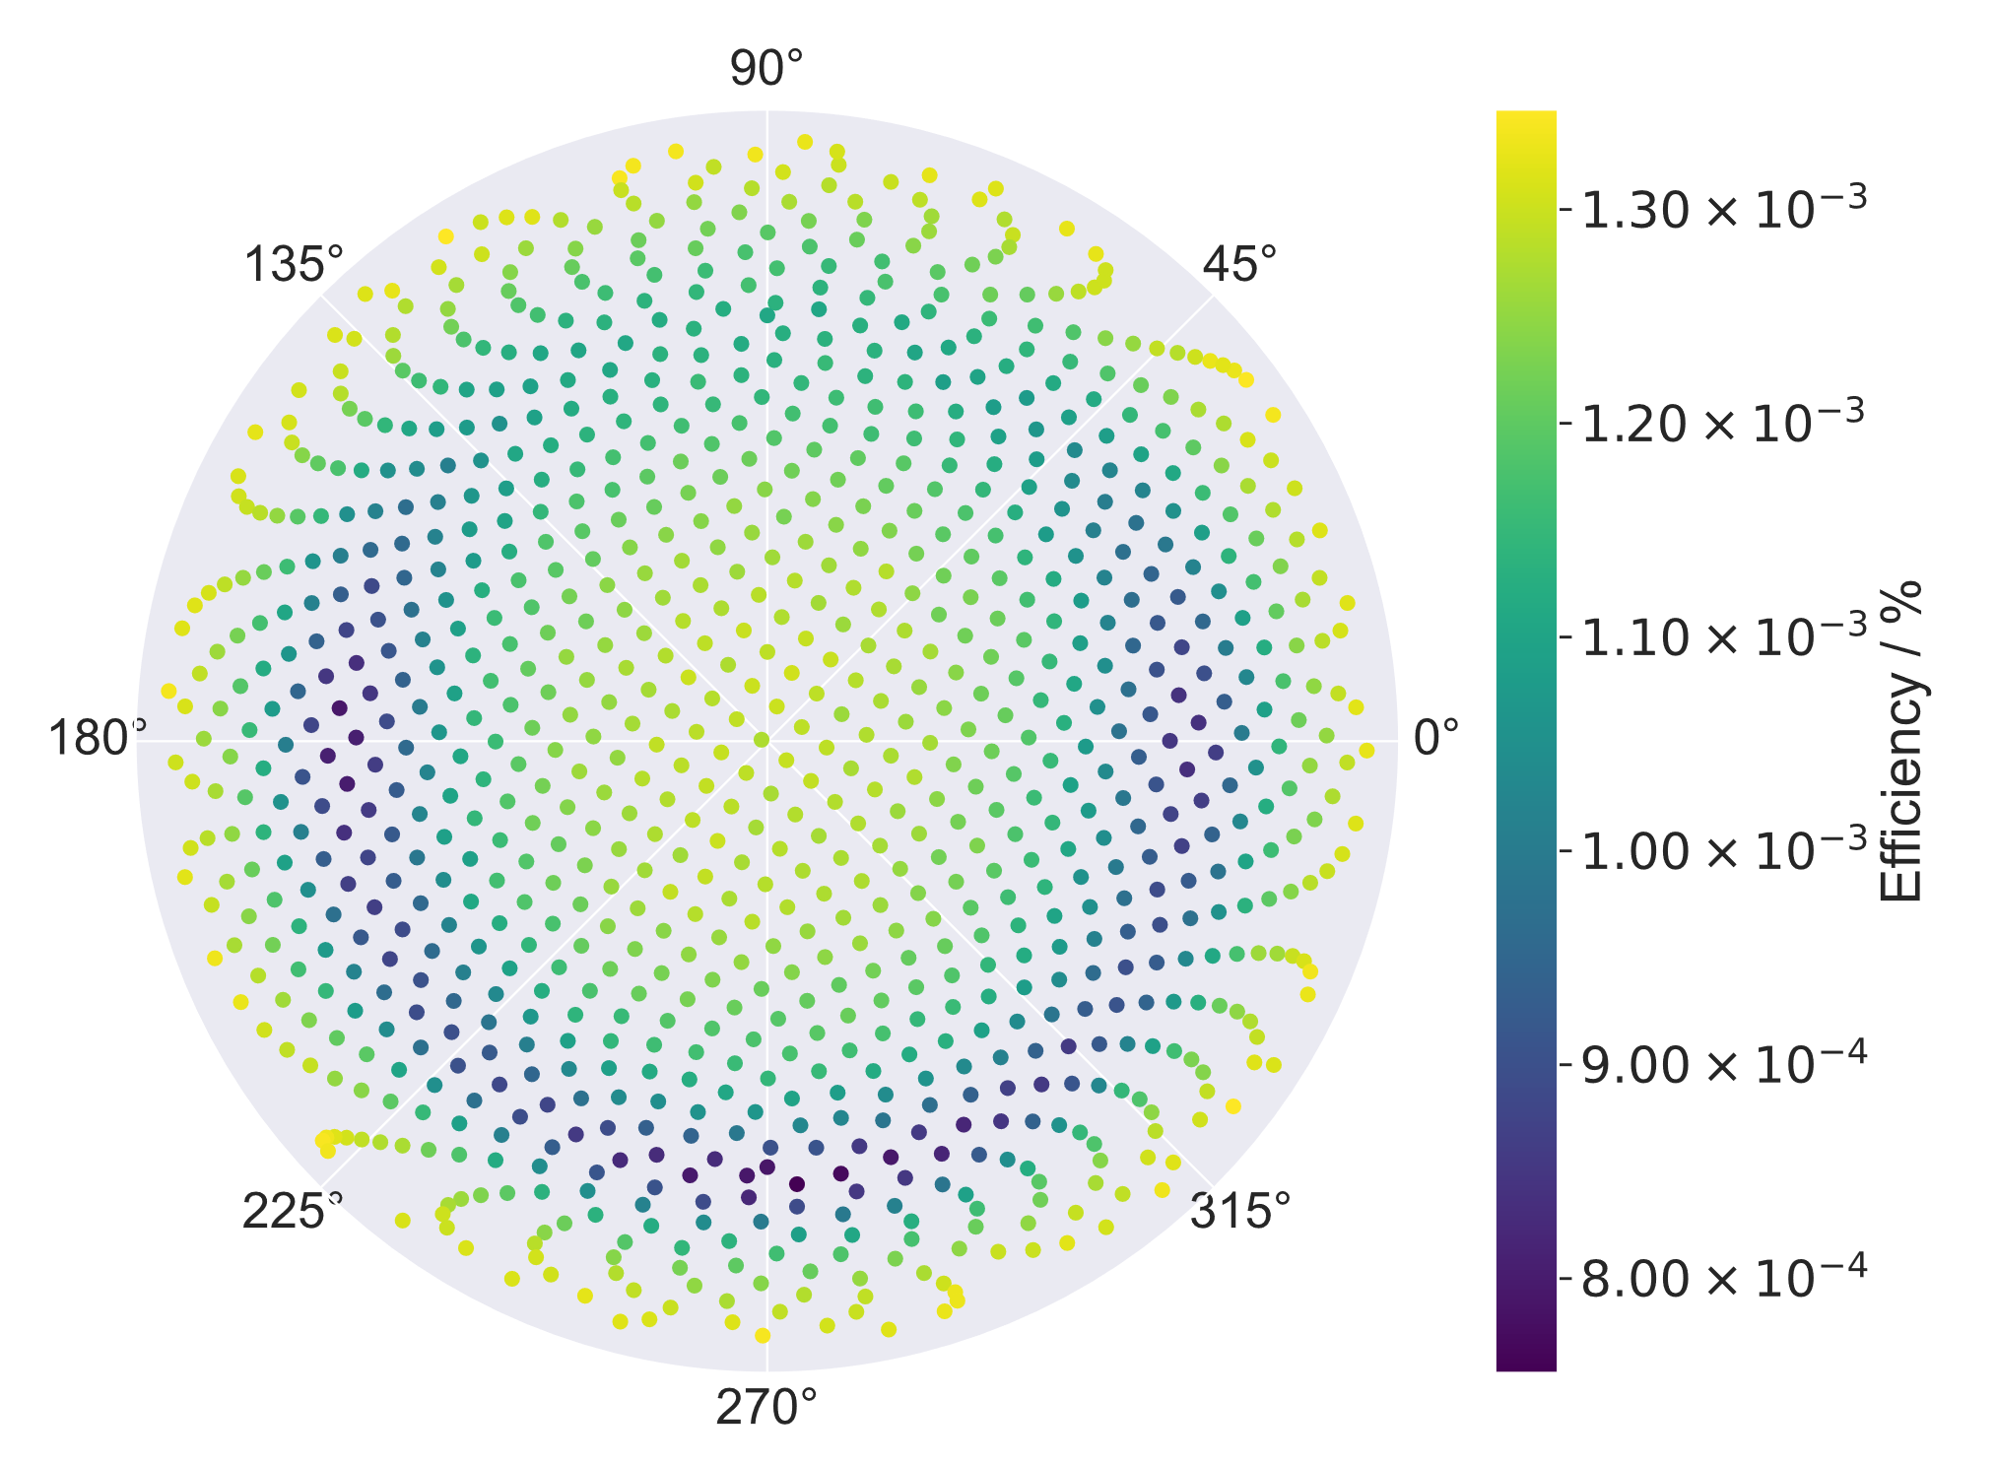
Detector Response Function
UK Ministry of Defence © Crown owned copyright 2023/AWE

Slide 10
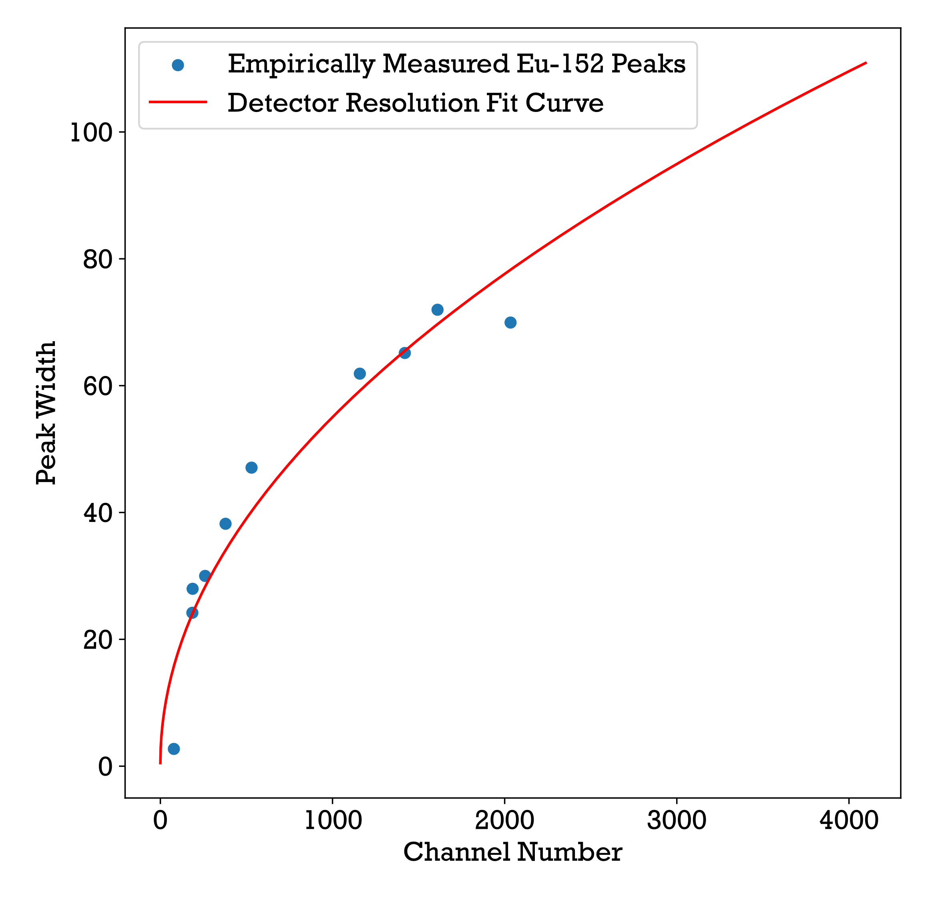
Modelling Detector Response
D3S Energy Resolution Curve
Spectral lines need to be broadened as detector response to gamma is Gaussian
By finding and fitting peak widths (FWHM) for D3S, we can simulate its response to the modelled interactions
UK Ministry of Defence © Crown owned copyright 2023/AWE

Slide 11
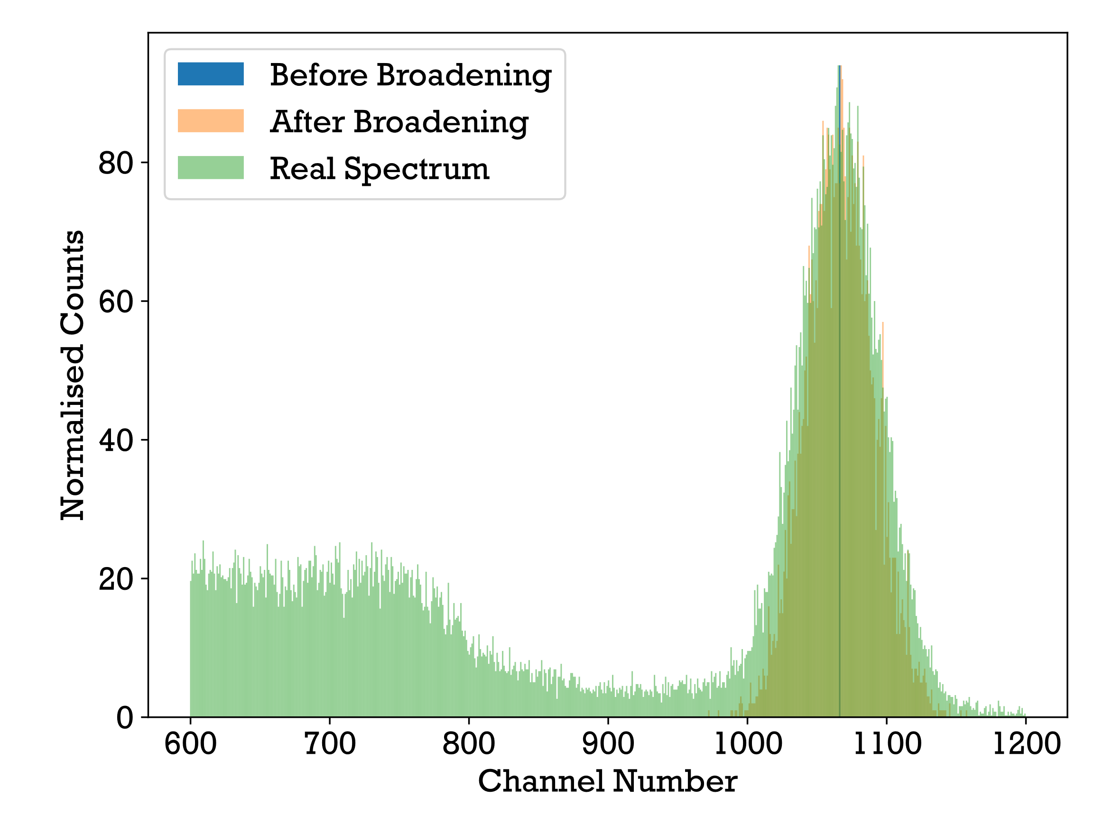
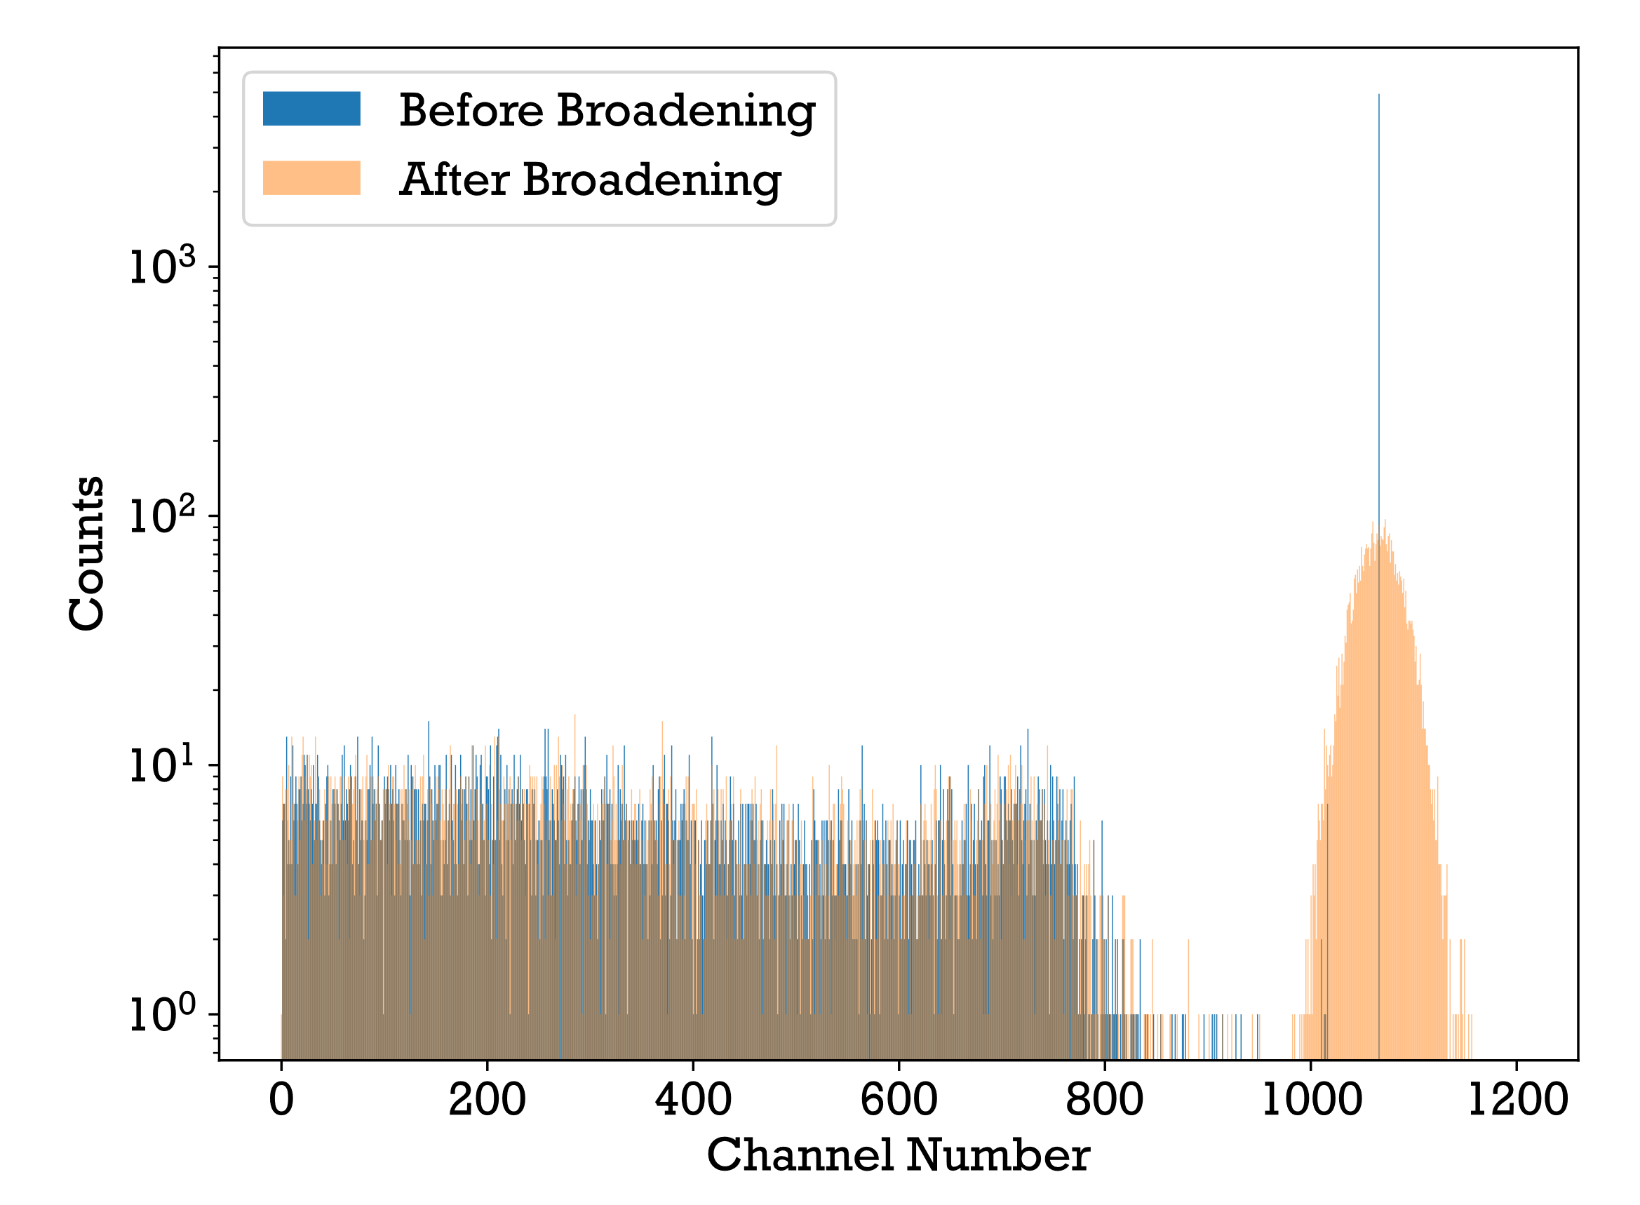
Modelling Detector Response
662 keV emission line broadening and real Cs-137 spectrum
All energy depositions modelled by GEANT4 for a 662 keV source
UK Ministry of Defence © Crown owned copyright 2023/AWE

Slide 12
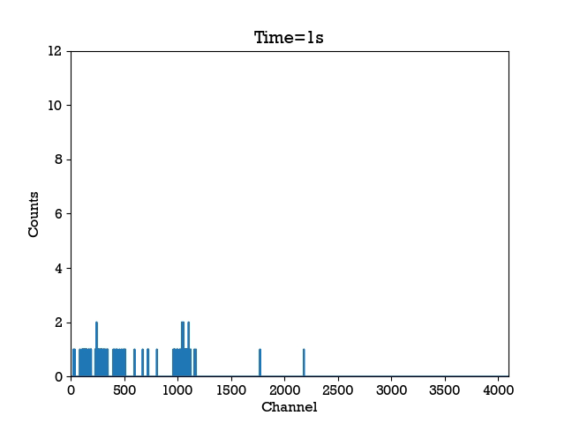
Introducing Modelled Spectra Into SIGMA Data
Modelled energy spectrum is broadened then sampled using Poisson random variable scaled by activity, detector response and distance squared.
Shielding can be factored in using attenuation coefficients, but scattering will not be accounted for unless included in GEANT4 simulations.
UK Ministry of Defence © Crown owned copyright 2023/AWE

Slide 13
Spectral Analysis for Threat Detection
Need to detect threat spectra but keep false alarm rates low.
Spectral analysis can allow better sensitivity than gross counts
Principal component analysis [1] and non-negative matrix factorisation [2] have been used to detect and identify threats in larger volume detectors
[1] Cosofret, B. et al., (2014). Utilization of advanced clutter suppression algorithms for improved standoff detection and identification of radionuclide threats. 907316. 10.1117/12.2049831.
[2] K. J. Bilton et al., (2019). Non-negative Matrix Factorization of Gamma-Ray Spectra for Background Modeling, Detection, and Source Identification, 10.1109/TNS.2019.2907267.
UK Ministry of Defence © Crown owned copyright 2023/AWE

Slide 14
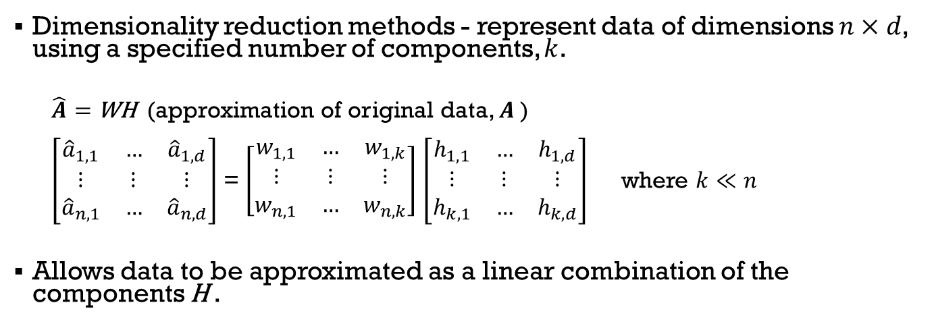
Non-negative Matrix Factorisation (NMF) and Principal Component Analysis (PCA)
Dimensionality reduction methods - represent data of dimensions $n×d$, using a specified number of components, $k$.
  $\hat{A}=$WH (approximation of original data, $A$ )
  $\left[\begin{matrix}{\hat{a}}_{1,1} & … & {\hat{a}}_{1,d} \\ \text{⋮} & \text{⋮} & \text{⋮} \\ {\hat{a}}_{n,1} & … & {\hat{a}}_{n,d}\end{matrix}\right]$ = $\left[\begin{matrix}w_{1,1} & … & w_{1,k} \\ \text{⋮} & \text{⋮} & \text{⋮} \\ w_{n,1} & … & w_{n,k}\end{matrix}\right]$ $\left[\begin{matrix}h_{1,1} & … & h_{1,d} \\ \text{⋮} & \text{⋮} & \text{⋮} \\ h_{k,1} & … & h_{k,d}\end{matrix}\right]$ where $k≪n$
Allows data to be approximated as a linear combination of the components H .
UK Ministry of Defence © Crown owned copyright 2023/AWE

Slide 15
NMF
PCA
Positive values in components – more physical in context of gamma-ray spectra.
All components account for similar amount of variation.
Components are dependent on each other, changing number of components changes all components.
Decomposition into primary modes of variation.
First component accounts for most variation.
Components independent, increasing the number does not change the first components.
UK Ministry of Defence © Crown owned copyright 2023/AWE

Slide 16
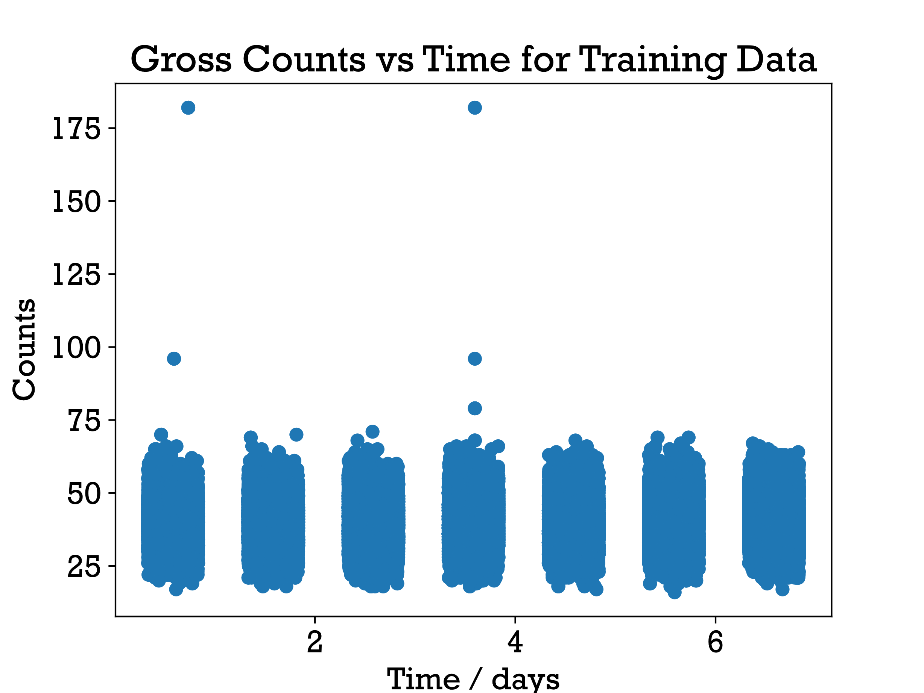
Obtaining Models
To get NMF and PCA components, chose 1 week of training data 8AM to 8PM for 1 specific detector – “D3 SGM107547” static at a bus stop outside Margaret Thatcher Infirmary.
Sampled 150,000 spectra randomly from this set for the decomposition into 100 components.
Not known what is in the data but should be sparse - majority of the spectra will be background.
UK Ministry of Defence © Crown owned copyright 2023/AWE

Slide 17
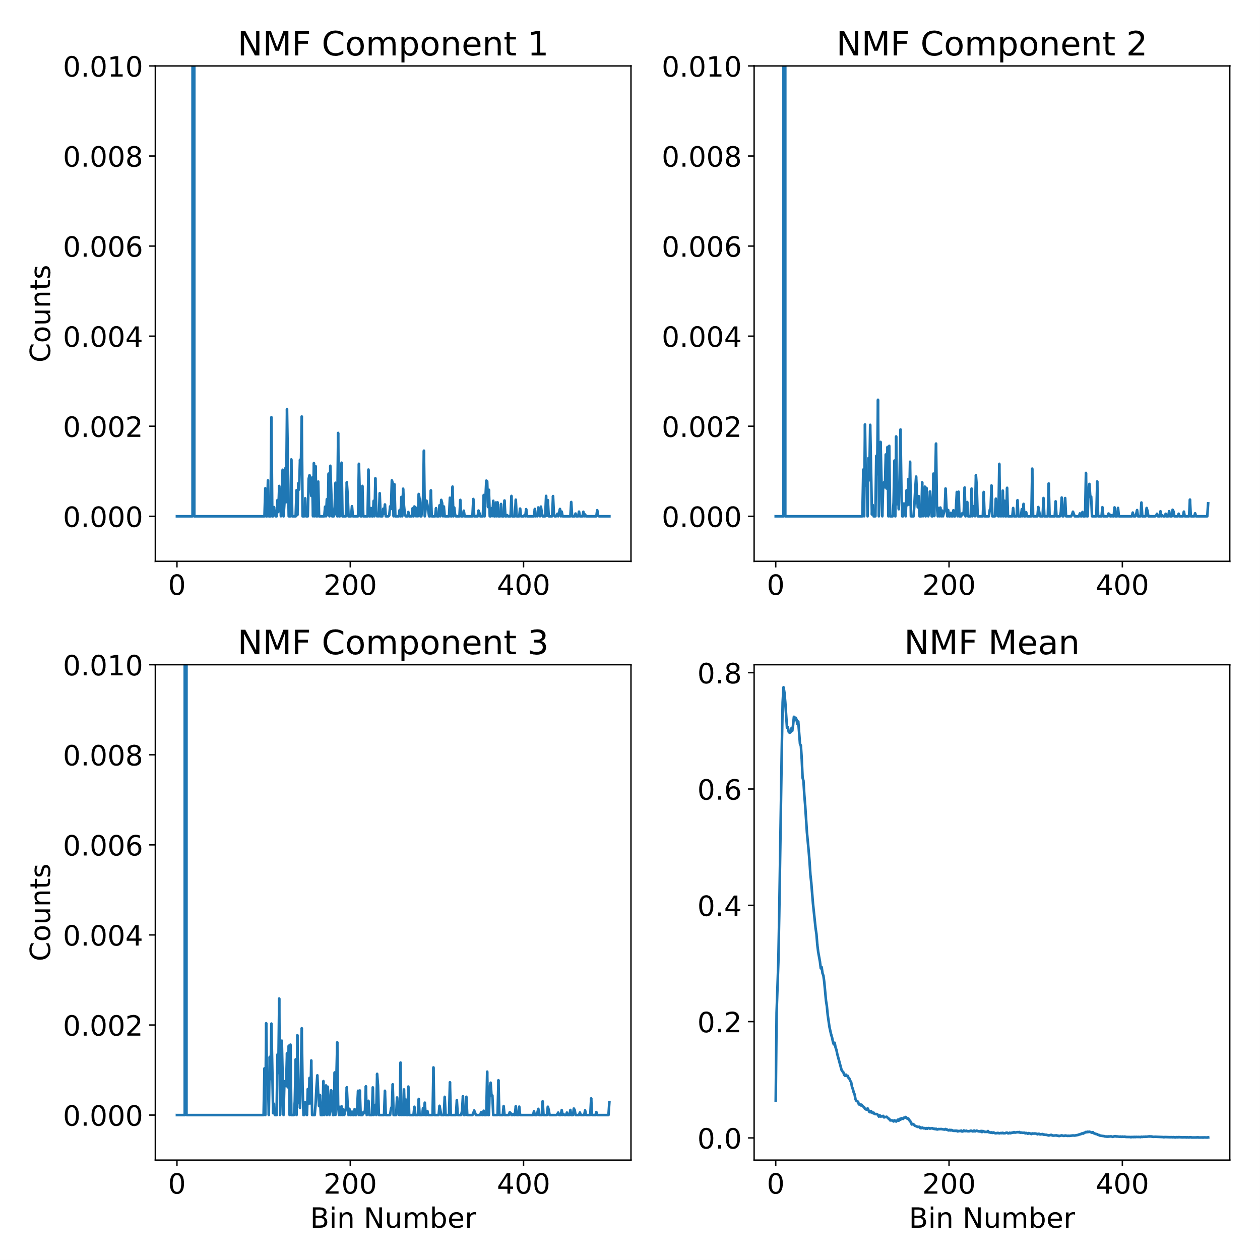
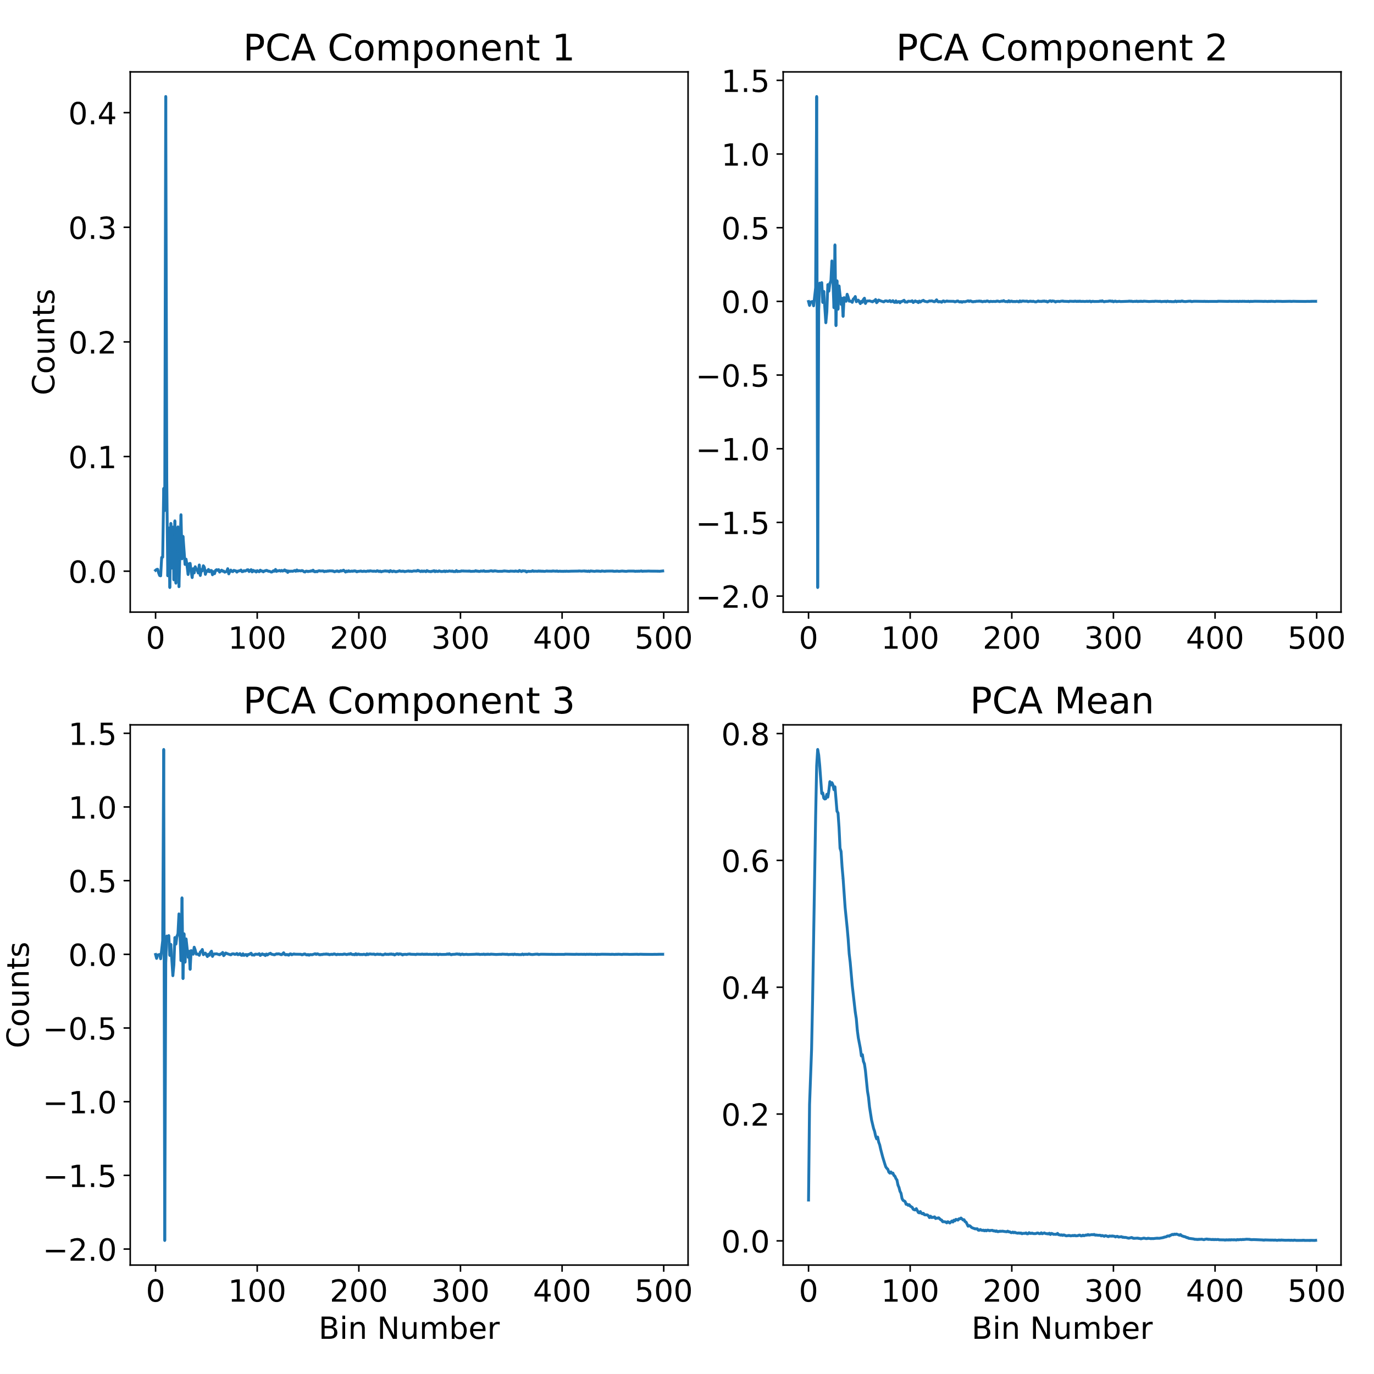
NMF
PCA
UK Ministry of Defence © Crown owned copyright 2023/AWE

Slide 18
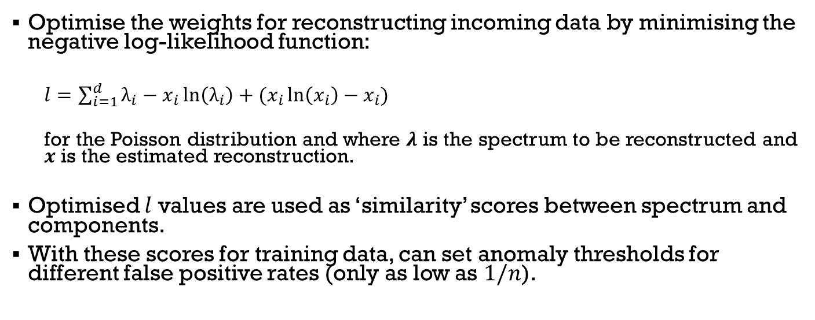
Reconstructing Data
Optimise the weights for reconstructing incoming data by minimising the negative log-likelihood function:
  $l=\sum_{i=1}^{d}{λ_{i}}−x_{i}\ln\left(λ_{i}\right)+(x_{i}\ln\left(x_{i}\right)−x_{i})$
  for the Poisson distribution and where $λ$ is the spectrum to be reconstructed and $x$ is the estimated reconstruction.
Optimised $l$ values are used as ‘similarity’ scores between spectrum and components.
With these scores for training data, can set anomaly thresholds for different false positive rates (only as low as $1/n$).
UK Ministry of Defence © Crown owned copyright 2023/AWE

Slide 19
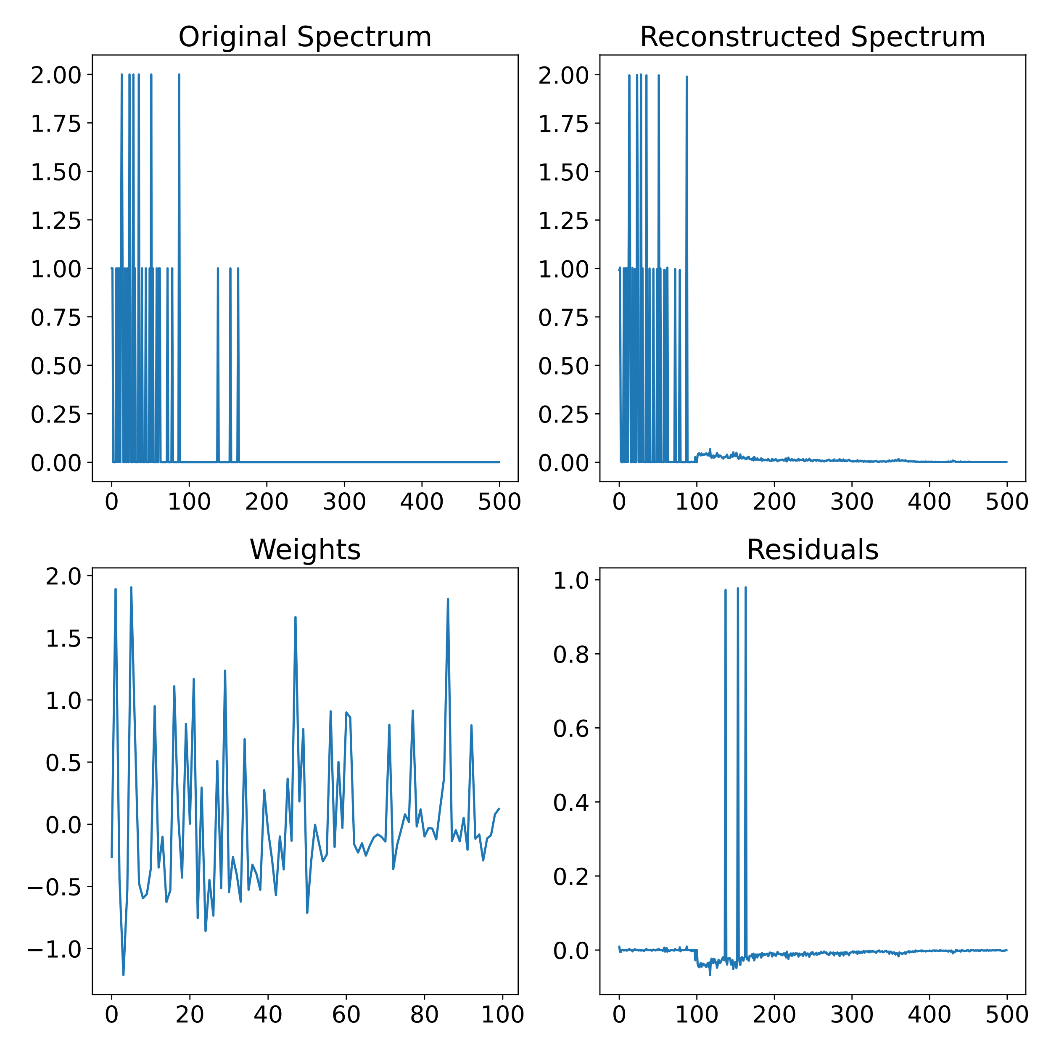
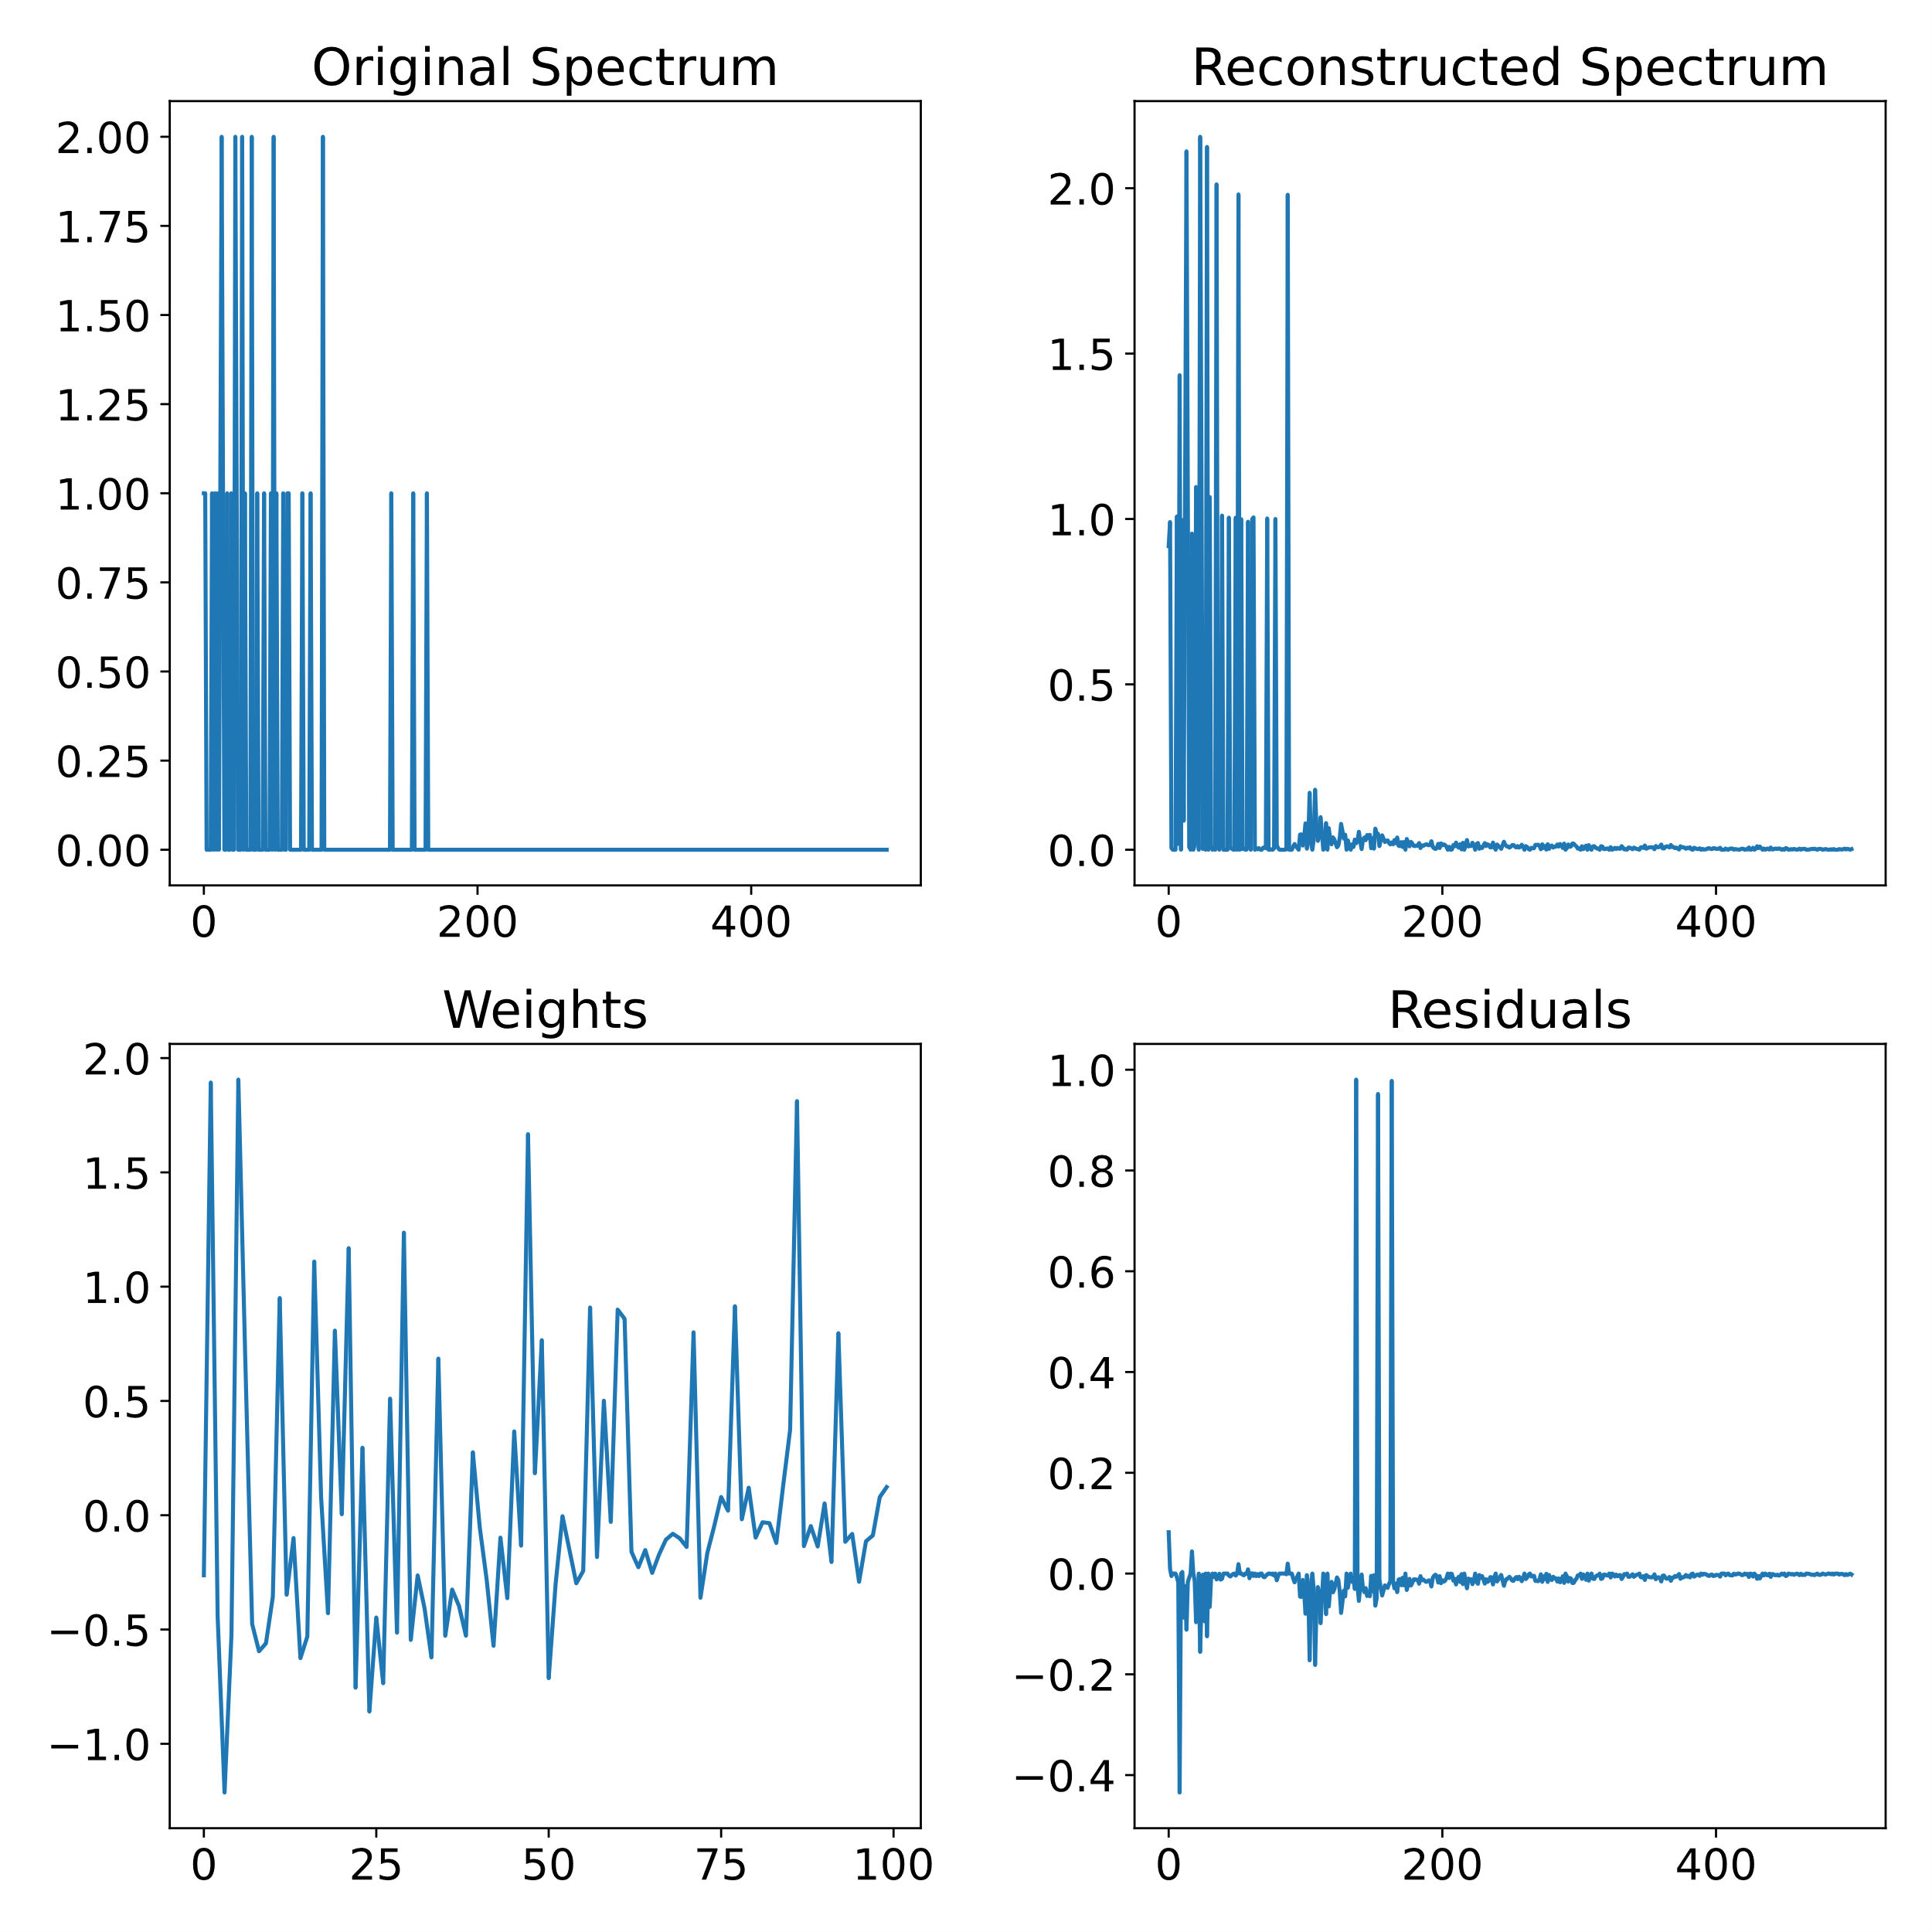
NMF
PCA
UK Ministry of Defence © Crown owned copyright 2023/AWE

Slide 20
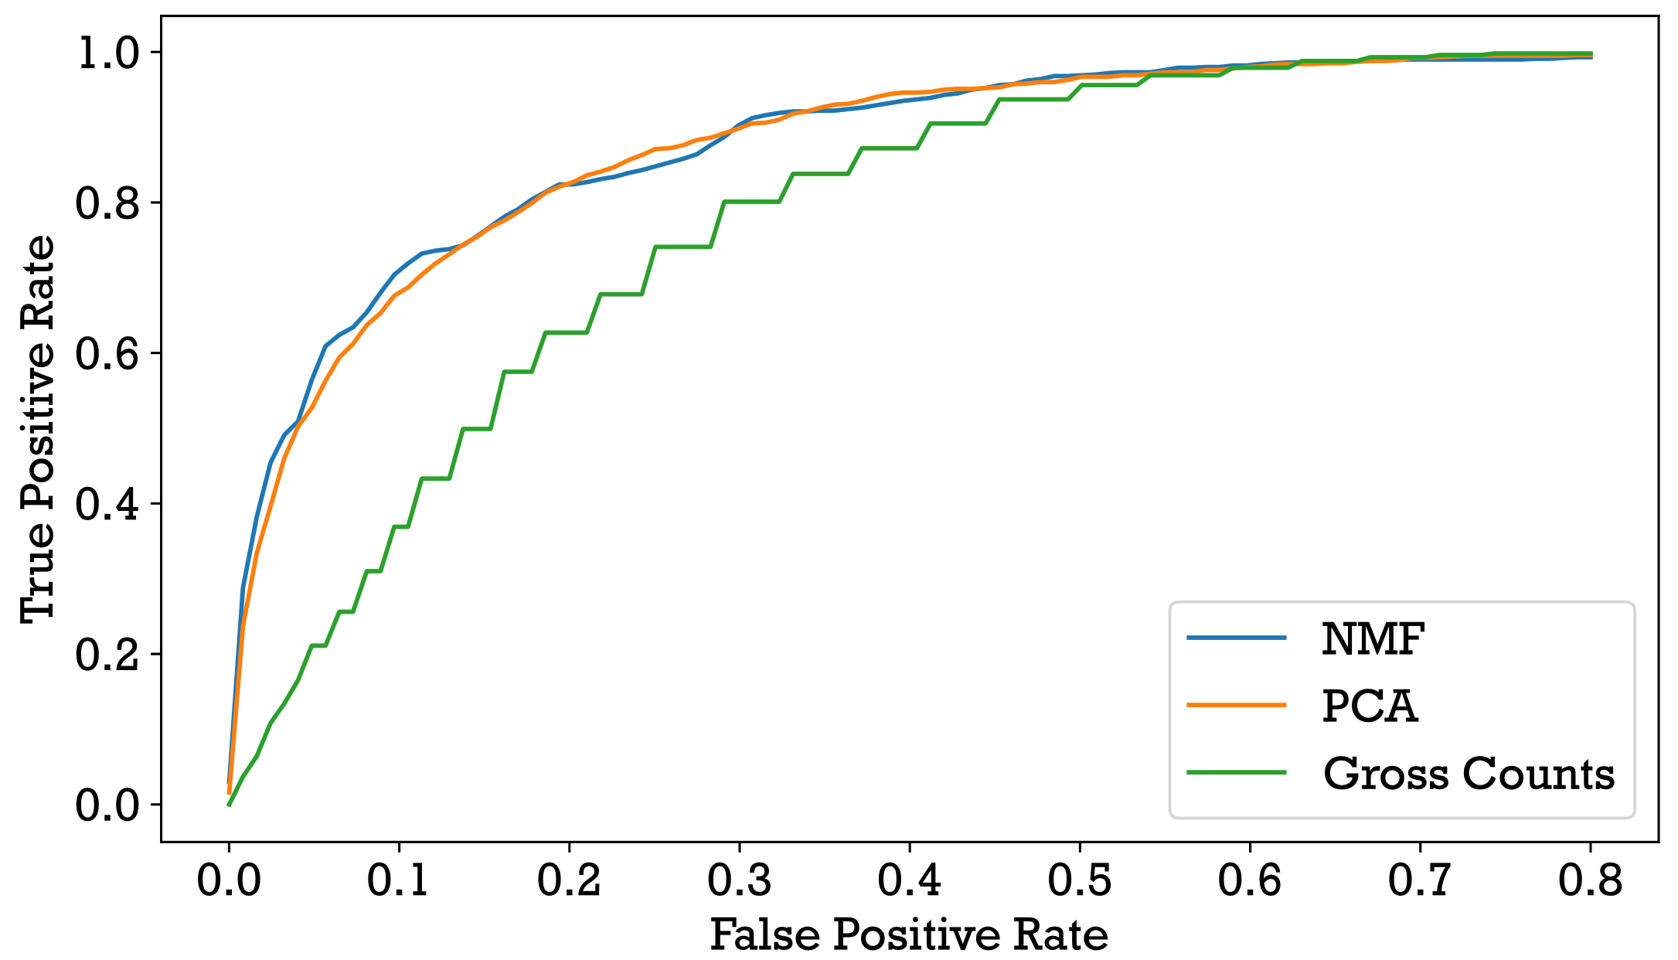
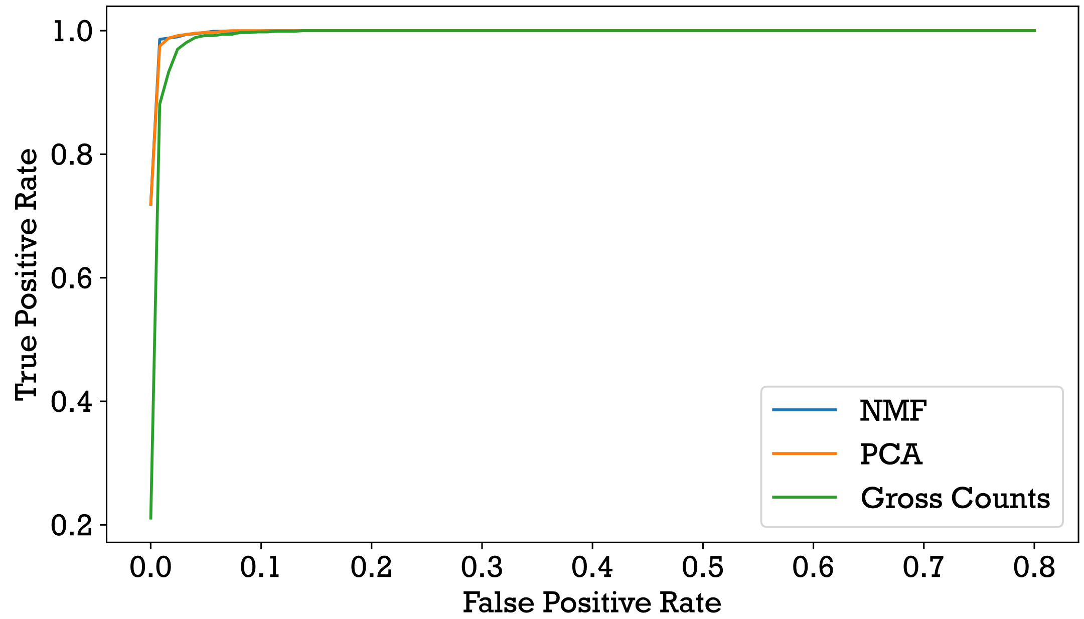
ROC Curves
[3] Currie, L. A. (1968). Limits for qualitative detection and quantitative determination. doi:10.1021/ac60259a007
Minimum detectable signal [3] = 1.80 MBq
(at an FPR of 1/8 per hour and distance of 1m from detector)
20% of min. detectable signal
60% of min. detectable signal
UK Ministry of Defence © Crown owned copyright 2023/AWE

Slide 21
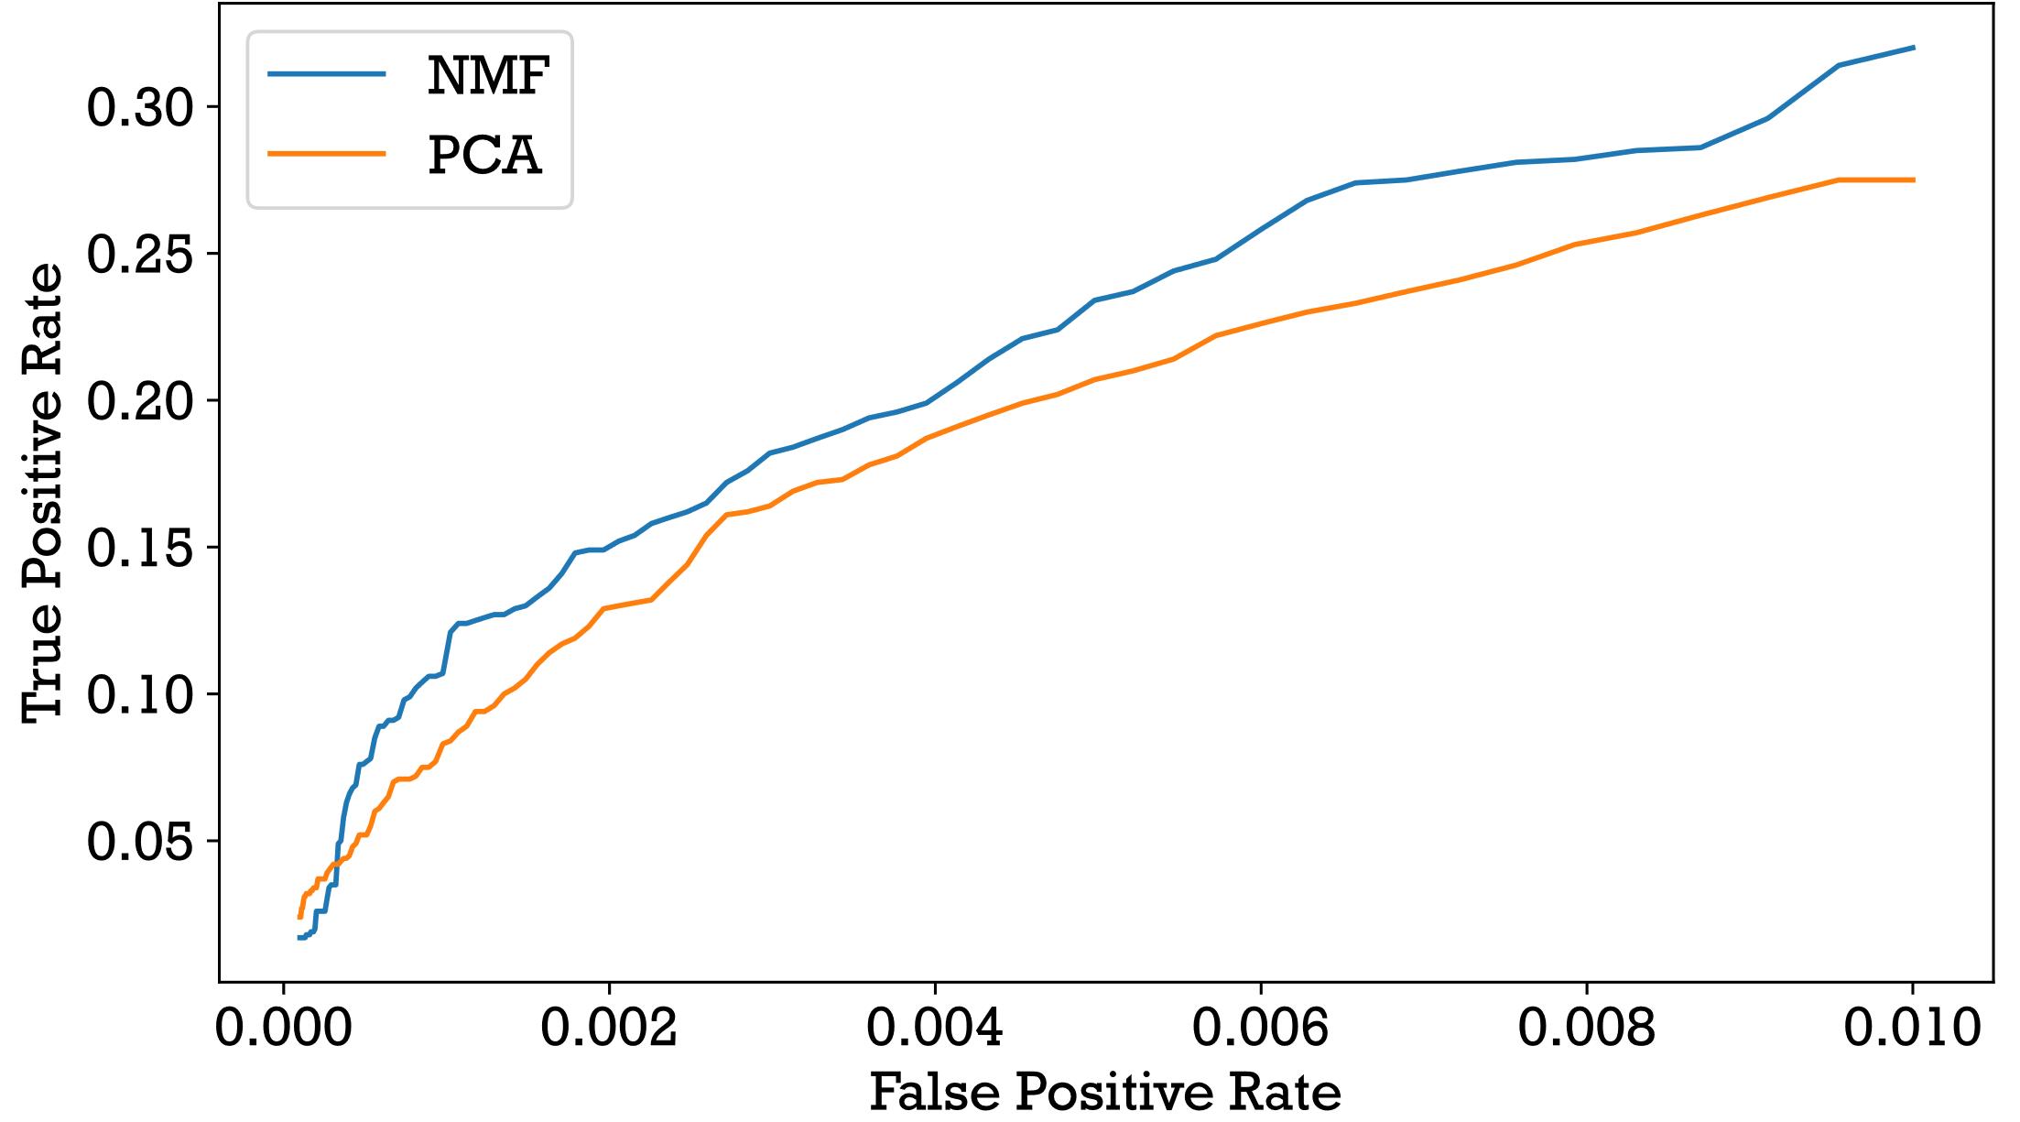
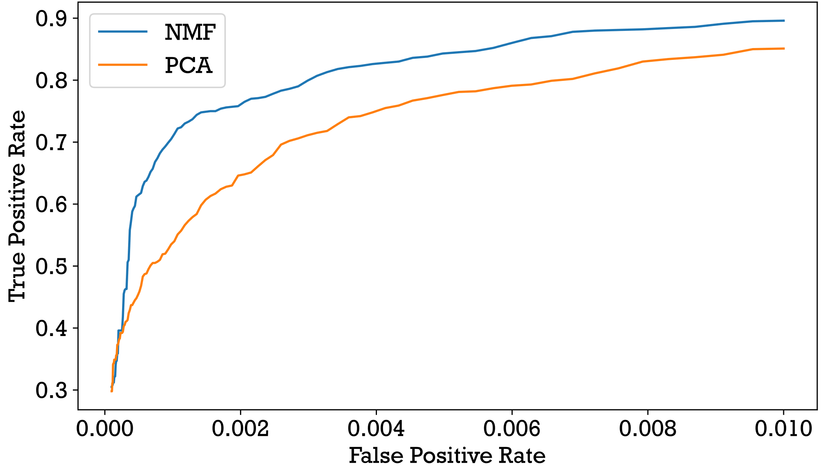
ROC Curves
Minimum detectable signal = 1.80 MBq
(at an FPR of 1/8 per hour and distance of 1m from detector)
20% of min. detectable signal
40% of min. detectable signal
UK Ministry of Defence © Crown owned copyright 2023/AWE

Slide 22
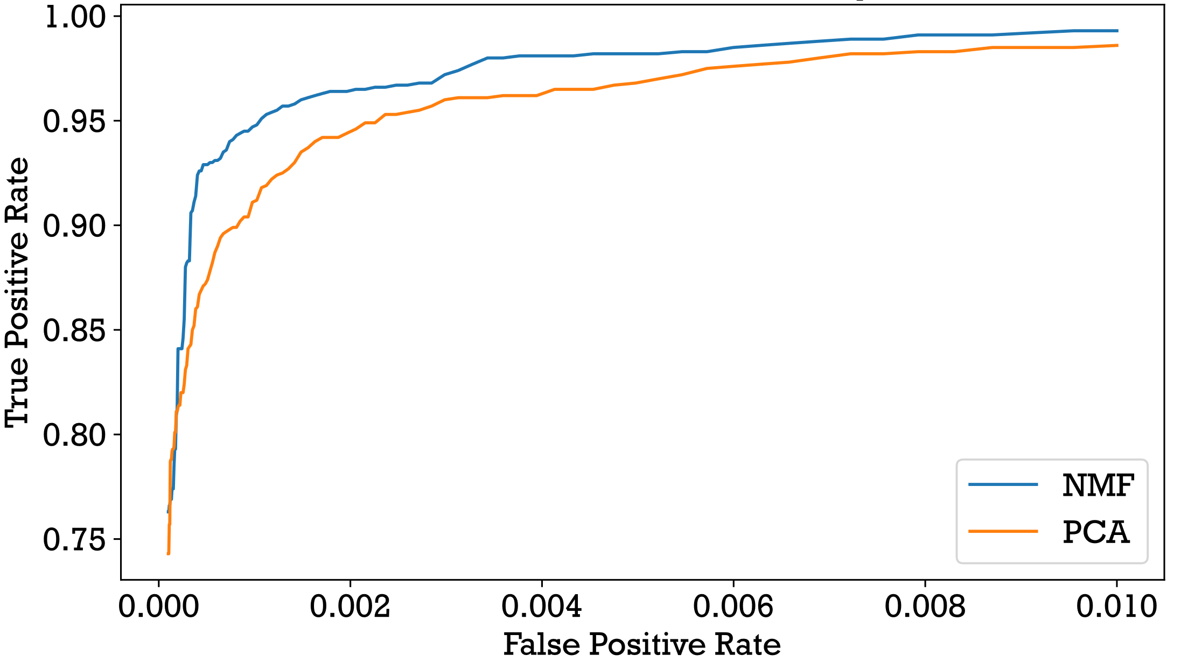
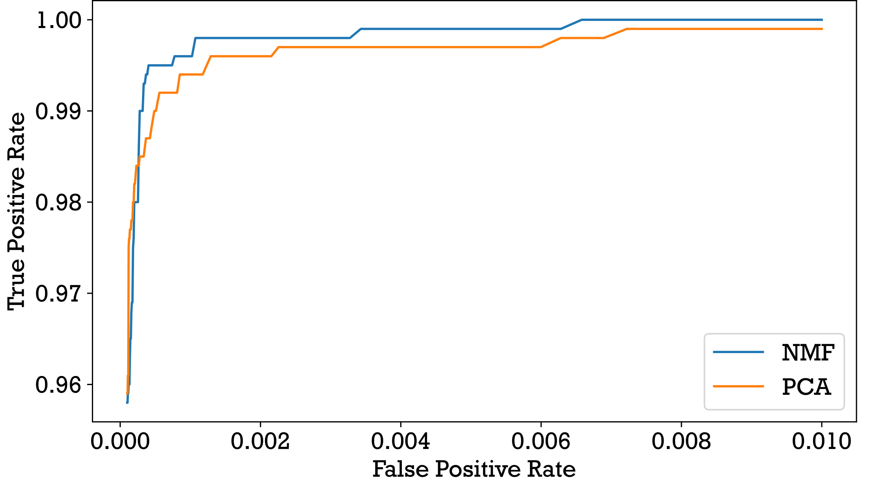
ROC Curves
Minimum detectable signal = 1.80 MBq
(at an FPR of 1/8 per hour and distance of 1m from detector)
60% of min. detectable signal
80% of min. detectable signal
UK Ministry of Defence © Crown owned copyright 2023/AWE

Slide 23
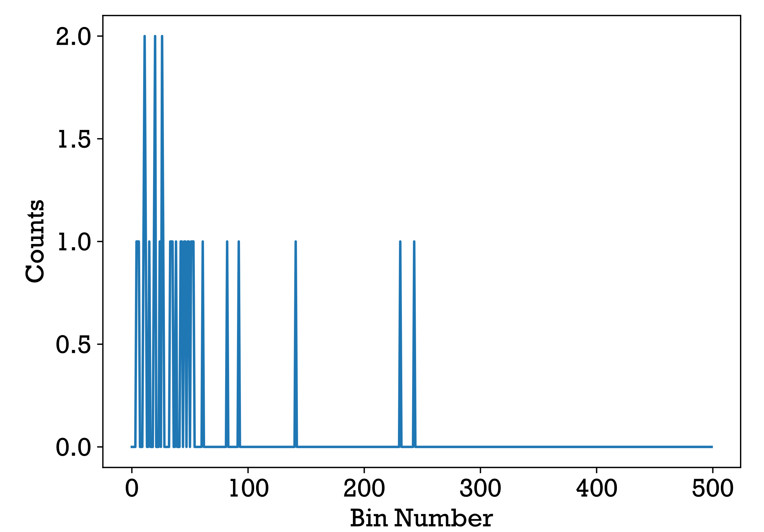
Testing on SIGMA Data
With FPR set at 1/8 per hour, tested 1 week of data from 8am to 8pm.
NMF model found 13 anomalies and PCA found 16 with 1 agreement between the two.
Implies mostly background and a few small alarms or large fluctuations in background
Anomalous spectra found using gross counts alone were not found – high counts at low energies not always caught due to most variation in this region
NMF and PCA agreed anomaly
UK Ministry of Defence © Crown owned copyright 2023/AWE

Slide 24
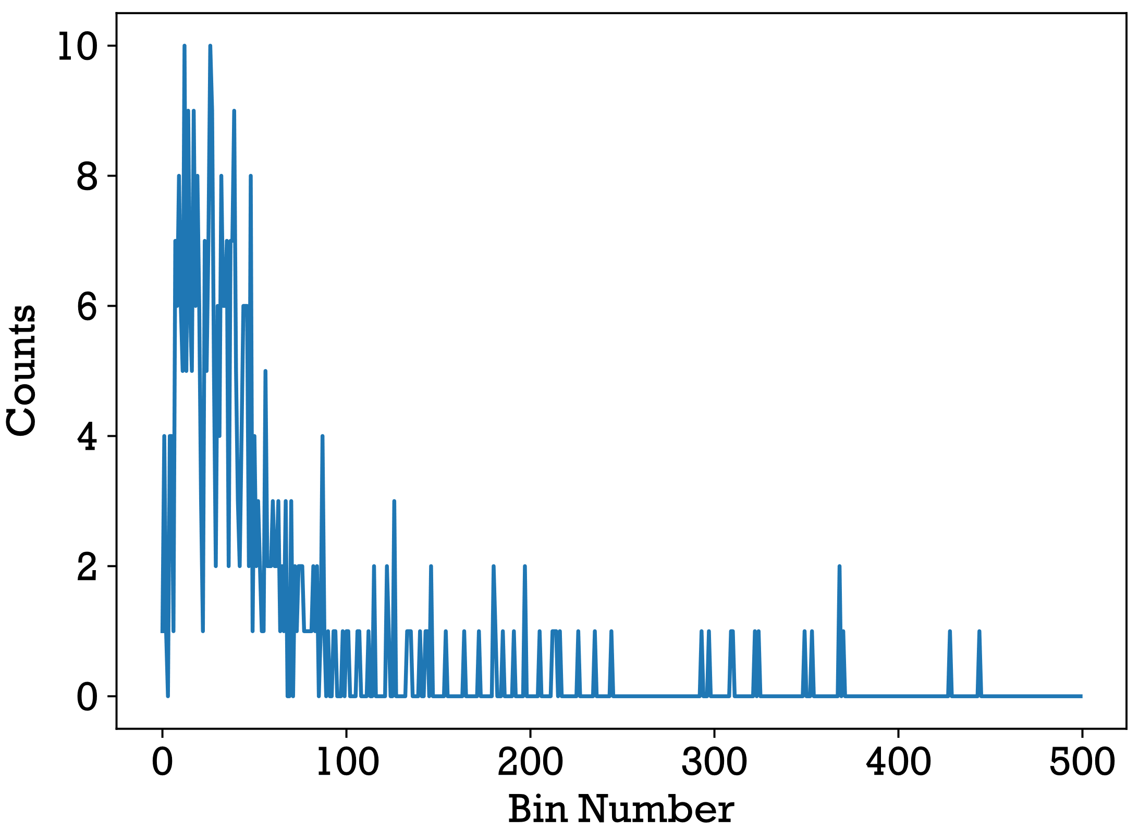
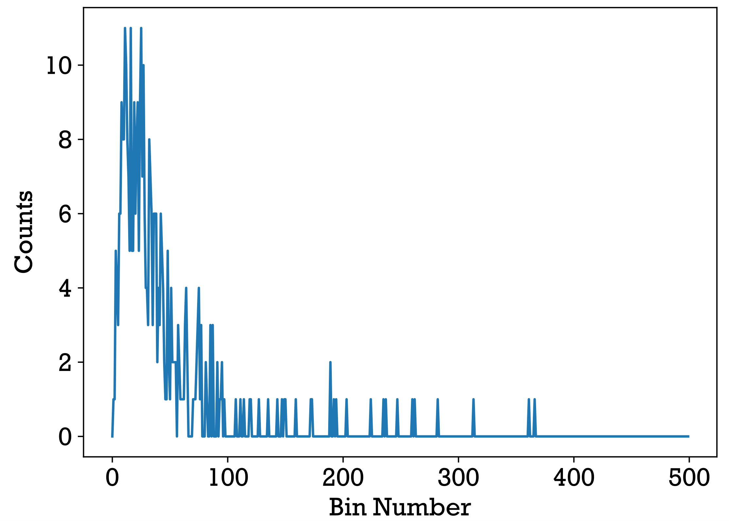
Testing on SIGMA Data
NMF anomaly (10 seconds summed)
PCA anomaly (10 seconds summed)
UK Ministry of Defence © Crown owned copyright 2023/AWE

Slide 25
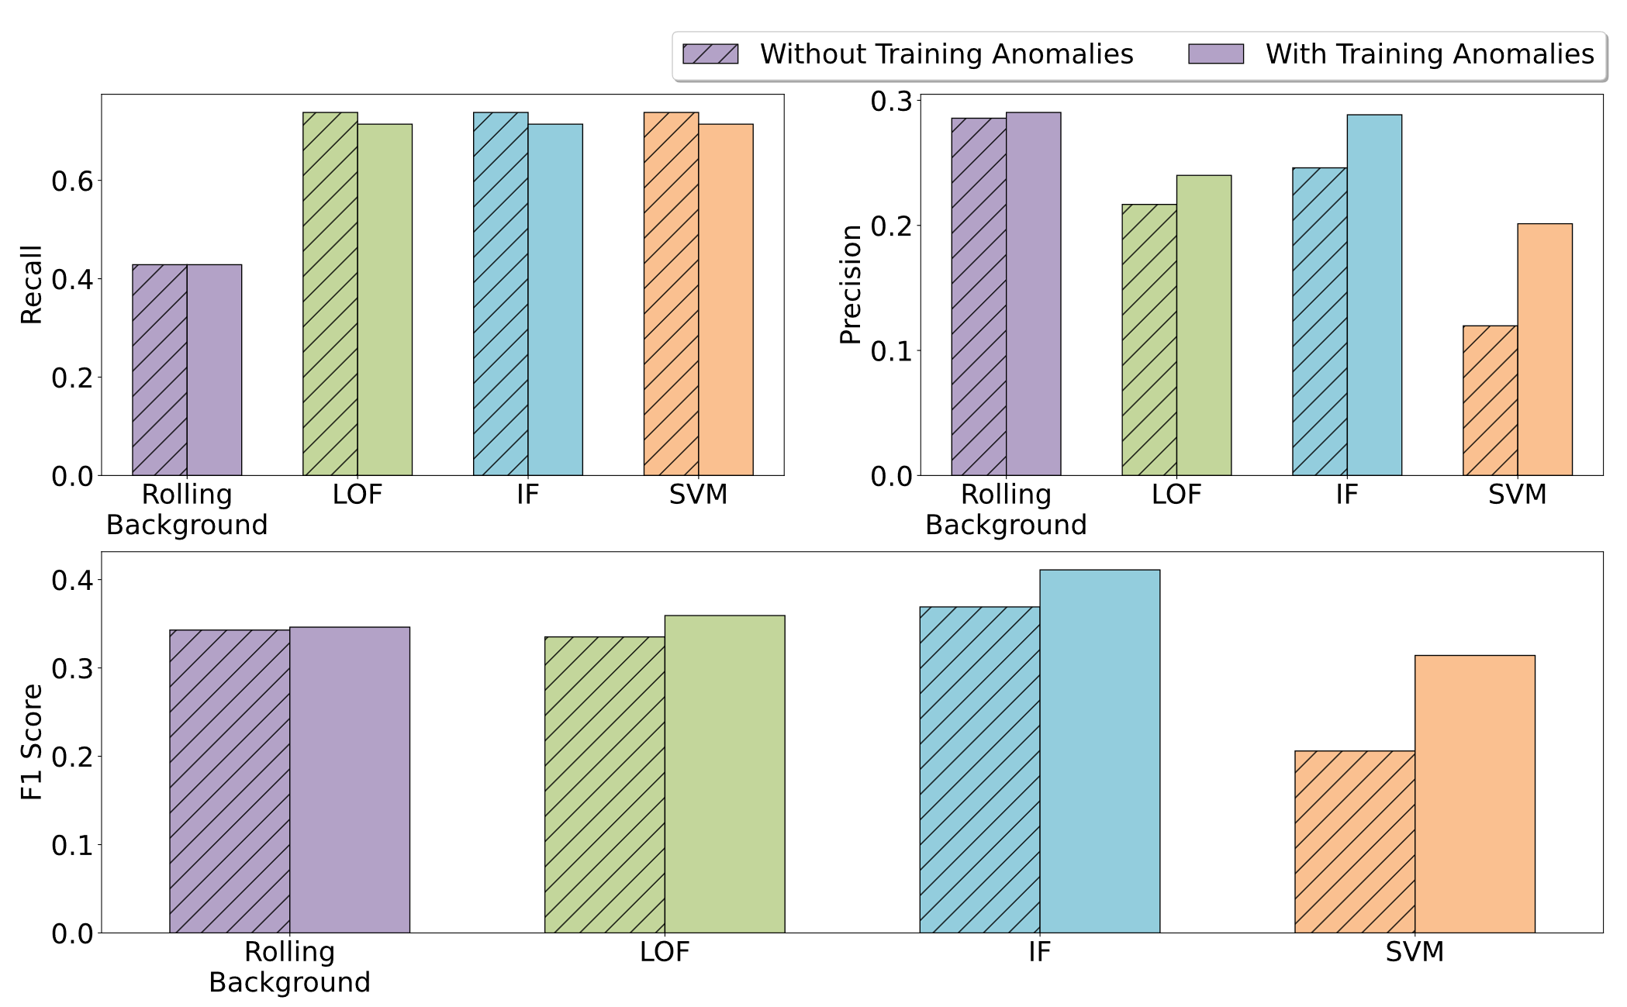
Summary & Future Work
NMF and PCA perform well for specific sources with activities smaller than the minimum detectable activity using gross counts alone.
Capable of finding anomalous spectra for injected sources.
Training and testing with more detectors, different sources, shielding etc.
Training models with source data for identification.
Test performance on real data with known parameters.
UK Ministry of Defence © Crown owned copyright 2023/AWE

Slide 26

Questions?
Acknowledgements:
Euan Connolly
Matt Ryan Tucker
Alex Dascombe-Olson
Dr. Peter Martin
UK Ministry of Defence © Crown owned copyright 2023/AWE

