Slide 1



Organic semiconductor radiation detectors for alpha and neutron detection
Aled Matthew Horner
09/10/23
a.m.horner@qmul.ac.uk
Supervisors: Prof. A Bevan, Dr. T Kreouzis
Copyright 2023 UK Ministry of Defence © Crown Owned Copyright 2023/AWE

Slide 2
Overview
Introduction
Alpha detection by organic semiconductor devices
Neutron detection by organic semiconductor devices
Organic material: Carborane-NDI
Detector array
Conclusions and future trajectory

Slide 3
Introduction
Stockpiled and production rates of He-3 used historically in neutron detectors is not enough to meet demand for global security coverage[1]
Neutron detector usages:
  Security (detecting fissile materials shielded from gamma radiation)
  Scientific research (dark matter, radiation monitoring)
Organic materials:
  Tunable, scalable, low-cost, sensitisable
  Can be used for detecting alpha, beta, gamma and x-ray radiation
  Alpha detection possible, can adjust to neutrons
[1] RT Kouzes, The ³He Supply Problem, US Department of Energy, PNNL-18388 (2009), https://doi.org/10.2172/956899.

Slide 4
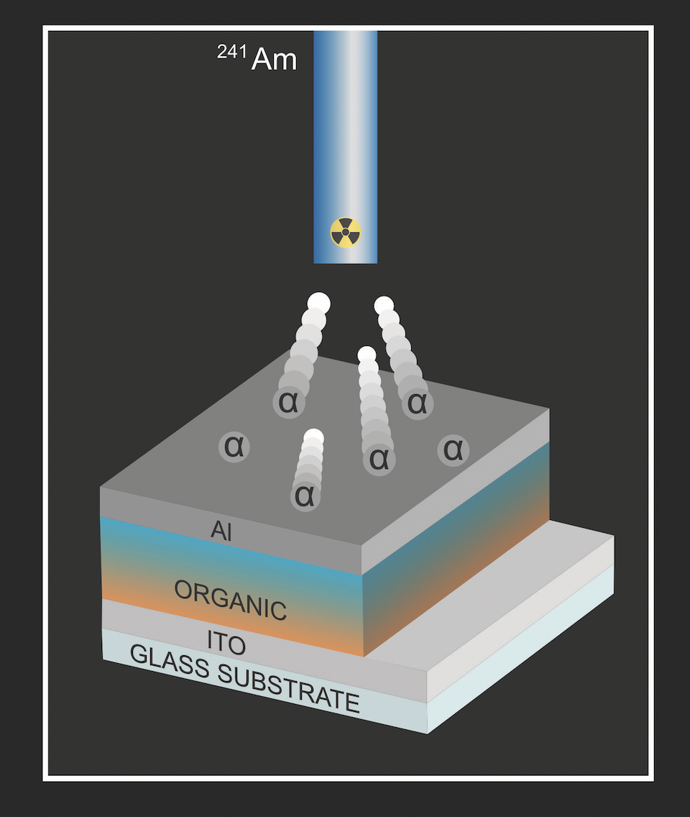
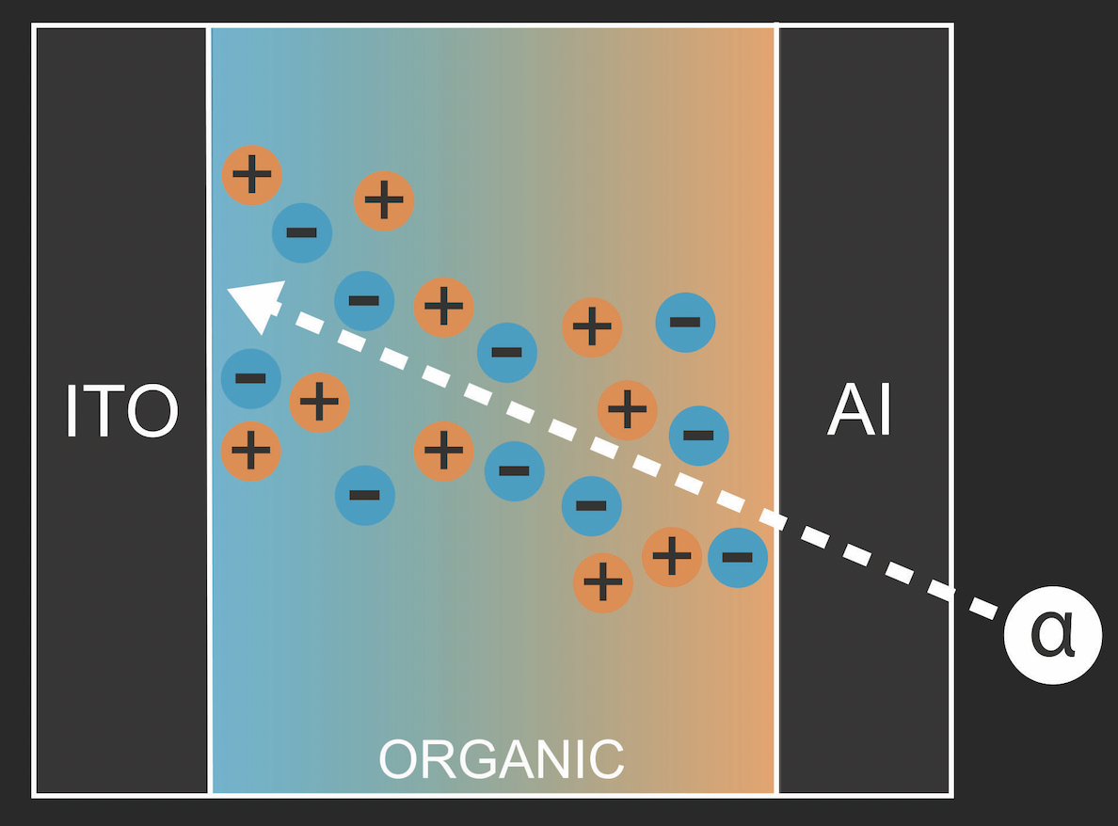
Organic semiconductor detectors: Alpha particles
Use organic polymers to detect alpha particles
Many different polymers and polymer blends used successfully internally (P3HT, P3HT:PC₆₀BM, PNDI(2HD)2T, etc.)
Alpha particles come in, electron-hole pairs form (depending on HOMO/LUMO levels, medium’s thickness), make a current when under a voltage bias
Tested by opening and closing a shutter: significant increase in current when shutter is opened → radiation is being detected
Figure 1: Left: Composition of a simple "diode-style" device.
Above: Formation of electron-hole pairs in organic medium
of devices irradiated by alpha radiation.

Slide 5

Organic semiconductor devices: How to build
Photolithography: Pattern ITO on glass substrate into desired “fingers” shape
Drop-casting: Using a pipette, drop polymer/solvent mixture onto substrate (left to set)
Evaporation: Evaporate aluminium top contact through shadow mask
Uncovering: Dissolve/scrape away polymer to give access to ITO contacts
Device: each area of overlapping top/bottom contacts (typically 4 mm²)
Figure 2: Step-by-step animation of device fabrication.

Slide 6
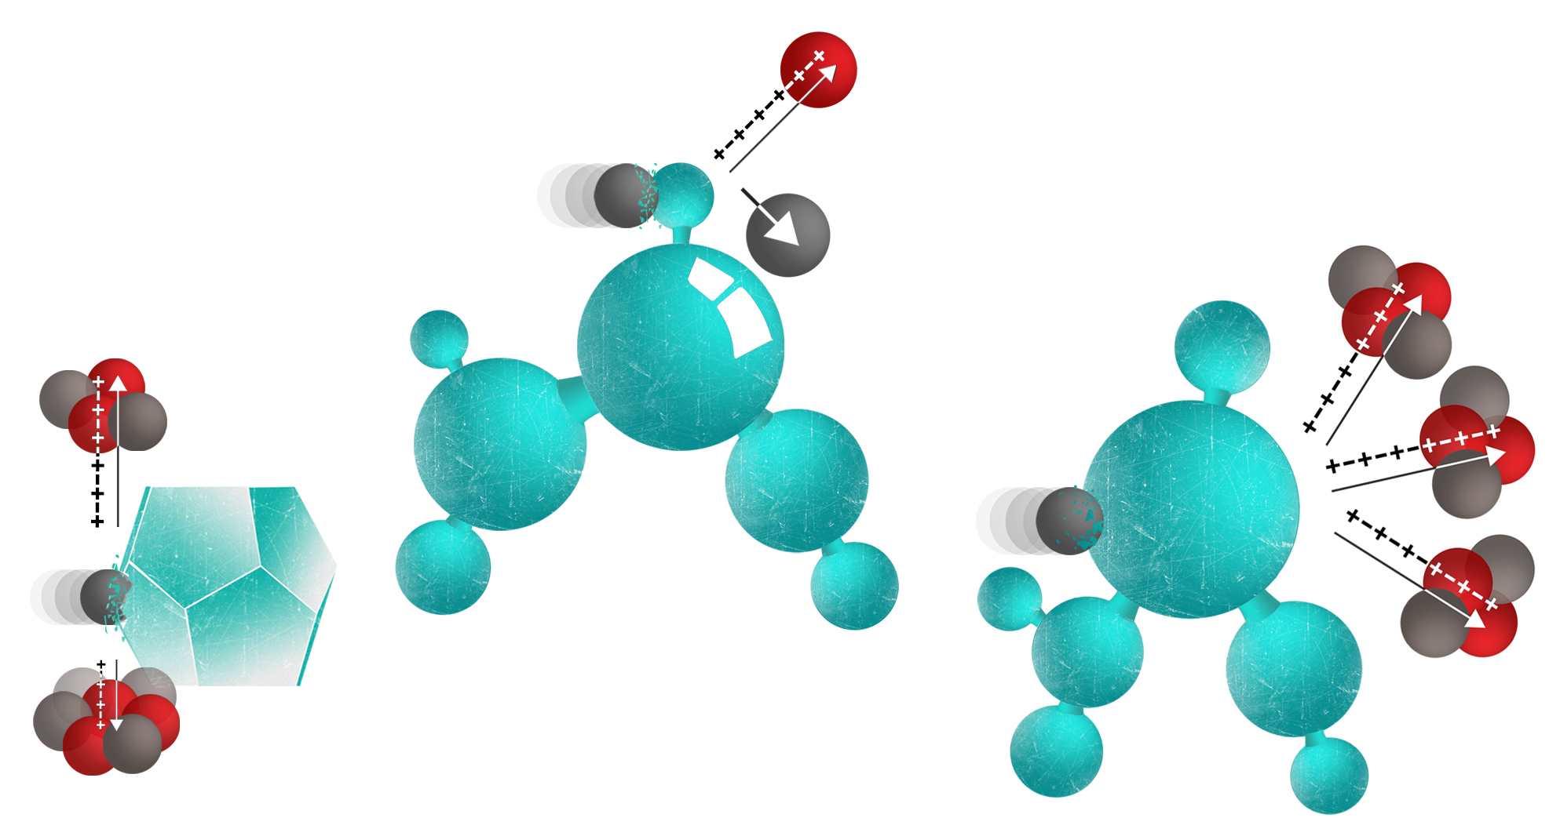
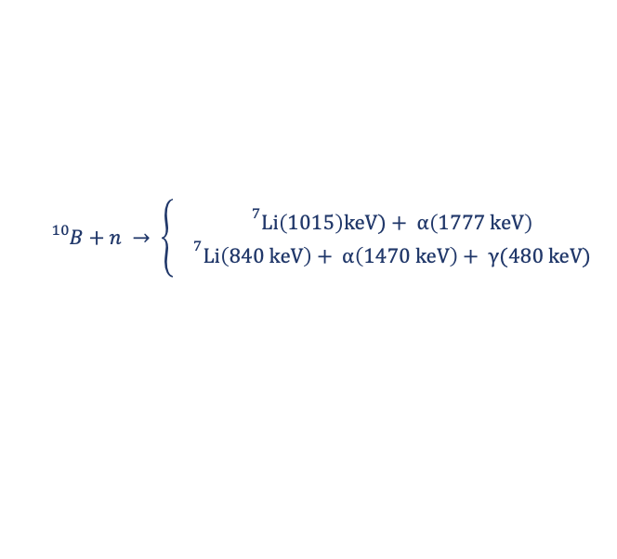
Organic semiconductor detectors: Neutrons
$${}_{}^{10}B+n → \left\{\begin{aligned}{}^{7}\text{Li}\left(1015\right)\text{keV})+ \text{α}\left(1777 \text{keV}\right) \\ {}^{7}\text{Li}\left(840 \text{keV}\right)+ \text{α}\left(1470 \text{keV}\right)+ \text{γ}(480 \text{keV})\end{aligned}\right.$$
6%
94%
Neutrons do interact with matter, but require different ways to detect
Thermal neutrons have a high cross section with ¹⁰B, making detectable alpha particles (and lithium)
One solution: stir in some boron nanoparticles, i.e., boron carbide, boron nitride, elemental boron, etc.
Issue: big problem with clumping and causing conductive paths between electrodes
Solution in [2] to add a surfactant to prevent agglomeration + ultrasonic dispersion
Currently only alpha sources easily accessible without travelling to external neutron source (NPL, ISIS, AWE) until upcoming source arrival
Figure 3: Three schematic neutron interactions are indicated. Left: Thermal neutron ¹⁰B capture at a B₄C microparticle, Middle: Elastic neutron-proton scattering at a PNDI H site. Right: Inelastic ¹²C decay into 3 α particles at a PNDI C site. Fig from [3].
[2] Chatzispyroglou, P.; Keddie, J. L.; Sellin, P. J., Boron-Loaded Polymeric Sensor for the Direct Detection of Thermal Neutrons. ACS Appl. Mater. Interfaces 2020, 12 (29), 33050-33057.
[3] J. Borowiec et al, Scalable Organic Semiconductor Neutron Detectors, arXiv:2212.08438.
[4] IAEA, Modern Neutron Detection: Proceedings of a Technical Meeting, IAEA-TECDOC-1935.

Slide 7
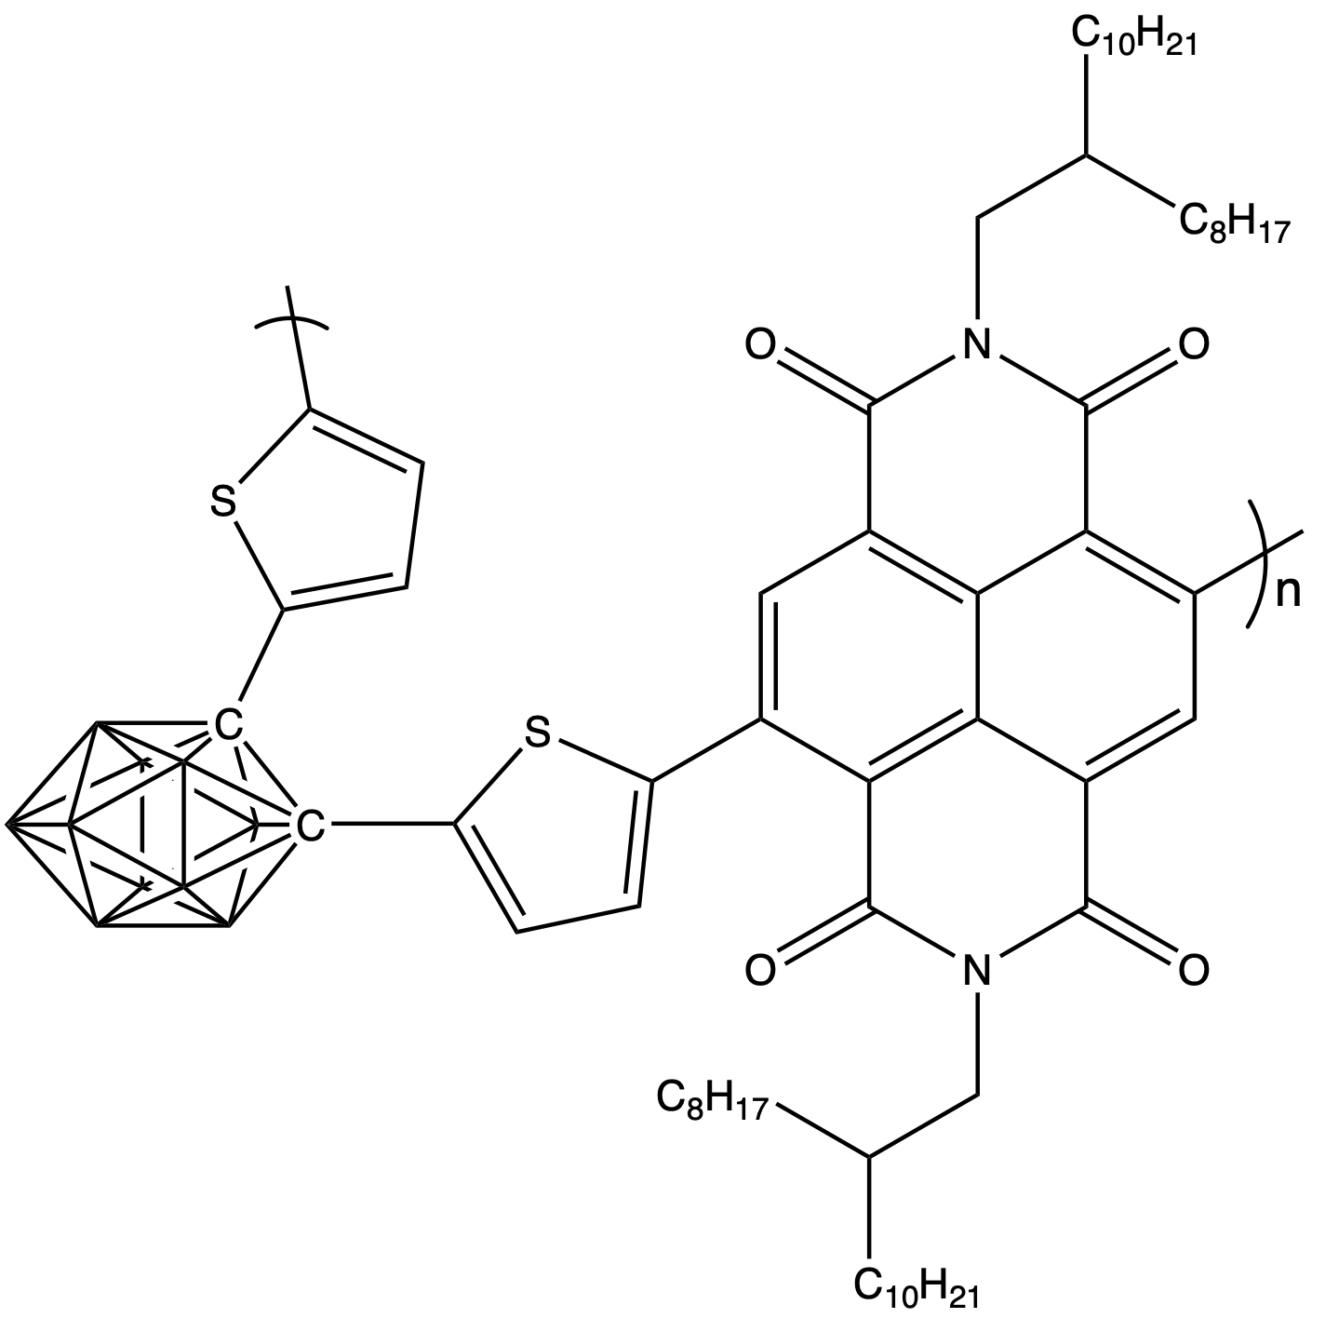
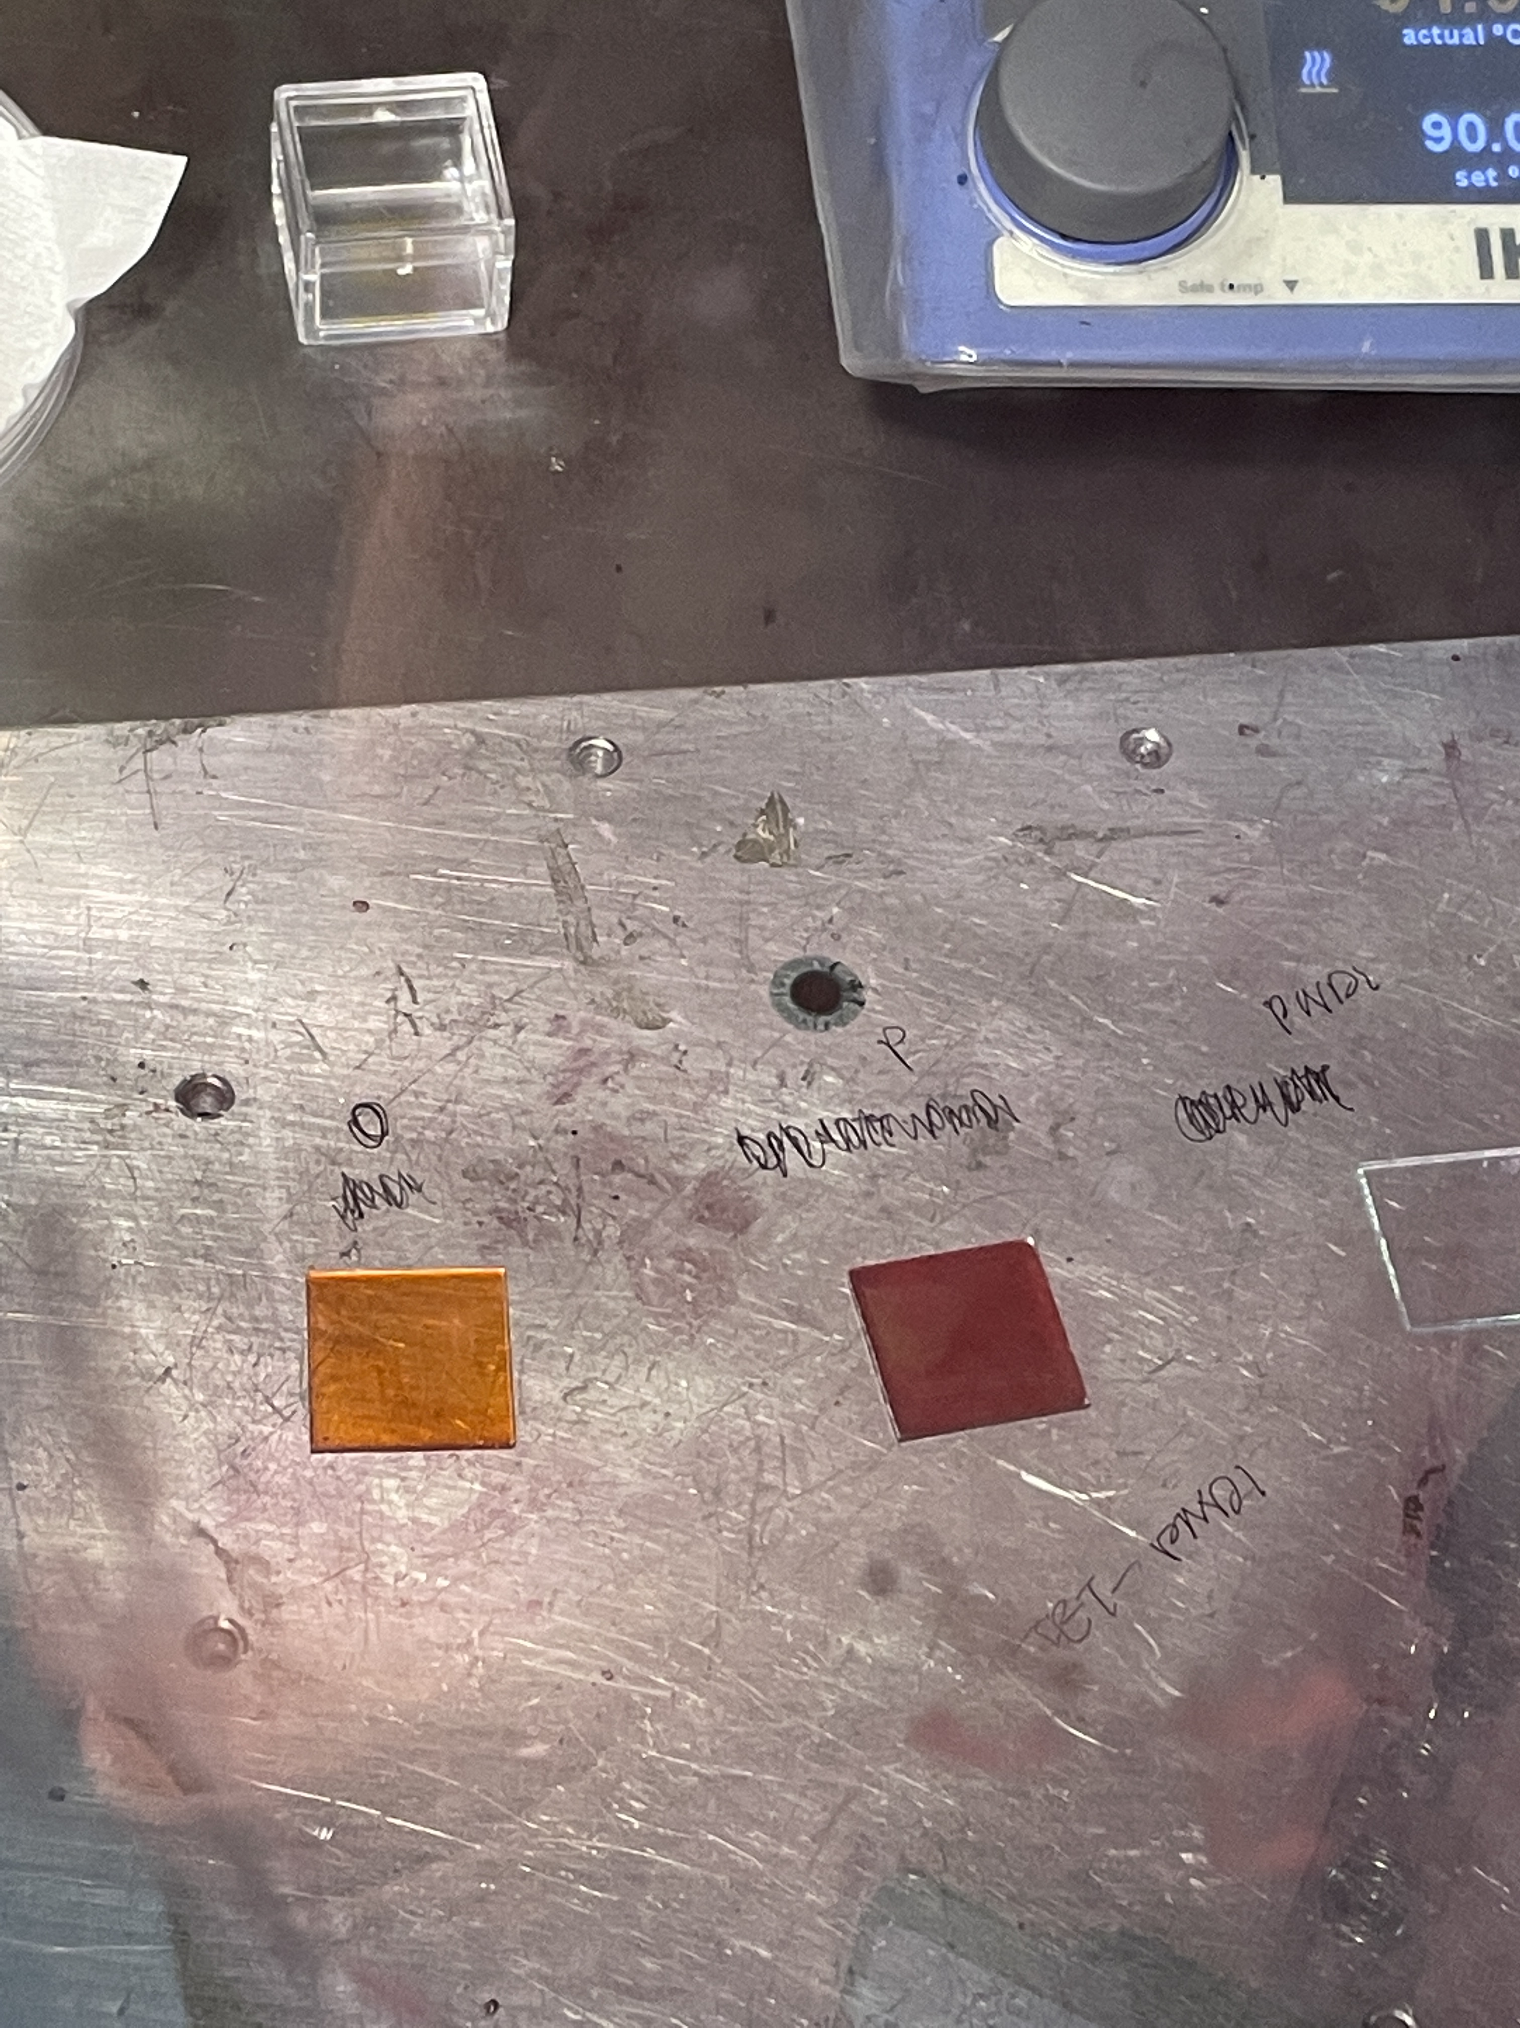
Organic material: Carborane-NDI
Carborane: a polyhedral cluster of carbon, boron and hydrogen [3]
Carborane derivatives highly relevant for medical applications, particularly for potential cancer treatments via boron neutron capture therapy
Carborane-NDI: a variant of PNDI(2OD)2T with carborane directly incorporated in the molecular backbone
If carborane-NDI can detect alpha particles, boron inside should allow it to detect neutrons like the nanoparticles
Given a small supply of meta-, ortho-, and para-carborane-NDI by authors of [5]
Figure 4: Top: Chemical structure of the oCbT₂-NDI form of carborane-NDI. Bottom: Picture of two carborane-NDI films before top contacts were added via evaporation. Left: oCbT₂-NDI. Right: pCbT₂-NDI. A noticeable difference in colour may be seen in this picture between the two isomer forms.
[5] Aniés, F. et al, N-type polymer semiconductors incorporating para, meta, and ortho-carborane in the conjugated backbone, Polymer 2022 240 124481.

Slide 8
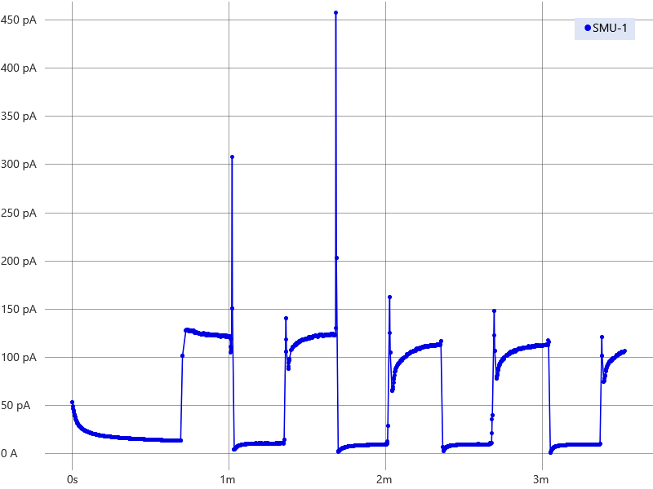
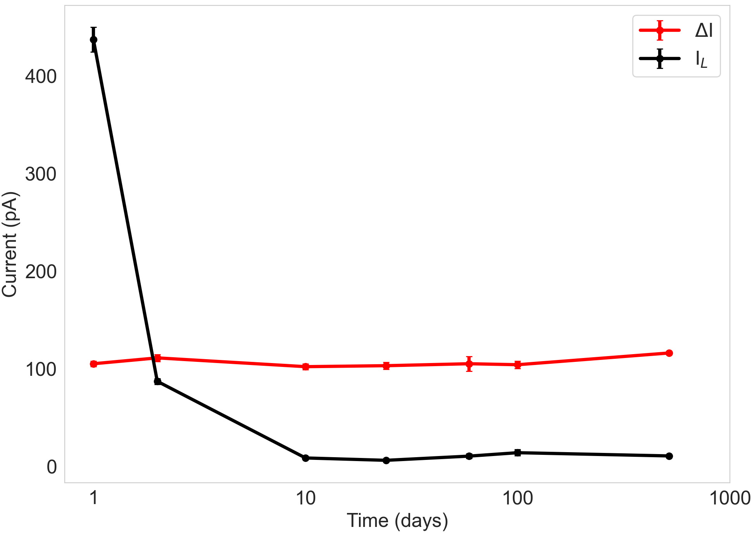
10 V bias
oCbT₂-NDI: Alpha detection
= Current enhancement
= Leakage (dark) current
Figure 5: Left: Raw current response data of oCbT₂-NDI device under 10V bias being exposed to 370 kBq Americium-241 alpha source showing distinct periods of a shutter being closed and opened (data from day 59 of air exposure). Right: Plot showing variation of current enhancement (ΔI) and leakage current (I_{L}) in the same device under the same conditions over the course of 517 days.

Slide 9
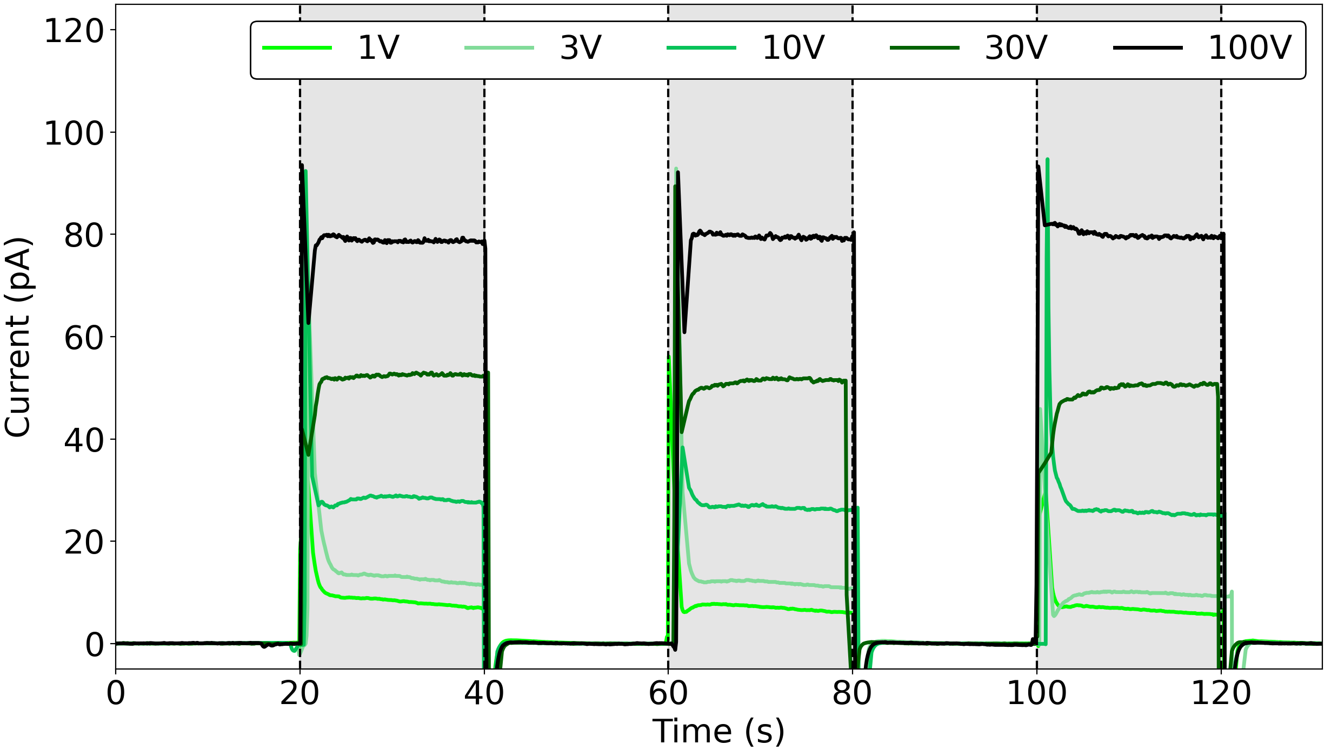
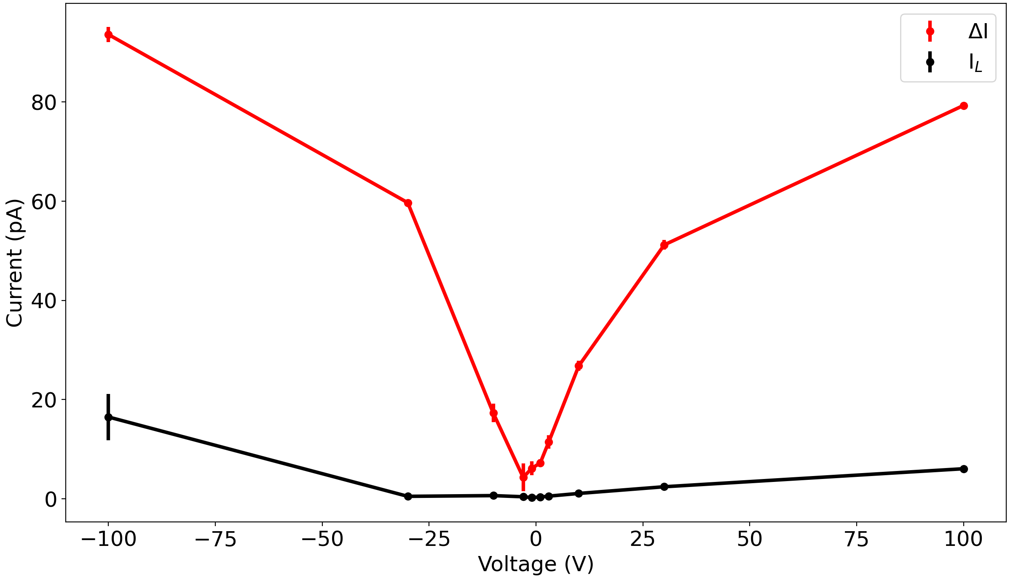
oCbT₂-NDI: Alpha detection
Figure 6: Left: Plot showing current enhancement (“signal”) of oCbT₂-NDI device under different (positive) voltage biases being exposed to alpha source after 40 days' exposure to air with leakage current (“dark current”) subtracted away. Right: Variation of current enhancement (ΔI) and leakage current (I_{L}) with voltage bias. Both plots show same device as each other but differ from previous slide.
Leakage current and current enhancement both increased with voltage bias
Enhancement appears to saturate whilst leakage continues to rise

Slide 10

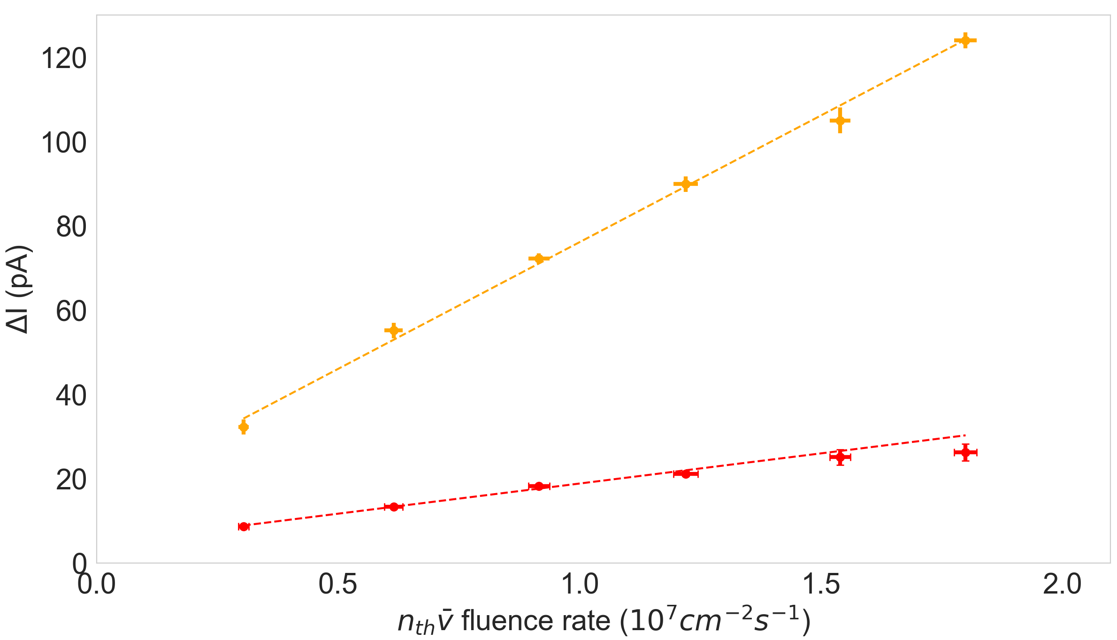
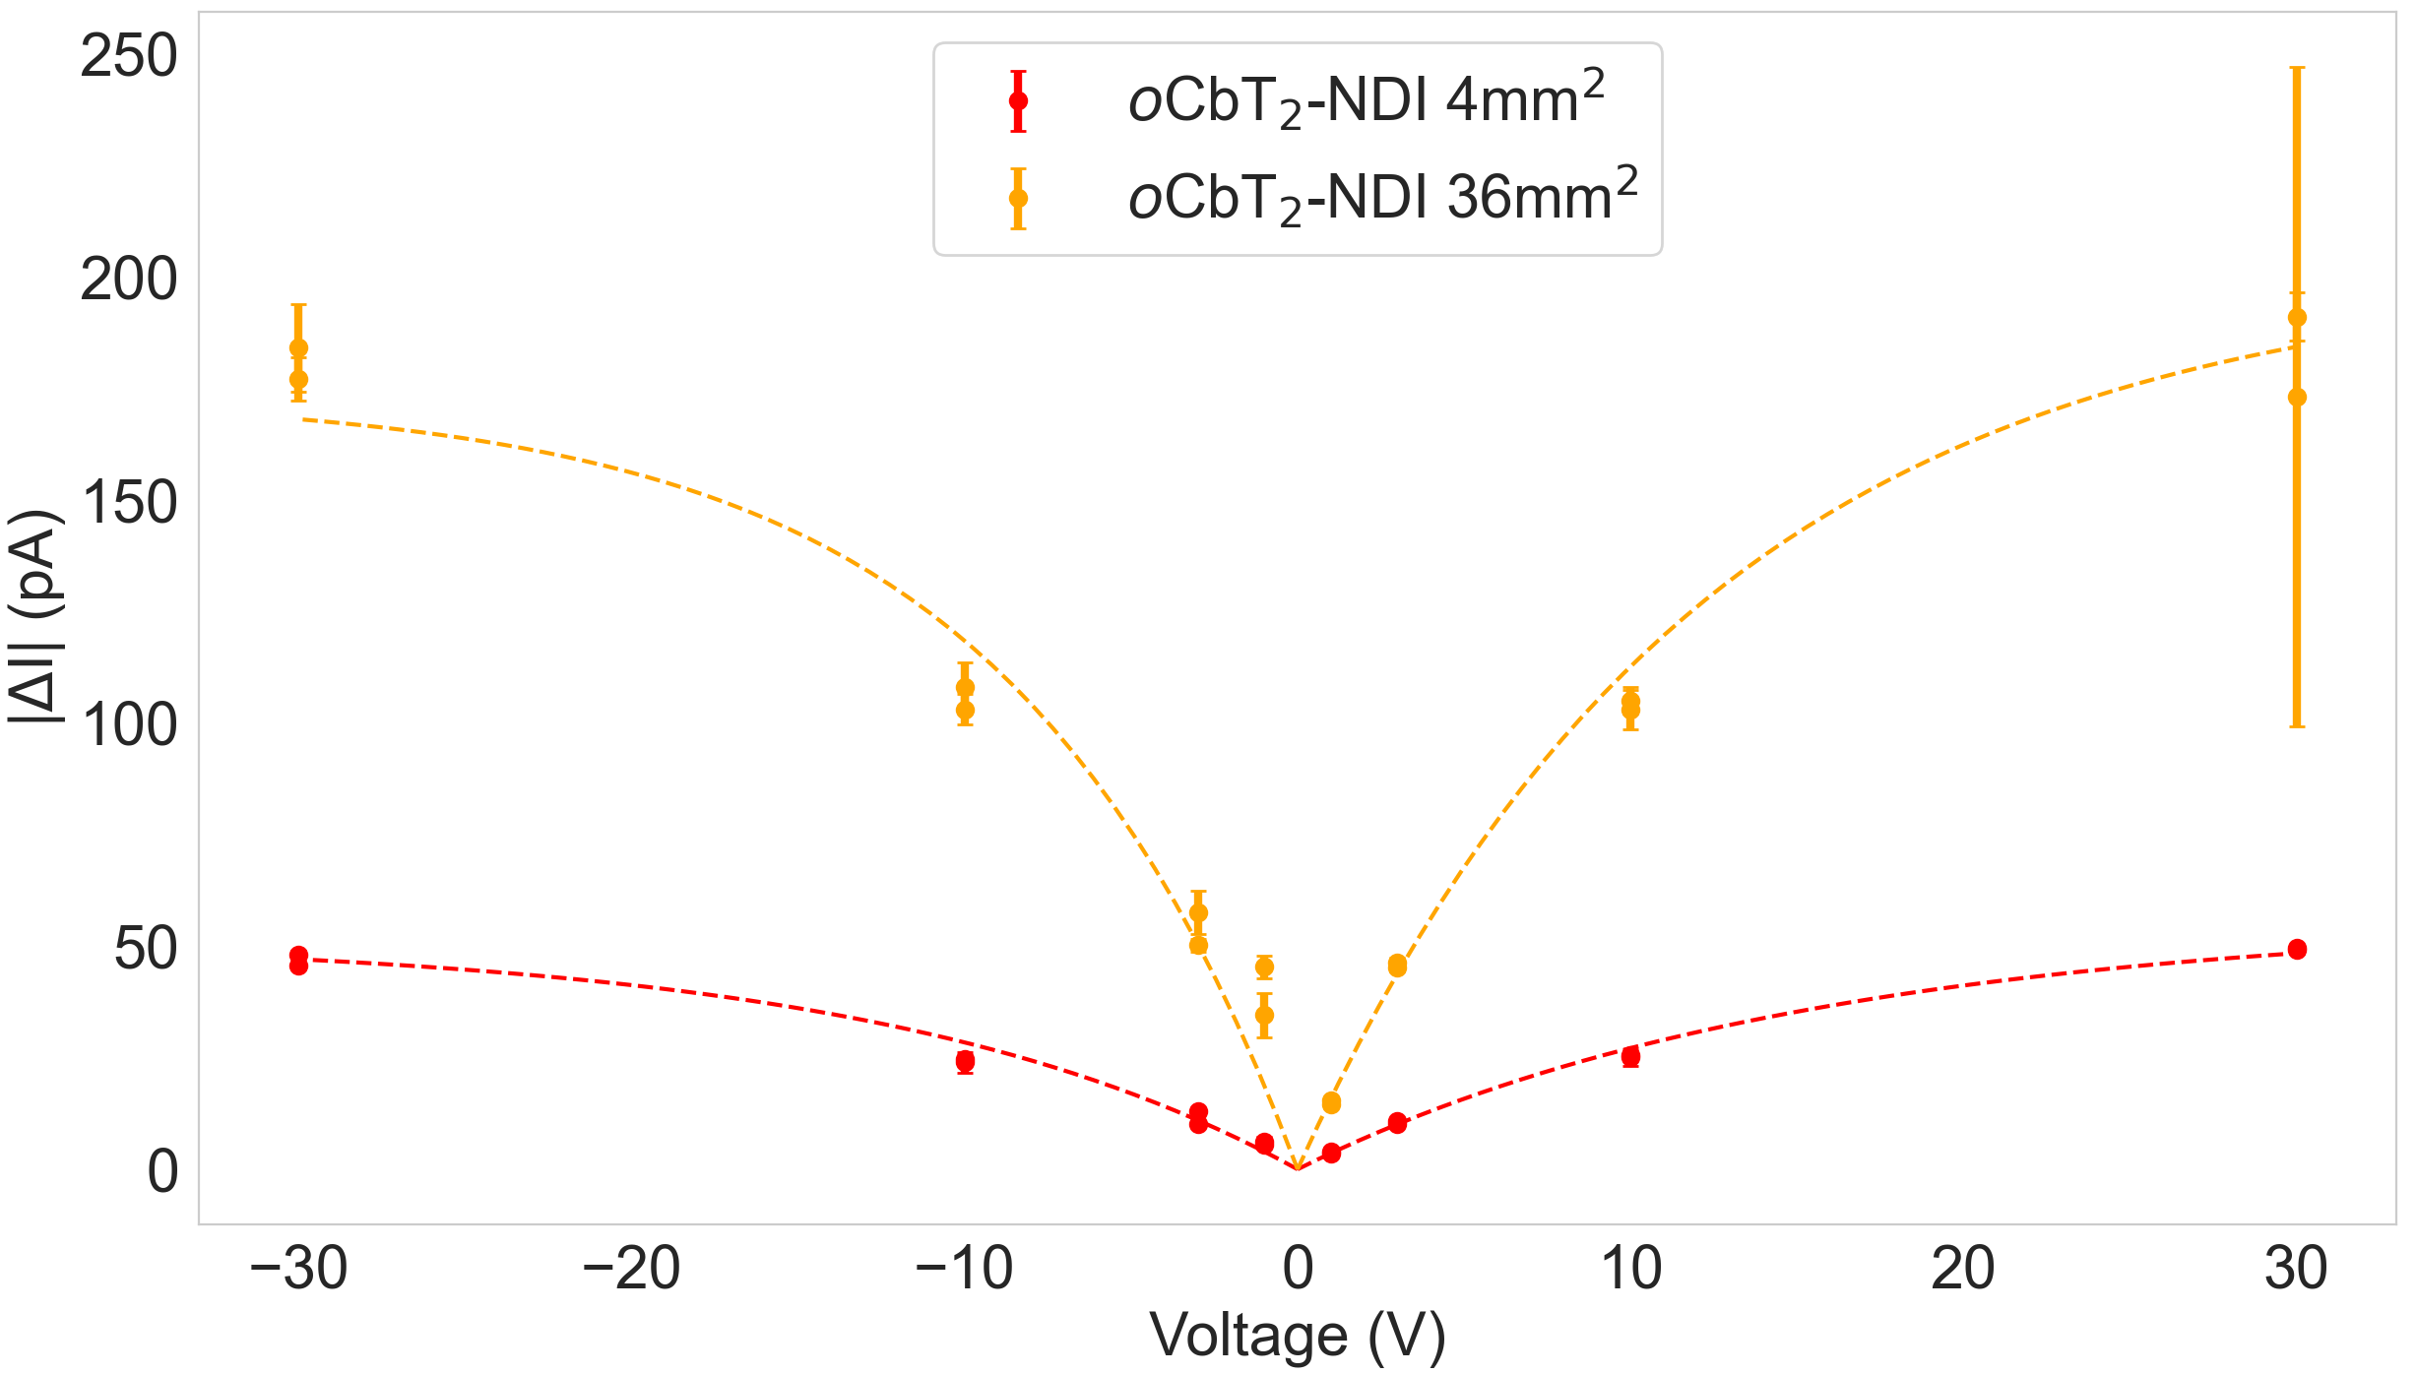
oCbT₂-NDI: Neutron detection
a = Saturation current
b = 1/Characteristic V₀
NPL site visit (using thermal pile)
Figure 7: Left: Variation of current enhancement (ΔI) due to exposure to various neutron beam fluxes under 10V bias for a 4mm² and a 36mm² oCbT₂-NDI device. Right: Absolute values of current enhancement versus voltage bias of one 4mm² device and one 36mm² device exposed to neutrons at NPL. Dashed lines made by fitting to equation above. Under negative voltage biases these enhancements are negative.
Neutron tests: ~4 times signal with 9x scale. Alpha tests: ~5 times.

Slide 11
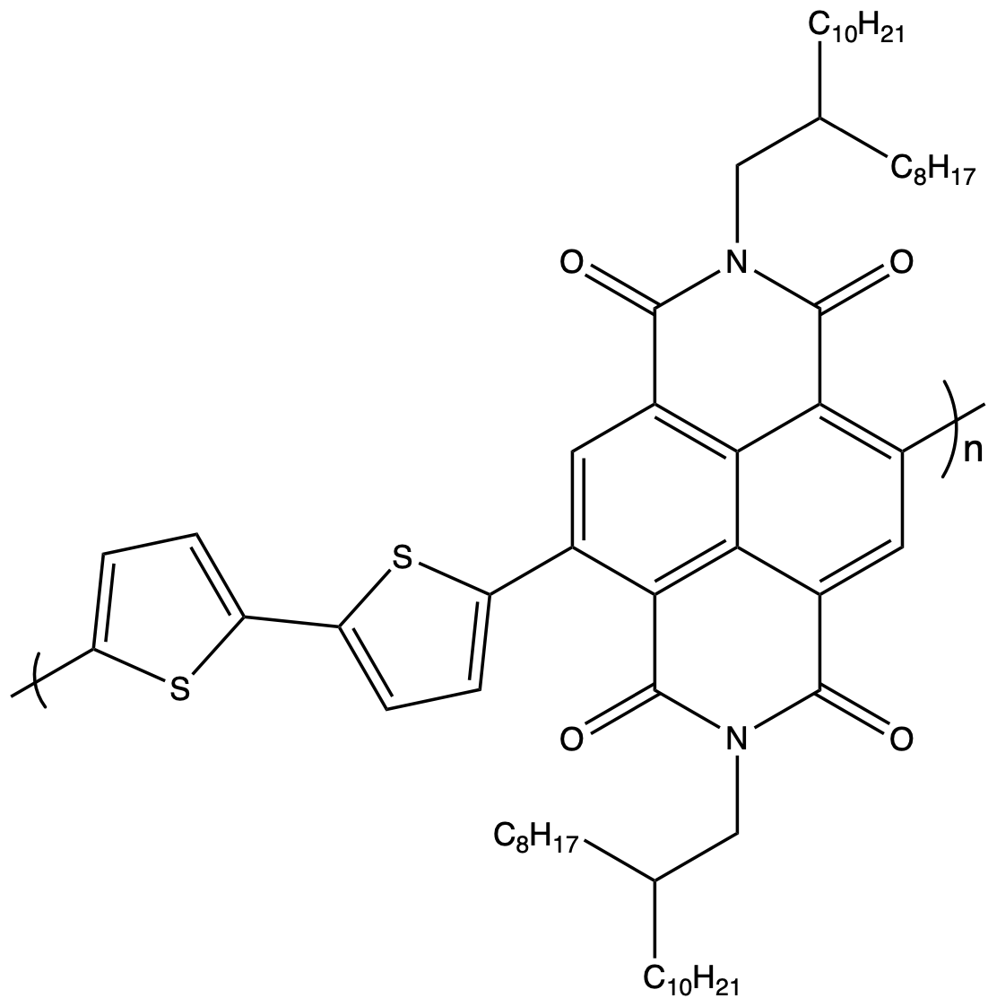
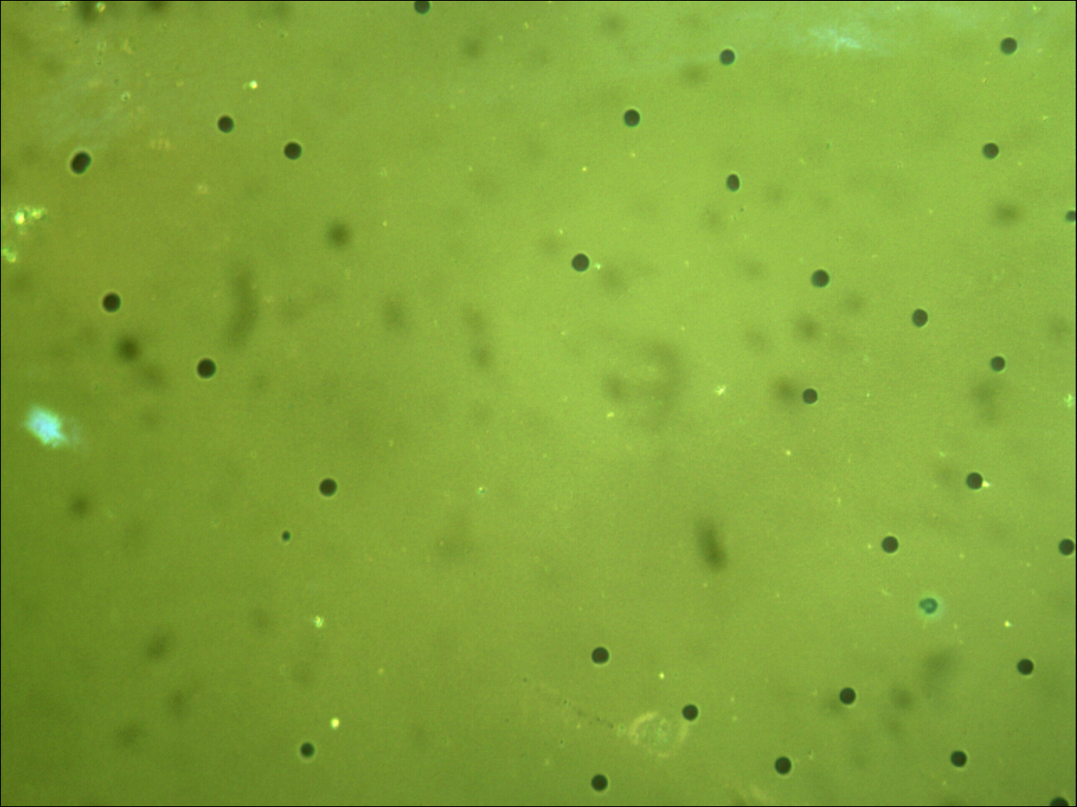
Organic material: PNDI(2OD)2T
The material on which oCbT₂-NDI is based (carborane in between the thiophenes)
Also taken to NPL for neutron testing: with and without enriched B₄C nanoparticles included for thermal neutron sensitization
Amount of B₄C chosen specifically to match ¹⁰B content of oCbT₂-NDI for direct sensitizing comparison
Much lower concentration compared to previous trip: didn’t clump as much
50µm
Figure 8: Top: Chemical structure of PNDI(2OD)2T. Arrow shows where, in oCbT₂-NDI, carborane is included. Bottom: Reflected microscope image of PNDI(2OD)2T with dispersed B₄C microparticles.

Slide 12
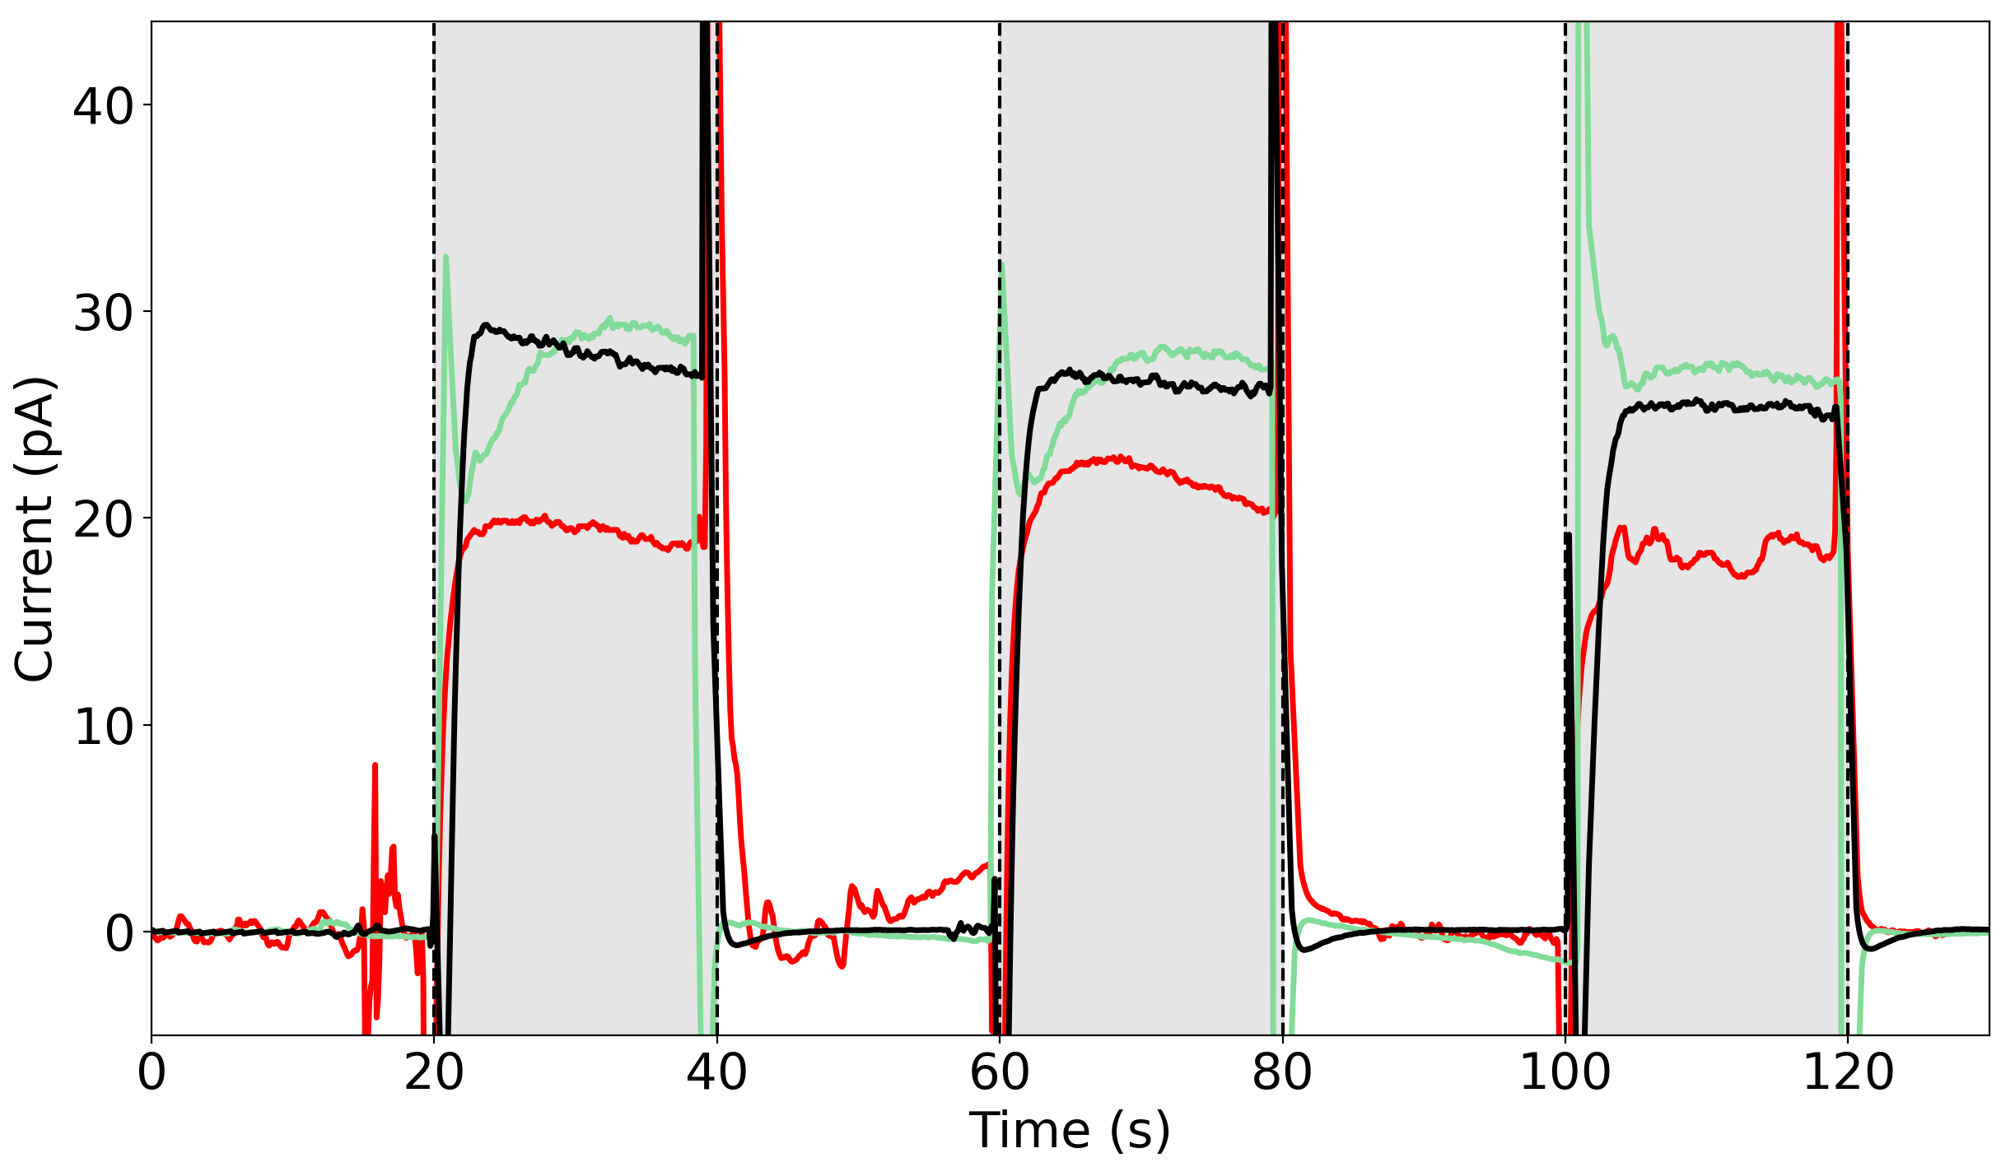
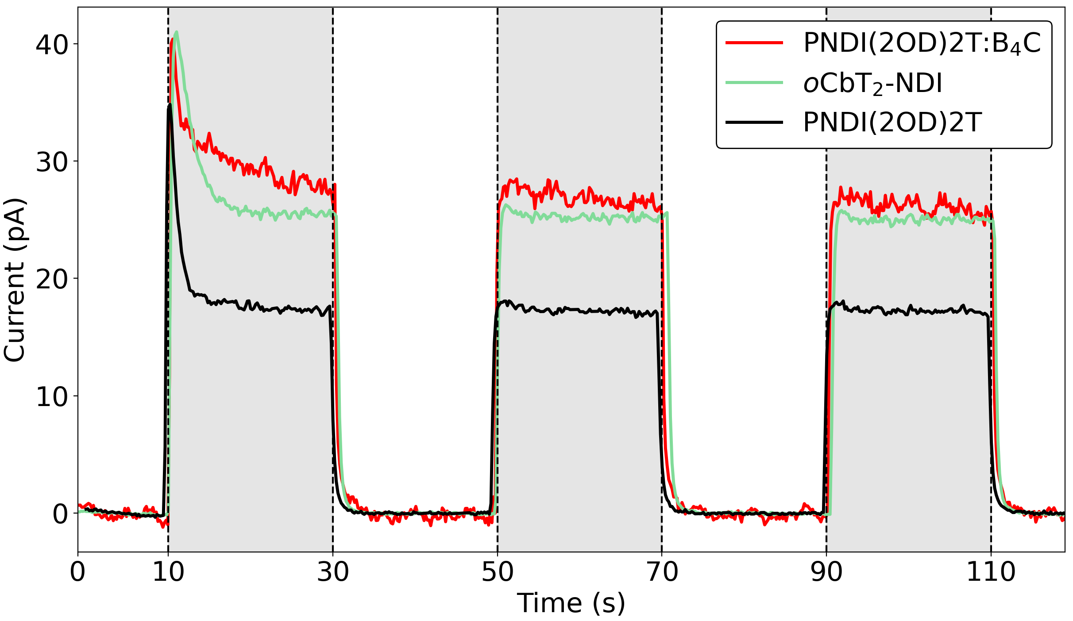
10 V bias
NDI Polymers: Radiation detection
Alpha tests NPL site visit (using thermal pile)
Figure 9: Left: Plot showing current enhancement of three 4mm² devices under 10V bias exposed to 370 kBq Americium-241 alpha source with leakage current (“dark current”) subtracted away. Right: Plot showing current enhancement of the same three devices under 10V bias exposed to neutrons at the NPL thermal pile. Legend in this plot corresponds to both graphs. Time exposed to air significantly above 10 day settling period.

Slide 13
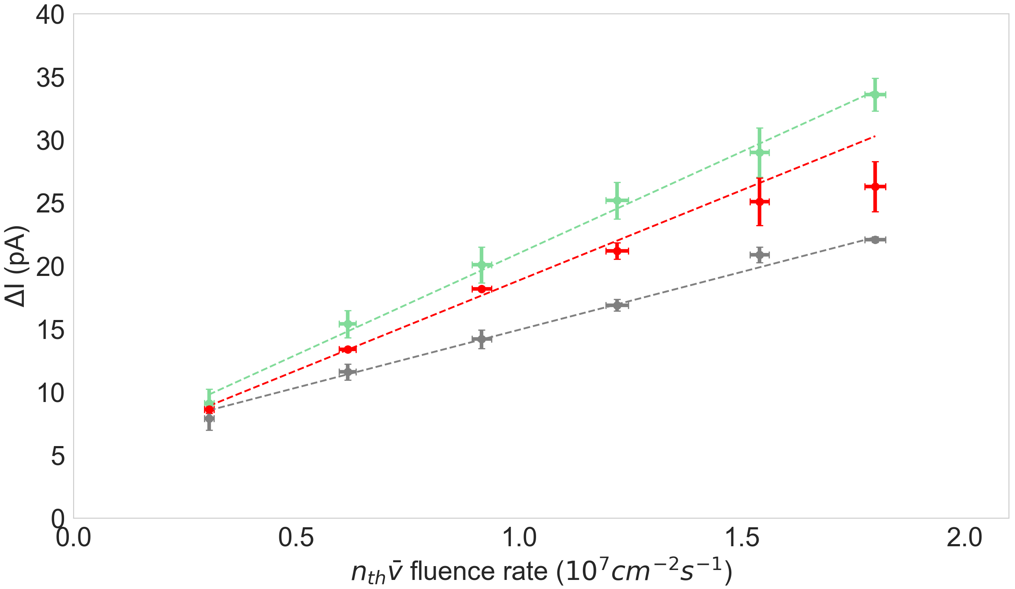
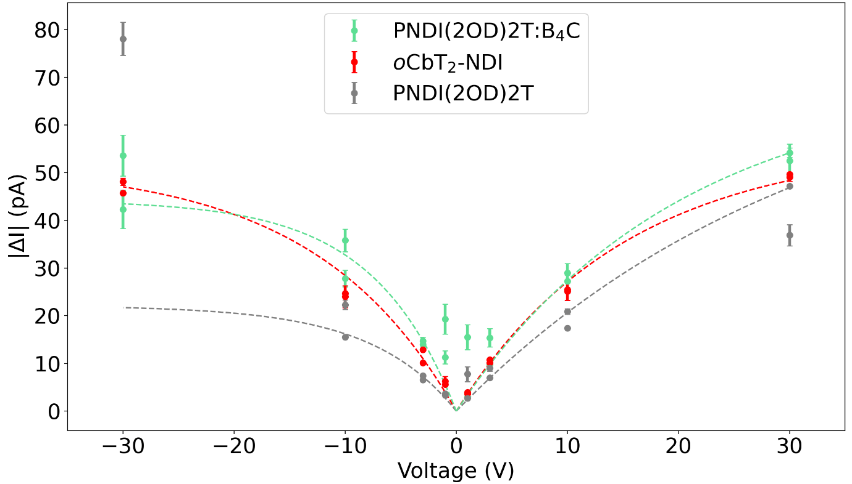
NDI Polymers: Neutron detection
NPL site visit (using thermal pile)
Figure 10: Left: Plot showing current enhancement of three 4mm² devices under 10V bias exposed to 370 kBq Americium-241 alpha source with leakage current (“dark current”) subtracted away. Right: Plot showing current enhancement of the same three devices under 10V bias exposed to neutrons at the NPL thermal pile. Legend in this plot corresponds to both graphs. Time exposed to air significantly above 10 day settling period.

Slide 14
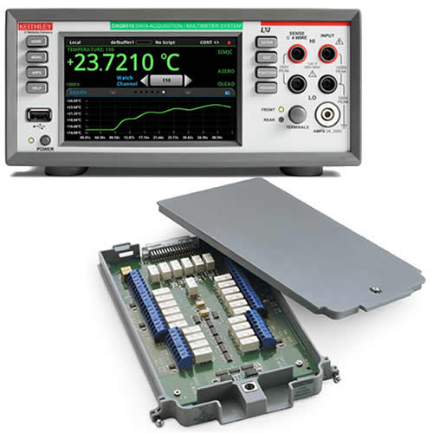
Large-area OSC detector
Scaled up detector
  Simply take current method, make it larger
  Less resolution
  Two sizes done with 3 PNDI variants
Array of detectors
  Increase effective area
  Triangulate location of source
  Use a data acquisition device with multiple channels to simultaneously get results such as DAQ6510 with 7700 multiplexer
  Working on a single channel before scaling up once the setup is working
Figure 11: Keithley DAQ6510 with 7700 multiplexer containing 20 channels.

Slide 15
Large-area OSC detector
Scaled up detector
  Simply take current method, make it larger
  Less resolution
  Two sizes done with 3 PNDI variants
Array of detectors
  Increase effective area
  Triangulate location of source
  Use a data acquisition device with multiple channels to simultaneously get results such as DAQ6510 with 7700 multiplexer
  Working on a single channel before scaling up once the setup is working
Figure 11: Keithley DAQ6510 with 7700 multiplexer containing 20 channels.

Slide 16
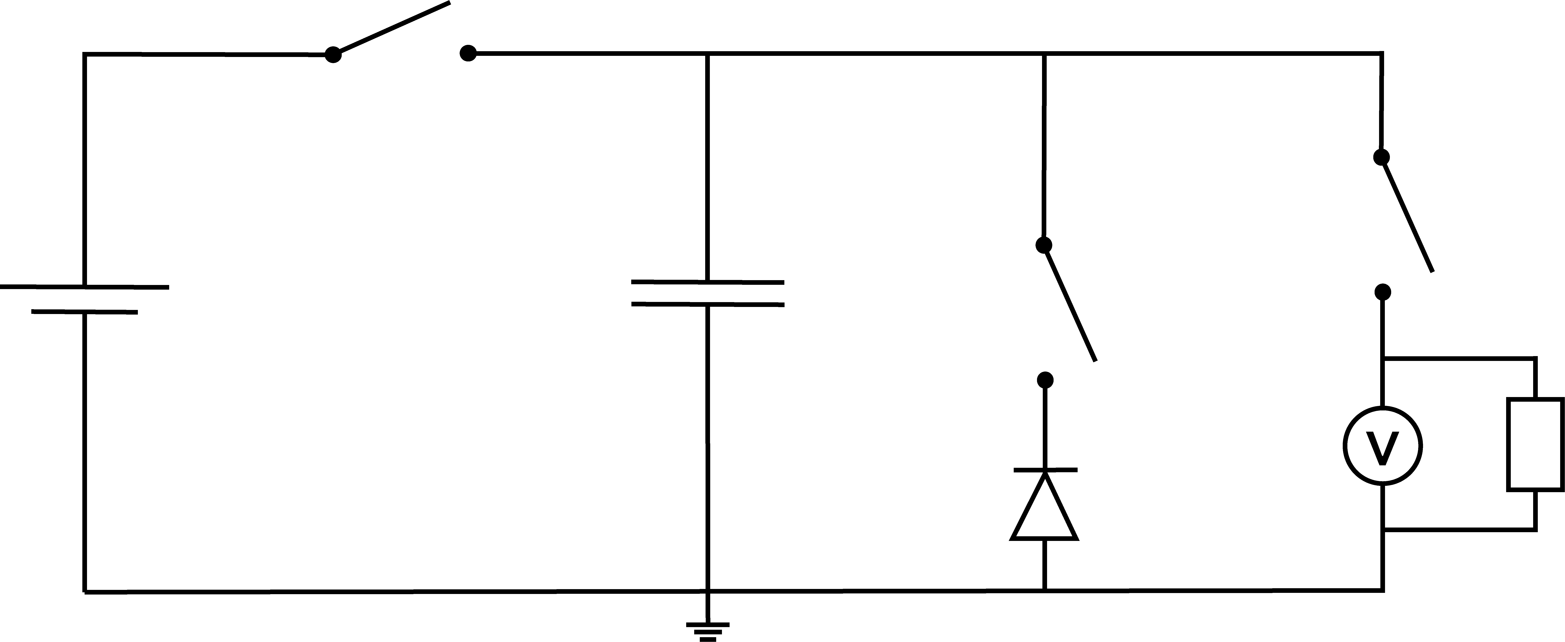

Detector array
Capacitor bank to integrate charge over time, increase signal-to-noise ratio, higher standoff distance:
  $$CV_{0}=IΔt$$
includes four unknowns to be appropriately obtained. Experimentation results in I ∼ 10 pA under a voltage bias V₀ = 10V and time to walk past a device Δt ∼1s lead to choosing a C = 1 pF capacitor.
A
B
C
V₀
Battery charges capacitor up to V₀, which discharges through diode, resulting in lower voltage across capacitor when read out after 1s
A closed → A opened, B closed → B opened, C closed → repeat
Multiple “units” of Fig. 12 configuration can be made using more multiplexer channels to expand (1 unit = 4 channels out of 20)
Figure 12: Circuit diagram of single detector-capacitor unit. Switches and voltage readout done by multiple channels of a multiplexer. This diagram may be scaled to include multiple capacitors, detectors, and readouts, all working together.

Slide 17
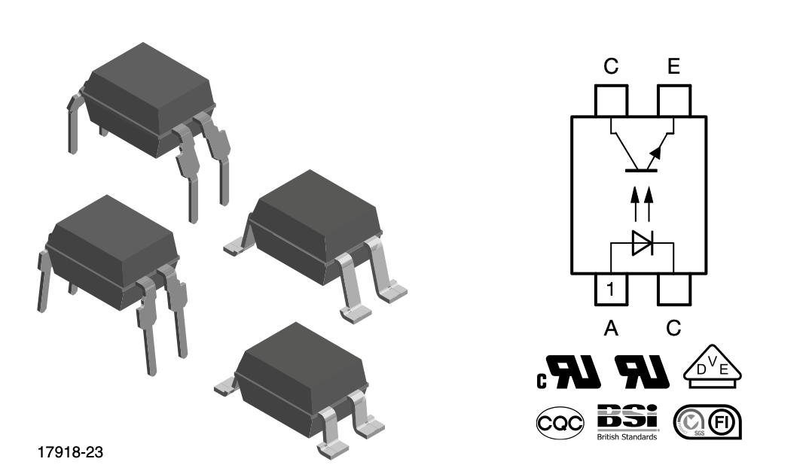
Detector array: Current circuit design
Multiplexer switches not high enough isolation resistance
Replaced with high isolation resistance optocoupled transistors working as switches
Multiplexer switches still used to control LEDs in optocoupled switches (red switches)
Effectively the same working principle as previous setup
1pF
A
B
C
1V
V₀
V
=
Figure 13: Left: A phototransistor optically coupled to a gallium arsenide infrared-emitting diode. Above: Circuit diagram of single detector-capacitor system incorporating the optocoupled system shown on the left.

Slide 18
Conclusions/Future trajectory
Organic materials can be used as alpha and neutron radiation detectors
Increasing the area of detectors increases the detection capability, but there is not enough data to draw any conclusions on a relationship. More sizes are incoming…
Incorporating boron-containing carborane into the backbone of PNDI(2OD)2T sensitises it to thermal neutrons
Papers: In process of writing neutron detection paper based on NPL results, followed by an alpha detection paper
Detector array: switches without leaking for single unit, followed by scaling up to multiple detectors
Simulation: investigating detection capabilities with respect to Soviet era cruise missile [6], IAEA historically reported illicitly trafficked materials [7]
[6] Fetter et al., Gamma-Ray Measurements of a Soviet Cruise-Missile Warhead, https://doi.org/10.1126/science.248.4957.828.
[7] IAEA, Combating Illicit Trafficking in Nuclear and other Radioactive Material, https://www-pub.iaea.org/MTCD/Publications/PDF/pub1309_web.pdf.

Slide 20
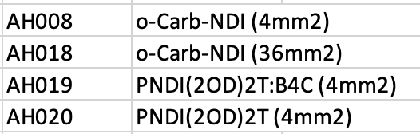
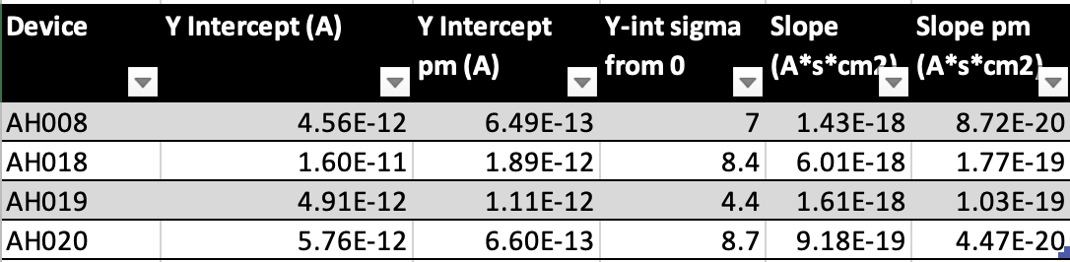
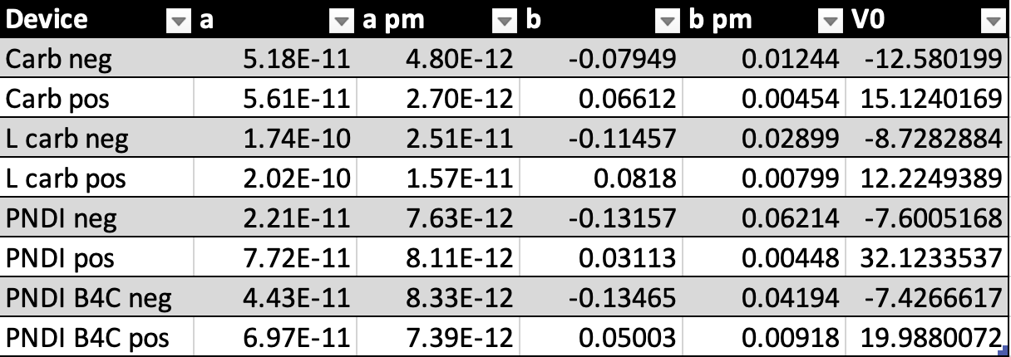
Appendix: Fitting Parameters
Linear fit parameters for ΔI vs flux graphs:
Exponential fit parameters for ΔI vs V graphs:
a = Saturation current
b = 1/Characteristic V₀

Slide 21
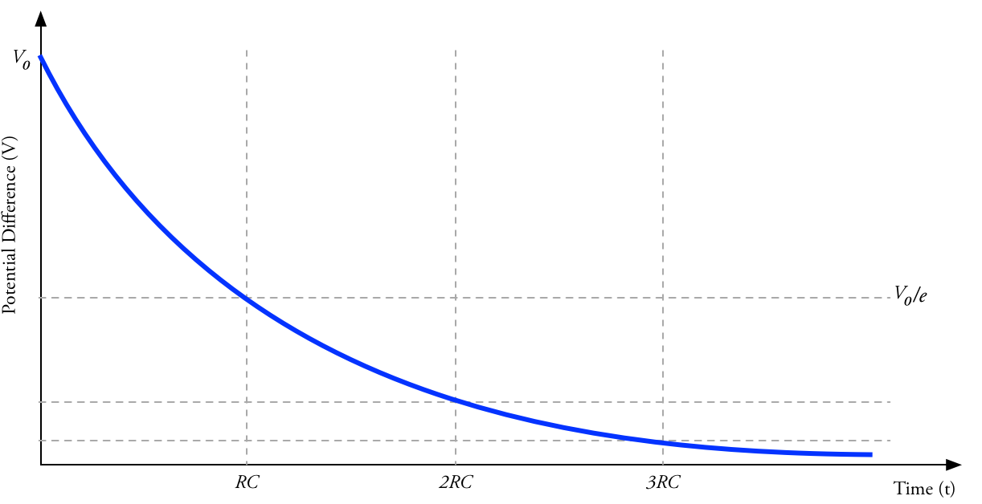
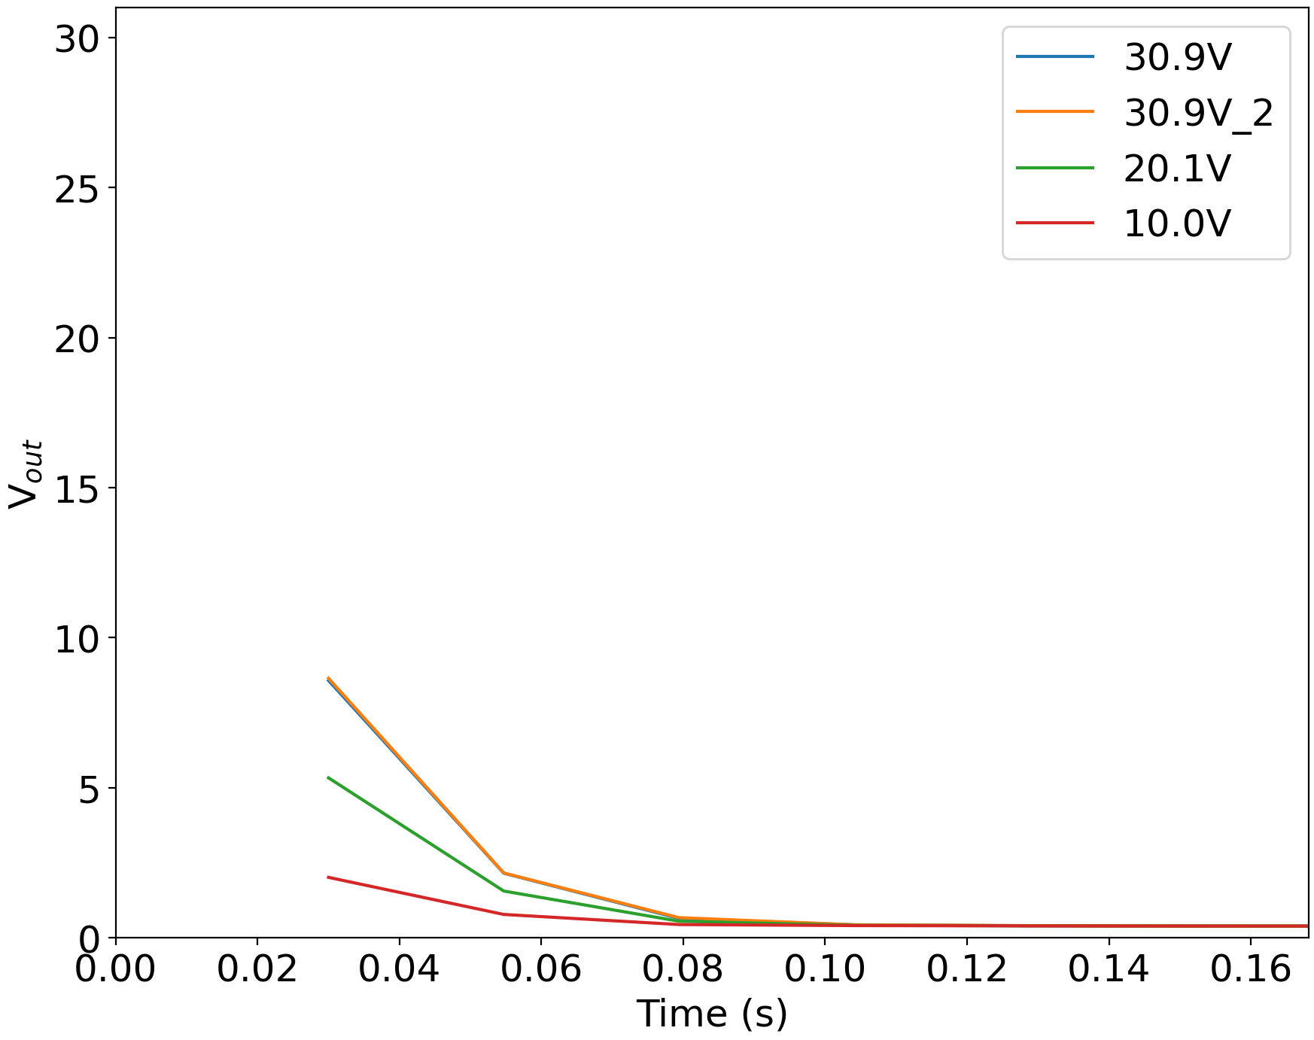

Appendix: DAQ
Each reading takes minimum ∼ 0.025s
∼$\frac{1}{3}$V₀ *
0.03s?
Above: Capacitor discharge graph. Right: Readings taken as quickly as possible with DAQ start around ⅓V₀
0.03s

Slide 22
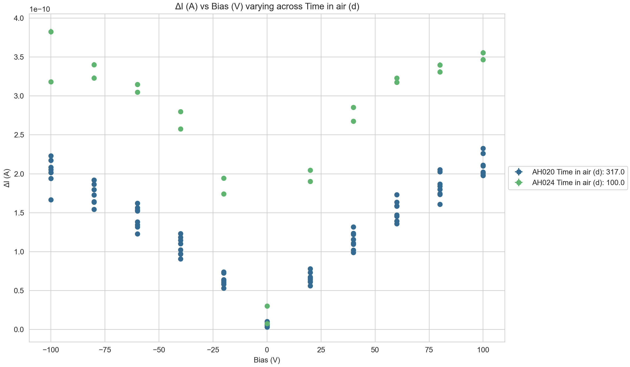
Appendix: Large vs Small PNDI(2OD)2T
AH020: 4mm² sample taken to NPL
AH024: 36mm² larger area sample

Slide 23

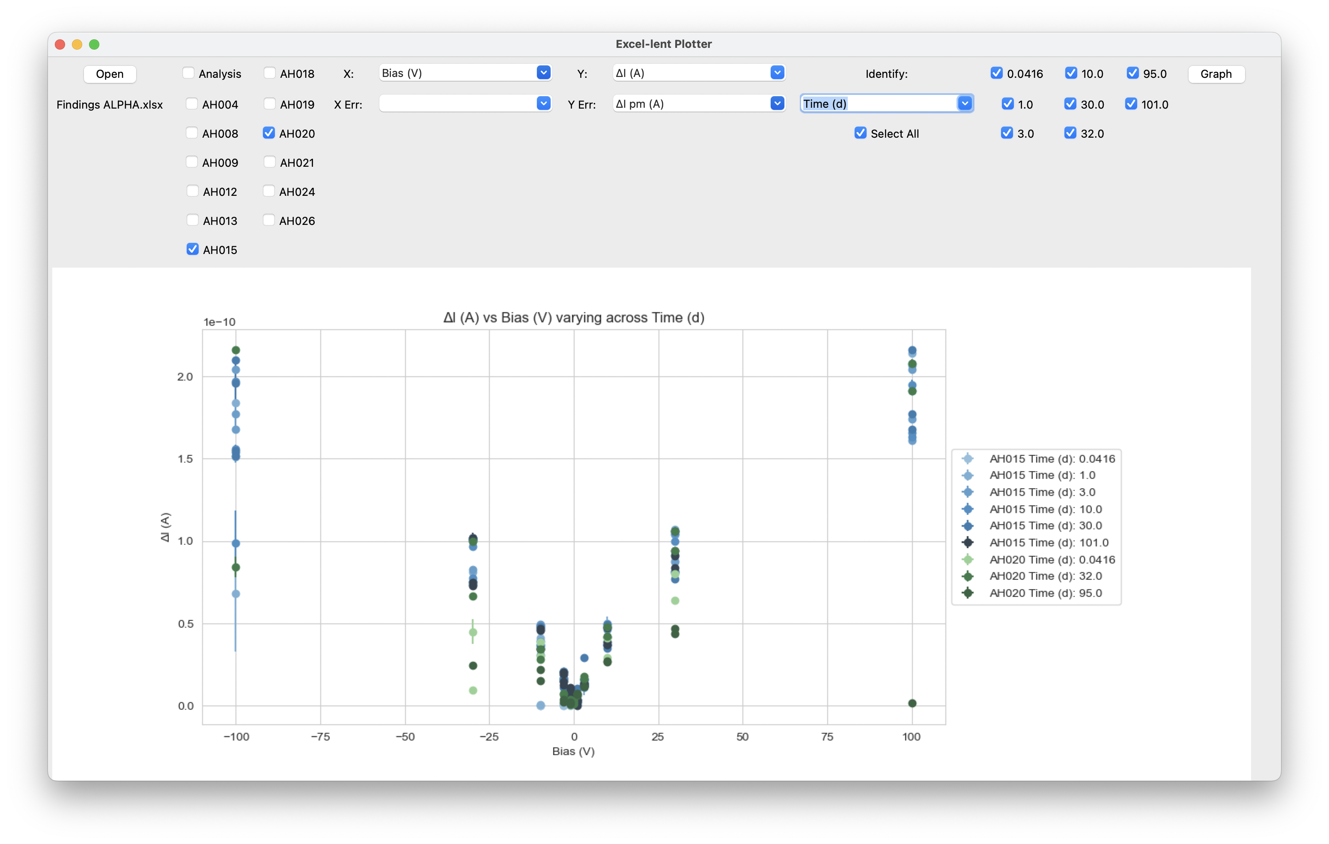
Appendix: Results Plotter
Massive amount of data to sift through, made easier with automatic plotting GUI

