Slide 1


CsPbBr₃ Nanocrystals based Plastic Scintillator for Ionizing Radiation Detection
J. Ghosh, S.S. Alghamdi, S. Alanazi, I. J. D. Jayarathne, C. Crean, P.J. Sellin
University of Surrey

Slide 2
Outline
Introduction of metal halide perovskites
Mechanochemical synthesis of CsPbBr₃ nanocrystals for plastic scintillators
CsPbBr₃ polycrystalline direct X-ray detector
Conclusion
Acknowledgements

Slide 3
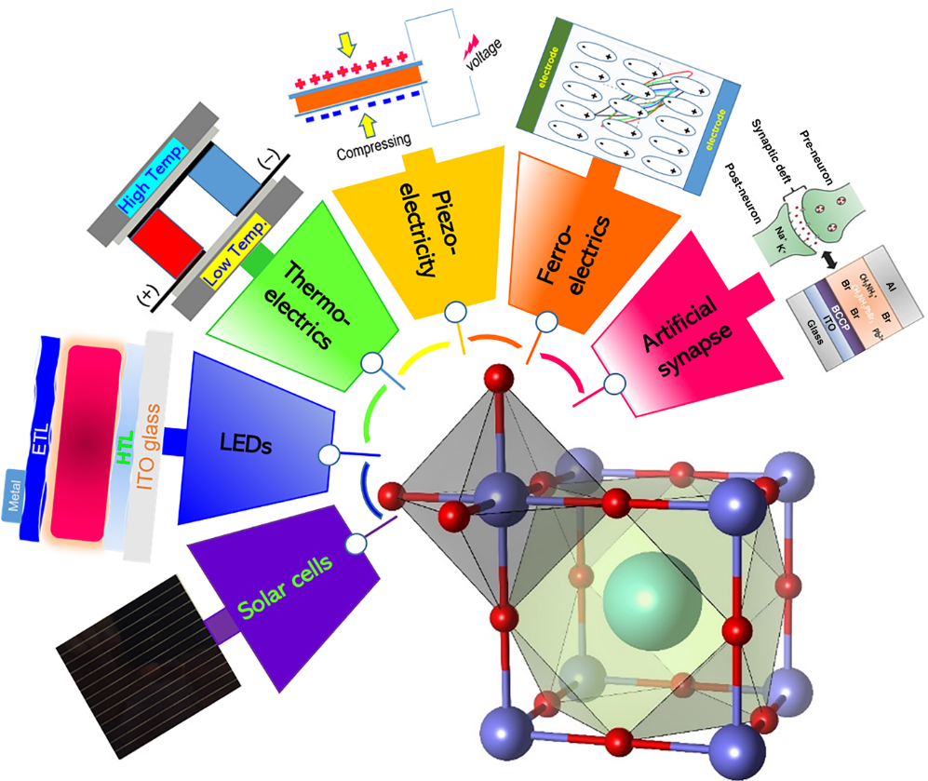
Metal halide perovskite
Halide perovskites with formula ABX_{3,} where A is a large cation, B is a metal cation, and X is halide anion (Cl, Br or I))
Simple fabrication
Tunable bandgap
Excellent performance in solar cell (PCE>23%), photodetector, LEDs
Promising in radiation detection
MRS Bulletin, 45(6), 427-430, 2020

Slide 4
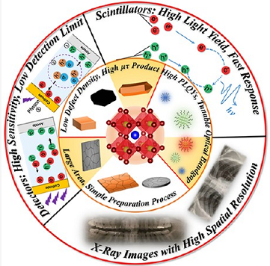
Halide Perovskite for Radiation Detection
Metal halide perovskite for radiation detection
Large absorption coefficient
High μτ product and large resistivity
Tunable bandgap and high PLQYs
Low-cost, simple solution processable fabrication.
ACS Energy Lett.2021, 6, 739−768

Slide 5
Gram Scale Solid-state Synthesis of CsPbBr₃ nanocrystals
Gram scale CsPbBr₃ nanocrystals (NCs) was synthesized by nearly solvent free two-step surfactant (Oleylamine) assisted ball milling method.
The surfactant (OAM) concentration was varied to tune the optical properties of the NCs.
The surfactant reduces the aggregation of the NCs in plastic scintillator.
J. Ghosh el al. ACS Appl. Nano Mater. 2023, 6, 16, 14980–14990

Slide 6
Morphology with Different OAM Concentration
TEM imaging
Cubic shaped morphology with high crystalline quality of CsPbBr₃ NCs.
Particle size decreased with the increase of OAM concentration.
XRD confirms proper crystalline phase of CsPbBr₃.
XRD pattern
J. Ghosh el al. ACS Appl. Nano Mater. 2023, 6, 16, 14980–14990

Slide 7
Optical Properties of Perovskite NCs Dispersed in Toluene
PL & Absorbance
Highest PL quantum yield was observed for 0.2 ml of OAM.
Blue shift in PL peak - particle size decreased with the increase of OAM concentration.
J. Ghosh el al. ACS Appl. Nano Mater. 2023, 6, 16, 14980–14990

Slide 8
Optical Properties of Perovskite NCs in PMMA plastic
Perovskite PMMA disc
PL of Perovskite@PMMA
Different concentration of CsPbBr₃ NCs were loaded in PMMA polymer.
PMMA disc with 0.4 OAM shows highest PL emission which may be due to the less aggregation.
The nanocomposite scintillator exhibits high stability.
Storage stability of the nanocomposite in water
J. Ghosh el al. ACS Appl. Nano Mater. 2023, 6, 16, 14980–14990

Slide 9
Radioluminescence Properties
RL
RL decay
PMT response
The CsPbBr₃/PMMA nanocomposite disc shows a highly intense RL emission peak at 536 nm with FWHM ~ 16 nm with a fast RL decay time of 29.4 ns.
J. Ghosh el al. ACS Appl. Nano Mater. 2023, 6, 16, 14980–14990

Slide 10
X-ray imaging
X-ray imaging set up
X-ray imaging
Resolution
PMMA disc with 10% perovskite loading shows good performance in X-ray imaging with high resolution.
High X-ray imaging resolution of ~8 lp/mm.
J. Ghosh el al. ACS Appl. Nano Mater. 2023, 6, 16, 14980–14990

Slide 11
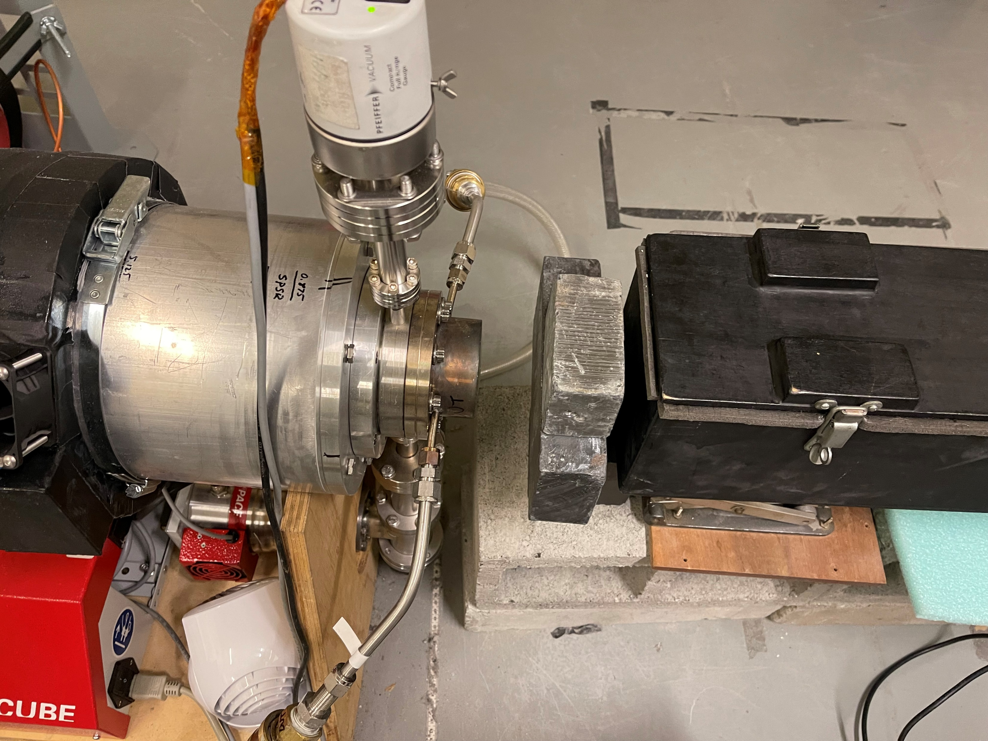
Neutron response of the scintillator
The NuSec NNSA grant has allowed us to start a new collaboration with Prof Anna Erickson at Georgia Tech.
The neutron response of the CsPbBr₃ plastic scintillator was tested using a DD neutron generation in DD neutron generator during the visit to the Georgia Institute of Technology.

Slide 12
Fabrication steps of the CsPbBr₃ polycrystalline direct X-ray detector

Slide 13
I-V characteristics of the polycrystalline detector under dark and illumination of a LED.
Characterization
The Hecht plot using the photocurrent of the device. High μτ value of 1.0x10⁻³ cm²V⁻¹ was obtained.

Slide 14
X-ray sensitivity measurement
Temporal X-ray current response
X-ray current density vs dose rate
High X-ray sensitivity of 3040 μCGy⁻¹cm⁻² was obtained under 10 V of applied bias.

Slide 15
Conclusions
Highly luminescent CsPbBr₃ NCs were synthesized by ball milling method.
X-ray and neutron response of CsPbBr₃ plastic scintillators were studied.
Polycrystalline CsPbBr₃ X-ray detectors were fabricated by using ball milled CsPbBr₃ powder.
The optimized X-ray detector exhibits sensitivity of 3040 μCGy⁻¹cm⁻² under 10 V of applied bias.
We are further optimizing the device performance by different additive and passivation technique.

Slide 16

Acknowledgements
We acknowledge support from the DTRA ‘IIRM’ University Research Alliance and NuSec, UK.

Slide 17

Thank you

