Slide 1
Technologies for HEP
and
life applications
G. Iaselli, Politecnico di Bari and INFN
The 7th School of High Energy Physics, Cairo, Ain Sham, January 2019

Slide 2
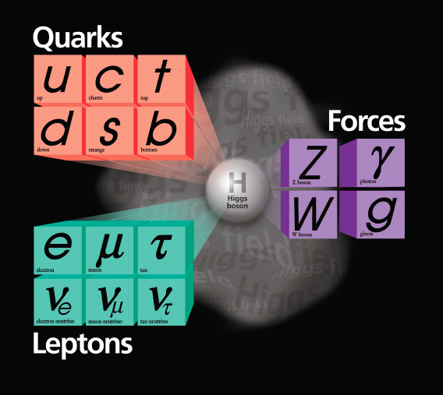
The prologue
The Standard Model of Particle Physics
3 Quark families, 3 Lepton Families, 4 Forces
Matter
  is made out of fermions
Forces
  are mediated by bosons
Higgs boson
  breaks the electroweak symmetry and gives mass to fermions and weak gauge bosons
The theory describes the known forces and particles, with the exception of Gravity
G. Iaselli, Politecnico di Bari and INFN
The 7th School of High Energy Physics, Cairo, Ain Sham, January 2019

Slide 3
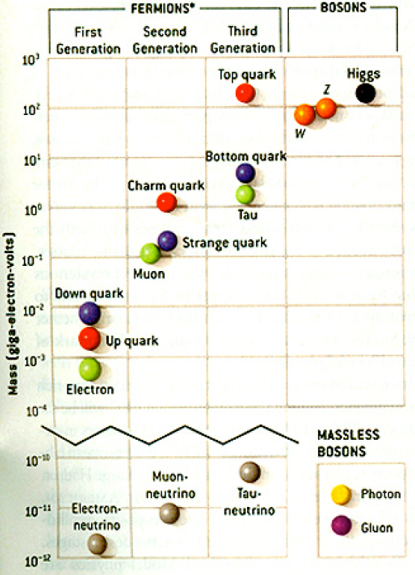
Have we done it?
  The prologue
Is Nature Unified ? Is there Supersymmetry ?
What is the nature of dark matter ?
Why is gravity so weak; are there
extra space-time dimensions?
Why is any matter left in the universe?
Why do neutrino and quark flavors oscillate ?
What is the dark energy ?
G. Iaselli, Politecnico di Bari and INFN
The 7th School of High Energy Physics, Cairo, Ain Sham, January 2019

Slide 4
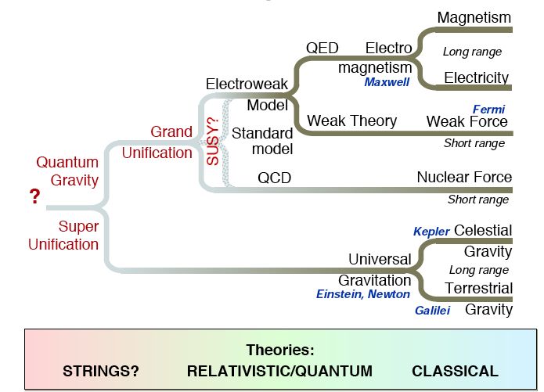
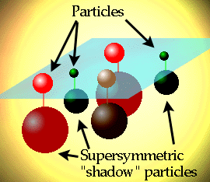
Path to Unification
The prologue
G. Iaselli, Politecnico di Bari and INFN
The 7th School of High Energy Physics, Cairo, Ain Sham, January 2019

Slide 5
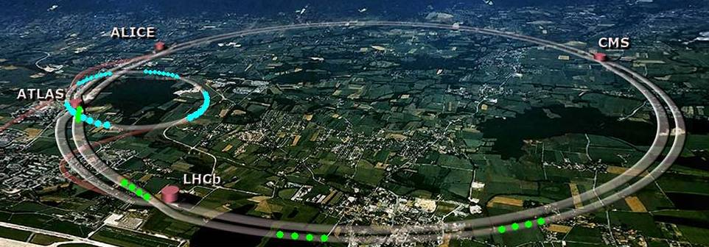
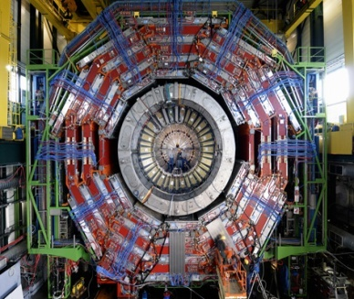
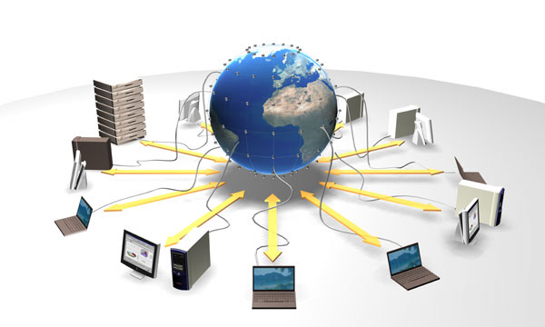
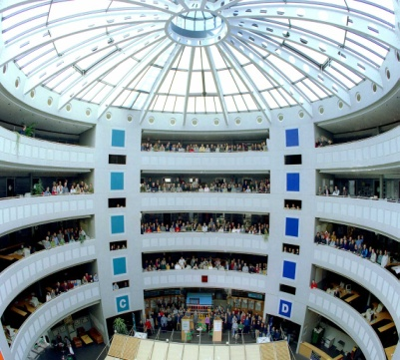
What we need
The prologue
Accelerators: powerful machines to accelerate particles to extremely high energies and bring them into collision with other particles
Detectors: gigantic instruments
that record the particles as they
“stream” out from the point of collision
Computing & software: to collect, store, distribute and analyse the vast amount of data
People: worldwide collaboration of scientists, engineers, technicians to design, build and operate a complex instruments
G. Iaselli, Politecnico di Bari and INFN
The 7th School of High Energy Physics, Cairo, Ain Sham, January 2019

Slide 6

The LHC project
Large Hadron Collider
27 km circumference
Lake Leman Geneva
CMS
LHCb
ALICE
ATLAS
G. Iaselli, Politecnico di Bari and INFN
The 7th School of High Energy Physics, Cairo, Ain Sham, January 2019

Slide 7
The LHC project
The Large Hadron Collider
Cover domain ~ 1 TeV
Largest possible primary energy
Largest possible luminosity
1982 : First studies for the LHC project
1983 : Z0/W discovered
1989 : Start of LEP operation
1994 : Approval of the LHC by the CERN Council
1996 : Final decision to start the LHC construction
2000 : Last year of LEP operation above 100 GeV
2002 : LEP equipment removed
2003 : Start of the LHC installation
2005 : Start of LHC hardware commissioning
2008 : First LHC beams
G. Iaselli, Politecnico di Bari and INFN
The 7th School of High Energy Physics, Cairo, Ain Sham, January 2019

Slide 8
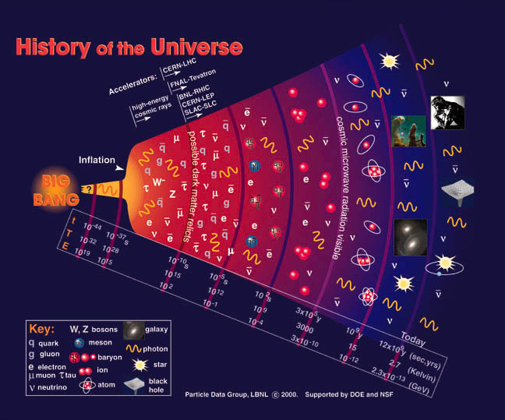
The LHC project
The LHC allow us to recreate particles rarely seen in nature since 10⁻¹² seconds after the Big Bang
LHC
A Brief History of Time
10⁻⁴³ s Quantum gravity era
10⁻³⁵ s Grand unification era
10⁻¹⁰ s Electro-weak era
10⁻⁴ s Protons and neutrons
100 s Nuclei
0.3 Myr Atoms formed
1 Gyr Galaxy
G. Iaselli, Politecnico di Bari and INFN
The 7th School of High Energy Physics, Cairo, Ain Sham, January 2019

Slide 9
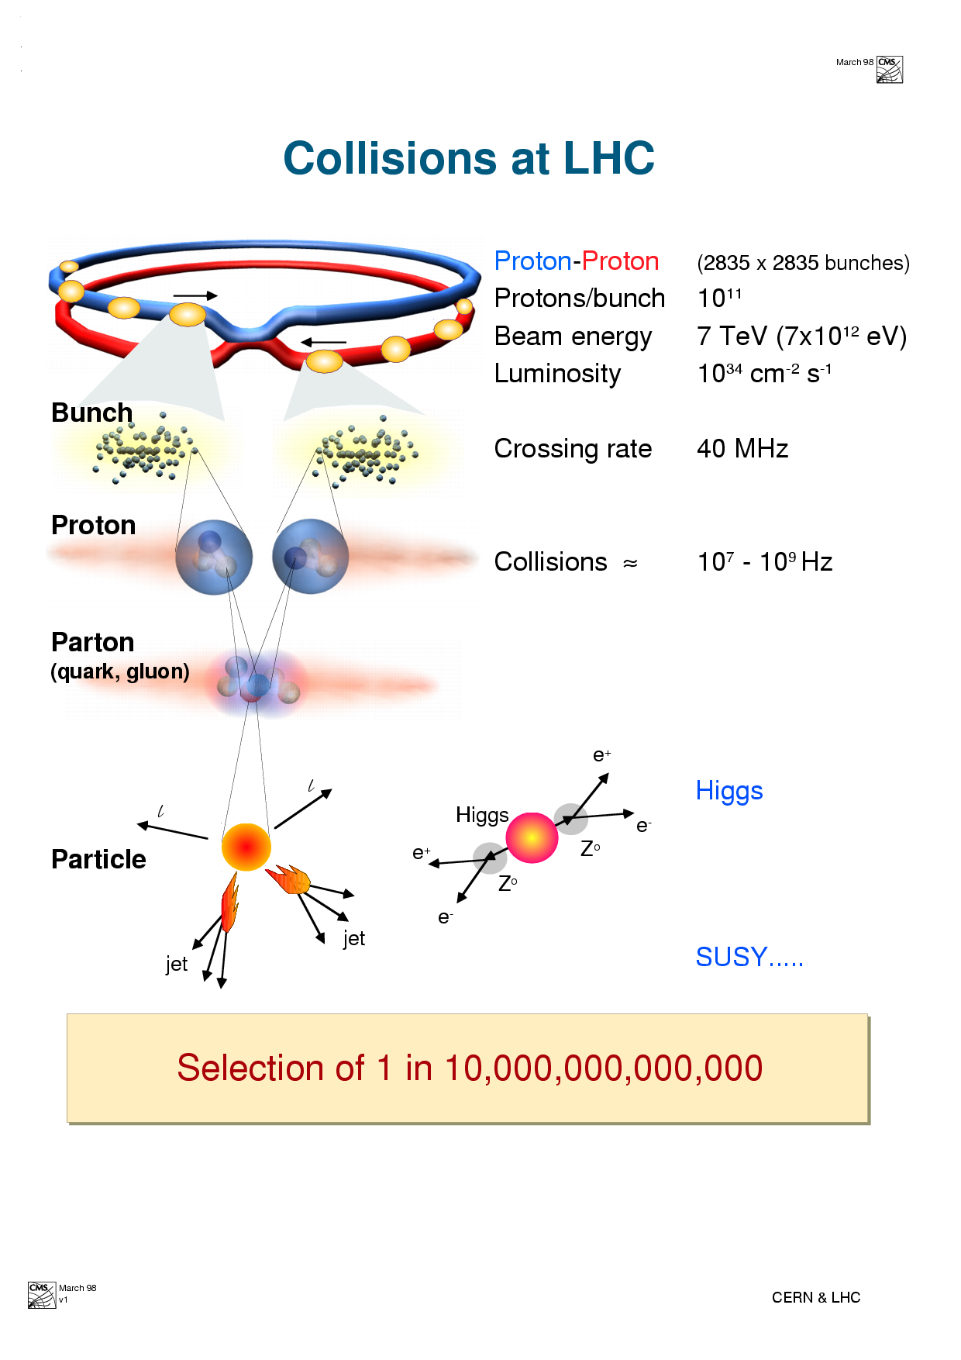
The LHC CMS project The accelerator
Proton – Proton 2808 x 2808 Bunches
Protons/Bunch 1.1 . 10¹¹
Beam Energy 7 TeV (7 x 10¹² eV)
Luminosity 10³⁴ cm⁻² sec⁻¹
Crossing Rate 40 MHz
Collisions ~10⁹ Hz
The LHC surpasses existing accelerators/colliders in 2 aspects :
  The energy of the beam of 7 TeV that is achieved within the size constraints of the existing 26.7 km LEP tunnel.
  LHC dipole field 8.3 T
  HERA/Tevatron ~ 4 T
  The luminosity of the collider that will reach unprecedented values for a hadron machine:
  LHC pp ~ 10³⁴ cm⁻² s⁻¹
  Tevatron pp 2x10³² cm⁻² s⁻¹
G. Iaselli, Politecnico di Bari and INFN
The 7th School of High Energy Physics, Cairo, Ain Sham, January 2019

Slide 10
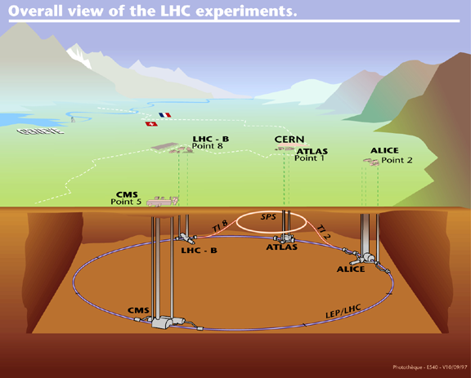
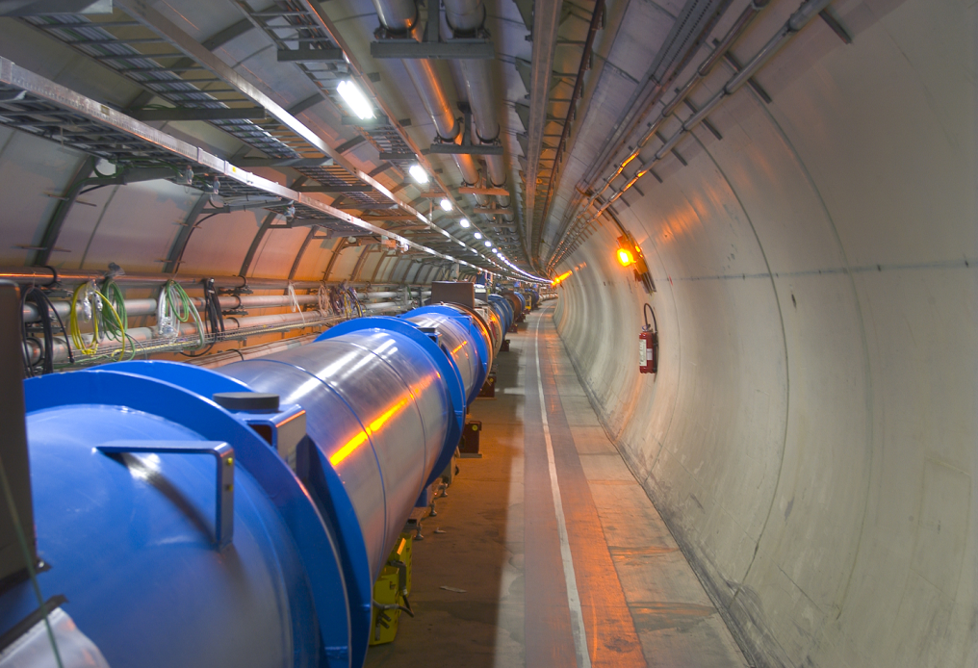
The LHC project
To reach the required energy in the existing 27 km tunnel, the super conducting magnets operate at 83 Kilogauss (200.000 x Earth’s field) in super fluid helium.
Protons travel in a tube with better vacuum & colder than interplanetary space at T = 4-20 º K
G. Iaselli, Politecnico di Bari and INFN
The 7th School of High Energy Physics, Cairo, Ain Sham, January 2019

Slide 11
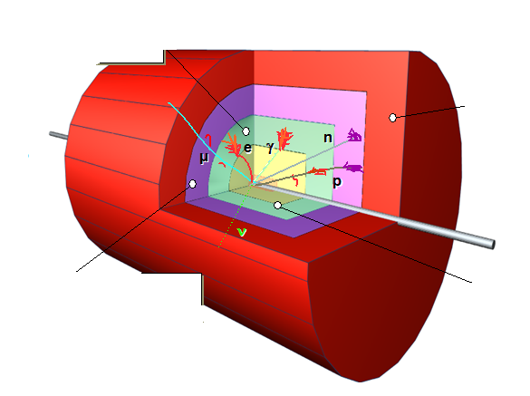
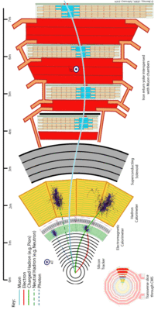
The detectors
Coverage of full solid angle
Measurement of momentum and/or energy
Detect, track and identify all particles (mass, charge)
Relevant scale is the nuclear interaction length λ_{L} (for Fe 16.8 cm).
λ_{L} ≈ 10 X_{0,} so hadronic showers are longer than EM
G. Iaselli, Politecnico di Bari and INFN
The 7th School of High Energy Physics, Cairo, Ain Sham, January 2019

Slide 12
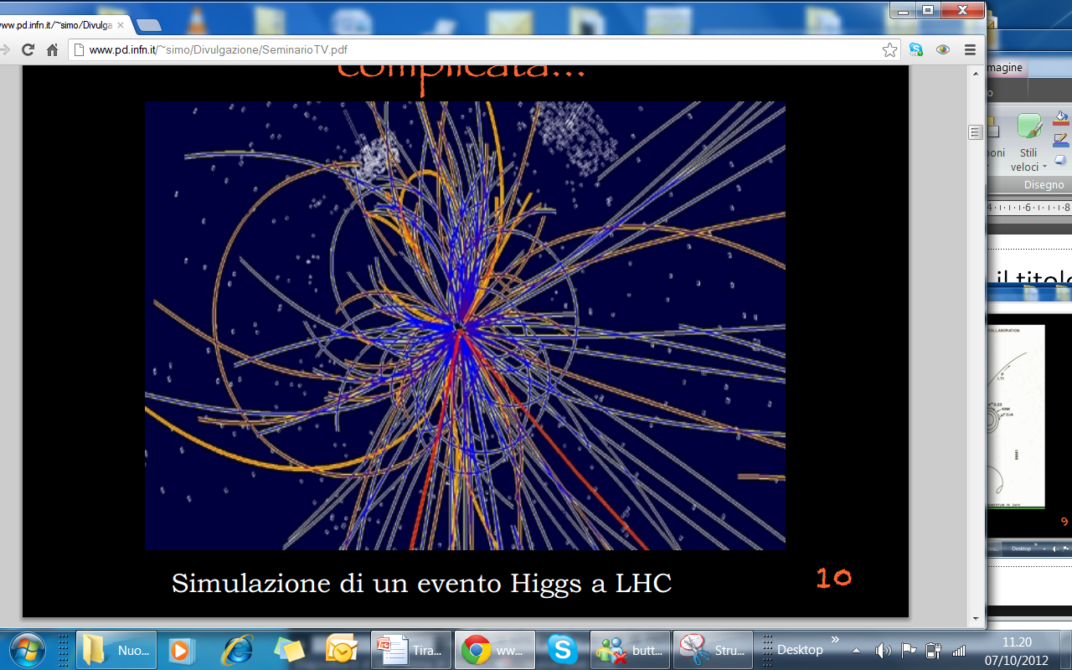
Experimental Challenge
The detectors
High Interaction Rate
1 billion interactions/s
Data can be recorded for only ~100 out
of the 40 million crossings/sec
Level-1 trigger decision will take ~2-3 ms
Large Particle Multiplicity
~ <20> superposed events in each crossing
~ 1000 tracks stream into the detector every 25 ns
need highly granular detectors with
High Radiation Levels
radiation hard (tolerant) detectors and electronics
We need
High frequency of sampling (40 MHz)
High resolution in space and time (100 μm and few ns)
No dead time
High data storage capability (TB)
G. Iaselli, Politecnico di Bari and INFN
The 7th School of High Energy Physics, Cairo, Ain Sham, January 2019

Slide 13
The Compact Muon Solenoid
The detectors
G. Iaselli, Politecnico di Bari and INFN
The 7th School of High Energy Physics, Cairo, Ain Sham, January 2019

Slide 14
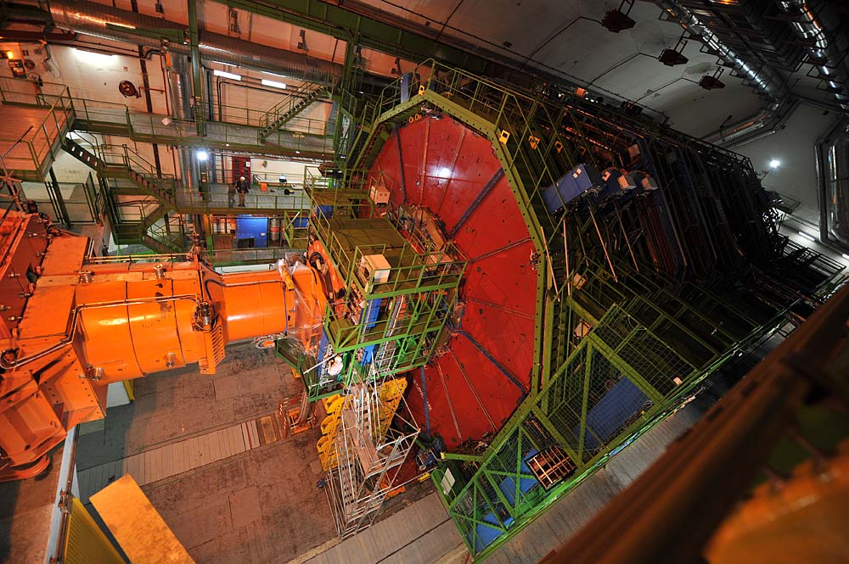
Gigantic, but “compact”
The detectors
G. Iaselli, Politecnico di Bari and INFN
The 7th School of High Energy Physics, Cairo, Ain Sham, January 2019

Slide 15
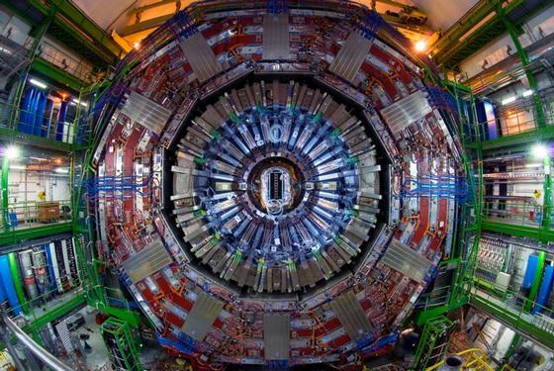
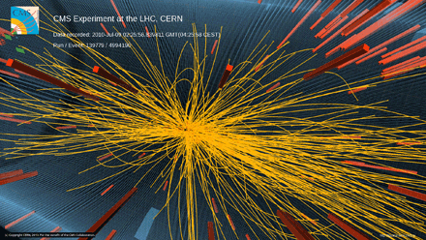
The detectors
Detect 600 million proton-proton collisions per second
Sophisticated detectors to precisely measure the passage of a particle with time accuracies of 10⁻⁹ second and space accuracy of 10⁻⁵ meter.
  Crystal
  Gaseous detectors
  Silicon detectors
G. Iaselli, Politecnico di Bari and INFN
The 7th School of High Energy Physics, Cairo, Ain Sham, January 2019

Slide 16
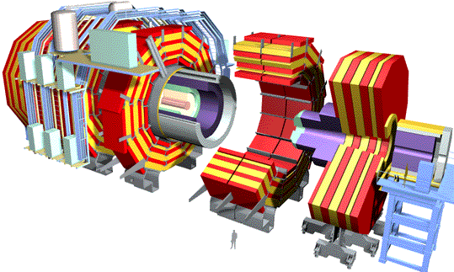

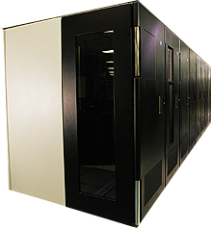
The CMS Data Grid Hierarchy
Data analysis
~PByte/sec
~300-1500 MBytes/sec
Tier 0
Online System
Experiment
CERN Center
10 – 40 to 100 Gbps
Italy
France
USA
Egypt
Tier 1
Tier 2
Tier2 Center
Tier2 Center
Tier2 Center
Institute
Institute
Institute
Tier 3
G. Iaselli, Politecnico di Bari and INFN
The 7th School of High Energy Physics, Cairo, Ain Sham, January 2019

Slide 17
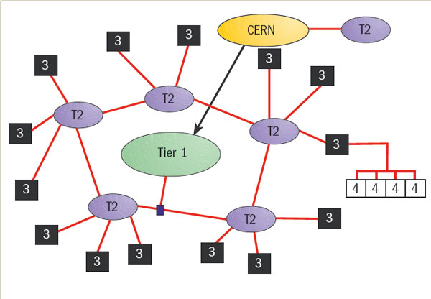
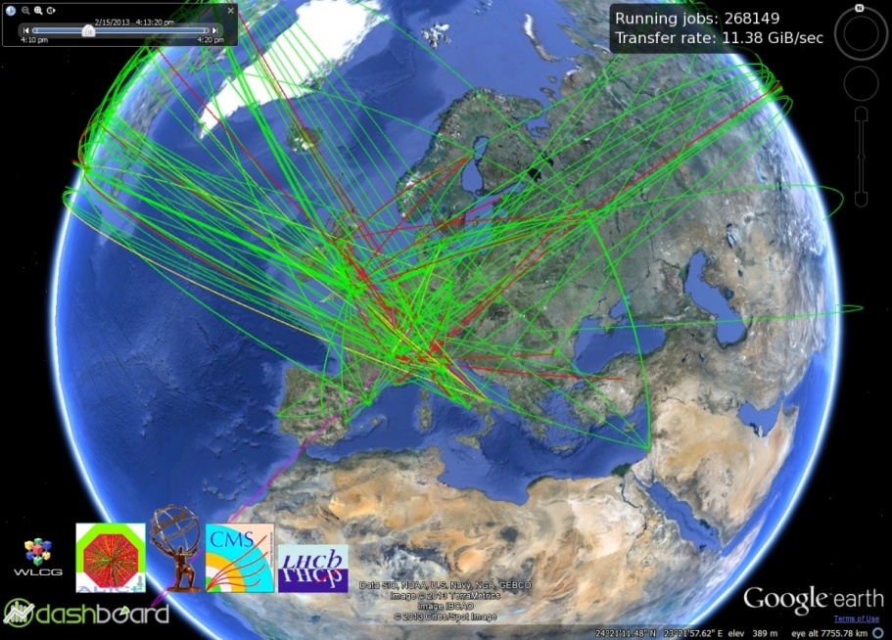
Computing
Worldwide LHC Computing Grid (WLCG)
370 Sites
40,000 computers
Tens of Thousands of GRID jobs running concurrently
The mission of the WLCG project is to provide global computing resources to store, distribute and analyse the ~30 Petabytes (30 million Gigabytes) of data annually generated by the Large Hadron Collider.
G. Iaselli, Politecnico di Bari and INFN
The 7th School of High Energy Physics, Cairo, Ain Sham, January 2019

Slide 18
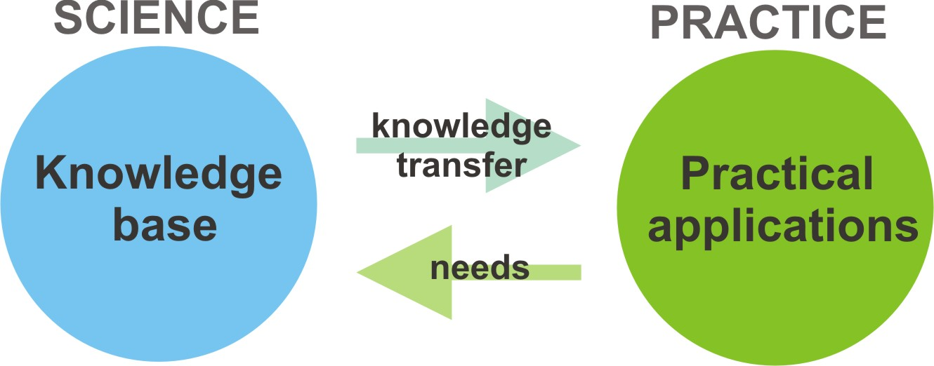
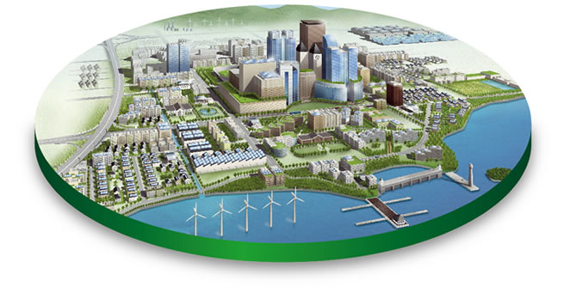
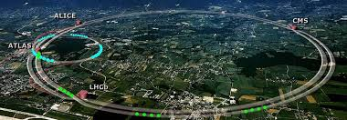
HEP technologies transfer to everyday life
G. Iaselli, Politecnico di Bari and INFN
The 7th School of High Energy Physics, Cairo, Ain Sham, January 2019

Slide 19
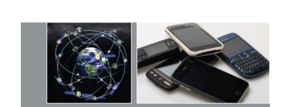
Einstein relativity 100 years later
Physics underpins so much of modern life
The global positioning systems (GPS) that are used to achieve pinpoint position accuracy in today’s most modern vehicles depend on general relativity, Einstein’s theory of gravity.
G. Iaselli, Politecnico di Bari and INFN
The 7th School of High Energy Physics, Cairo, Ain Sham, January 2019

Slide 20
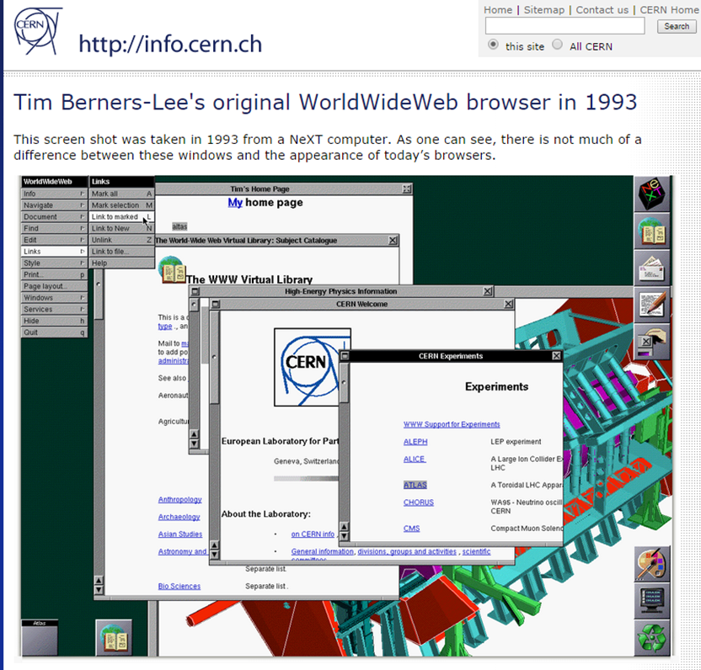
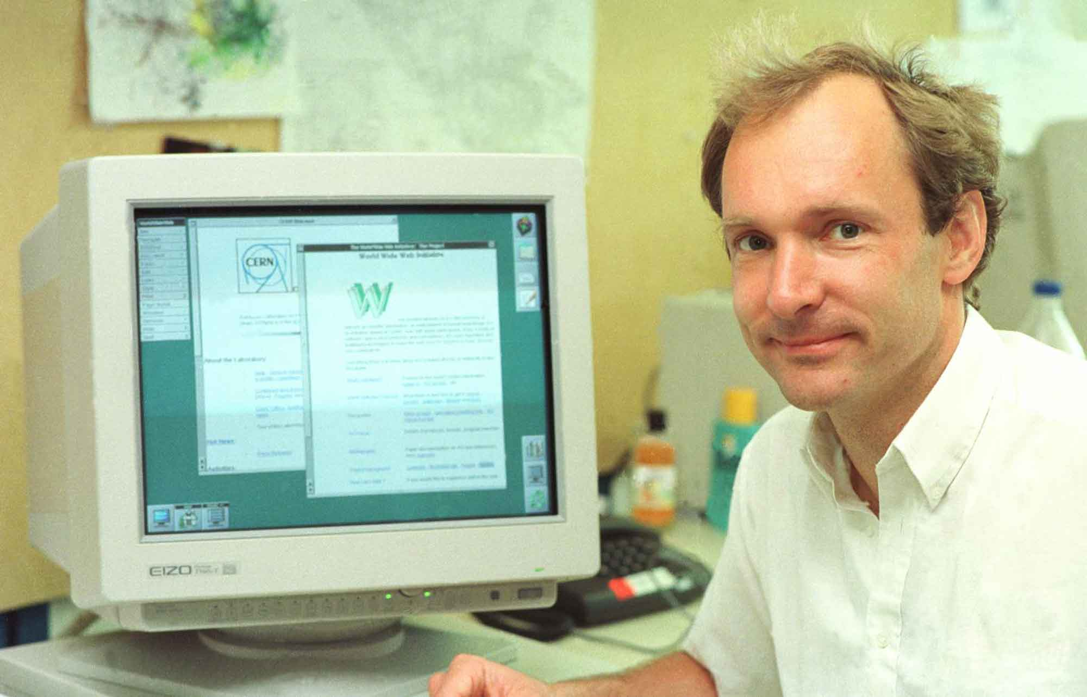
A milestone case: WWW
Tim Berners Lee with his NeXT computer that he used to invent the World Wide Web
G. Iaselli, Politecnico di Bari and INFN
The 7th School of High Energy Physics, Cairo, Ain Sham, January 2019

Slide 21
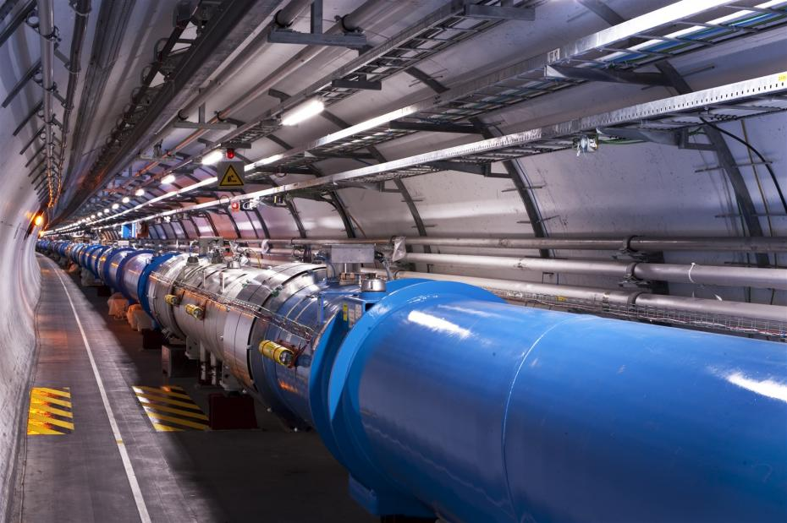
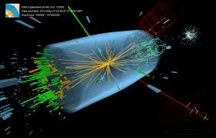
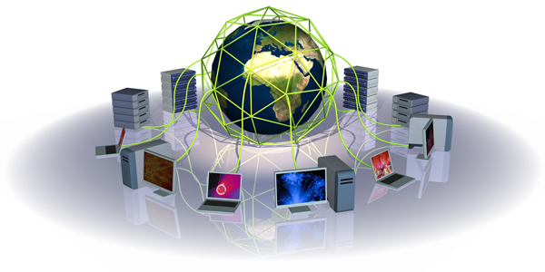
HEP technologies
Accelerating particle beams
Detecting particles
Large scale computing & software
G. Iaselli, Politecnico di Bari and INFN
The 7th School of High Energy Physics, Cairo, Ain Sham, January 2019

Slide 22
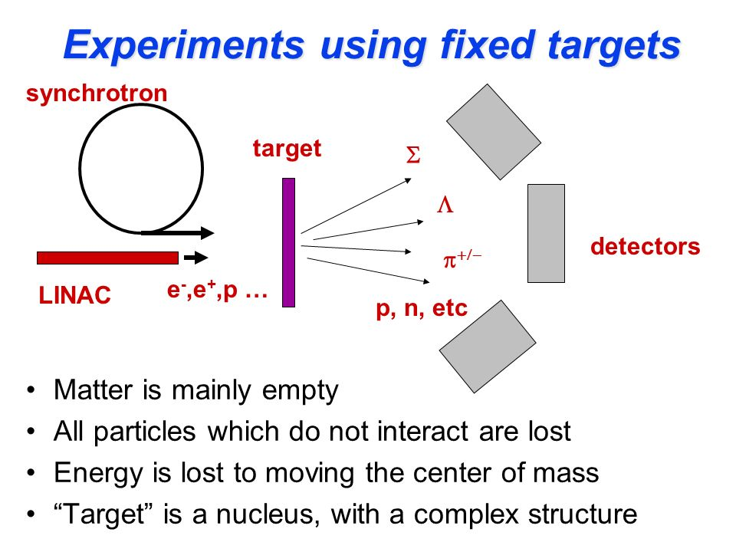
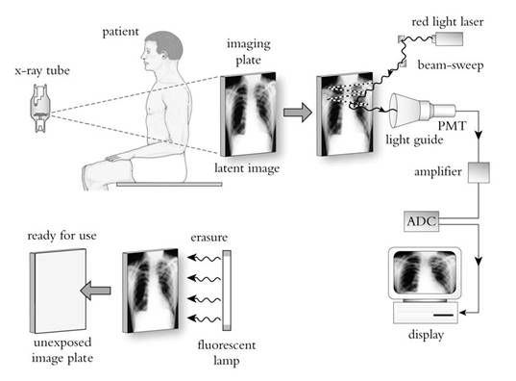
HEP technologies for medicine
DD
DD
DD
Same concept for an HEP experiment and a radiological investigation
G. Iaselli, Politecnico di Bari and INFN
The 7th School of High Energy Physics, Cairo, Ain Sham, January 2019

Slide 23
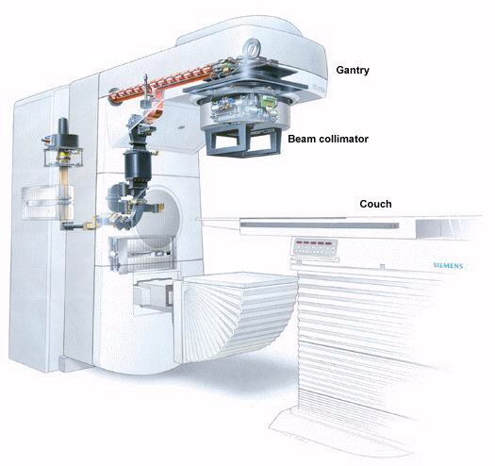
Accelerating particles
There are many medical application of accelerators
Basic type of accelerators
-Linear
Cyclotron
Betatron
Synchrotron
Common medical application
-Radiation therapy (photon/electron)
Isotope production (Cyclotron)
Equipment sterilization
Hadron therapy
Future Application
-Angiography
-Boron neutron Capture Therapy
G. Iaselli, Politecnico di Bari and INFN
The 7th School of High Energy Physics, Cairo, Ain Sham, January 2019

Slide 24
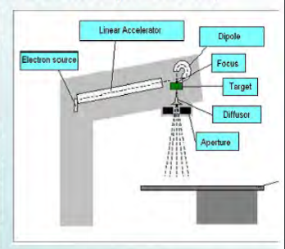
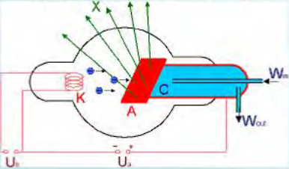
Accelerating particles
Linear accelerators (LINAC) for radiotherapy
Schematics of an X ray tube for
an electrostatic accelerator
Modern LINAC concept
G. Iaselli, Politecnico di Bari and INFN
The 7th School of High Energy Physics, Cairo, Ain Sham, January 2019

Slide 25
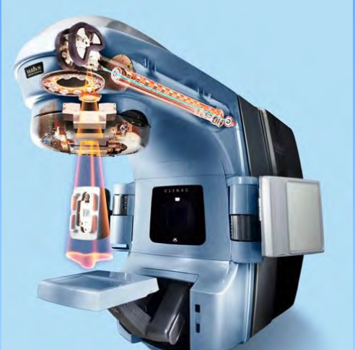
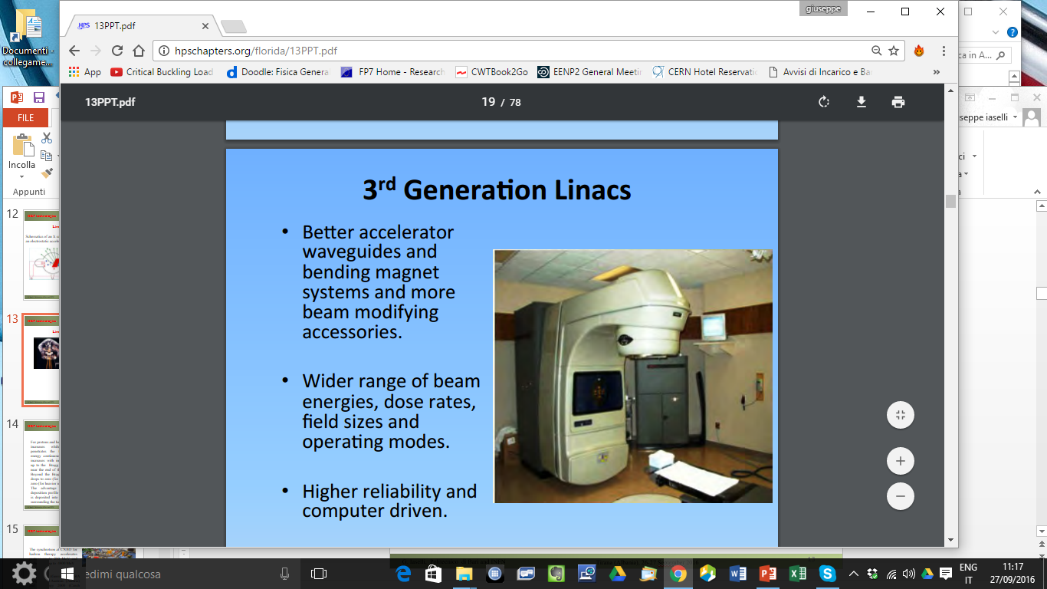
Accelerating particles
LINAC
LINAC uses microwave technology to accelerate electrons in a part of the LINAC called waveguide, then allows these electrons to collide with a heavy metal target. As a result of these collisions, high energy X-Rays (Photons) are produced from the target.
G. Iaselli, Politecnico di Bari and INFN
The 7th School of High Energy Physics, Cairo, Ain Sham, January 2019

Slide 26
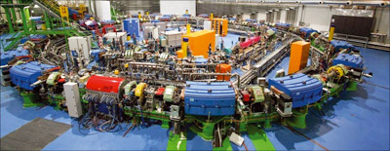
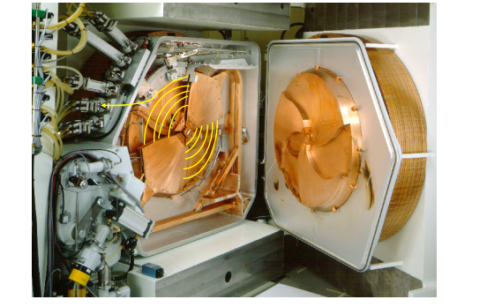
Accelerating particles
Accelerating particles for medical treatments
The synchrotron at CNAO for hadron therapy accelerates protons up to 250 MeV and carbon ions up to 4800 MeV
Cyclotrons for production of radio pharmaceutics substances are now quite common
es. ¹⁴N +p → ¹¹C + α +Q (MeV)
G. Iaselli, Politecnico di Bari and INFN
The 7th School of High Energy Physics, Cairo, Ain Sham, January 2019

Slide 27
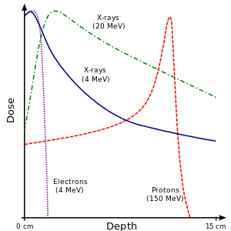
Accelerating particles
Hadron therapy
For protons and heavier ions the dose increases while the particle penetrates the tissue and loses energy continuously. Hence the dose increases with increasing thickness up to the Bragg peak that occurs near the end of the particle's range. Beyond the Bragg peak, the dose drops to zero (for protons) or almost zero (for heavier ions).
G. Iaselli, Politecnico di Bari and INFN
The 7th School of High Energy Physics, Cairo, Ain Sham, January 2019

Slide 28
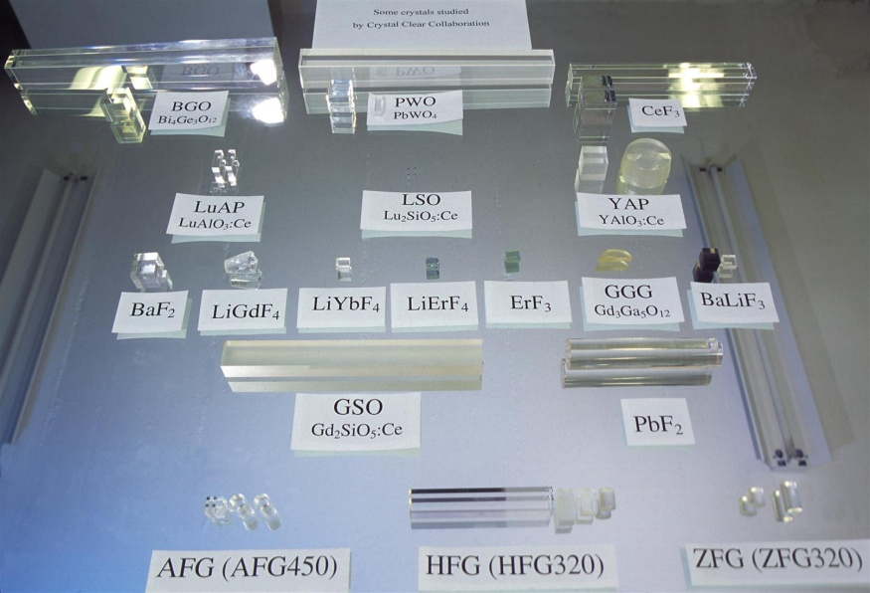
Detecting particles
  Scintillators detectors
Scintillators are applied in high-energy physics to measure the energy of particles that are produced in particle physics experiments. Their use is motivated by the very good detection efficiency of these materials for hard radiation
A wide range of applications
Dosimetry: radiation therapy, equipment calibration, active exposure monitoring
Nuclear applications: homeland security, nuclear reactors and fusion experiments
Synchrotrons: white beam monitoring
UV detectors: photolithography, flame detection and solar physics
Alpha/Beta: air-Flow and survey meters, waste incineration
G. Iaselli, Politecnico di Bari and INFN
The 7th School of High Energy Physics, Cairo, Ain Sham, January 2019

Slide 29
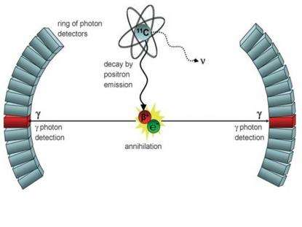
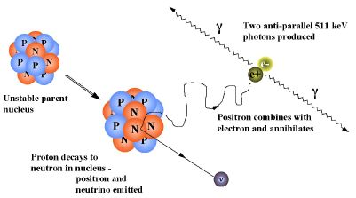
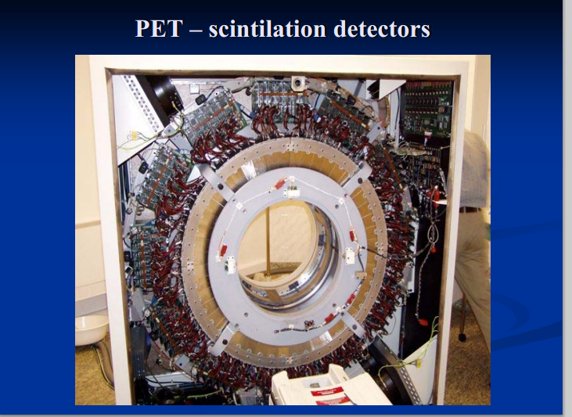
Detecting particles
The PET concept
A PET detector is as complex as an HEP detector
Inorganic scintillators are widely used in PET imaging and medical imaging in general.
G. Iaselli, Politecnico di Bari and INFN
The 7th School of High Energy Physics, Cairo, Ain Sham, January 2019

Slide 30
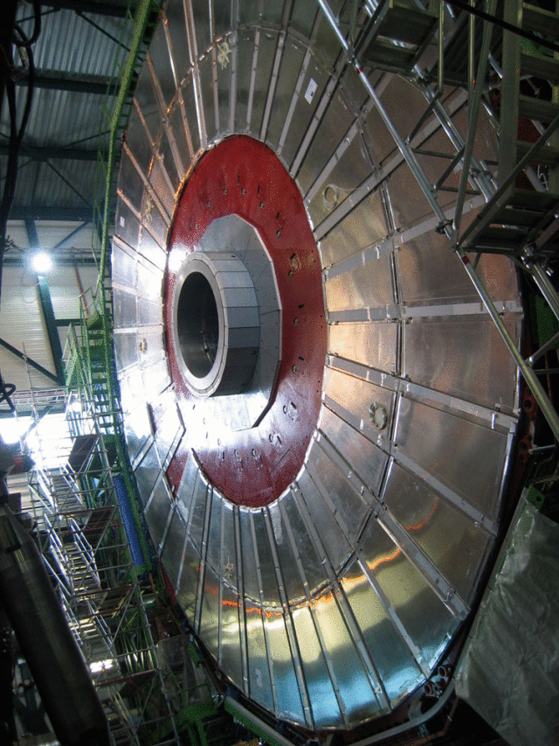
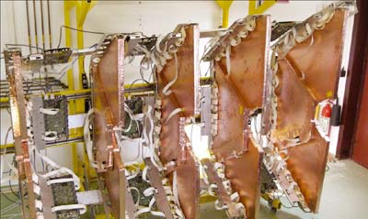
Detecting particles
  Gaseous detectors
  Various type of detectors, GEMs, RPCs, MRPCs, MICROMEGA, traditional WIRE CHAMBERS and DRIFT TUBES
  Large areas, extreme time resolution, extreme spatial resolutions, high rate capability
G. Iaselli, Politecnico di Bari and INFN
The 7th School of High Energy Physics, Cairo, Ain Sham, January 2019

Slide 31
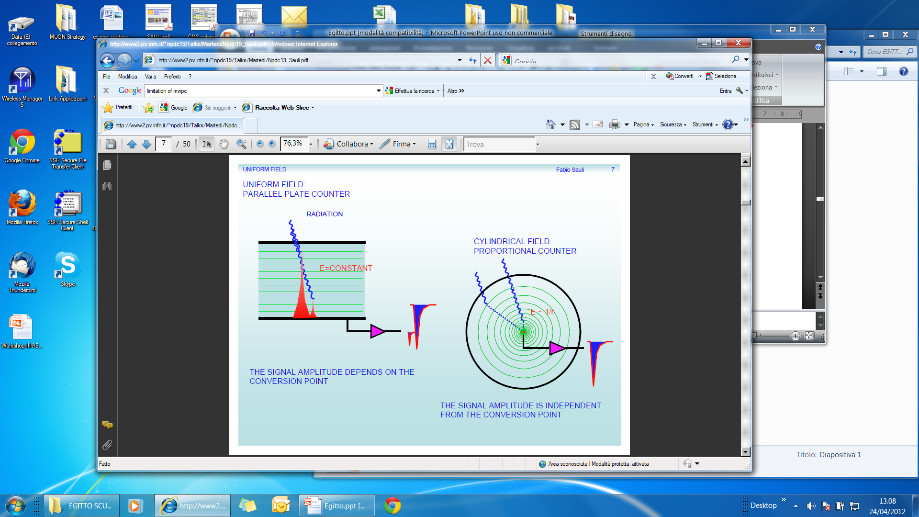
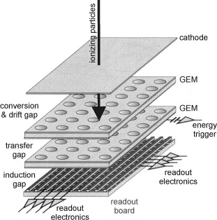
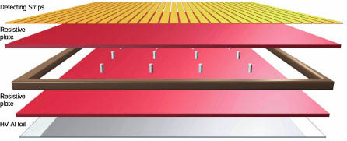
Detecting particles
  Gaseous detectors
Use ionization in gas. Then collect the electrons on an appropriate electrode produces our signal. To drive the electrons towards the electrode, an electric field is needed
  Mostly used as muon detectors
  RPC
  GEM
G. Iaselli, Politecnico di Bari and INFN
The 7th School of High Energy Physics, Cairo, Ain Sham, January 2019

Slide 32
Detecting particles
x rays screening with GEM
Large-area micro-pattern gaseous detectors with fast electronics can offer a unique opportunity for rapid air cargo scanning at affordable costs. Joint ventures with academia, industry and funding bodies to develop are in progress
Radioactive waste
Thermal neutron
G. Iaselli, Politecnico di Bari and INFN
The 7th School of High Energy Physics, Cairo, Ain Sham, January 2019

Slide 33

Detecting particles
G. Iaselli, Politecnico di Bari and INFN
The 7th School of High Energy Physics, Cairo, Ain Sham, January 2019

Slide 34

Detecting particles
Large scale gaseous detector with high spatial resolution are needed
Image reconstruction can spot material of different density
Reconstruction software is crucial
G. Iaselli, Politecnico di Bari and INFN
The 7th School of High Energy Physics, Cairo, Ain Sham, January 2019

Slide 35

Detecting particles
The concept is not new, but now we can profit of advanced instruments
G. Iaselli, Politecnico di Bari and INFN
The 7th School of High Energy Physics, Cairo, Ain Sham, January 2019

Slide 36


Detecting particles
An interesting application is the determination of high density object in mines
G. Iaselli, Politecnico di Bari and INFN
The 7th School of High Energy Physics, Cairo, Ain Sham, January 2019

Slide 37




Machine Learning in Particle Physics
Software
In HEP experiments each event yields a collection of numbers
which depends on the type of event produced, i.e., signal or background.
What kind of decision boundary best separates the two classes?
What is optimal test of hypothesis that event sample contain sonly background?
G. Iaselli, Politecnico di Bari and INFN
The 7th School of High Energy Physics, Cairo, Ain Sham, January 2019

Slide 38

Machine Learning in Particle Physics
Software
Machine learning has been used in particle physics for 30 years, mostly neural networks (NN) and more recently boosted decision trees (BDT). These methods were crucial for the following recent discoveries:
2009 Discovery of single top quark production (D0, CDF)
2012 Discovery of the Higgs boson (ATLAS, CMS)
The focus today is using lower-level data (calorimeter hits, tracks, etc.) to build more powerful classifiers. A recent example (Pileup Mitigation with Machine
Learning, Metodiev, Komiske, Nachman,
Schwarz, JHEP 12 (2017) 051) applies image classification to remove from jets the contribution of neutral particles that come from vertices other than the
leading one, i.e., to remove pileup.
G. Iaselli, Politecnico di Bari and INFN
The 7th School of High Energy Physics, Cairo, Ain Sham, January 2019

Slide 39
Software
Machine Learning fields other then HEP
Machine learning is preferred approach to
  Speech recognition, Natural language processing
  Computer vision
  Medical outcomes analysis
  Robot control
  Computational biology
This trend is accelerating
  Improved machine learning algorithms
  Improved data capture, networking, faster computers
  Software too complex to write by hand
  New sensors / IO devices
G. Iaselli, Politecnico di Bari and INFN
The 7th School of High Energy Physics, Cairo, Ain Sham, January 2019

Slide 40


Software
GEANT 4: The physics simulation toolkit
Geant4 is a toolkit developed at CERN for the simulation of the passage of particles through matter. The simulation reproduces in detail the detector geometry, the generation of events at the interaction point, the propagation of the resulting particles through the detector and the response of the detector to these particles. Detector response quantities are then used to construct candidate events which may analyzed as if they were real data.
G. Iaselli, Politecnico di Bari and INFN
The 7th School of High Energy Physics, Cairo, Ain Sham, January 2019

Slide 41


Software
GEANT 4: applications
Because of its general purpose nature, Geant4 is well suited for development of computational tools for analyzing interactions of particle with matter in many areas:
Space applications where it is used to study interactions between the natural space radiation environment and space hardware or astronauts;
Medical applications where interactions of radiations used for treatment are simulated.
Nuclear physics where radiation effects in microelectronics semiconductor devices are modeled.
Simulations of Emission Tomography (Positron Emission Tomography – PET)
G. Iaselli, Politecnico di Bari and INFN
The 7th School of High Energy Physics, Cairo, Ain Sham, January 2019

Slide 42

Software
OpenGATE
OpenGATE is an extension of GEANT4, and provides a complete environment for simulating the behaviour of the next generation of nuclear medicine scanners, which may be used in clinics or for the development of drugs.
The simulation platform incorporates the basis of nuclear physics, the electronic response of the scanners, and various image reconstruction algorithms.
G. Iaselli, Politecnico di Bari and INFN
The 7th School of High Energy Physics, Cairo, Ain Sham, January 2019

Slide 43
Computing
The Bari ReCaS DataCenter originally was set up in 2009 to support scientific computing needs of the ALICE and CMS experiments running at the Large Hadron Collider (LHC) at CERN in Geneva.
Some of non HEP projects
PERSON
PERvasive game for perSOnalized treatment of cognitive and functional deficits associated with chronic and Neurodegenerative diseases
ENPADASI
European Nutritional Phenotype Assessment and Data Sharing Initiative
PRISMA
PIATTAFORME CLOUD INTEROPERABILI PER SMART-GOVERNMENT
OCP
OPEN CITY PLATFORM
G. Iaselli, Politecnico di Bari and INFN
The 7th School of High Energy Physics, Cairo, Ain Sham, January 2019

Slide 44

Drug Design: Data Intensive Computing on Grid
Computing
Molecules
Chemical Databases
(legacy, in .MOL2 format)
Protein
It involves screening millions of chemical compounds (molecules) in the Chemical DataBase (CDB) to identify those having potential to serve as drug candidates.
G. Iaselli, Politecnico di Bari and INFN
The 7th School of High Energy Physics, Cairo, Ain Sham, January 2019

Slide 45



Computing
Distributed Data (Image) Analysis
  Patient history (query to the MetaData Catalogue)
  Exam Comparison (download the previous exam(s))
  Comparison with reference data base
Statistical analysis data base
Analysis Station
G. Iaselli, Politecnico di Bari and INFN
The 7th School of High Energy Physics, Cairo, Ain Sham, January 2019

Slide 46

Computing
  Cloud computing is now developing fast in every day life: your smartphone, notebook and tablet are interconnected and exchange information through a database server
G. Iaselli, Politecnico di Bari and INFN
The 7th School of High Energy Physics, Cairo, Ain Sham, January 2019

Slide 47
Conclusion
Large impact of HEP projects on technologies development
Pushing industrial capabilities and developing new production protocols
Important impact for everyday life (medical diagnostic, sustainable energy, parallel computing)
Role of CERN (and other funding agency) is crucial
G. Iaselli, Politecnico di Bari and INFN
The 7th School of High Energy Physics, Cairo, Ain Sham, January 2019

