Slide 1


DARK MATTER (1)
A long history, … not finished
Philippe Miné, Laboratoire Leprince-Ringuet, France

Slide 2
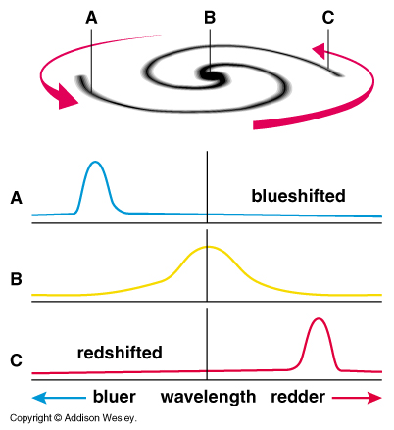
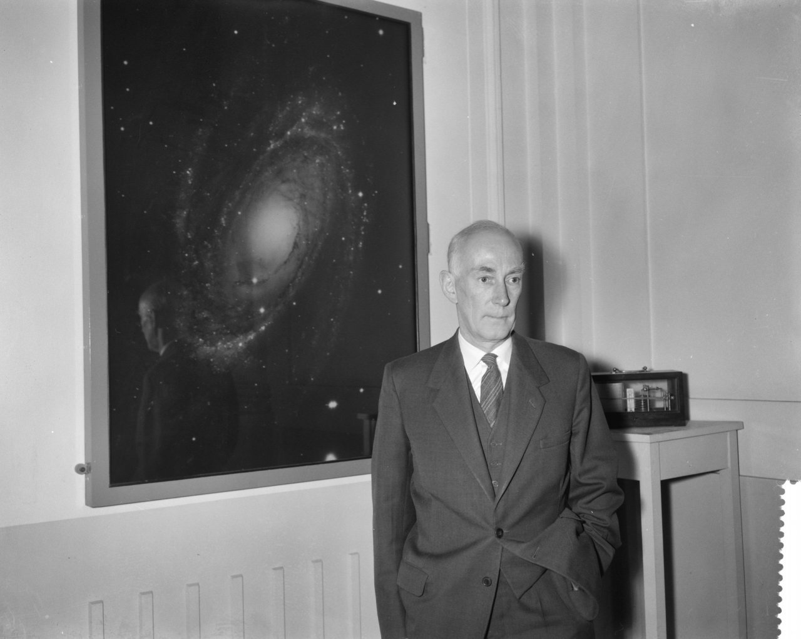
DARK MATTER EVIDENCE
Gravitation is the major interaction structuring the Universe
Measure of mass and rotation
of the stars of our galaxy, Milky Way
Oort 1932
Rubin 1970 : idem
for other galaxies
⇒ 90% of “dark matter“

Slide 3
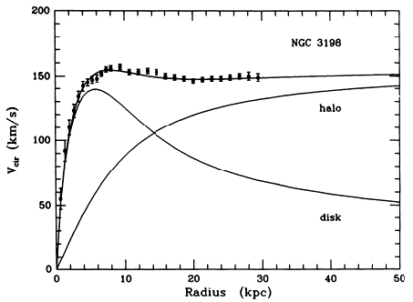
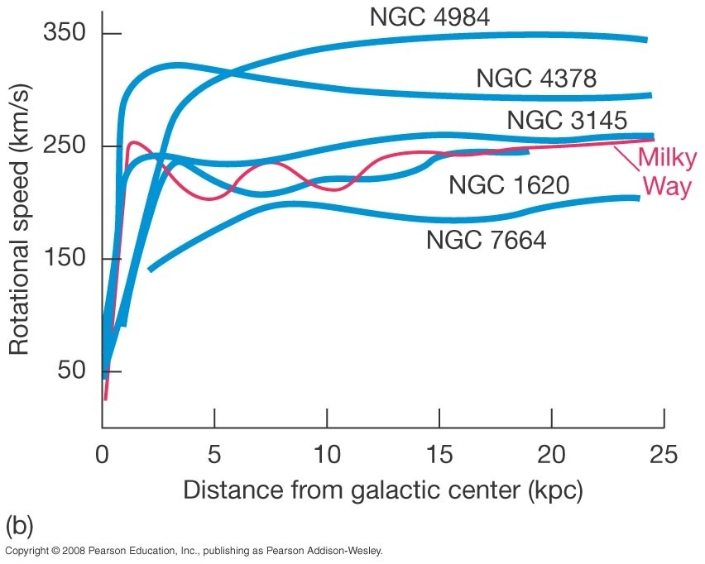
DARK MATTER EVIDENCE
rotation curve of galaxy NGC 3198
Zwicky, same result
for galaxy clusters (1933)

Slide 4
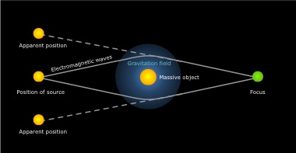
DARK MATTER EVIDENCE
General relativity : deviation of light by gravitational force
Measure of masses for very distant objects by light gravitational deviation
⇒ dark matter

Slide 5
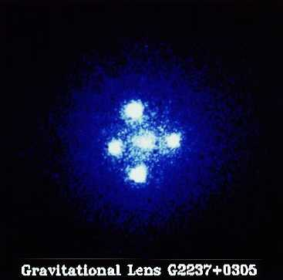
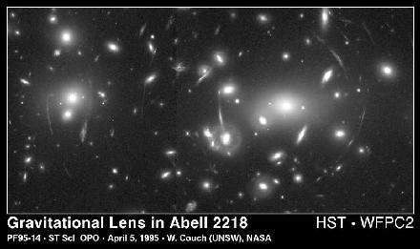
DARK MATTER EVIDENCE
Gravitational mirages
Einstein cross
cluster of galaxies Abell 2218

Slide 6
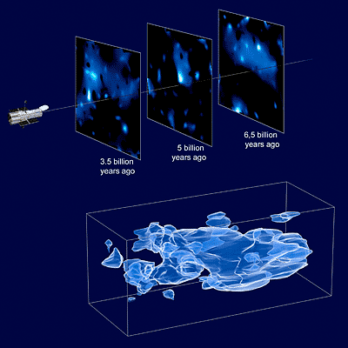
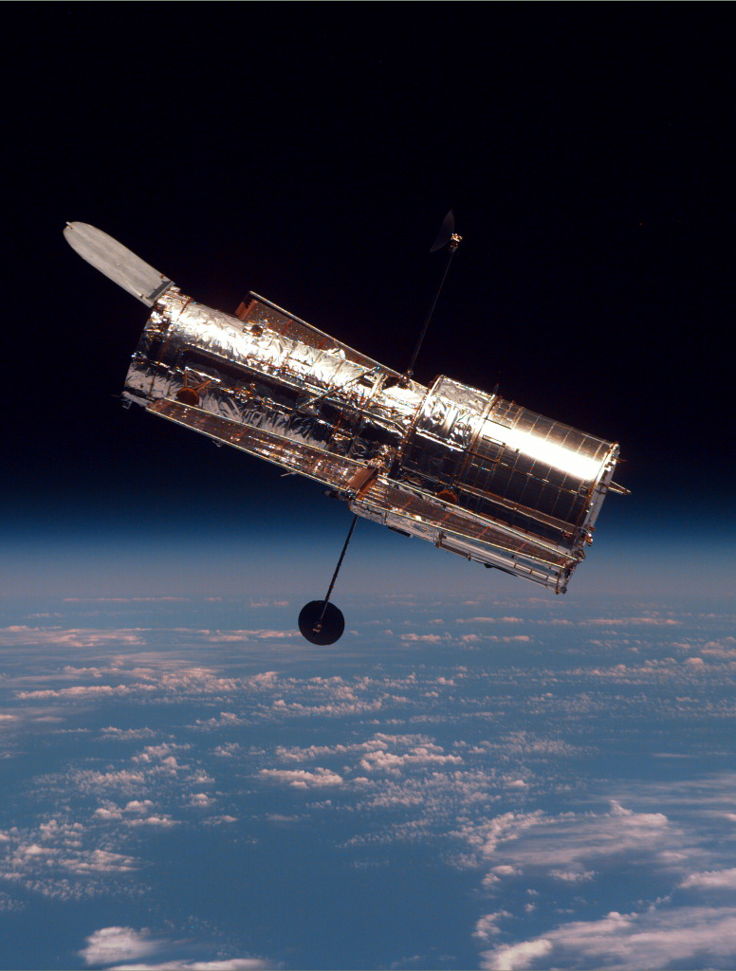
DARK MATTER EVIDENCE
3D map of dark matter
by HST
(Hubble Space Telescope)
red shifts are measured
by terrestrial telescopes
Massey et al., Nature, 7 Janvier 2007

Slide 7
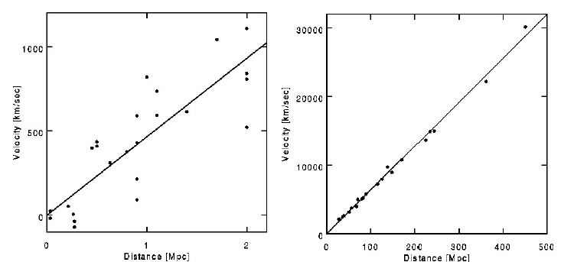
COSMOLOGY
A new paradigm : Universe is NOT eternal, Universe is AGING
Hubble constant = 67,8 ± 0.9 km s⁻¹ Mpc⁻¹ (Planck 2015 arXiv:1502.01589v3)
1929
1999
Freidmann-Lemaître : what is the cause of the expansion ?
static state is impossible, due to gravity of matter (could cause only contraction)

Slide 8
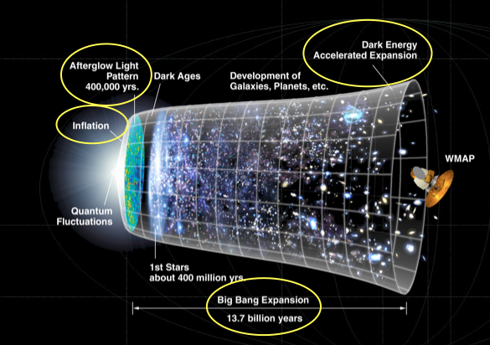
COSMOLOGY
    When the Universe was much smaller
    First theory by Gamow,
    Alpher, Herman,
    around 1940
    Understand stellar evolution,
    application of nuclear physics,
    around 1950
    The initial ultra dense state
    is hot, homogeneous,
    like a compressed gas
    application of statistical physics
Massey et al., Nature, 7 Janvier 2007

Slide 9
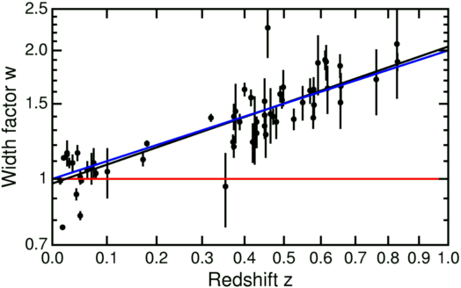
ACCELERATING EXPANSION
A new method to measure very long distances : supernovae Ia
These explosive stars called
“standard candles” :
- have the same characteristics
everywhere
(luminosity, period, …)
- are very bright,
can be seen from large distance
Periods of supernovae Ia (Supernovae Cosmology Project 2001)
dilatation of time : an independent proof of the expansion of the Universe !

Slide 10
ACCELERATING EXPANSION
Cosmological constant introduced by Einstein in General Relativity
so that Universe is static
⇒ modification of gravitation law
Can be interpreted as a repulsive force proportional to distance
accelerating expansion equilibrates the self gravity of matter in the Universe
BUT Hubble discovers expansion: Universe is NOT static
The biggest mistake in my life (Einstein)
BUT now there is an accelerating expansion ⇒ Λ comes back “dark energy”
constant “vacuum density” = “negative pressure”

Slide 11
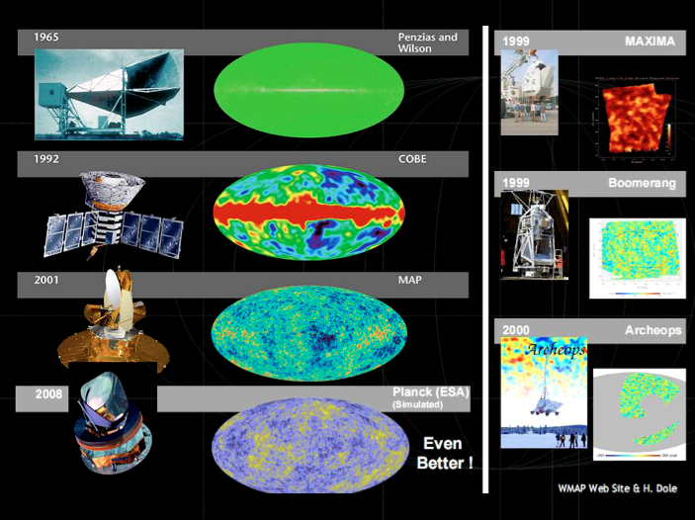
Cosmic Microwave Background

Slide 12
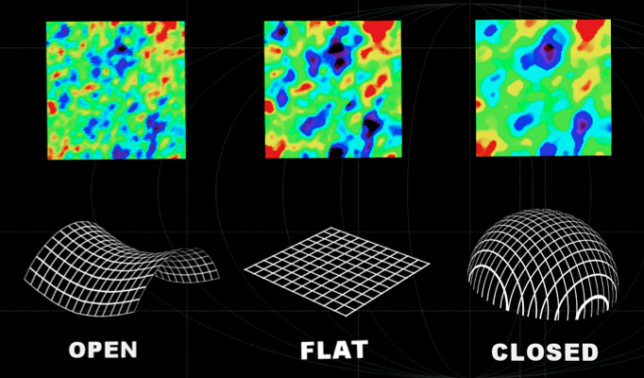
COSMOLOGY
Non-Euclidian curvature of the Universe measured by CMB non-homogeneity

Slide 13

COSMOLOGY
Inertia (baryons) and pressure (photons) create oscillations in photon-baryon fluid
sound waves => measure of density of baryons in early Universe
This effect does not exist for dark matter having no interaction with photons

Slide 14
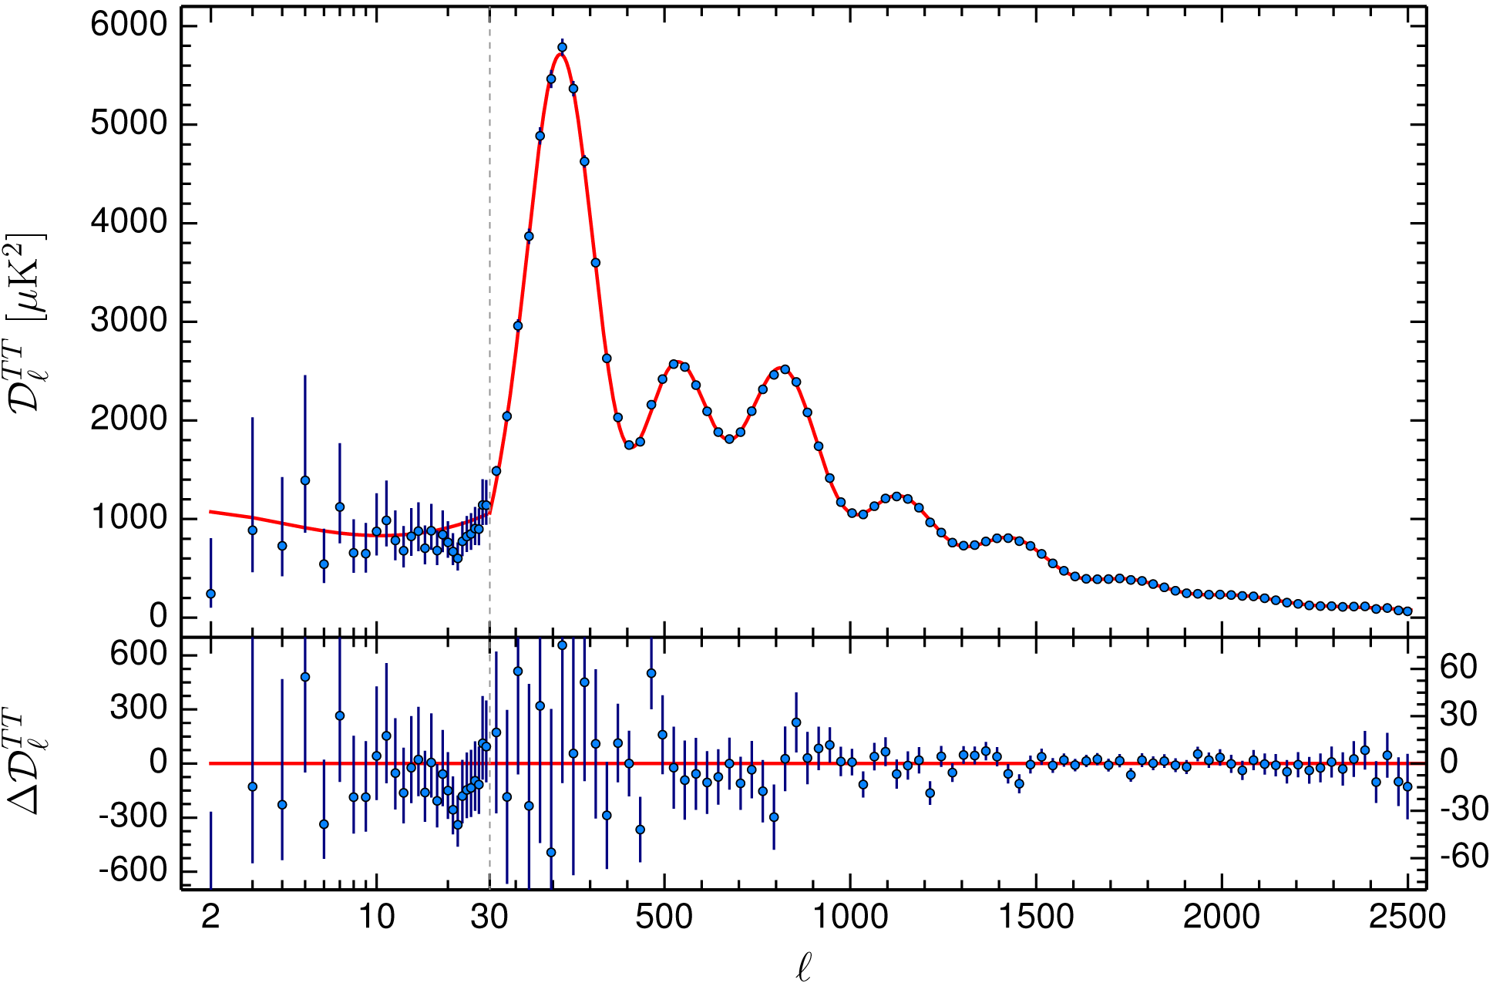
COSMOLOGY
Very precise Planck satellite data

Slide 15
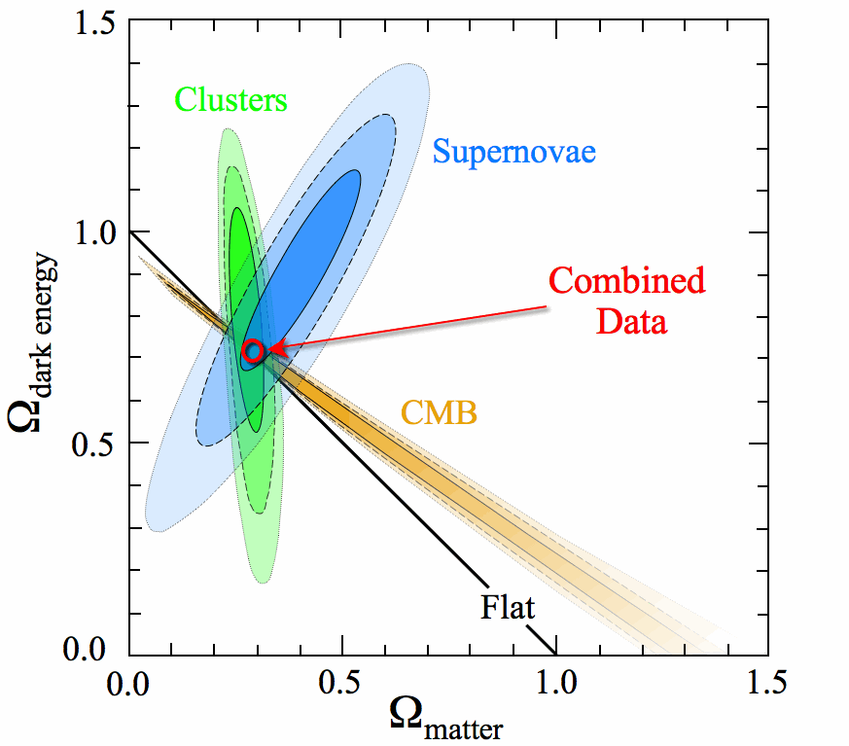
COSMOLOGY
The Λ-CDM model
(lambda-cold dark matter)
Universe is flat
Dark energy is 70 %
Λ ≠ 0
Baryonic matter is 5 %
Non baryonic (cold)
dark matter is 25 %
Independent measurements give compatible parameters for the model
Massey et al., Nature, 7 Janvier 2007

Slide 16
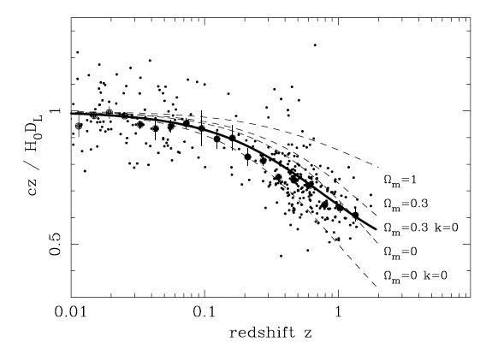
ACCELERATING EXPANSION
Model fits of the Universe
λ_{e} : emitted
wavelength
λ_{o} : observed
wavelength
k = 0 if Universe is flat

Slide 17
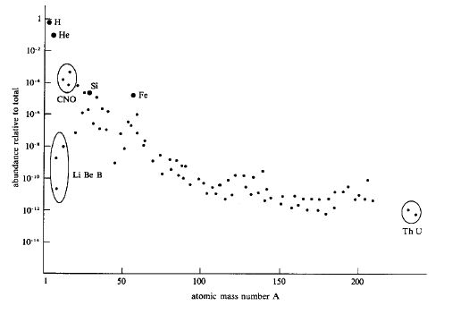
BARYONIC MATTER
Present abundance of elements in the Universe
    Nuclear synthesis happens
    when the temperature
    is higher than 10⁸ K
What was the abundance before stellar nucleosynthesis ?
Primordial nucleosynthesis ?

Slide 18
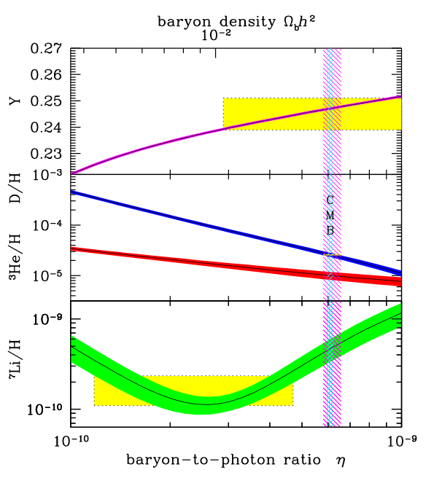
BARYONIC MATTER
    Production of deuterium, helium 3, helium 4, lithium 7 => 4 independent measurements
    disintegration of neutrons and expansion
    of the Universe stops the synthesis
    after 3 minutes
    this is a measure of the density of Universe
    by the ratio :
    baryon (neutron + proton) / photon
    BBN (Big Bang Nucleosynthesis)
    baryonic matter ≈ 4 times luminous matter
    (stars, gas) ➔ dark baryonic matter
    total dark matter ≈ 6 times baryonic matter
Massey et al., Nature, 7 Janvier 2007

Slide 19
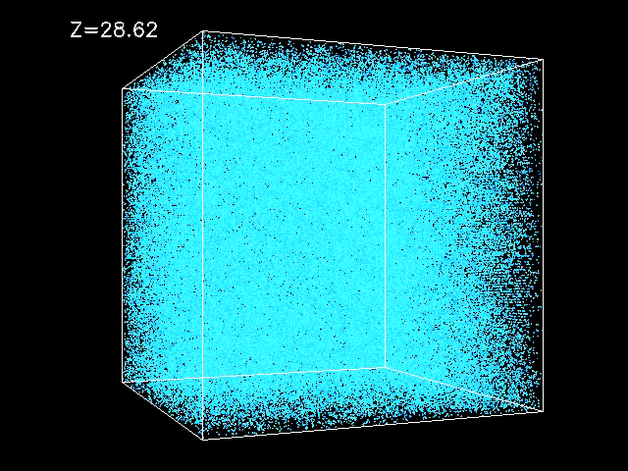
BARYONIC MATTER
Formation of structures (galaxies, stars)
Competition
between
gravity and
pressure
> Jeans mass
importance of
non baryonic
dark matter :
insensitive to
electromagnetism
M_{J} > [ v_{s} / (G ρ )^{1/2} ]³ ρ
M_{J} ~ 10⁵ M
Massey et al., Nature, 7 Janvier 2007

Slide 20
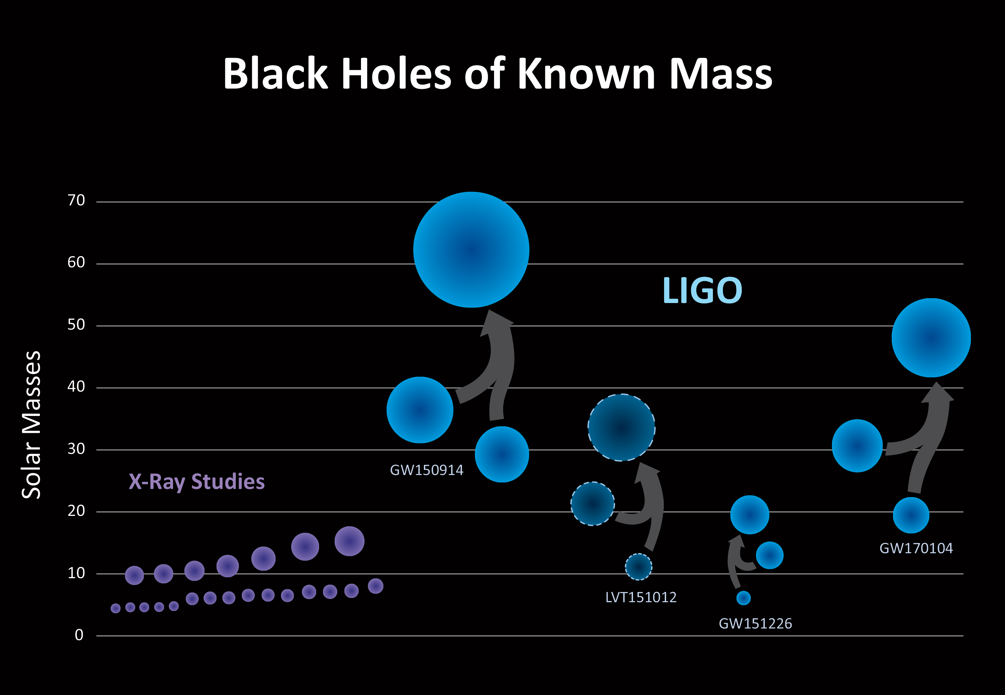
MISSING BARYONIC MATTER
In classical physics and General Relativity, black holes are objects that are so dense
that nothing, even light, cannot escape Schwarzschild radius R_{S} = 2 G M / c²
In astrophysics, black holes are predicted as final collapse of heavy stars,
detected in 2015
by gravitational waves
Any M is possible
micro black holes can be
produced in the LHC
Quantum effect :
Hawking radiation
evaporation (decay)
of the black hole

Slide 21
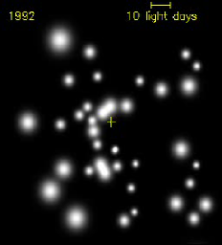
MISSING BARYONIC MATTER
In our galaxy : some candidates ?
central supermassive black hole
Sagittarius A* = 4×10⁶ 
(as in many galaxies)
many exoplanets have been found ≈ 2500
masses are not important compared to stars
MACHOs (Massive Halo Objects) :
very heavy planets, brown stars,
old dwarf stars, neutron stars,
could explain the galaxy rotation pattern
some were found by light deviation,
but not enough
Massey et al., Nature, 7 Janvier 2007

Slide 22
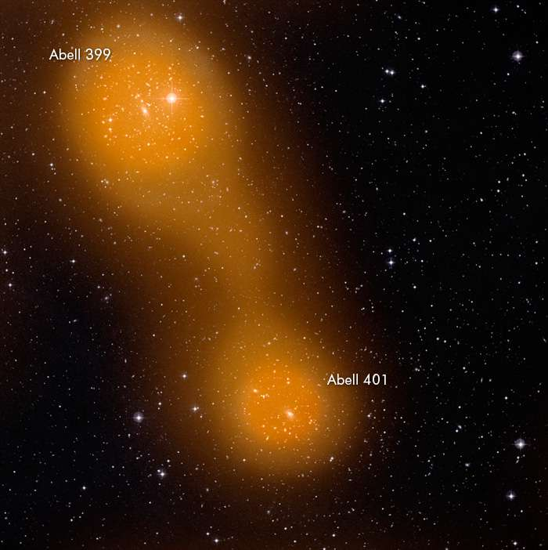
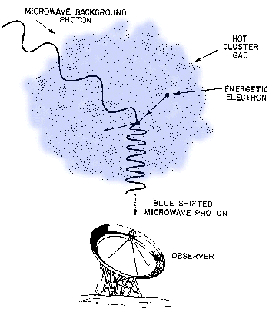
MISSING BARYONIC MATTER
Light from CMB scattered
by electrons in diffuse strands between galaxy clusters
Observation by Sunyaev-Zeldovich effect
Planck satellite 2017
Massey et al., Nature, 7 Janvier 2007

Slide 23
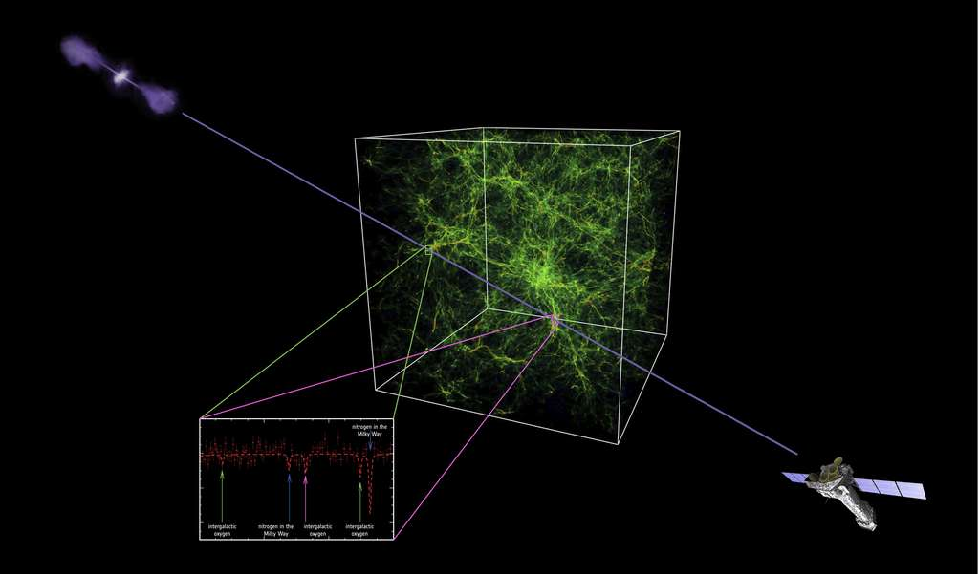
MISSING BARYONIC MATTER
XMM-Newton X ray satellite 2018
detection of oxygen lines
in hot gas strands 10⁵ - 10⁷ K
possibility to measure
the density
Massey et al., Nature, 7 Janvier 2007

Slide 24
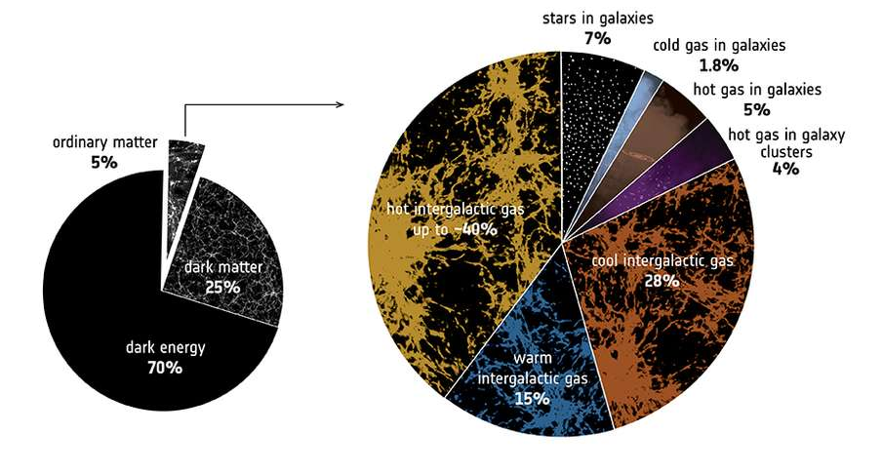
MISSING BARYONIC MATTER
Missing baryonic matter problem solved
Stars are only 7% of the “ordinary” baryonic matter
luminous or dark gas in and out of galaxies
accounts for the rest
What is non baryonic matter ?
Massey et al., Nature, 7 Janvier 2007

Slide 25
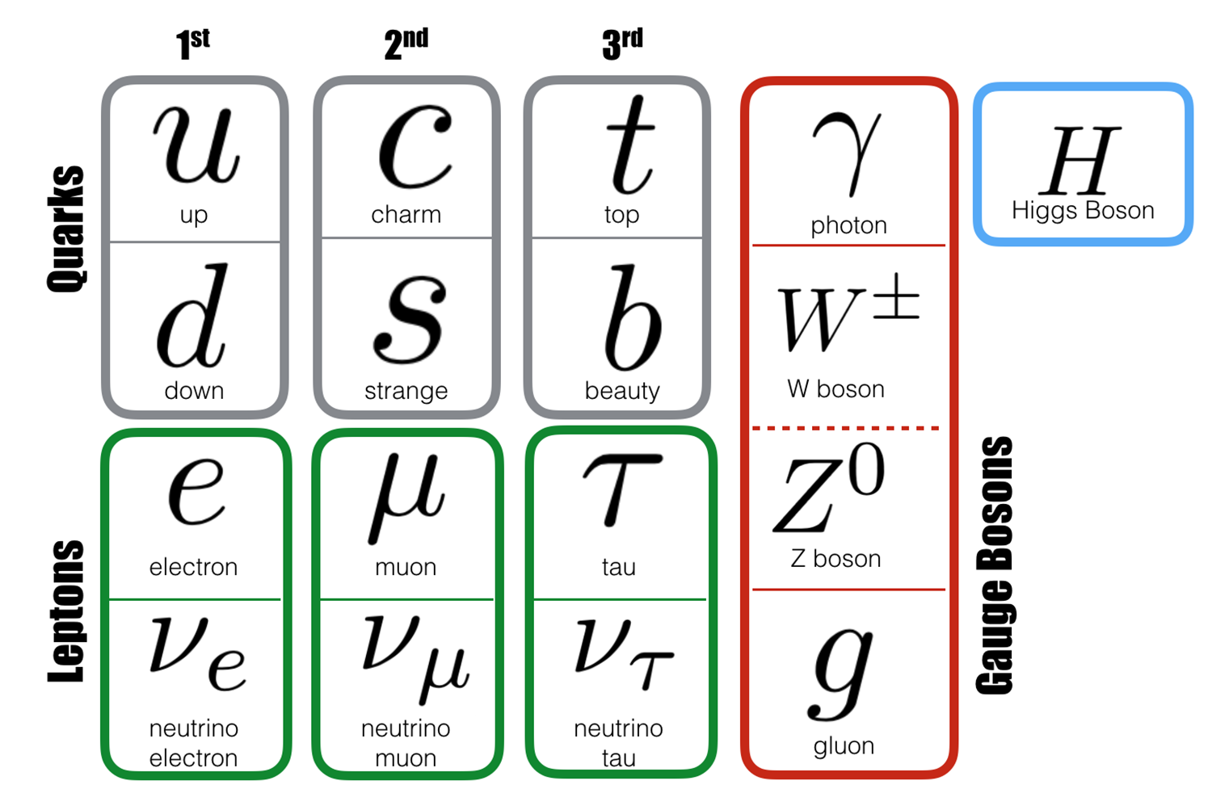
WHAT IS MATTER ?
Standard Model of particle physics
Matter is quarks and leptons, in 3 generations
fermions spin ½, all massive
first generation (u, d, e) is stable
“ordinary matter” proton, neutron, electron
3 interactions carried by gauge bosons spin 1
W and Z massive, γ and g zero mass
quarks and gluons are confined
by strong interaction QCD
gauge symmetries are spontaneously broken by the Brout-Englert-Higgs mechanism,
which gives non zero mass to matter fermions, increasing with generation number
and to W and Z bosons, which are unstable
the BEH mechanism is carried by the Higgs boson, massive, spin 0

Slide 26
WHAT IS MATTER ?
Neutrinos have very specific properties
they are electrically neutral and sensitive only to weak interaction
their masses are so low that we have only experimental upper limits
(Particle data group 2018)
ν_{e} 2 eV beta decay
ν_{μ} 0.19 MeV muon decay
ν_{τ} 18.2 MeV tau decay
Z decay width measured at LEP indicates that there are only 3 generations of neutrinos
whose masses are lower than m_{Z} / 2 = 45 GeV
neutrinos have only chirality left (and antineutrino right) : the way they respond to weak interaction uses a term P_{L} = ½(1 – γ⁵) in the SM Lagrangian

Slide 27
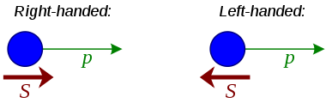
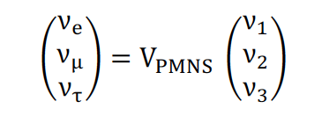
WHAT IS MATTER ?
Chirality is equivalent to helicity p.σ only for a massless particle
helicity is not Lorentz invariant for a massive particle
neutrino eigenstates of the weak interaction differ from mass eigenstates
they are related by the Pontecorvo-Maki-Nakagawa-Sakata 3 × 3 unitary matrix
neutrinos are produced by decay, and named by the corresponding charged lepton

Slide 28
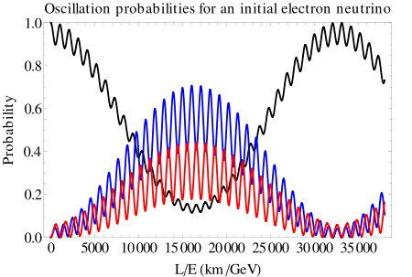
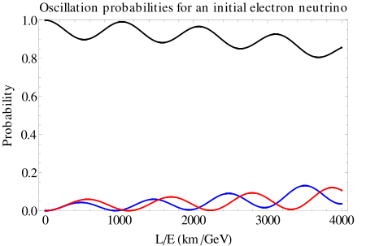
WHAT IS MATTER ?
Neutrinos are stable, but when they travel, they transform into each other
because the speeds of the 3 different mass states are different : oscillation
solution of the “solar neutrino mystery” (1960 -1990)
1/3 of the expected ν_{e} were detected
experiments on accelerators and nuclear reactors

Slide 29

WHAT IS MATTER ?
Cosmic neutrinos : neutrinos and antineutrinos from supernova 1987
In the minimal SM the neutrinos have zero mass
Right-handed chirality neutrinos can exist Beyond Standard Model (GUT, …)
Their mass can be anything
between 1 eV and 10¹⁵ GeV,
The mass is different from
their SM left-handed partner
(seesaw mechanism)
light
neutrino
heavy
neutrino

Slide 30
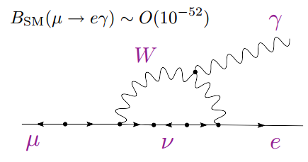
WHAT IS MATTER ?
Being sensitive only to gravitation they are sterile neutrinos
They can by produced by oscillation from their partner, but not detected
Majorana neutrinos: neutrino is identical to antineutrino ≠ Dirac neutrinos
Some experiments still search for Majorana neutrinos (double beta decay)
Violation of the lepton number
due to oscillation
has very low branching ratio

Slide 31
SUPERSYMMETRY
Extension of the Standard Model with a new symmetry
Each particle of the SM has a “superpartner” whose spin differs by ½
boson <-> fermion
electron <-> selectron quark <-> squark
photon <-> photino gluon <-> gluino Higgs <-> higgsino Z <-> zino
neutralino is a combination of photino, zino, higgsino
neutral, lightest ➔ candidate for dark matter (if R-parity is conserved)
The symmetry is broken : mass of partner ≠ mass of SM particle
Expected at LHC in 2009, but no superparticle found yet !

Slide 32
AXION
Particle introduced in 1977 to solve a “mystery” :
there is no CP violation in QCD, like in Electroweak sector of the Standard Model
Very weakly coupled, very low mass ➔ good candidate for DM
Can be converted into photon by a strong magnetic field : detection on Earth
Can be produced in the Sun by X rays interacting with matter and solar magnetic field
Can be produced in the early universe, and still exist (primordial axions)
because their low mass prevent them from disintegration
Looked for in large range of masses μeV to meV

Slide 33
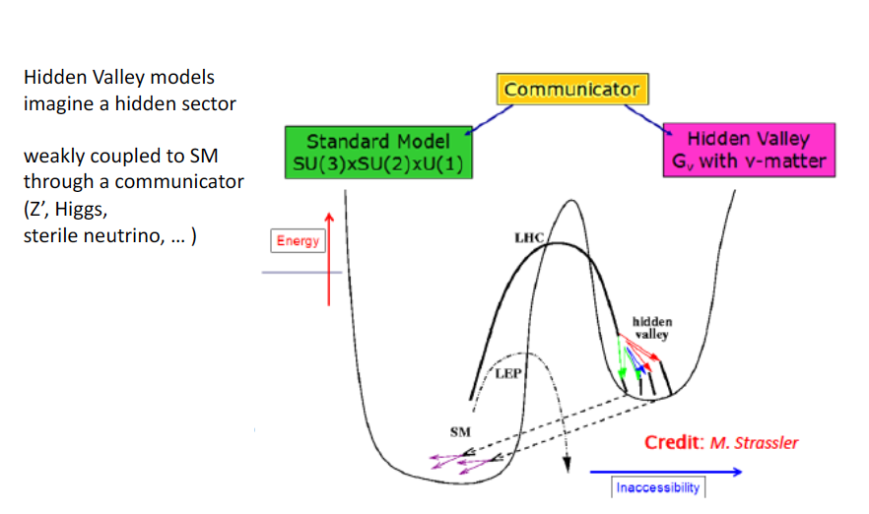
HIDDEN VALLEY

Slide 34

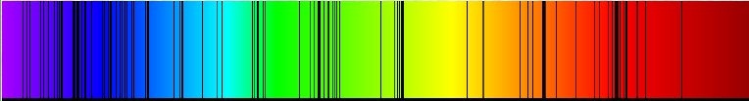
EXTRA SLIDE
small speed v = c z
in Special Relativity
spectroscopy lines : measure of radial speed by Doppler effect,
H
Ca
different interpretation in General Relativity (expansion of Universe)

