Slide 1


DARK MATTER (2)
A long history, … not finished
Philippe Miné, Laboratoire Leprince-Ringuet, France

Slide 2
NEUTRINOS
Electron antineutrinos are produced by nuclear reactors (beta decay)
first detected by Cowan and Reines in 1956
Electron neutrinos from Sun are detected by underground experiments since the first attempts in the 1960s by Davis (Nobel prize 2002)
at the Homestake Gold Mine. The experiment was running from 1970 to 1994.
The solar neutrino mystery was definitively solved by proof of oscillation in SNO (Sudbury Neutrino Observatory in 2001.
24 electron neutrinos and antineutrinos from supernova 1987A were observed
by 3 experiments
The 3 flavors of neutrinos and antineutrinos are produced by high energy accelerators
These “ordinary” neutrinos have too light mass to account for all dark matter

Slide 3
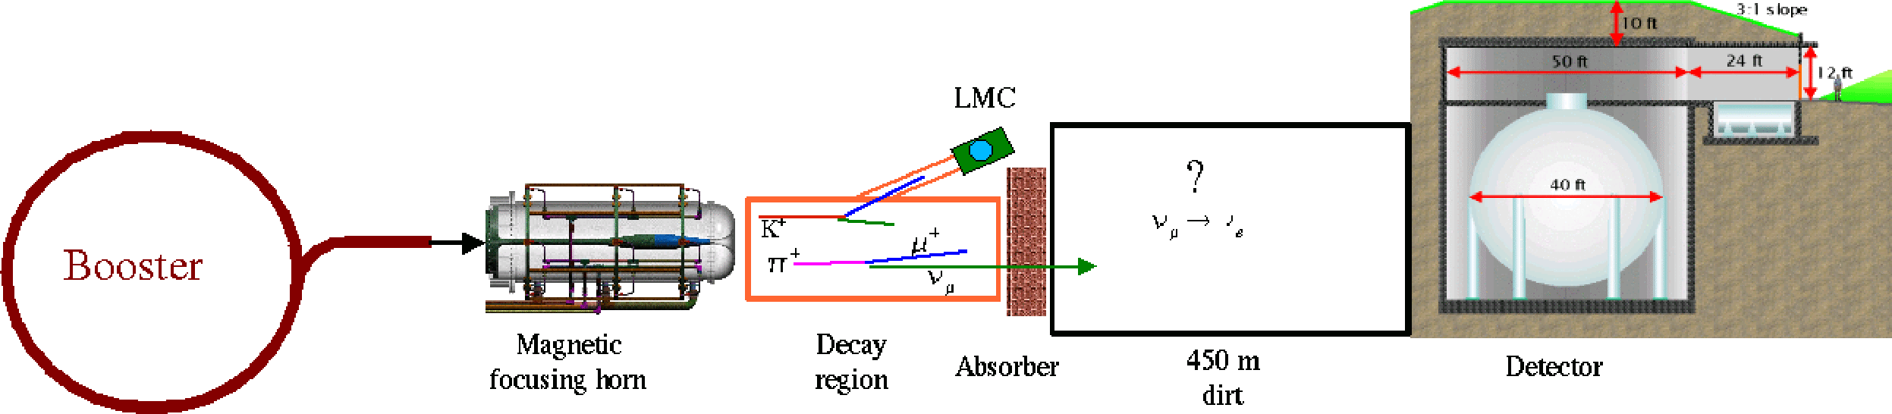
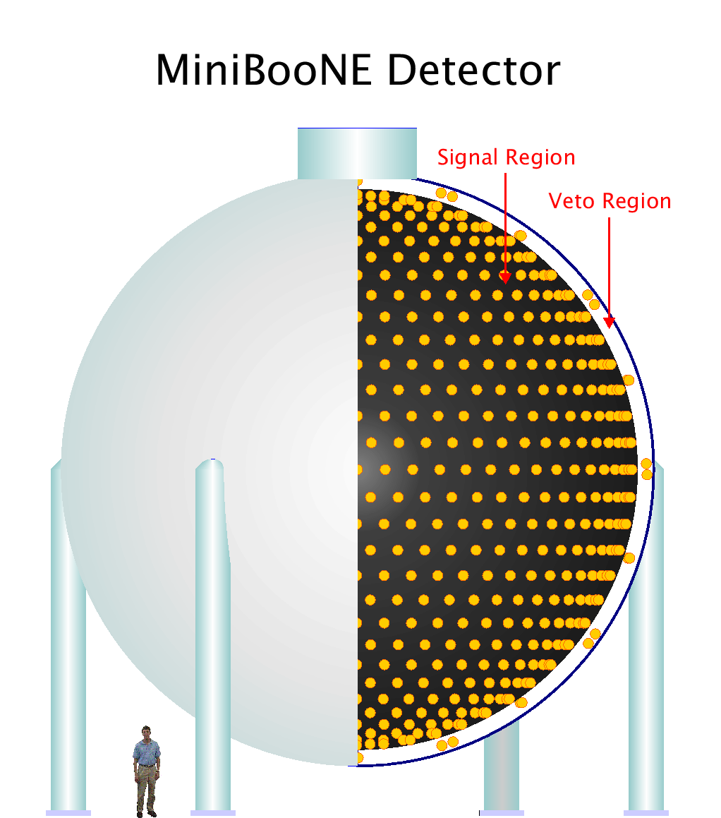
NEW NEUTRINO SEARCH
Sterile neutrinos in reactor and accelerator, produced by oscillation
MiniBooNE at Fermilab 2018
« Observation of a Significant Excess of Electron-Like Events
in the MiniBooNE Short-Baseline Neutrino Experiment »

Slide 4
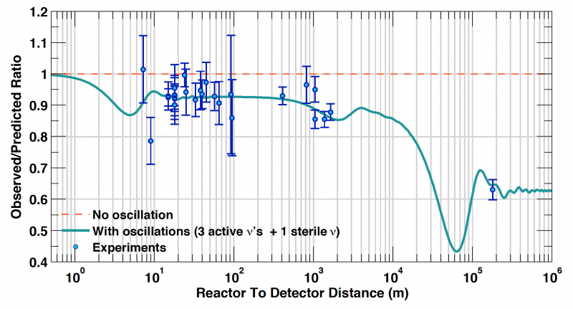
NEW NEUTRINO SEARCH
Reinterpretation of antineutrino detections by all reactor experiments
with new uranium and plutonium spectra (CEA, France, 2011)
One point fits better with a new neutrino !

Slide 5
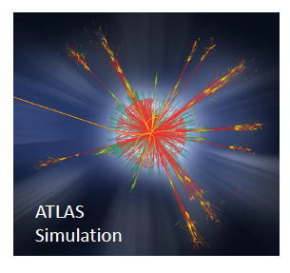
BLACK HOLES AT LHC
Gravitational interaction is negligible in particle physics,
except if extra dimensions of space exist
Micro BH will decay in ~ 10⁻²⁷ s
Absence of complete quantum theory of gravitation
Cross section calculation is semi classical : σ = π R_{S}²
Analysis strategy :
M_{TH} threshold mass to eliminate QCD background
isotropy of the decay and particles democracy
high multiplicity of all types of high P_{T} jets

Slide 6
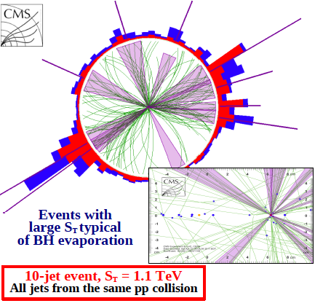
BLACK HOLES AT LHC
High multiplicity event
Good tracker quality
vertices from
simultaneous interactions
are well separated
many jets are reconstructed
S_{T} = scalar sum of E_{T} of objects
(jets, electrons, muons, gammas)

Slide 7
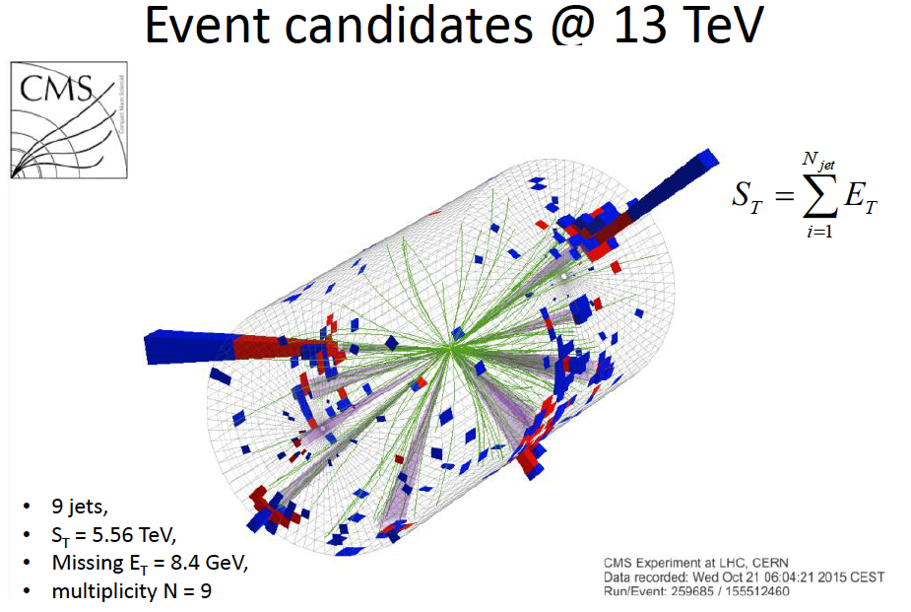
BLACK HOLES AT LHC

Slide 8
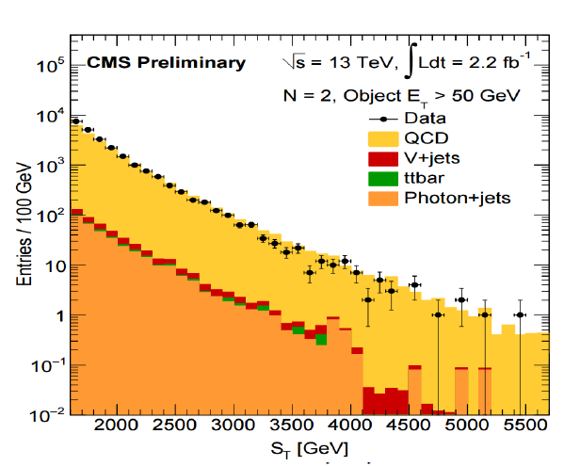
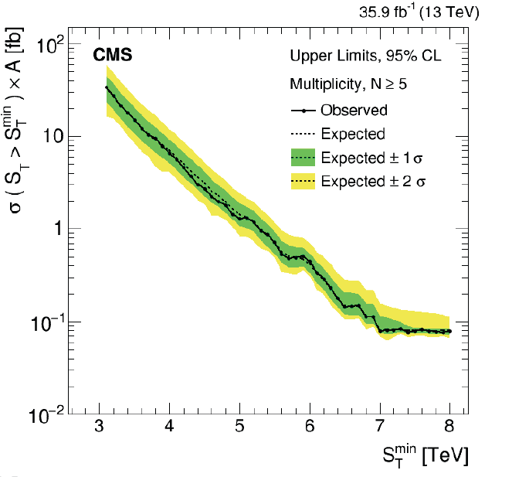
BLACK HOLES AT LHC
QCD backgroud
Model independent limit on cross-section
Limits are roughly 0.04 fb at high values of S_{T}

Slide 9
HEAVY PARTICLE at LHC
ATLAS and CMS detect measure the kinematical variables of all SM particles,
except neutrinos.
The total energy is measured by calorimeters, except in the beam region.
A missing transverse energy E_{T} is the signature of a neutrino or some DM particles
Results are presented for 36 fb⁻¹ collected in run 2 at 13 TeV
- SUSY models with conserved R-parity predict lightest SUSY particle (LSP)
stable, electrically neutral, feebly interacting with SM
simplified models : mediator particle
- invisible decays of 125 GeV Higgs boson
Trigger is : at least one visible object (jet, lepton, photon)

Slide 10
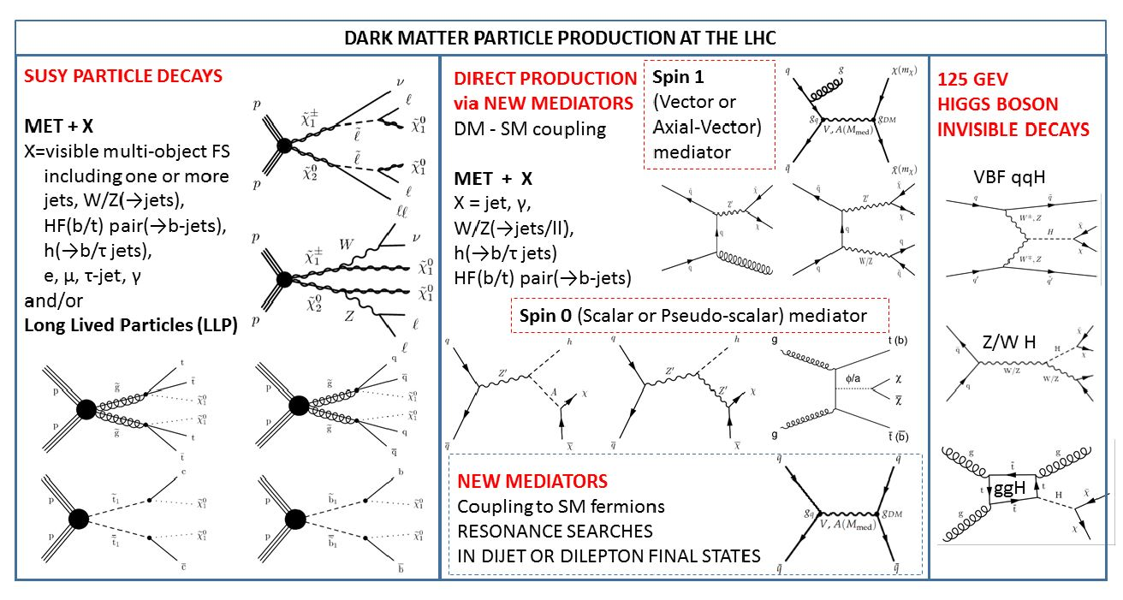
HEAVY PARTICLE at LHC

Slide 11
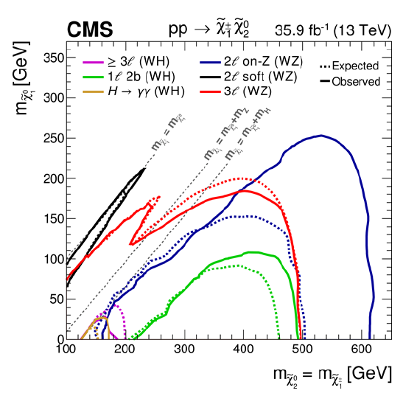
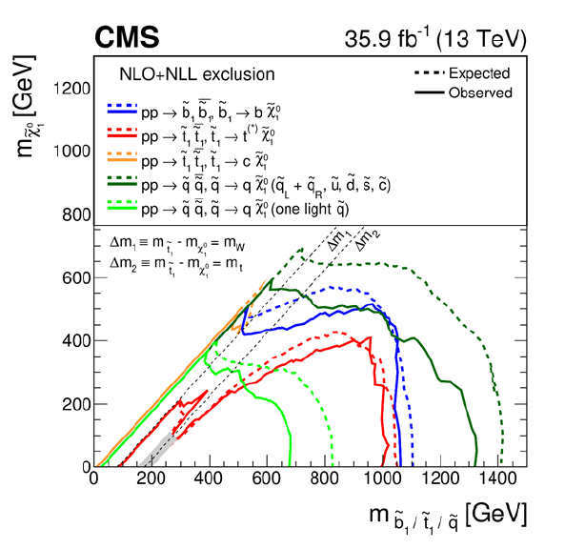
HEAVY PARTICLE at LHC
SUSY search : complete models but with many parameters
Results provided as cross-section limit for given process,
as a function of masses of the heaviest SUSY particle and the LSP SUSY particle
chargino and neutralino top, bottom, light flavour squark

Slide 12
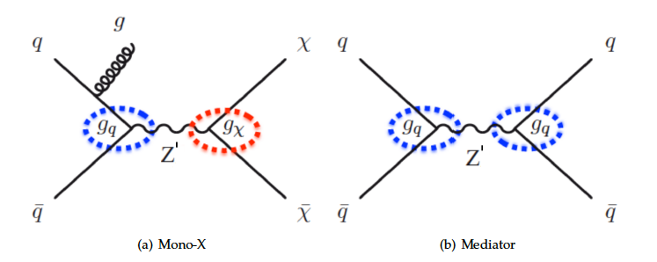
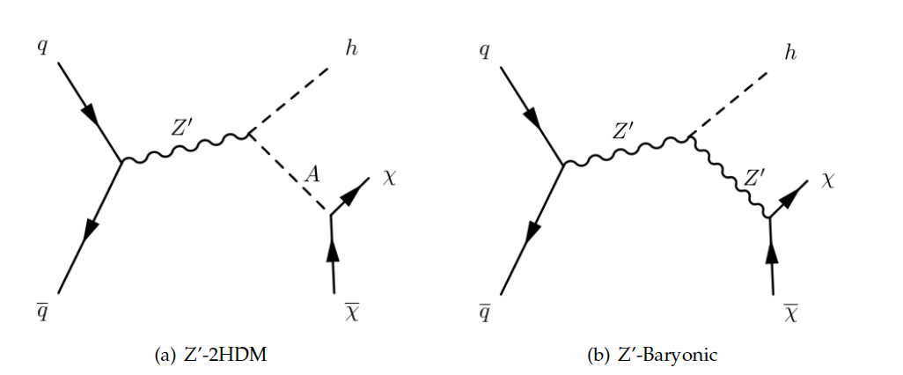
HEAVY PARTICLE at LHC
A more generic simplified model : the SM and DM interact through a new boson
termed “mediator”
Only 4 parameters m_{med}, m_{DM}, g_{q} (coupling to quarks) and g_{DM} (coupling to DM)
Mediator can be spin1 (vector or axial vector) or spin 0 (scalar or pseudo scalar)
mono-jet, mono-Z, mono-γ mono-Higgs

Slide 13
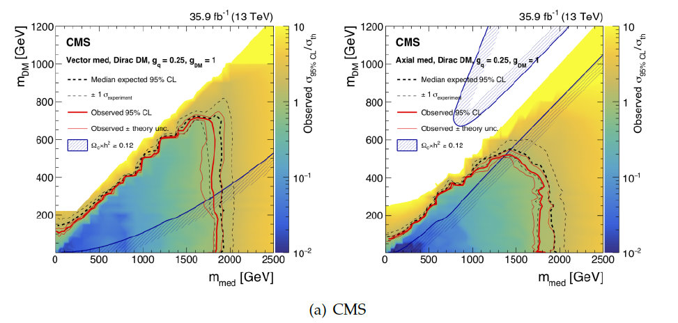
HEAVY PARTICLE at LHC
CMS mono-jet

Slide 14
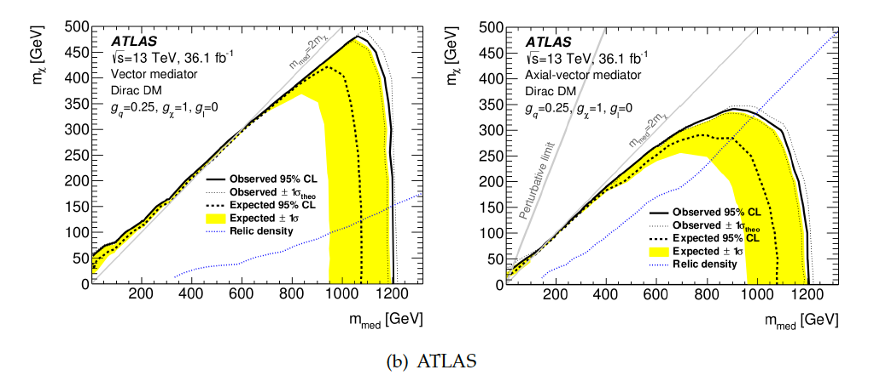
HEAVY PARTICLE at LHC
ATLAS mono-γ

Slide 15
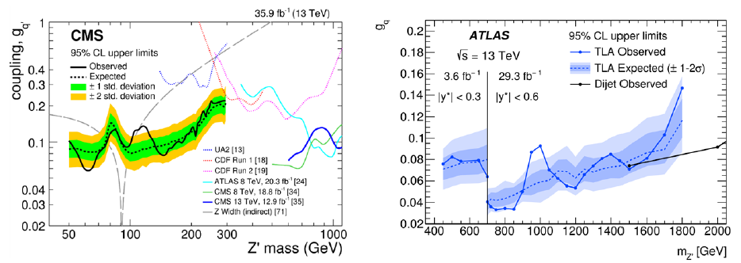
HEAVY PARTICLE at LHC
Mediator can also decay into fermions pair
as a resonance ≤ 1 TeV
undetected in previous search (Z’, extra dimensions, etc)
because of weak coupling to SM
=> dedicated analysis of jet substructure

Slide 16
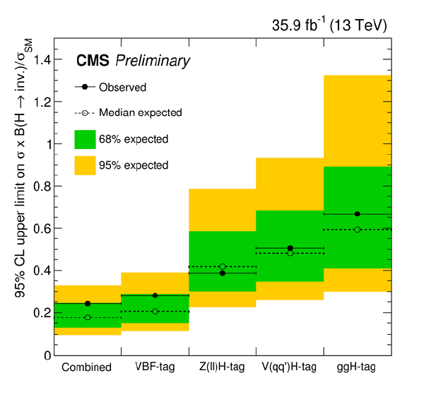
HEAVY PARTICLE at LHC
Higgs boson invisible decays :
H → ZZ → 4 neutrinos, branching ratio 0.1 %
May be largely enhanced by BSM scenarios
Search : qq → qqH , gg → H , qq → ZH

Slide 17
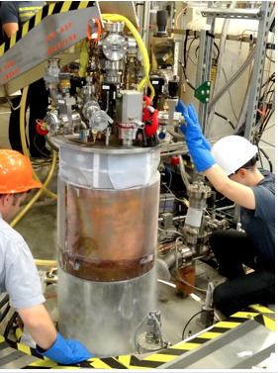
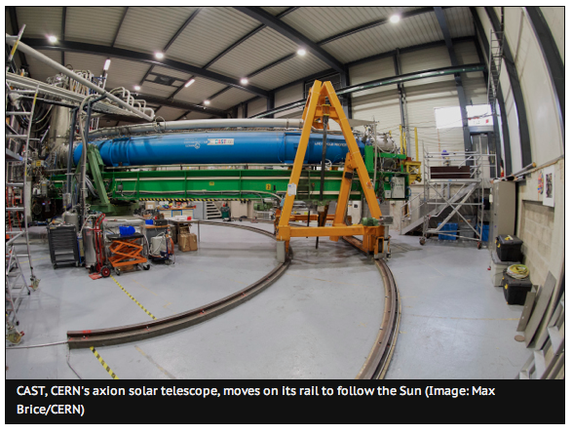
AXION
Instead of producing new particles in laboratory, detect natural ones
Many experiments built to detect solar axions
with superconducting magnets
ADMX (U. Washington) microwave
CAST (CERN) X rays

Slide 18
COSMOLOGIC CONSTRAINTS
History of Universe constraints some properties of DM
DM must have a role in the formation of structures (large : galaxy clusters, galaxies)
and small (gas clouds, stars) since DM is 5 times more abundant than matter
N-body simulations : best agreement with observations, suggest that DM particles
were non relativistic and short mean free path: CDM (cold dark matter)
DM interaction with SM particles must have a cross section σ
compatible with present DM density “relic density”
Early Universe: T >> M_{DM} → equilibrium DM-SM
Present Universe: T << M_{DM} → DM annihilation into SM, no DM creation
DM disappearance until mean free path in the Universe is large enough (decoupling)
→ σ ≈ weak interaction

Slide 19
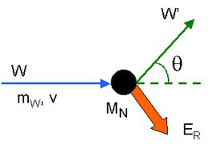
COSMIC WIMP DIRECT DETECTION
Stable (τ > age of Universe), neutral, low σ, massive M ≈ 1 GeV to 100 TeV
Weak Interactive Massive Particle WIMP
Dark matter accumulates in the center of galaxies
Evaluated density 0.39 GeV/cm³ , speed 220 km/s Maxwellian distribution
Elastic scattering on the matter nucleus of a detector
Isotropic or forward peaked (massive nucleus)
Unknown : mass and cross section
E_{R} ≈ 10 – 100 keV for m_{W} ≈ 10 GeV – 10 TeV
MSSM → 1 evt.day⁻¹.kg⁻¹ much lower than usual radioactive background
Limitations : detector sensitivity at low m_{W} , WIMP flux at high m_{W}
Signatures : day and annual effect of Earth rotation and speed around Sun

Slide 20
COSMIC WIMP DIRECT DETECTION
Natural activity of human body is 10 000 Becquerel (1 bq = 1 decay/s)
Cosmic muons at sea level are ≈ 100 per second in 1 m²
Experiments are shielded from cosmic muons by installation in mines
(Homestake and Soudan in USA, Sudbury SNOLAB in Canada, Kamiokande in Japan)
or tunnels under mountains (Modane in France, Gran Sasso in Italy, Jin Pin in China)
To reduce the background, several concentric shielding :
- polyethylene for neutrons
- lead for gammas (low radioactive lead from sunk Roman ships)
- scintillation counters to veto residual muons
High purity materials are mandatory to avoid contamination :
semi-conductor crystals (Ge, Si) or noble gas (Argon, Xenon)
E_{R} measured by temperature increase, ionisation and/or scintillation

Slide 21
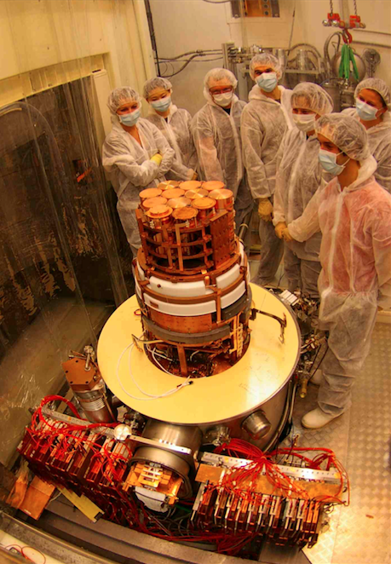
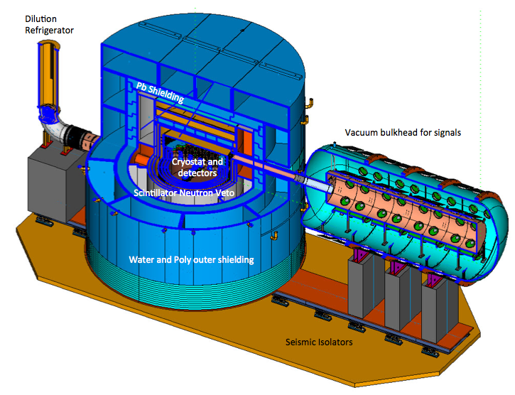
COSMIC WIMP DIRECT DETECTION
EDELWEISS (Modane) SuperCDMS (SNOLAB)
In Ge or Si crystals at low temperature (few mK), vibration energy (heat) is quantified
giving phonons which are detected, together with ionisation/scintillation

Slide 22
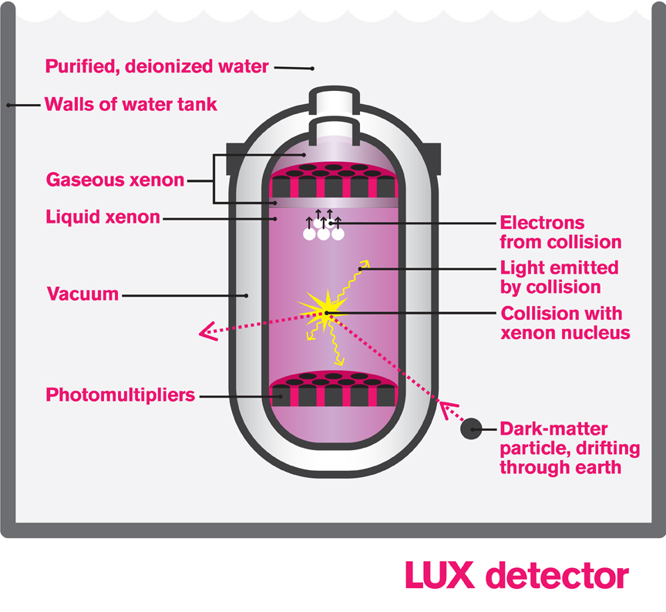
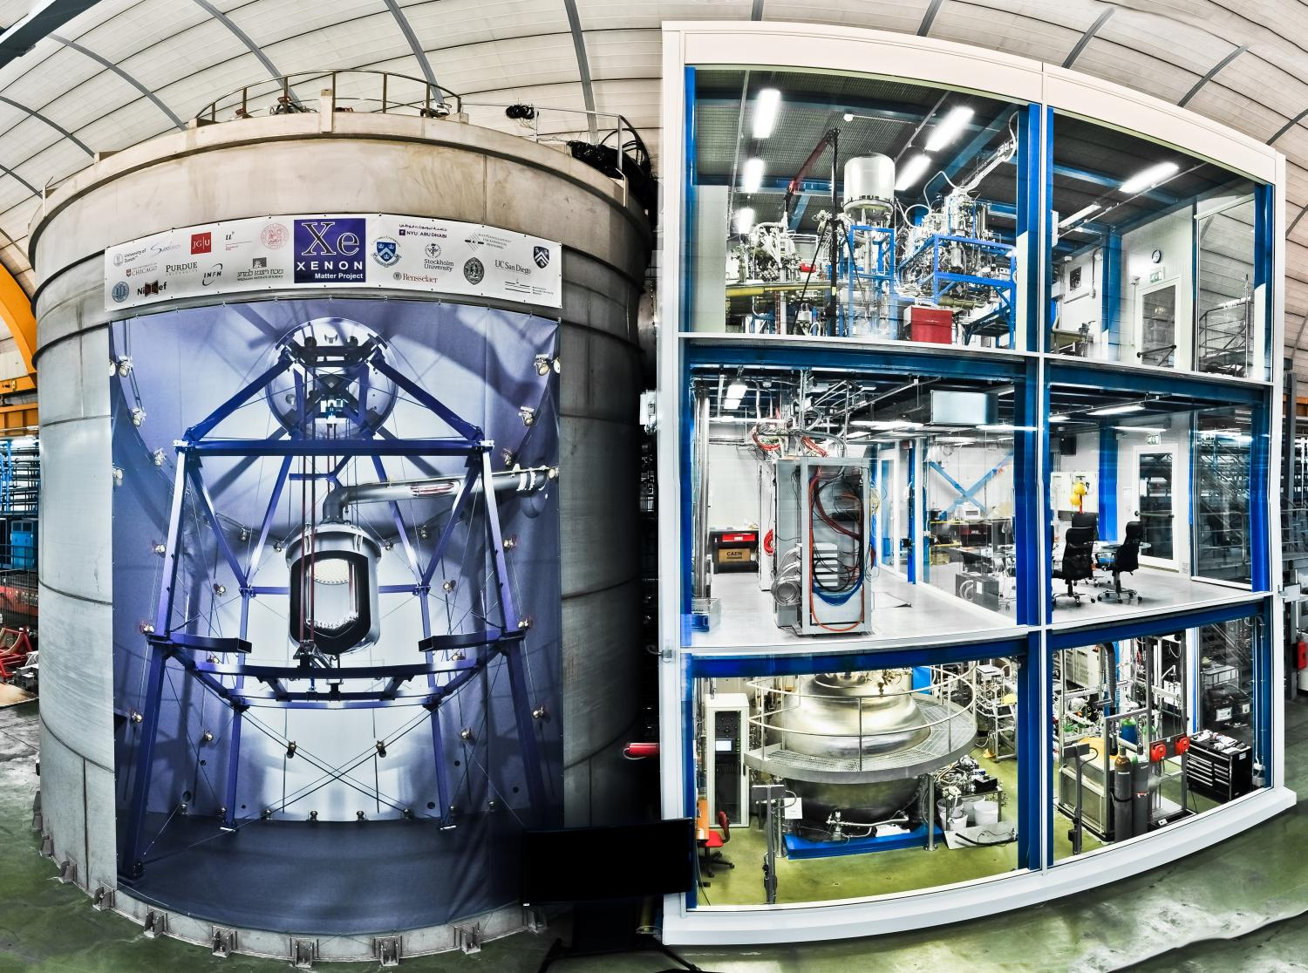
COSMIC WIMP DIRECT DETECTION
LUX (Homestake) Xenon 1T (Gran Sasso)
Ar is cheap (1 % of air) Xe is expensive and heavier (9 × 10⁻⁸ of air), noble gas are easy to purify
Measure of scintillation and ionisation by drifting electrons in the gas phase
Scintillation/Ionisation ratio distinguish DM recoil against electrons

Slide 23
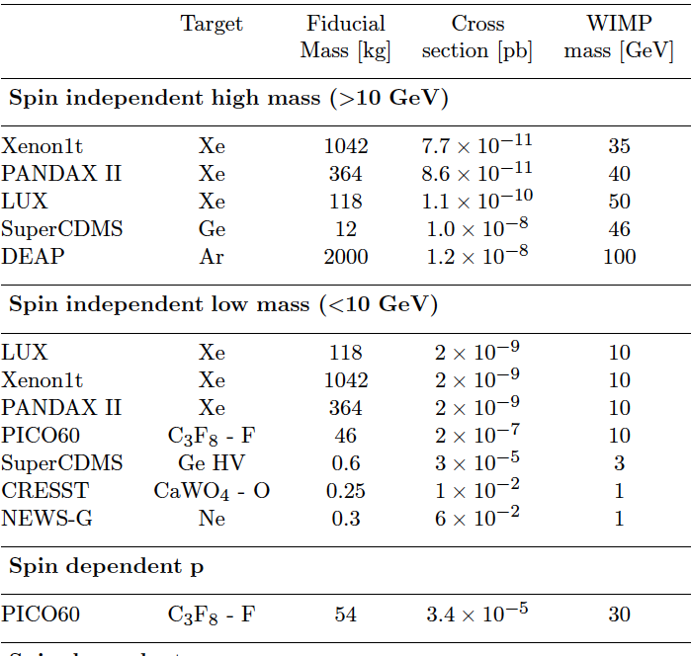
COSMIC WIMP DIRECT DETECTION
PICO60
bubble chamber
NEWS-G
gaseous Ne detector
specific for low-mass
WIMP
crystal mK experiments
are also designed
to detect axions
EDELWEISS

Slide 24
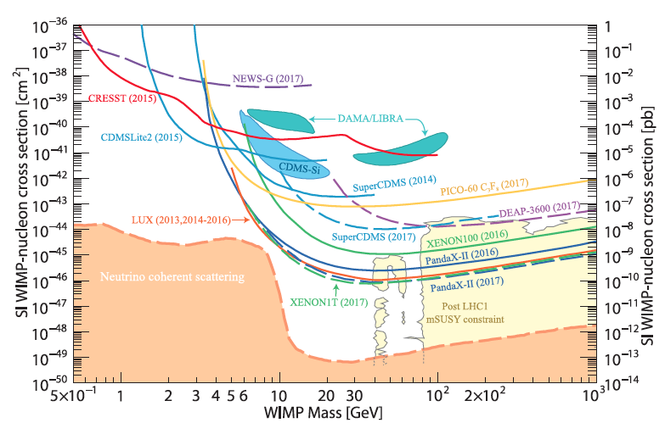
COSMIC WIMP DIRECT DETECTION
positive DAMA result is controversial aim : reach the “neutrino floor”

Slide 25
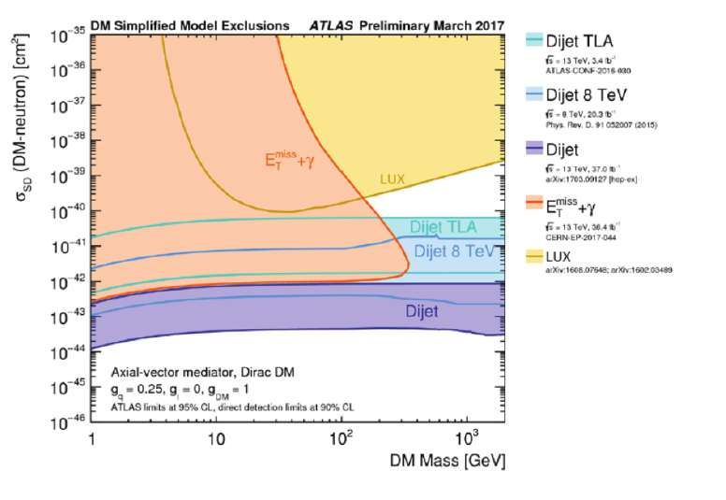
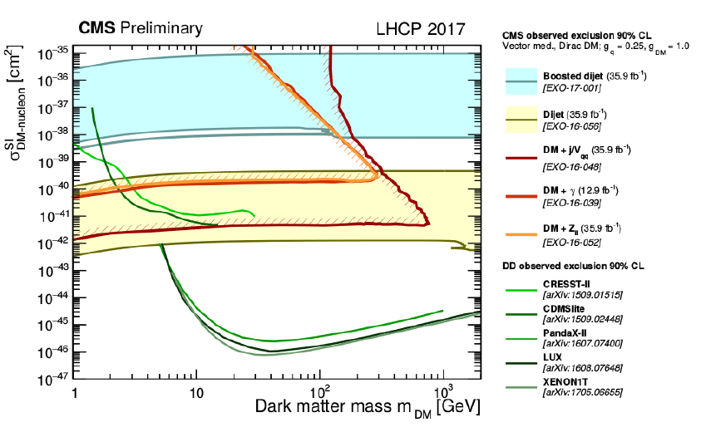
WIMP DIRECT DETECTION

Slide 26
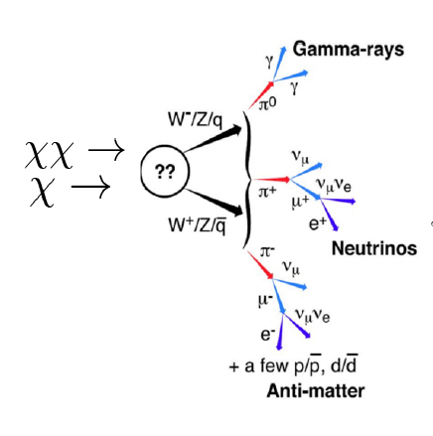
WIMP INDIRECT DETECTION
If one does not detect WIMP on the Earth,
one can try to detect
the result of WIMP
self-annihilation or decay
somewhere in the Universe
Background : many astrophysical mechanisms
can produce gammas, neutrinos,
or charged antiparticles

Slide 27
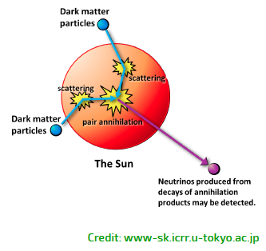
WIMP INDIRECT DETECTION
DM is sensitive mainly to gravitation,
it accumulates in the centre of Sun or Earth
The direction is a good signal
of the origin
Neutrinos are detected
by interaction in large
volume of water or ice
Gammas in space or on ground
Antiparticles in space

Slide 28
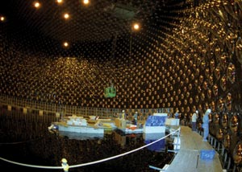
WIMP INDIRECT DETECTION
Neutrino detection in 50 000 tons of water SuperKamiokande (Japan)
Electron or muon give
Cerenkov light :
energy and direction
ν_{μ} from accelerator
at 295 km distance
Detection of atmospheric ν_{μ}
decays of charged cosmic rays
High energetic ν_{μ} from DM ?
Low DM mass ≈ 50 GeV

Slide 29
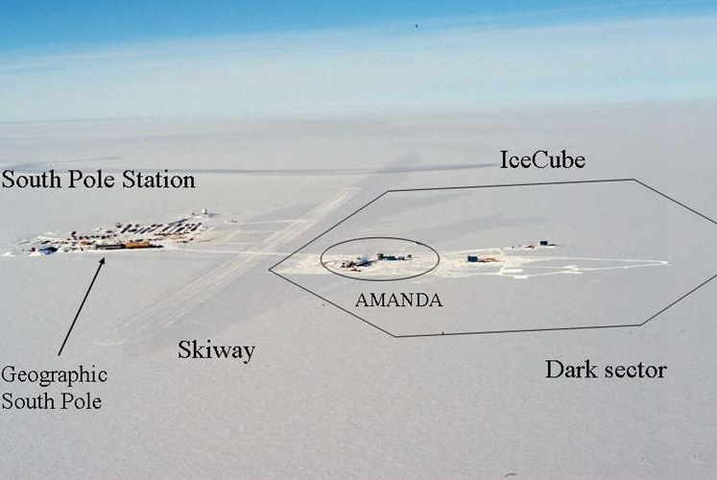
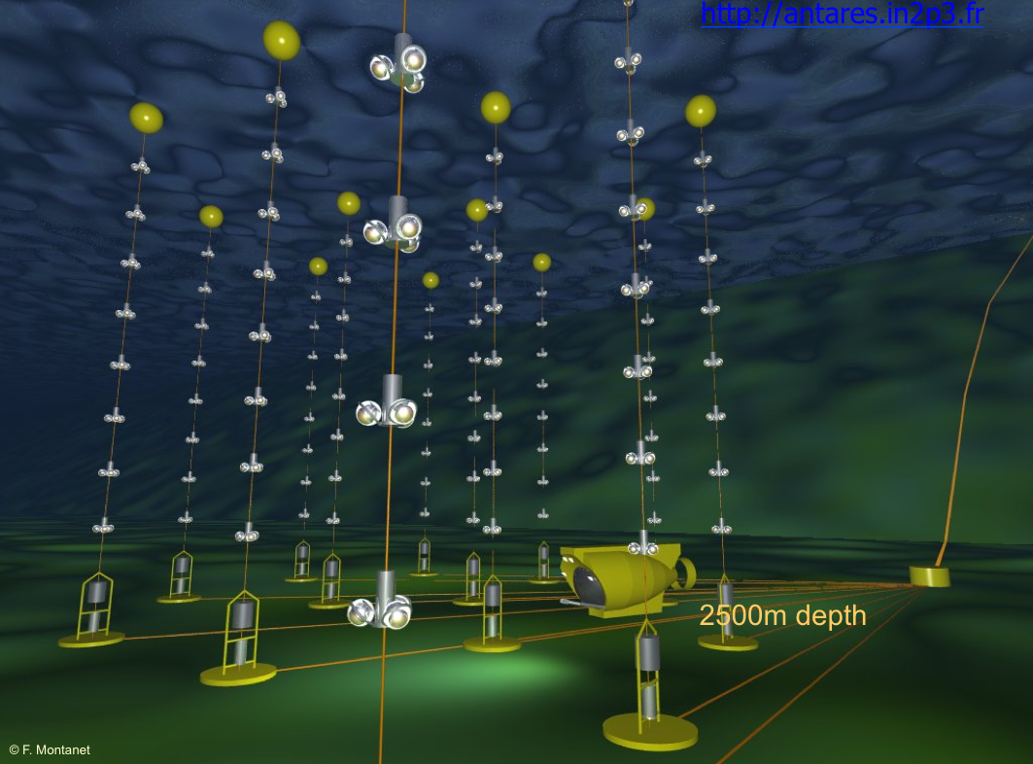
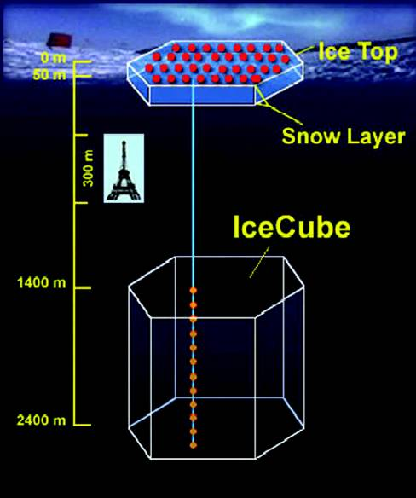
WIMP INDIRECT DETECTION
Water : Mediterranean sea Ice : South pole
ANTARES, KM3NeT
AMANDA,
Ice Cube (1 km³)
Larger volume, more spaced photomultipliers
=> higher WIMP mass > 50 GeV

Slide 30
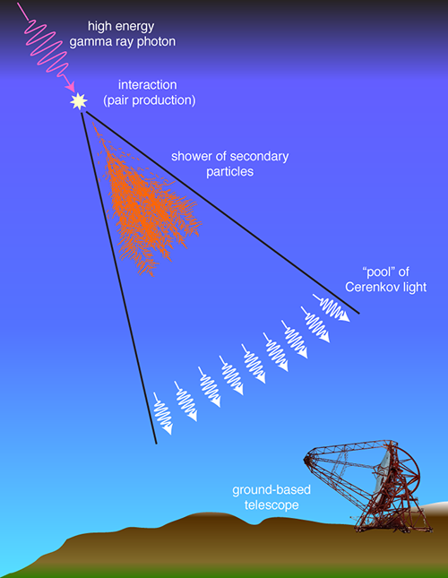
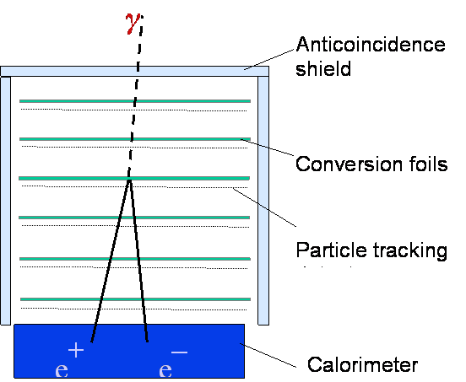
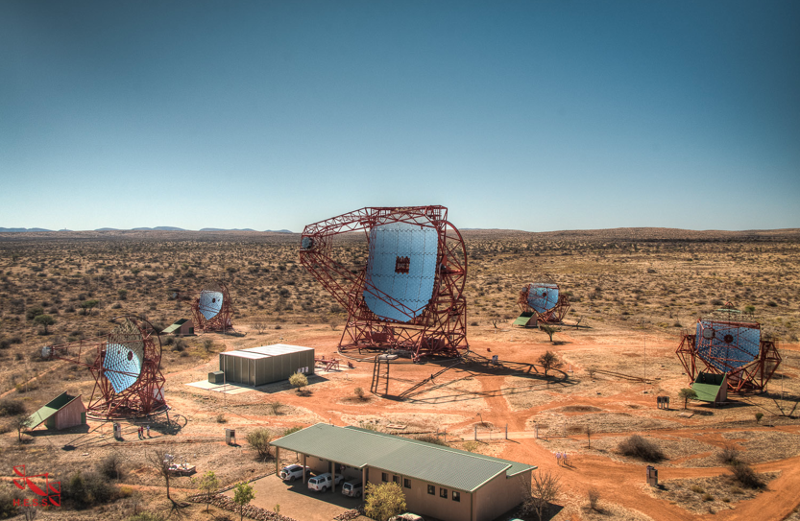
WIMP INDIRECT DETECTION
Gamma detectors
HESS
Cerenkov detector
Namibia
0.1 – 100 TeV
FERMI satellite
0.1 – 10 GeV

Slide 31
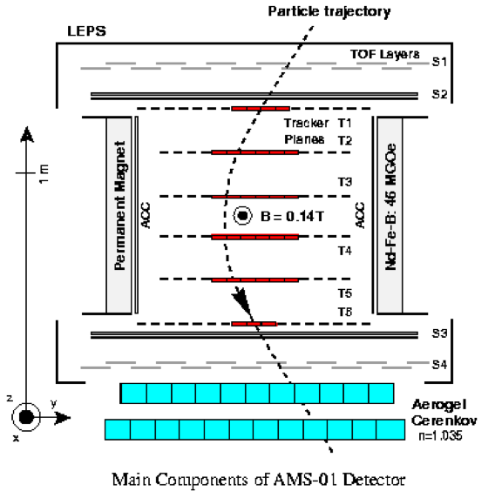
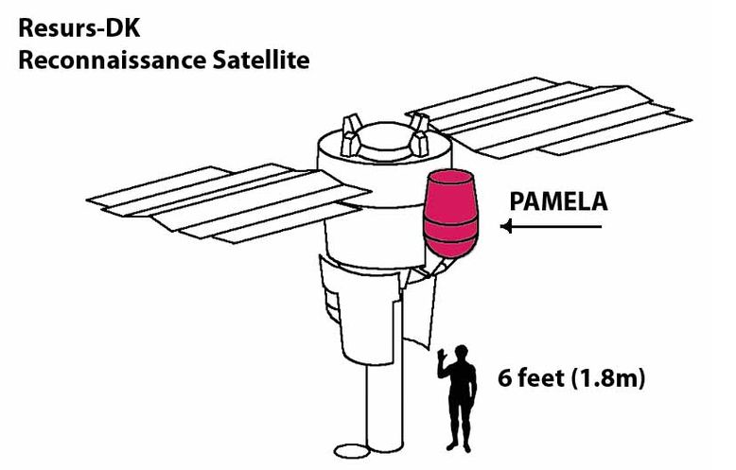
WIMP INDIRECT DETECTION
Detection of antimatter from space by satellites
Tracking of e⁺, antiproton, antinuclei with permanent magnet
PAMELA mission AMS in ISS

Slide 32
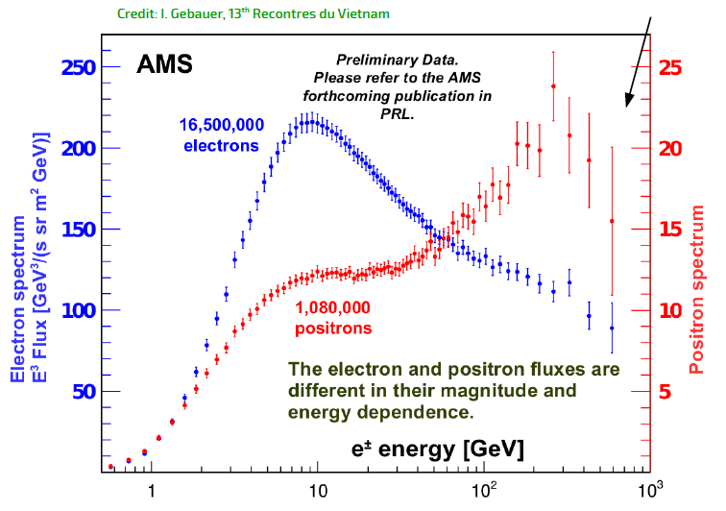
WIMP INDIRECT DETECTION
The positron excess,
also seen by PAMELA,
cannot be due
only to DM,
because no signal
is seen in gamma
and antiproton
a possibly detectable antideuteron could be a good signal
of DM

Slide 33



IF DARK MATTER DOES NOT EXIST
MOND : MOdified Newtonian Dynamics proposed in 1983 by Milgrom
Acceleration of gravitation a is smaller than 1 / r² law for low value of a
is replaced by
μ → 1 when a >> a₀ in the Solar system when a << a₀
The empirical choice a₀ = 1.2 × 10⁻¹⁰ m s⁻² to fit galaxy rotation
Relativistic versions exist
To compete with Λ-CDM model, MOND has to agree with data : gravitational lenses,
galaxy clusters, Planck precise data, new results on gravitational waves
Combining MOND and a small amount of hot DM by neutrinos is a possibility

Slide 34
IF DARK MATTER DOES NOT EXIST
Theory of Dirac-Milne Universe (Chardin)
Instead of modifying Newton law, modify the equivalence principle
(gravitational mass = inertial mass)
Antimatter has a negative gravitational mass, its inertial mass is positive
This Universe contains as much antimatter than matter
the antimatter is repulsive, so it is diffuse and separated from matter
Need to fit astrophysical data
Direct test : 3 experiments in progress to measure the effectof the Earth gravitational field
on antihydrogen atoms at CERN
Gbar, AEgIS, ALPHAg

Slide 35

CONCLUSION
The Λ-CDM model is the most precise tool ever found for understanding the Universe
BUT the dark matter has not been detected yet in particle physics, despite experiments
everywhere at accelerators, underground, undersea or in space
New developments are still
in progress to increase the
sensibility, and beat the
backgrounds
If we succeed to find dark matter
particles, a new era is open
in particle physics
If not, gravitation theory, as known
since Newton and Einstein, must
be amended, that would be
another revolution in physics

Slide 36

EXTRA SLIDE

Slide 37
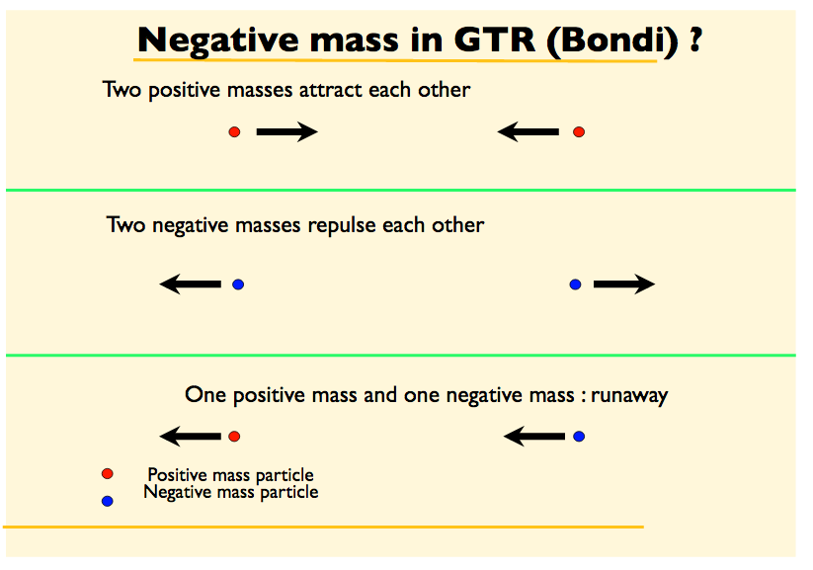
EXTRA SLIDE

