Slide 1
Introduction to Statistics in Particle Physics
Harrison B. Prosper
Florida State University
ENHEP 19, Ain Shams University, Egypt
29 January, 2019

Slide 2
Topics
Introduction
Frequentist Analysis: An Example
Hypothesis Tests: An Example
Summary
Bibliography
Tutorials

Slide 3
Introduction

Slide 4
Introduction: Statistical Inference
The main goal of statistical inference is to use a sample, which is necessarily finite, to infer something about its associated population, which, by definition, is infinite.
Note:
The great thing about physics is that there is a single judge of its correctness (namely, Nature). The bad thing about statistics is that there too many judges!
Consequently, there is no such thing as “the right approach”; rather, there are different approaches, with different assumptions, and different opinions about them.

Slide 5
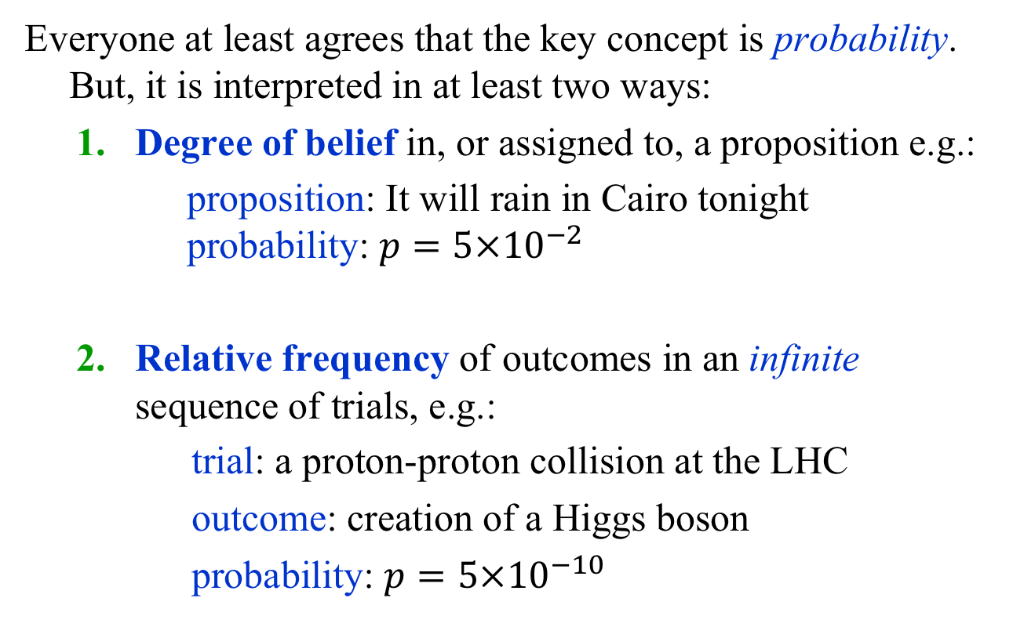
Introduction: Statistical Inference
Everyone at least agrees that the key concept is probability. But, it is interpreted in at least two ways:
  Degree of belief in, or assigned to, a proposition e.g.:
    proposition: It will rain in Cairo tonight
    probability: ${p=5×10}^{−2}$
  Relative frequency of outcomes in an infinite sequence of trials, e.g.:
  trial: a proton-proton collision at the LHC
  outcome: creation of a Higgs boson
  probability: ${p=5×10}^{−10}$

Slide 6
Frequentist Analysis
An Example

Slide 7
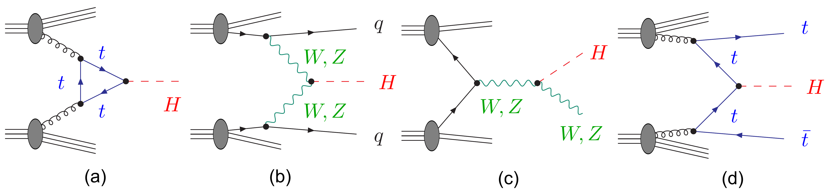


Example: $pp→H→ZZ→4l$
Process $σ × BR (fb)$
Gluon gluon fusion (ggF) 12.18
Vector boson fusion (VBF) 1.044
Associated production (VH) 1.047
Top anti-top fusion (ttH) 0.393
Before event selection, the background ~ 1700 times larger!
http://www.scholarpedia.org/article/The_Higgs_Boson_discovery

Slide 8
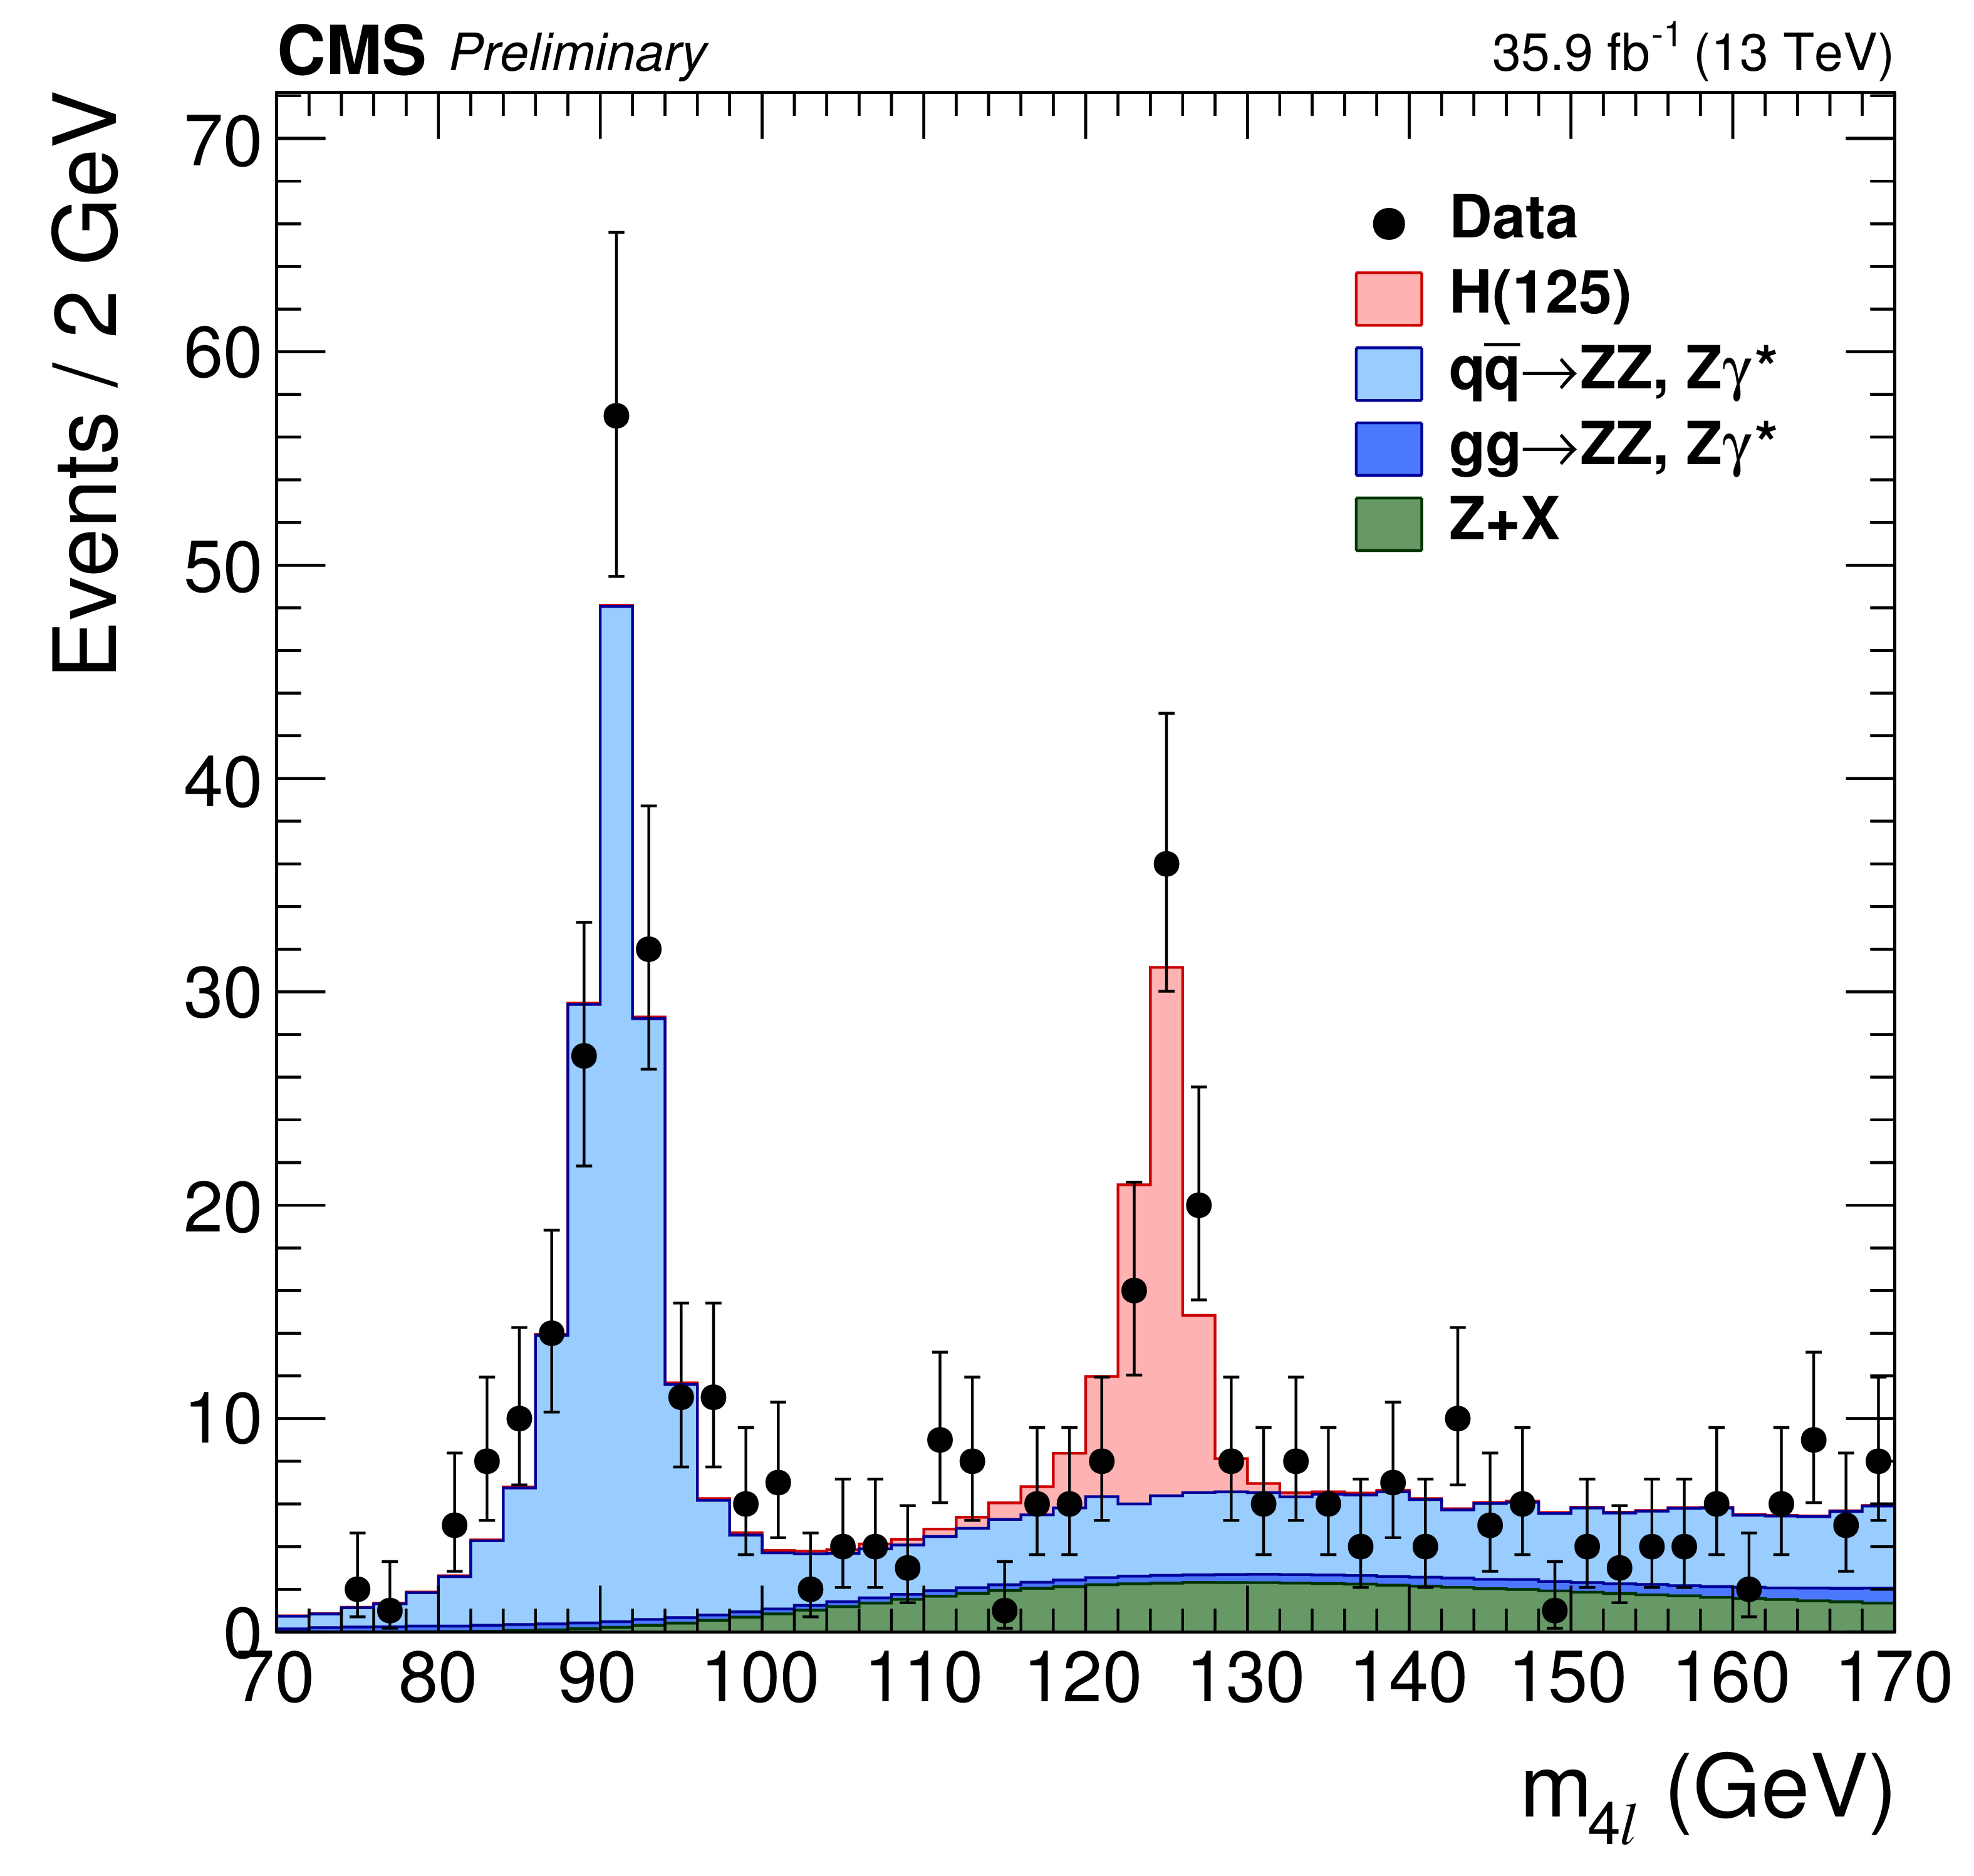
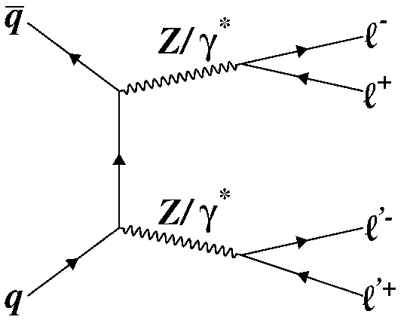


CMS (2018) $pp→H→ZZ→4l$
The main backgrounds:
$Z→4l$
$ZZ→4l$

Slide 9
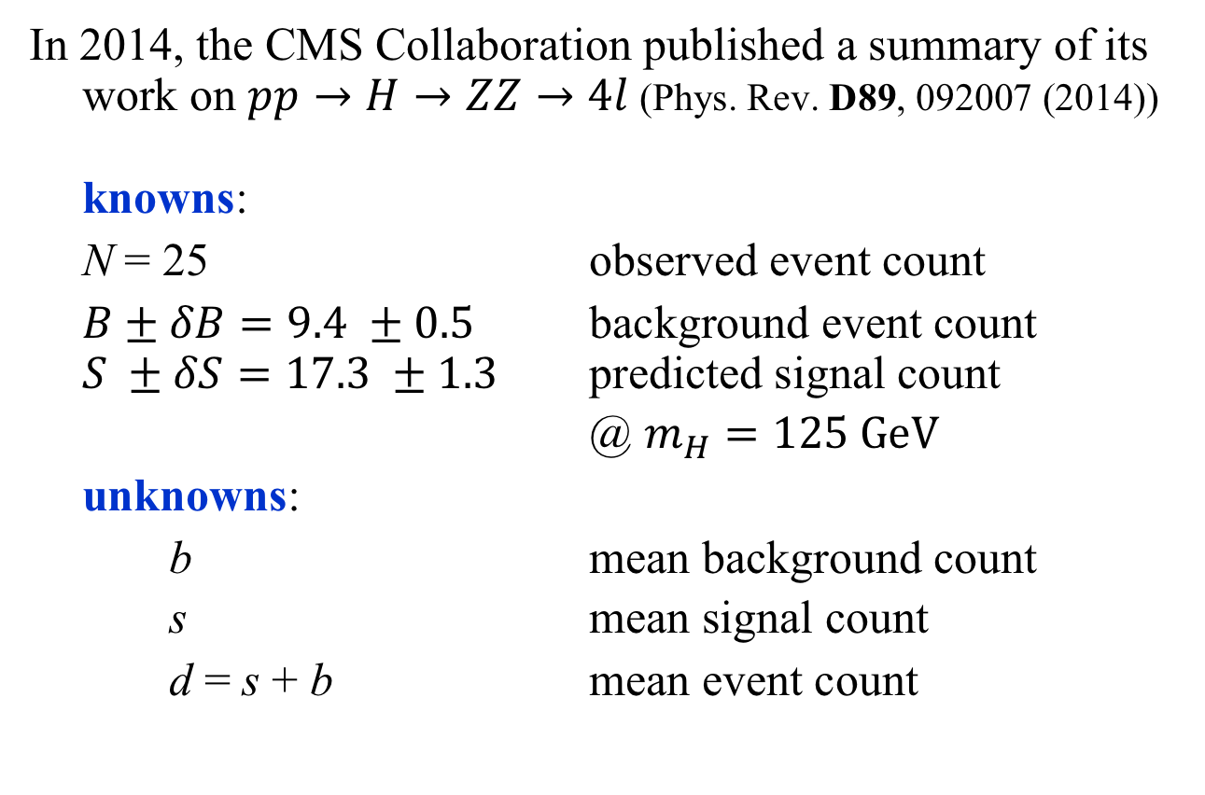

Knowns and Unknowns: $H→ZZ→4l$
In 2014, the CMS Collaboration published a summary of its work on $pp→H→ZZ→4l$ (Phys. Rev. D89, 092007 (2014))
knowns:
N = 25 observed event count
$B±δB=9.4 ±0.5$ background event count
$S ±δS=17.3 ±1.3$ predicted signal count
@ $m_{H}=125 \text{GeV}$
unknowns:
b mean background count
s mean signal count
d = s + b mean event count

Slide 10

Probability Model: $H→ZZ→4l$
Goals:
Estimate (i.e., measure) the mean signal, s.
Quantify the accuracy of the estimate.
Quantify the significance of the signal.
In order to do the above, we need first to construct a probability model of the data generation mechanism.
Let’s start from scratch…

Slide 11

Bernoulli Trial (1): $H→ZZ→4l$
A Bernoulli trial has two outcomes:
S = success or F = failure.
Example: Each collision between protons at the LHC is a Bernoulli trial in which either something interesting happens (S) or does not happen (F).
What is the probability of this sequence of events?
Without assumptions, there is no answer!

Slide 12
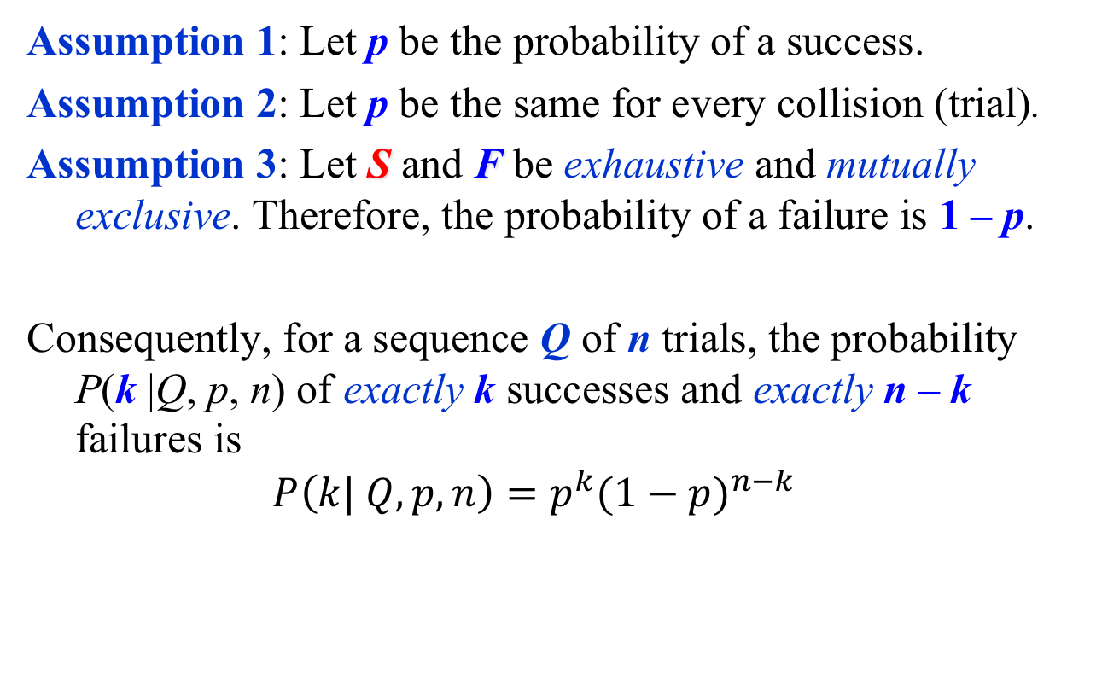

Bernoulli Trial (2) : $H→ZZ→4l$
Assumption 1: Let p be the probability of a success.
Assumption 2: Let p be the same for every collision (trial).
Assumption 3: Let S and F be exhaustive and mutually exclusive. Therefore, the probability of a failure is 1 – p.
Consequently, for a sequence Q of n trials, the probability
P(k |Q, p, n) of exactly k successes and exactly n – k failures is
$$P\left(k| Q, p, n\right)=p^{k}{(1−p)}^{n−k}$$

Slide 13
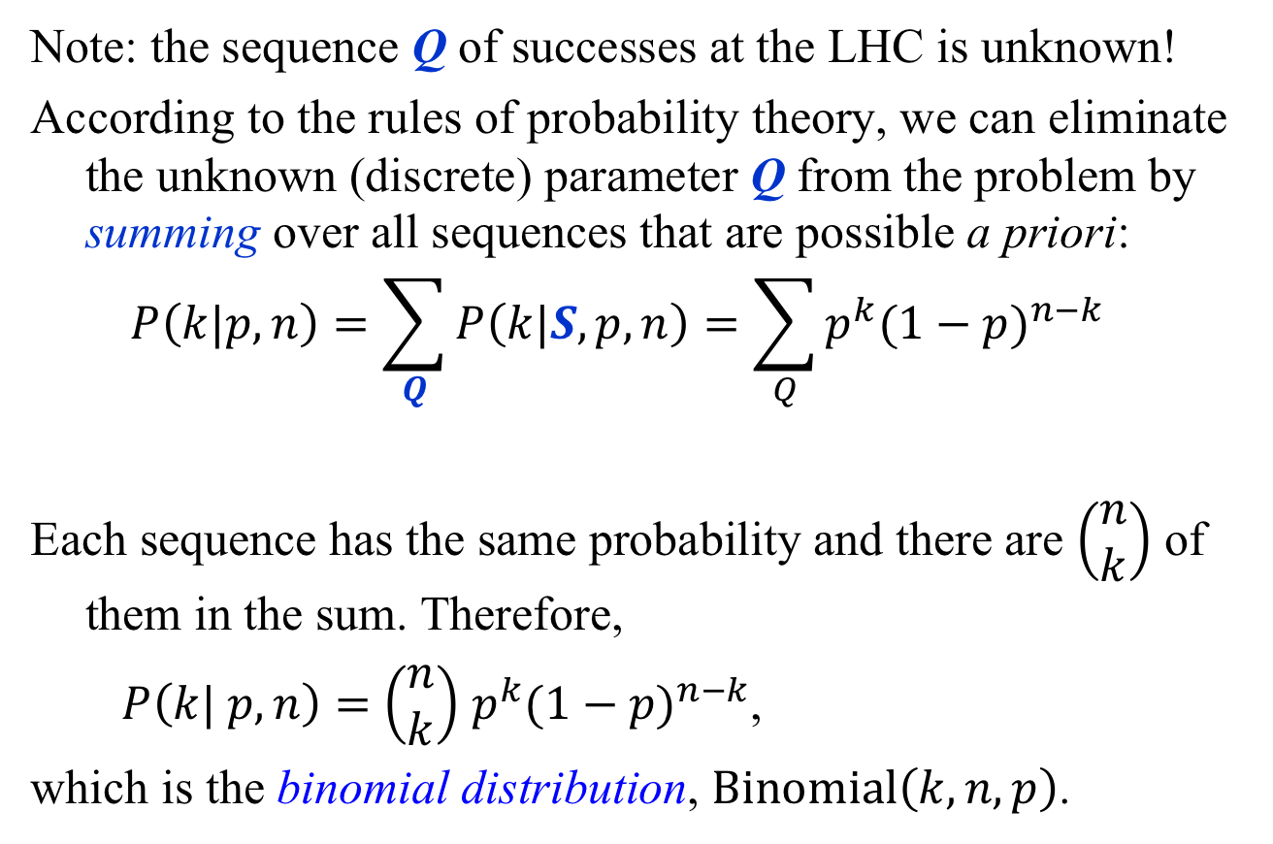

Binomial Distribution: $H→ZZ→4l$
Note: the sequence Q of successes at the LHC is unknown!
According to the rules of probability theory, we can eliminate the unknown (discrete) parameter Q from the problem by summing over all sequences that are possible a priori:
$$P\left(k|p, n\right)=\sum_{Q}{P\left(k|S, p, n\right)}=\sum_{Q}{p^{k}{(1−p)}^{n−k}}$$
Each sequence has the same probability and there are $\left(\begin{matrix}n \\ k\end{matrix}\right)$ of them in the sum. Therefore,
$P\left(k| p, n\right)=$ $\left(\begin{matrix}n \\ k\end{matrix}\right)$ $p^{k}{(1−p)}^{n−k}$,
which is the binomial distribution, $\text{Binomial}\left(k, n, p\right)$.

Slide 14
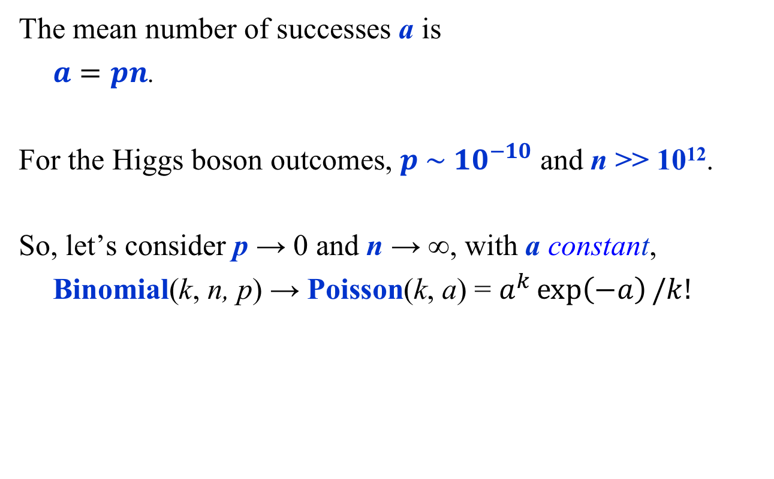

Poisson Distribution: $H→ZZ→4l$
The mean number of successes a is
$a=pn$.
For the Higgs boson outcomes, $p \sim {10}^{−10}$ and n >> 10¹².
So, let’s consider p → 0 and n → ∞, with a constant,
Binomial(k, n, p) → Poisson(k, a) = $a^{k}\exp\left(−a\right)/k!$
Exercise 1: Show this
Exercise 2: Show that Binomial(k, n, p) → Poisson(k, a)

Slide 15

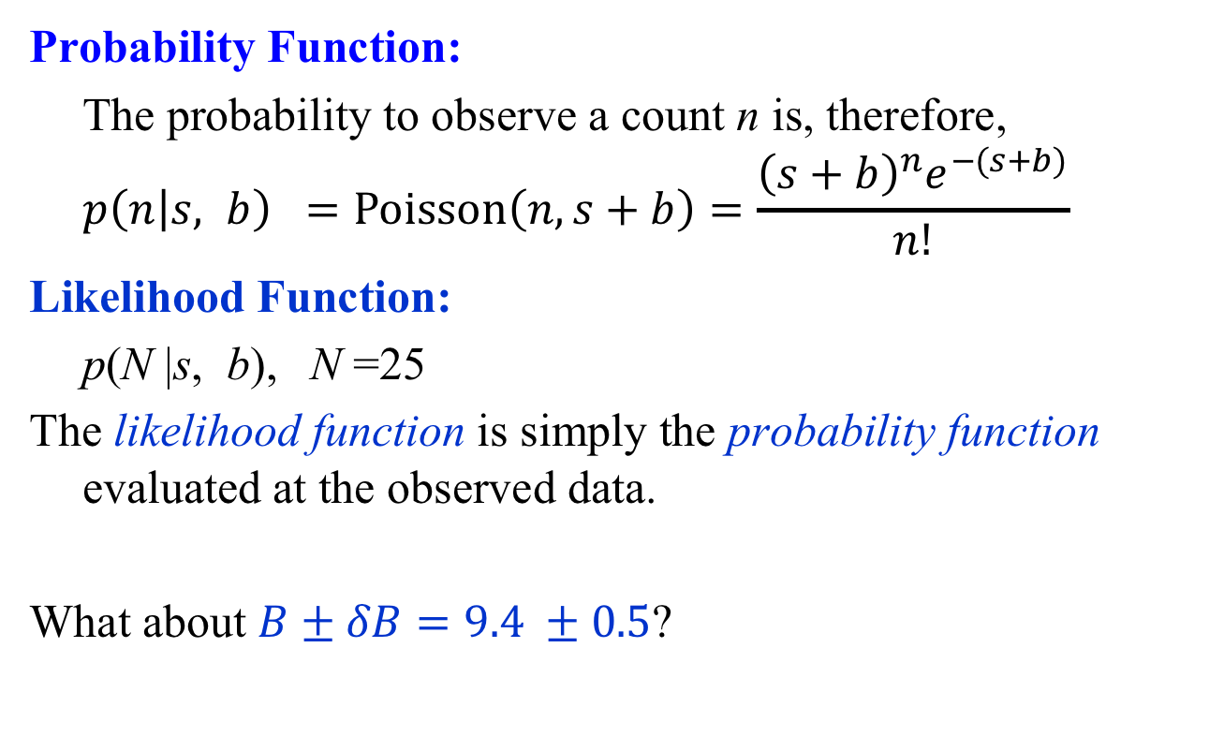
Example: $H→ZZ→4l$
Probability Function:
The probability to observe a count n is, therefore,
$$p\left(n | s, b\right) =Poisson\left(n, s+b\right)=\frac{{\left(s+b\right)}^{n}e^{−(s+b)}}{n!}$$
Likelihood Function:
p(N |s, b), N =25
The likelihood function is simply the probability function evaluated at the observed data.
What about $B±δB=9.4 ±0.5$?

Slide 16
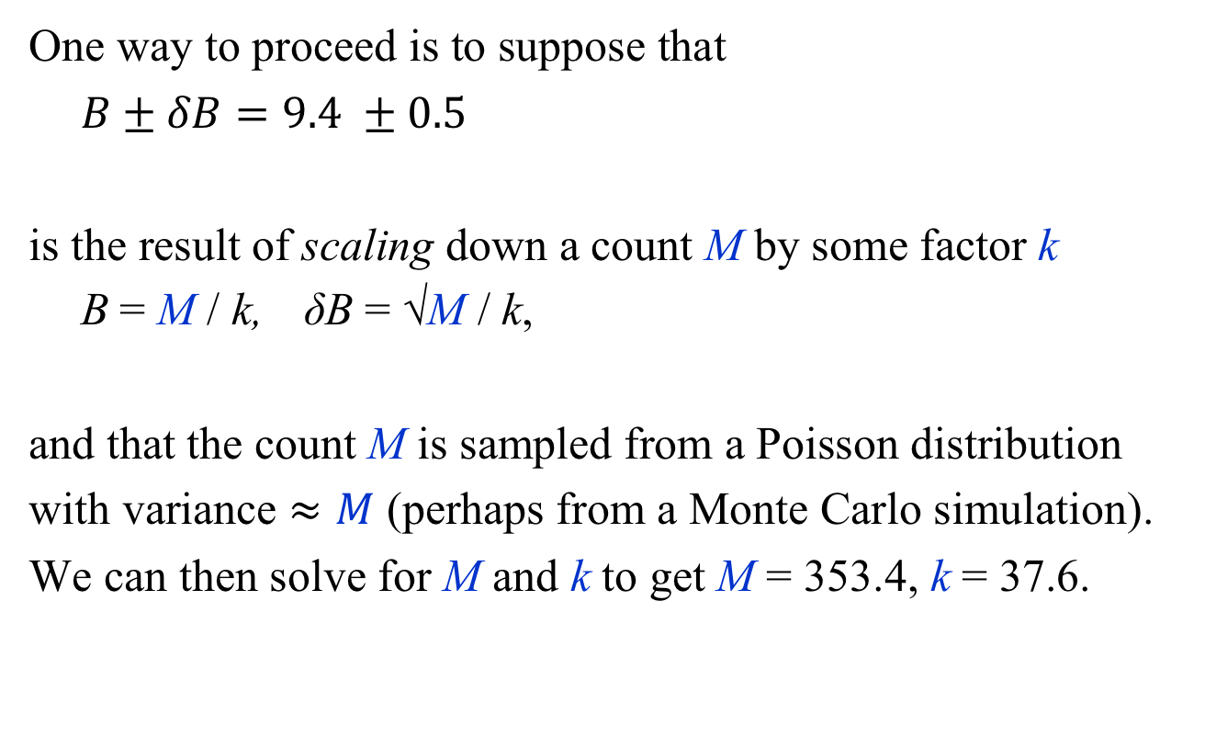
Example: $H→ZZ→4l$
One way to proceed is to suppose that
$B±δB=9.4 ±0.5$
is the result of scaling down a count M by some factor k
B = M / k, δB = √M / k,
and that the count M is sampled from a Poisson distribution
with variance $≈M$ (perhaps from a Monte Carlo simulation).
We can then solve for M and k to get M = 353.4, k = 37.6.

Slide 17
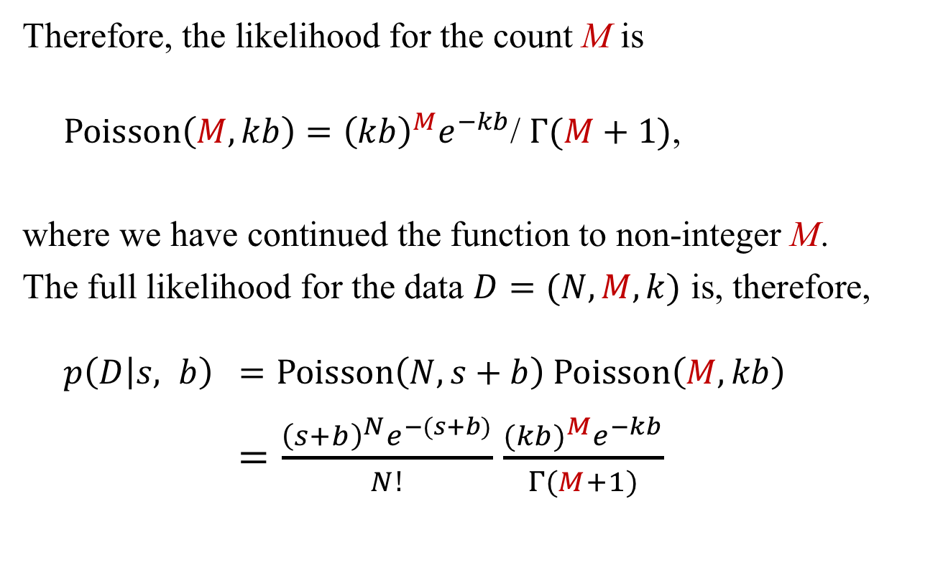
Example: $H→ZZ→4l$
Therefore, the likelihood for the count M is
${Poisson\left(M, kb\right)=\left(kb\right)}^{M}e^{−kb}$/ $Γ(M+1)$,
where we have continued the function to non-integer M.
The full likelihood for the data $D=(N, M, k)$ is, therefore,
$$p\left(D | s, b\right) =Poisson\left(N, s+b\right) Poisson\left(M, kb\right)$$
$=\frac{{\left(s+b\right)}^{N}e^{−(s+b)}}{N!}$ $\frac{{(kb)}^{M}e^{−kb}}{Γ(M+1)}$

Slide 18
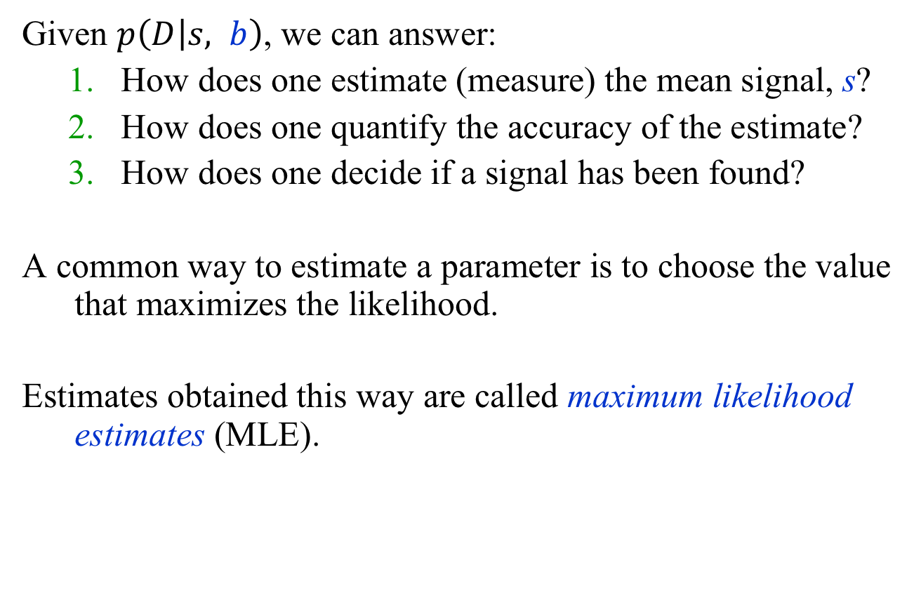

Example: $H→ZZ→4l$ Summary
Given $p\left(D | s, b\right)$, we can answer:
  How does one estimate (measure) the mean signal, s?
  How does one quantify the accuracy of the estimate?
  How does one decide if a signal has been found?
A common way to estimate a parameter is to choose the value that maximizes the likelihood.
Estimates obtained this way are called maximum likelihood estimates (MLE).

Slide 19
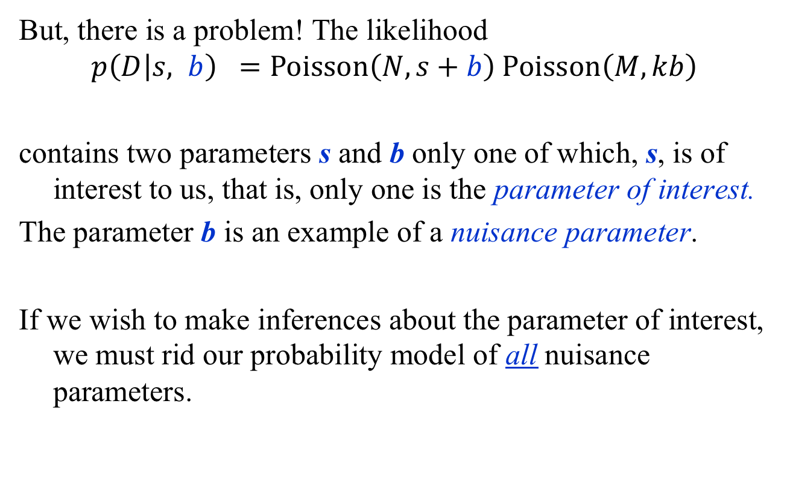
Nuisance Parameters are a Nuisance!
But, there is a problem! The likelihood
$$p\left(D | s, b\right) =Poisson\left(N, s+b\right) Poisson\left(M, kb\right)$$
contains two parameters s and b only one of which, s, is of interest to us, that is, only one is the parameter of interest.
The parameter b is an example of a nuisance parameter.
If we wish to make inferences about the parameter of interest, we must rid our probability model of all nuisance parameters.

Slide 20
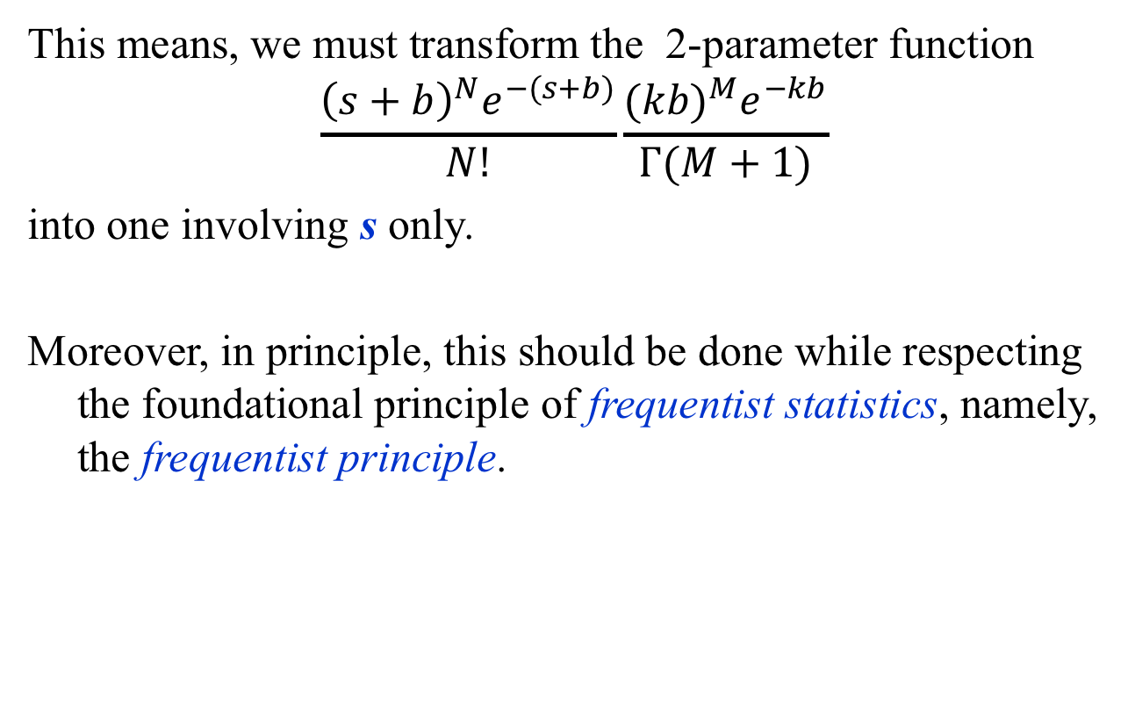

Example: $H→ZZ→4l$
This means, we must transform the 2-parameter function
$$\frac{{\left(s+b\right)}^{N}e^{−(s+b)}}{N!}\frac{{(kb)}^{M}e^{−kb}}{Γ(M+1)}$$
into one involving s only.
Moreover, in principle, this should be done while respecting the foundational principle of frequentist statistics, namely, the frequentist principle.

Slide 21
The Frequentist Principle
The Frequentist Principle (FP) (Jerzy Neyman, 1937)
Given a probability p, statements should be constructed so that we can guarantee that a fraction f ≥ p of them are true over an ensemble of statements, even if we do not know which ones are true and which are false.
The fraction f is called the coverage probability (or coverage for short) and p is called the confidence level (C.L.).
Statements that obey the frequentist principle are said to cover.

Slide 22
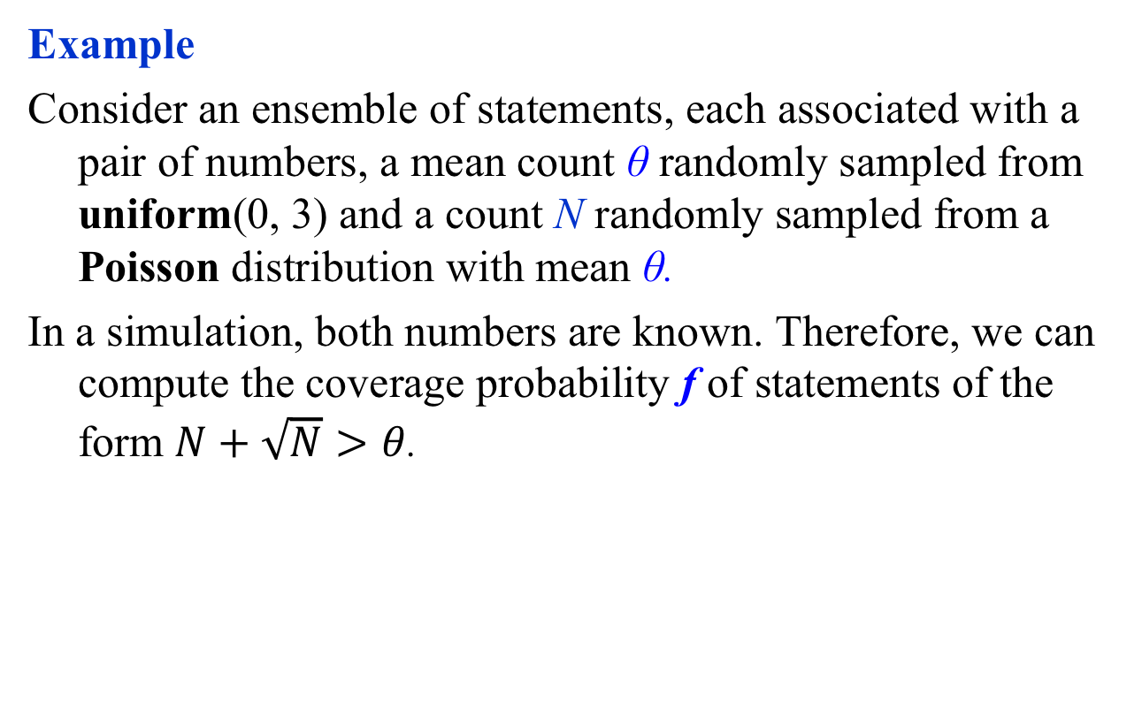
The Frequentist Principle
Example
Consider an ensemble of statements, each associated with a pair of numbers, a mean count θ randomly sampled from uniform(0, 3) and a count N randomly sampled from a Poisson distribution with mean θ.
In a simulation, both numbers are known. Therefore, we can compute the coverage probability f of statements of the form $N+\sqrt{N}>θ$.
Exercise 3:
What is the coverage probability of these
statements? Repeat using uniform(0, 3000).

Slide 23
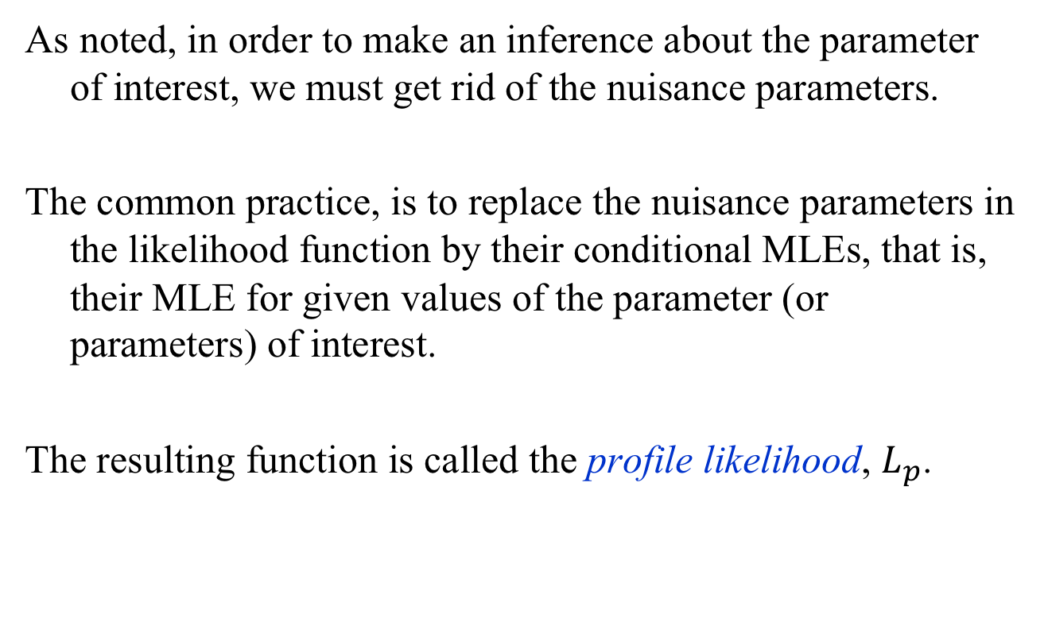

Profile Likelihood: $H→ZZ→4l$
As noted, in order to make an inference about the parameter of interest, we must get rid of the nuisance parameters.
The common practice, is to replace the nuisance parameters in the likelihood function by their conditional MLEs, that is, their MLE for given values of the parameter (or parameters) of interest.
The resulting function is called the profile likelihood, $L_{p}$.

Slide 24
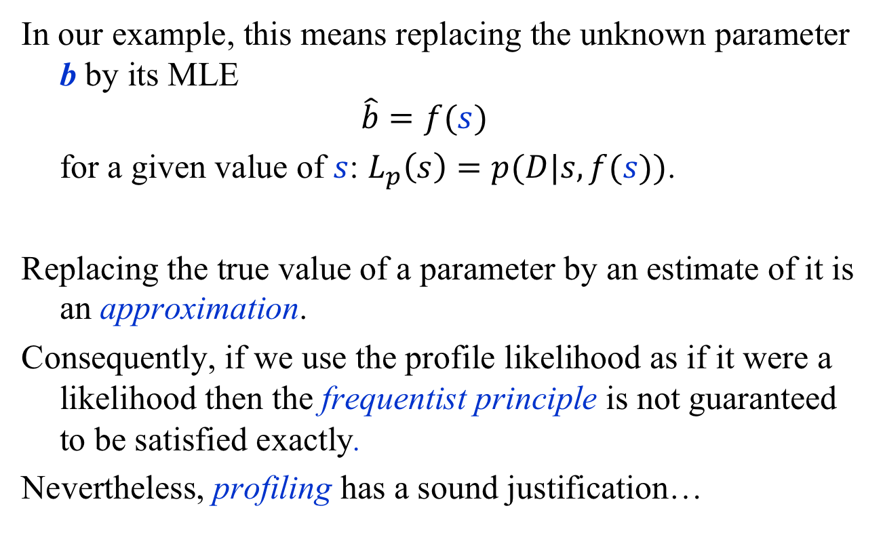
Profile Likelihood: $H→ZZ→4l$
In our example, this means replacing the unknown parameter b by its MLE
$$\hat{b}=f(s)$$
for a given value of $s$: $L_{p}\left(s\right)=p(D|s,f(s))$.
Replacing the true value of a parameter by an estimate of it is an approximation.
Consequently, if we use the profile likelihood as if it were a likelihood then the frequentist principle is not guaranteed to be satisfied exactly.
Nevertheless, profiling has a sound justification…

Slide 25
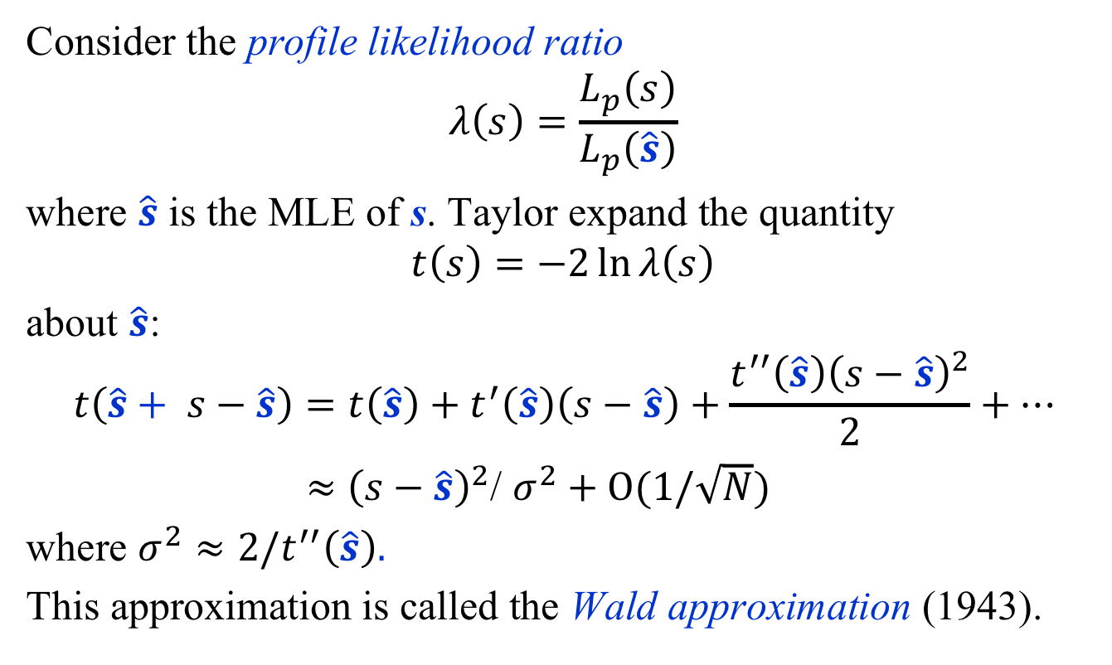

Wald Approximation: $H→ZZ→4l$
Consider the profile likelihood ratio
$$λ\left(s\right)=\frac{L_{p}\left(s\right)}{L_{p}\left(\hat{s}\right)}$$
where $\hat{s}$ is the MLE of s. Taylor expand the quantity
$$t\left(s\right)=−2\ln{λ\left(s\right)}$$
about $\hat{s}$:
$$t\left(\hat{s}+ s−\hat{s}\right)=t\left(\hat{s}\right)+t^{′}\left(\hat{s}\right)\left(s−\hat{s}\right)+\frac{t^{′′}\left(\hat{s}\right){\left(s−\hat{s}\right)}^{2}}{2}+…$$
$≈$ ${\left(s−\hat{s}\right)}^{2}$/ $σ^{2}+O(1/\sqrt{N})$
where ${σ^{2}≈2/t}^{′′}\left(\hat{s}\right).$
This approximation is called the Wald approximation (1943).

Slide 26
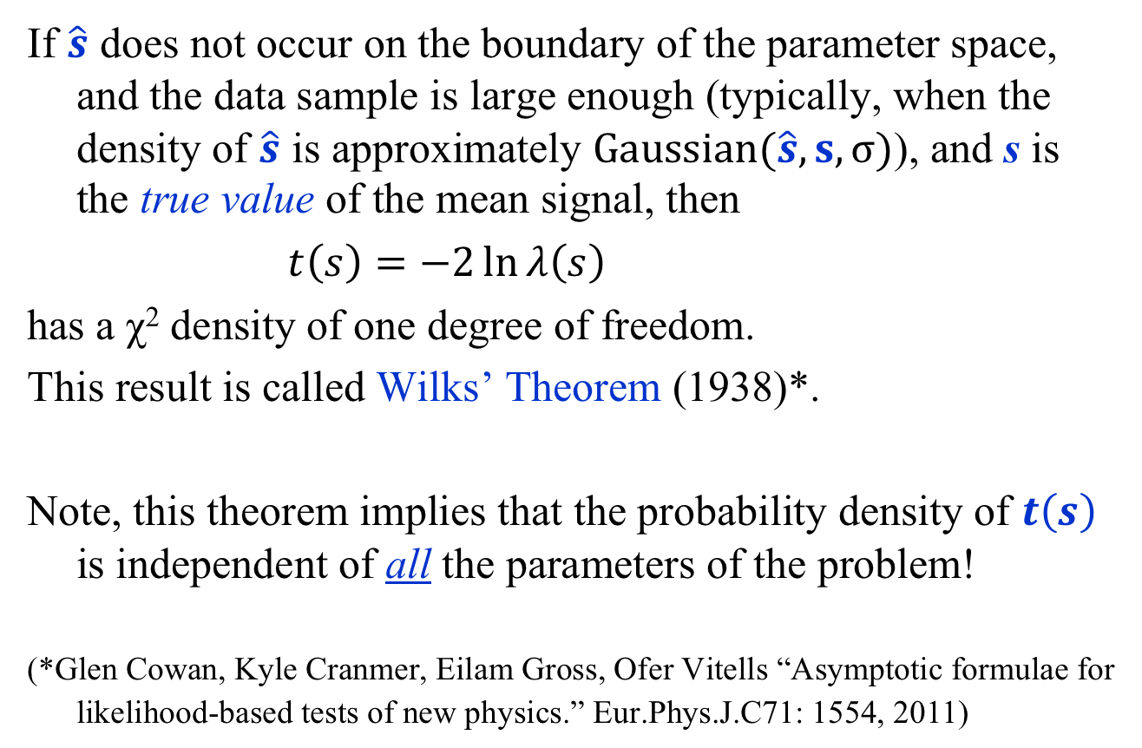

Wilks’ Theorem: $H→ZZ→4l$
If $\hat{s}$ does not occur on the boundary of the parameter space, and the data sample is large enough (typically, when the density of $\hat{s}$ is approximately $\text{G}\text{aussian}(\hat{s}, s, σ)$), and s is the true value of the mean signal, then
$t\left(s\right)=−2\ln{λ\left(s\right)}$
has a χ² density of one degree of freedom.
This result is called Wilks’ Theorem (1938)*.
Note, this theorem implies that the probability density of $t\left(s\right)$ is independent of all the parameters of the problem!
(*Glen Cowan, Kyle Cranmer, Eilam Gross, Ofer Vitells “Asymptotic formulae for likelihood-based tests of new physics.” Eur.Phys.J.C71: 1554, 2011)
Exercise 4: Verify this theorem through simulation

Slide 27
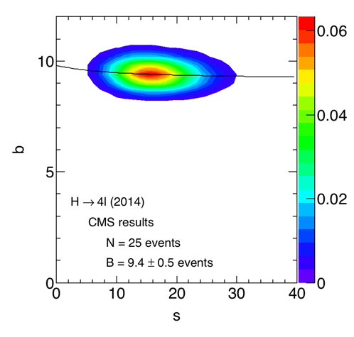


MLE: $H→ZZ→4l$
The MLE of b, given s, is
$\hat{b}=f\left(s\right)=\frac{g+\sqrt{g^{2}+4\left(1+k\right)Ms}}{2(1+k)}$
$$g=N+M−\left(1+k\right)s$$
Note,
s = N – B = 15.6 events
b = B
is the mode (location of the
peak) of the likelihood
function.
Exercise 5: Show this

Slide 28
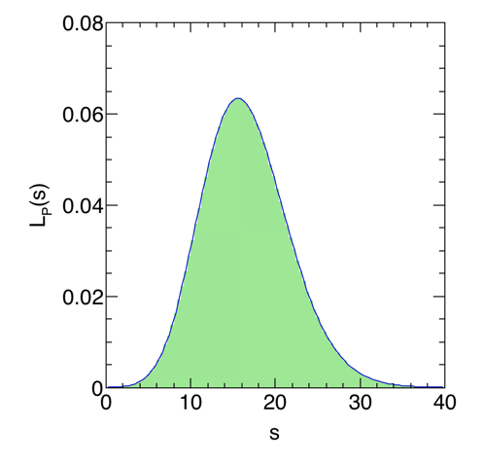


Confidence Interval: $H→ZZ→4l$
Since ${t\left(s\right)≈χ}^{2}$, we can
compute an approximate
68% confidence interval
by solving
$$t\left(s\right)=−2\ln{λ\left(s\right)=1}$$
for s. The result is the statement
$s∈\left[10.9, 21\right]$
@ ~ 68% confidence level (CL).
Exercise 6: Show this by solving $t\left(s\right)=1$ numerically

Slide 29
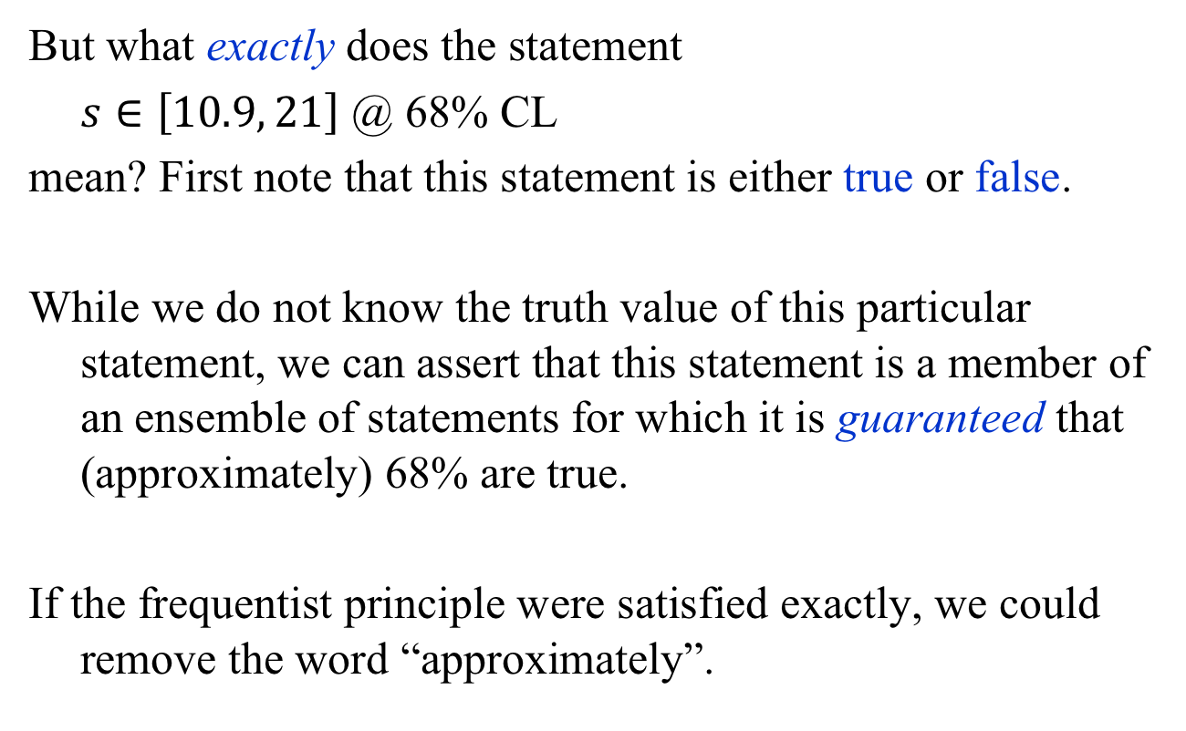
Confidence Interval: $H→ZZ→4l$
But what exactly does the statement
$s∈\left[10.9, 21\right]$ @ 68% CL
mean? First note that this statement is either true or false.
While we do not know the truth value of this particular statement, we can assert that this statement is a member of an ensemble of statements for which it is guaranteed that (approximately) 68% are true.
If the frequentist principle were satisfied exactly, we could remove the word “approximately”.

Slide 30
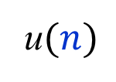



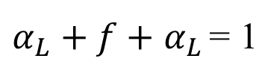


Confidence Interval: $H→ZZ→4l$
The confidence interval algorithm just described approximates the method devised by Neyman (1937):
For every n solve,
u$(n)$
$$f≥p$$
s
$$α_{L}=P(x≤n|u)$$
$$l(n)$$
$$α_{R}=P(x≥n|l)$$
parameter space
u
l
$α_{L}+f+$ $α_{L }$= 1
n
If $α_{L}$ = $α_{R}$ the resulting intervals are called central intervals.

Slide 31
But Is The Signal Real?
In the real world, we can never know for sure.
We can, however, make a probabilistic statement about whether the signal is real or the result of a fluctuation of the background.
In particle physics, the broad consensus is that we declare a signal real if the background-only hypothesis is extremely unlikely.
But, to be quantitative, we need a way to test hypotheses.

Slide 32
Hypothesis tests
An example

Slide 33
Hypothesis Tests – 1
Decide which hypothesis is to be rejected and call it the null hypothesis, denoted by H₀. At the LHC, this is usually the background-only hypothesis.
Construct a function of the data called a test statistic such that large values of it would cast doubt on the truth of the null hypothesis.
Choose a test statistic threshold above which we are inclined to reject the null. Do the experiment, compute the statistic, and reject the null if the threshold is exceeded.

Slide 34
Hypothesis Tests – 2
There are two related variations on this general procedure:
Fisher: reject the null if the test statistic is large enough.
Neyman: compare the null to an alternative hypothesis using a statistic that depends on both hypotheses. Reject the null if the alternative is preferred.
In particle physics, we do a mixture of both!

Slide 35


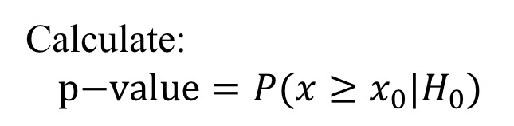

Hypothesis Tests – 3
Fisher’s Approach: Null hypothesis (H₀), e.g., background-only
$$p(x|H_{0})$$
Calculate:
$$\text{p}\text{−}\text{value}=P(x≥x_{0}|H_{0})$$
$$x_{0}$$
$$x$$
x₀ is the observed value of the test statistic x.
The null hypothesis is rejected if the p-value is judged
to be small enough, i.e., if x₀ is large enough.

Slide 36

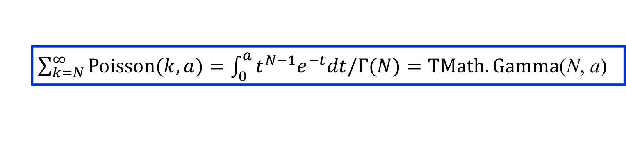
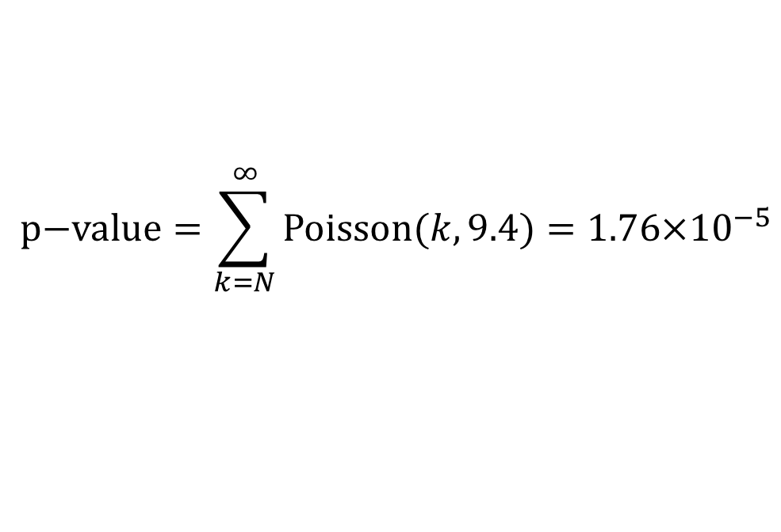

Example: $H→ZZ→4l$
Background, B = 9.4 events (ignoring uncertainty in background)
$$p\left(x_{0}=N | H_{0}\right)=Poisson(N, B=9.4)$$
$$N=25$$
observed count
$$\text{p}\text{−}\text{value}=\sum_{k=N}^{∞}{\text{Poisson}(k, 9.4)}=1.76×{10}^{−5}$$
$\sum_{k=N}^{∞}{\text{Poisson}(k, a)}=\int_{0}^{a}{t^{N−1}e^{−t}dt/Γ(N)}=TMath.Gamma$(N, a)

Slide 37
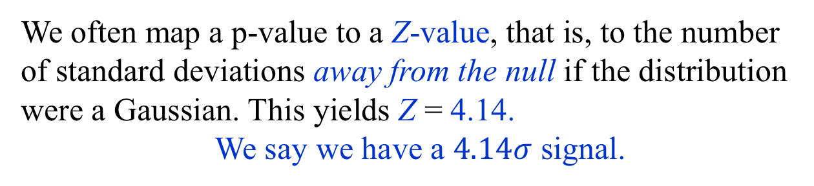


Example: $H→ZZ→4l$
Background, B = 9.4 events (ignoring uncertainty)
$$p\left(25 | H_{0}\right)=Poisson(25, 9.4)$$
$$\text{p}\text{−}\text{value}=1.76×{10}^{−5}$$
$$N=25$$
observed count
We often map a p-value to a Z-value, that is, to the number
of standard deviations away from the null if the distribution
were a Gaussian. This yields Z = 4.14.
We say we have a $4.14σ$ signal.

Slide 38

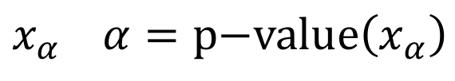



Hypothesis Tests – 4
Neyman’s Approach: Null hypothesis (H₀) + alternative (H₁)
Neyman argued
that it is
necessary to
consider
alternative
hypotheses
H₁
Alternative hypothesis
$$p(x|H_{0})$$
$$x_{α} α=\text{p}\text{−}\text{value}\left(x_{α}\right)$$
$$p(x|H_{1})$$
$$x_{0}$$
$$x$$
Choose a fixed value of α before data are analyzed. Reject
the null in favor of the alternative if the p-value < α.
Statisticians call α the significance (or size) of the test,
while particle physicists call the Z-value the significance!

Slide 39

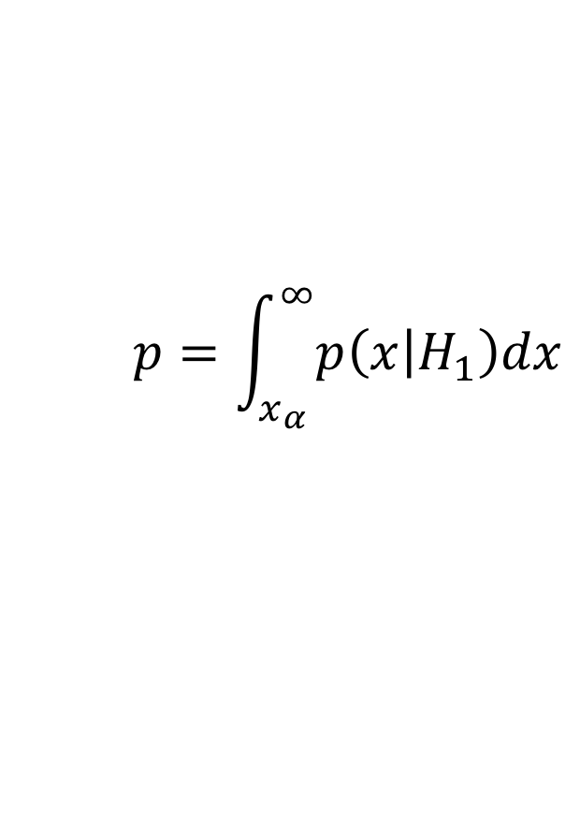

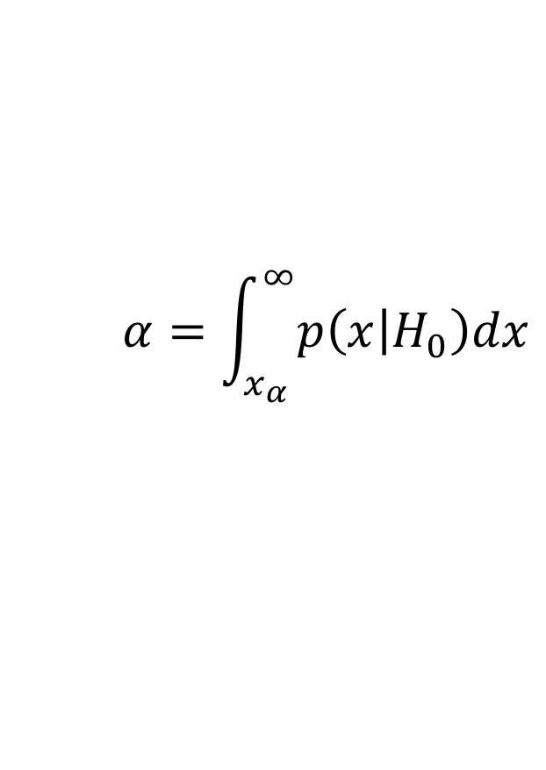


The Neyman-Pearson Test
In Neyman’s approach,
hypothesis tests are
a contest between
significance and
power, which is the
probability to accept a
true alternative.
$$p(x|H_{0})$$
$$x_{α}$$
$$p(x|H_{1})$$
$$x$$
$$α=\int_{x_{α}}^{∞}{p\left(x | H_{0}\right)dx}$$
$$p=\int_{x_{α}}^{∞}{p\left(x | H_{1}\right)dx}$$
significance of test
power of test

Slide 40
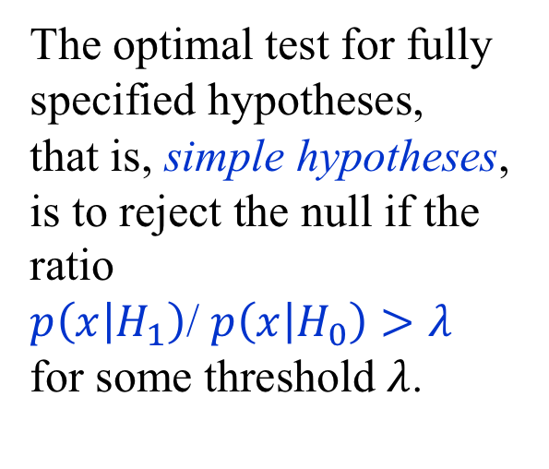
The Neyman-Pearson Test
The optimal test for fully
specified hypotheses,
that is, simple hypotheses,
is to reject the null if the
ratio
$p\left(x | H_{1}\right)$/ $p\left(x | H_{0}\right)>λ$
for some threshold $λ$.
$$p(x|H_{0})$$
$$x_{α}$$
$$p(x|H_{1})$$
$$x$$
$$α=\int_{x_{α}}^{∞}{p\left(x | H_{0}\right)dx}$$
$$p=\int_{x_{α}}^{∞}{p\left(x | H_{1}\right)dx}$$
significance of test
power of test

Slide 41
Hypothesis Tests – 5
All realistic analyses contain nuisance parameters that we must get rid of in order to perform an hypothesis test.
There two primary ways:
Profiling: Use the profile likelihood.
Marginalizing: Use the marginal likelihood, i.e., a
likelihood integrated over the nuisance
parameters.

Slide 42
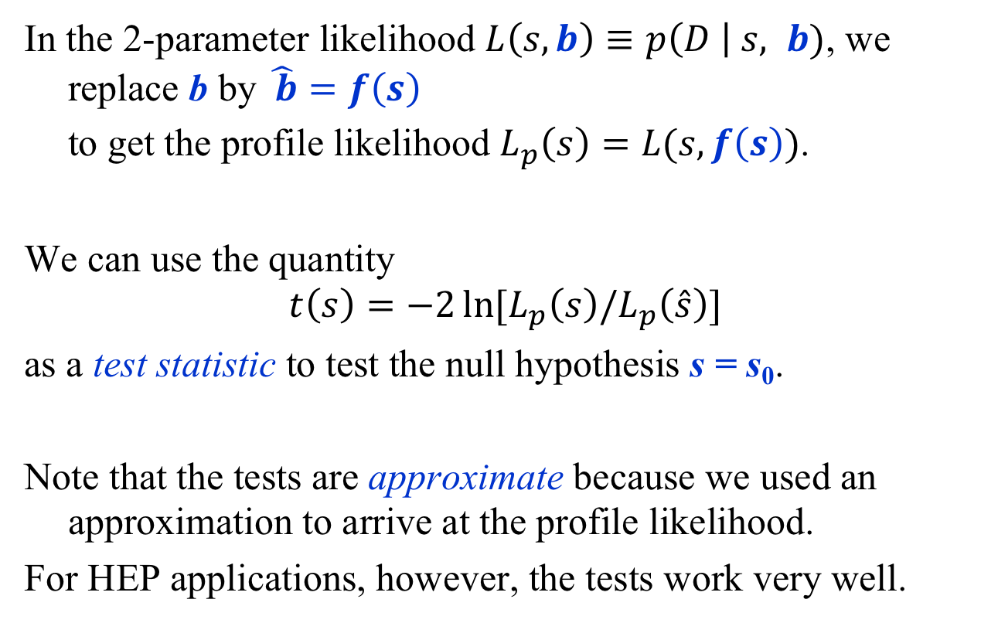

Example: $H→ZZ→4l$ (Profiling)
In the 2-parameter likelihood $L\left(s, b\right)≡p\left(D \right| s, b)$, we replace b by $\hat{ b}=f\left(s\right)$
to get the profile likelihood $L_{p}\left(s\right)=L(s, f\left(s\right))$.
We can use the quantity
$$t\left(s\right)=−2\ln{[L_{p}\left(s\right)/L_{p}\left(\hat{s}\right)]}$$
as a test statistic to test the null hypothesis s = s₀.
Note that the tests are approximate because we used an approximation to arrive at the profile likelihood.
For HEP applications, however, the tests work very well.

Slide 43
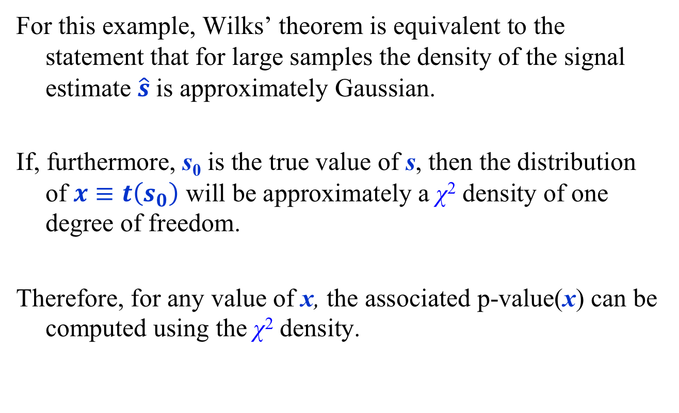
Example: $H→ZZ→4l$ (Profiling)
For this example, Wilks’ theorem is equivalent to the statement that for large samples the density of the signal estimate $\hat{s}$is approximately Gaussian.
If, furthermore, s₀ is the true value of s, then the distribution of $x≡t\left(s_{0}\right)$ will be approximately a χ² density of one degree of freedom.
Therefore, for any value of x, the associated p-value(x) can be computed using the χ² density.

Slide 44
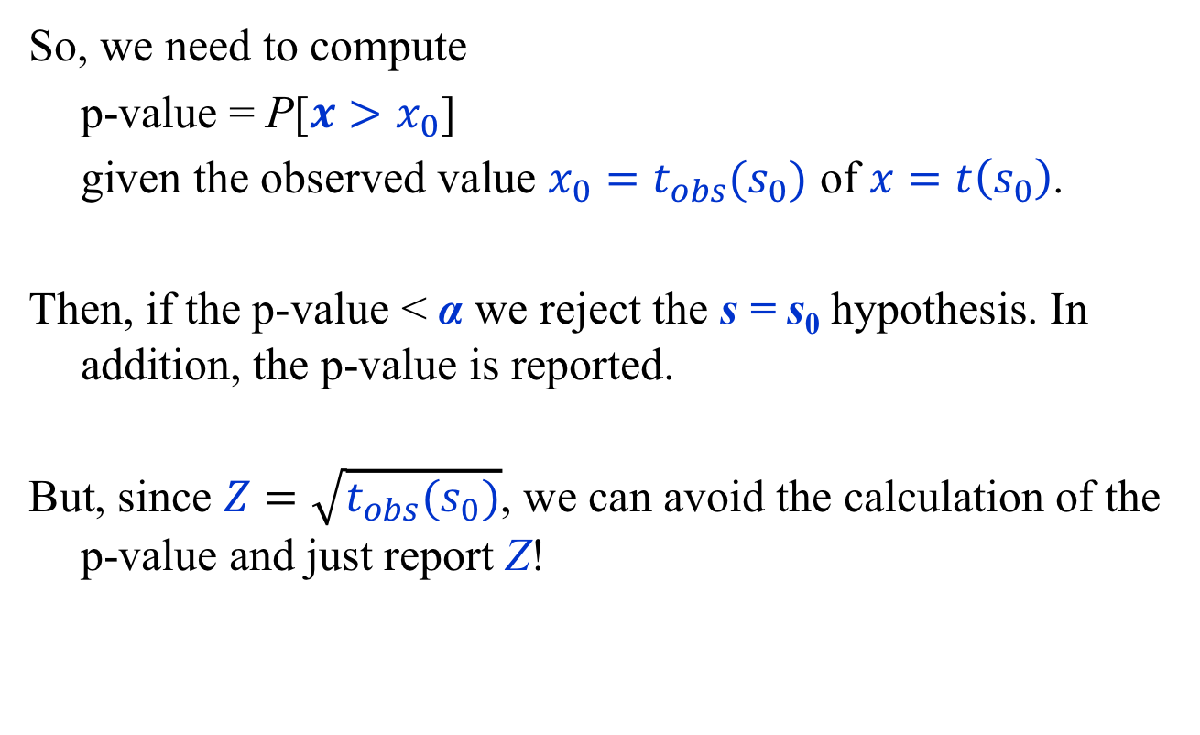
Example: $H→ZZ→4l$ (Profiling)
So, we need to compute
p-value = P[$x>x_{0}$]
given the observed value $x_{0}=t_{obs}(s_{0})$ of $x=t\left(s_{0}\right)$.
Then, if the p-value < α we reject the s = s₀ hypothesis. In addition, the p-value is reported.
But, since $Z=\sqrt{t_{obs}(s_{0})}$, we can avoid the calculation of the p-value and just report Z!

Slide 45
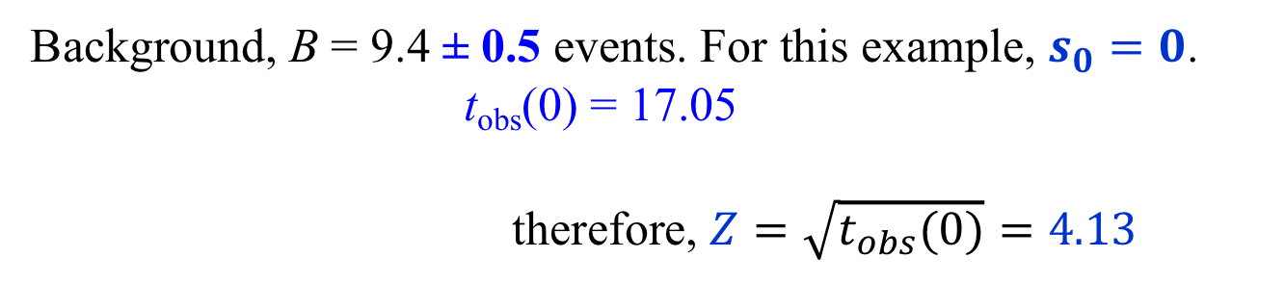


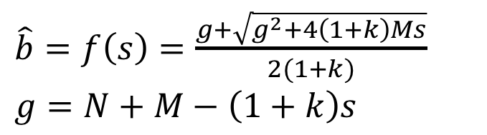
Example: $H→ZZ→4l$ (Profiling)
Background, B = 9.4 ± 0.5 events. For this example, $s_{0}=0$.
t_{obs}(0) = 17.05
therefore, $Z=\sqrt{t_{obs}(0)}=4.13$
$\hat{b}=f\left(s\right)=\frac{g+\sqrt{g^{2}+4\left(1+k\right)Ms}}{2(1+k)}$
$$g=N+M−\left(1+k\right)s$$
$$L_{p}\left(s\right)=L(s, f\left(s\right))$$
$$t\left(s\right)=−2\ln{[L_{p}\left(s\right)/L_{p}\left(\hat{s}\right)]}$$
Exercise 7: Verify this calculation

Slide 46
Summary
Probability
  Interpretations: degree of belief, relative frequency
Likelihood Function
  Probability function into which data have been inserted.
Frequentist Principle
  Construct statements such that a fraction f ≥ C.L. of them are true over an infinite ensemble of statements.
Frequentist Analysis
  Eliminate nuisance parameters by profiling likelihood.
  Tests: decide on a fixed threshold α and reject null hypothesis if the p-value < α; report the p-value.

Slide 47
Bibliography
G. Cowan, Statistical Data Analysis, Oxford University Press, Oxford (1998).
L. Lyons, Statistics for Nuclear and Particle Physicists, Cambridge University Press, Cambridge (1989).
R. J. Barlow, Statistics: A Guide To The Use Of Statistical Methods In The Physical Sciences, The Manchester Physics Series, John Wiley and Sons, New York (1989).
F. James, Statistical Methods in Experimental Physics, 2nd Edition, World Scientific, Singapore (2006).
H. B. Prosper, Practical Statistics for Particle Physicists, CERN-2015-004 (2016).

Slide 48
Tutorials
Download the tutorials from github using
git clone https://github.com/hbprosper/ENHEP
or update your local copy using git pull
Requirements
ROOT (from https://root.cern.ch) 6.14/06 or greater.
jupyter, which is needed to run the Python notebooks, with Python 2.7.X (X > 9) or Python 3 provided you replace statements such as print “hello” by print(“hello”) (thanks for testing this Ulrich!).
Python packages: pandas, numpy, matplotlib, scipy, and scikit-learn; sympy is also very handy.

Slide 49
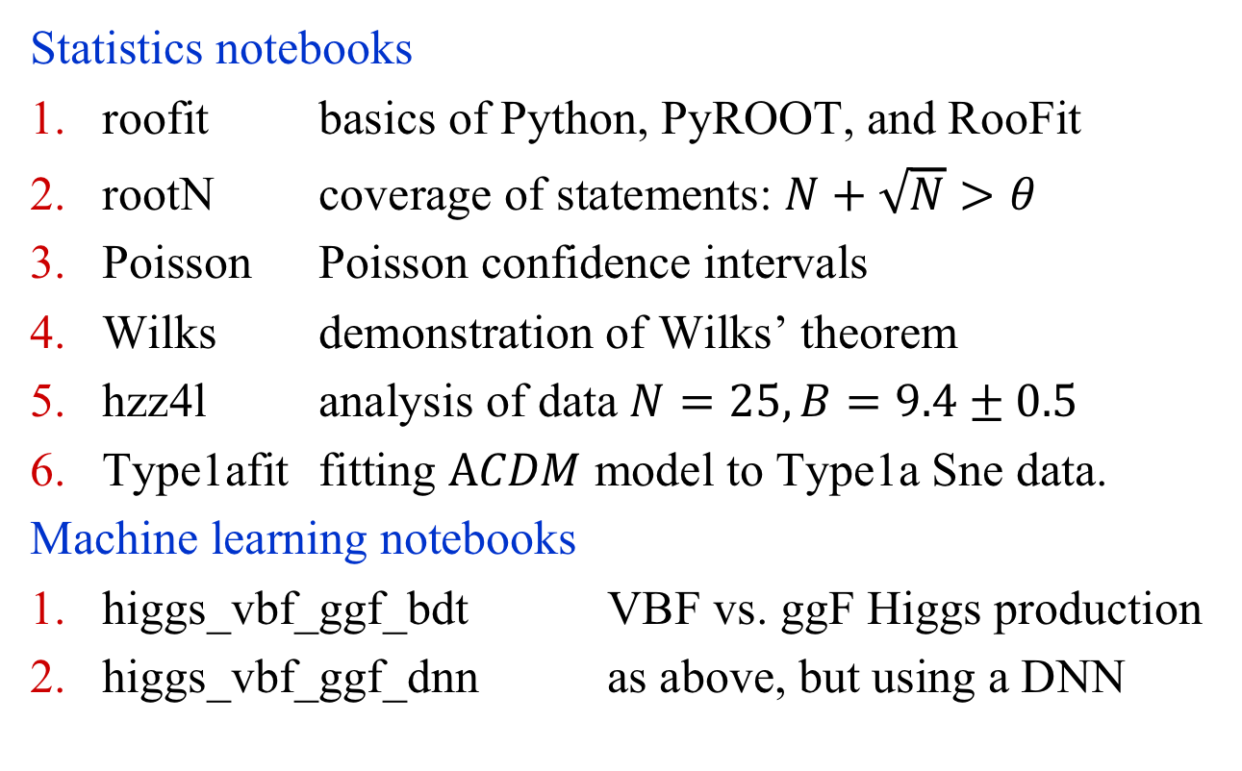
Tutorials
Statistics notebooks
roofit basics of Python, PyROOT, and RooFit
rootN coverage of statements: $N+\sqrt{N}>θ$
Poisson Poisson confidence intervals
Wilks demonstration of Wilks’ theorem
hzz4l analysis of data $N=25, B=9.4±0.5$
Type1afit fitting $ΑCDM$ model to Type1a Sne data.
Machine learning notebooks
higgs_vbf_ggf_bdt VBF vs. ggF Higgs production
higgs_vbf_ggf_dnn as above, but using a DNN

Slide 50
Backup slides

Slide 51
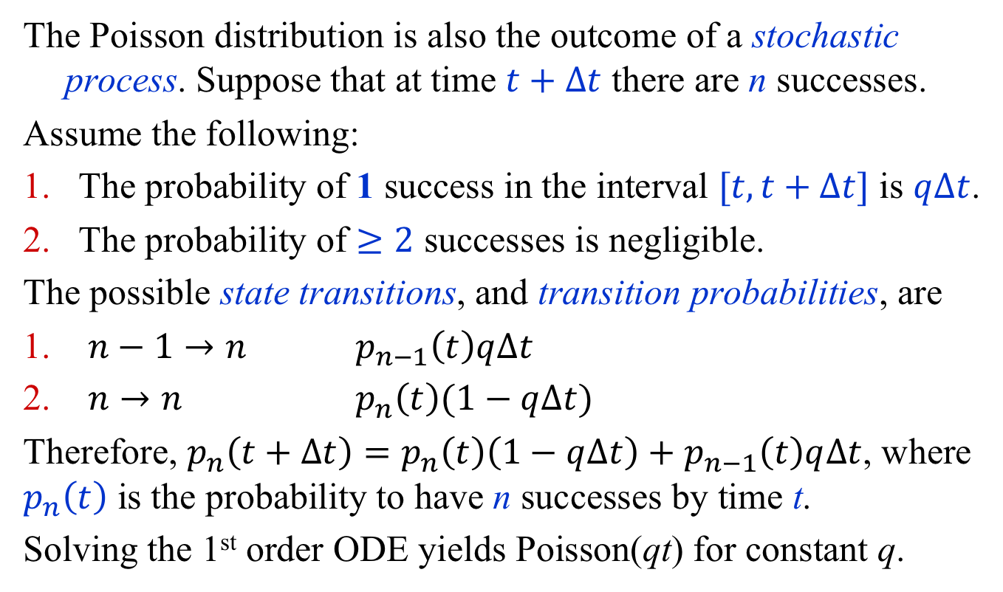
The Poisson Process
The Poisson distribution is also the outcome of a stochastic process. Suppose that at time $t+∆t$ there are n successes.
Assume the following:
The probability of 1 success in the interval $[t, t+∆t]$ is $q∆t$.
The probability of $≥2$ successes is negligible.
The possible state transitions, and transition probabilities, are
$n−1→n$ $p_{n−1}\left(t\right)q∆t$
$n→n$ $p_{n}\left(t\right)(1−q∆t)$
Therefore, $p_{n}\left(t+∆t\right)=p_{n}\left(t\right)\left(1−q∆t\right)+$ $p_{n−1}\left(t\right)q∆t$, where $p_{n}\left(t\right)$ is the probability to have n successes by time t.
Solving the 1st order ODE yields Poisson(qt) for constant q.

Slide 52

The Neyman-Pearson Test
Power curve
power vs. significance.
Note: in general, no
analysis is uniformly the
most powerful.
p
Blue is the more
powerful below
the cross-over point
and green is the
more powerful above.
$$α$$
$$α=\int_{x_{α}}^{∞}{p\left(x | H_{0}\right)dx}$$
$$p=\int_{x_{α}}^{∞}{p\left(x | H_{1}\right)dx}$$
significance of test
power of test

Slide 53
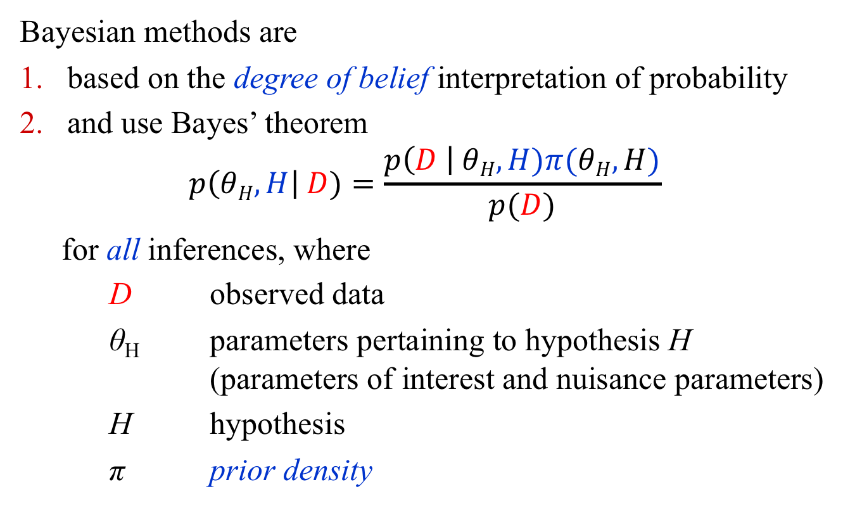
The Bayesian Approach in a Nutshell!
Bayesian methods are
based on the degree of belief interpretation of probability
and use Bayes’ theorem
$p\left(θH, H\right| D)=\frac{p\left(D \right| θH, H)π(θH,H)}{p(D)}$
  for all inferences, where
  D observed data
  θ_{H} parameters pertaining to hypothesis H (parameters of interest and nuisance parameters)
  H hypothesis
  π prior density
Nuisance parameters
are removed by
marginalization.

Slide 54

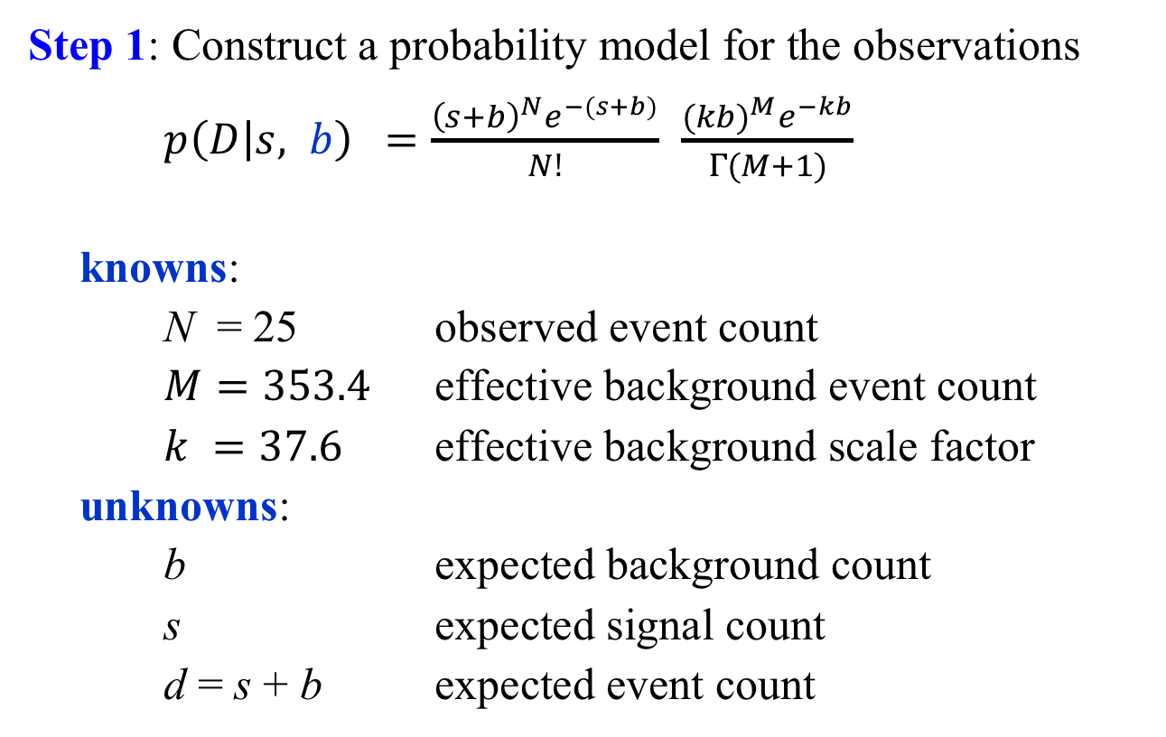
Example: Bayesian Analysis $H→4l$
Step 1: Construct a probability model for the observations
$p\left(D | s, b\right) =\frac{{\left(s+b\right)}^{N}e^{−(s+b)}}{N!}$ $\frac{{(kb)}^{M}e^{−kb}}{Γ(M+1)}$
knowns:
N = 25 observed event count
$M=353.4$ effective background event count
$k =37.6$ effective background scale factor
unknowns:
b expected background count
s expected signal count
d = s + b expected event count

Slide 55
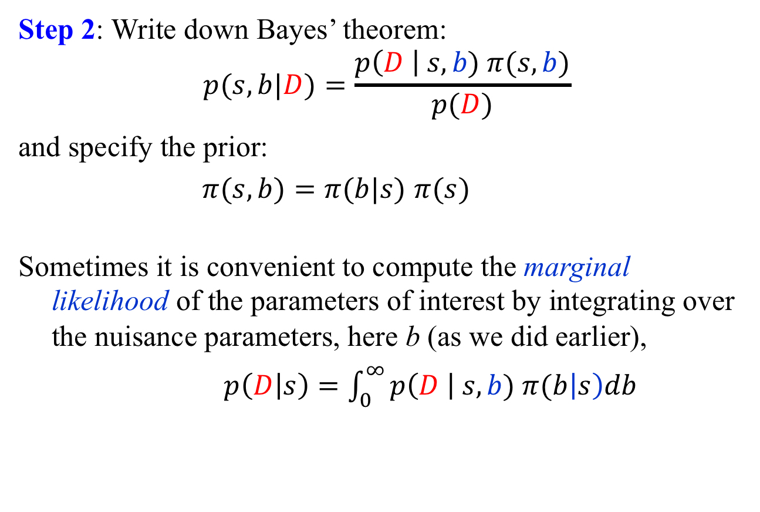
Example: Bayesian Analysis $H→4l$
Step 2: Write down Bayes’ theorem:
$$p(s, b|D)=\frac{p\left(D \right| s, b) π(s,b)}{p(D)}$$
and specify the prior:
$π(s,b)=π(b|s)$ $π(s)$
Sometimes it is convenient to compute the marginal likelihood of the parameters of interest by integrating over the nuisance parameters, here b (as we did earlier),
$p\left(D | s\right)=\int_{0}^{∞}{p\left(D \right| s, b) π(b\left|s\right)db}$

Slide 56
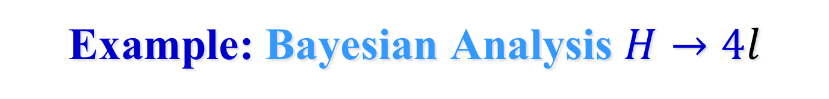
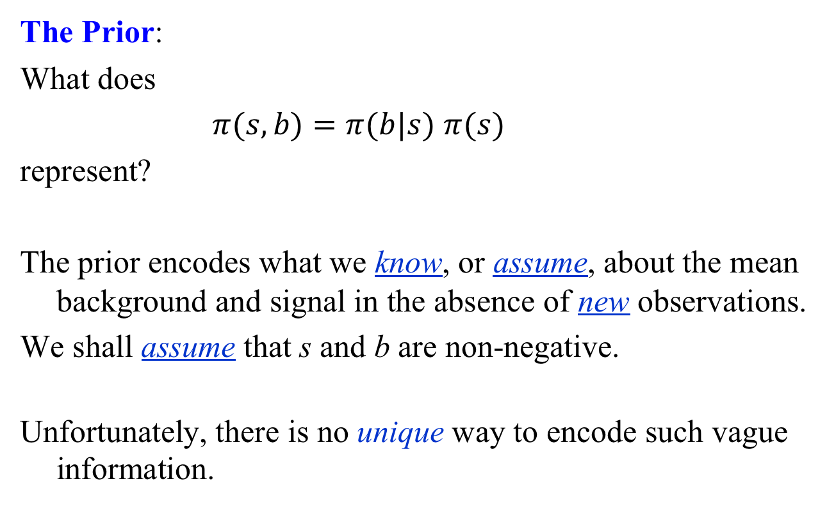
Example: Bayesian Analysis $H→4l$
The Prior:
What does
$π(s,b)=π(b|s)$ $π(s)$
represent?
The prior encodes what we know, or assume, about the mean background and signal in the absence of new observations.
We shall assume that s and b are non-negative.
Unfortunately, there is no unique way to encode such vague information.

Slide 57
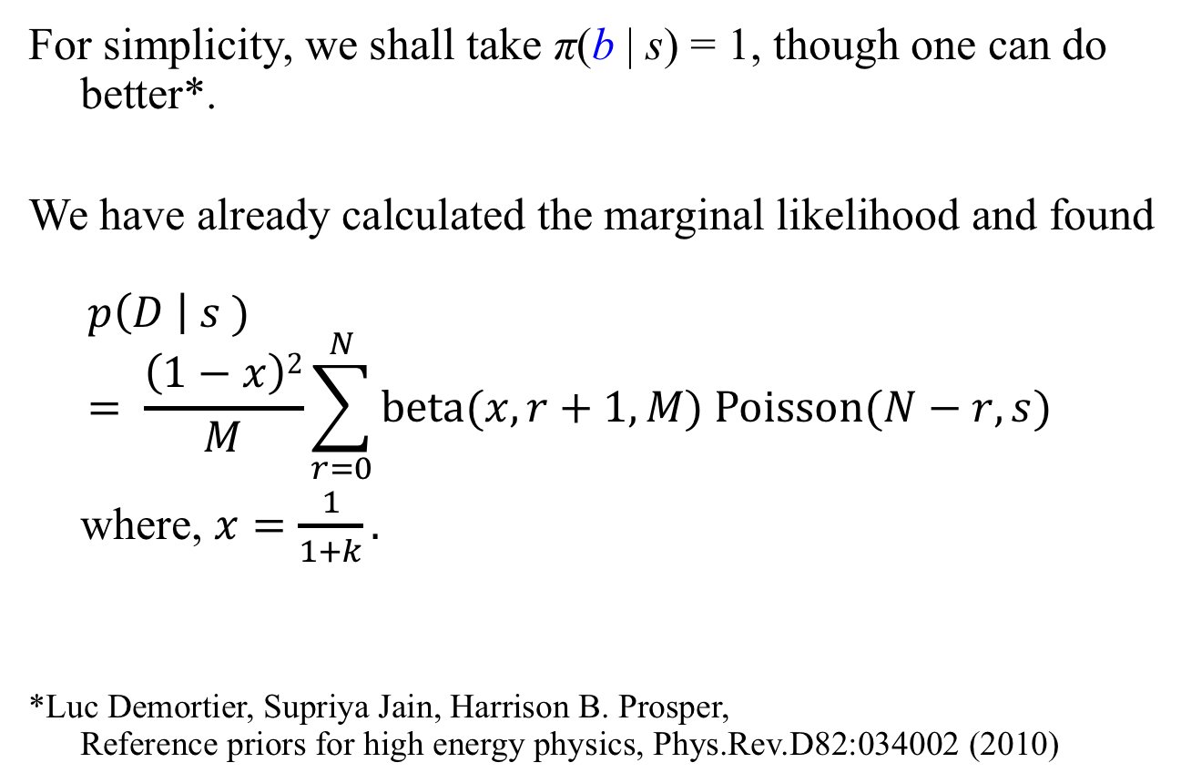
Example: Bayesian Analysis $H→4l$
For simplicity, we shall take π(b | s) = 1, though one can do better*.
We have already calculated the marginal likelihood and found
$$p\left(D \right| s )= \frac{\left(1−x\right)2}{M}\sum_{r=0}^{N}{beta(x, r+1, M) Poisson(N−r, s)}$$
where, $x=\frac{1}{1+k}.$
*Luc Demortier, Supriya Jain, Harrison B. Prosper,
Reference priors for high energy physics, Phys.Rev.D82:034002 (2010)

Slide 58
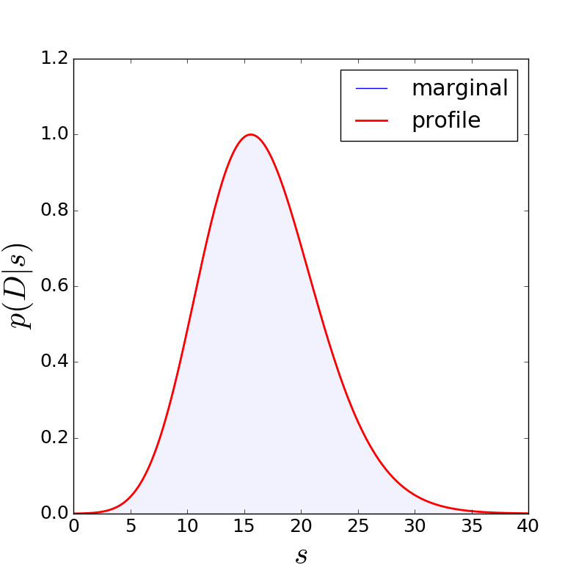
Example: Bayesian Analysis $H→4l$
L(s) = P(25 | s) is the
marginal likelihood for
the expected signal s.
Here, we compare the
marginal and profile
likelihoods. For this
problem they are almost
identical.
But, this does not always
happen!

Slide 59
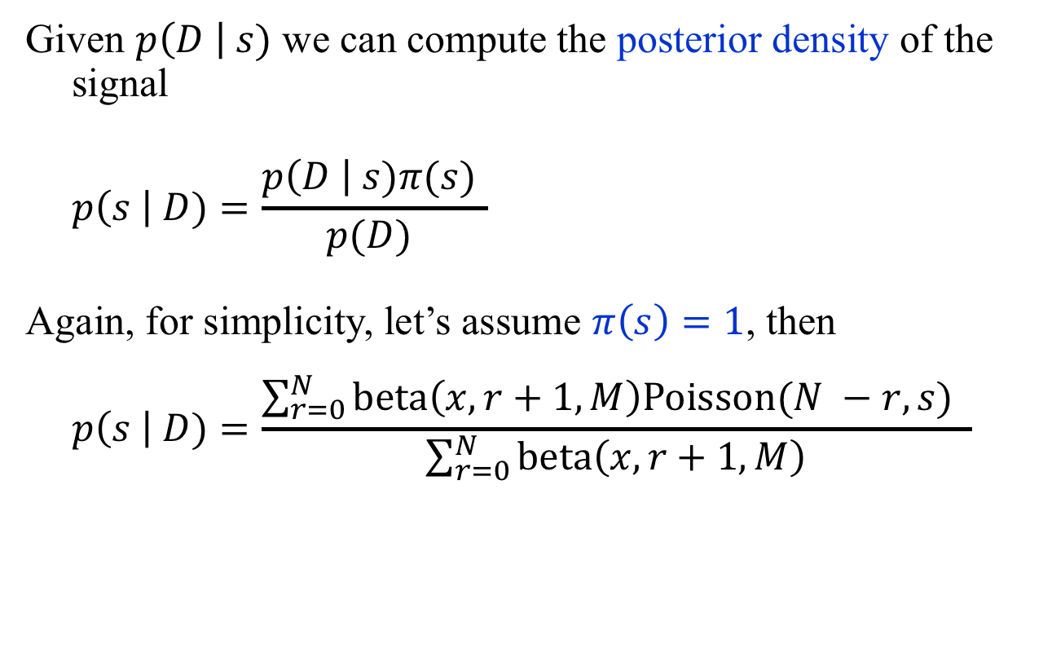
Example: Bayesian Analysis $H→4l$
Given $p\left(D \right| s)$ we can compute the posterior density of the signal
$$p\left(s \right| D)=\frac{p\left(D \right| s)π(s) }{p(D) }$$
Again, for simplicity, let’s assume $π\left(s\right)=1$, then
$$p\left(s \right| D)=\frac{\sum_{r=0}^{N}{beta\left(x, r+1, M\right)Poisson(N −r, s)} }{\sum_{r=0}^{N}{beta\left(x, r+1, M\right)}}$$
Exercise 9: Derive an expression
for p(s | D) assuming a gamma
prior Gamma(qs, U + 1) for π(s)

Slide 60

Example: Bayesian Analysis $H→4l$
Computing Central Credible Intervals
Solve
$$\int_{0}^{l(N)}{p\left(s \right|D) ds=(1−CL)/2}$$
$$\int_{0}^{u(N)}{p\left(s \right|D) ds=(1+CL)/2}$$
with CL = 0.683, we obtain $s ∈\left[11.5, 21.7\right] \text{at}\text{ 68\% }\text{CL}$.
Since this is a Bayesian calculation, this statement means:
the probability that s lies in [11.5, 21.7] is 0.68.

Slide 61

Example: Bayesian Analysis $H→4l$

Slide 62

Example: Bayesian Analysis $H→4l$
Finally, we can test different hypotheses $H$about the signal s by marginalizing over the parameters of each hypothesis. In our case, the parameters are $θ_{H_{0}}=b$ and $θ_{H_{1}}=b, s$ for hypotheses H₀ and H₁, respectively.
Since we have already marginalized over b, we just need to compute
$$p\left(D \right|H1)=\int_{0}^{∞}{p\left(D | s,H1 \right)π\left(s|H1\right)ds}$$
The simplest choice for the prior is π (s | H₁) = δ(s – 15.6), which yields
$p\left(D | H_{1}\right)≡p\left(D\right| s=15.6)=7.91×{10}^{−2}$.
Note also that
$$p\left(D | H_{0}\right) ≡p\left(D\right| s=0)=1.59×{10}^{−5}$$

Slide 63

Example: Bayesian Analysis $H→4l$
From
p(D | H₁ ) = $7.91×{10}^{−2}$ and
p(D | H₀ ) = $1.59×{10}^{−5}$
we conclude that the results increase the probability of hypothesis H₁ relative to H₀ by ~5000.
The increased odds can be converted to a Z-value (S. Sekmen, HBP) roughly equivalent to the frequentist measure using
$$Z=sign(\ln{B_{10})\sqrt{2\left\lceil \ln{B_{10}}\right\rceil }}$$
This yields Z = 4.13.
Exercise 10: Verify this number

Slide 64

Generalization to Multiple Bins
The generalization to so-called “shape” analyses, that is, to multiple bins introduces no new concepts.
Here is a model for M independent bins, each with N sources:
Mean count in i^{th} bin: $d_{i}=\sum_{j=1}^{N}{p_{j}a_{ji}}$, where each bin contains N sources with mean counts $a_{ji}$. The $p_{j}$ are parameters such as the signal strength $μ$.
Likelihood for i^{th} bin: $p\left(D_{i} | d_{i}\right)=Poisson(D_{i},d_{i})$.
Likelihood for i^{th} bin of j^{th} source:
$p\left(A_{ji} | {r_{ji}a}_{ji}\right)=Poisson\left(A_{ji},{r_{ji}a}_{ji}\right),$ where $r_{ji}$are known scale factors.

Slide 65

Generalization to Multiple Bins
The overall probability model is
$$p\left(D | a\right)=\prod_{i=1}^{M}{p\left(D_{i} | d_{i}\right)\prod_{j=1}^{N}{p\left(A_{ji} | {r_{ji}a}_{ji}\right)}}$$
which can be marginalized with respect to $a_{ji}$ exactly*:
$p\left(D | p_{j},r_{ji}\right)=\prod_{i=1}^{M}{\sum_{k_{1}…,k_{N}=0}^{D_{i}}{\prod_{j=1}^{N}{\left({A_{ji}+k_{j} \atop k_{j}}\right)\frac{{p_{j}}^{k_{j}}{r_{ji}}^{{A_{ji}+k}_{j}}}{{\left(p_{j} +{ r}_{ji}\right)}^{k_{j}}}}}}$
with $k_{1}+…+k_{N}=D_{i}.$
If the scale factors $r_{ji}$ are not known precisely, the above can be extended to incorporate the appropriate uncertainties.
*Former FSU undergraduate Robert Orlando.

