Slide 1
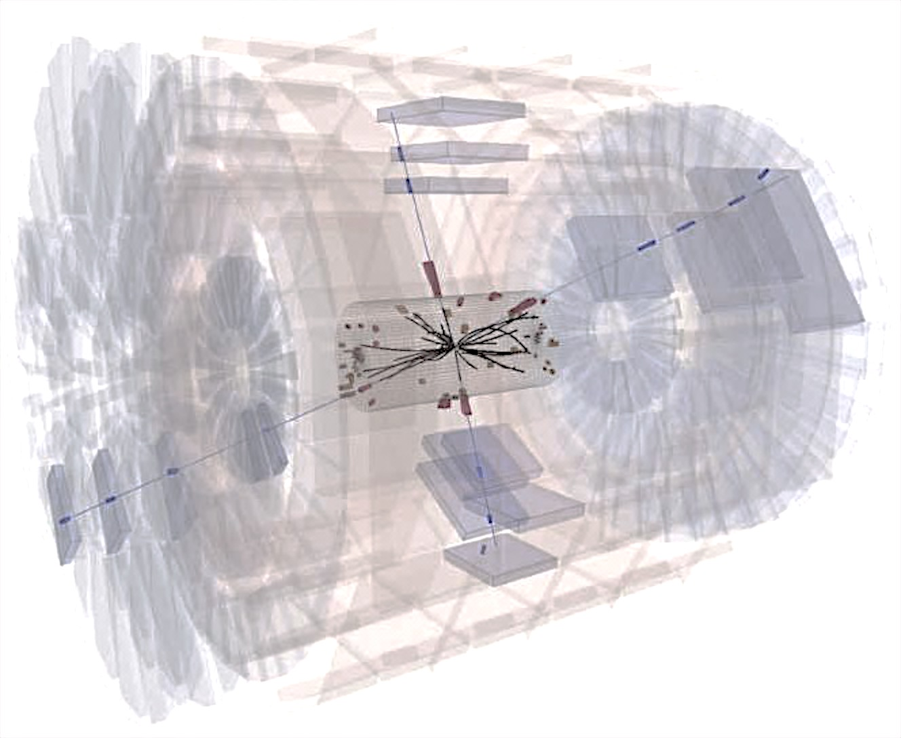
Muon Phase2 Upgrade
The upgrade of the CMS Muon Spectrometer for HL-LHC
Anna Colaleo - INFN-Bari
7th ENHEP School on High Energy Physics
26-31 January 2019
Ain Shams University

Slide 2
CMS Upgrade towards HL-LHC
PU ~200
Goal: keep the same performance as in Phase-1
LHC Phase-1
LS2: Upgrade injection to increase beam brightness
HL-LHC Phase-2
LS3: Upgrade int. Region to increase beam overplap
CMS Upgrades
New tracker (4 pixel layers +3 disks)
New trigger/DAQ:
  Track information at L1 with extended trigger latency (from 3.2 total of 12.5 μs)
  Increased L1 bandwidth from 100 kHz to 750 kHz
Calorimeters with higher granularity
Upgrade of Muon system
|η| < 3

Slide 3
Phase-2 Muon Upgrade overview
Plan for operation in the future decades requires three elements in the Muon upgrade:
Upgrades of the existing muon detectors
  Assess longevity of current detectors/electronics to withstand at HL-LHC
  Upgrade electronics to ensure longevity, cope with trigger and readout requirements
Enhancement of the forward region 1.6<|η|<2.4:
  Additional GEM and RPC layers with new technology for improved triggering, background rejection.
Extension of coverage to the very forward region 2.0<|η|<2.8:
  new ME0 detector using GEM technology for triggering and tagging: extra coverage and reduced physics backgrounds from “lost leptons”

Slide 4
Upgrades of the existing muon detectors
  Assess longevity of current detectors/electronics to withstand at HL-LHC

Slide 5
Radiation particles at LHC
Hadronic interactions lead to activation of materials and give rise to neutron backgrounds. Long living neutrons can interact with nuclei and produce photons which further decay to electrons/positrons with some possibility to generate fake signals.
very high flux→ low detector sensitivity to the neutron and photons required
Monte Carlo estimation of the flux of all particles at CMS using FLUKA. Inelastic collision cross section used for normalization is 80 mb. Used simulation cut offs: Hadrons 1 keV, Muons 1 keV, Neutrons 0.01 meV, Photons 3 keV, Electrons 30 keV. Photons and Electrons have significantly higher cut-offs in some regions (heavy parts). The plot shows the particle flux in the whole CMS cavern for nominal instantaneous luminosity, (L = 10³⁴ cm⁻² s⁻¹) .

Slide 6
Radiation particles at LHC
Hadronic interactions lead to activation of materials and give rise to neutron backgrounds. Long living neutrons can interact with nuclei and produce photons which further decay to electrons/positrons with some possibility to generate fake signals.
very high flux→ low detector sensitivity to the neutron and photons required

Slide 7
Radiation particles
neutrons: originate as “fast”, O(100) MeV, (the end product of hadron showers) and then “thermalize” down to 0.025 eV via multiple nuclear scattering
photons: 0.1-10 MeV, from nuclear capture of thermal neutrons, followed by nuclear de-excitation
electrons/positrons: 0.1-10 MeV, from photon conversions and Compton scattering
minimum ionizing particle (MIPs): muons (prompt, π/K in-ﬂight decays ) and punch-through hadrons
neutrons
: photons
: e⁺/e–
: mips
Although absolute ﬂuxes change dramtically from place to place, the relative ﬂuxes of diﬀerent species are approximately the same (except for mips):
3 : 1 : 0.01 : 0.001-0.01
Probability (sensitivity) for diﬀerent particles to cause a “hit” is almost detector technology independent, approximately:
0.2% : 1% : 20% : 100%

Slide 8
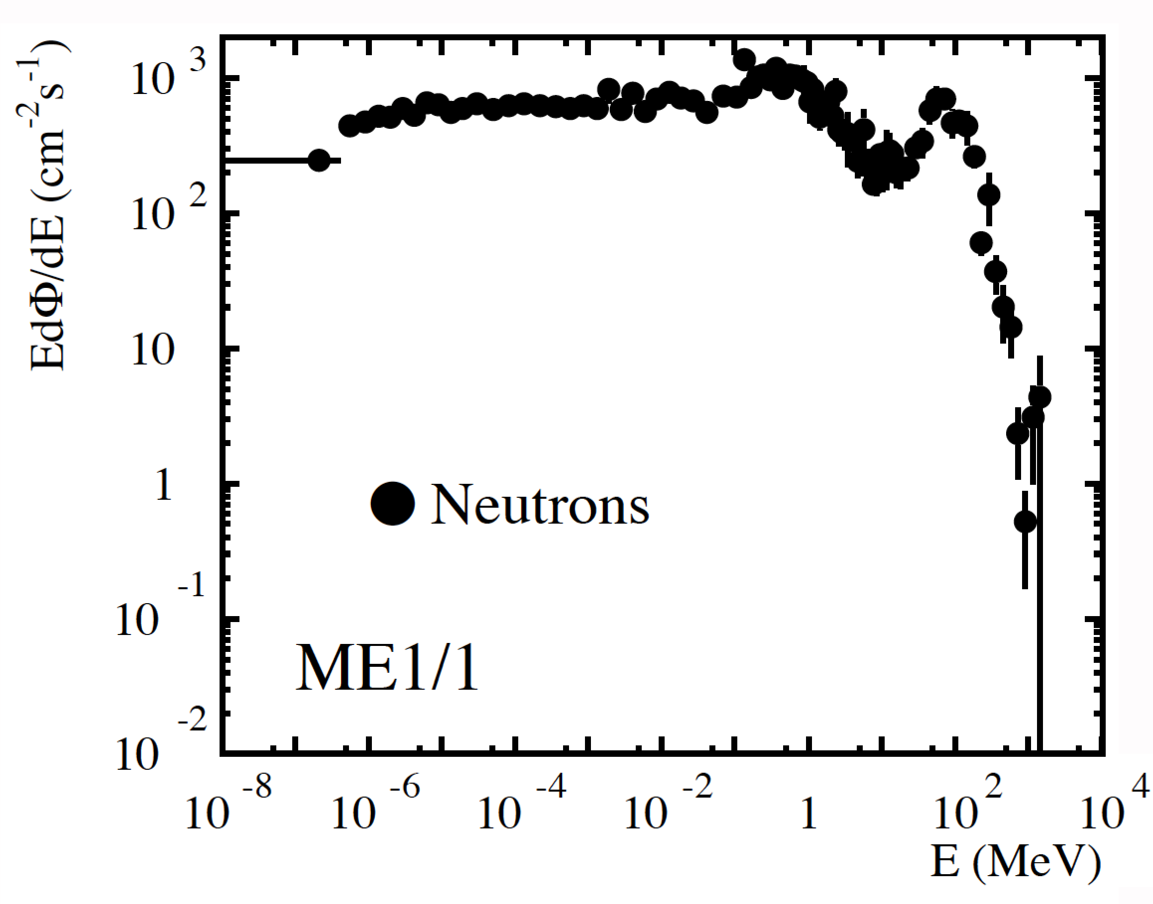
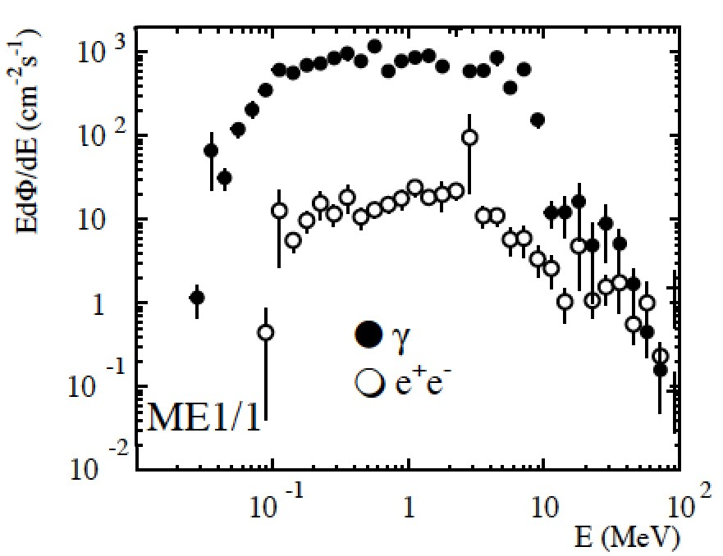
Energy spectra
Plots from Muon TDR
The shapes of the energy spectra of neutrons, photons, e⁺/e– are about the same throughout the muon system

Slide 9
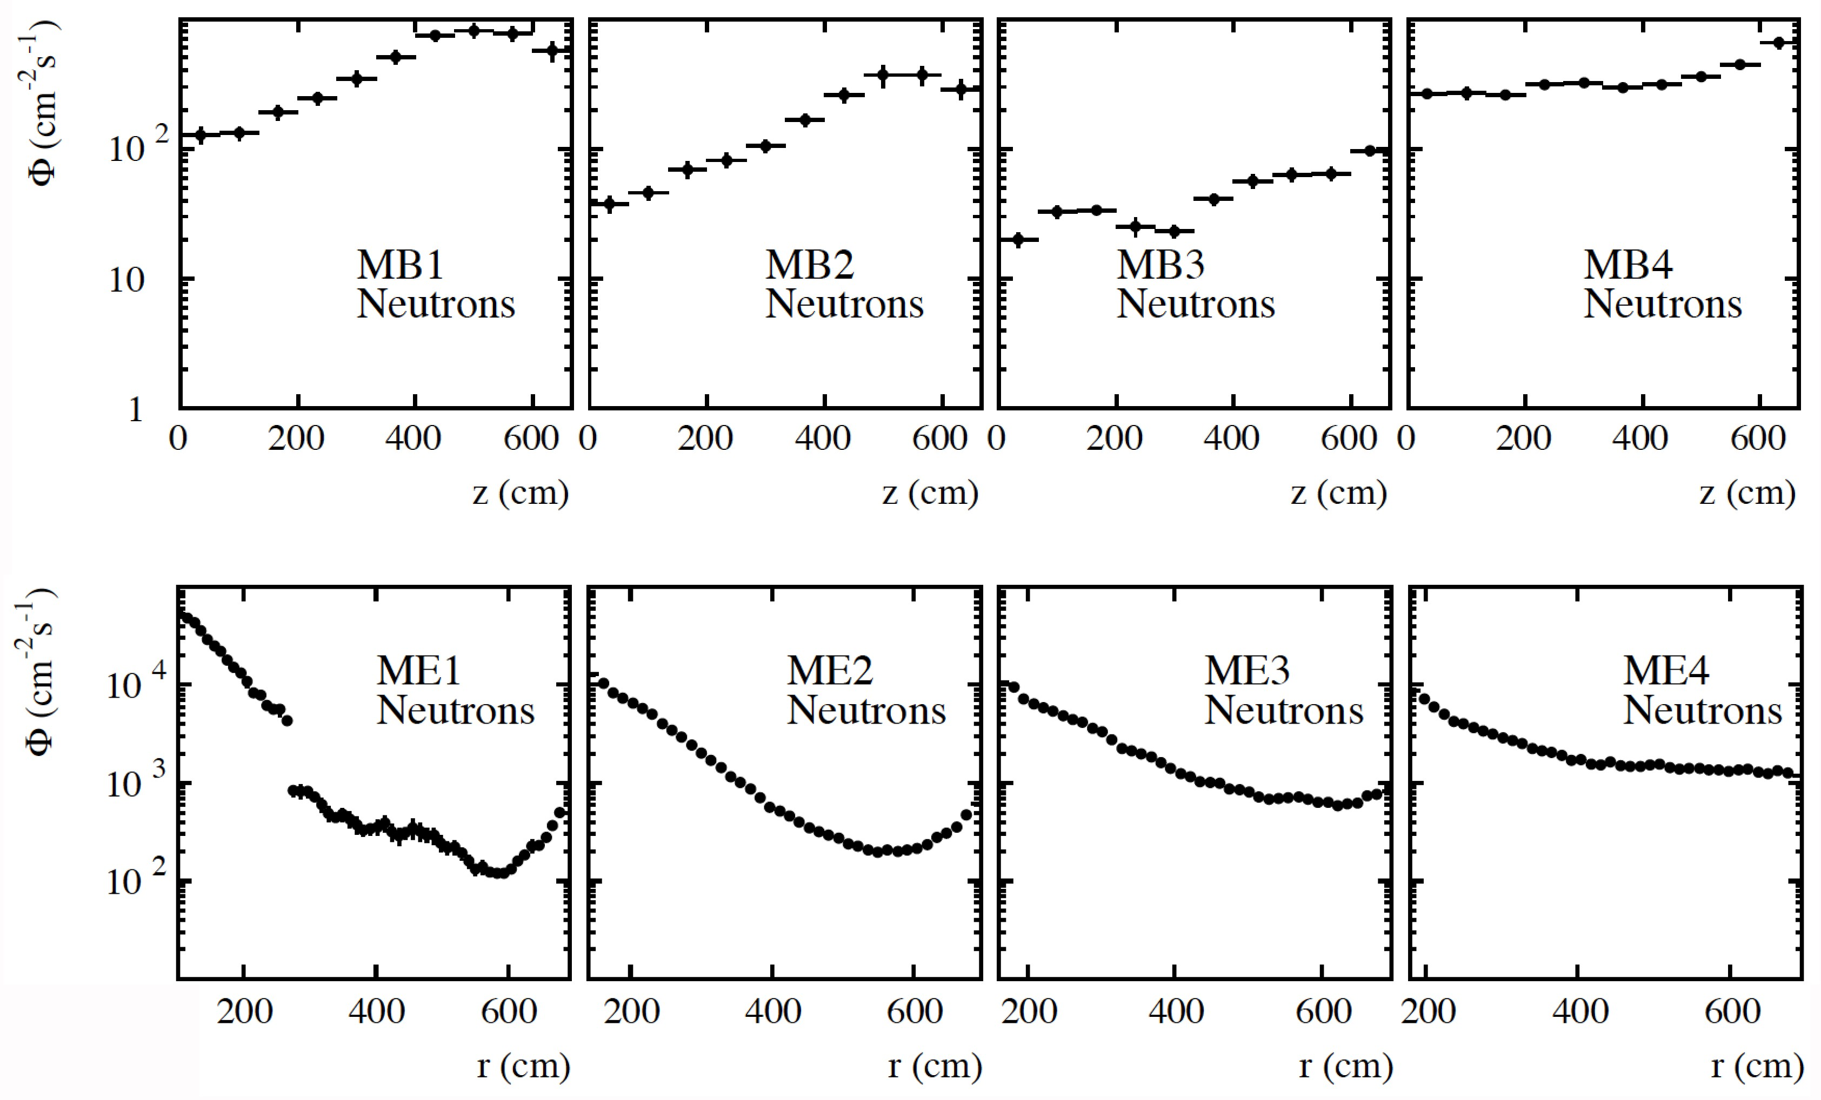
Flux: neutrons (Muon TDR)

Slide 10
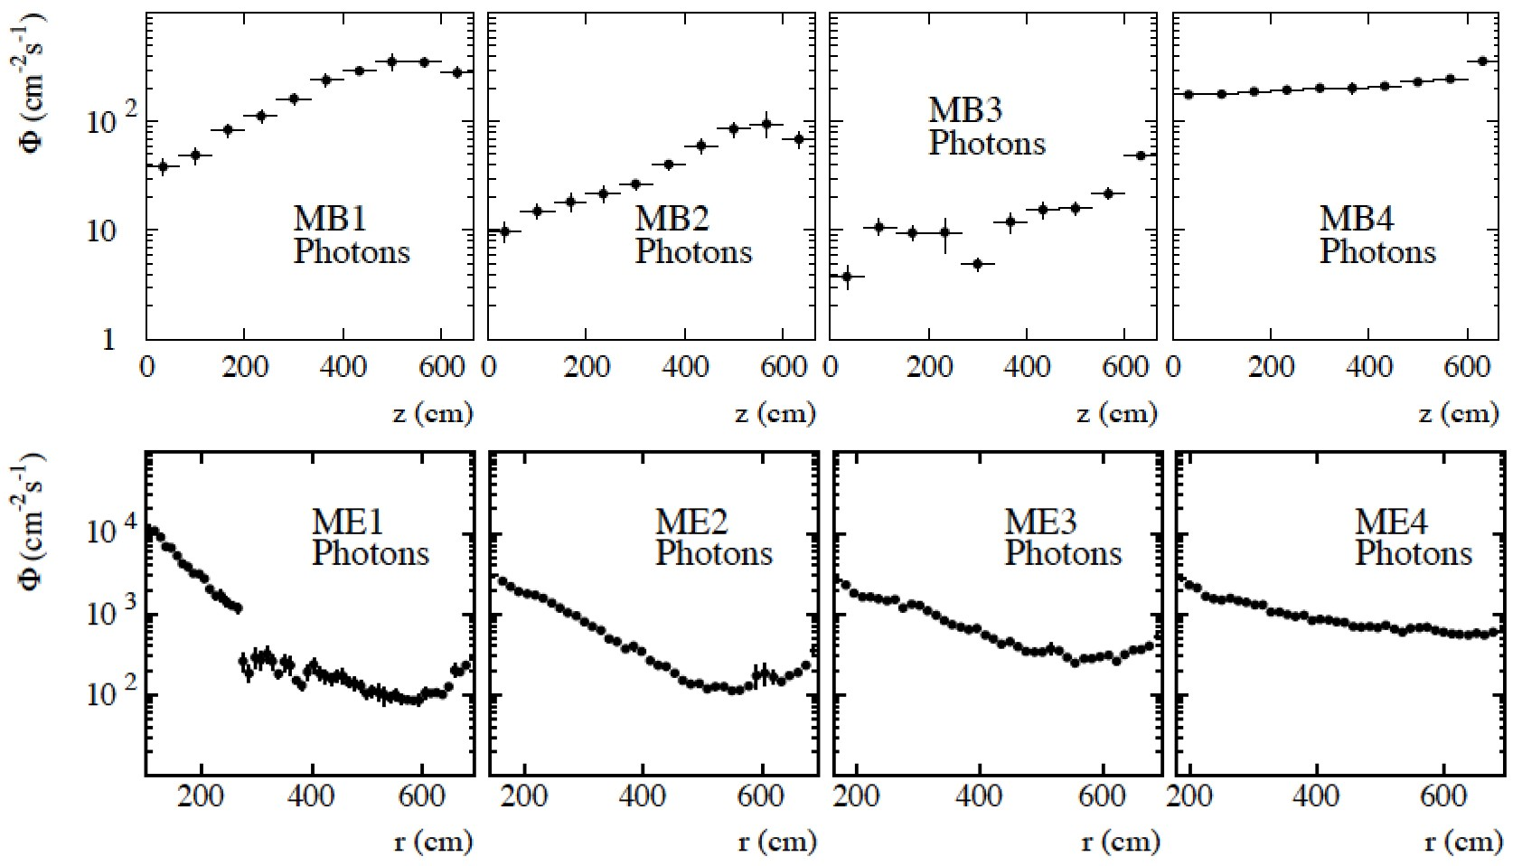
Flux: photons (Muon TDR)

Slide 11

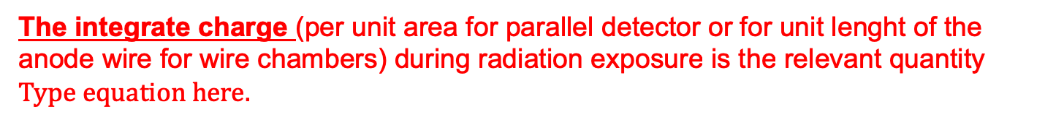
Aging and Long Term Operation
The degradation of operating conditions of wire chambers under sustained irradiation are the main limitation to the use of gas detector in high-energy physics.
‘Classical aging effects’ are deposits formed on electrode surfaces by chemical reactions in avalanche plasma near the anode.
During gas avalanches many molecules break up and form free radicals (unionized atomic or molecular particles with one or more unsatisfied valence bonds).
Free-radical polymerization is regarded at the dominating mechanism of wire chamber aging
The integrate charge (per unit area for parallel detector or for unit lenght of the anode wire for wire chambers) during radiation exposure is the relevant quantity

Slide 12
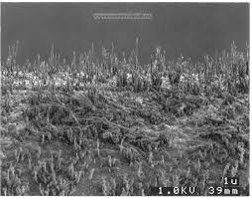
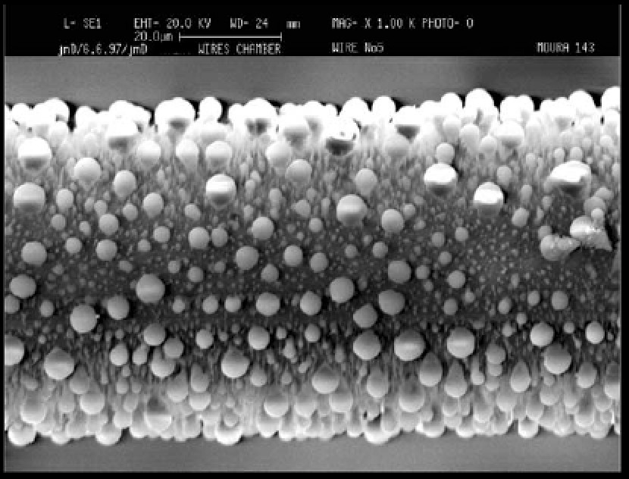
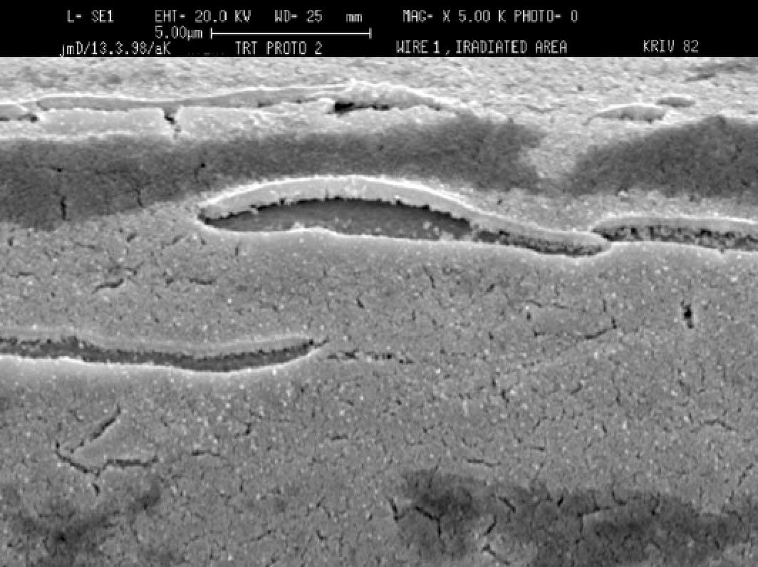
Aging and Long Term Operation: wires
• polymerization
– wires get eﬀectively thicker:
• smaller non-uniform gas gain
• loss of eﬃciency
– long whiskers:
• can cause spurious pulses
• and eventual HV breakdown
• oxidation under gold coating:
– wires swell:
• smaller non-uniform gas gain
• loss of eﬃciency
– gold coating cracks:
• sharp edges can cause spurious pulses
• and eventual HV breakdown

Slide 13
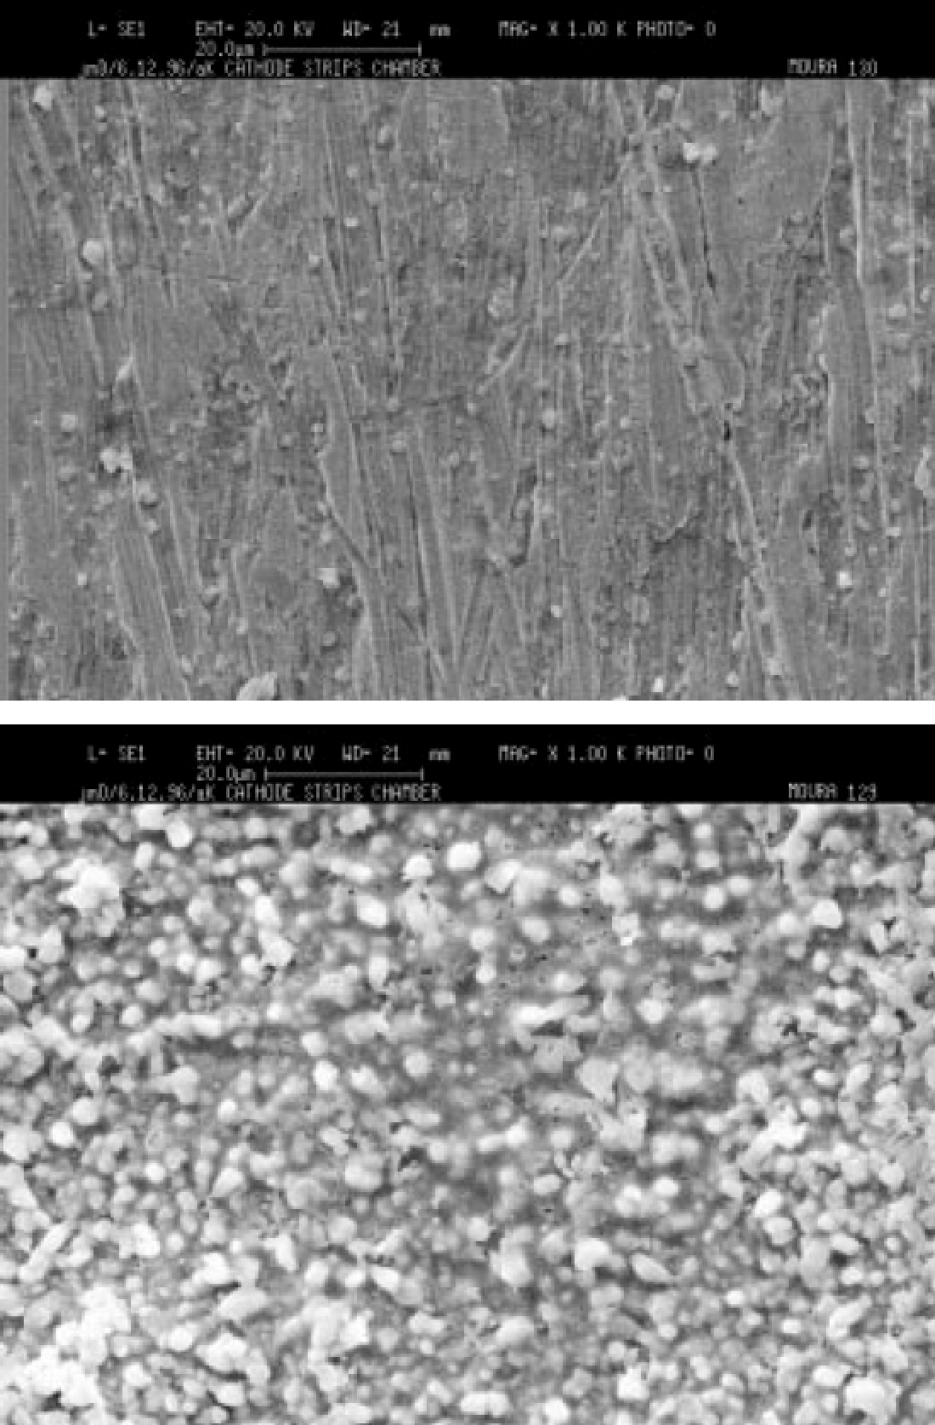
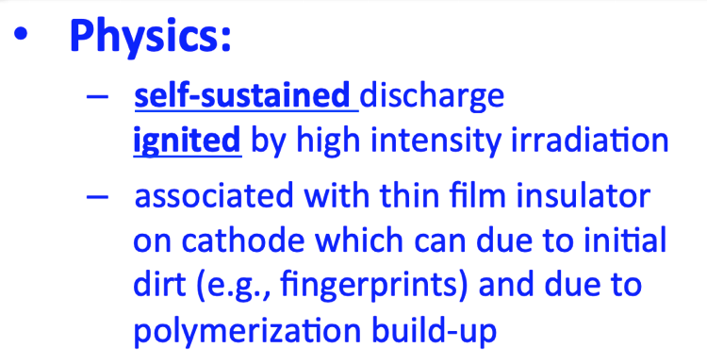
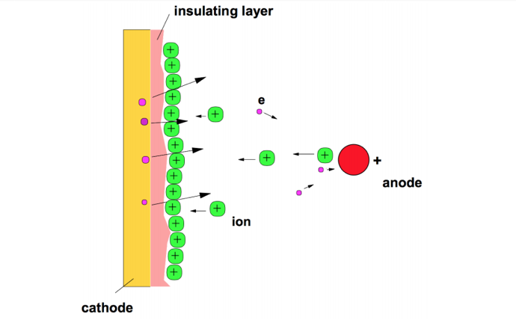
Aging and Long Term Operation: surface
– increased conductivity:
• leak currents
• loss of the proper electric ﬁeld conﬁguration
• Polymerization on surfaces:
initial (clean)
– decreased conductivity; insulating blemishes can charge up and cause:
• erratic changes of the proper electric ﬁeld conﬁguration (unstable operation)
self-sustained discharges (Malter currents)
after irradiation

Slide 14
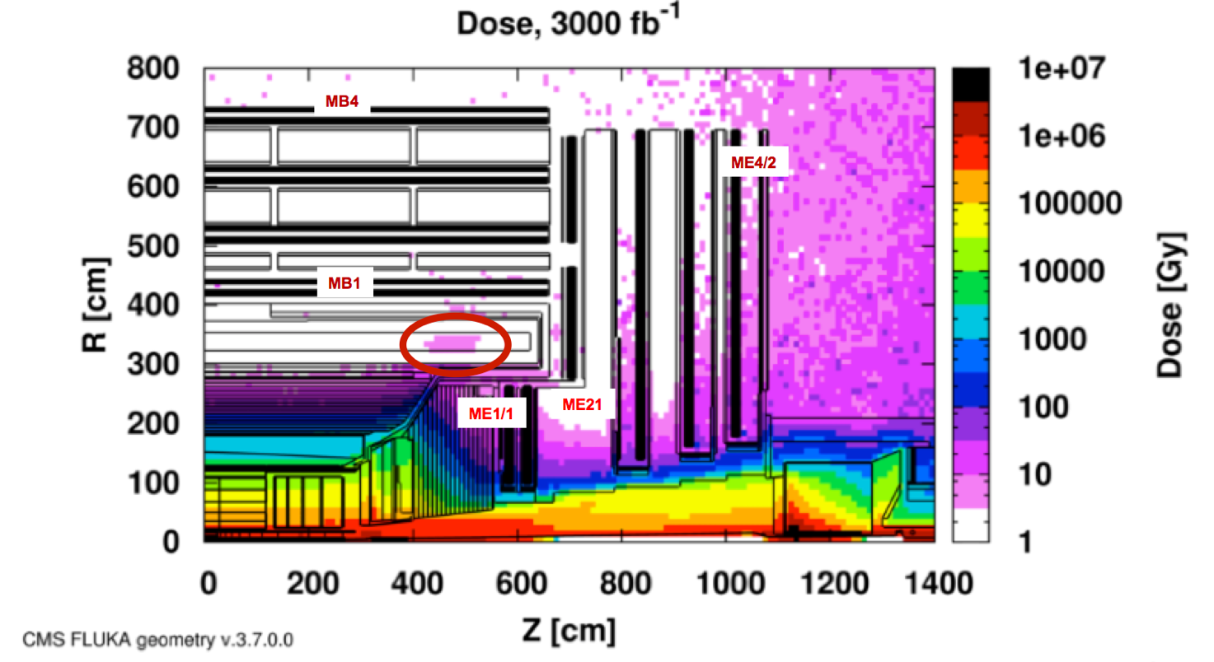
HL-LHC: Assess longevity of detectors/electronics longevity
Different Radiation Environment in different stations
Background – 5x rates and 6x total doses with respect to LHC
Exceed the design tolerances of several components of the muon system:
- new assessment of the chambers and electronics longevity and performance under accelerated aging tests.
14

Slide 15
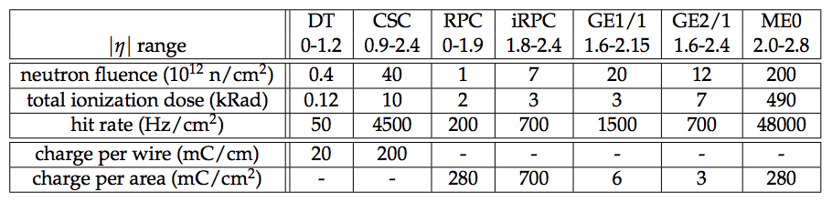
Background and longevity issues
Very harsh conditions expected at HL-LHC with integral radiation dose parameters and hit rates at the instantaneous luminosity of 5 · 10³⁴ cm⁻²s⁻¹
High radiation affects both the detectors and electronics:
can decrease the gas gain and increase hit-efficiency losses
radiation damage of the silicon substrate in electronic chips can lead to noisier electronics performance and even fatal failures of entire electronic boards.
elements of current system date even before 2000, currently 15-20 years old, eventually may need to last 40 years
must re-certify existing equipment to HL-LHC for the expected integrated radiation doses and signal and background rates.

Slide 16
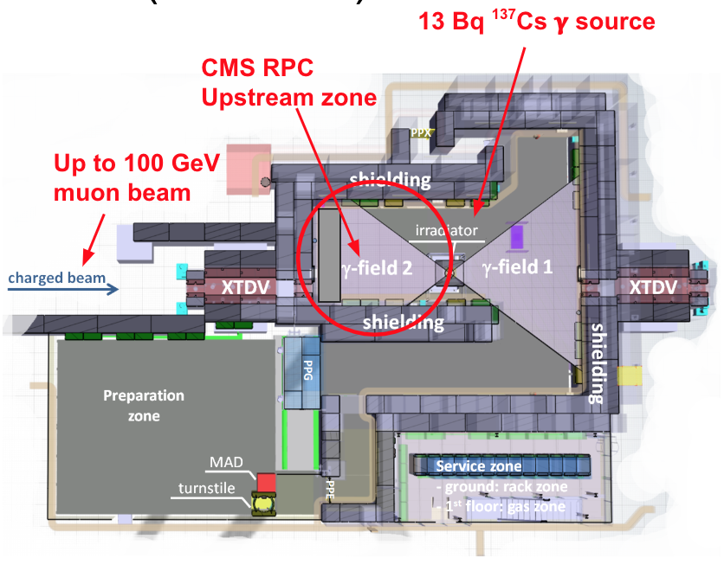
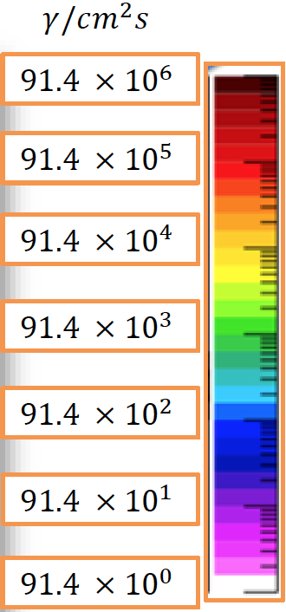
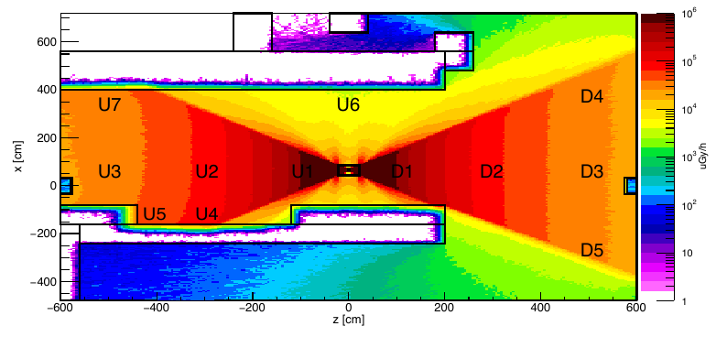


Muon longevity studies at GIF++
All detectors profit from the CERN gamma irradiation facility, GIF++: 662 keV photons emitted by an intense 14 TBq ¹³⁷Cs source + high momentum particle beam
DT
RPC
ME1/1
ME2/1
GE1/1
ME2/1
16
16

Slide 17
Muon longevity studies at GIF++
All detectors profit from the CERN gamma irradiation facility, GIF++: 662 keV photons emitted by an intense 14 TBq ¹³⁷Cs source + high momentum particle beam
CSC
Irradiate one ME1/1 (higher rate) and one ME2/1.
Monitoring of gas gain and current. Measure trigger rates at HL-LHC condition.
Monitor Malter effect.
DT
RPC
ME1/1
ME2/1
GE1/1
ME2/1
DT
Study radiation effect on the material: small Drift-tubes are installed at Gif++
Operated one spare MB1
GEM
Test GE1/1 triple-GEM chamber at HL-LHC condition
Also accelerated test with X-ray
RPC
RE2 and RE4 chambers and six spare gaps under test:
detector performance and dark current/noise will be monitored
17
17

Slide 18
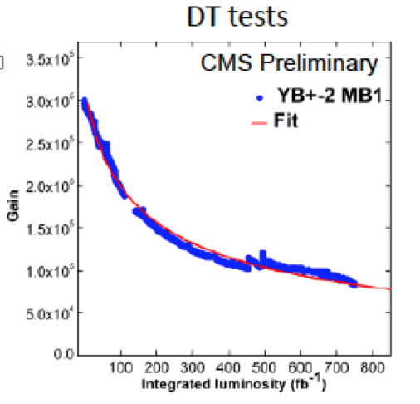
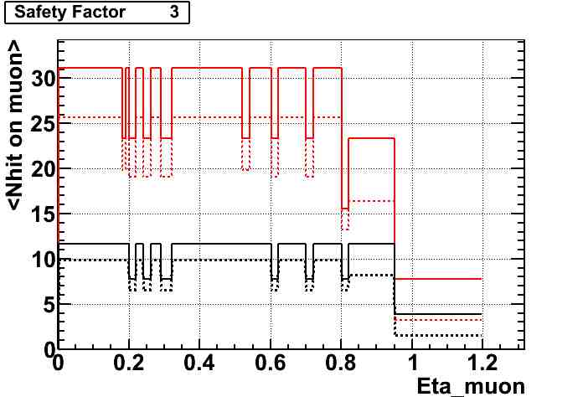
Present Detector longevity status
• DTs (Ar : CO₂)
about 15% of chambers, most exposed to background, could see noticeable gas gain loss but:
  muon reconstruction will remain high, thanks to multiple layers of DTs on the path of a muon
• CSCs (Ar : CO₂ : CF₄)
– longevity test with standard mixture completed: no gas gain loss up to 3 × HL-LHC
#DTφ hits
#DTφ hits aged
#DTθ hits
#DTθ hits aged
CSC at GIF++
• RPCs (i-C₄H₁₀ : C₂H₂F₄ : SF₆)
– no detector degradation effect so far..test continuing
GEM (Ar : CO₂ )
  – At GIF++: 30 x HL-LHC of the GE1/1 expected charge (0.6 of ME0) accumulated.
  – At B904: More than 1 C/cm² has been accumulated with X-ray test.
Operation conditions are stable no gas gain change observed
All installed Muon detectors will be kept operational at HL-LHC

Slide 19
Upgrades of the existing muon detectors
  Upgrade electronics to ensure longevity, cope with trigger and readout requirements

Slide 20
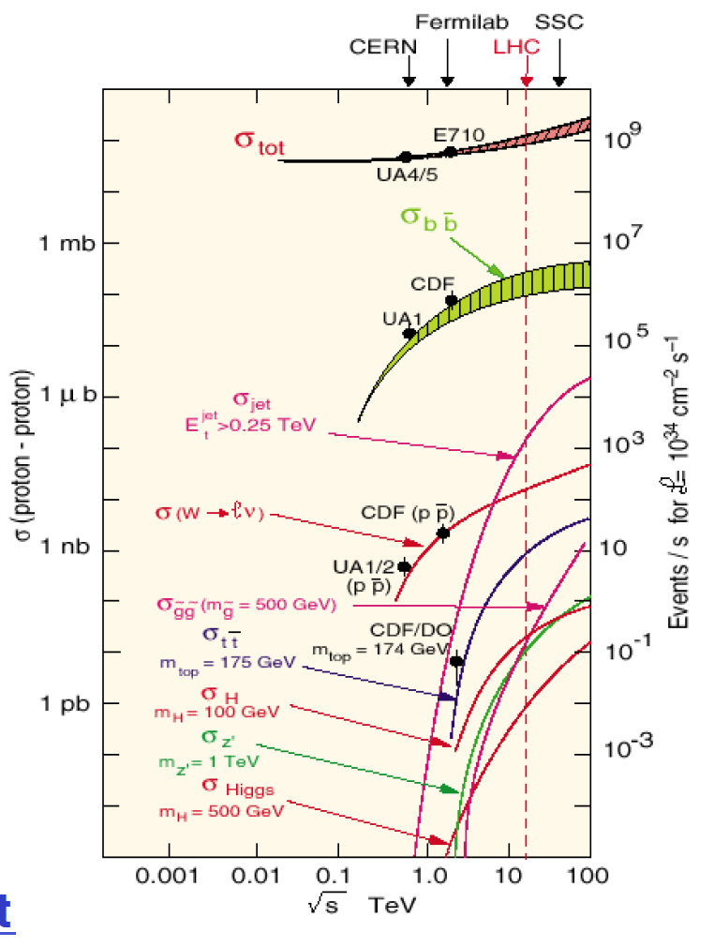
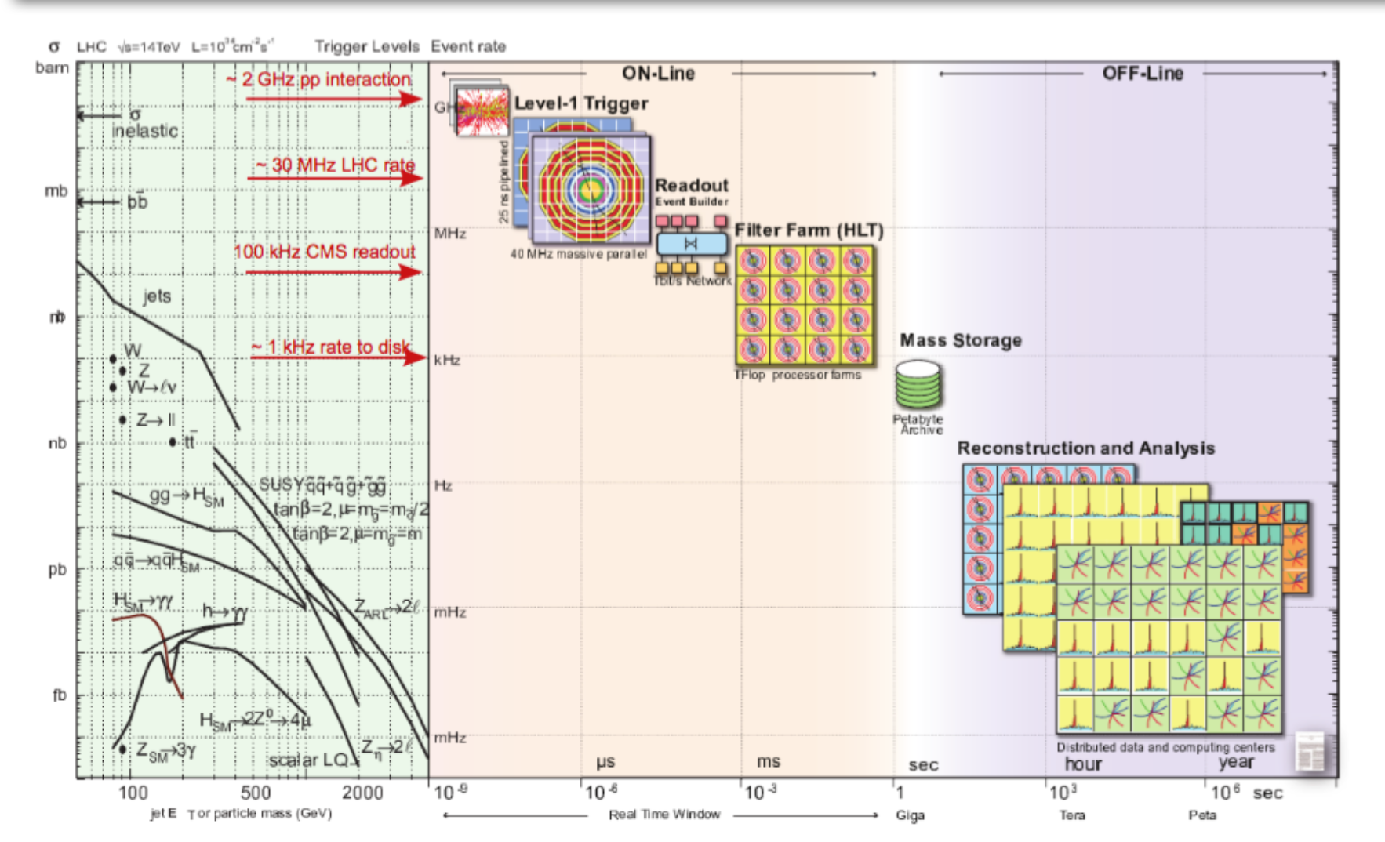
LHC cross section and trigger rates

Slide 21
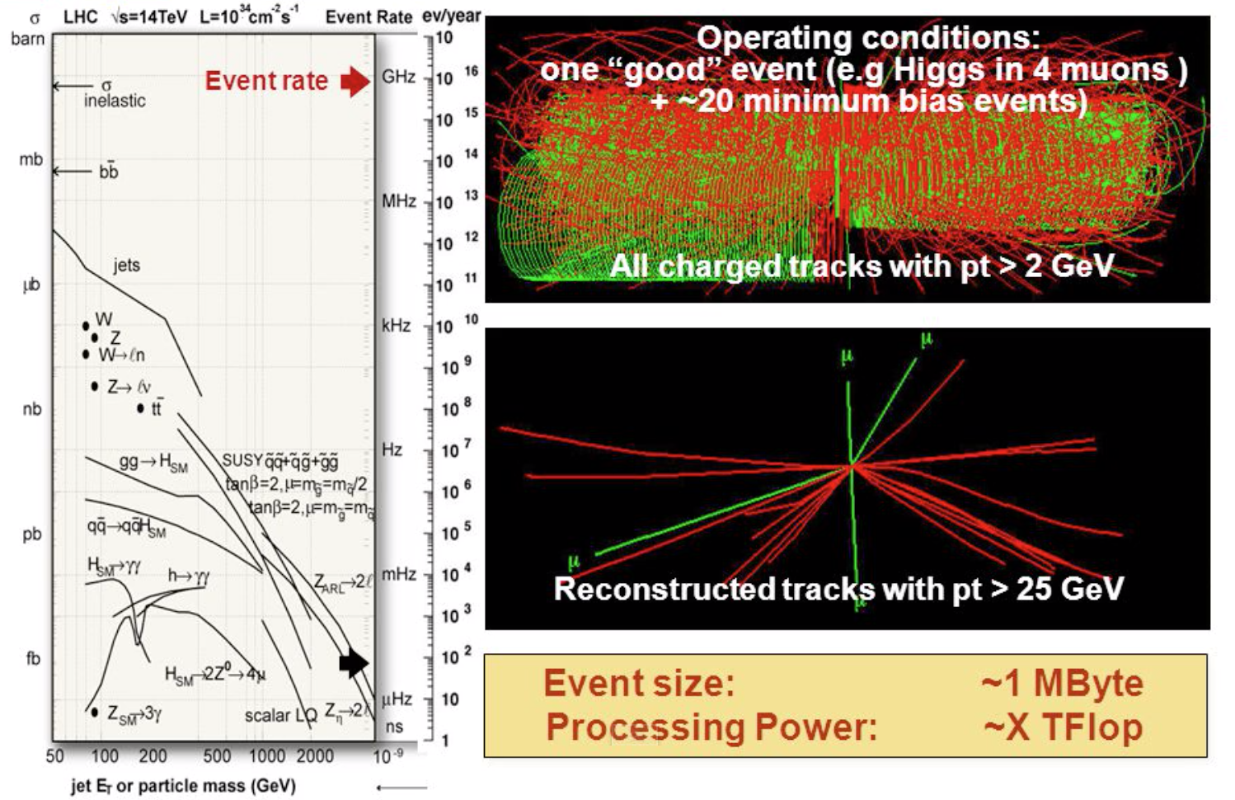
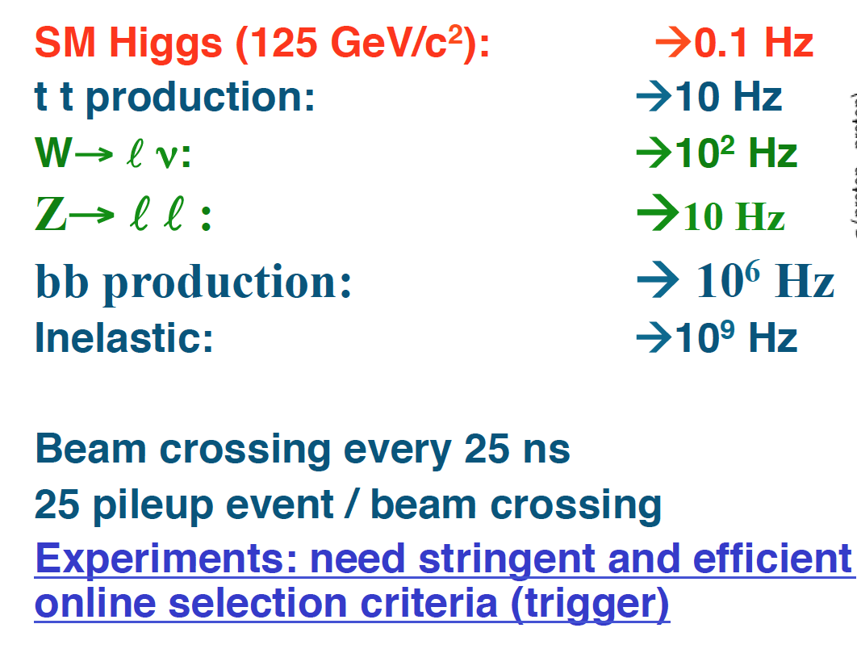
LHC cross section and trigger

Slide 22
Level 1 muon trigger
Why high-momentum leptons?
  QCD (strong interaction) provides many jets and large energy deposition, but generally not signatures of electroweak processes
  So signatures with large energy deposition face large QCD backgrounds
  Electrons, muons, taus are signatures of W, Z bosons, top quarks, higgs bosons, SUSY decays, etc., but are rare from QCD.
Muons especially:
  Excellent background reduction possible.
  Excellent momentum resolution for invariant masses etc.
Muon triggering:
  Typical W→μν muon transverse momentum <40 GeV/c. Wish to trigger above 15 or 20 GeV/c, typically.

Slide 23
Level 1 trigger
New trigger/DAQ:
  Track information at L1 with extended trigger latency (from 3.2 total of 12.5 μs)
  Increased L1 bandwidth from 100 kHz to 750 kHz
HL-LHC

Slide 24
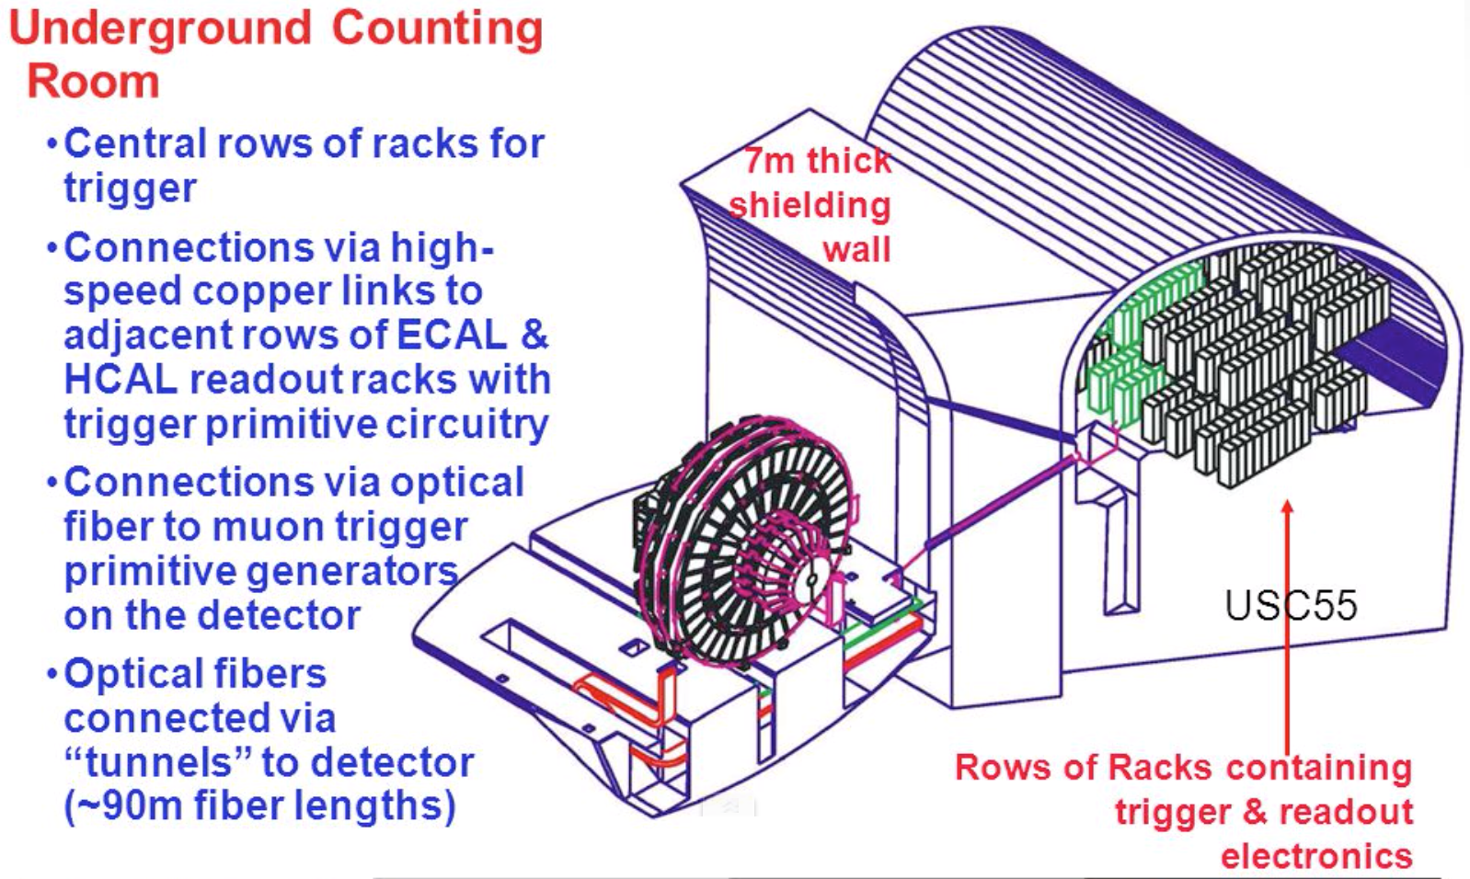
Level 1 trigger: where?

Slide 25
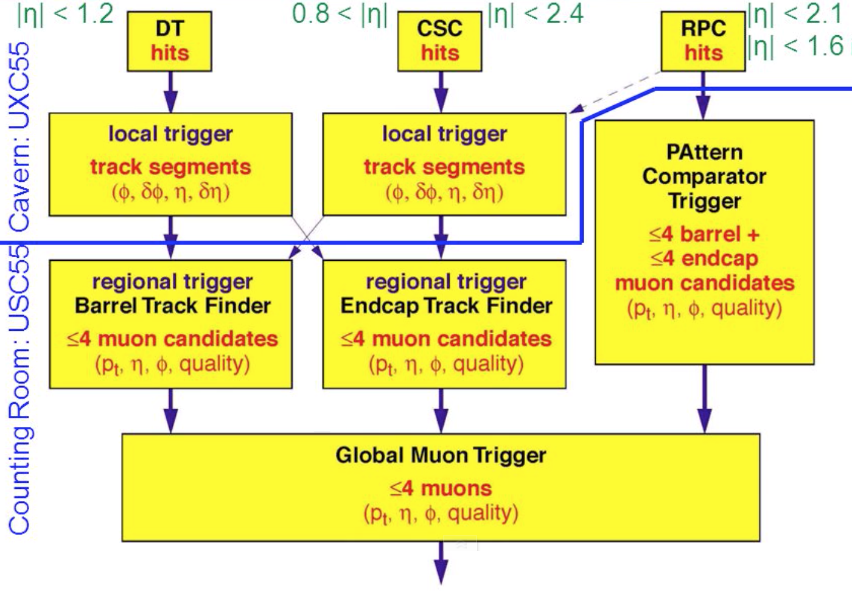
Level 1 trigger LHC

Slide 26
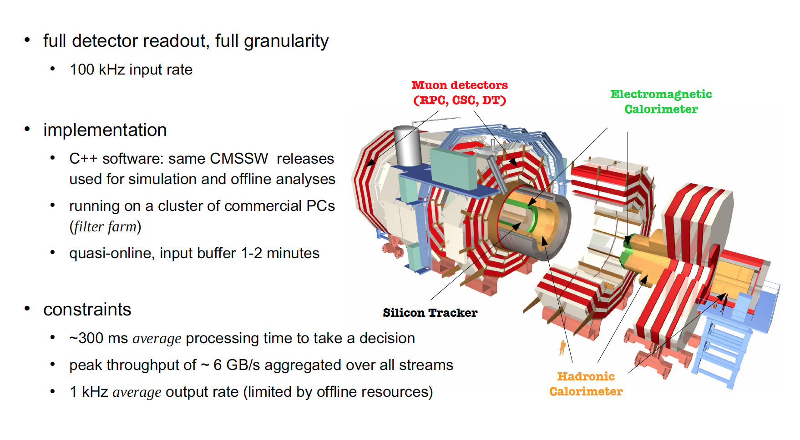
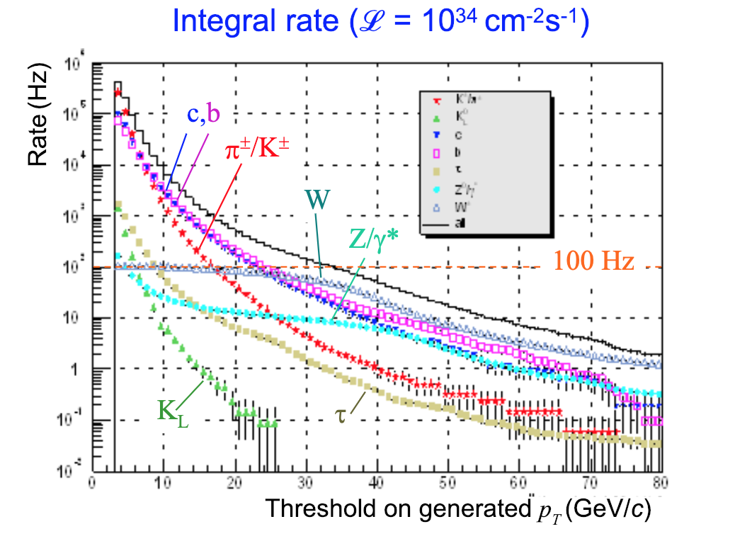
High level trigger (HLT)
1kHz

Slide 27
High level trigger (HLT)
1kHz

Slide 28
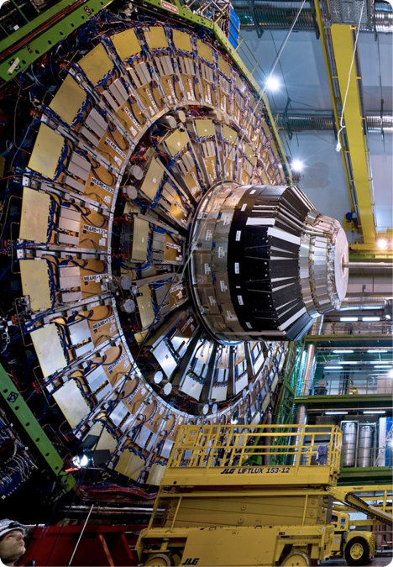
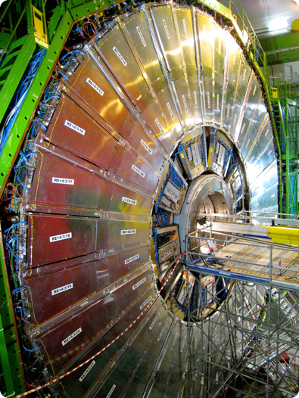
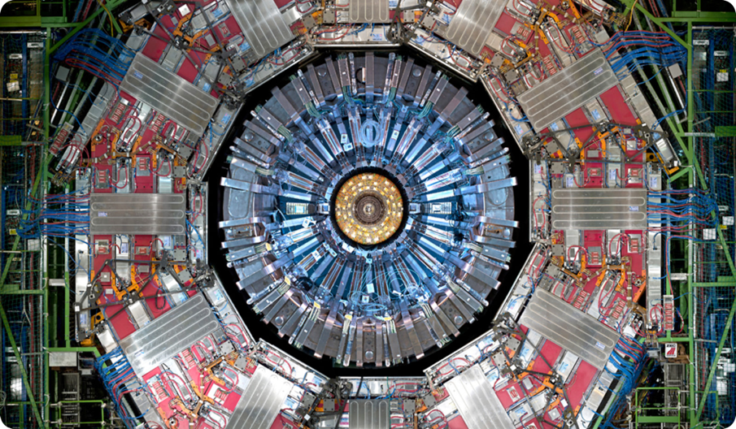
Muon Electronics Upgrade
After initial installation completed in 2009, the Muon system underwent many upgrades in order to recover the initial system descoping and to improve the functionality
+ GEM
CSC & RPC
in the endcap
DT and RPC in barrel
Phase-2 CMS Upgrade: replace on chamber electronics to cope with longevity and operational issues, high rate and latency requirements
28

Slide 29
L1T Muon Trigger Architecture upgrade evolution after LS1

Slide 30
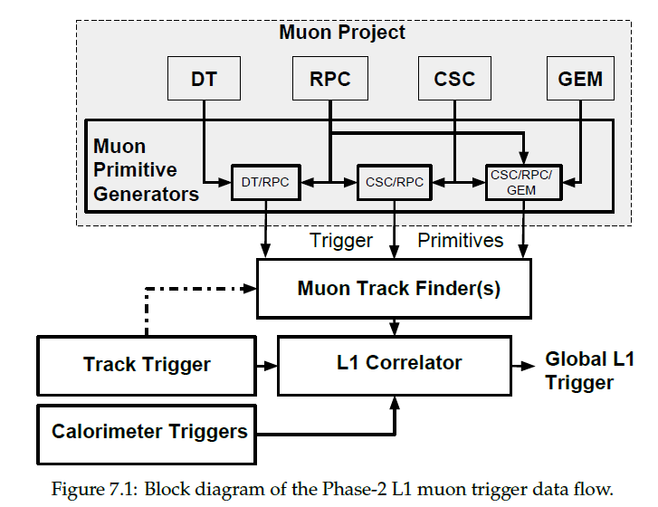
CMS: Muon L1 trigger flow at Phase2

Slide 31
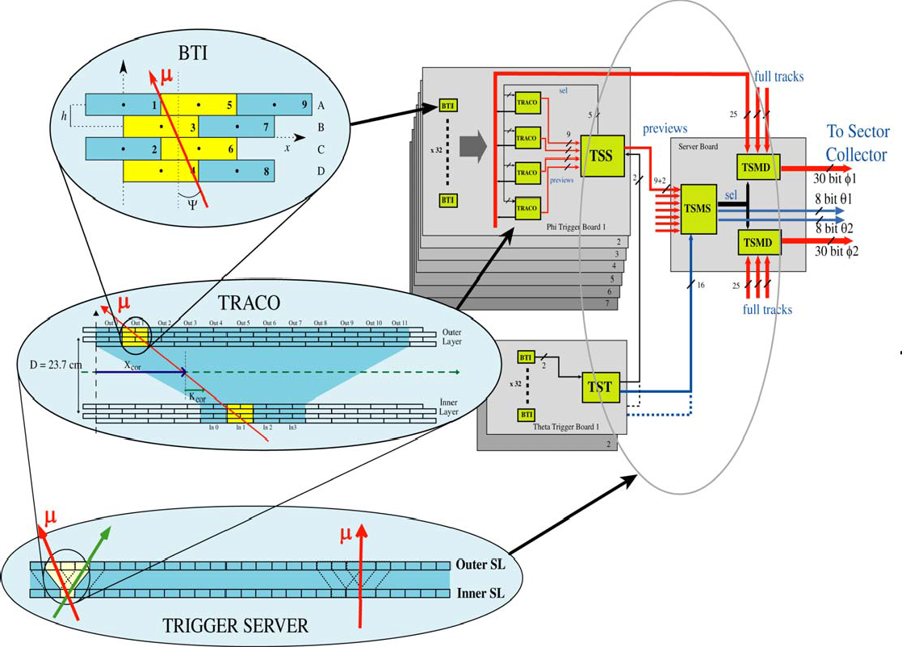

DT electronics and trigger primitives generation
Trigger boards housed in on-chamber MiniCrates for trigger primitive generation
•A single large synchronous 40 MHz digital system of 55000 ASICs
•Two best muon segments on output from each chamber:
STEP 1
Signals from wires are processed by Bunch and Track Identiﬁer (BTI): Rough track finding within a Super Layer (SL)
STEP 2
TRAck COrrelators (TRACO) Put out two best muon segments from each chamber. Correlate inner and outer superlayers
STEP 4
Sector Collector (SC), on balcony, reﬁnes the sorting per sector and performs BX alignments before sending data to the track finder
STEP 3
Trigger Server (TS) performs a quality based selection on segments coming from TRACOs

Slide 32
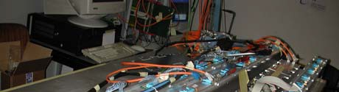
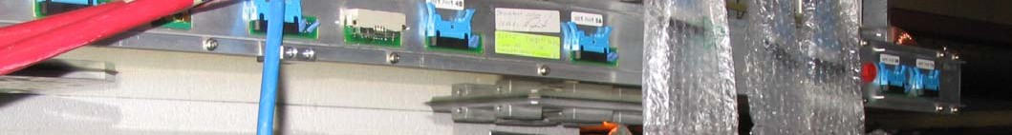
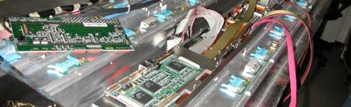
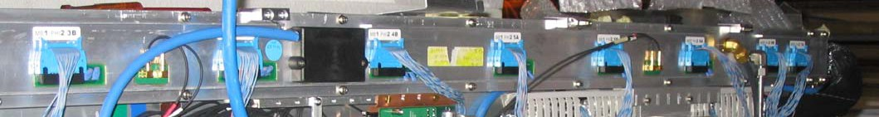

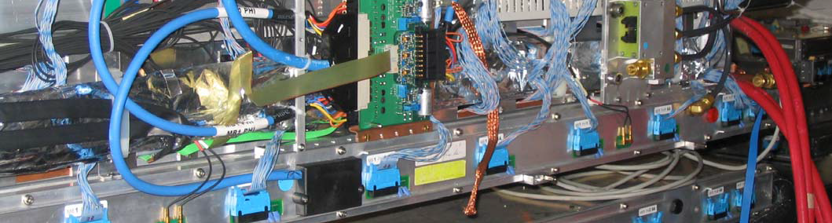
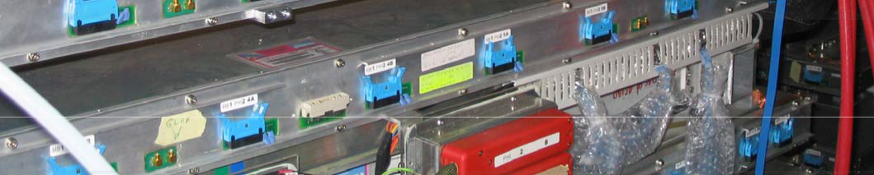
DT minicrates
BTI, TRACO, and TS trigger electronics, etc.
An average MC has ~17 boards:
6 ROB, 6 TRB, SB/CCB, LB

Slide 33

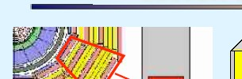

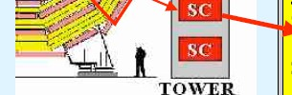




DT Sector collector and readout server crates
TTC ck,LV1A,bgo
local-LV1A (veto)
fibers to DTTF
CMS trigger stream
CMS DAQ stream
fibers to DDU
Local DAQ
Tower Near
TDC data LVDS
TTC fiber ck, LV1A, bgo
TRIG data LVDS
DCS fibers
LV 5V;3.3V
local-LV1A (veto)

Slide 34
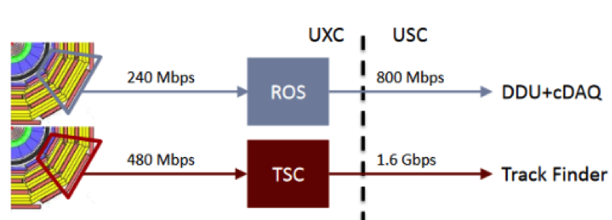
DT electronics evolution
During LS1 Trigger Sector Collector and Read Out Server crates have been relocated by simple electronics converting copper signal to optical.
CuOF does a parallel conversion from copper to optical and OFCu reconverts the signal to copper
After LS1
More powerful electronics based on μTCA has replaced the Trigger Sector Collector and the Read Out Server:
  Such electronics is needed to overcome the limitations from the increase of luminosity in terms of processing speed and trigger rates
  Optical decoupling facilitated the electronics improvement without interfering LHC schedule (optical splitting)
Now

Slide 35
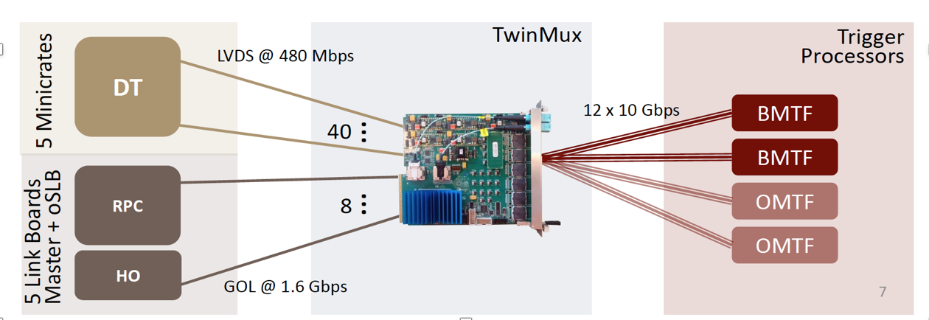
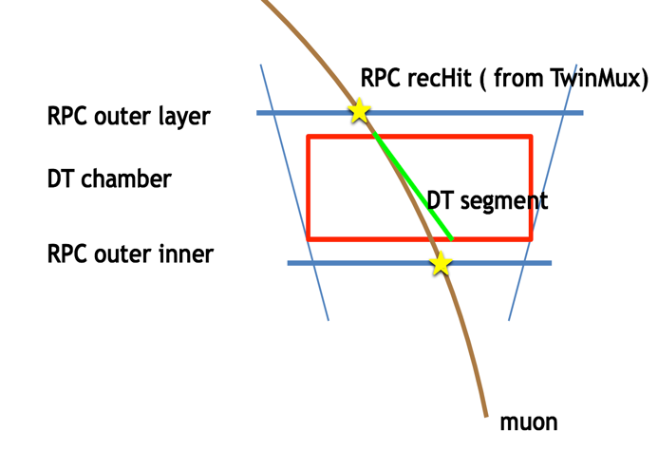
Barrel electronics upgrade after LS1
  Readout and trigger electronics moved from VME standard to uTCA standard
  Trigger (TwinMux): Build Superprimitives (SP) with DT+RPC information.
  Readout (uROS):
    Same HW as TwinMux but different firmware
    Installalled in YETS 2017-2018, operating very well in 2018.

Slide 36
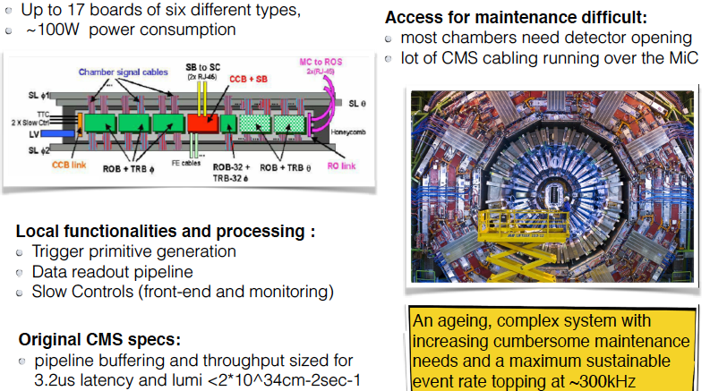
The aging of the DT electronics
In “Minicrates”, located at the ends of DT chambers

Slide 37



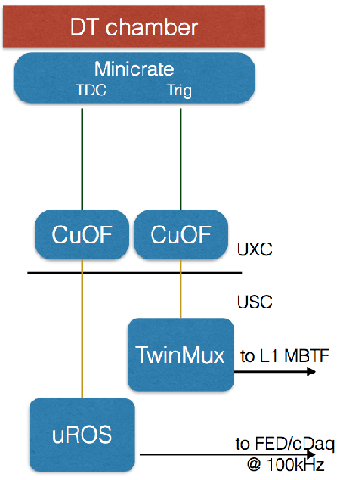
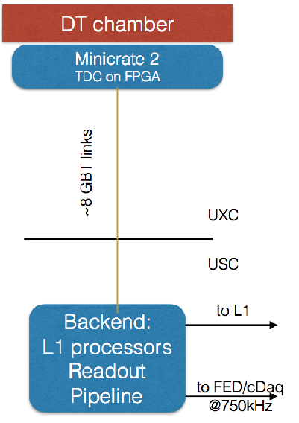
Overview of DT electronics upgrade in Phase-2
Electronics need to be upgraded
➡ Limited to L1 rate of 300 kHz
Current
Phase 2
Need at least 500 kHz for the HL-LHC
➡ Designed for TIDs corresponding to 500 fb⁻¹
➡ Buried in iron yoke → difficult maintenance
➡ Not robust against single-hit inefficiency
Due to trigger primitives generated locally
Aging of DTs could lead to significant chamber trigger inefficiency
Phase-2 electronics move complexity to USC
➡ Same analog front end
➡ New on-detector board: OBDT
➡ Trigger primitive generation in new back-end electronics in USC (underground control room

Slide 38


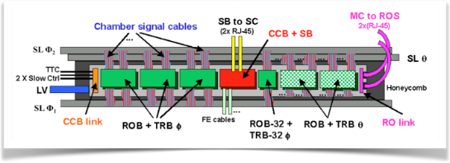
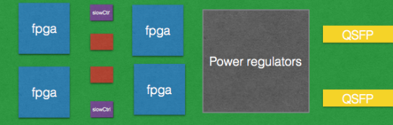

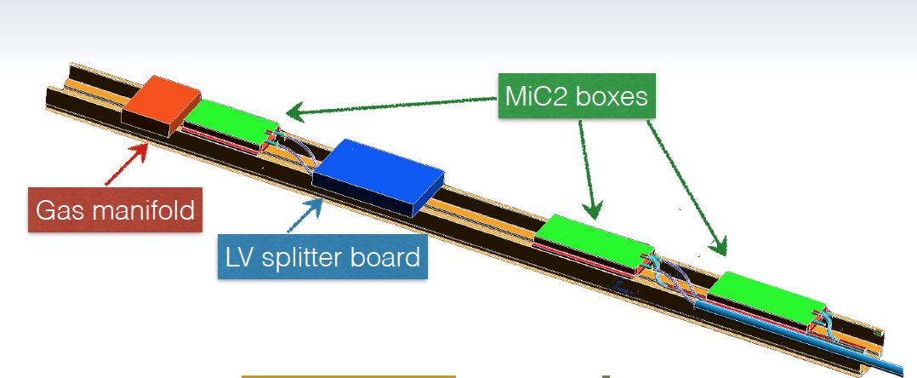
DT On detector electronics for Phase-2
DT chamber
DT chamber
Minicrate
TDC Trig
Minicrate 2
TDC on FPGA
Current
Phase 2
UXC
CuOF
CuOF
~ lpGBT links
UXC
USC
USC
1 minicrate
per chamber
TwinMux
Goals:
Reduced power consumption
enhanced reliability,
address legacy electronics longevity issues,
L1/ReadOut performance requirements
3-5 OBDTs
per chamber
to L1 MBTF
to L1
One single type of board
Backend:
FPGA
L1 processors
Readout Pipeline
New MiC2 designed over one single type of board (OBDT) that contains:
  time digitization (required resolution achievable with FPGAs)
  optical transmission (profit from CERN developments)
  reduced slow control
uROS
to FED/cDaq
@ 100kHz
RPC

Slide 39
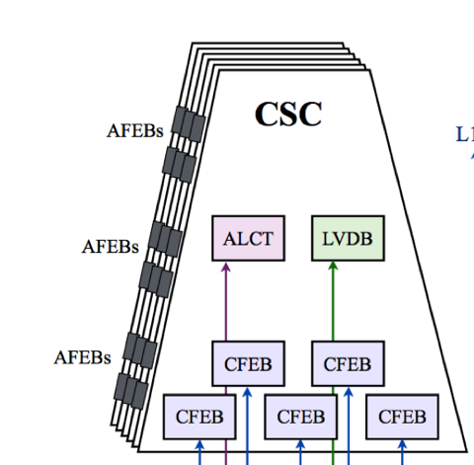



CSC electronics and trigger primitives generation
Wires spaced at 3.2mm, drift times 0-50 ns with small tail up to 75ns
6 layers of information for both anodes and cathodes
ALCT board:
FPGA looks for a pattern of hits every 25 ns
Anodes “non-bend plane”
Pattern the same for all muons from interaction point
Bunch ID
Fine delay adjustment (2.2ns steps) for times-of-flight
Time history (16 bx) recorded for each wire group
CFEB:
Serves 6 (planes) x 16 strips
Ampliﬁer ­‐shaper ( τ = 100 ns )
Precision charge information stored every 50 ns
Comparator ASIC finds half-strips hit
FPGA (programmable) finds 6-layer patterns
  Patterns are different, depending on Pt of the muon
  Pt threshold around 3 GeV/c

Slide 40


CSC Trigger Mother Board

Slide 41

CSC Upgrade in LS1: ME1/1 chamber
DCFEBs continuously digitize strip signals
➡ Signals stored in deep buffers inside powerful Virtex-6 FPGA
Trigger/readout data sent via 3.2 Gb/s links to OTMB/ODMB
ALCT mezzanine upgraded
➡Based on more powerful Spartan 6 FPGA (ALCT-LX150 (it has a Spartan-6 LX150 FPGA), capable of improved algorithms
TMB upgraded (OTMB) with much more powerful Virtex-6 PFGA
➡ Also increased bandwidth from DCFEBs with 3.2 Gb/s optical link
New DMB is capable of handling 7 DCFEBs
➡ Data received via seven 3.2 Gb/s links
➡ Powerful Virtex-6 FPGAs stores data in internal FIFOs.
Same 1.6 Gb/s output link to DDU

Slide 42

CSC Electronics Upgrade for Phase-2
On chamber Electronics:
Cathode Front End Board (CFEB) will be update with Digital CFEB in all ME234/1 chambers
DCFEBv2 very similar to DCFEB (installed in 2013-14 in ME1/1 ring)
DCFEB will be updted to xDCFEB in ME1/1 chamber:
Main difference with respect to DCFEBv1 is increased radiation hardness
Anode local charged Track (ALCTs)
designs based on ALCT mezzanine boards installed in ME1/1 and ME4/2 during LS1
New ALCT with Optical link in ME1234/1 (LX100/LX150)
Current ALCT from ME1/1 to ME1/3
Low Voltage Distributor Boards will be update to provide power to new DCFEBs and ALCTs
Off chamber Electronics:
Trigger Motherboard (TMB): replaced with Optical TMB in order to receive DCFEB trigger data; increased algorithmic power
Data Mother Boards (DMB): replaced with Optical DMBs
based on new generation Artix-7 FPGAs
new optical fibers at 6.4 Gb/s

Slide 43
RPC Link System Upgrade in Phase-2
Off-detector electronics: consists of Link and Control Boards ("Link System") and is located in crates on the balconies around CMS.
Cu-cables
Control Board
Control & diagnostic
Link Board
Link Board
Link Board
Synchronization Unit & LMUX
Optic Links
90 m @ 1.6 GHz
492 fibers
1376 Link Boards
in 108 Crates,
Steered by 216 Control Boards
Motivation for Upgrade:
Operation issues:
  the CBs are connected into ring configuration. If one CB fails then the entire ring does not work, leading to a loss of 6 % of the system.
Maintenance: Not enough spares available (rely on old ASICs)
Low speed data transmission links (1.6 Gbps)
FEB
FEB
FEB
FEB
FEB
FEB
Resistive Plate Chambers
Up to 6 layers of detectors.
480 chambers in Barrel, 648 in Endcap
Electronics will be replaced during Long Shutdown3.
43

Slide 44

RPC New Link System Design
New LB and CB
Back compatible with the present Link Boxes. Signal cables from the chambers will be not removed.
Based on Xilinx 7 FPGAs (replace ASICs)
RPC signal sampling frequency will be 640 MHz clock from the present 40 MHz clock
  Time resolution will be improved: from 25 ns to 1.6 ns. Impact on muon trigger and offline reconstruction.
  Background hits out of time could be removed and synchronization facilitated
  More robust
  Higher bandwidth (10 Gbps output, lpGBT and VL+)
44

Slide 45
2. Enhancement of the forward region 1.6<|η|<2.4:
  Additional GEM and RPC layers with new technology for improved triggering, background rejection.

Slide 46

HL-LHC: Muon requirements in endcap region
Very challenging region:
High rates: muons, background hits, punchthrough
Small bending of muons by magnetic ﬁeld
Currently only CSC chambers at high η
Event reconstruction capabilities (trigger and offline) require, particularly in forward region:
to enhance redundancy, to increase # of measurements with good spatial and time resolution, to solve track reconstruction ambiguities.
Extended acceptance
to complement the wider tracking and calorimeter coverage and to reduce physics backgrounds from “lost leptons”

Slide 47





Enhancement and extension of the forward region
UPGRADE: augment the system with new detectors.
improved RPC (iRPC)
GEM detectors

Slide 48




Forward muon system enhancement: improved RPC in RE3/1 and RE4/1
RE3/1
RE4/1
New 72 chambers (RE3/1 and RE4/1), related electronics and services to extend the coverage in |η| to 1.8 < |η| < 2.4 using an improved design of RPCs (iRPCs) in order to:
handle the particle rates foreseen at HL-LHC (2 KHz/cm² including safety factor 3)
restore redundancy L1 muon trigger.

Slide 49



Requirements for the iRPC chambers
 | Present system | iRPC
|η| coverage | 0 – 1.9 | 1.8 – 2.4
Max expected rate (Safety factor SF = 3 included) | 600 Hz/cm² | 2 kHz/cm²
Max integrated charge at 3 ab⁻¹ (SF = 3 included) | ~ 0.8 C/cm² | ~ 1.0 C / cm²
φ granularity | ~ 0.3 ˚ | ~ 0.2̊
η resolution | ~ 20 cm | ~ 2 cm
time resolution | 1.5 ns | < 1 ns

Slide 50


Requirements for the iRPC chambers

Slide 51



iRPC Electronics
Electronics scheme of the project with 2 sided readout: 2 cm resolution in |η| with limited number of channels.
Based on OMEGA ASIC in TSMC 130 nm (Petiroc) with 64 chan/chip.
TDC implemented in FPGA
Both sides are connected at the same PETIROC to reduce jitter
New power system, new services
FULL SIZE PROTOTYPE
51

Slide 52

Validation of iRPC detector
WP ~ 6950 V
WP ~ 7250 V
No background, only muons: 98 % efficiency at Working Point (WP) ~ 7 kV.
Background of 2 kHz/cm²: 94% efficiency with WP + 300 V.
The average charge (or the gain) within the gap is constant at WP optimized for each rate. The iRPC charge is 3 times lower than for RPC.

Slide 53


Forward muon system enhancement: GEM project
GE2/1:
Trigger and reconstruction
1.6 < |η| < 2.4
18 staggered SC per endcap, each Triple-GEM chamber spans 20°→ 72 chambers each divided in 4 modules: 288 chambers
Installation in YETS 2021/22, 2022/23
GE1/1:
Trigger and reconstruction
1.5 < |η| < 2.2
36 staggered super-chambers (SC) per endcap, each Triple-GEM chamber spans 10°→ 144 chambers in total
Installation: LS2 (2019-21)
1

Slide 54

The background in forward region
54
GE1/1
GE2/1
ME0
GE2/1
ME0
GE1/1

Slide 55



The background in forward region
55
GE1/1
GE2/1
ME0
Expected hit rate up to 100’s Hz – 100’s kHz/cm²
GE2/1
ME0
GE1/1

Slide 56




The GE1/1 and GE2/1 detectors
Two additional detectors with good spatial resolution for triggering and reconstruction purpose.
Based on triple-GEM technology:
  high gas gain 10⁴
  High spatial resolution O(100 μm)
  Rate capability to MHz/cm2
  very resistant to aging
Two layers of triple-GEM (super-chamber) to be installed in front of existing CSC chamber: signals to be used in conjunction with CSC trigger primitives
GE1/1 consists of 72 10° triple-GEM super-chambers
  Covers 1.6 < |η| < 2.2 and it would be installed already in LS2 (2019-2020)
  A slice of the system (5 superchambers installed since Spring 2017.
GE2/1 consists of 36 20° triple-GEM super-chambers
- Covers 1.6 < |η| < 2.4
to installed already in YETS (2021/2022) and YETS (2022/2023)
GE1/1

Slide 57



The GEM working principle
50 μm thick kapton foil, copper clad on each side and perforated by an high surface-density of bi-conical channels;
  Kapton is a high-resistivity material
By applying a potential difference between the two copper sides an electric field as high as 100 kV/cm is produced in the holes acting as multiplication channels.
Potential difference ranging between 400 - 500 V
Copper etching by chemical solution
kapton etching using the copper mask

Slide 58

The Single GEM working principle
Electrons are collected on patterned readout board.
All readout electrodes are at ground potential.
Positive ions partially collected on the GEM electrode
Drift electrode
To study gain in GEM we have to analyze which are the mechanisms of charge amplification
We identify three electric fields: drift field, moltiplication field, induction field

Slide 59

Ion Backflow suppression
Ion backflow=ratio of positive ions reaching the drift electrode to the electron charge detected at the anode
Ions are re-absorbed by the walls!!!
electrons are lost on the lower face of the GEM electrode,
The electric fields (drift and induction) play a crucial role to define the so called Transparency
Another important parameter is the geometry of holes

Slide 60
Gain Determination
Collection efficiency
Extraction efficiency
Intrinsic gain
G_{eff} = G_{intr}* ε^{coll} * ε^{extr} = G_{intr} * T
Effective gain
Since a field-dependent fraction of the multiplying electrons is lost on the lower face of the GEM electrode, the useful or effective gain, defined as ratio of the detected to the primary ionization charge, is always lower than the real gain of the multiplier.

Slide 61

GEM detector parameters
Electron transparency of a standard GEM electrode (at 140 um pitch, 70 um holes ) as a function of drift field for fixed induction field, for several values of GEM voltage.
Electron transparency dependence vs
Different drift and induction electric field
increade too much the hole diametr is not beneficial on the gain value
Electron transparency for different GEM geometry labeled as pitch/holes diameter.

Slide 62


Single vs Triple GEM
With an appropriate choice of the fields, the fraction of amplified electrons transferring to the gas gap following a first electrode can be injected and multiplied in a second foil, and yet again in a cascade of GEM electrodes
Multiple structures provides equal gain at lower voltage
Discharge probability on exposures to α particles is strongly reduced

Slide 63


Signal in Triple-­‐GEM detectors
• understand the detector signal shape

Slide 64
Signal in Triple-­‐GEM detectors

Slide 65
Signal in GEM detector

Slide 66
Signal in GEM detector
40

Slide 67


Signal in GEM detector
the signal induction is caused by the motion of the electrons towards the electrode;

Slide 68


Signal in GEM detector
the signal induction is caused by the motion of the electrons towards the electrode;

Slide 69




Signal in Triple-­‐GEM detectors
3 mm
mm
mm
1 mm
Anode current produced by 1 muon
GARFIELD simulation including GEM ampliﬁcation
  signal length: ~60 ns
  detector capacitance: 10-­‐30 pF
  charge range (MIP): 4-­‐110 fC

Slide 70

Rate capability
A systematic study of rate dependence of gain in multi-GEM devices in a range of operating conditions and geometry has shown the gas gain to keep constant wrt to the rate;
Gas gain is observed to be constant over four orders of magnitude of incident particle rate up to 100 MHz/cm2.
In HEP experiment a maximum rate on the order of 10 kHz/cm2 is expected

Slide 71



CMS GEM-CSC bending requirements
Adding detector in front of CSC to measure the muon bending angle in magnetic field in the each station, keeps the rate under control and adds redundancy:
Requirement high rate capability
precise Δφ meas.→spatial resolution

Slide 72

CMS GEM-CSC bending: GEM requirements and performance
Adding detector in front of CSC to measure the muon bending angle in magnetic field in the each station, keeps the rate under control and adds redundancy:
Requirement high rate capability
precise Δφ meas.→spatial resolution
X5 reduction
GEM detector main characteristics:
Excellent rate capability: up to 10⁵/cm²
Gas mixture: Ar/CO₂ – not flammable
Angular resolution 500 mrad or better
Time resolution 8-10 ns
Gain uniformity of 15% or better across the module
No gain loss due to aging effect after 10 years of operation at HL-LHC
Large areas ~1 m x 2m with industrial processes
Long-term operation in COMPASS, TOTEM and LHCb

Slide 73


GEM GE1/1 Project Status
  GE1/1 in high-η region 1.5<|η|<2.2
  36 superchambers in each endcap (144 modules)
Muon
Endcap
Station 1
Single-mask technology
1D radial strip read-out with
3 × 8 × 128 = 3,072 channels
40/47 HV sectors
3/1/2/1 mm gap sizes
No glue in the assembly
Gas mixtures:
  Ar/CO₂ (70:30)
  Gas flow ≈ 5 l/h
Chamber
GE1/1
superchambers
10º
short
long
Foils
Installation in LS2 (2019-2020)

Slide 74







GE2/1 design
GE2/1 consists of 20° 36 triple-GEM super-chambers and covers 1.6 < |η| < 2.4
GE2/1 chambers made up of 4 modules
➡ Different shape but similar size to single ME0 chamber
➡ Modules have different lengths → non-projective
GE2/1 superchambers made up of 2 chambers
Front Chamber
Back Chamber
GE2/1 Superchamber
Front Chamber Back Chamber
M8
M4
longer
M8/M4
M4
GE2/1 back chamber
M7
M3
35.5 mm
74
Triple-GEM Modules
M6
M2
M7/M3
coupling bars
M3
M5
M1
35.5 mm
GE2/1 Triple-GEM Modules
M6/M2
M2
Chamber frame with longitudinal
reinforcement bars & coupling bars
35.5 mm
M1
I.P.
M5/M1
shorter
VFATs

Slide 75



Forward muon system enhancement: GEM project
ME0:
Triggering and reconstruction
2 < |η| < 2.8
36 wedges of 6 layers Triple-GEM
each chamber spans 20°
Installation: LS3 (2024-26)

Slide 76



The ME0 Detector
New station to efficiently identifying and triggering muons, low in transverse momentum (but large in momentum) while maintaining a low rate of background in the harsh HL-LHC conditions up to η=2.8. Installation scheduled in LS3.
ME0 consists of 6 layers of triple-GEMs arranged in 20⁰ super-module wedges: 216 chambers.
High granularity and spatial segmentation for:
    Position and bending measurement of the muon stubs for efficient matching of the offline pixel tracks.
Multi-layered structure to:
  improve local muon track reconstruction
  discriminate muon (segment) against neutrons (uncorr hits).
  Large lever arm between ME0 and CSC (ME1/1) up to η~2.4
    Allows large trigger rate reduction
ICHEP 2018 - A. COLALEO

Slide 77


Muon trigger improvement
CSC-GEM tandem improves trigger-level muon momentum measurement, by providing the local direction measurement
Background has steeply falling momentum spectrum
  Trigger rate reduction (otherwise raising trigger thresholds would harm physics acceptance)
Schematic view of a muon trajectory from the collision point
x10 reduction in muon trigger rate
Very good separation between soft and hard muon

Slide 78

Standalone L1 Trigger: efficiency
Level-1 muon track finding efficiency in the endcap region benefits from the addition of GEM and iRPC in the high η region.
  →iRPC additional hits recover the efficiency losses due to acceptance gaps in this region
  → GEM and iRPC hits allows considerably higher efficiency in comparison to a L1 trigger based on CSC detectors alone.

Slide 79


Summary
The CMS Muon system is performing very well
  many upgrades have followed the initial installation made the system very robost
Some electronics need to be replaced to meet HL-LHC requirements.
The high η region to be enhanced with additional GEM and iRPC detectors.
Upgraded detector capabilities open windows for new physics opportunities.
Installation starts in the Long Shutdown2 (2019-2020); continues in Year-End-Techinical-Stops; and finishes in the Long Shutdown 3 (2024-mid 2026)
CMS Muon Upgrade TDR is published
For any question/information contact me at Anna.Colaleo@cern.ch

Slide 81


New physics search: triggering on unconventional signals
Trigger on highly displaced muons
Adding GEM makes it possible to build trigger- level muons without assuming muons come from the proton collision point
factor of 50 improvement
Trigger on Heavy Stable Charge Particles
The upgraded RPC link system fully exploits the RPC time resolution, enabling to identify patterns of delayed hits from one station to the next, with a precision of ~1 ns
up to a factor 4-5 improvement

Slide 82


Extended muon acceptance
Many BSM searches and SM measurements beneﬁt from extended muon acceptance:
5σ- observation limit on BR( τ→3μ) = 1.1 x 10⁻⁸ @ 90% CL ( x2 Belle limit)
H → ZZ → 4µ: 17% more signal, with a very good background rejection
|η| of the most forward muon (p>2.5 GeV)
D/Bàτ, τà3μ
CMS Signal acceptance
more than doubled
Help in suppressing background such as WZ.
Ex. WZ→ µµµ decays signature, with two same-sign leptons and third non-reconstructed muon:
extended coverage up to 2.8 in η allows more efficient reconstruct and veto of WZ→ µµµ decays
In WZ events

Slide 83
Slow-moving muon-like particles
Search for heavy “colorless” charged particles (HSCP) with masses larger than O(1) TeV and very long lifetimes (β ∼ 0.3–0.5):
→ slow muons emerging from IP.
Upgraded RPC electronics with precision timing allows to trigger on such slow “muons”
provide already at trigger level a mass resolution achieved only offline in Run2
with β < 0.5 can be triggered with nearly 90% efficiency for η < 1.4.
1.6 TeV stau: mass resolution

Slide 84


Displaced signatures
Several new physics models predict long-lived particles would potentially lead to displaced signatures, decay outside the tracker volume
Trigger and tracking algorithms using position of the primary vertex not efficient in reconstructing tracks with such large impact parameters
Stand-alone capabilities of the muon system constitute the only possibility for detection of the signature:
  Additional GEM detectors in combination with CSC in improved algorithms permit to efficient triggering on displaced muon tracks and increase the physics sensitivity for many searches.
Ex. Improved upper limits on pair production of hypothetical particles, decaying in with lifetime distance cτ = 100 cm, as a function of the sparticle mass.

Slide 85

GE1/1 Chamber construction
• GE1/1 chambers introduced a novel technique of GEM chambers construction, which avoid the usage of glue
• GE1/1 chambers are realizing using GEM foils stretched by means of moveable FR4 frame (internal). Cathode and Readout electrode made by standard single layer PCB. Electrical signal extracted by “vias” on PCB trough 130 pins Panasonic connectors
• The internal frames are controlled by “stretching screws”
• The tightness of the chambers is assured by an external FR4 frame sealed with o-­‐ring
Chamber assembly have to be performed in clean room (at least class 1000) to avoid GEM foils contamination
• GE1/1 Mass producton started in April 2017. Production completed!
8

Slide 86
GEM Electronics
Feast DC-DC converter (designed by CERN)

Slide 87
Time Resolution
The time resolution is dominated by fluctuations of the nearest distance of the primary ionisation processes to the region where the gain is acquired, dnear.
Defining N as the average number of primary clusters generated by an ionising particle inside the gas, this distance follows a classical exponential distribution
The contribution of the time resolution to the drift velocity is
Typical values for gases employed in MPGDs are N = 3(electrons-ion)/mm and vd ~ 0.12 mm/ns leading to few-10 ns time resolution with the best choice of gas mixtures and operating voltages
d= exp(-Nx)/N
σ_{t}=1/N*v_{D}

Slide 88


Example: upgrade of the DT Readout for Phase-II
BTI -Bunch & Track Identifier
TRACO TRAck COrrelator
Phase 0/1: Trigger primitives constructed locally from the TDC readings of the DTs
Phase-II: The bare TDC readings are sent via a “Patch Panel” to USC for processing
Current R/O
Phase-II R/O
Local generation of trigger primitives from the DT- TDCs, implemented in ASICs, housed in the “minicrates”
CuOF Copper to Opt. Fib. Translator
TwinMux: Combines trigger primitives from DT and RPC and sends them to the Track Finder

Slide 89
LHC trigger overview
Triggering takes much more time than the 25ns between crossings (bx)
  Speed of light c = 7.5 m / bx
  Calculations:
    Electrons, photons, and jets: energy clusters are calculated
    Missing-Et: all calorimeter energies are summed
    Muons: tracks are found and Pt calculated
  Path to electronics cavern is ~100 m (not straight-line)
Therefore, store temporary data while trigger does its calculations…
Detector n
front-end
Local trigger electronics
Global trigger electronics
100 bx
0 Time (bx) 128
New trigger/DAQ:
  Track information at L1 with extended trigger latency (from 3.2 total of 12.5 μs)
  Increased L1 bandwidth from 100 kHz to 750 kHz

Slide 90



Barrel muon track finder
Accepts DT segments from 4 stations in a sector
+ neighbours
Accepts also CSC segments in “overlap” η region
Combines segments into full tracks
Assigns Pt,η,ϕ,quality to each muon track
Sector Processor ( PHI Track Finder)
Accepts DT segments from 4 stations in a sector
+ neighbours
Accepts also CSC segments in “overlap” η region
Combines segments into full tracks
Assigns Pt,η,ϕ,quality to each muon track
36

Slide 91

Endcap Muon Track Finder(EMTF)

