Slide 1


Beyond the Standard Model
Shaaban Khalil
Center for Fundamental Physics
Zewail City of Science and Technology

Slide 2
Two-Higgs Doublet Model

Slide 3
Two-Higgs-Doublet Model

Slide 4
Two-Higgs-Doublet Model

Slide 5
Two-Higgs-Doublet Model

Slide 6
Left-Right Asymmetry in the SM

Slide 7
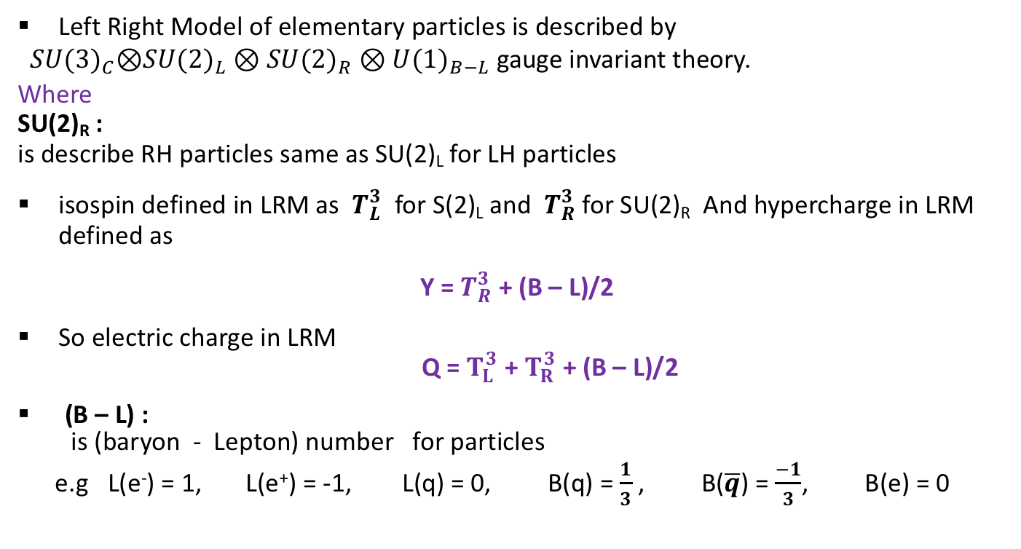
Left Right Model
Left Right Model of elementary particles is described by
${SU(3)}_{C}$⊗${SU(2)}_{L}⊗{SU(2)}_{R}⊗{U(1)}_{B−L}$ gauge invariant theory.
Where
SU(2)_{R} :
is describe RH particles same as SU(2)_{L} for LH particles
isospin defined in LRM as $T_{L}^{3}$ for S(2)_{L} and $T_{R}^{3}$ for SU(2)_{R} And hypercharge in LRM defined as
Y = $T_{R}^{3}$ + (B – L)/2
So electric charge in LRM
Q = $T_{L}^{3}$ + $T_{R}^{3}$ + (B – L)/2
(B – L) :
is (baryon - Lepton) number for particles
e.g L(e⁻) = 1, L(e⁺) = -1, L(q) = 0, B(q) = $\frac{1}{3}$ , B($\overline{q}$) = $\frac{−1}{3}$, B(e) = 0

Slide 8

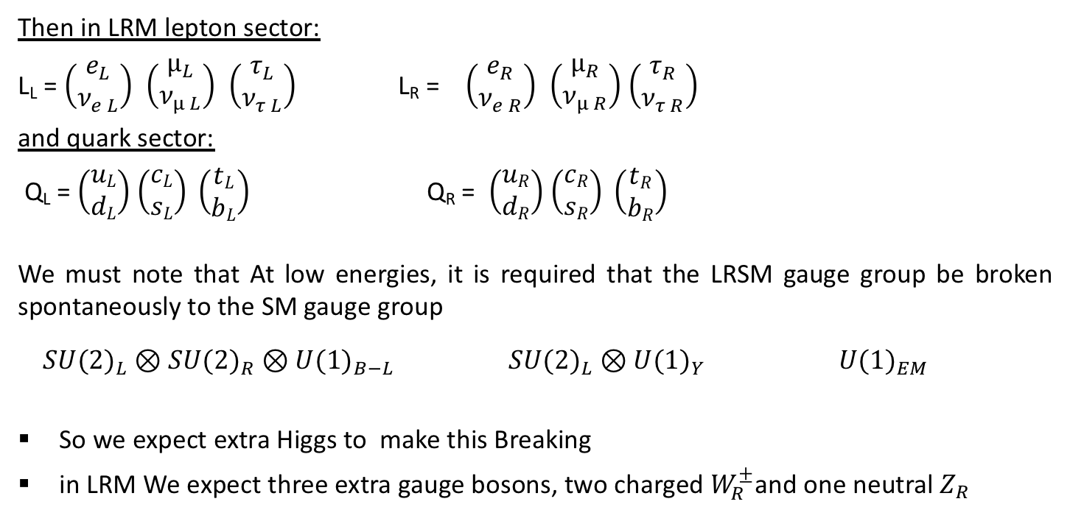

Left Right Model
Then in LRM lepton sector:
L_{L} = $\left(\begin{matrix}e_{L} \\ ν_{e L}\end{matrix}\right)$ $\left(\begin{matrix}µ_{L} \\ ν_{µ L}\end{matrix}\right)$ $\left(\begin{matrix}τ_{L} \\ ν_{τ L}\end{matrix}\right)$ L_{R} = $\left(\begin{matrix}e_{R} \\ ν_{e R}\end{matrix}\right)$ $\left(\begin{matrix}µ_{R} \\ ν_{µ R}\end{matrix}\right)$ $\left(\begin{matrix}τ_{R} \\ ν_{τ R}\end{matrix}\right)$
and quark sector:
Q_{L} = $\left(\begin{matrix}uL \\ dL\end{matrix}\right)$ $\left(\begin{matrix}cL \\ sL\end{matrix}\right) \left(\begin{matrix}tL \\ bL\end{matrix}\right)$ Q_{R} = $\left(\begin{matrix}uR \\ dR\end{matrix}\right)$ $\left(\begin{matrix}cR \\ sR\end{matrix}\right) \left(\begin{matrix}tR \\ bR\end{matrix}\right)$
We must note that At low energies, it is required that the LRSM gauge group be broken spontaneously to the SM gauge group
${SU(2)}_{L}⊗{SU(2)}_{R}⊗{U(1)}_{B−L}$ ${SU(2)}_{L}⊗{U(1)}_{Y}$ ${U(1)}_{EM}$
So we expect extra Higgs to make this Breaking
in LRM We expect three extra gauge bosons, two charged $W_{R}^{±}$and one neutral $Z_{R}$
$\underset{→}{scale >TeV }$
$\underset{→}{scale >100 GeV }$

Slide 9
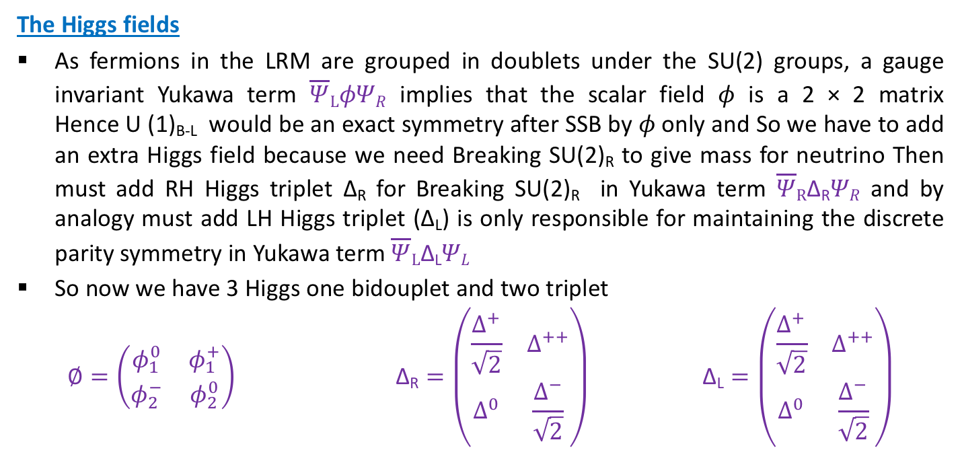
Left Right Model
The Higgs fields
As fermions in the LRM are grouped in doublets under the SU(2) groups, a gauge invariant Yukawa term $\overline{Ψ}LφΨR$ implies that the scalar field $φ$ is a 2 × 2 matrix
Hence U (1)_{B-L} would be an exact symmetry after SSB by $φ$only and So we have to add an extra Higgs field because we need Breaking SU(2)_{R} to give mass for neutrino Then must add RH Higgs triplet ∆_{R} for Breaking SU(2)_{R} in Yukawa term $\overline{Ψ}R\text{∆}\text{R}ΨR$ and by analogy must add LH Higgs triplet (∆_{L}) is only responsible for maintaining the discrete parity symmetry in Yukawa term $\overline{Ψ}L\text{∆}\text{L}ΨL$
So now we have 3 Higgs one bidouplet and two triplet
$∅=\left(\begin{matrix}φ_{1}^{0} & φ_{1}^{+} \\ φ_{2}^{−} & φ_{2}^{0}\end{matrix}\right) \text{∆}\text{R}=\left(\begin{matrix}\frac{∆^{+}}{\sqrt{2}} & ∆^{++} \\ ∆^{0} & \frac{∆^{−}}{\sqrt{2}}\end{matrix}\right) \text{∆}\text{L}=\left(\begin{matrix}\frac{∆^{+}}{\sqrt{2}} & ∆^{++} \\ ∆^{0} & \frac{∆^{−}}{\sqrt{2}}\end{matrix}\right)$

Slide 10
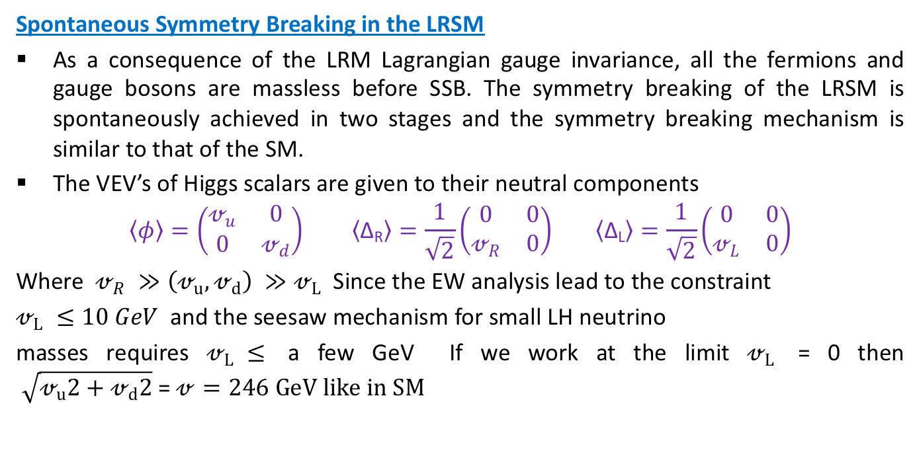
Left Right Model
Spontaneous Symmetry Breaking in the LRSM
As a consequence of the LRM Lagrangian gauge invariance, all the fermions and gauge bosons are massless before SSB. The symmetry breaking of the LRSM is spontaneously achieved in two stages and the symmetry breaking mechanism is similar to that of the SM.
The VEV’s of Higgs scalars are given to their neutral components
$$\left\langle φ\right\rangle =\left(\begin{matrix}𝓋_{u} & 0 \\ 0 & 𝓋_{d}\end{matrix}\right) \left\langle \text{∆}\text{R}\right\rangle =\frac{1}{\sqrt{2}}\left(\begin{matrix}0 & 0 \\ 𝓋_{R} & 0\end{matrix}\right) \left\langle \text{∆}\text{L}\right\rangle =\frac{1}{\sqrt{2}}\left(\begin{matrix}0 & 0 \\ 𝓋_{L} & 0\end{matrix}\right)$$
Where $𝓋_{R} ≫\left(𝓋_{u},𝓋_{d}\right) ≫𝓋_{L}$ Since the EW analysis lead to the constraint
$𝓋_{L} ≤10 GeV$ and the seesaw mechanism for small LH neutrino
masses requires $𝓋_{L} ≤$ a few GeV If we work at the limit $𝓋_{L}$ = 0 then
$\sqrt{𝓋_{u}2+𝓋_{d}2}$ = $𝓋=246 GeV like in SM$

Slide 11
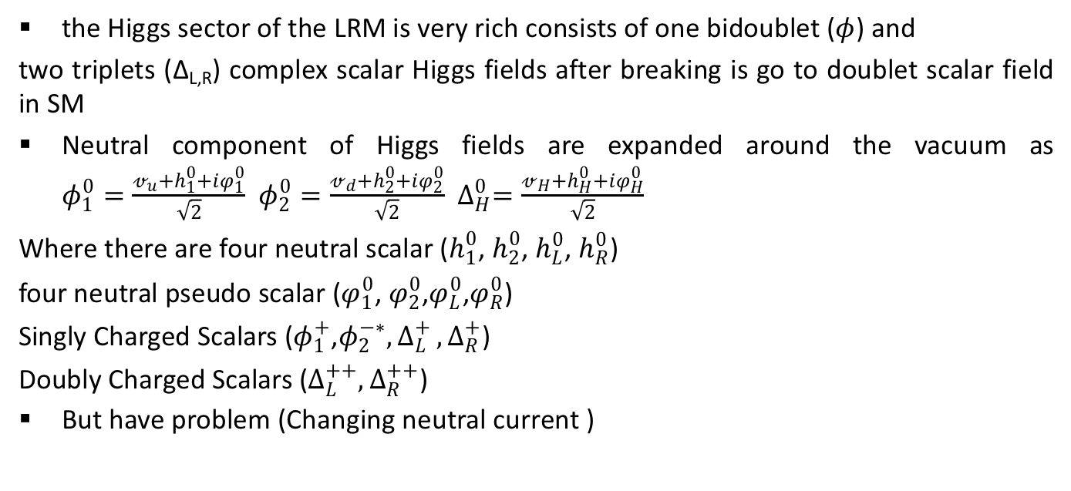
Higgs sector of The LR
the Higgs sector of the LRM is very rich consists of one bidoublet ($φ$) and
two triplets ($\text{∆}\text{L}$_{,R}) complex scalar Higgs fields after breaking is go to doublet scalar field in SM
Neutral component of Higgs fields are expanded around the vacuum as
$φ_{1}^{0}=\frac{𝓋_{u}+h_{1}^{0}+iφ_{1}^{0}}{\sqrt{2}}$ $φ_{2}^{0}=\frac{𝓋_{d}+h_{2}^{0}+iφ_{2}^{0}}{\sqrt{2}}$ $∆_{H}^{0}=\frac{𝓋_{H}+h_{H}^{0}+iφ_{H}^{0}}{\sqrt{2}}$
Where there are four neutral scalar ($h_{1}^{0}$, $h_{2}^{0}$, $h_{L}^{0}$, $h_{R}^{0}$)
four neutral pseudo scalar ($φ_{1}^{0}$, $φ_{2}^{0}$,$φ_{L}^{0}$,$φ_{R}^{0}$)
Singly Charged Scalars ($φ_{1}^{+}$,$φ_{2}^{−∗}{,∆}_{L}^{+},∆_{R}^{+}$)
Doubly Charged Scalars ($∆_{L}^{++},∆_{R}^{++}$)
But have problem (Changing neutral current )

Slide 12
SU(5) GUT Model

Slide 14
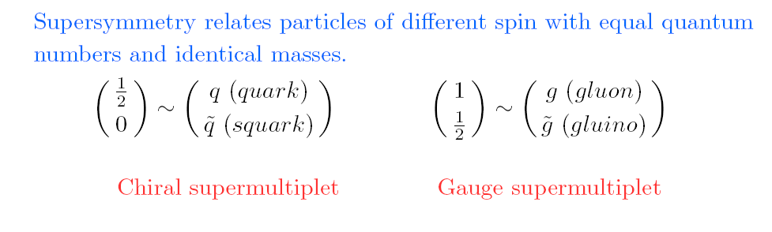
With supersymmetry, the SM gauge couplings are unified at GUT scale M_{G} ≈ 2 x10¹⁶ GeV.

Slide 15
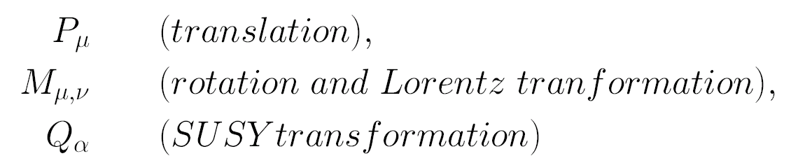
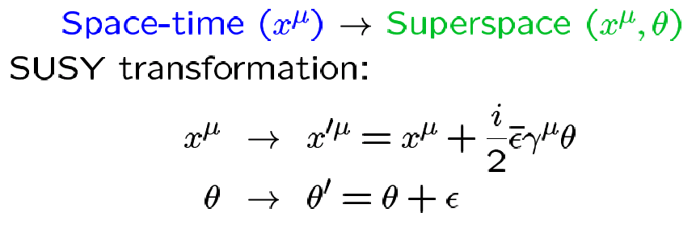
What is Supersymmetry
Supersymmetry (SUSY): a symmetry between bosons and fermions.
Introduced in 1973 as a part of an extension of the special relativity.
Super Poincare algebra.
SUSY = a translation in Superspace.

Slide 16
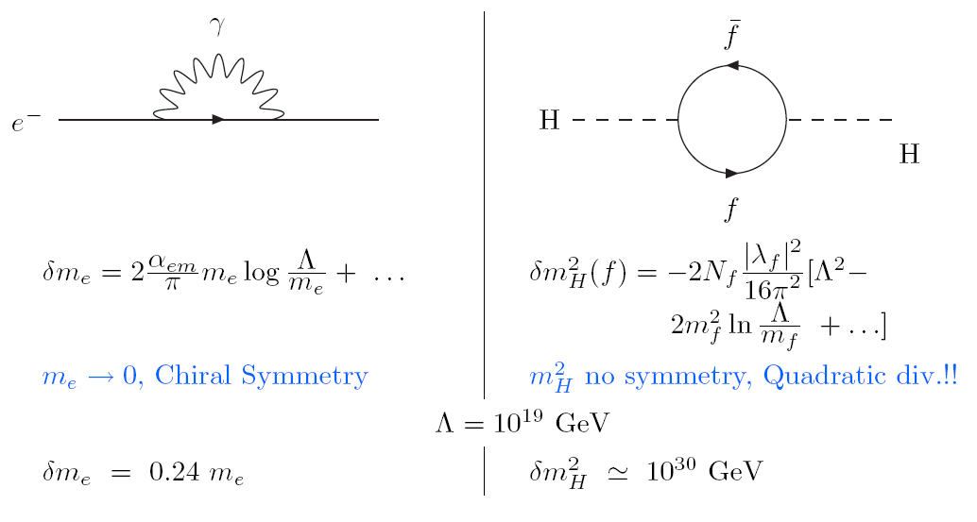
Hierarchy problem

Slide 17
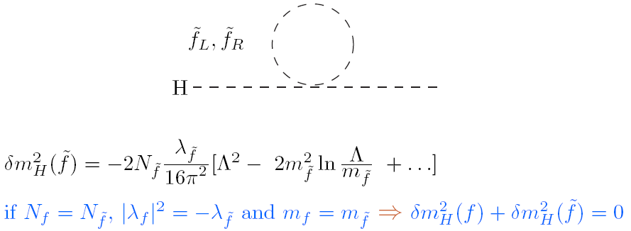
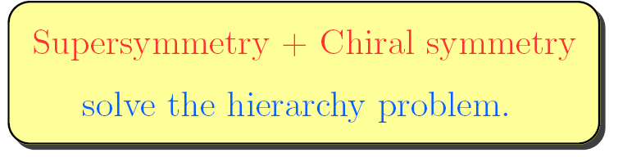
Hierarchy problem and SUSY

