Slide 1
Synchronisation Needs for New PSB Injection with Linac4
S. Albright, F. Antoniou, C. Bracco, G.P. Di Giovanni, V. Forte, B. Mikulec

Slide 2
Introduction
After LS2:
Injection of 160 MeV H⁻ beam from Linac4 into PSB
New injection principle
Stripping foil (H⁻ beam → p beam)
Injection chicane (4 BSW magnets producing bump of circulating beam)
Transverse and longitudinal phase-space painting (optimise transverse emittances and minimise space charge detuning)
Injection into accelerating waiting buckets
Keep principle of beam distribution into 4 PSB rings (distributor + septum + correctors/quads/bend)
Have to make sure to maintain current operational flexibility of the PSB (e.g. several hundreds of different beam cycles covering O(10⁴) in intensity; use betw. 1-4 rings; adjust regularly intensity/ring (number of injected turns corresponding to pulse length); parasitic cycles etc.)
Improve performance

Slide 3
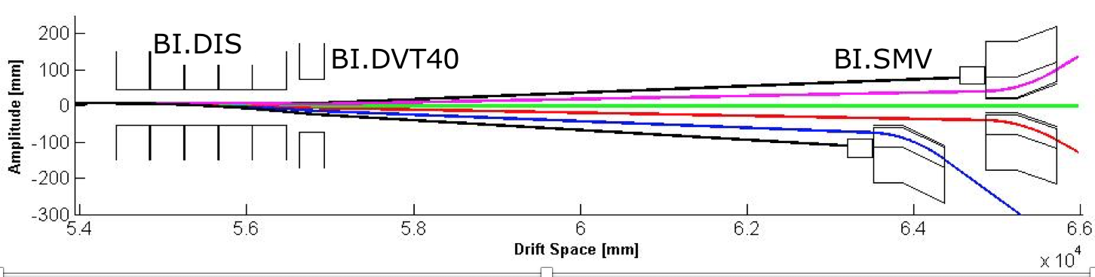
DIStributor Operation
Distributor
Vertical septum
1-150
µs
1-150
µs
~1.5 µs
~1.5 µs
Start time of different distributor levels flexible, taking into account:
Programmed number of injected turns per ring (pulse length), by-ring interlocks (External Conditions) and software interlocks (SIS); example (B): No beam for Ring 3; adjusted ‘on-the-fly’ with External Fast Timings

Slide 4
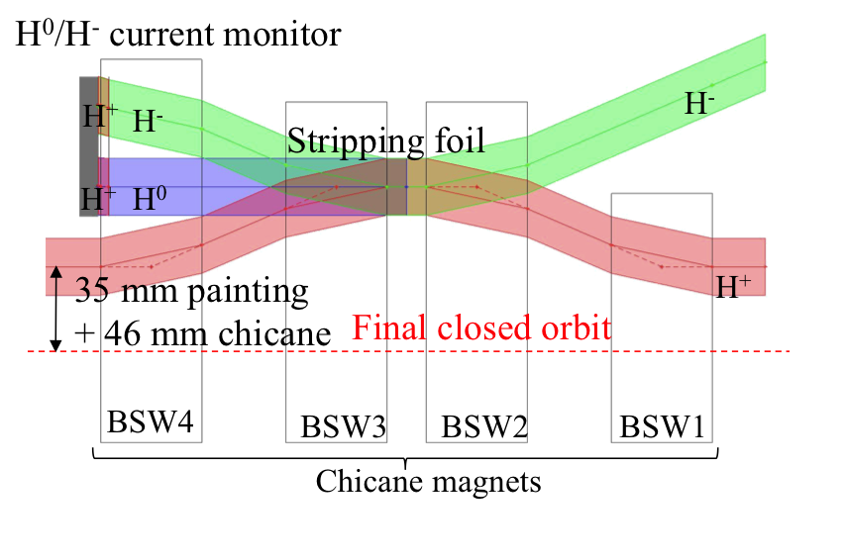
New injection section
Injected beam
Dump for unstripped
or partially stripped
particles
Chicane bump will
collapse after 5 ms
Circulating beam
The circulating beam has to
be removed from the foil to
minimise multiple scattering
(emittance blow-up, losses) and
to avoid foil destruction

Slide 5
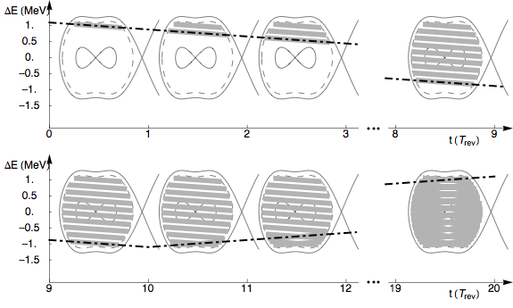
Filling of PSB buckets
Chopper ON/OFF (no beam/beam) pattern needs to correspond to desired filling factor of accelerating PSB buckets → optimise line density and long. parameters, minimise losses!
Irregular chopping pattern during longitudinal painting (for more homogenous bucket filling), where also synchronisation with 2 last Linac4 PIMS cavities + the debuncher is needed
Correction of energy differences between rings at injection due to ramping B-field through Bdls
Ch. off
Ch. on
Ch. off
Ch. on
Ch. off
Ch. on
Ch. off
Ch. on
PIMS,
debuncher,
Bdls
chopper

Slide 6
Synchronisation needs for new PSB injection
By-ring correction of magnetic
field at injection (injection during
ramping B-field)
Correction of vertical beta-beating
introduced by BSW magnets (+
working point)
Produce bump during injection;
chicane fall after 5 ms to nominal
orbit
Transverse phase-space painting and
fast beam removal from stripping foil
Defines length of Linac4 pulse
Produces 1.5 us holes betw. rings to avoid
losses during distributor rise-time;
chopping pattern for loss-free beam-to-
bucket transfer; longitudinal painting
Distributes beam slices of flexible
length into 4 PSB rings
Linac4 RF: Ramping of last 2 PIMS cavities for longitudinal painting + debuncher
PSB RF: To align RF buckets per ring to
Linac4 beam slice arrival
Synchro
Pre-Chopper
Chopper
Distributor
Linac4 and PSB RF
Injection Kicker
Injection Chicane Bumpers
Bdl
Q-strips
(QDE3/14)
TE-ABT equipment
BE-RF equipment
TE-EPC equipment

Slide 7
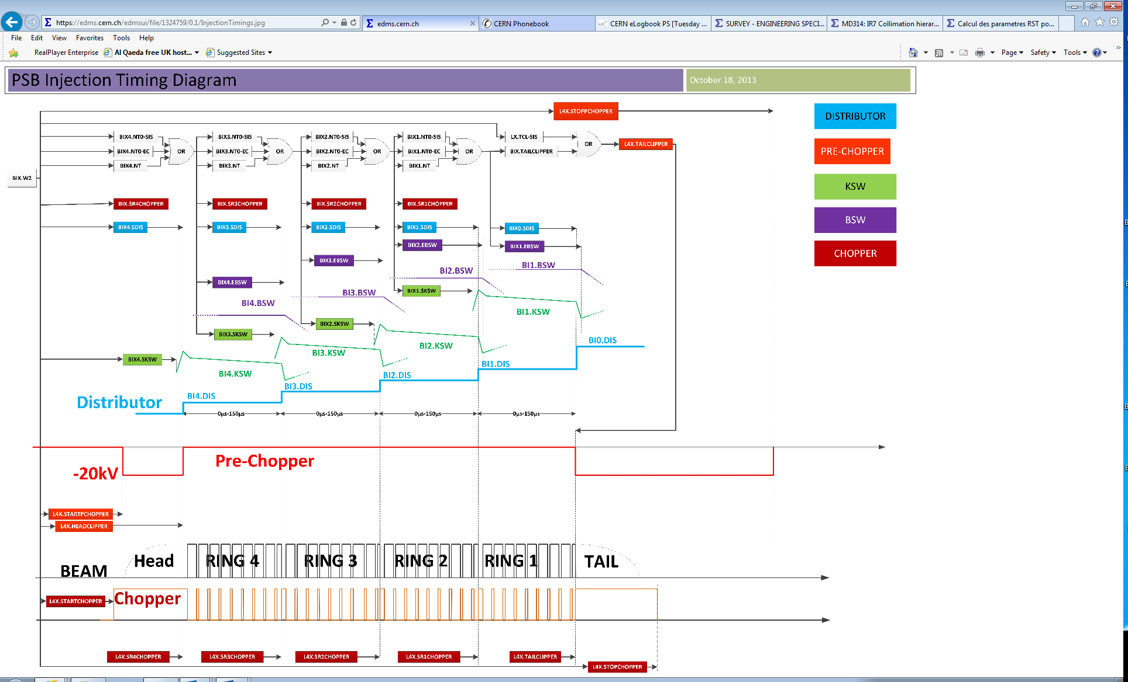

Slide 8
Synchronisation KSw - BSW

Slide 9
KSW Waveform
Start of injection
Original KSW waveform
35 mm
End of injection

Slide 10
KSW Waveform
Start of injection
Original KSW waveform
We introduced the possibility of producing a negative bump with the KSW to keep the beam as far as possible from the stripping foil and reduce the number of crossing ➔ losses!
35 mm
End of injection
1 ms (1/5 BSW fall time)
-9.2 mm
(1/5 BSW bump amplitude)
T0: KSW bump back to 0 linearly in 1 ms and start of BSW chicane fall

Slide 11
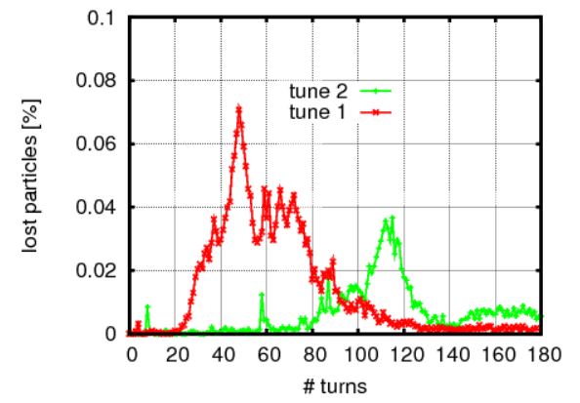
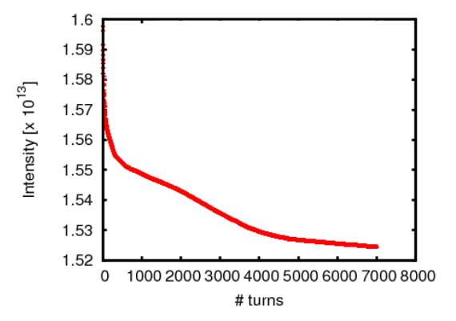
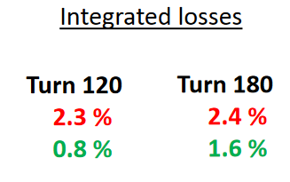

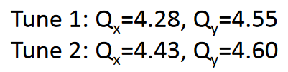
Total loss budget ISOLDE beams
Full cycle up to PSB extraction: 5% of total beam
At injection: 2.5% of total beam
Present situation according to simulations (no imperfections included)
Remark: The total int. losses were ~independent of the tune.

Slide 12
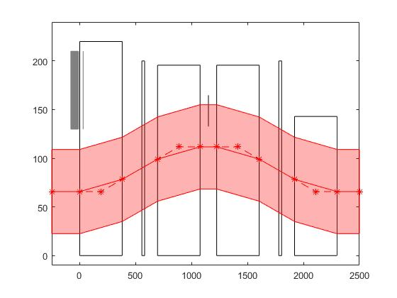
ISOLDE beam
ISOLDE beam envelope = +/- 43.3 mm
(3 sigma, 20% beta error, 10 mm mrad normalised emittance, Dp/p = 0.0044,
+/-2 mm orbit normalized by beta function)
Stripping foil for current measurements
Valve
Valve
BSW4
Stripping foil
BSW3
BSW2
BSW bump = 45.9 mm
KSW bump = 0 mm
Dump
BSW1
x [ mm ]
Circulating beam
s [ m ]

Slide 13
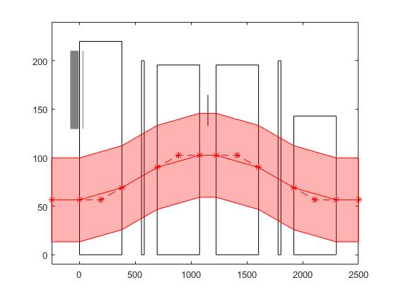
ISOLDE beam
ISOLDE beam envelope = +/- 43.3 mm
(3 sigma, 20% beta error, 10 mm mrad normalised emittance, Dp/p = 0.0044,
+/-2 mm orbit normalized by beta function)
Stripping foil for current measurements
Valve
Valve
BSW4
T0
1000 us
Stripping foil
BSW3
BSW2
BSW bump = 45.9 mm
KSW bump = -9.2 mm
Dump
BSW1
Total losses over 1000 us from T0:
without negative bump = 0.081%
With negative bump: 0.036%
> X2 loss reduction
x [ mm ]
Circulating beam
s [ m ]

Slide 14
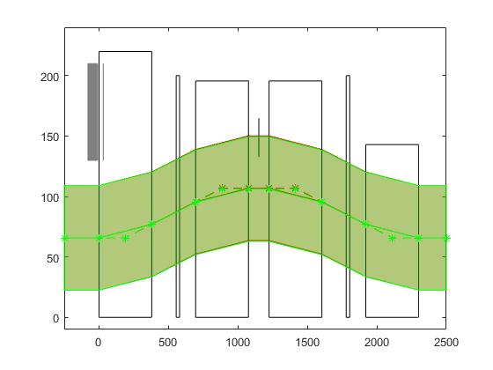

ISOLDE beam 100 $μ$s
ISOLDE beam envelope = +/- 43.3 mm
(3 sigma, 20% beta error, 10 mm mrad normalised emittance, Dp/p = 0.0044,
+/-2 mm orbit normalized by beta function)
Stripping foil for current measurements
1000 us
Valve
Valve
BSW4
Stripping foil
BSW3
BSW2
BSW bump = 41.1 mm/40.4 mm KSW bump = 0mm
Dump
BSW1
Total losses over 1000 us from T0: Sync. BSW-KSW: 0.036%
100 us delay BSW-KSW = 0.038%
<10% higher losses (negligible)
x [ mm ]
Circulating beam
s [ m ]

Slide 15
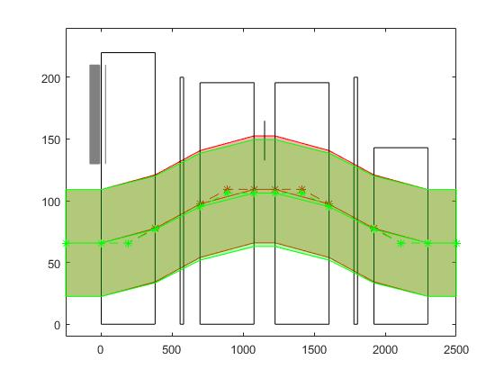

ISOLDE beam 500 $μ$s
ISOLDE beam envelope = +/- 43.3 mm
(3 sigma, 20% beta error, 10 mm mrad normalised emittance, Dp/p = 0.0044,
+/-2 mm orbit normalized by beta function)
Stripping foil for current measurements
1000 us
Valve
Valve
BSW4
Stripping foil
BSW3
BSW2
BSW bump = = 43.4 mm/40.4 mm
KSW bump = 0mm
Dump
BSW1
Total losses over 1000 us from T0: Sync. BSW-KSW: 0.036%
500 us delay BSW-KSW (interlock on R4, R3 and R2) = 0.053%
45% higher losses
Lost half of the gain achieved by introducing the negative bump
x [ mm ]
Circulating beam
s [ m ]

Slide 16
Synchronisation BSW – Q-strips

Slide 17
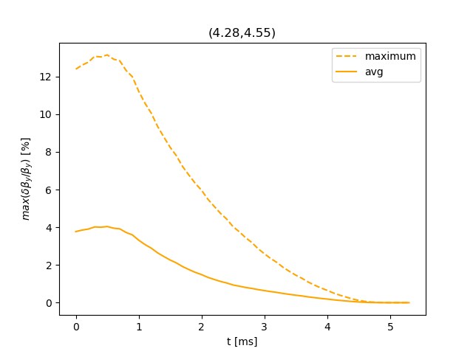
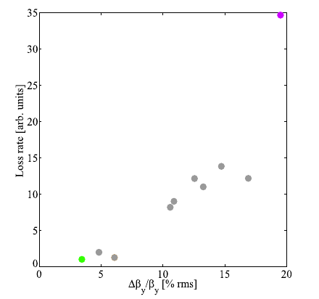
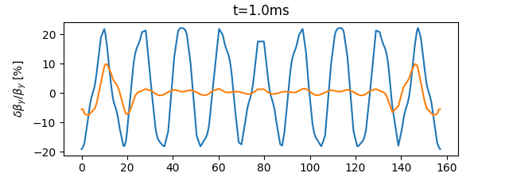
Beta beating during the fall of the chicane: Q3, Q14
E. Benedetto, V. Forte
Vertical beta beating versus loss rate
S [m]

Slide 18
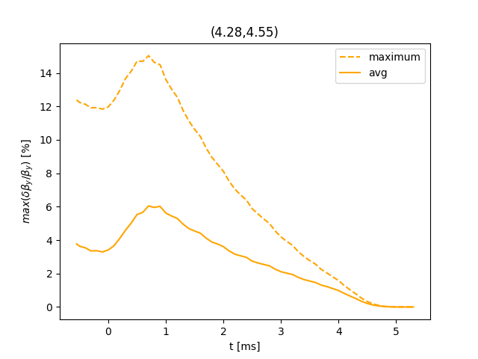
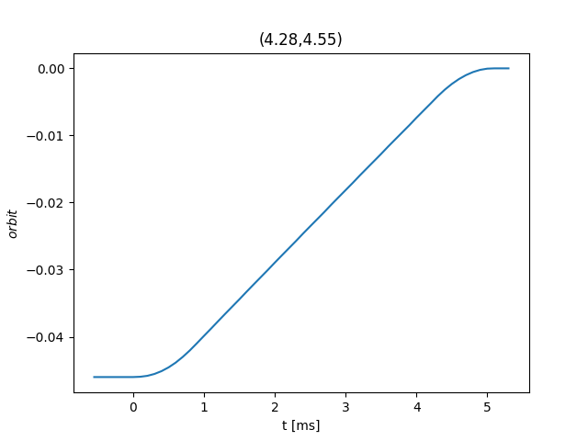

Delay of the BSW by 550 $μ$s
(interlocking of rings 4, 3 and 2) + 100 us jitter

Slide 19
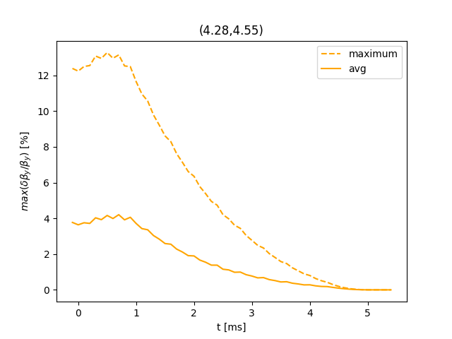
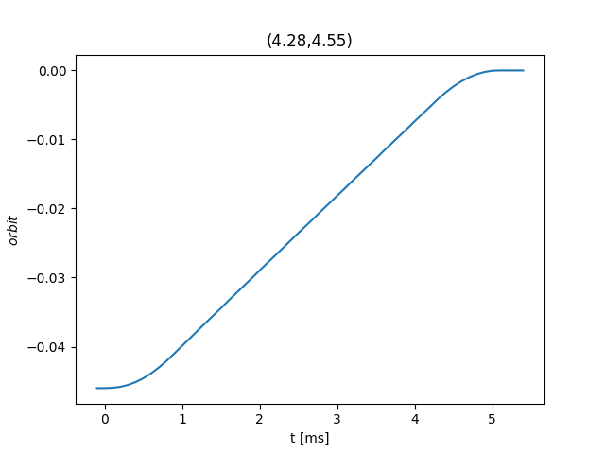
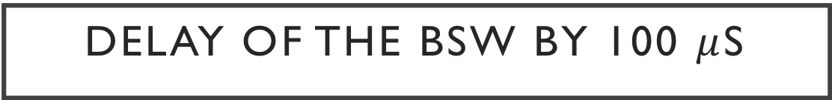
Delay of the BSW by 100 $μ$s
100 us jitter

Slide 20
Synchronisation Bdls – B-field

Slide 21
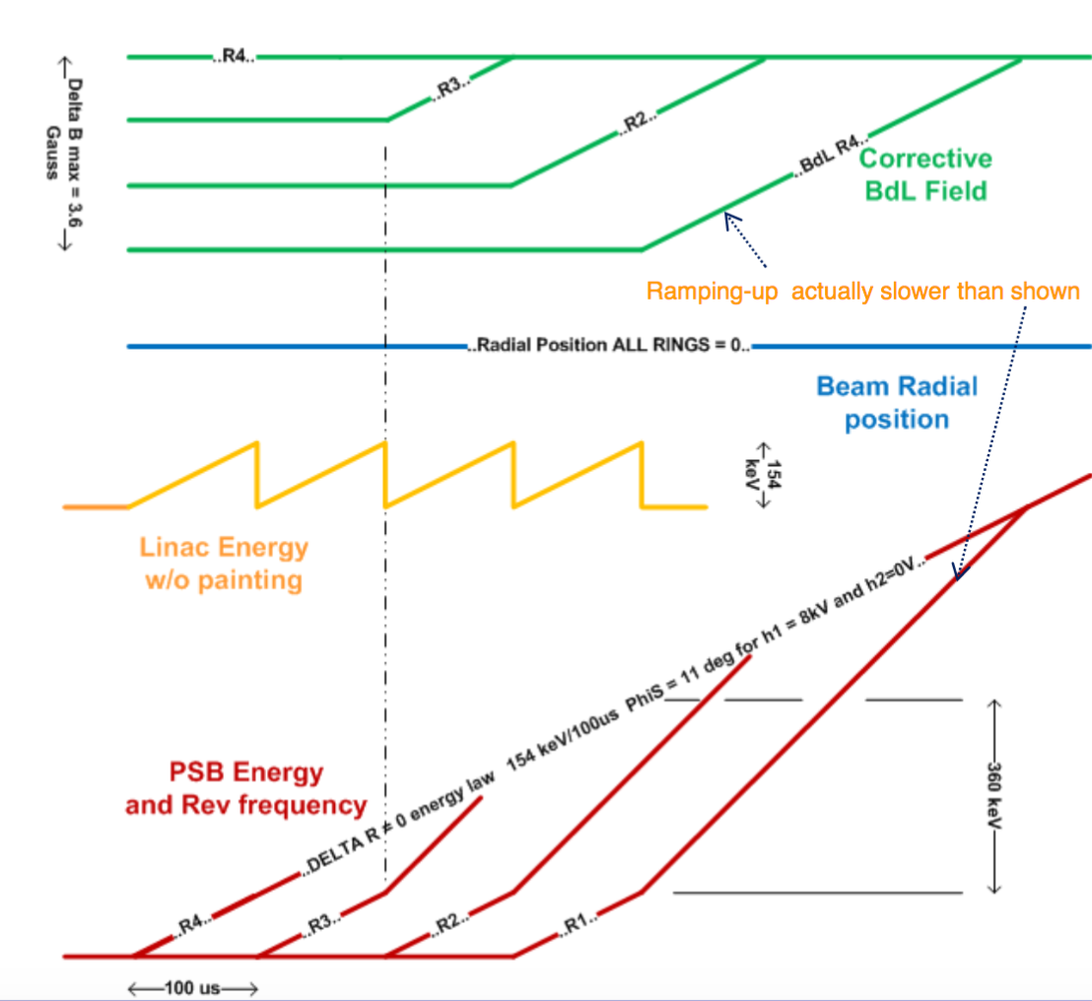
Bdl correction
Injection: R4-R3-R2-R1
Injection on ramping B-field
R1 arrives at same energy, but B-field at injection is already higher than for R4 → beam not anymore centred in bucket; also important for longitudinal painting
Bdls act as a trim to reduce the B-field for rings <4 such that each ring sees the same B-field at injection
Amplitude of Bdl correction is a function of total injection duration of all preceding rings

Slide 22
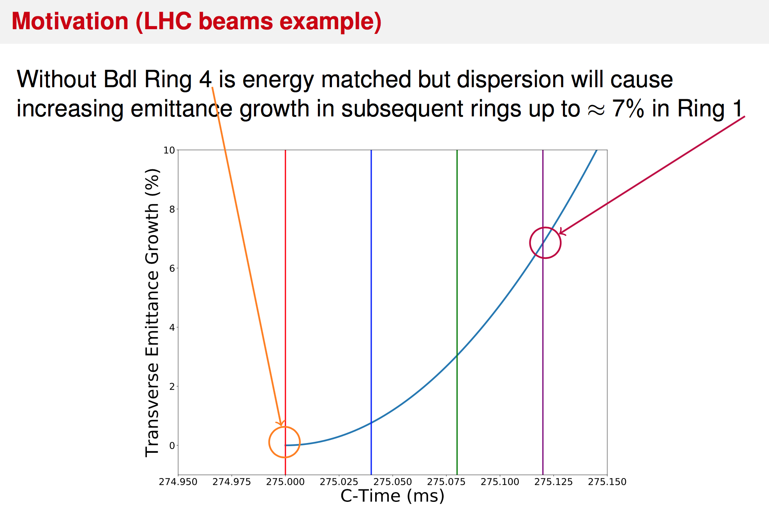
for 40 turns
per ring
Bdl current needs to be set from
cycle to cycle to correct B-field
with changing injection duration to
preserve required beam quality

Slide 23
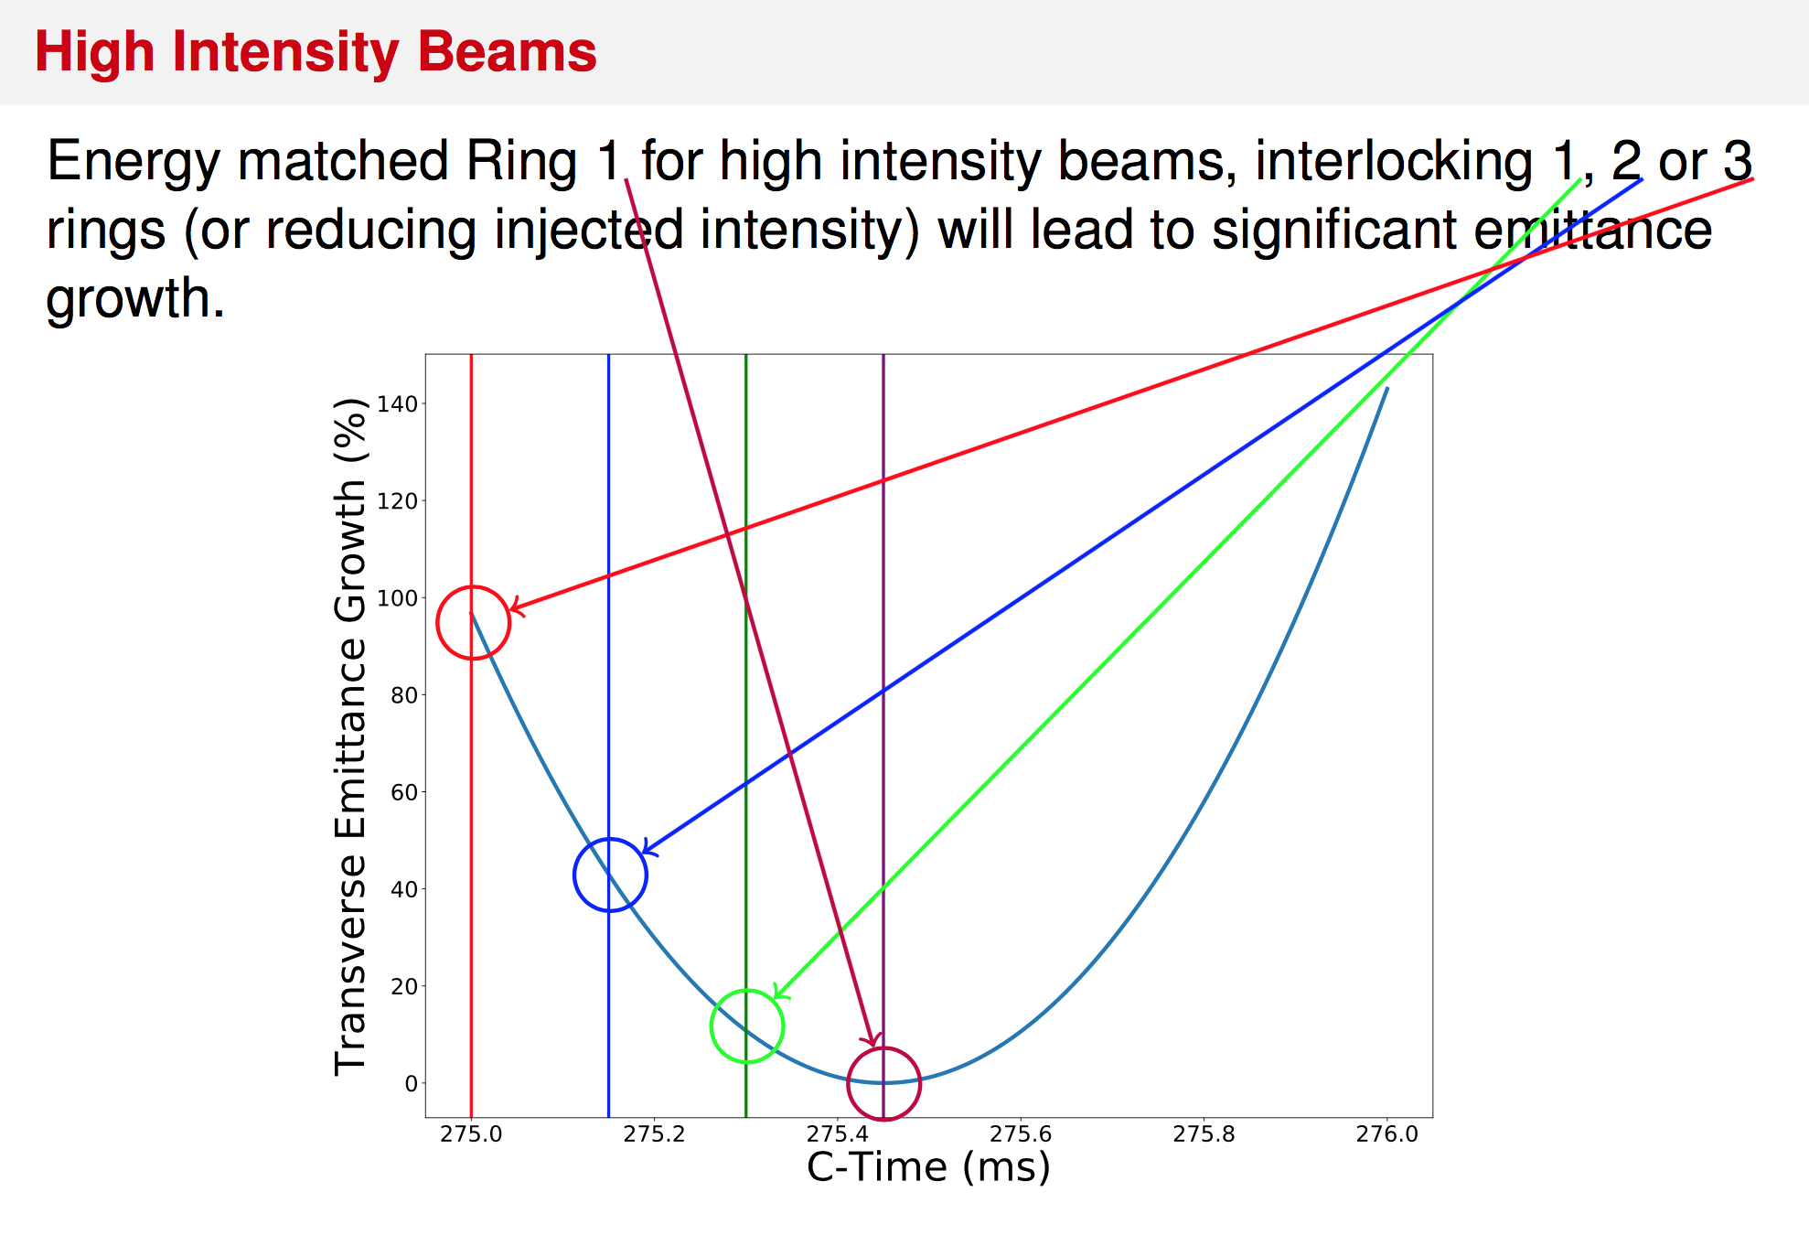
for 150 turns
per ring

Slide 24
Longitudinal painting
Aim to fill the PSB bucket as uniformly as possible at ~80% filling factor
If not synchronised with B-field, the painted beam will not anymore be correctly centred in the bucket
Longitudinal emittance blow-up
Possibly losses

Slide 25
Summary Synchronisation studies
Simulations were redone by colleagues from TE-ABT, BE-ABP and BE-RF to evaluate implications of not using fast timings for the TE-EPC power converters (BSWs, Bdls) → synchronisation uncertainties of max. 100 us or max. 550 us in the worst case of simultaneous interlocks in rings 4,3 and 2 (3x150 + 100 us).
Synchronisation BSWs - KSWs:
~45% higher losses at injection in case of 500 us synchronisation error between KSWs and BSWs
This would mean losing half of the gain achieved by introducing a negative bump in the KSW function after injection
Synchronisation BSWs – Q-strips:
Increased vertical beta beating → could lead to increased losses, which seem negligible with today’s simulations, but the effect is difficult to quantify
Synchronisation Bdls – B-field at injection:
Up to ~7% longitudinal emittance blow-up with incorrect Bdl current (in case of interlock on 3 rings)
For LHC beams: Horizontal emittance growth around 3% for 100 us jitter
Significant (and variable) horizontal emittance growth for large intensity beams → losses?
Longitudinal painting (to reduce space-charge effects): Would impose limitations on the longitudinal emittance we can safely inject (losses) + long. emittance blow-up

Slide 26
Concluding remarks
Very complex new injection scheme with Linac4 that requires synchronisation of various equipment in Linac4 and PSB
TE-ABT and BE-RF equipment have been designed to allow for highest performance related to the injection process
Despite a lot of effort was put into trying to understand the repercussions of synchronisation errors, it is very difficult to predict the final effects in terms of beam losses, emittance growth, intensity limits and limitations to longitudinal painting (no higher order effects included etc.)
BE-OP would highly recommend that affected TE-EPC equipment (Bdls, QDE3/14 and BSWs) will accept fast external timings in order not to cancel optimisations already implemented in other equipment and to eat up operational (unknown) margins

