Slide 1
Data access optimizations for ROOT files
F.Furano (IT-DM)

Slide 2
The starting point
I was contacted by a site with this question:
  Q: The data access pattern of the ATLAS jobs is so sparse and difficult that it kills the performance of our disks. Can you do something?
  A: Probably I can. Give me a trace of what a job does and let’s see.

Slide 3
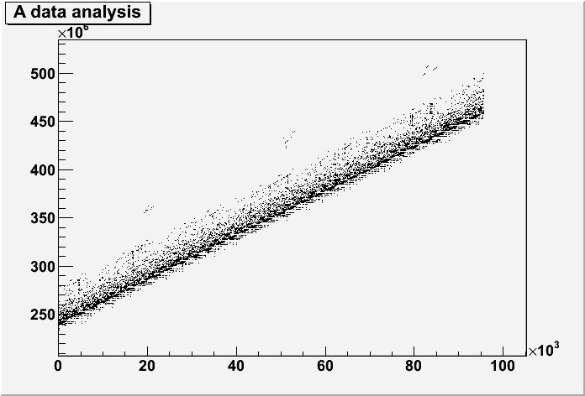
First look
Ah, OK. They do not (or cannot) use the TTreeCache, hence the resulting pattern is particularly difficult
Synchronous requests for very small chunks (here’s a part of them)
  Pay the network latency for each request (make the app inefficient by itself even with the fastest disks)
  The disk sees a nasty random pattern and performs badly
  It is not able to serve many clients as it should

Slide 4
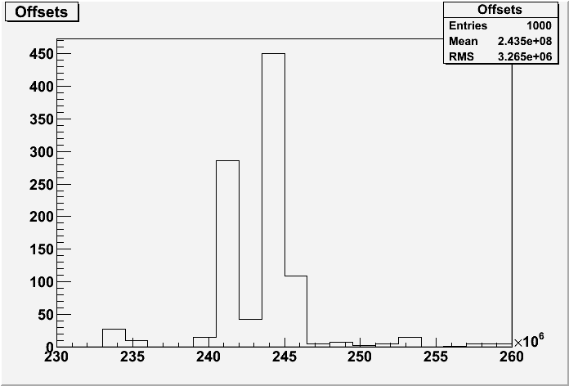
An idea
We could analyze the traffic as it is produced at the client side (here’s an histogram of 1000 offsets)
  Detect if it can be summarized by a few big blocks of data
    In this example it can be done with a block of 20-30M
  Make this “window” slide together with the average offset, by dropping the least 1M and advancing by chunks of 1M
  It is likely that it will be hit many times (up to 99%)

Slide 5
Another idea
Doing what any OS would do, but in a bigger scale
  Internally in the OS, reads are enlarged and aligned to “pages”, typically of 4K
  We can do the same in the Xrootd client, but with a bigger page size (up to 1M)
      The danger is to read the file more than once
      This cannot happen with the previous algorithm
      Only enough memory can avoid this, like in the OS case
      But the OS uses the unallocated memory for that

Slide 6
Memory!
The drawback of these statistics-based techniques is memory consumption
  Memory is needed to cache enough data for the access to be fast (=low miss rate)
  We tried a lot of combinations from 30 up to 200MB of cache. They start to work from ~30-50M
  A heavier test was performed by Max Baak, using 200M (!) and many jobs
    The average usage of CPU jumped from <40% to >95%, multiplying by ~2-3 the event rate
    Very good results… but I don’t know if or where this is applicable.

Slide 7
A quick comparison
Using the previously discussed ATLAS AOD trace fed into my Xrootd test tool (95K reads, cache=100M):
    These are good estimations of the time spent accessing data by a true app.
  Legacy access : 52s
  Windowed r/a : 4.5s
  Page-based r/a : 7.6s
  ReadV TTreeCache-like : down to 2.2s*
*TTreeCache internally sorts the data accesses. For this result the fed
ATLAS trace was sorted by increasing offsets. It needs only ~10MBytes.
If not sorted the result would be around 11s.
There are current developments in xrootd which are supposed to make this
even more effective in the case of several concurrent clients hitting the same
Disk.

Slide 8
Where is it?
Right now everything is in the XROOTD CVS head
  Which contains other fixes/enhancements as well
    The ReadV optimization instead will have to wait for the next update (need to test it heavily)
  An XROOTD pre-production tag for ROOT is foreseen in these days
The modifications to use these techniques from TFile/TXNetFile are in the ROOT trunk

Slide 9
Questions?
Thank you!

