Slide 1
JLAMP Proposed 4th Generation Soft X-ray Light Source
Tom Powers, for the JLAB Team
May 6, 2009

Slide 2
What are (4th) Next Generation Light Sources?
Superconducting radio-frequency linac based, as opposed to rings
Significantly higher brightness than existing sources
Short pulse capability (< 100 fs)
High transverse coherence and ideally longitudinal coherence
Concept covers broad spectral range from THz through VUV to soft and hard X-rays but the push is toward X-rays
Complementary capability – they do not displace 3rd generation rings!
Configuration loosely divided into Free Electron Lasers or Energy Recovering Linacs

Slide 3
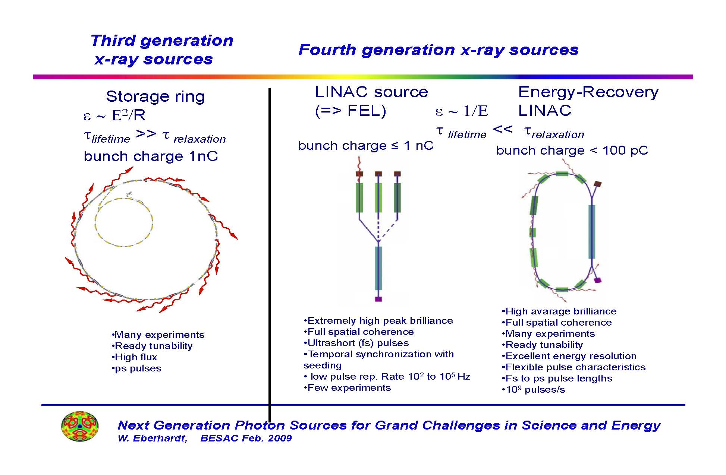
Courtesy W. Eberhardt

Slide 4
So why haven’t CW 4th Generation sources been built?
CW Linacs are expensive!
  Get 1 eV photon with energy of ~100 MeV
  Get 100 eV with ~ 1GeV
  Get 1000 eV with 3 GeV
  Get 10 keV with 10 GeV
Linacs presently achieve < 12 MV/m real estate gradient CW
3 GeV means > 300m of linear accelerator, >$200M for the linac!
Undulators are also expensive > 0.4M/m x 100m = $40M per undulator x 10? = $ 400M
Add in the cost of cryogenic refrigerator, conventional facilities, etc. and the total for 1 Angstrom output is well above $1B

Slide 5
Physics advances are also required
Injectors: ultimate brightness at low (100 pC) and high (1 nC) charge.
  Approaches: DC gun, copper RF gun, SCRF gun, . . .
  We don’t presently know how to make a high charge, high brightness CW gun.
Brightness preservation in transport: Solutions to
  Coherent synchrotron radiation (CSR)
  Emittance degradation,
  Longitudinal space charge (LSC) effects in pulse compression
Is recirculation feasible while retaining brightness? Cuts linac cost by 2x!
Halo and dark current control are essential for CW operations
High order mode & beam breakup control in cavities
Wakefield and propagating mode damping
JLAMP is a path to understand many of the machine design issues at a cost that is affordable.

Slide 6
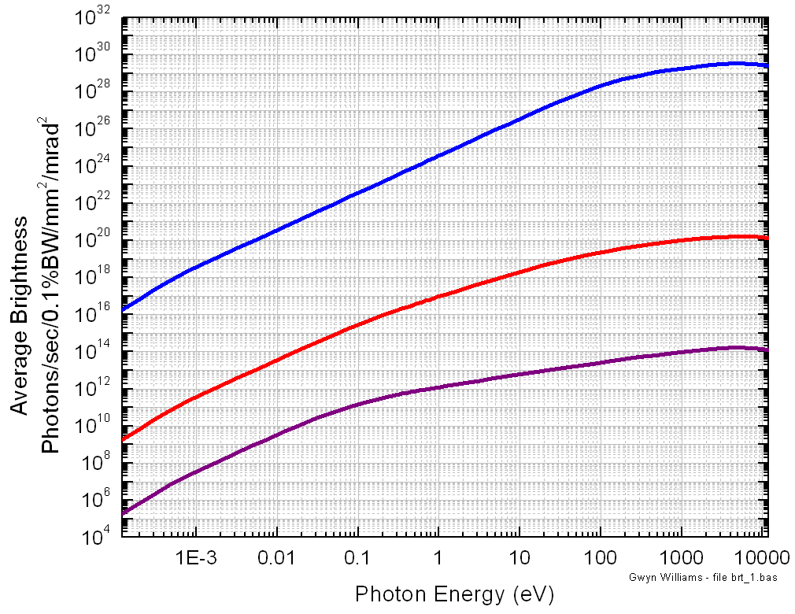
CW operation gives high average brightness in both fundamental and harmonics
NLS
JLAMP
XFEL
JLAB-UV FEL
JLAMP harm
LCLS
4th Gen
UV harm
FLASH
JLAB-THz
Infrared FELs
3rd Gen
2nd Gen

Slide 7
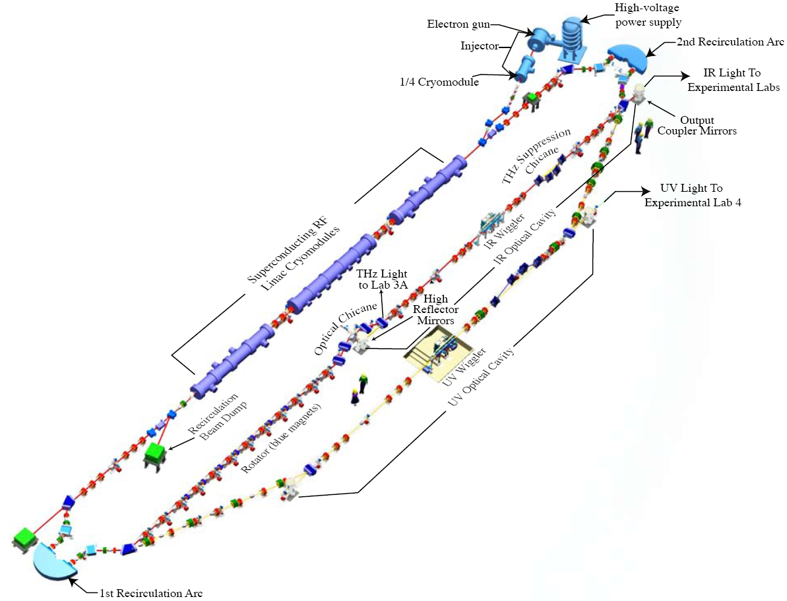
Existing JLab 4th Generation IR/UV Light Source
E = 125 MeV
135 pC pulses @ 75 MHz
(20 μJ/pulse in 250–700 nm UV-VIS
in commissioning)
120 μJ/pulse in 1-10 μm IR
1 μJ/pulse in THz
The first high current ERL
14 kW average FEL power
Ultra-fast (150 fs)
Ultra-bright - (10²³ ph/sec/mm²/mrad²/0.1%BW)
UV harmonics exceed FLASH average brightness (10²¹ average, 10²⁷ peak ph/sec/mm²/mrad²/0.1%BW)

Slide 8
First Conceptual Design
A simple model of a machine was built so that the beam physics team had a notion of what they were designing.
Two pass machine
Linac must remain 0.7 m beam line height
Chicane so that Wiggler beam line is at standard Light source height of 1.4 m.
Potential for multiple wiggler beam lines

Slide 9
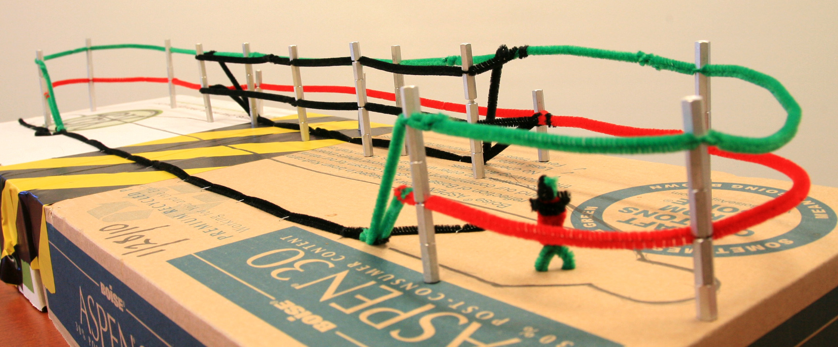
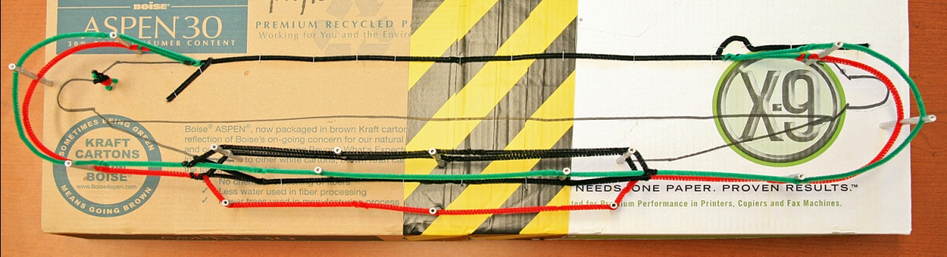
First Conceptual Design
A simple model of a machine was built so that the beam physics team had a notion of what they were designing.
Two pass machine
Linac must remain at 0.7 m beam line height because of ceiling clearance for U-Tubes
Chicane included so that Wiggler beam line is at standard light source height of 1.4 m.
Potential for multiple wiggler beam lines

Slide 10
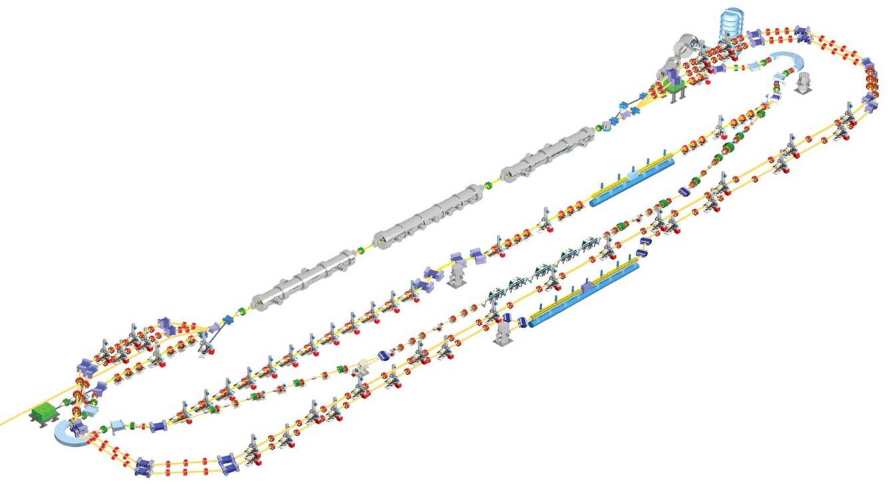
Transforming to JLAMP
Upgrade
The injector to a high brightness DC or RF Gun and 750 MHz booster
Notes:
All of the machine lattice figures are notional in nature but the FEL has been modeled. The beam physics team is working on a detailed machine lattice.

Slide 11
Transforming to JLAMP
Replace 3 cryomodules with 100-plus MeV modules

Slide 12
Transforming to JLAMP
Add
Two more arcs

Slide 13
Transforming to JLAMP
Add
Two more arcs
A low energy back leg

Slide 14
Transforming to JLAMP
Add
Two more arcs
A low energy back leg
A high energy back leg

Slide 15
Transforming to JLAMP
Add
Two more arcs
A low energy back leg
A high energy back leg
A VUV/Soft X-Ray wiggler/FEL and beam line
A Xray end station outside of the FEL Vault
Notes:
We will still use one or more of your existing user labs for optical experiments in the VUV, UV, visible and infrared.

Slide 16
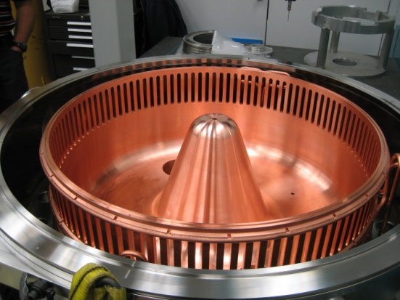
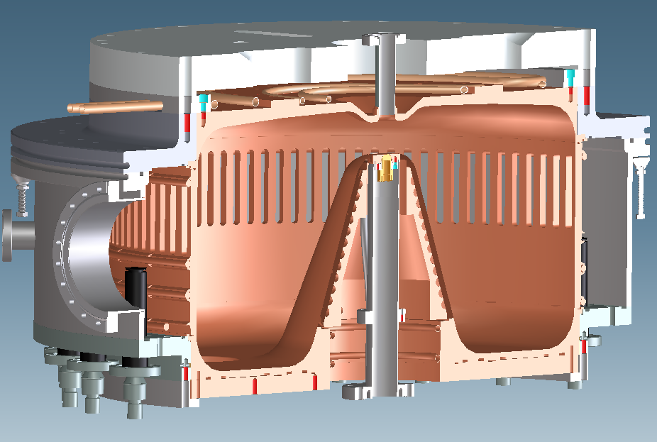
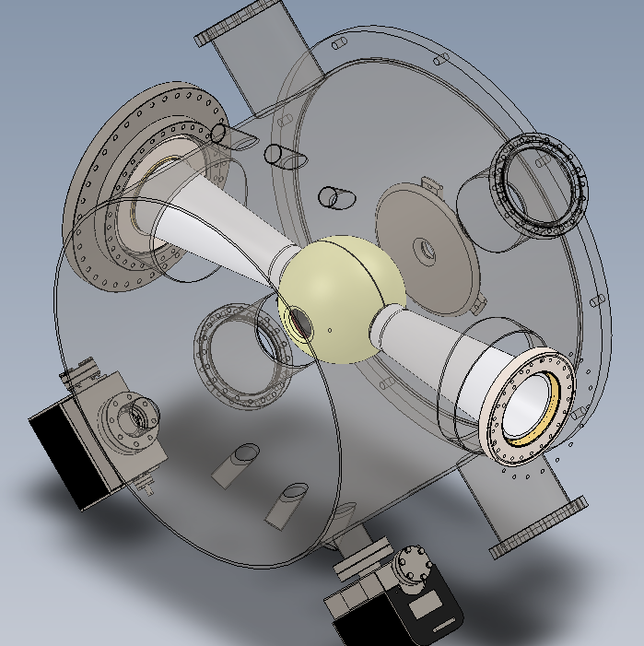
Injector Gun Technologies
Berkley NCRF gun*
24.1 MV/m peak surface fields
19.5 MV/m at the cathode
750 keV output beam energy
Easy Cathode Installation.
Operating frequency 187.1 MHz
Dual coaxial RF feeds.
JLAB inverted insulator DC gun
500 keV operation
Integral load lock
Water cooled cathode
Ultra high vacuum pumping
Designed for 1 nC at >100 MHz
*Ken Baptiste, et. al. Lawrence Berkeley National Lab

Slide 17
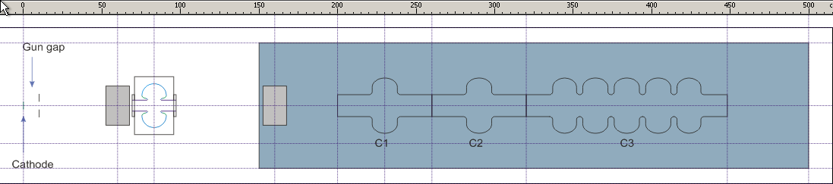
Injector Layout
Common Booster/Merger layout for either gun.
Presently considering layout with:
  Buncher cavity
  Two single-cell capture cavities β < 1
  One 5-cell accelerating cavity β = 1
  Operating frequency of 748.5MHz

Slide 18
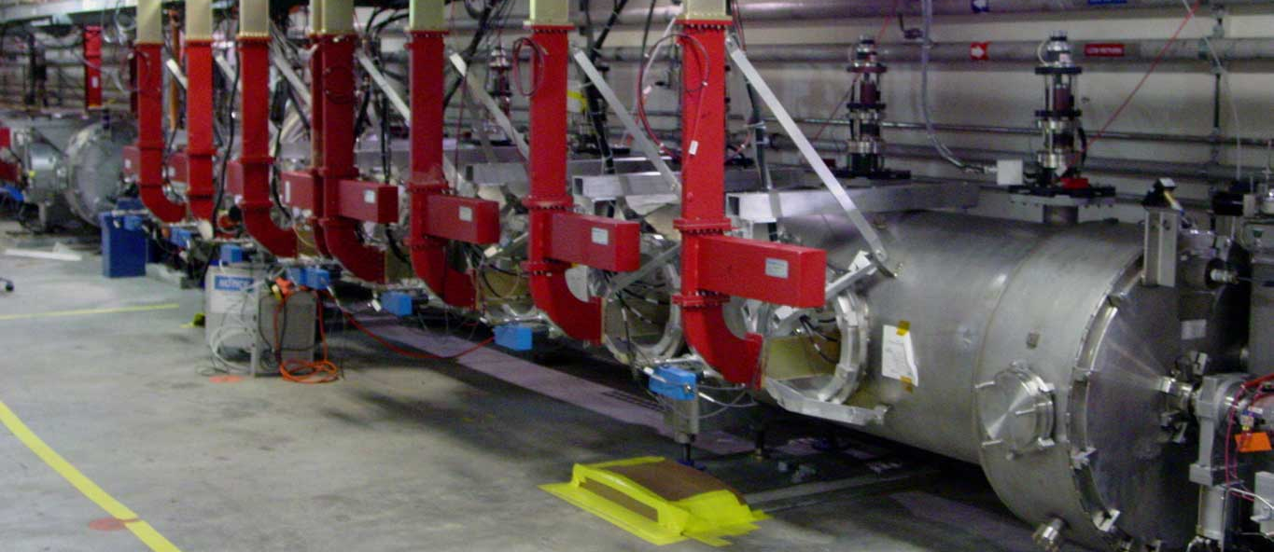
ERL Cryomodules
ERL cryomodules are based on the proven 12 GeV C100 cryomodule design
Three cryomodules each with 5.6 m of active length.
Design gradient 19 MV/m average with the potential to operate at higher gradients.

Slide 19
RF Power Required for Different Operating Modes
 | 1 Pass Tune Beam | 2 Pass Tune Beam | Pulsed 2 Pass ERL Oscillator | CW 2-Pass ERL Oscillator | 2 Pass FEL Amplifier
Maximum Charge (pC) | 200 | 200 | 200 | 200 | 200
Repetition rate (MHz) | 2.34 | 1.17 | 4.68 | 4.68 | Single or double shot to 0.10
Macro Pulse Length (μs) | 100 | 100 | 100 to 1000 | CW | CW
Macro Pulse Rep. Rate (Hz) | 2 | 2 | 2 to 60 | CW | CW
Beam Current During Pulse or CW (μA) | 468 | 468 | 936 | 936 | < 20
Linac Power / Cavity at 22 MV/m (kW) | 10.6 | 10.6 | 7.2 | 7.2 | 4.4
Minimum Injector RF Power for 20 MeV (kW) | 9.36 | 4.68 | 18.7 | 18.7 | 0.4

Slide 20
NCRF Gun RF Requirements*
Calculated RF power requirement 87.7 kW at 187.125 MHz
Amplifier implementation
  Thales TH 571B based, class AB tetrode amplifier.
  Frequency 187 ± 3 MHz
  Output Power 120 kW
Anode HVDC PS
11 kV @ 22 A
To Cavity Input
Coupler #1 via Circulator #1
3 kW
60 kW
Grid PS
Screen PS
Fil. PS
RF Input
Drive On/Off
Div
LLAmp
To Cavity Input
Coupler #2 via Circulator #2
3 kW
60 kW
Grid PS
Screen PS
Fil. PS
SSPA
Stage
FA
Stage
High Power Amplifier with HVDC Power Supply
*Ken Baptiste, et. al. Lawrence Berkeley National Lab

Slide 21
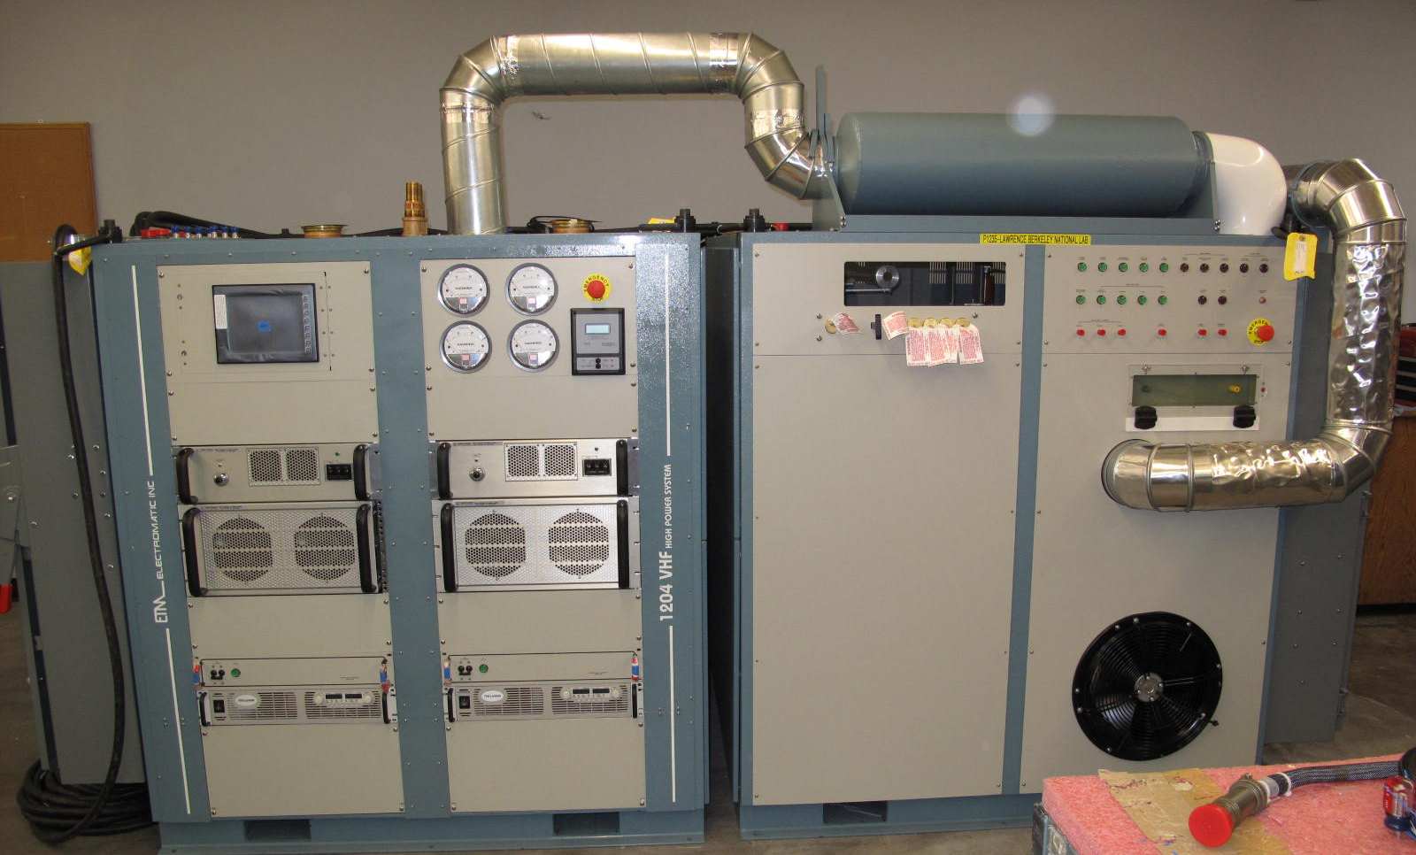
Commercial Vendor Developed High Power Amplifier
HPA developed by ETM Electromatic For LBNL working under a DOE Contract.
  Order placed in June 2009
  Production testing to be completed May 2010
  Delivery expected May 2010
Approximate costs $1M for HPA and HVPS only.
Parameter | Expected
Frequency | 187 MHz
Bandwidth (-1dB) | 3 MHz
Filament Voltage | 7.5 V
Anode Voltage | 9.6 kV
Anode Current | 9.7 A
Screen-grid Voltage | 710 V
Screen-grid Current | 310 mA
Control-grid Voltage | -110 V
Control-grid Current | 180 mA
TH 571B RF Input | 1.4 kW
RF Output | 2 x 60 kW
HPA
HVPS
Approximately 3.3m W x 1.55m H x 1.5m D and 4,300 kg
*Ken Baptiste, et. al. Lawrence Berkeley National Lab

Slide 22
Buncher and Injector Cryomodule HPRF requirements
Total injector RF power to the beam < 20 kW
Frequency is 748.5 MHz
The bulk of the acceleration comes from the 5-cell cavity:
Margin added for
  Microphonics
  Cavity detuning effects
  Non-ideal loaded-Q
Currently the predicted RF Power needs are:
  5-cell cavity approximately 25 kW
  1-cell cavities less than 10 kW
  Buncher cavity less than 5 kW
The Current plan is to use off the shelf IOT technology for the system.
DC power compatible with pulsed cavity and beam operations is critical.

Slide 23
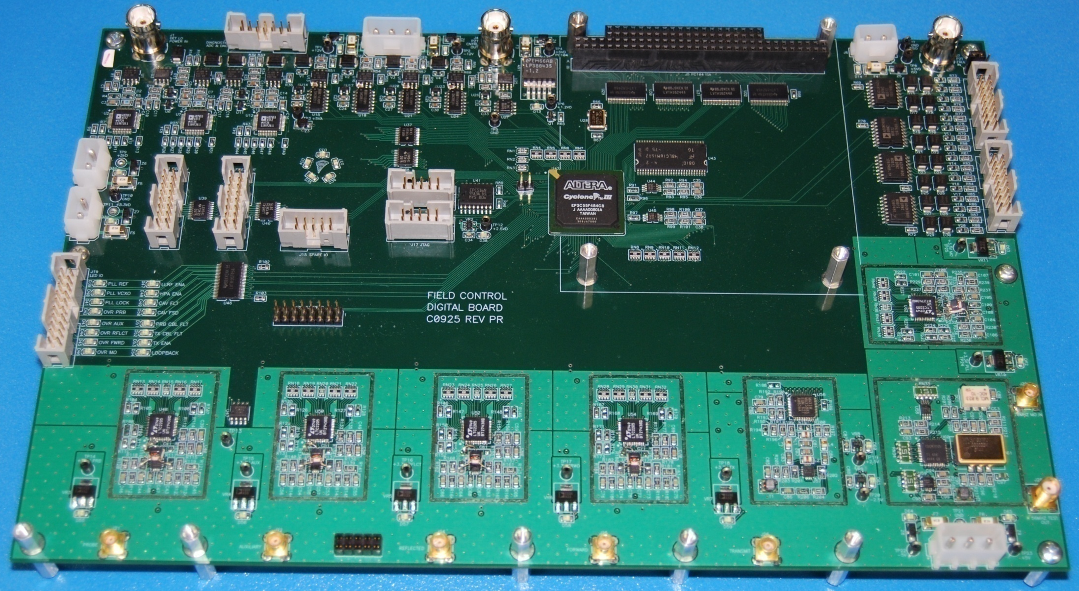
Low Level RF
LLRF system based on 12 GeV upgrade system.
  Common digital board, interface and packaging
  100 units currently in production
  Will require the development of two new RF front end daughter cards one for 748.5 MHz and one for 187.125 Mhz.
Drive/Seed laser will use the same control electronics.
  Will be designed such that the standard LLRF module will control drive and seed laser phase and frequency.
  Will require development of tuning algorithms as well as a method to synchronize other electro optical devices to the drive laser micro pulse repetition frequency.
  Seed Laser will make use of beam based phase feedback system for tracking beam phase drifts.
Fiber optic based timing system required for triggering of end station experiments, and desirable for the injector and linac synchronization.

Slide 24
Linac RF Requirements
Linac RF to be copies of the CEBAF 12 GeV systems.
  Will make use of existing infrastructure and personnel.
  Will make use of existing spare parts, test fixtures, etc.
  Substantially reduced NRE.
  If the timing works we can purchase components as options on existing contracts.
Klystron based system.
  13 kW saturated power.
  24 klystrons plus spares to be purchased.
  Current vendor costs is approximately $45k per klystron.
DC Power to be copies of 12 GeV hardware
  16 kV
  14 Amps per zone
  Interlocks, HPA and controls are CEBAF designs used for the 12 GeV project.
  Current vendor costs approximately $115k per 8-klystron zone.
Requires new circulators, loads, and some waveguide hardware
Controls, packaging and system integration are an in-house effort.
Notes:
Total RF systems costs installed and commissioned including labor are estimated at about $6 Million of today’s dollars which is about 8% of the project costs.

Slide 25
JLAMP FEL designed for unparalleled
10-100 eV average brightness
600 MeV, 2 pass acceleration
200 pC, 1 mm mrad injector
Up to 4.68 MHz CW repetition rate
Recirculation and energy recovery
10 nm fundamental output, 10 nm/H harmonic
50 fs-1000 fs near-Fourier-limited pulses
Baseline: Seeded amplifier operation using HHG
HGHG amplifier + oscillator capability
THz wiggler for synchronized pump/probe

Slide 26
JLAMP FEL Will be a Multi-Lab Cooperative Effort
Lawrence Berkeley National Lab
  NCRF Gun and VHF amplifier
  Injector design studies
  Fiber optic based timing system development
Brookhaven National Lab
  X-Ray Beam Line Design
  X-Ray End Stations
Sandia National Lab
    X-Ray End Stations
Lawrence Livermore National Lab
  X-Ray End Stations
Pacific Northwest National Lab
  Photocathode development
Others ? ? ?

Slide 27
JLAMP – 4th Generation VUV/Soft X-Ray Light Source
Operates from 7 eV table-top laser energy to 500 eV with harmonics
3 to 6 orders of magnitude brighter than FLASH
Scientific case focused on DOE-BES Grand Challenges from world-class committee
  Materials science
  AMO (Atomic, Molecular, Optical Science)
  Imaging
Secondary goals address BES R&D priorities (injector, srf, collective effects, seed lasers) for next generation hard X-ray photon facility
< $100M and fast schedule since it builds on existing FEL infrastructure
Collaborative effort with support and funding from ? ? ?
Notes:
27

Slide 28
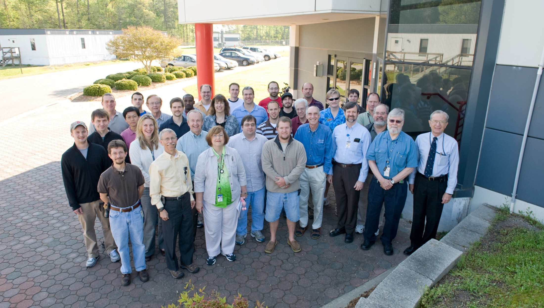
The Jefferson Lab FEL Team
This work supported by the Office of Naval Research, the Joint Technology Office, the Commonwealth of Virginia, the DOE Air Force Research Laboratory, The US Army Night Vision Lab, and by DOE under contract DE-AC05-060R23177.

Slide 29
Backups
Notes:
29

Slide 30
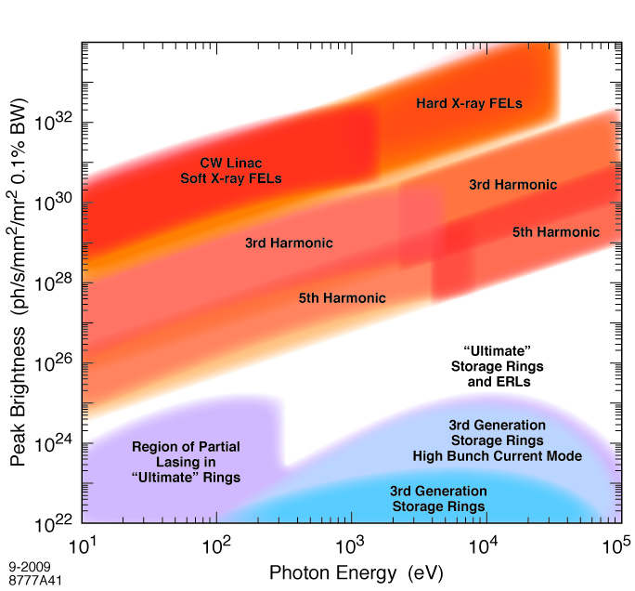
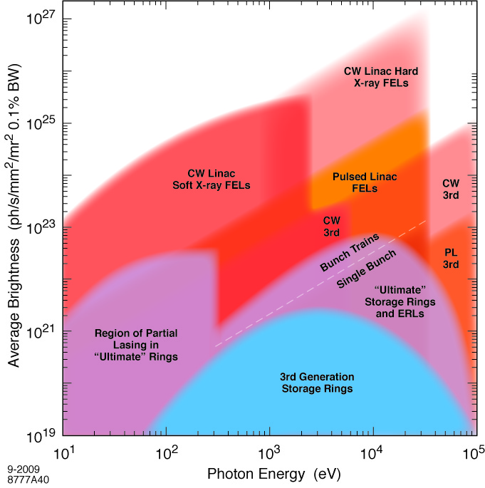

JLAMP in the Light Source Landscape
Ultimate LS
FLASH
LCLS
JLAMP
JLAMP
NGLS
NGLS
JLAMP
harmonics
JLAMP
harmonics
LCLS
FLASH
JLAMP delivers important parameter space un-addressed in hard X-ray proposals, with chemical selectivity to measure atomic structure at the nano-scale, measurement of dynamics on the attosecond timescale of electron motion, and imaging

Slide 31
User Topic Summary
Condensed matter physics
  Ultrafast photoemission spectroscopy of coherently controlled complex materials
  Femtosecond Pump/Probe ARPES in artificial nanosystems
  Electronic states in strongly correlated systems using soft X-ray scattering
Chemical physics and Atomic, Molecular, Optical physics
  Matter at small dimensions
    Atomic and electronic structure of size-selected clusters
    Chemical reactivity of size-selected neutral clusters and nanoparticles
    Time-resolved nanoscale “surface” dynamics
  Molecular movies
    Electronic dynamics using time-resolved ESCA
    Time-resolved photoelectron diffraction in gas-phase molecules
  Ultrasensitive trace analysis of noble gas isotopes
Imaging biological and soft condensed matter
  High resolution structural determinations of non-periodic materials and dynamic studies of soft matter

Slide 32
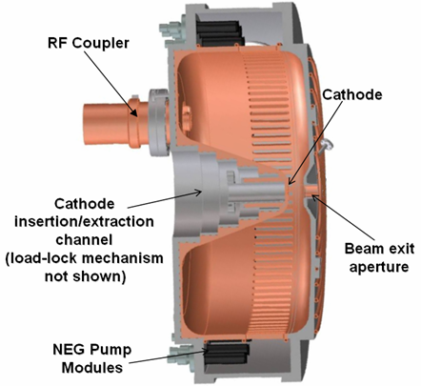
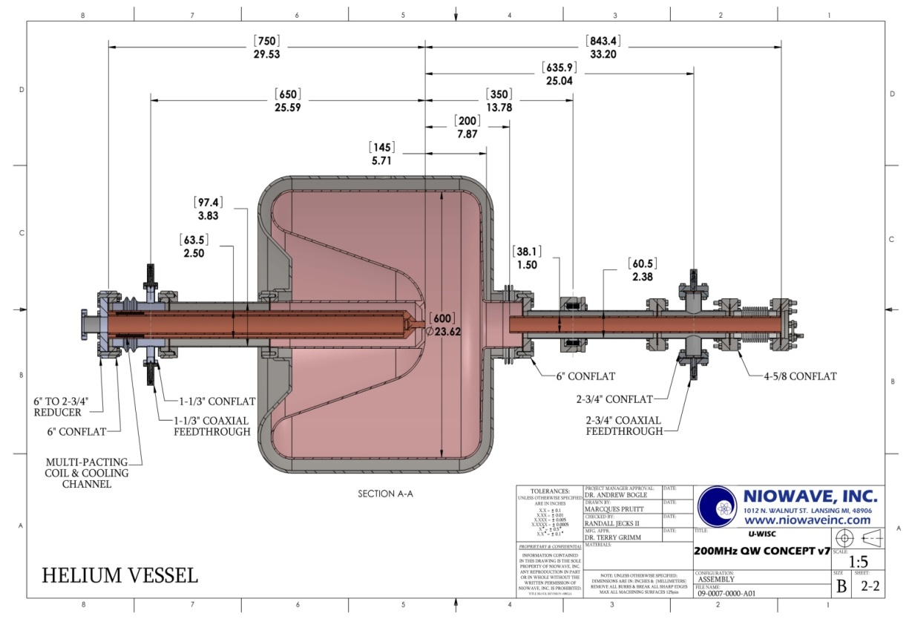


Many approaches for a CW High Brightness Gun – but none working yet
JLab Advanced DC Gun
LBNL Low Frequency RF Gun
F. Sannibale
C. Hernandez-Garcia
WiFEL/Niowave SRF Gun
J. Bisognano

Slide 33
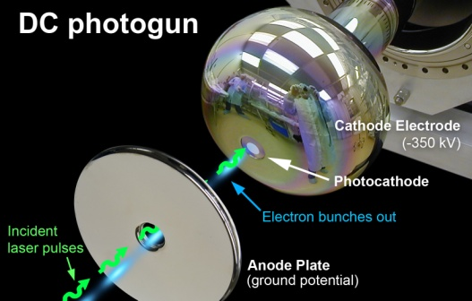
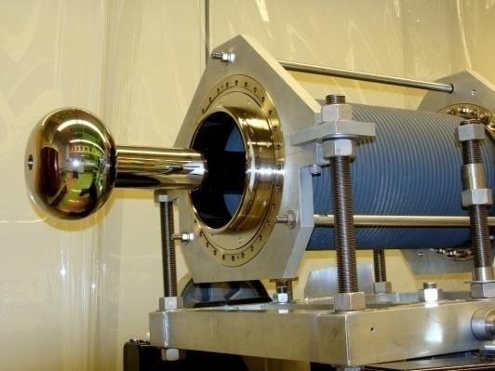
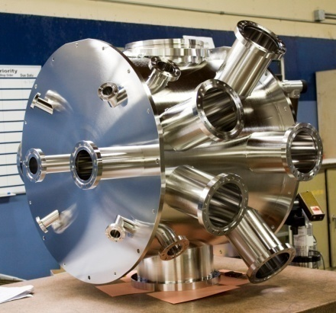
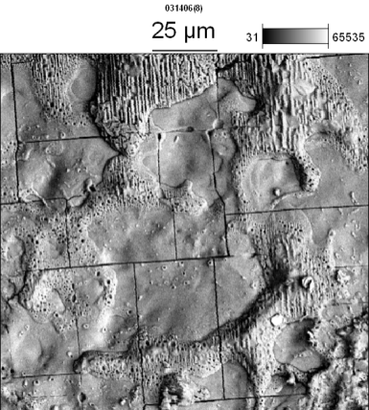
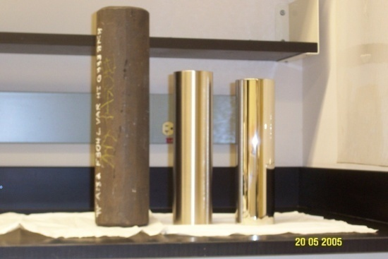
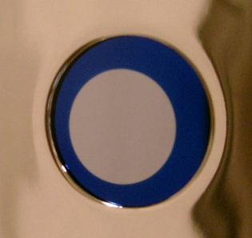
HV DC Photoemission Guns for 4th Generation Light Sources
Carlos Hernandez-Garcia, Jefferson Lab
The 4GLS accelerators need unprecedented average brightness electron beam (sub-micron emittance like the LCLS injector AND >10 mA CW beam like the Jefferson Lab FEL injector)
Such an electron beam has not been demonstrated and represents a major technical challenge
We need support for R&D on fundamental cathode physics (electron emission) and on electron beam dynamics near the cathode surface
The JLab FEL team is developing the next generation of High Voltage DC electron guns designed to meet the beam requirements for high repetition rate VUV and soft X-ray accelerator based light sources
Electron pulses are generated when the GaAs photocathode is illuminated with laser pulses operating at a sub-harmonic of the accelerator frequency
The FEL gun has delivered a record 7000 Coulombs and over 900 hours of CW beam time between 2004 and 2007. At 10 mA and 350kV DC is the most powerful photoemission gun to ever power an FEL.
Fresh GaAs photocathode
Used GaAs photocathode
25 mm
Field emission from electrodes represents one of the technical challenges of ultra-high brightness and high current photoguns
Photocathode robustness at unprecedented average current is key for an user facility but has not been demonstrated yet

Slide 34
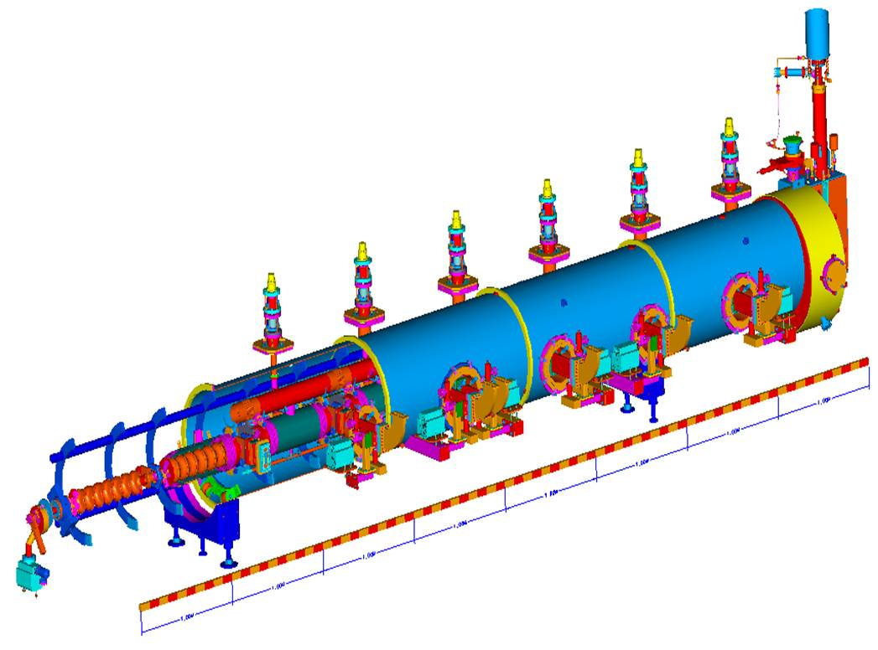
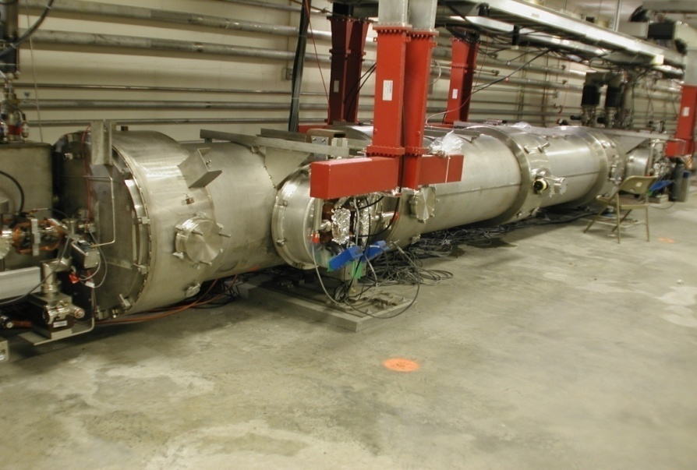
100 MeV High Gradient Module
Component procurements awarded for JLab 12 GeV Machine – 10 modules
Insulating vacuum
Multicell cavities
2K liq. He bath
Original CEBAF module

