Slide 1
High Power RF Processing of Couplers/Windows and Cavities for SNS Linac
Y. Kang
M. Crofford
T. Hardek
S. Kim
J. Mammosser
R. Peglow
C. Phibbs
A. Vassioutchenko
RAD/SNS/ORNL
6th CW and High Average Power RF Workshop
ALBA, Barcelona, Spain
May 4-7, 2010

Slide 2
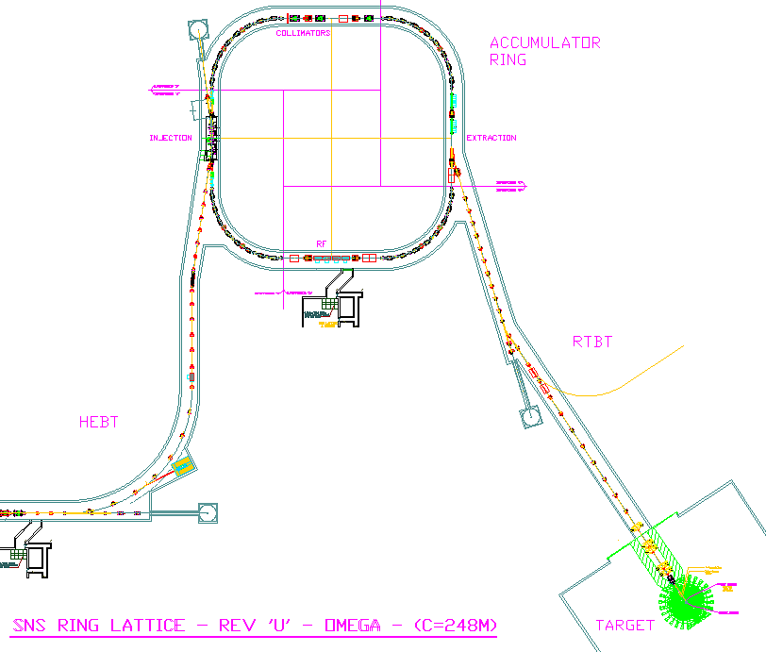
Machine layout
Front-End: Produce
a 1-msec long, chopped, H-beam
H- stripped to p
Linac; 1 GeV acceleration
Accumulator Ring;
Compress
1 ms long pulse
to 700 ns
402.5 MHz
805 MHz
RFQ
DTL
CCL
SRF, β=0.61
SRF, β=0.81
Liquid Hg Target
Injector
2.5
86.8
186
387
1000 MeV
945 ns
midi-pulse
Current
Current
1 ms macro-pulse
1ms
Chopper system makes gaps
Presentation_name
Notes:
2

Slide 3
SNS RF Systems
Linac
HEBT
Ring
Front End
H - Injector
RFQ
MEBT &
Chopper
DTL
CCL
SCL
Ring
2 MHz
80 kW
1 x IS
2.5 MeV
402.5 MHz
20 kW
4 x MEBT
86.8 MeV
185 MeV
1000 MeV
402.5 MHz, 2.5 MW
1 x RFQ
6 x DTL
805 MHz, 5.0 MW
4 x CCL
1 x HEBT
805 MHz, 550 kW
81 x SCL
1 MHz, 500 kW
4 x Ring
All SNS linac RF systems are pulsed at 8% duty cycle (1.3 msec, 60 Hz)

Slide 4
High Power Window/Couplers in SNS Linac
RFQ powered by one 2.5 MW Klystrons
  2 windows for 402.5 MHz Radio-frequency Quadrupole (RFQ)
6 DTL tanks powered by 2.5 MW Klystrons
  6 windows for 402.5 MHz Drift tube linac (DTL) cavities
4 CCL structures powered by 5 MW Klystrons
  Each CCL structure has 2 input ports
  Klystron output is divided with a quadrature hybrid
  8 windows for 805.0 MHz Coupled cavity linac (CCL) cavities
SCL cavities
  33 medium beta cavities in 11 cryomodules (with 0.55 MW Klystrons)
  48 high beta cavities in 12 cryomodules (with 0.55 MW Klystrons)
  81 windows for 805.0 MHz Superconducting linac (SCL) cavities
  36 high beta cavities will be added (9 cryomodules) in future power upgrade project

Slide 5
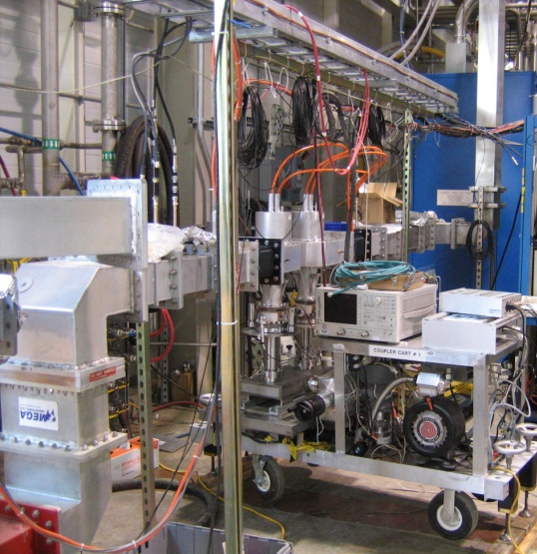
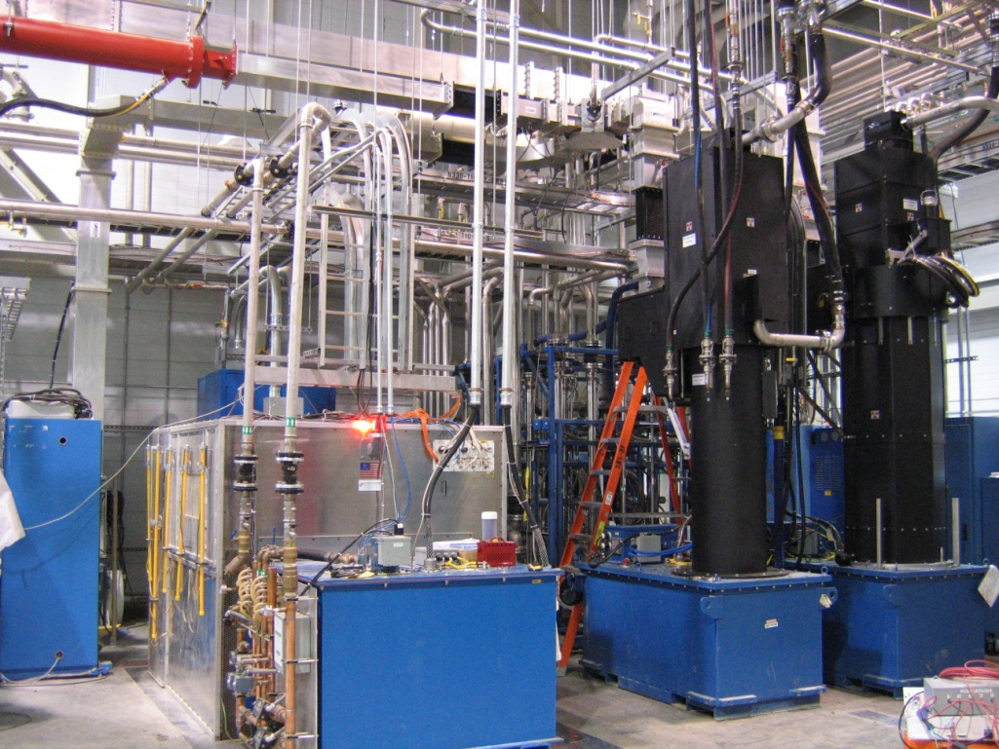
RF Processing in SNS RF Test Facility
High power RF testing and processing can be performed at 8% duty (1.3 msec 60 Hz)
  805 MHz, up to 5 MW peak power
  402.5 MHz, 2.5 MW max. peak power
  Complete low-level RF control and monitoring for reliable processing and operation in EPICS environment
SCL cavities and cryomodules are prepared and processed
  Cryomodules high power RF tested in test cave after repairs
  New cryomodule is being assembled (Building a medium-beta cryomodule will start)
  SRF cavities are plasma processed
More than 60 windows/couplers including new spares have been conditioned for RFQ, DTL, CCL, and SCL
  42 of 81 power couplers of the SNS SRF cavities were RF processed in the RF Test Facility during construction of SNS cryomodules
  Several cavity window/couplers for RF frequencies different from SNS frequencies were processed

Slide 6
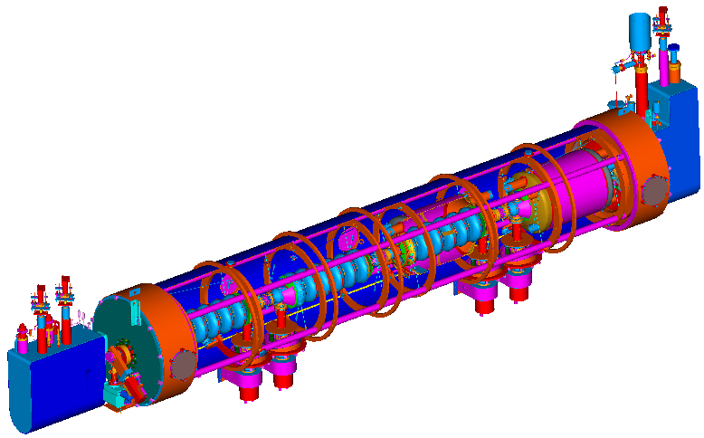
SNS SCL Cryomodules
Designed to operate at 2.1 K (superfluid helium)
Total 81 cavities in 23 Cryomodules
  med-β: 33 6-cell cavities in 11 cryomodules
  high-β: 48 6-cell cavities in 12 cryomodules
Medium Beta Cryomodule (β=0.61)
Return end can
Helium vessels
Space frame
Supply end can
Fundamental power couplers
High Beta Cryomodule (β=0.81)

Slide 7
SCL Present Status
Careful high power testing delivered practical operational limits of cavities (not fundamental limits) but to set a safe operating gradient (Sang-ho Kim)
SCL is providing a reliable operation for neutron production following SNS power ramp-up
930 MeV + 10 MeV (energy reserve)

Slide 8
SCL Considerations (J. Mammosser, S-H. Kim)
For > 1GeV operation with high system availability
  high-beta gradients need to be improved
  Collective system performance with other improvement
In-situ plasma processing of cavities successfully tested with possibility of 2 - 3 MV improvement per cavity
  More poorly performing high-beta cavities will be processed
Production of spare cryomodules with better performing cavities
  Building one high-beta cryomodule is under way and one medium-beta cryomodule will start
  Completion of SRF Facility (AIP Project)
Changes on the Cavities
  couplers are interlocked with e-current measurement (interlock using degrading CCGs abandoned)
  HOM feedthroughs will be taken out as needed
  Will not have HOM couplers for new cavities

Slide 9
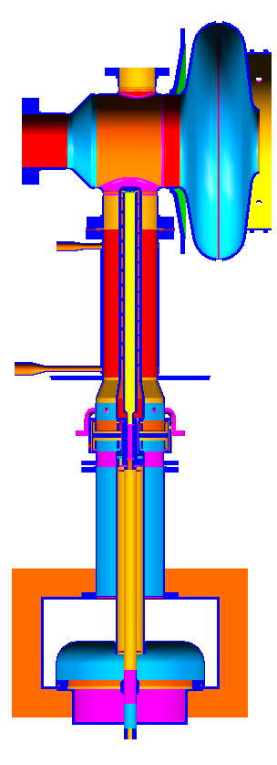
SCL Fundamental Power Coupler
6-cell cavity
Present coupler specifications:
  550 kW peak
50 kW average
  Qext ~ 7 x 10⁵
Performance:
  Conditioned up to 650 kW power in traveling wave and 2.4 MW power in standing wave
  Over 500 kW peak power in linac cavity operation
Consideration
  Higher peak and average power capability for the future SNS power upgrade & more stable operation may require additional cooling at the antenna tip
Inner conductor
conduction cooled
GHe-cooled
outer conductor
Ceramic window
Inner conductor
water cooled
Waveguide
Door knob
Transition

Slide 10
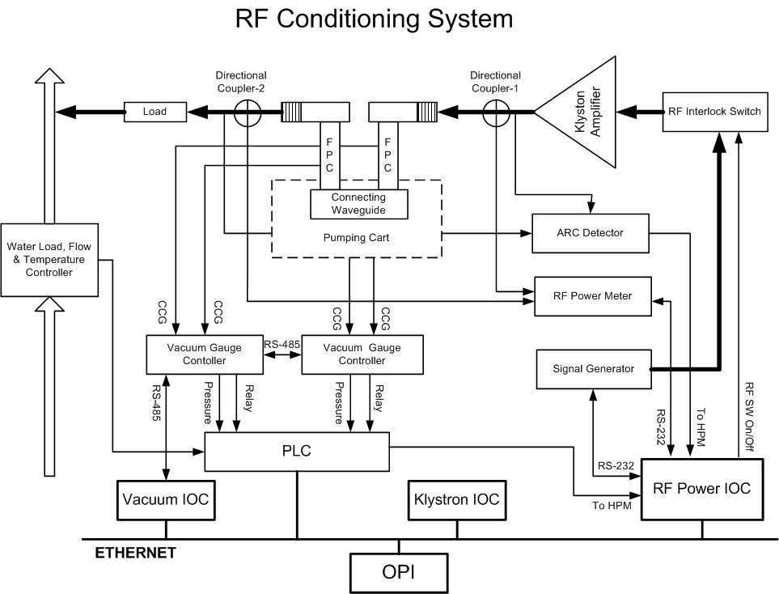
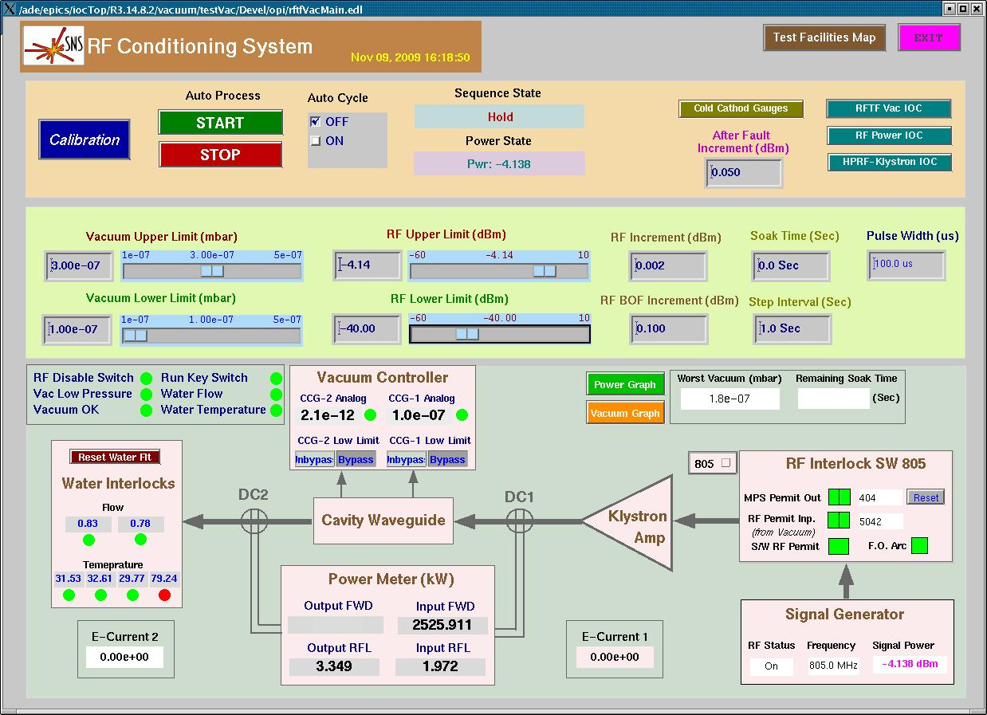
RF Processing Control Screen
Coupler RF Processing in EPICS

Slide 11
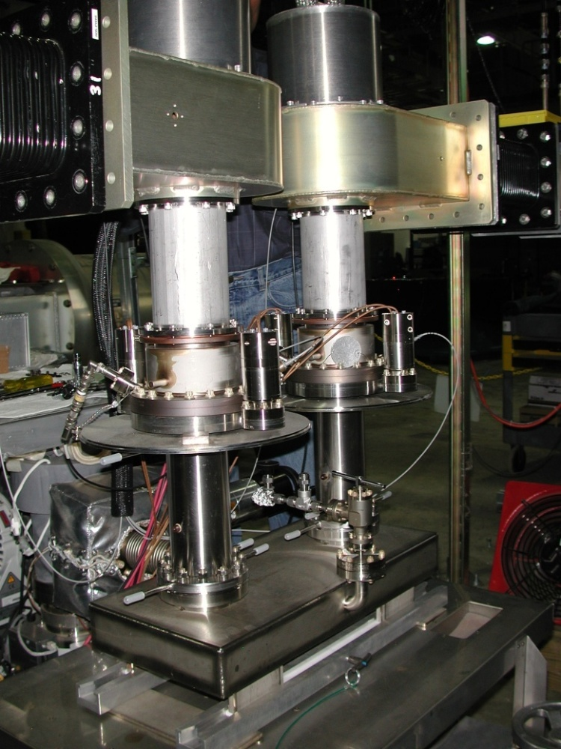

SCL Coupler Conditioning Setup
Coupler conditioning processes:
  Baked up to 200 °C with controlled slow ramp-up and cool down
  650 kW traveling wave to 6% duty cycle
  600 kW standing wave (2.4 MW peak) with variable waveguide short
  Use of DC biasing during conditioning

Slide 12
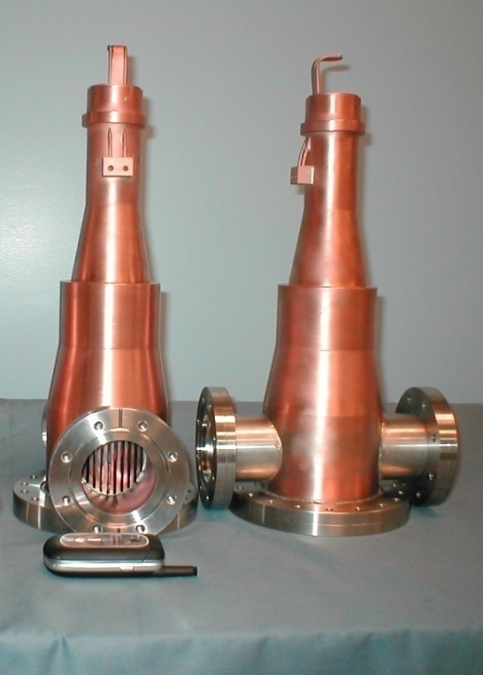
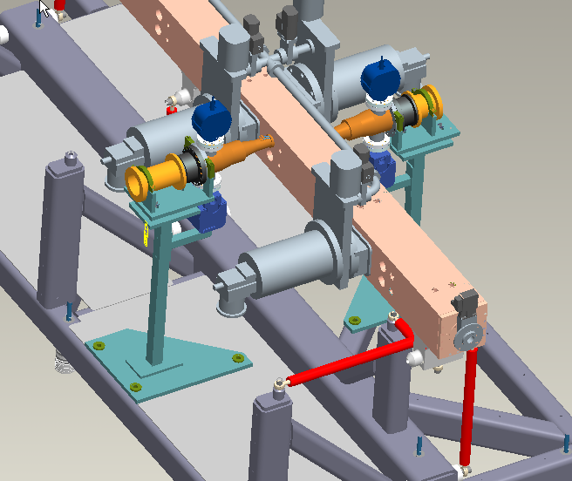
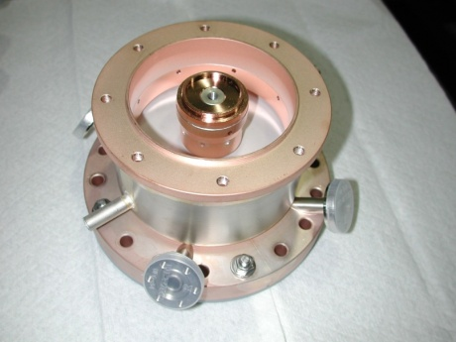
RFQ Window/Coupler Construction
RFQ system was upgraded with two coupler configuration (from 8 coupler configuration)
  Use a magic-T hybrid power splitter with a water load on the isolation port
  Operate at ~ 800 kW (400 kW / coupler)
  Use coupler ports farther away from the H- ion-source for better vacuum condition
New couplers designed using SCL coupler window routinely conditioned to 600 kW peak power @ 6% duty in traveling wave
  6 new couplers manufactured and RF conditioned at SNS/RFTF
  RF conditioned up to 450 kW @ 1 msec, 30 Hz through bridge waveguide

Slide 13
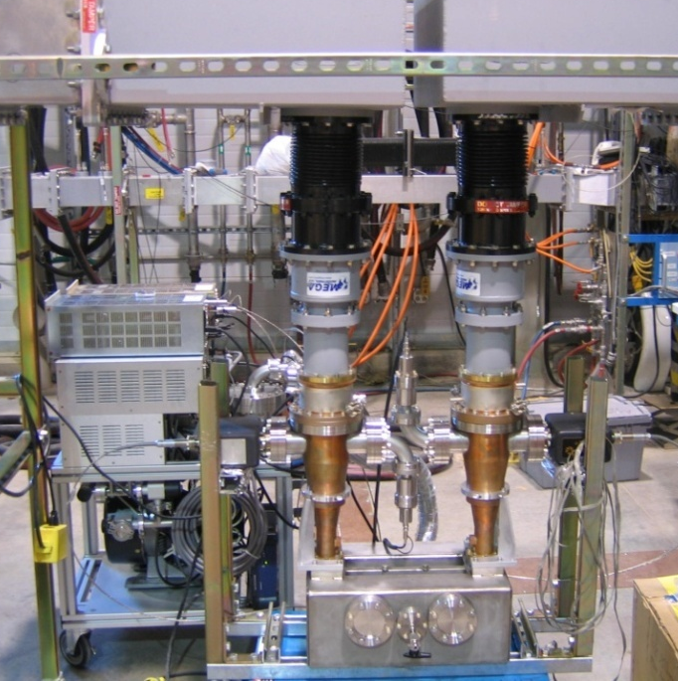
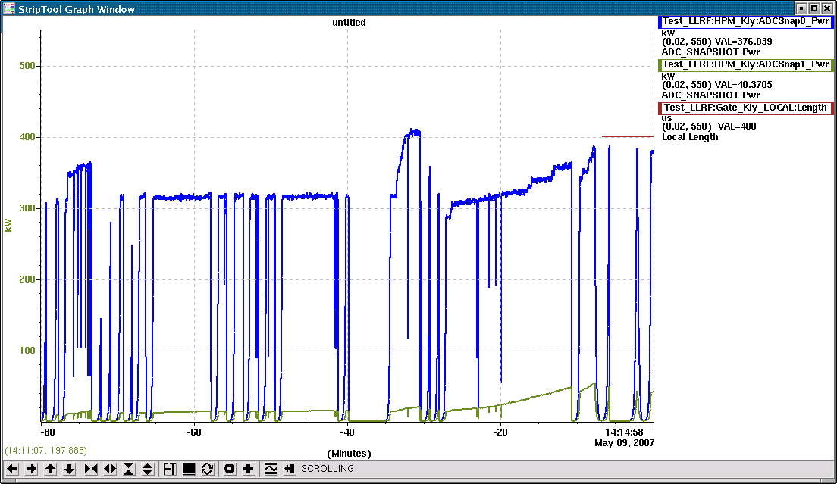
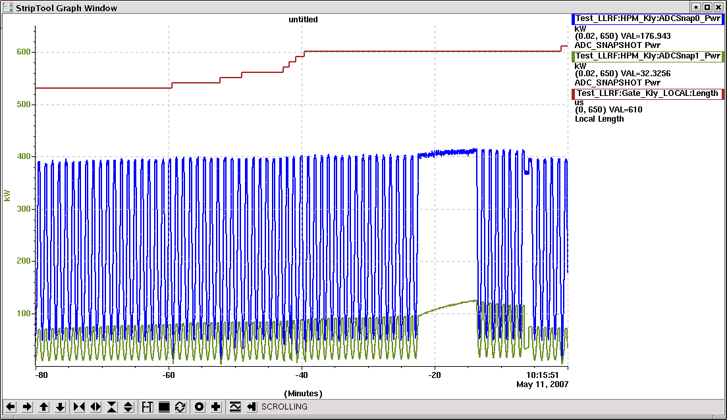
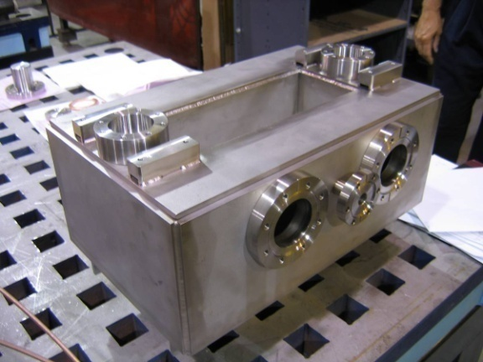
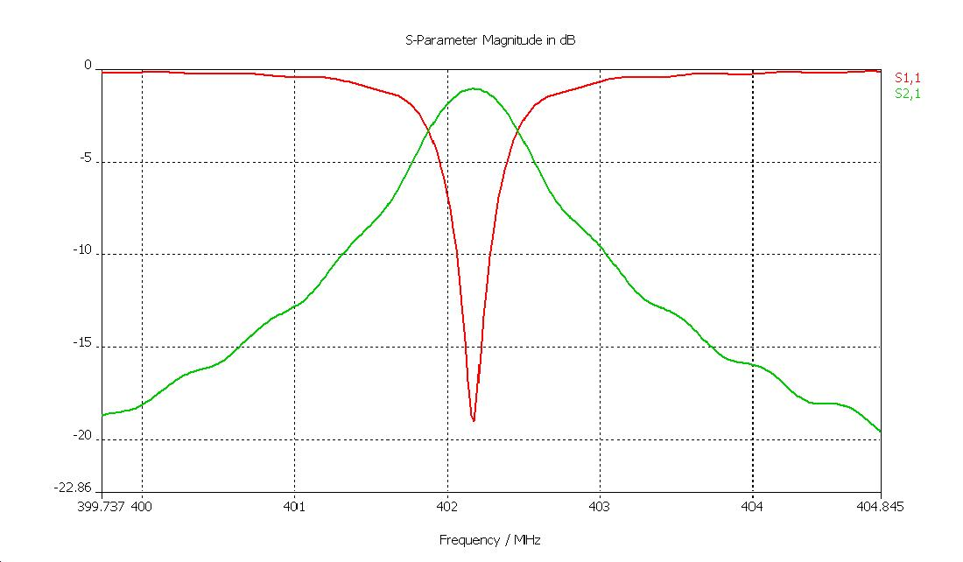
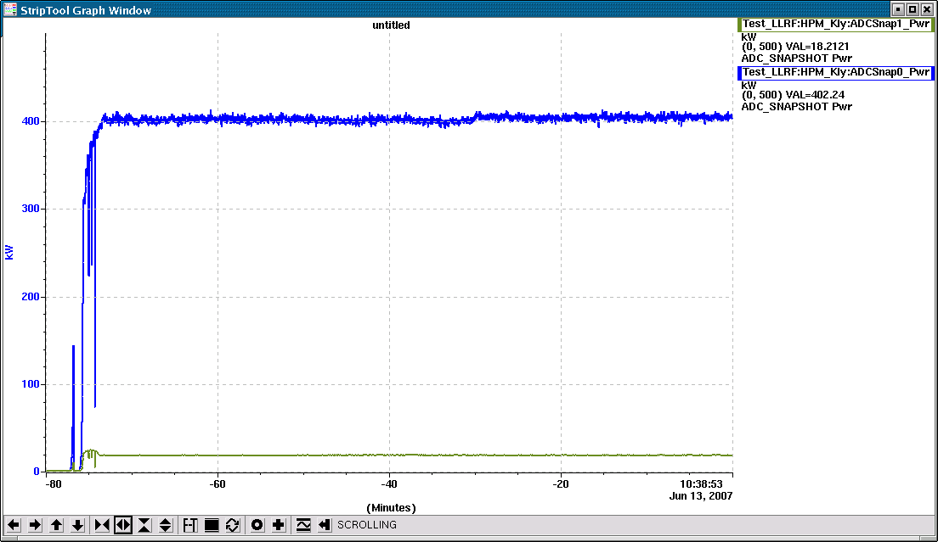
RFQ Coupler RF Conditioning
402.5 MHz operating frequency
Rectangular re-entrant cavity type (or ridge waveguide) is used as the bridge waveguide
Used special vacuum ports to accommodate the coupler loop antenna tip design
Return and insertion losses
through bridge waveguide and couplers

Slide 14
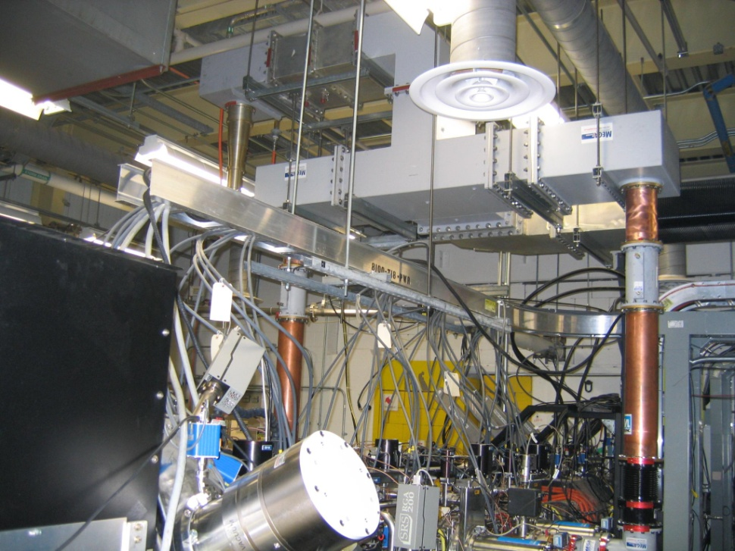
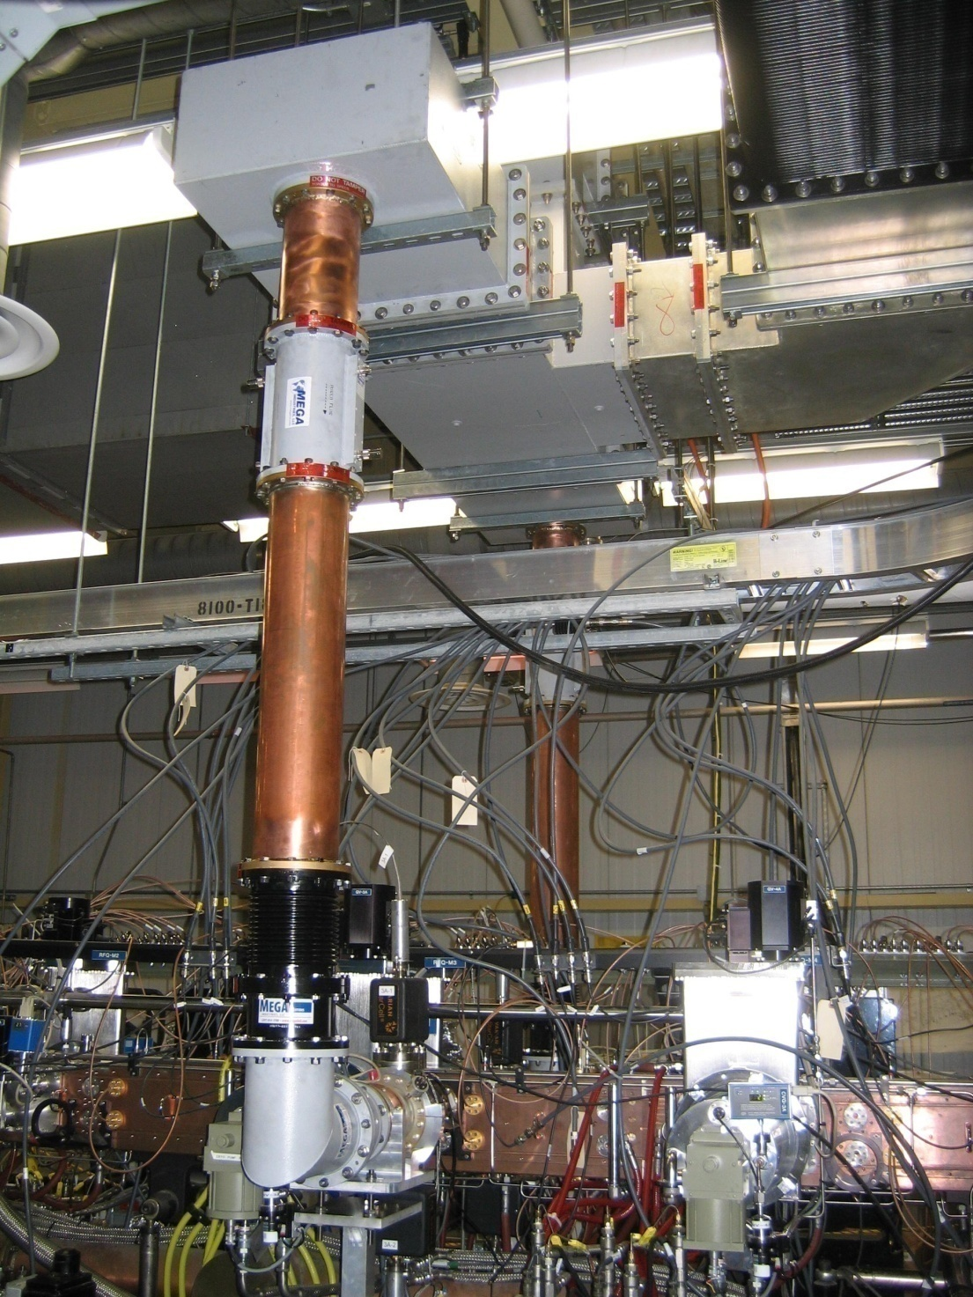
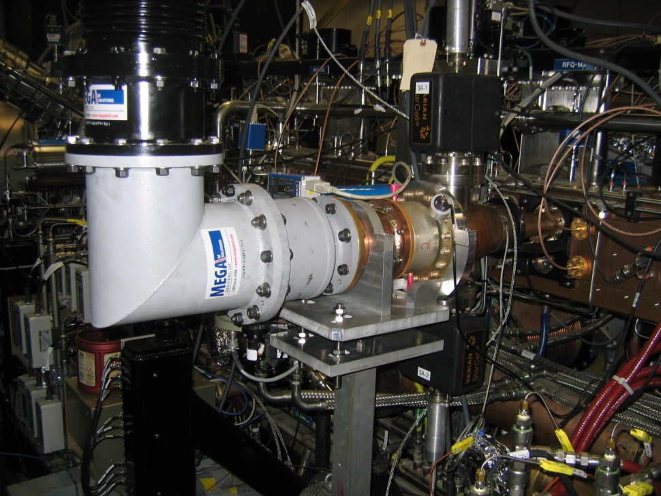
Upgraded RFQ Couplers

Slide 15
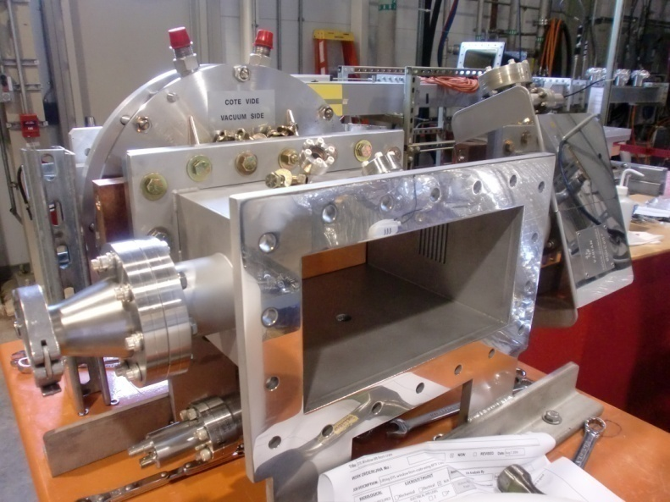
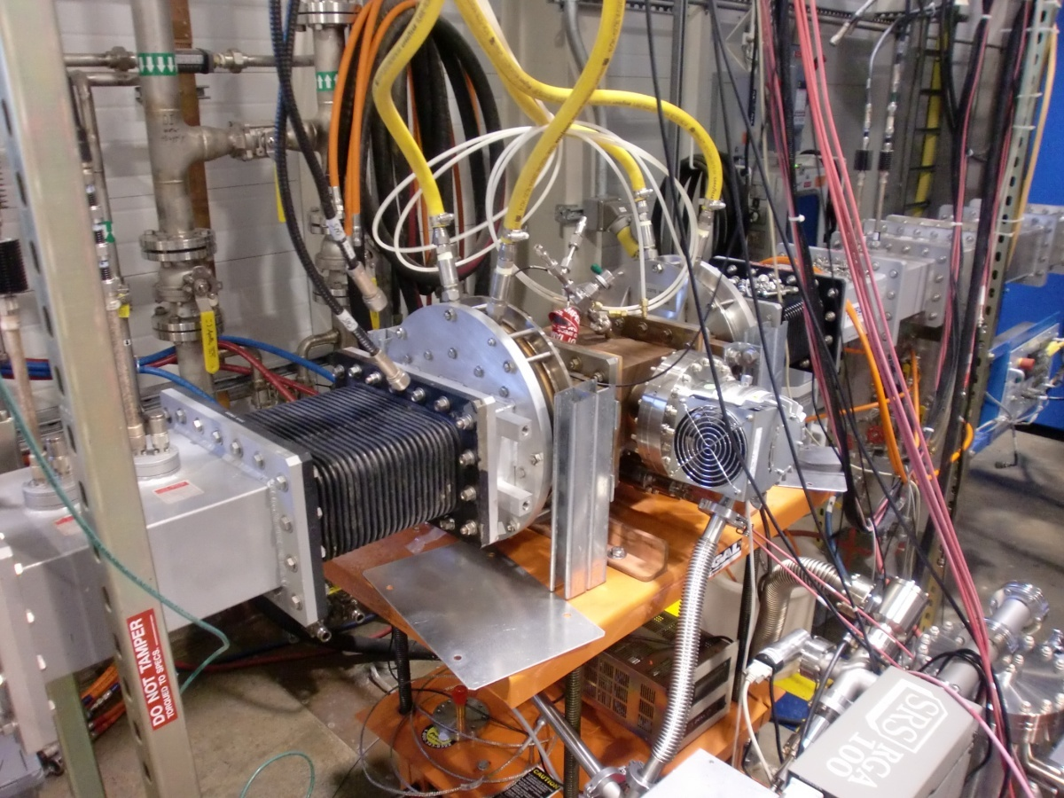
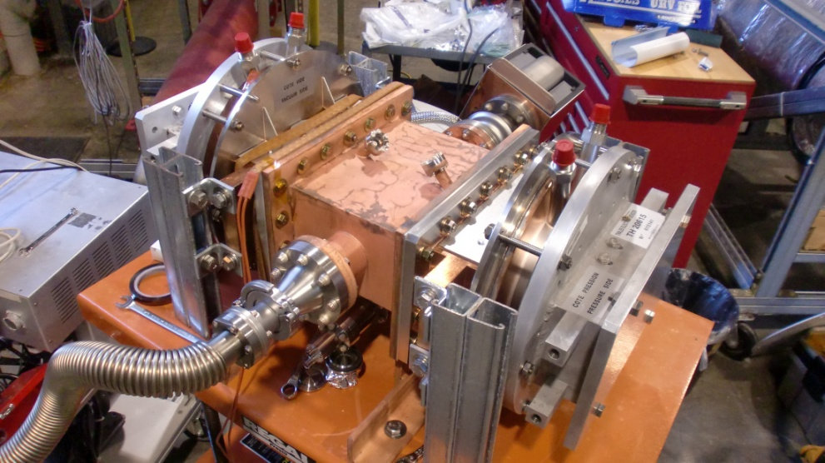
SNS CCL Window/Coupler Preparation
Bridge waveguide is copper plated
Pumping ports are equipped with RF screen
Extra ports are for arc detectors and vacuum gauges
Insertion loss of two windows with the bridge waveguide is <-0.03 dB
Baked for 48 hrs at 150 °C with 12 hrs ramp-up and 12 hrs cool down

Slide 16
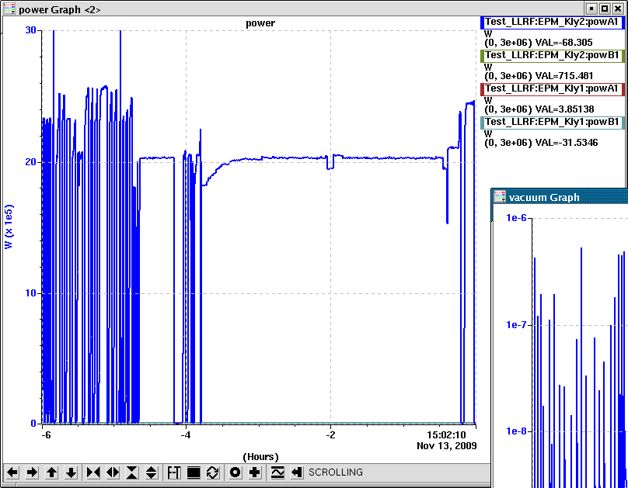
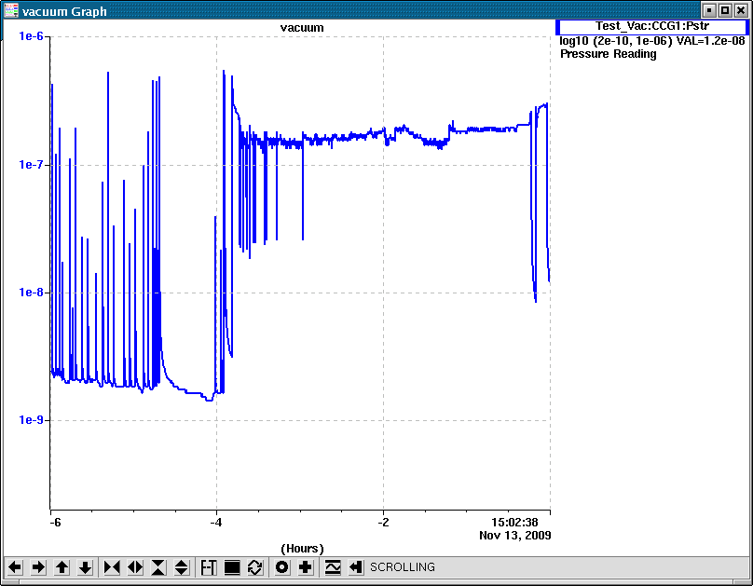
CCL Window RF Processing

Slide 17
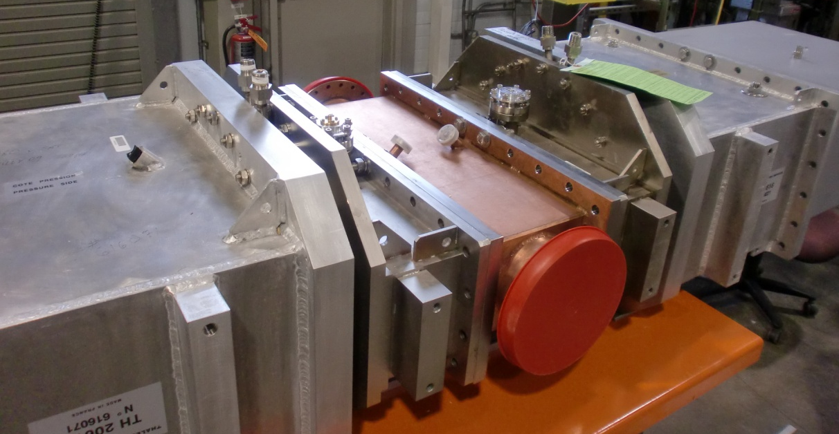
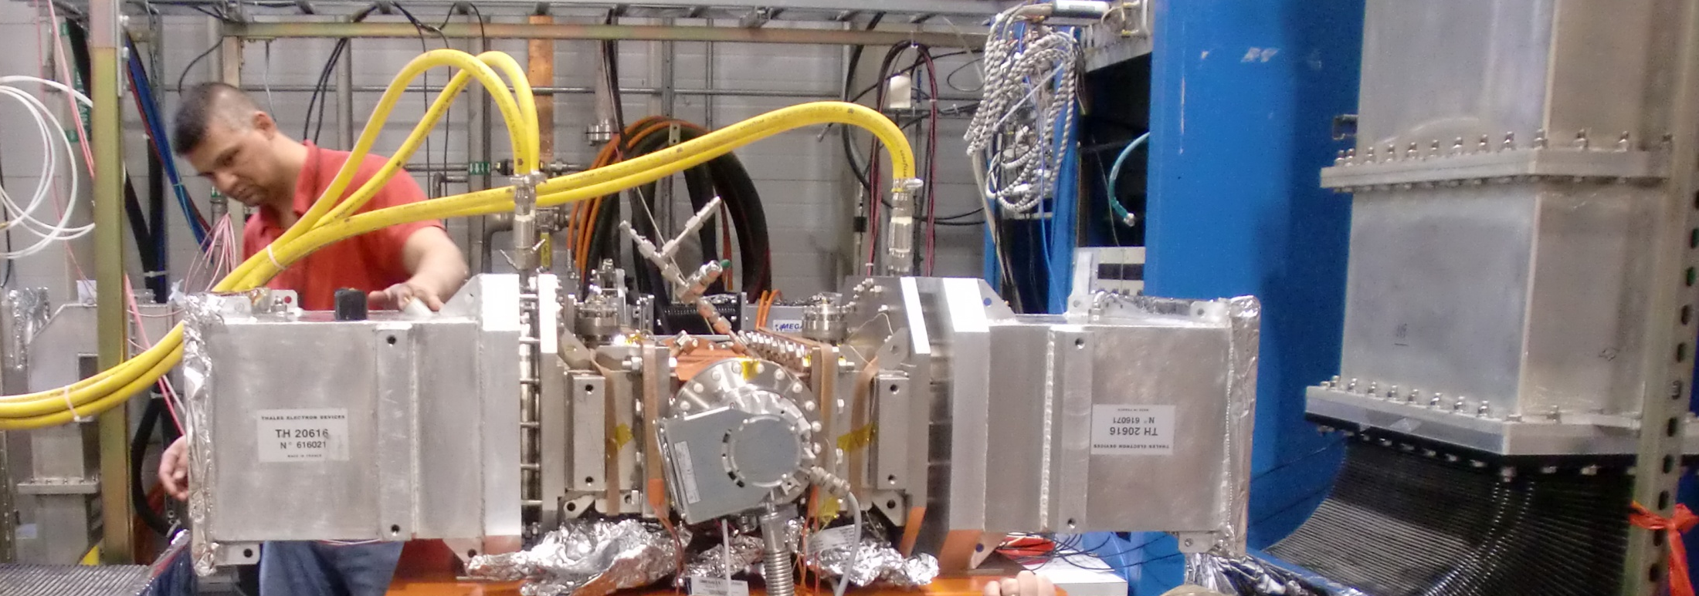
SNS DTL Window/Coupler Conditioning
Compact bridge waveguides have been built and copper plated
Spare windows for 402.5 MHz, 2.5 MW cavities have been conditioned
Conditioning setups for the DTL and CCL windows are similar except the waveguide dimensions

Slide 18
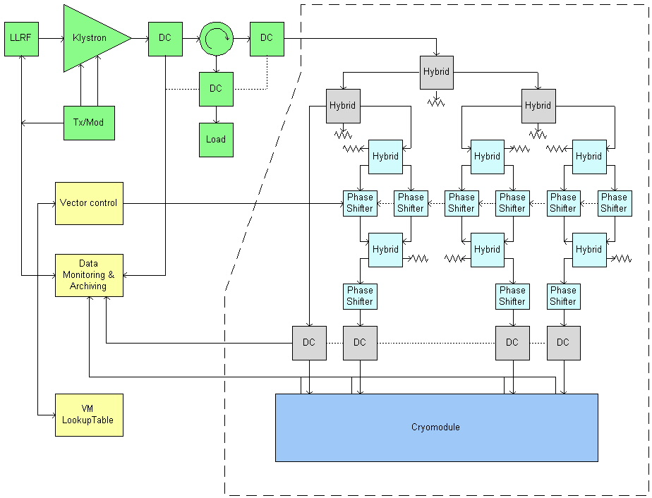
RF Distribution Setup for Cryomodule Test
(up to 4 cavities)
Vector
modulator

Slide 19
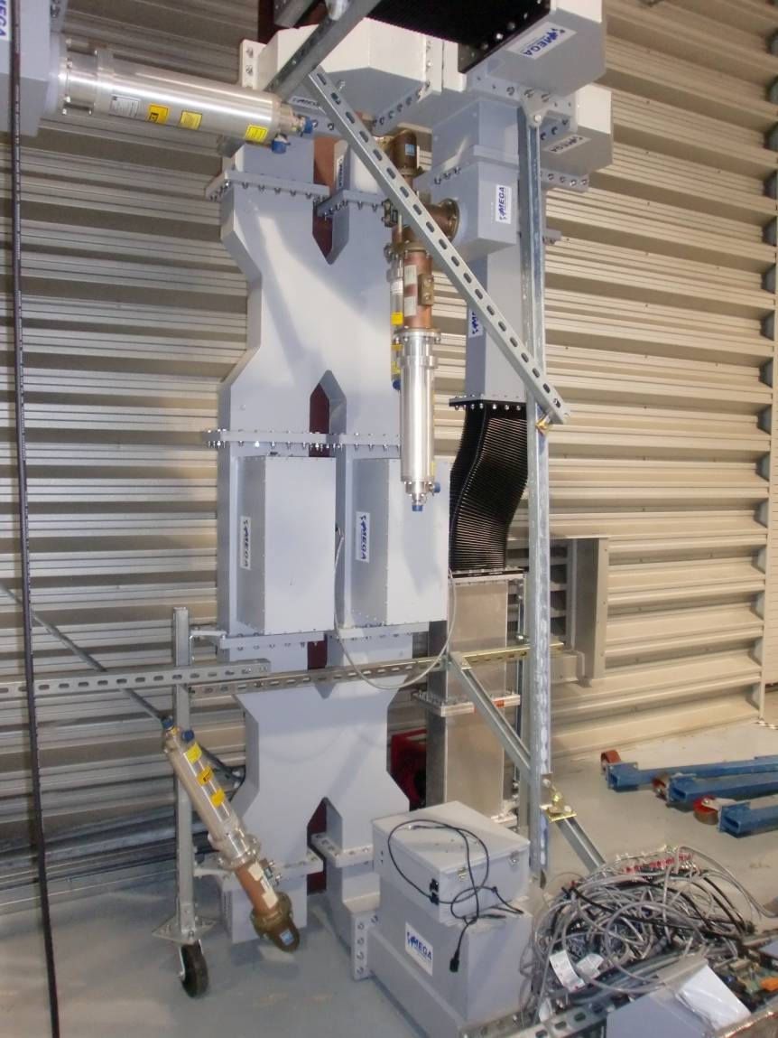
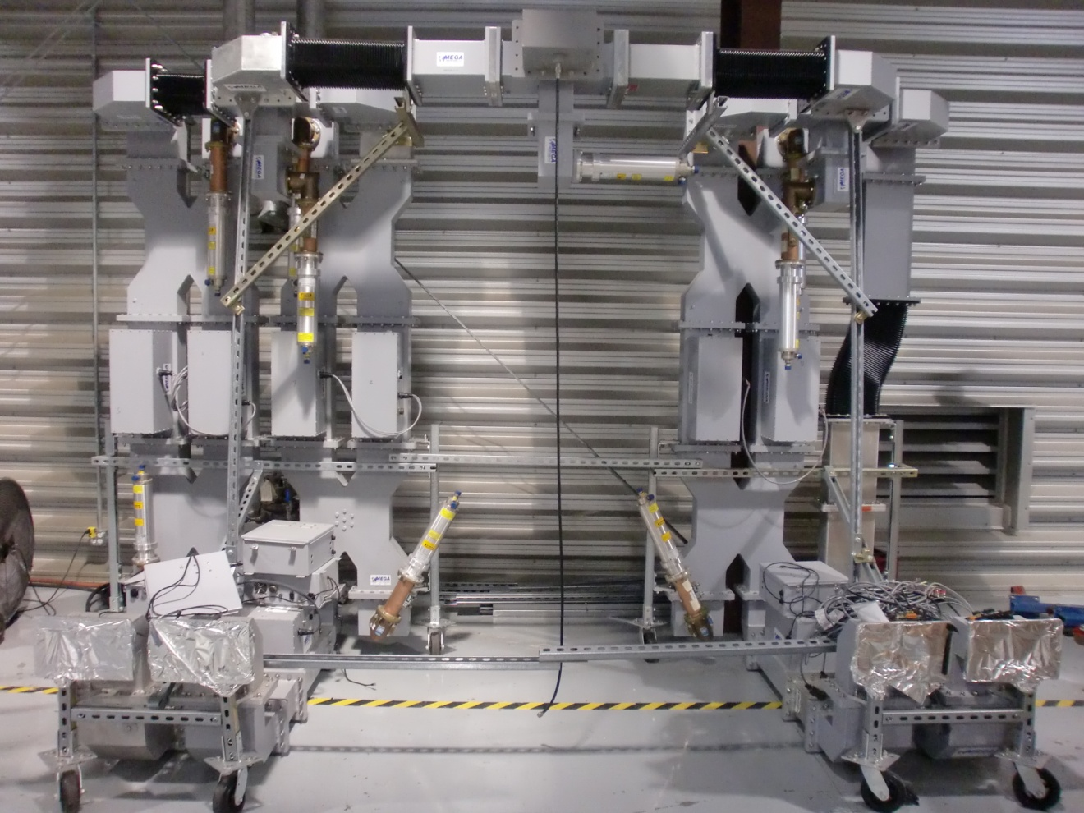
Waveguide Feed Network for Four Cavity Conditioning
Feed four SCL cavities with one klystron (available 5 MW tubes)
Use waveguide vector modulator employing the mechanical phase shifters
Adjust the power of four outputs connected to cavities to ±40% in amplitude and ±30° in phase

Slide 20
Summary
LINAC RF structures and their high power components are performing reliably with continuous improvements
RFTF completely equipped and operational:
  Two klystron tanks with complete waveguides in WR2100 (402.5 MHz) and WR1150 (805 MHz)
  One 11 MW peak power high voltage converter modulator (HVCM) for powering the klystrons up to 8% duty in 60 – 135 kV.
  Test cave measures 3.6 m x 8 m
  Clean room facility for SRF processing and other utilities for He cryo systems, vacuum, and water cooling
  Complete low-level RF control and monitoring for operation in EPICS environment
  Programmable bake out setup
Performed RF processing tasks successfully during construction, commissioning, and post-commissioning operation
  Conditioned new spare window/couplers have been conditioned for RFQ, DTL, CCL
  Conditioned more than 50 couplers for SCL
Ready for the upcoming power upgrade project (PUP) with assembling, testing, and conditioning of couplers and cavities

