Slide 1
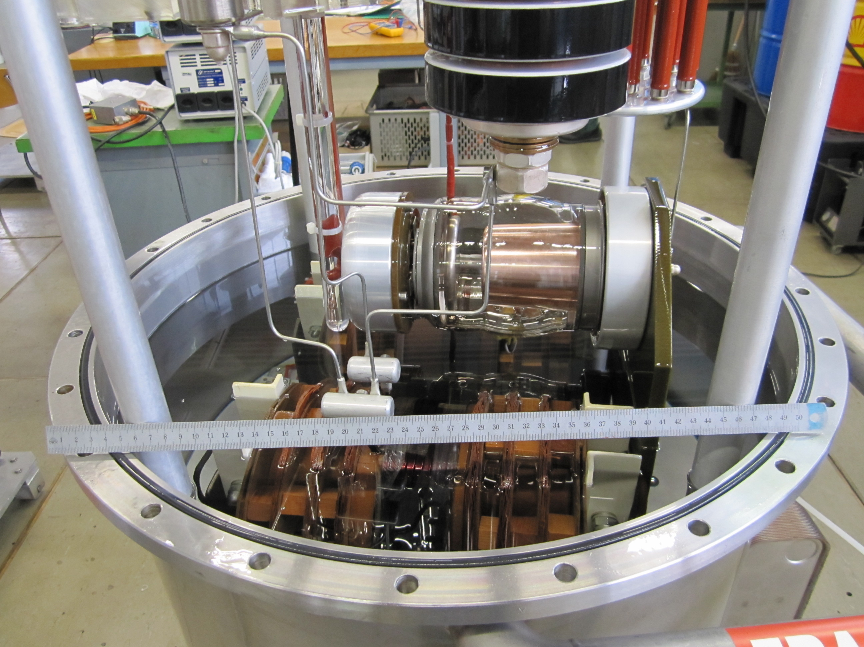
High voltage tetrode replacement in the LHC klystron modulator
Daniel Valuch

Slide 2
LHC RF
The LHC has 16 RF stations, each powered by 300 kW / 400 MHz CW klystron
Nominal DC working point of the klystron is 8.8 A @ 58 kV
The cathode current could be controlled by a means of “modulation anode”

Slide 3
LHC RF
With less intensity and only few bunches in the machine there is not need for the all available RF power and the full RF voltage
At the moment LHC needs only 5-8 MV (out of 16 MV) per beam

Slide 4
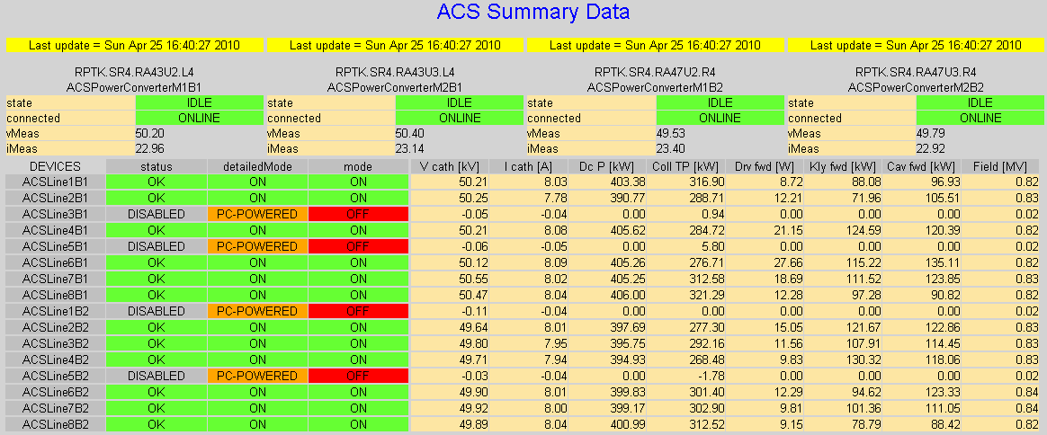
LHC RF

Slide 5
LHC RF
Reduce the RF drive and hence the total RF power
Reduce DC voltage by power convertor
Reduce DC current by mod. anode and keeping the HV constant
Run klystrons at full power and reduce number of powered cavities

Slide 6
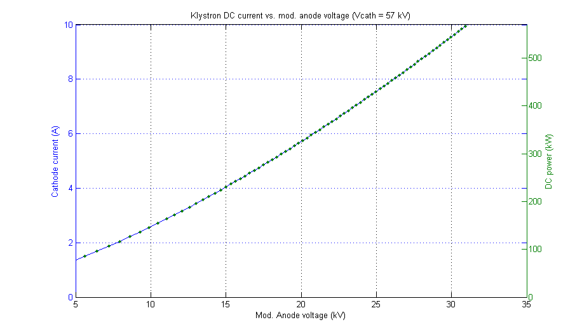
Klystron DC power vs. V_{MA}
Specified DC power limit
Current DC power limit

Slide 7
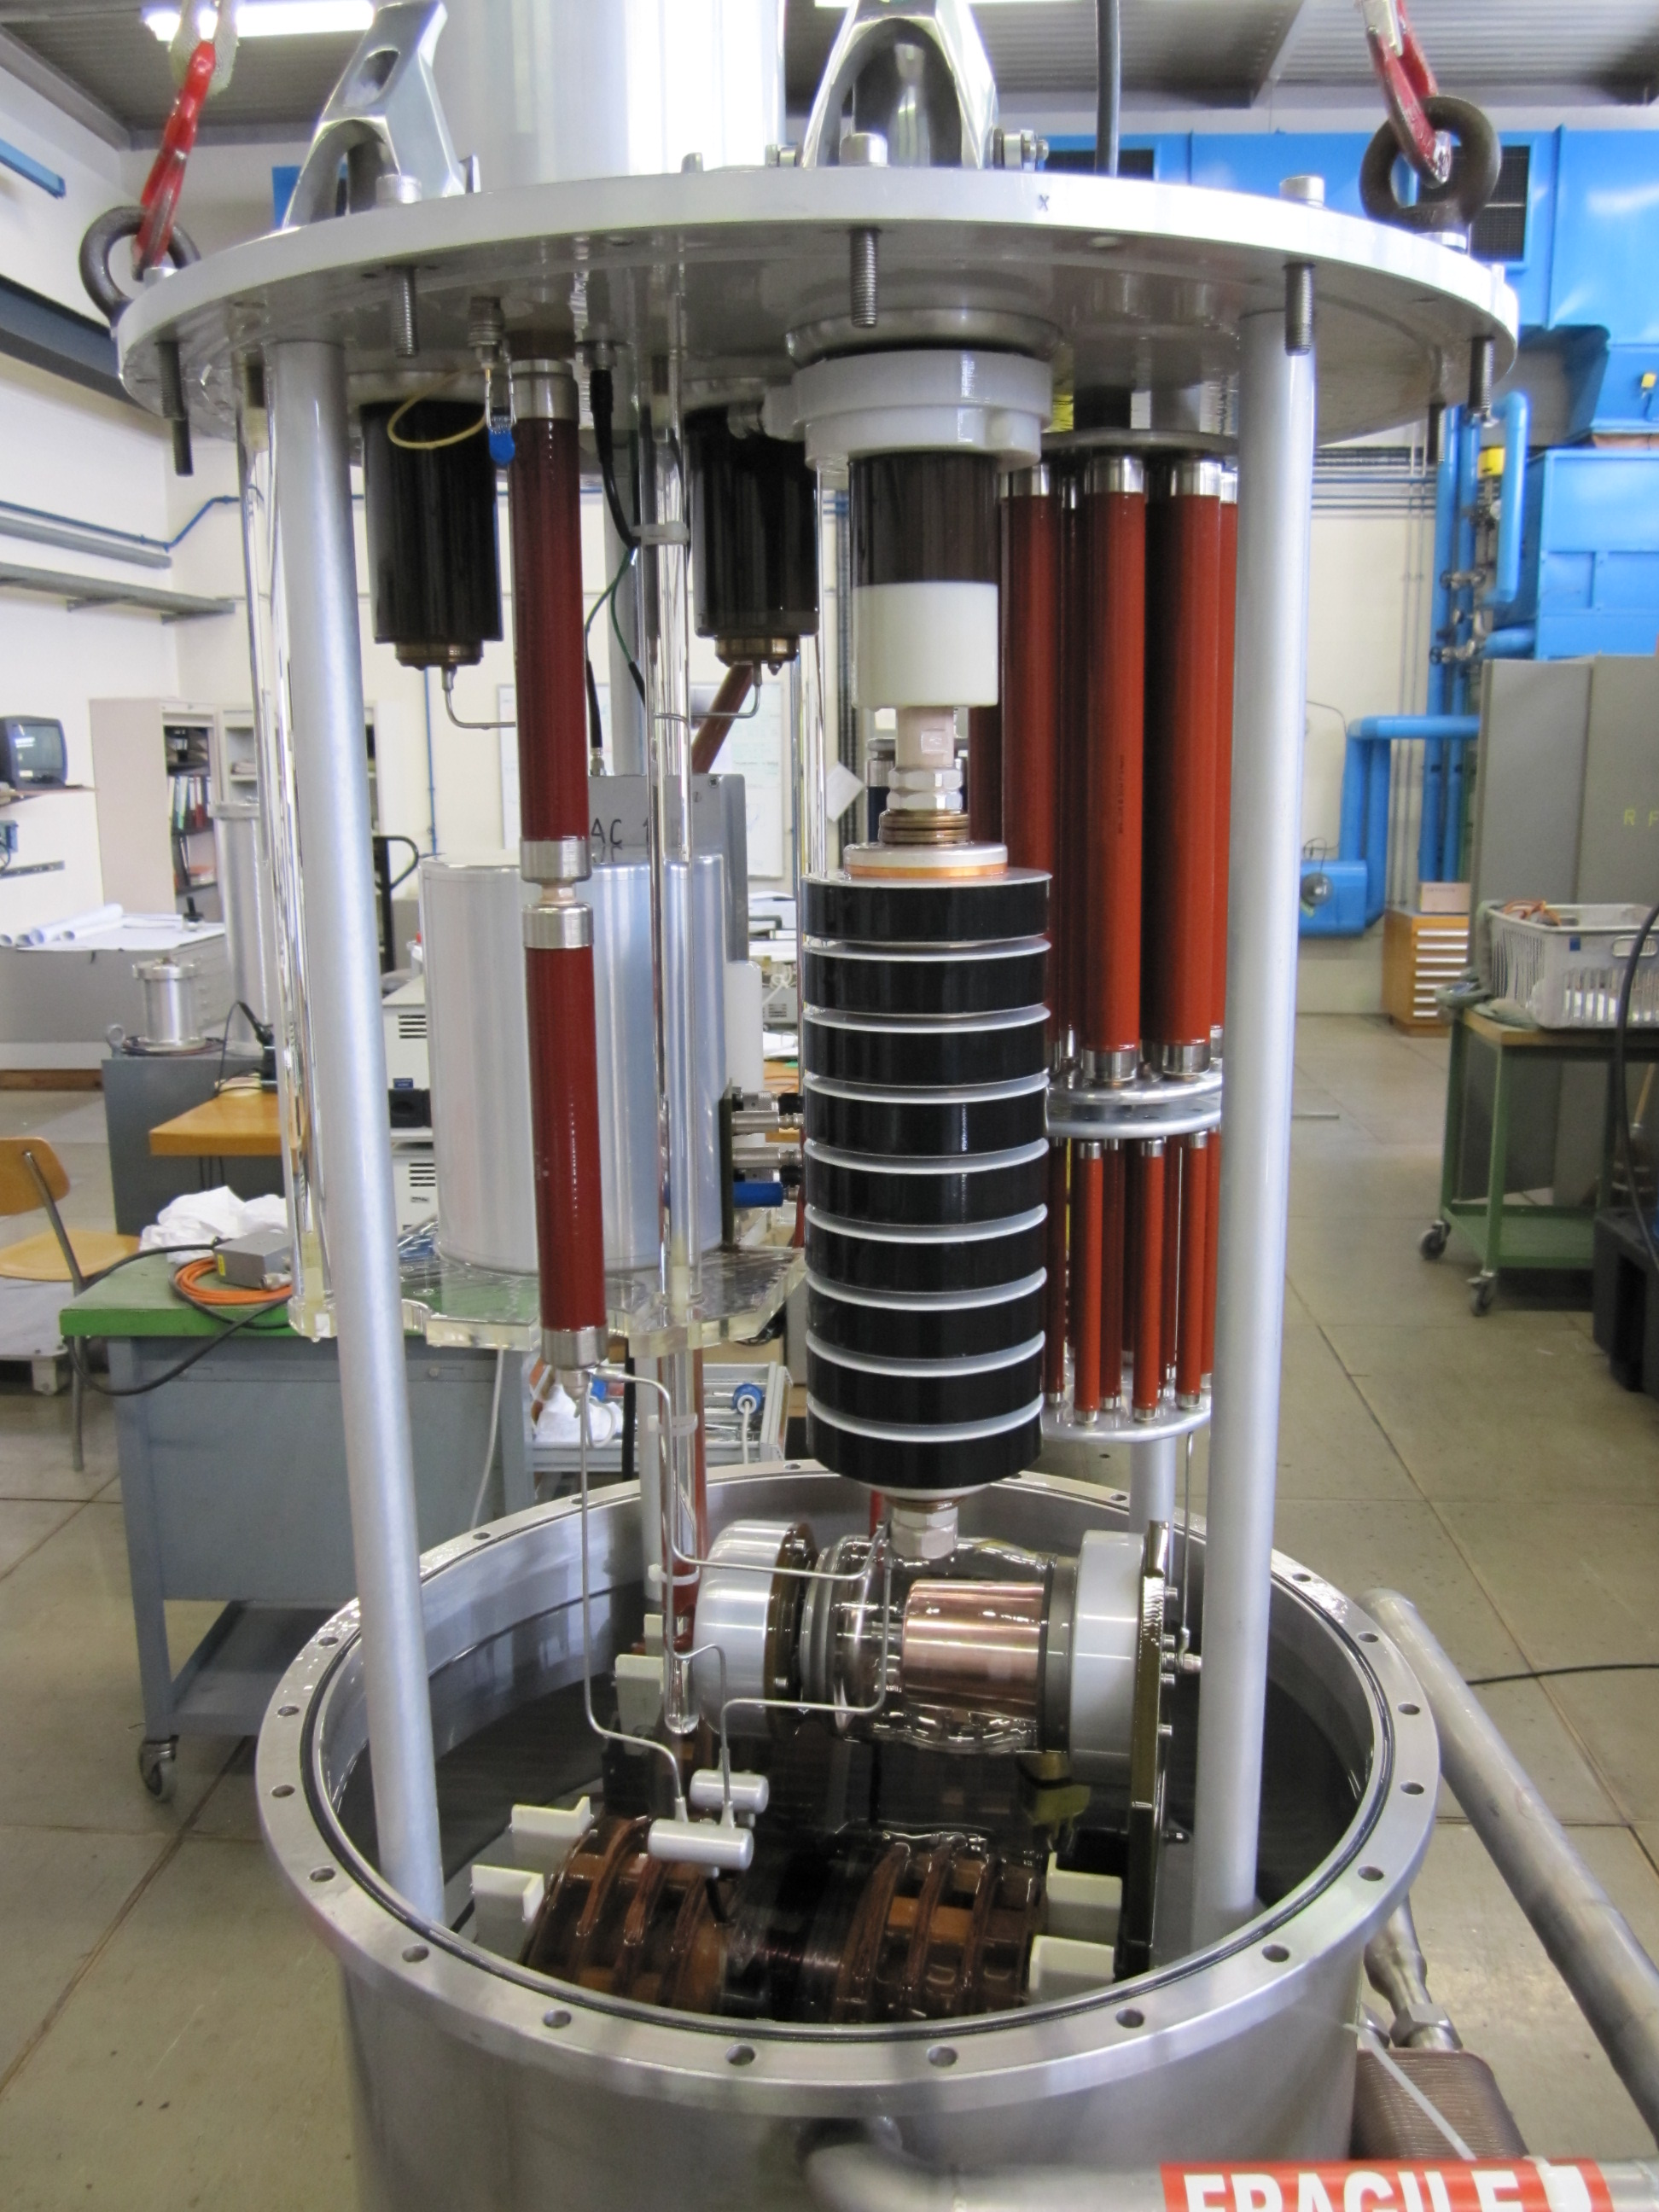
Klystron modulator tank
The Klystron modulator tank (1 per klystron) contains:
  Heater transformer
  Modulation Anode voltage divider
  Measurement and diagnostic circuitry

Slide 8
Current MA source
The current MA source uses the TH5186 tetrode
Cathode (-58 kV)
Opt. Fibers
MA control box
HV power supply
Mod. Anode
Gnd
Modulator Tank

Slide 9
Current MA source

Slide 10
New MA source
AC Supply chain
DC Supply
Digital Link chain
Digital Control
MA voltage chain

Slide 11
New MA source
AC Supply chain
Digital Link chain
Cathode terminal
MA terminal
Gnd

Slide 12
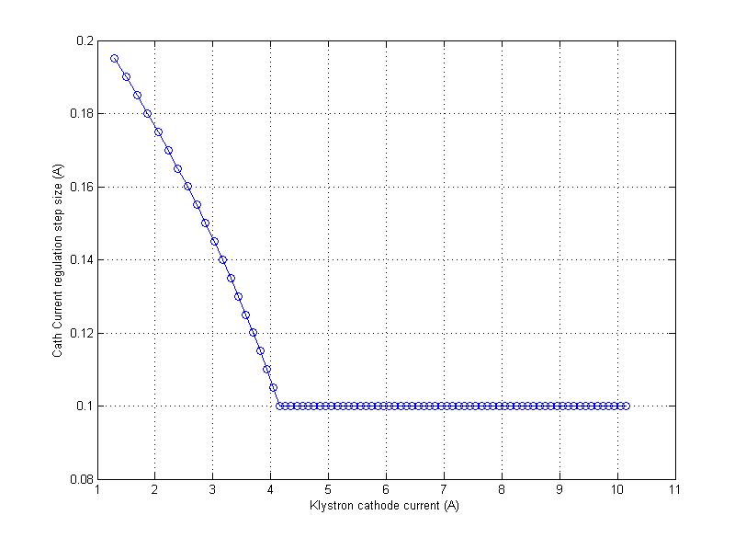
New MA source
Klystron current regulation granularity

Slide 13
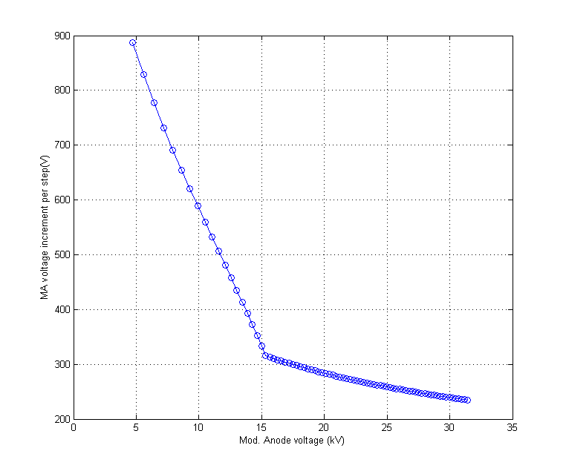
New MA source
Klystron MA voltage granularity

Slide 14
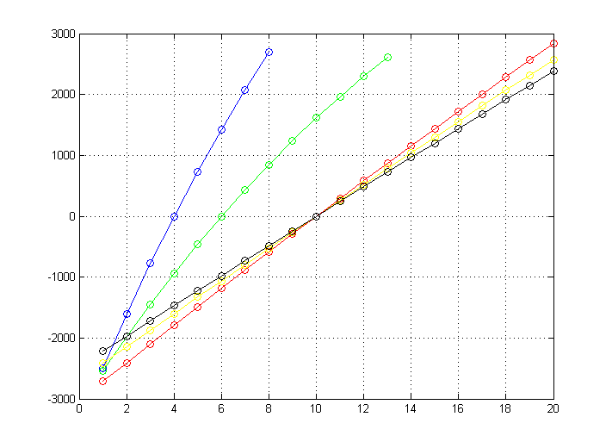
New MA source
Reed switch voltage loading

Slide 15
Summary
The new MA source should replace the current tetrode based modulator by a “solid-state” solution
The digital control will provide 0.1 A cathode current regulation steps in the active region (~100 reed relays)
Serial digital link will give us much better access to the “hot side” measurements (heater current and power, cathode current, MA current)
A prototype unit is currently being developed, it should occupy not more volume then the currently used tetrode

