Slide 1

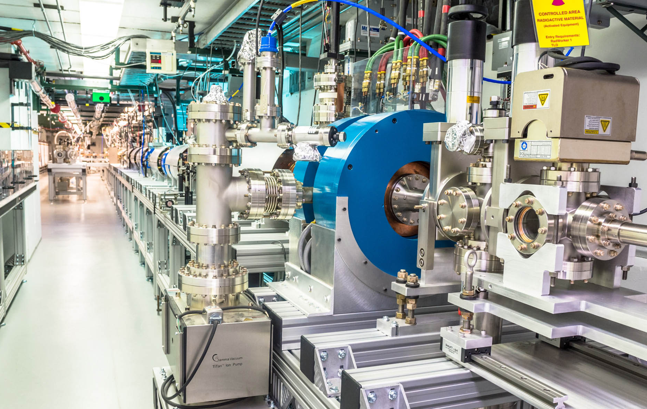
A Metamaterial Structure for Wakefield Acceleration at the
Argonne Wakefield Accelerator
(AWA)
Facility
John power (for Xueying lu now at SLAC)
jp@anl.gov
ALEGRO WORKSHOP
26-29 March 2019, CERN

Slide 2
AWA facility
outline
John Power, Manoel Conde, Jiahang Shao, Eric E. Wisniewski
Argonne National Laboratory (ANL)
Chunguang Jing
Euclid Techlabs LLC
Xueying Lu, Michael A. Shapiro, Ivan Mastovsky, Richard J. Temkin
Massachusetts Institute of Technology (MIT)
ALIC plans at AWA
(light version)
https://www.anl.gov/awa
Metamaterial experiment

Slide 3
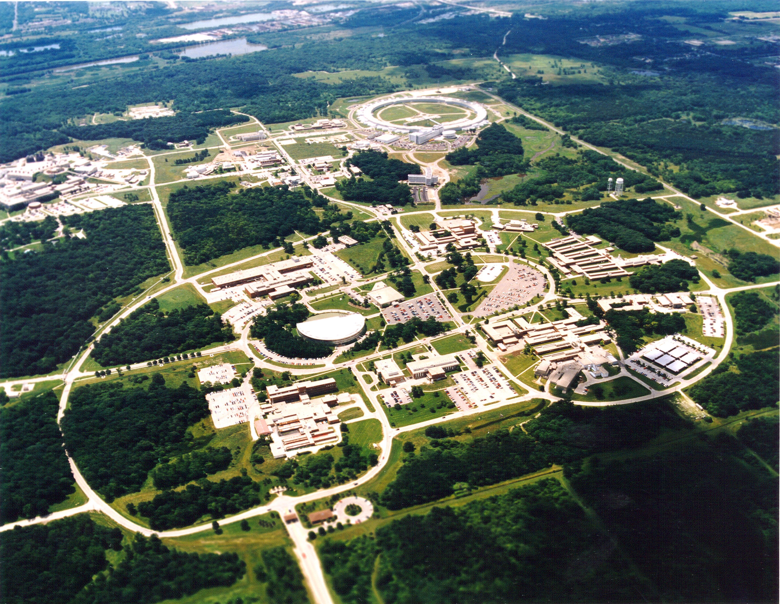
Argonne national laboratory
30 minuets west of Chicago
AWA (Advanced Accelerator)
Test Facility
APS (7GeV light source)
National User Facility
ATLAS (Heavy Ion Accelerator)
National User Facility

Slide 4
AWA Mission
https://www.anl.gov/awa
https://www.anl.gov/awa
Developing e⁻ Beam-driven Wakefield Acceleration
- SWFA (Two Beam Acceleration (TBA) and Collinear Wakefield Acceleration (CWA) and Novel structure R&D and RF breakdown study)
- PWFA (High Transformer Ratio)
Advanced Acceleration Concepts
- Longitudinal bunch shaping (EEX and Laser controlled)
- 6D emittance repartitioning (EEX + FBT)
- Diagnostics: Single shot & Non-destructive
Beam Physics
- Novel cathodes: field emission and photoemission
- High brightness beam generation (symmetrized)
- Bunch Shaping (both transversely and longitudinally)
Electron Sources
- TeV collider
- Compact X-ray source
- Tunable THz generation
- Electron cooling
- UED/UEM
Applications
https://www.anl.gov/awa

Slide 5
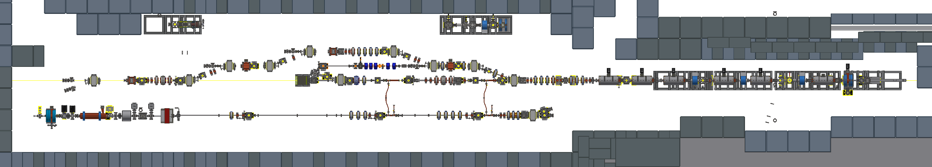
Awa Beamlines and test-stands
~40 m
20 MW RF power station
RF gun studies and conditioning
ACT
Cathode studies
Breakdown studies
drive beam
witness beam
Witness beamline
4 – 15 MeV
0.001 – 20 nC
Drive beamline
8 – 70 MeV
0.001 – 100 nC (single bunch)
Bunch trains (up to 32 bunches with 600 nC total)
Unique capabilities of AWA:
Two independent linacs
6D: Emittance exchange and flat beam
Wide range of bunch charge (highest)
Flexible Test facility for beam driven wakefield studies

Slide 6
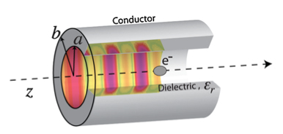
SWFA:
Structure-based Wakefield Acceleration
Advanced Acceleration Concepts
Several variations of scheme, geometry, frequency, material.
Two-Beam Acceleration (TBA)
Collinear Wakefield Acceleration
(CWA)
main beam
drive beam
drive beam
main beam
Geometry: cylindrical, planar, or novel (PBG, metamaterial, etc)
Frequency: typically from 10 GHz to 1 THz
Material: metallic, dielectric, hybrid
Goals:
high efficiency
high gradient
beam quality

Slide 7
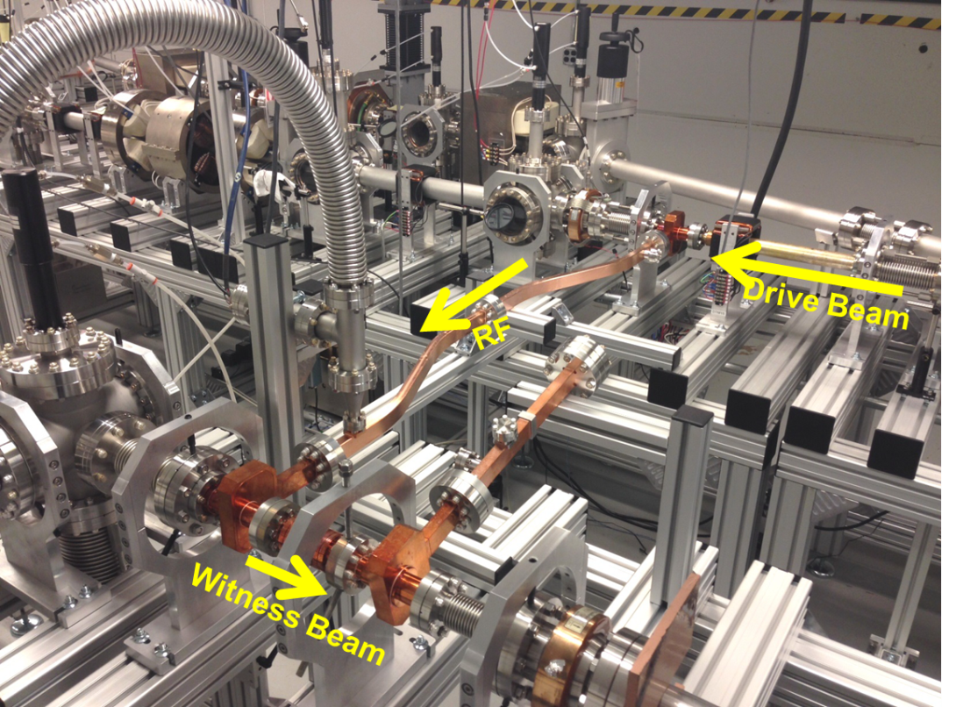
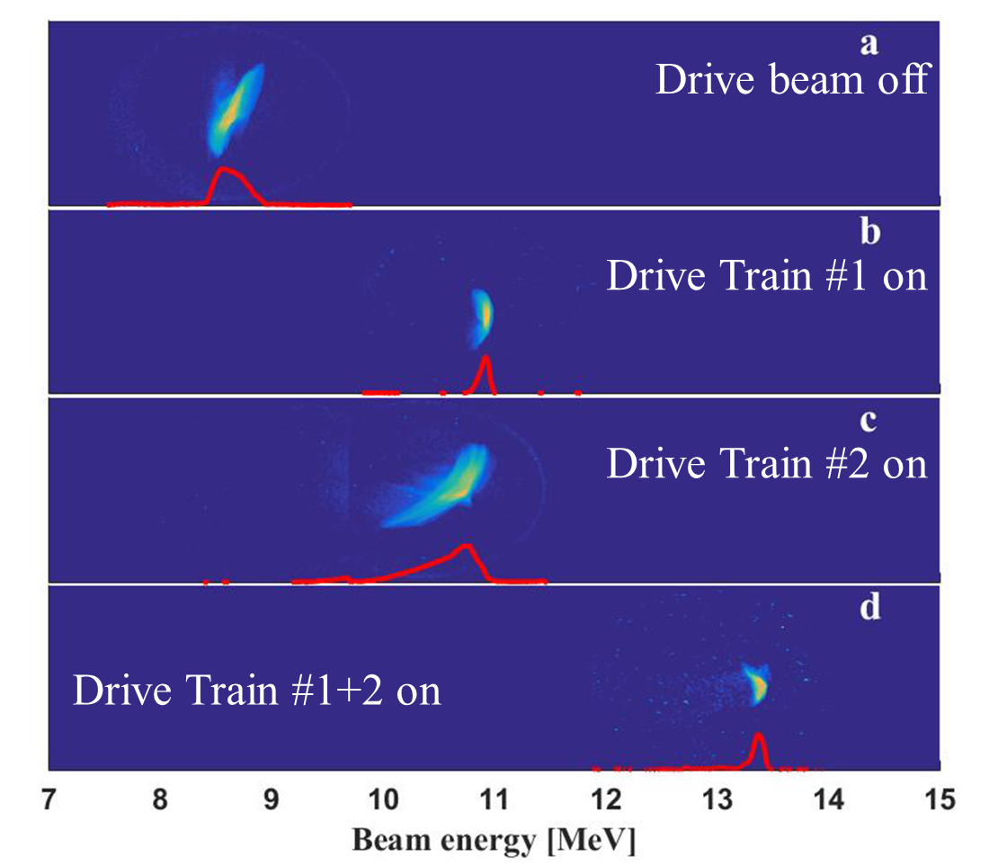
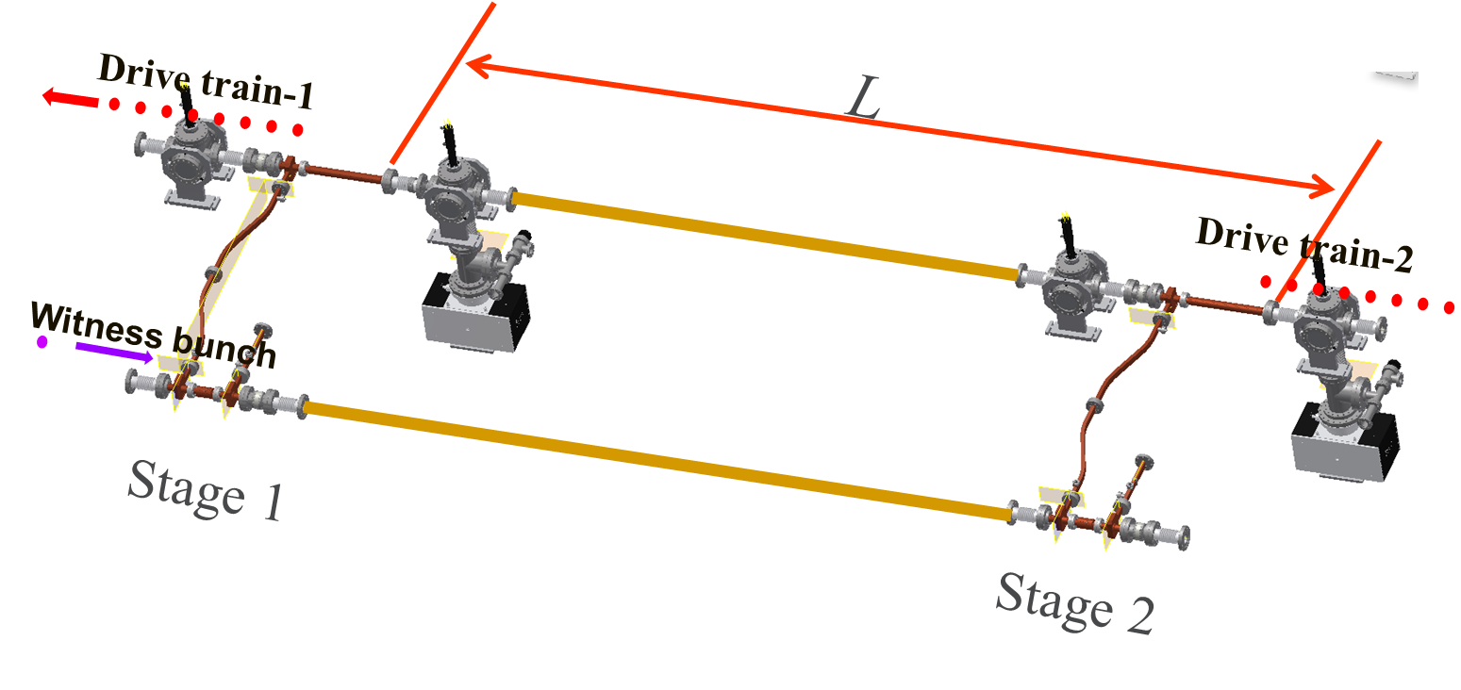
TBA: metallic structures
Advanced Acceleration Concepts
Demonstrated: High Gradient in a Single Stage
11.7 GHz metallic iris loaded structure
300 MW
150 MeV/m
New Dielectric TBA results
(See Alexei Kanareykin next talk)
Demonstrated: Staging
70 MeV/m
C. Jing et al., Nucl. Instr. Meth. in Phy. Res. A 898, 72-76 (2018)

Slide 8
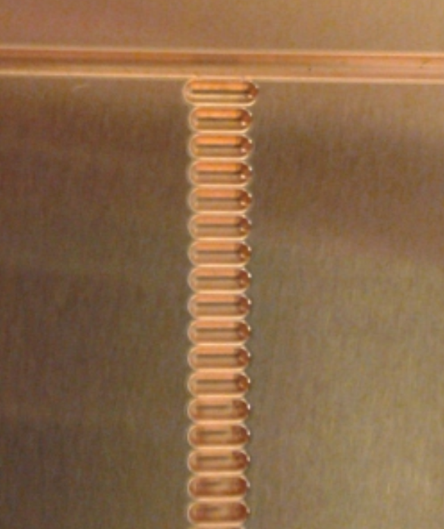
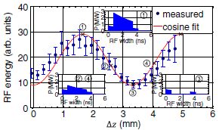
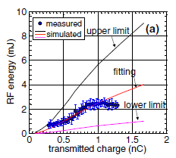

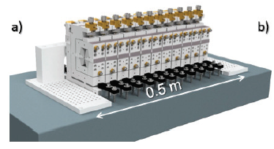
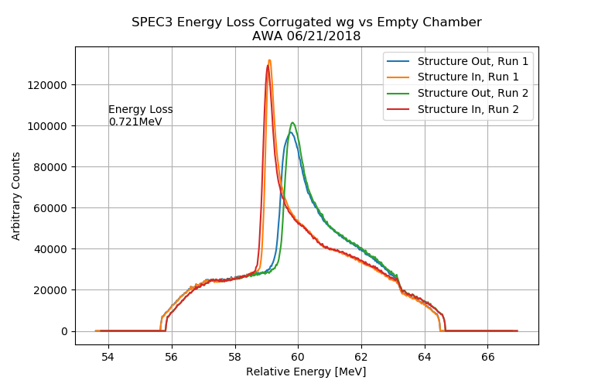
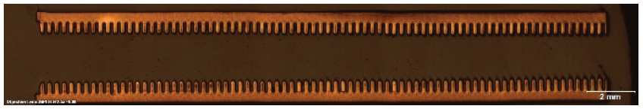
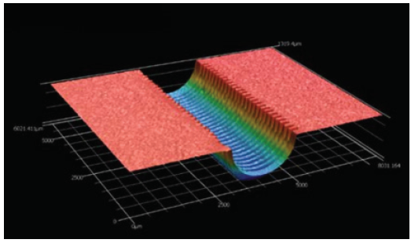
Cwa: metallic STRUCTURES
Advanced Acceleration Concepts
High power, high gradient at 91 GHz with two halves structure
D. Wang, et al, Phys. Rev. Lett., 116, 054801 (2016)
91 GHz
Peak power ~5 MW peak gradient 85 MeV/m
Corrugated waveguide structure for multi-beamline XFEL
G. Waldschmidt, et al, in Proceedings of IPAC2018 (2018)
21 GHz prototype
220 GHz
First deceleration

Slide 9
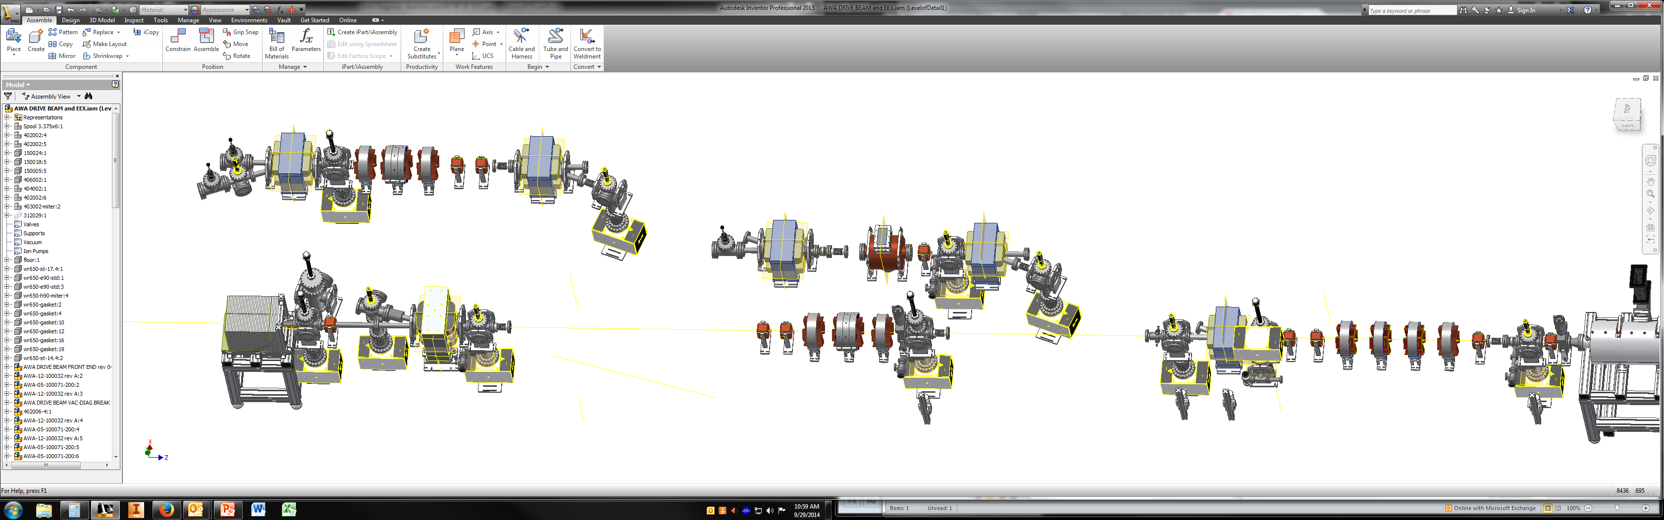
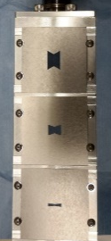
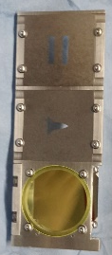

longitudinal shaping with EEX
Beam Physics
Train
Triangle
Rectangle
Trapezoid
z
z
z
z
Shaping with masks
5 nC / 48 MeV
Take final longitudinal current profile
y
y
y
y
Train
Triangle
*G. Ha et al., PRAB 19, 121301 (2016)
Rectangle
*G. Ha et al., PRL 118, 104801 (2017)
Trapezoid

Slide 10
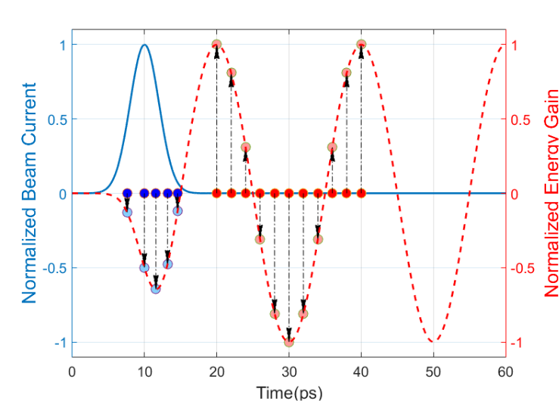
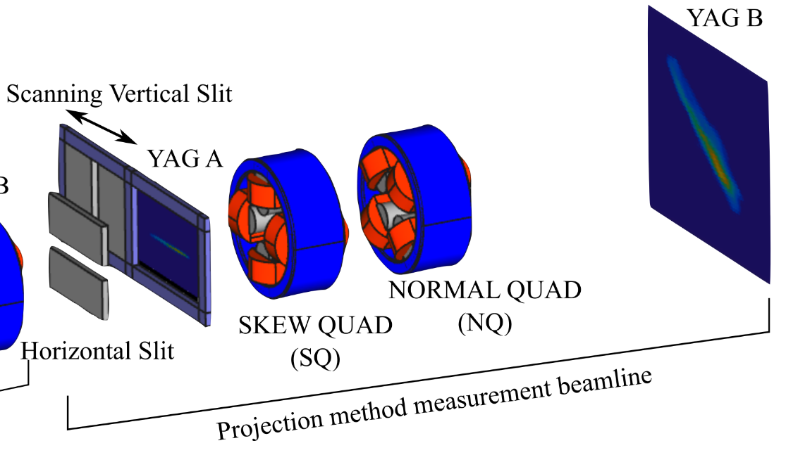
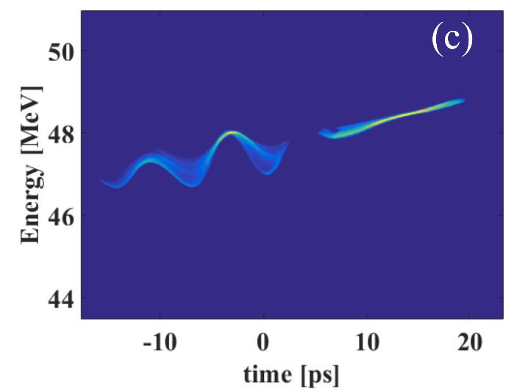
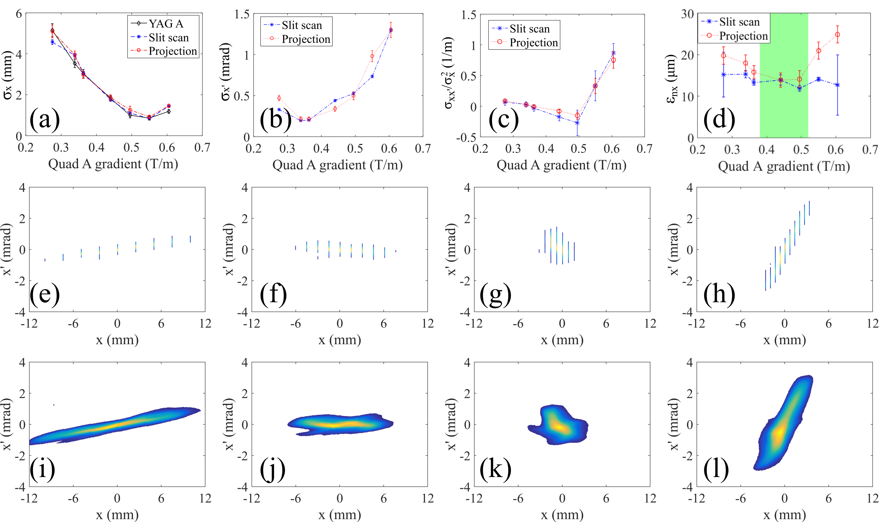
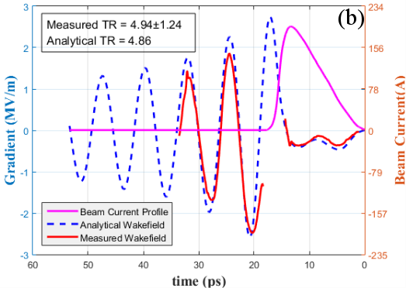
beam diagnostics development
Beam Physics
Single shot wakefield measurement
Transverse phase space measurement
This is new method introduced since 90’s
(x,x’) or (y,y’) can be projected in to (x,y) screen
A fast way to characterize the beam and beamline
Energy change follows wakefield
x-y coupling
x-x’ coupling
Comparison between with and without wake provides actual shape of the wake
Drive beam
Witness beam
Measured
phase space
w/o wake
Modulation from wakefield
Minimizing y-y’
Slit-scan result
Projection result
The second new method since AWA made witness scan method in 80’s
10 spot ⨉100 shots ⨉ 2 Hz → 500 s for avg image
Getting image of each shots
*G. Ha et al., submitted (2019)
*Q. Gao et al., PRAB 21, 062801 (2018)

Slide 11

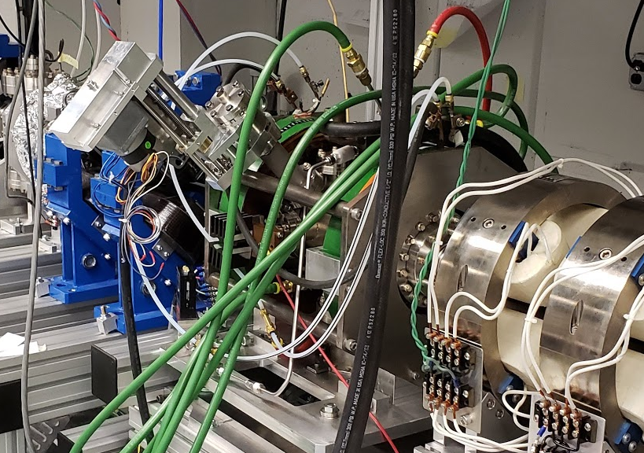
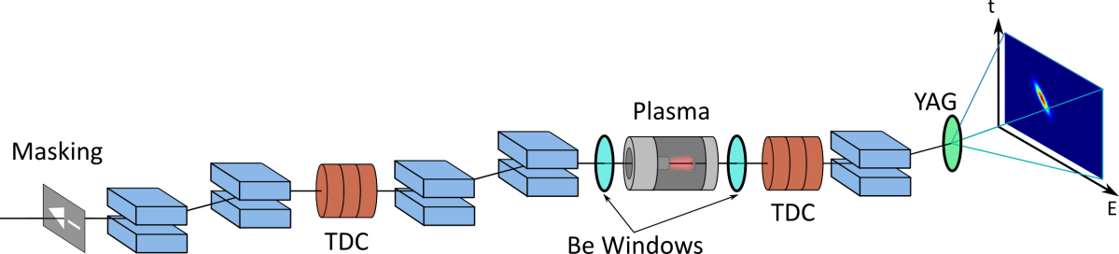
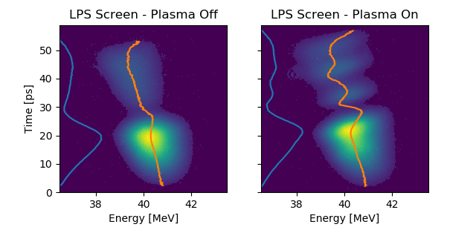
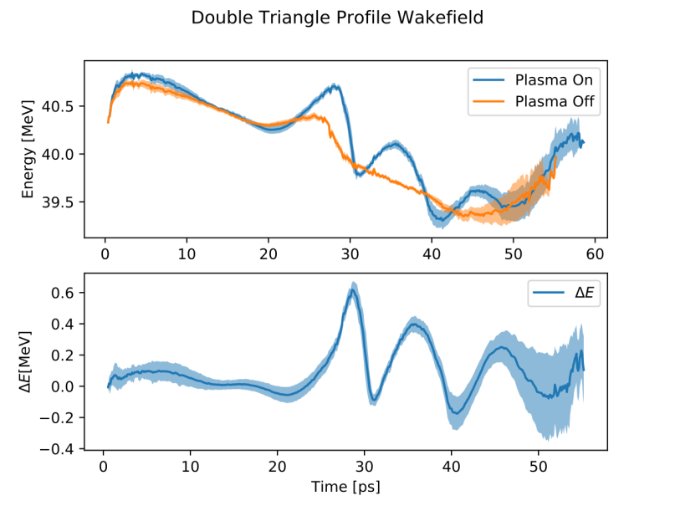
PWFA:
Plasma wakefield acceleration
Advanced Acceleration Concepts
Longitudinal Phase Space
(LPS) Diagnostic
High R with EEX
Courtesy: R. Roussell,
J. Rosenzweig, G. Andonian
Emittance Exchange
Preliminary

Slide 12
AWA Mission
Develop Science & Technology of e⁻ Beam-driven Wakefield Acceleration
- SWFA: Two Beam Acceleration (TBA) and Collinear Wakefield Acceleration (CWA)
- Novel structure R&D
- Fundamental field emission and RF breakdown study
- BBU control in wakefield accelerators
- PWFA
Advanced Acceleration Concepts

Slide 13
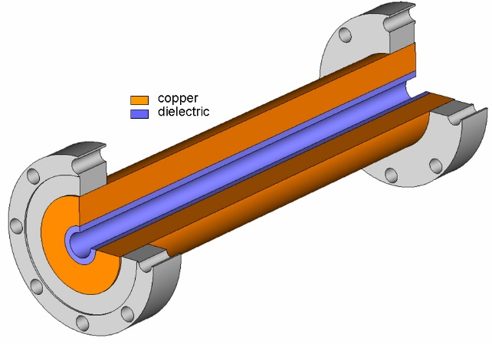
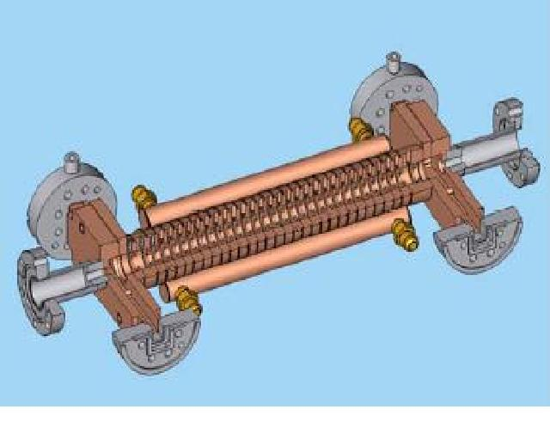
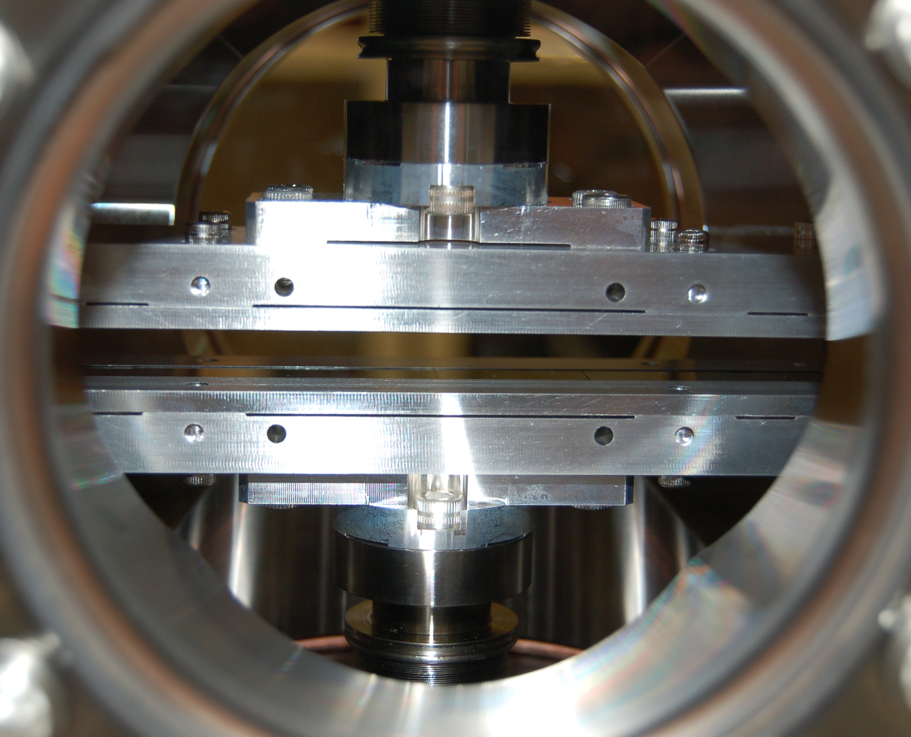
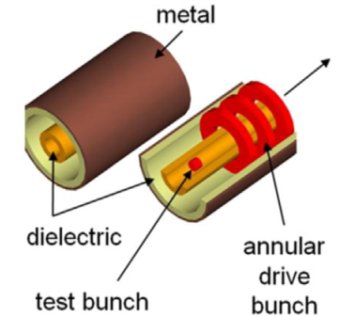
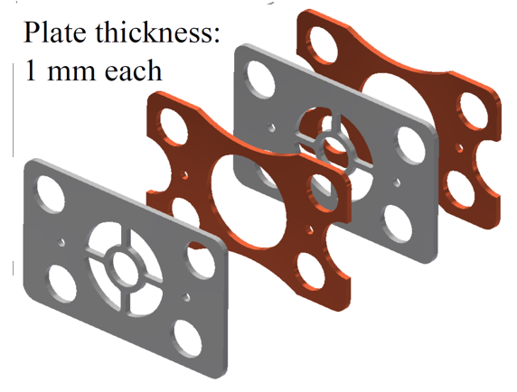
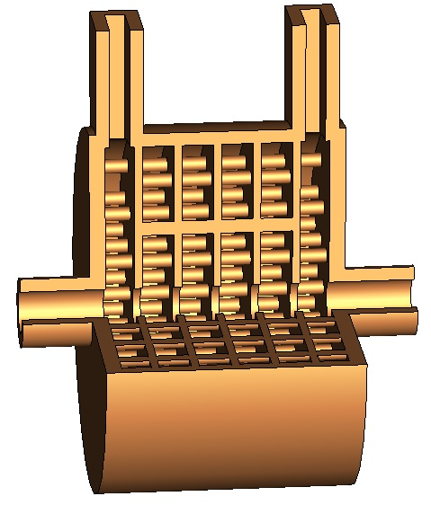
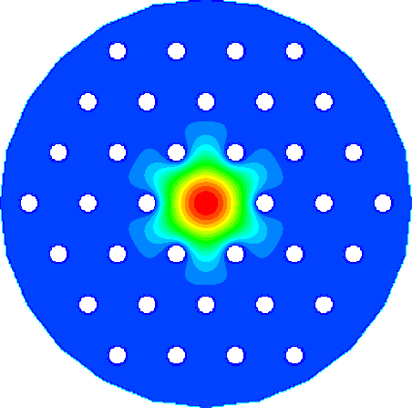
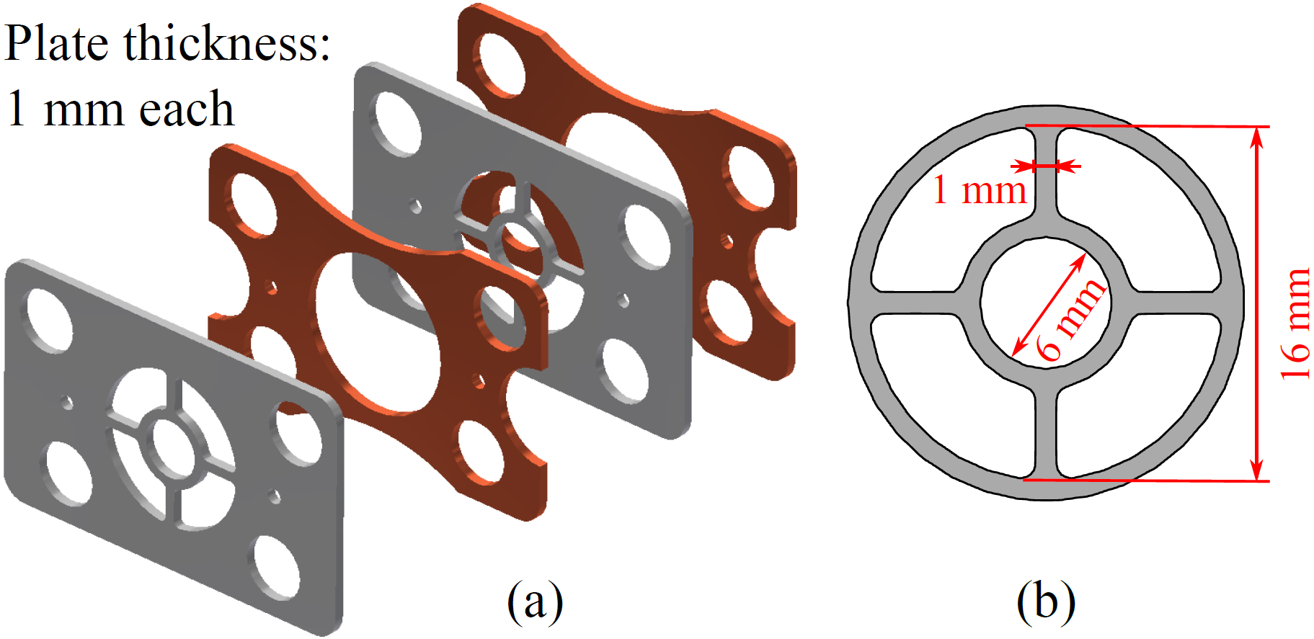
NOVEL structure R&D at the awa
Some of the structures that have been tested at the AWA facility
Cylindrical dielectric (AWA)
Iris loaded
Metallic (AWA)
Planar dielectric (Euclid)
Coaxial dielectric (Omega-P)
Meta/left-handed (MIT)
Photonic band gap (LANL)
Notes:
AWA and collaborators have tight integration.

Slide 14
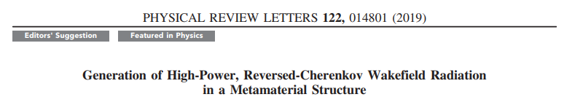
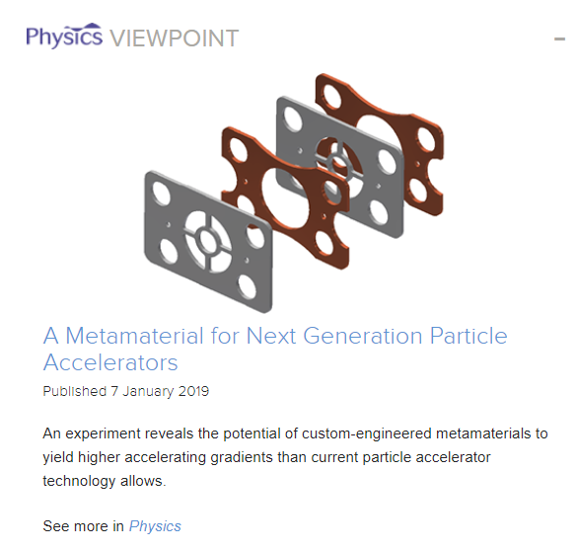
Recent Publication

Slide 15
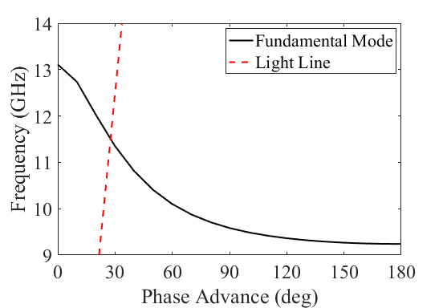
Wagon Wheel Structure Unit Cell
Wagon wheel structure
  Periodic subwavelength structure
    Period: 2 mm
    Free wavelength at 11.42 GHz: 26 mm
  Negative group velocity
  Fundamental mode: TM mode
  Interaction frequency: 11.42 GHz
    Cutoff frequency of an empty waveguide: 14.2 GHz
Dispersion Curve
Copper
Stainless steel

Slide 16
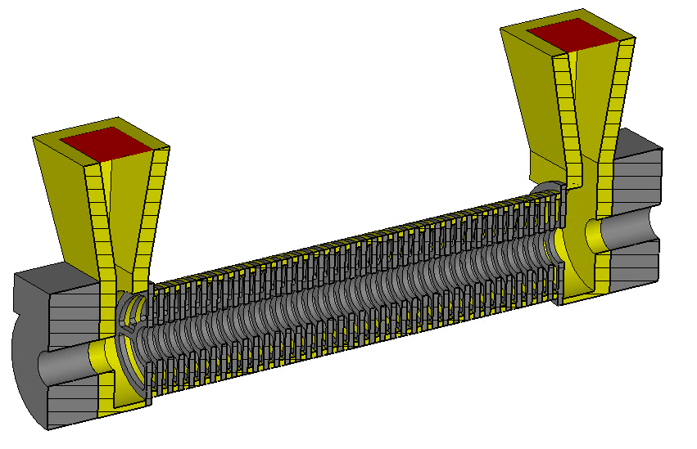
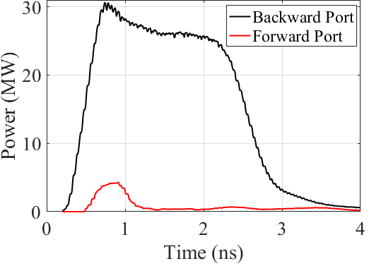

CST Simulation
Forward Port
CST Wakefield solver, single bunch
  45 nC, σ_{z} = 1.2 mm
26 MW steady state in the backward port
Much lower power in the forward port
  Reversed Cherenkov radiation
Analytical theory:
= 25 MW
Backward Port
Beam
Simulation

Slide 17

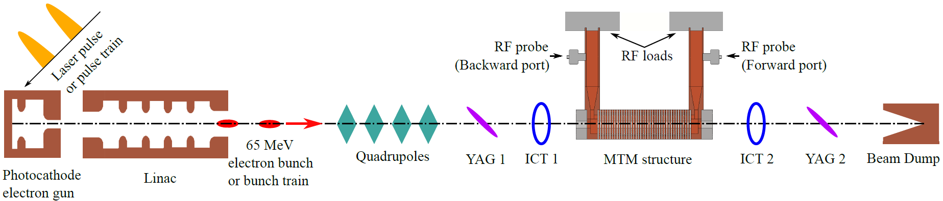
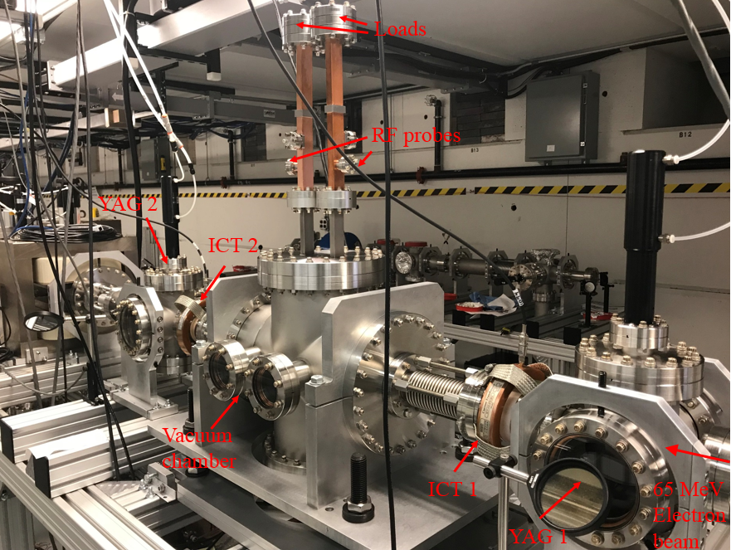
Experimental Setup at AWA
Diagnostics:
ICT (Integrating current transformer): Bunch charge
YAG screen:
Bunch transverse size
RF probes:
Output microwave

Slide 18
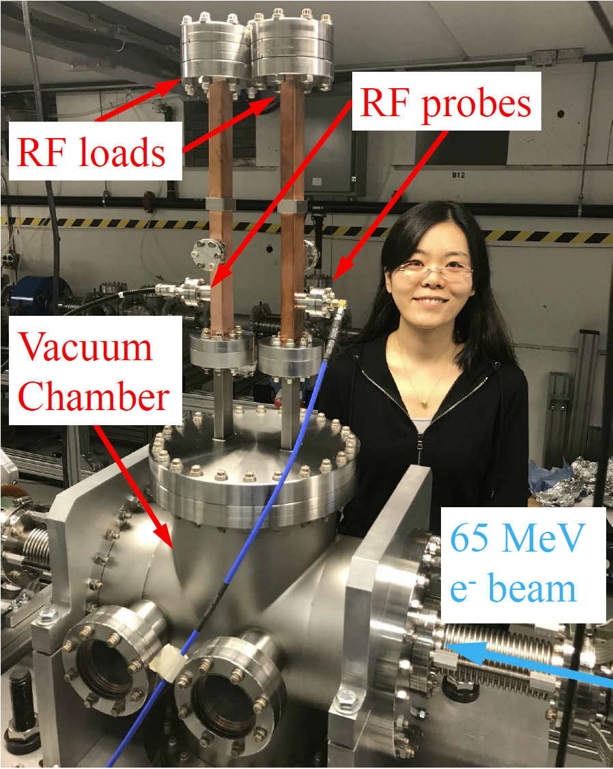
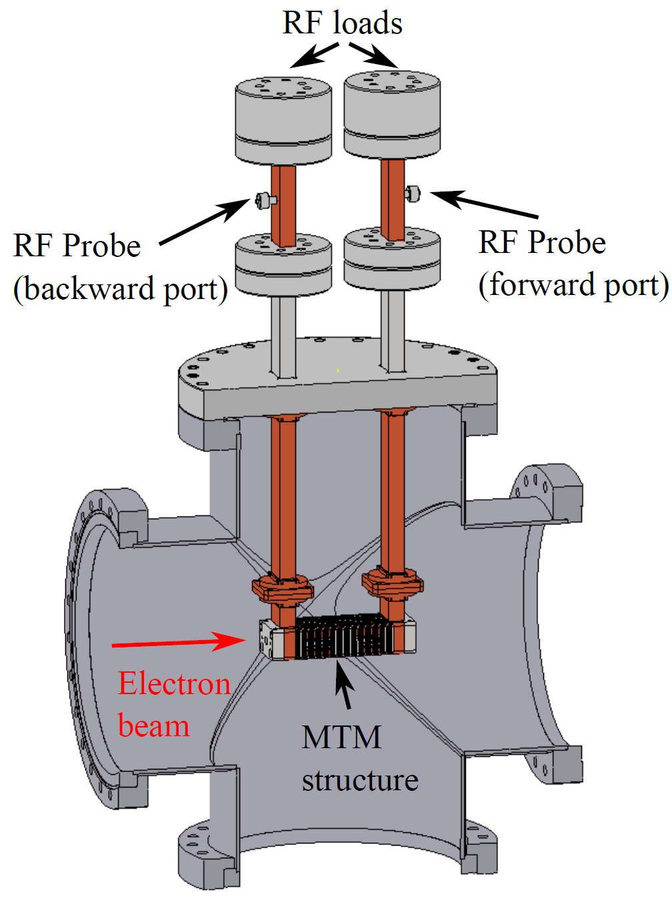
Installed Experiment at AWA

Slide 19
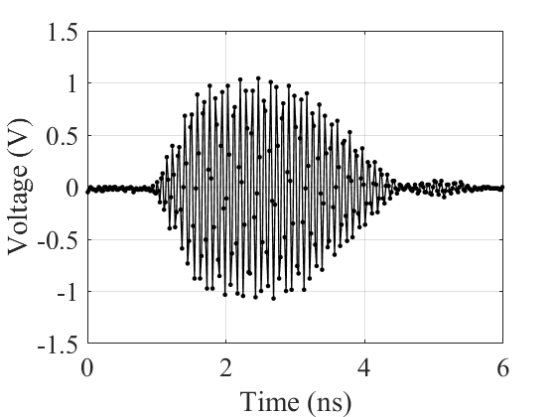
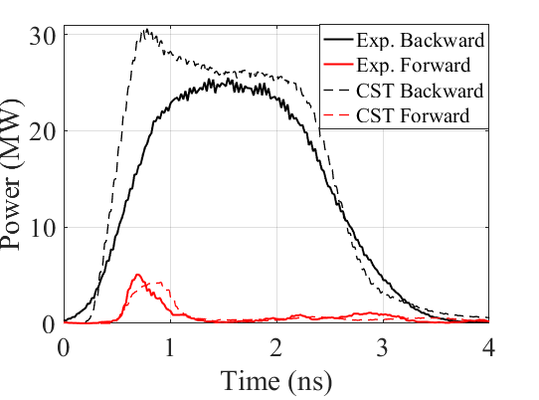
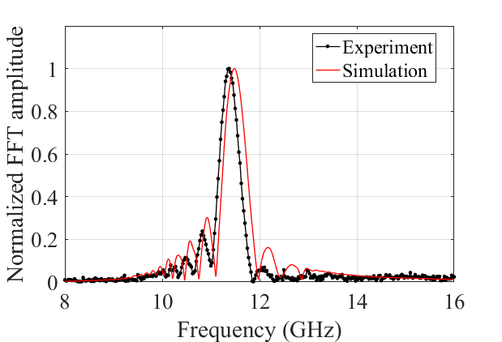
Single Bunch Experiment
High RF power from a single 45 nC bunch
  Experiment: 25 MW
  Simulation: 26 MW (steady state)
  Analytical theory: 25 MW
Reversed Cherenkov radiation verified
  Coherent radiation at 11.4 GHz
  Backward port has much more power
100 GSa/s, 16 GHz BW scope

Slide 20
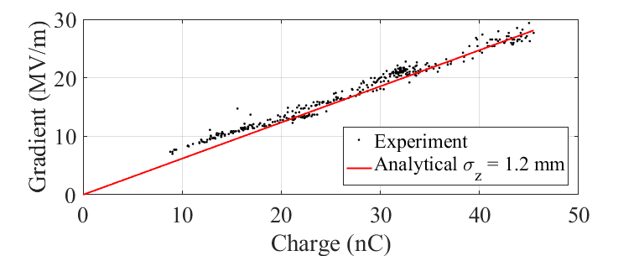
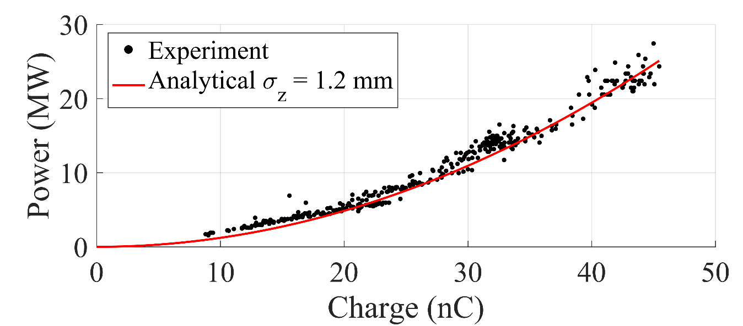
Scaling with Charge
Good linear scaling of gradient vs. charge, good agreement with theory
  No breakdown events

Slide 21
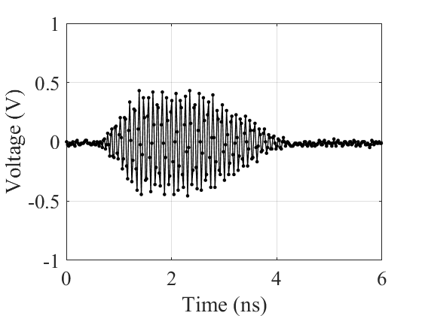
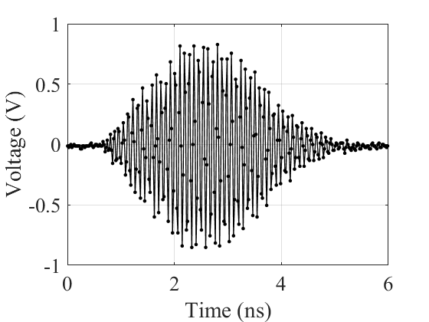

Two-Bunch Experiment
Single bunch
Two bunches with 0 deg phase difference
Two bunches with 180 deg phase difference

Slide 22

Highest power shot
Two bunches with a total charge of 85 nC
80 MW extracted RF power
50 MV/m decelerating electric field
  75 MV/m available accelerating gradient for a possible witness bunch
~130 MV/m maximum surface field

Slide 23


Next Experiment: Longer Structure
100-cell structure (20 cm long), 8 bunches, 40 nC/bunch
  0.9 GW peak power
  170 MV/m decelerating gradient
  250 MV/m available accelerating gradient for a witness bunch
To Output Ports
CST simulation of
output power in the backward port
Bunch Train

Slide 24


Acknowledgement
MIT
ANL-AWA
Funding agency:
MIT: U.S. Department of Energy, Office of Science, Office of High Energy Physics under Award Number DE-SC0015566.
ANL: U.S. Department of Energy, Office of Science under Contract No. DE-AC02-06CH11357.

