Slide 1
A primary electron beam facility at CERN – studies towards ALIC
ALEGRO workshop - March 27th, 2019
S. Stapnes (CERN)
on behalf of the working group PBC-acc-e-beams** (email: PBC-acc-e-beams@cern.ch)

Slide 2
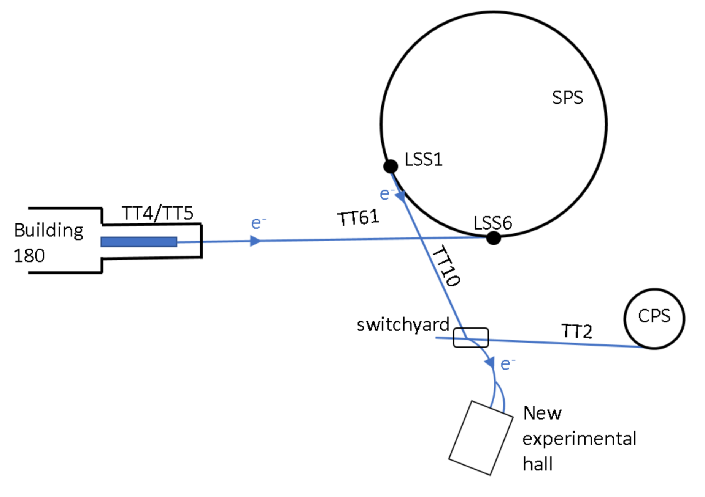
Motivations
Physics: Large increasing interest in Light Dark Matter – using e-beams, the key to the ”eSPS proposal” – LDMX talk: slides
Next step for X-band technology: Any next machine at CERN is beyond LHC, i.e. 15+ years away
    We have looked carefully at what we could do with CLIC beam and/or drive-beam at a small scale – scaling the industry experience
    Combing a compact linac with the SPS electron experience provides unique opportunities
Strategic: Will bring electrons back at CERN fairly rapidly (linacs and rings) – important relevance for the developments and studies needed for future e+e- machines at CERN – being linear or circular
Future accelerator R&D more generally: Accelerator R&D and project opportunities with e-beams as source
Main directions: Novel Acc. studies (ALIC) and CLEARER
Primary electron beam facility at CERN
2

Slide 3
Electrons at CERN, overview
Accelerator implementation at CERN of LDMX type of beam
X-band based 70m LINAC to ~3.5 GeV in TT4-5
Fill the SPS in 1-2s (bunches 5ns apart) via TT60
Accelerate to ~16 GeV in the SPS
Slow extraction to experiment in 10s as part of the SPS super-cycle
Experiment(s) considered by bringing beam back on Meyrin site using TT10
Beyond LDMX type of beam, other physics experiments considered (for example heavy photon searches)
Acc. R&D interests (see later): Overlaps with CLIC next phase (klystron based), future ring studies, FEL linac modules, e-beams for plasma, medical/irradiation/detector-tests/training, impedance measurements, instrumentation, positrons and damping ring R&D
Primary electron beam facility at CERN
3

Slide 4
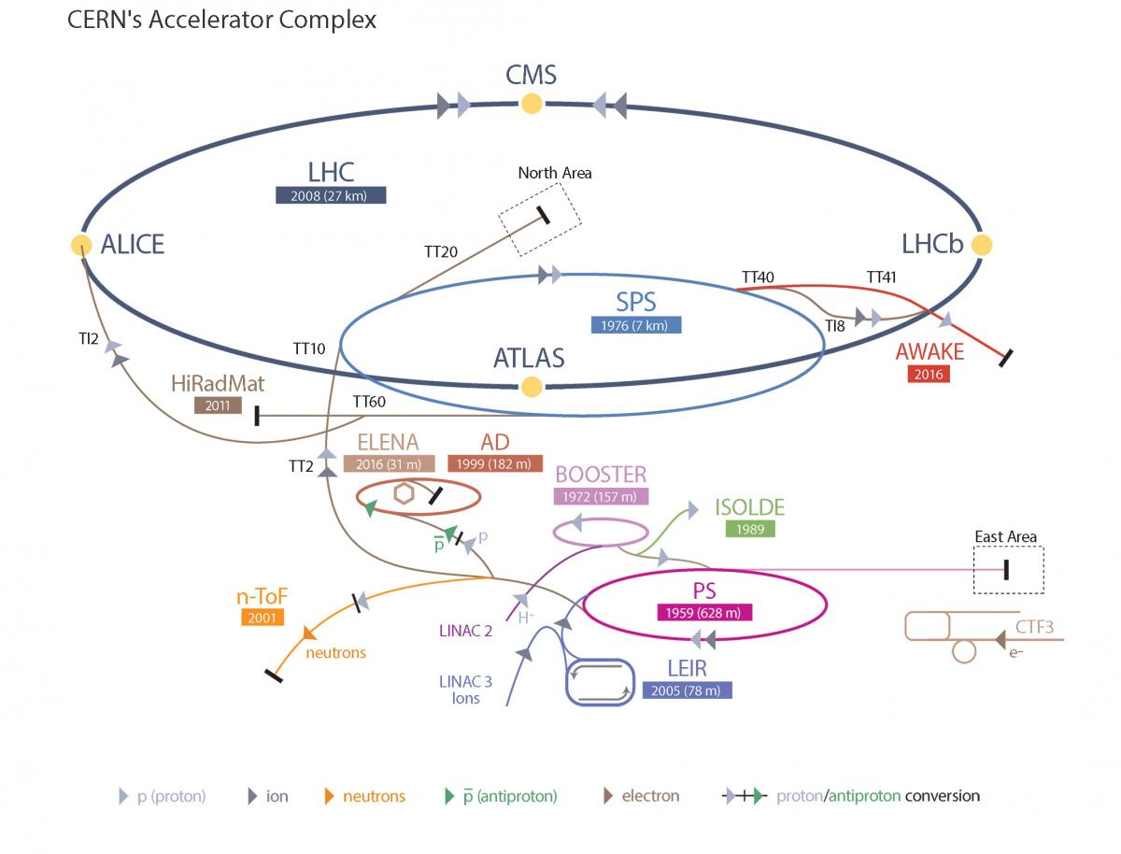
The flow
3.5GeV Linac
Transfer to SPS
Acceleration in SPS
Extraction
Primary electron beam facility at CERN
4

Slide 5
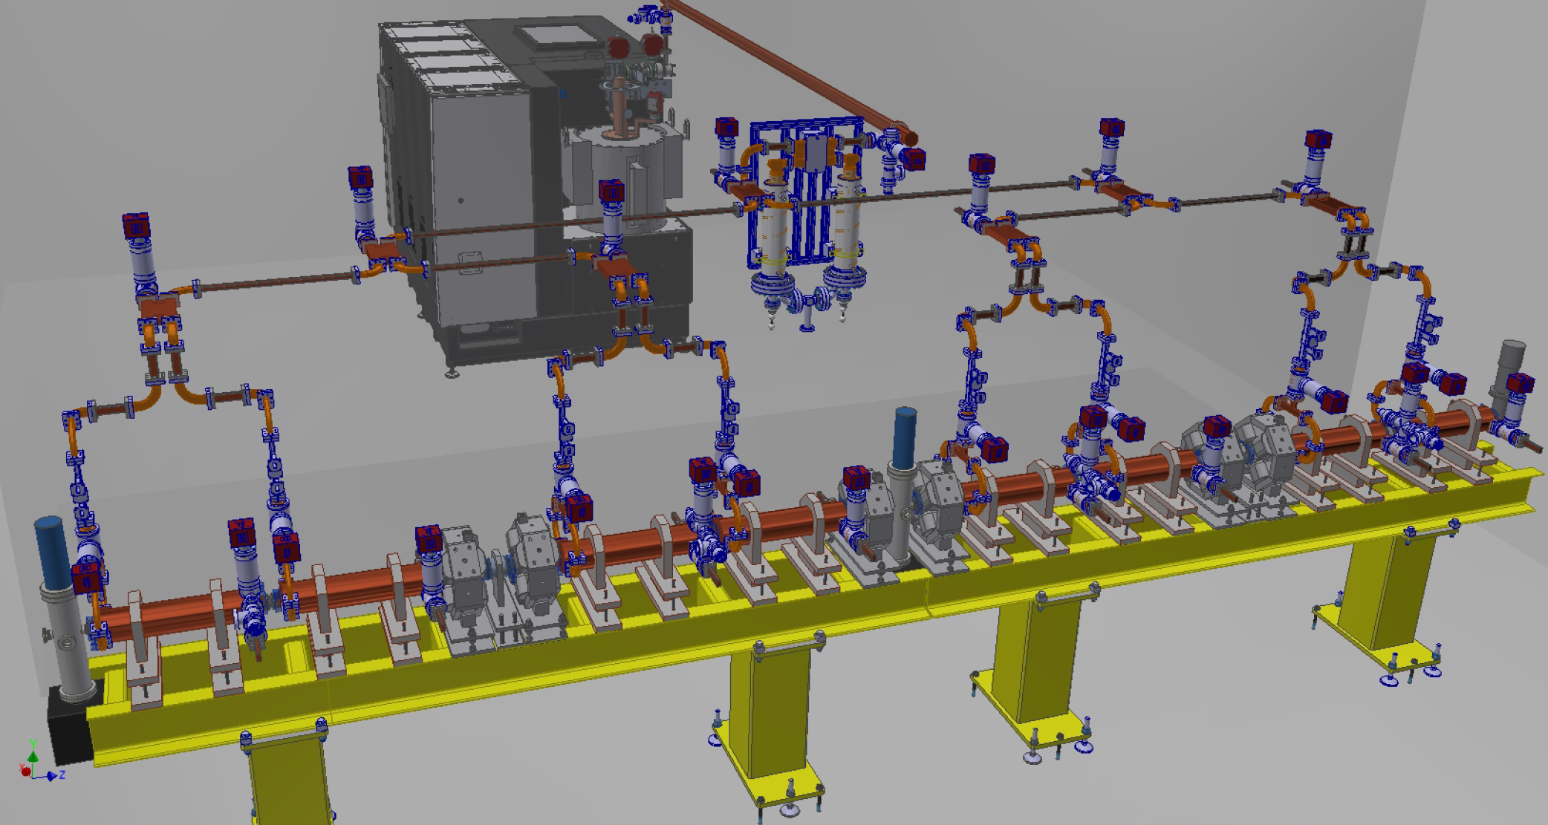
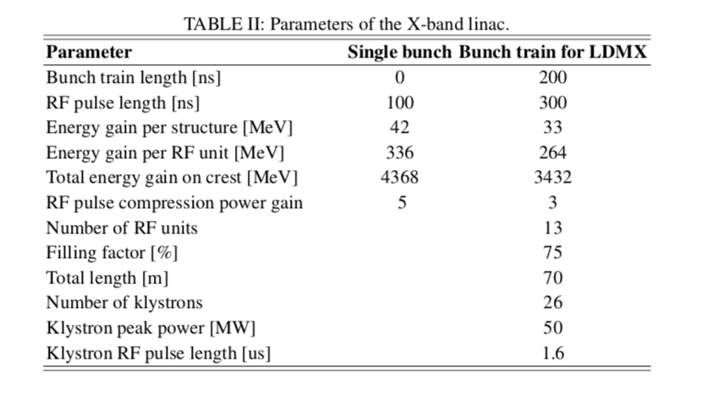
Linac parameters
0.1GeV S-band injector
3.4GeV X-band linac
  High gradient CLIC technology
  13 RF units to get 3.4 GeV in ~70 m
modulator
kl
kl
2 x 50MW
p
c
e⁻
~5.3m
Possible parameters
Energy spread (uncorrelated*) | <1MeV
Bunch charge | 52 pC
Bunch length | ~5ps
Norm. trans emittance | ~10um
N bunches in one train | 40
Train length | 200 ns
Rep. rate | 50/100 Hz
RF design of the X-BAND linac for the EUPRAXIA@SPARC_LAB project
M. Diomede Et al., IPAC18
Primary electron beam facility at CERN
5
Notes:
52pC is 3E8 electrons

Slide 6
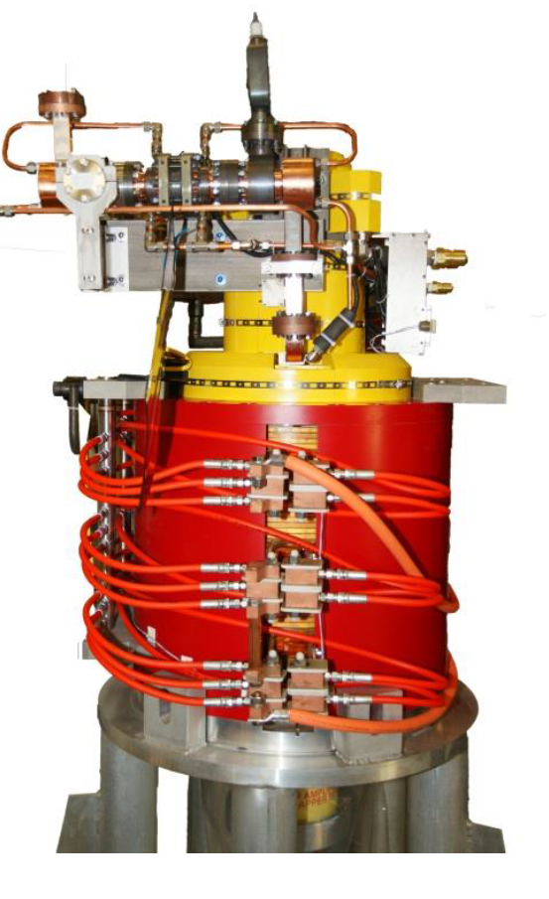
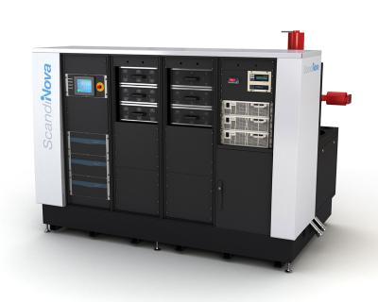
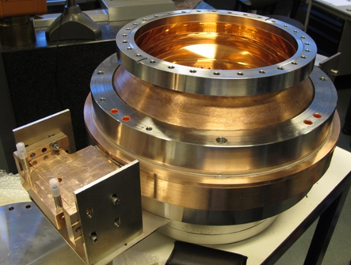
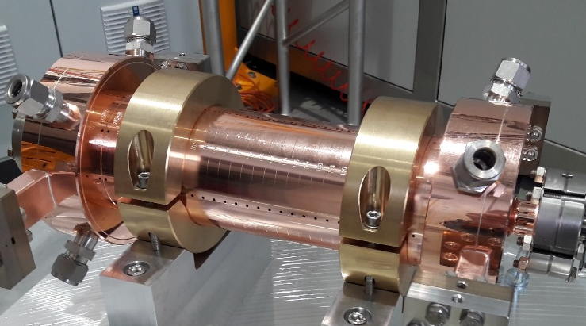
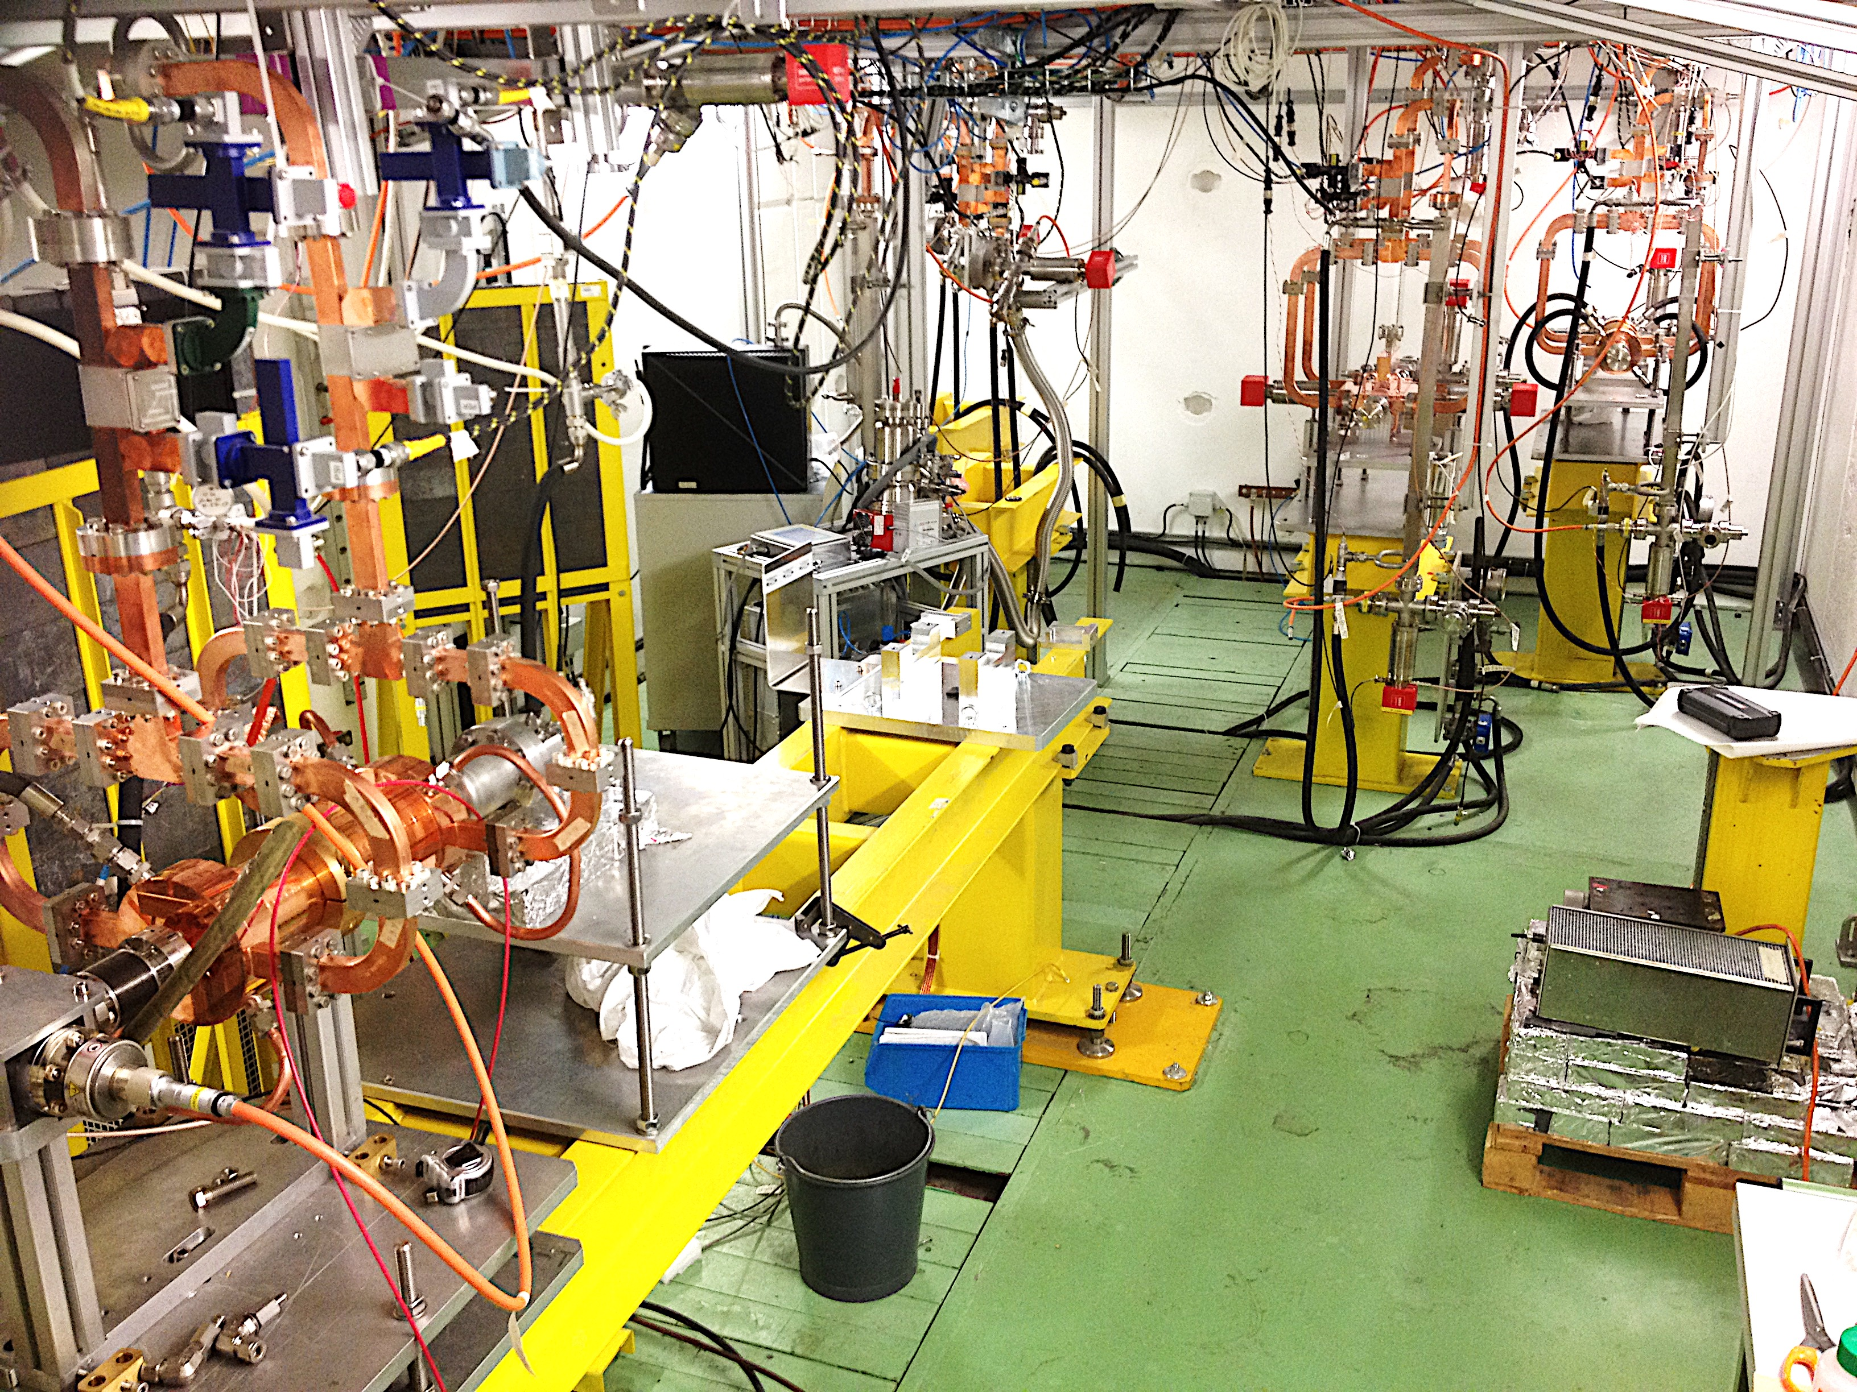
Linac components available
Examples
One RF unit accelerates
200ns bunch train up
to 264 MeV
modulator
kl
kl
p
c
e⁻
+
~5.3m
Pulse compressor
Accelerating structure
Klystron
Modulator
XBOX3
Lines 1&2
Assembled systems in continues operation at CERN
XBOX2
Primary electron beam facility at CERN
6

Slide 7
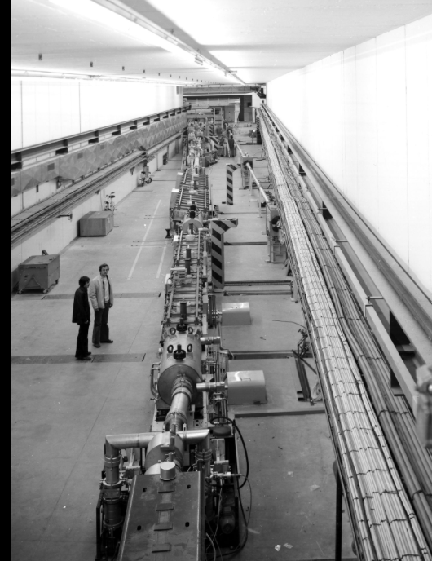
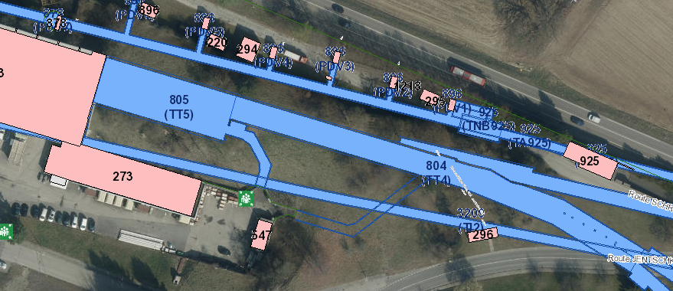
Linac in TT5/TT4
Flexible bunch pattern provided by photo-injector
5ns, 10ns, … 40ns bunch spacing
High repetition rate
  200 ns trains at 100 Hz
To be installed in the available transfer tunnels TT4, in line with the SPS
Room for accelerator R&D activities at end of linac (duty cycle in many cases low for SPS filling so important potential)
Primary electron beam facility at CERN
7

Slide 8
Beam to/in/from the SPS – see backup slides

Slide 9
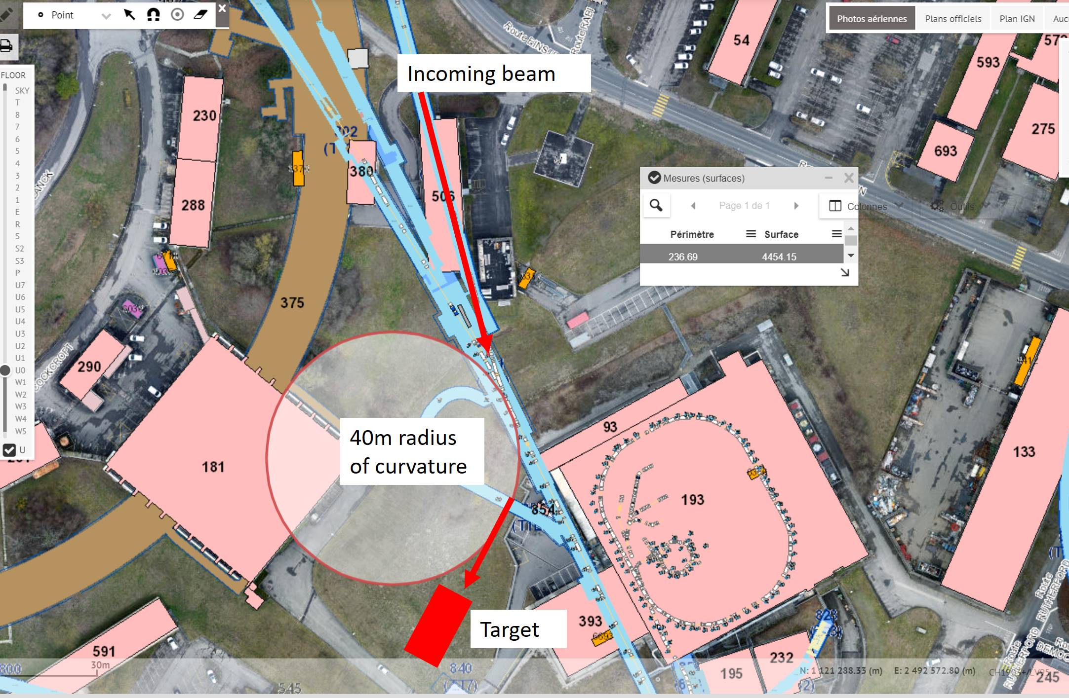
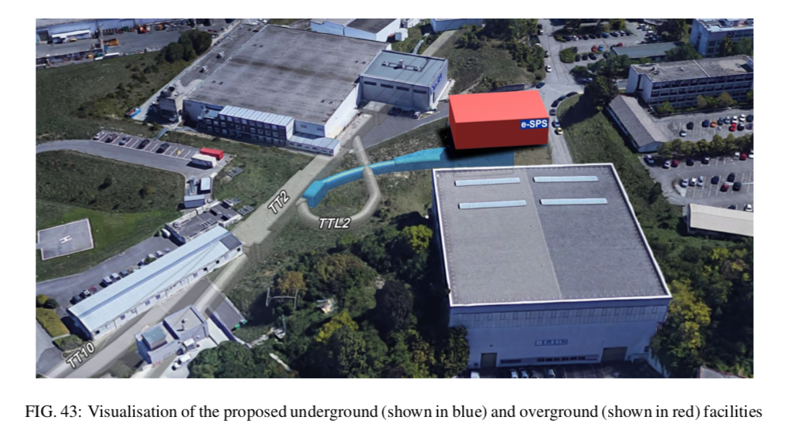
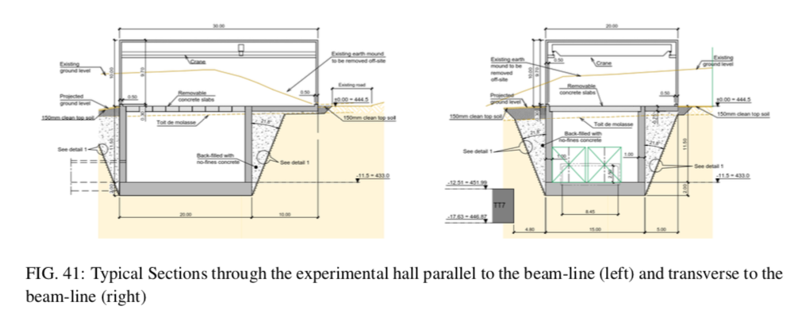
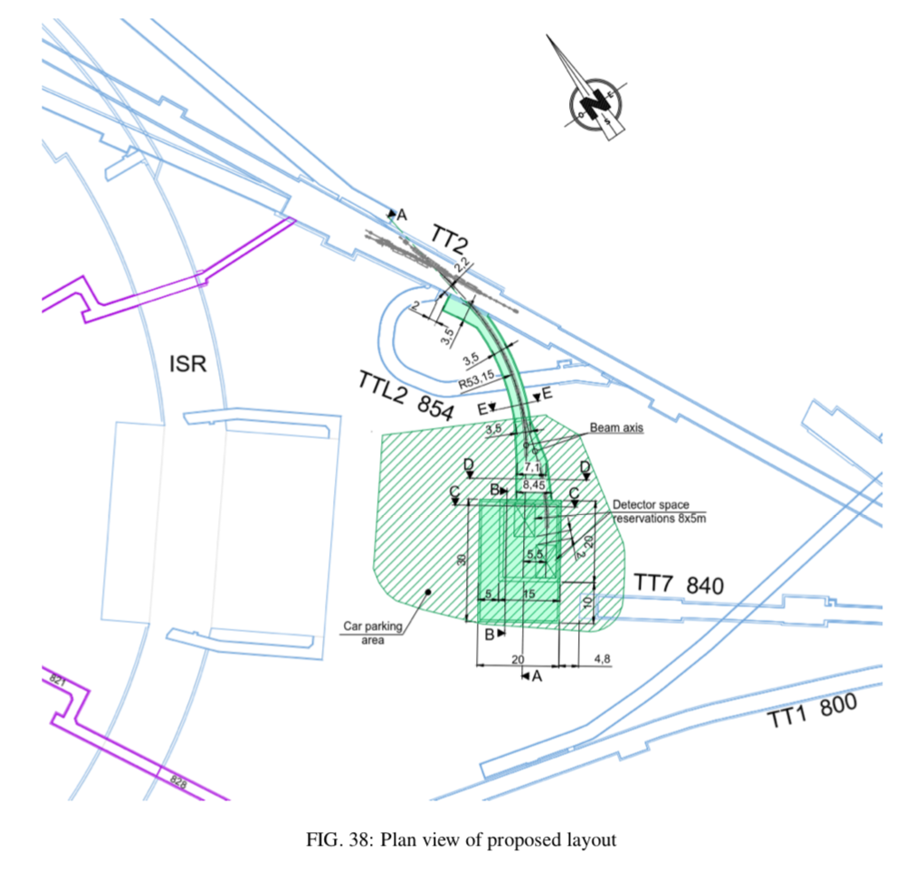
Extracted beam and experimental area
In total ~50 m new tunnel
Primary electron beam facility at CERN
18

Slide 10
Beams in exp. area – instrumentation (see backup slides)

Slide 11
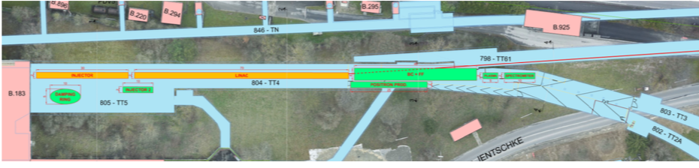
Potential use of such a facility
(linac more than 90% free)
Physics:
LDMX - Other hidden sector exp., incl. dump-type experiments using the available electrons - Nuclear physics
Accelerator physics opportunities:
CLIC: Linac goes a long way towards a natural next step for use of technology (collaborate with INFN and others also using technology for X-band linacs in coming years)
Relevant also for other potential future facilities using electrons (rings) considered at CERN
Plasma studies with electrons
  Use electron (3.5 GeV) beam as driver and/or probe – studied by AWAKE WG
General acc. R&D as in CLEAR – existing ~200 MeV linac - today (https://clear.web.cern.ch)
  Plasma-lenses, impedance, high grad studies, medical (electron irradiation), training, instrumentation, THz, ESA irradiation. Recent results: https://acceleratingnews.web.cern.ch/article/first-experimental-results-clear-facility-cern
Positron production (interesting for linear or circular colliders and plasma) and studies with positrons for plasma, and LEMMA concept for muon collider
General Linear or Ring related Collider related studies using SPS beam
  Example: damped beam for final focus studies (beyond ATF2), FCC-ee related studies
Primary electron beam facility at CERN
11

Slide 12
PLASMA WAKEFiELD ACCELERATOR (e⁻)
e⁻ Witness
e⁻ Driver
-
-
-
-
-
-
-
-
-
-
-
-
-
-
-
-
-
-
-
-
-
-
-
-
-
-
-
-
-
-
-
-
-
-
-
-
-
-
-
-
-
-
-
-
-
-
-
-
₊
₊
₊
₊
₊
₊
₊
₊
₊
₊
₊
₊
₊
₊
₊
₊
-
-
-
-
-
-
-
-
-
₊
-
-
-
-
-
-
-
₊
₊
-
-
-
-
-
-
₊
-
-
₊
₊
₊
₊
₊
₊
-
₊
₊
₊
₊
₊
₊
₊
₊
₊
₊
₊
₊
₊
₊
₊
₊
₊
₊
₊
₊
-
-
-
-
₊
₊
₊
₊
₊
₊
-
-
-
-
-
-
₊
₊
-
-
₊
₊
₊
₊
₊
-
₊
₊
₊
₊
₊
-
₊
₊
₊
₊
₊
₊
₊
₊
₊
₊
₊
₊
-
-
-
-
₊
₊
₊
₊
₊
₊
₊
₊
₊
₊
₊
₊
₊
₊
₊
₊
₊
₊
₊
₊
₊
₊
₊
₊
₊
₊
₊
₊
₊
₊
₊
₊
₊
₊
₊
-
-
-
-
-
-
₊
-
-
-
-
-
-
-
₊
₊
-
₊
₊
₊
₊
₊
₊
₊
₊
₊
₊
₊
₊
₊
₊
₊
-
-
-
-
-
-
e⁻ bunch
-
-
-
-
-
-
-
-
-
-
-
-
-
-
-
-
-
-
-
-
-
-
-
-
-
-
-
-
-
-
-
-
-
-
-
-
-
-
-
-
-
-
-
Main current challenges
True D-bunch/W-bunch experiments
Demonstrate emittance preservation (at the mm-mrad level)
Reach low energy spread (%-level)
Reach high energy transfer efficiency
Repeat with e⁺
Staging
Collider parameters …
Quality of the results limited by the drive (D) and witness (W) bunch parameters available

Slide 13
eSPS MOTiVATiONS
Goal: study accelerator-related PWFA topics
Provide quality accelerated bunch, same ∆E/E and ε_{N} as injected one
Aim for energy gain on the order of incoming energy, 3.5GeV
Aim for >1GeV/m accelerating gradient
Operate with independent D and W bunches, D=3.5GeV, W=CLEAR++
Matching of the W-bunch to the plasma
May still be the only facility with GeV drive bunch and independent D+W bunch
Possible studies:
Emittance preservation (in the blow-out regime)
Narrow final energy spread => beam loading
D-bunch energy depletion, energy transfer efficiency
Beam/plasma matching
Bunch shaping for >2 transformer ratio and energy transfer efficiency
Effect of drive bunch train on wakefields and plasma as a fct of time
Effect of plasma “quality”, longitudinal density profile, ramps, reproducibility, etc.
Test bed for plasma sources: helicon source, discharge source, etc.
Possibility to have suitable positron (e⁺) bunch for De⁻/We⁺-PWFA studies
Fits the ALEGRO roadmap
All knowledge at CERN, including CLEAR++, AWAKE, plasma source, etc.

Slide 14
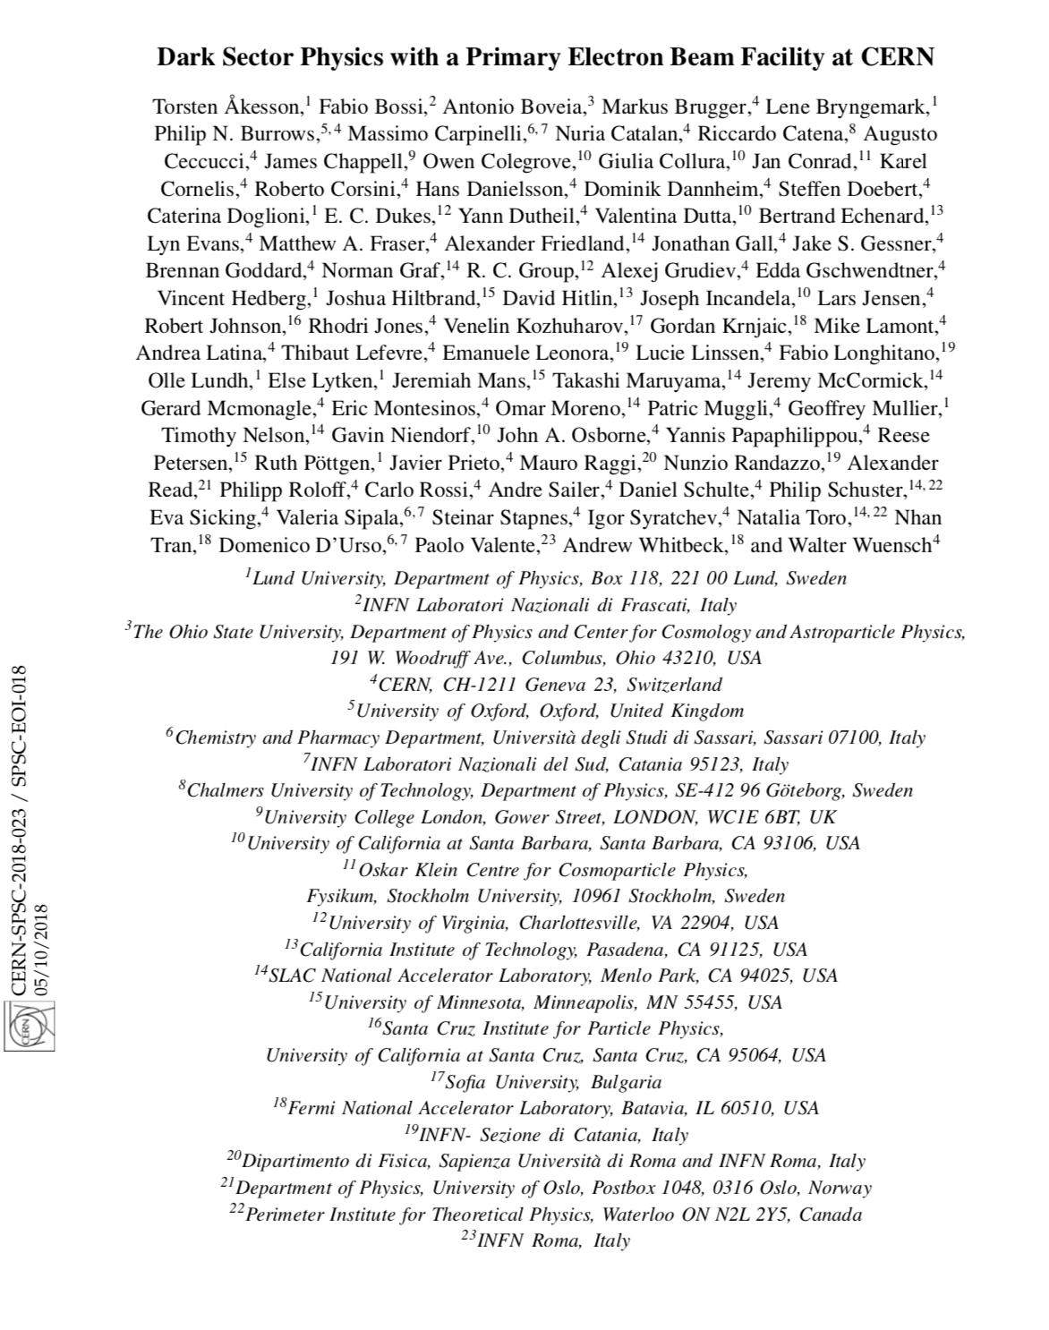
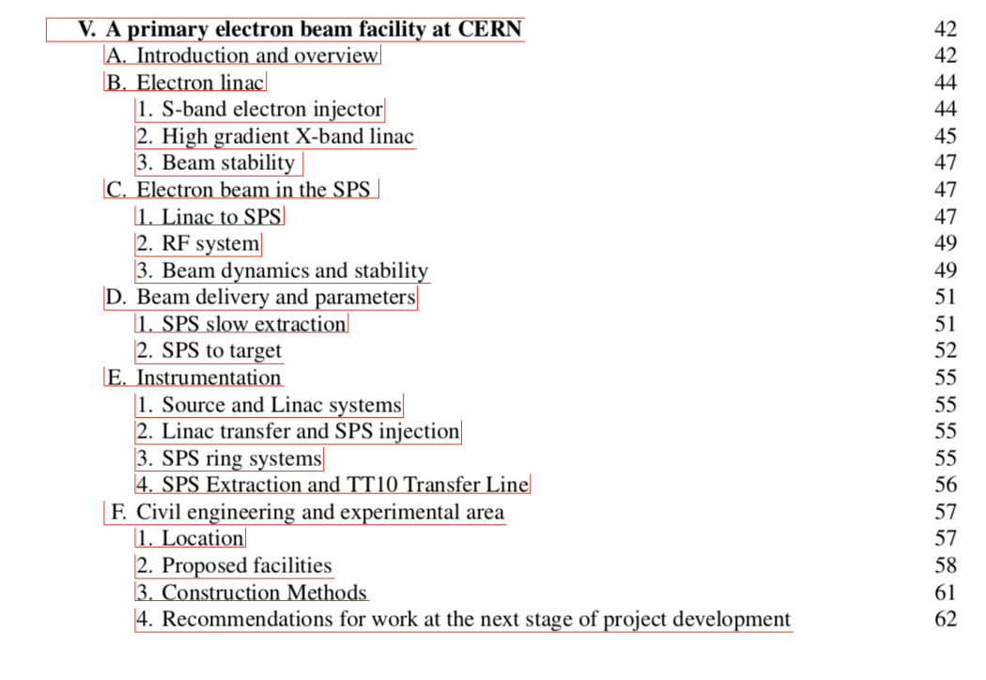
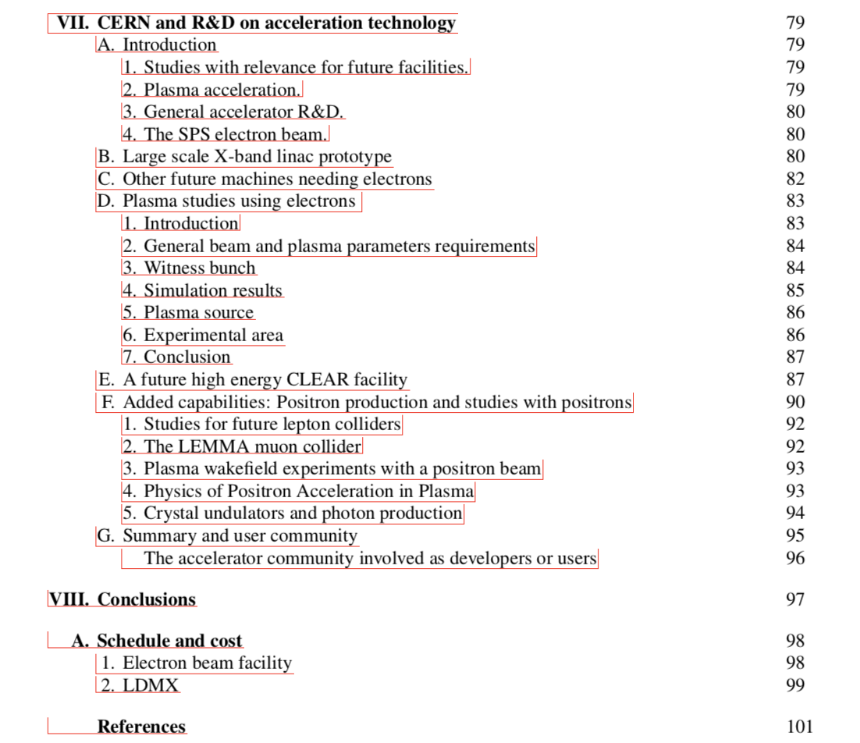
EoI to the SPSC Oct 2018: https://cds.cern.ch/record/2640784
Also submitted in “compact form” to ESPP update 18.12:
https://indico.cern.ch/event/765096/contributions/3295600/

Slide 15
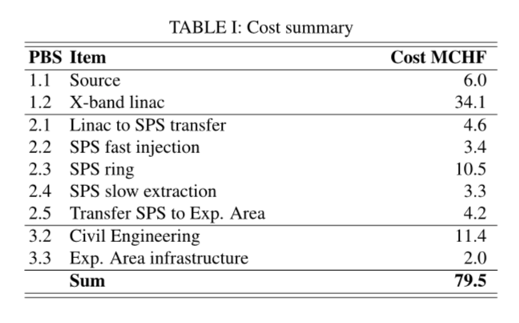
Costs
Sources
Industrial (e.g. RF components, structures for linacs)
”Standard” rates (e.g. civil engineering)
PBS with ~80 items, estimates from technical responsible
Primary electron beam facility at CERN
15

Slide 16
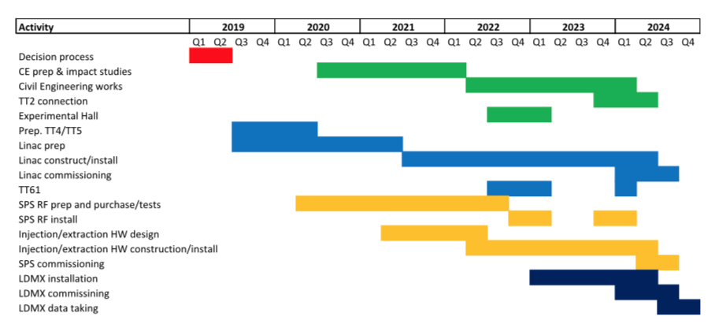
Schedule in the EoI
Technically based … however
Respects that efforts during LS2 has to be limited
No major spending or commitments until Spring/mid 2020 (ESU completion) -> need significant resources from then
Final connection after end of LHC run in 2023
Can run during LS3 when/if the SPS is available
Need to decide now if we move ahead towards a CDR or similar in a years time – resource/priority issue
Primary electron beam facility at CERN
16

Slide 17
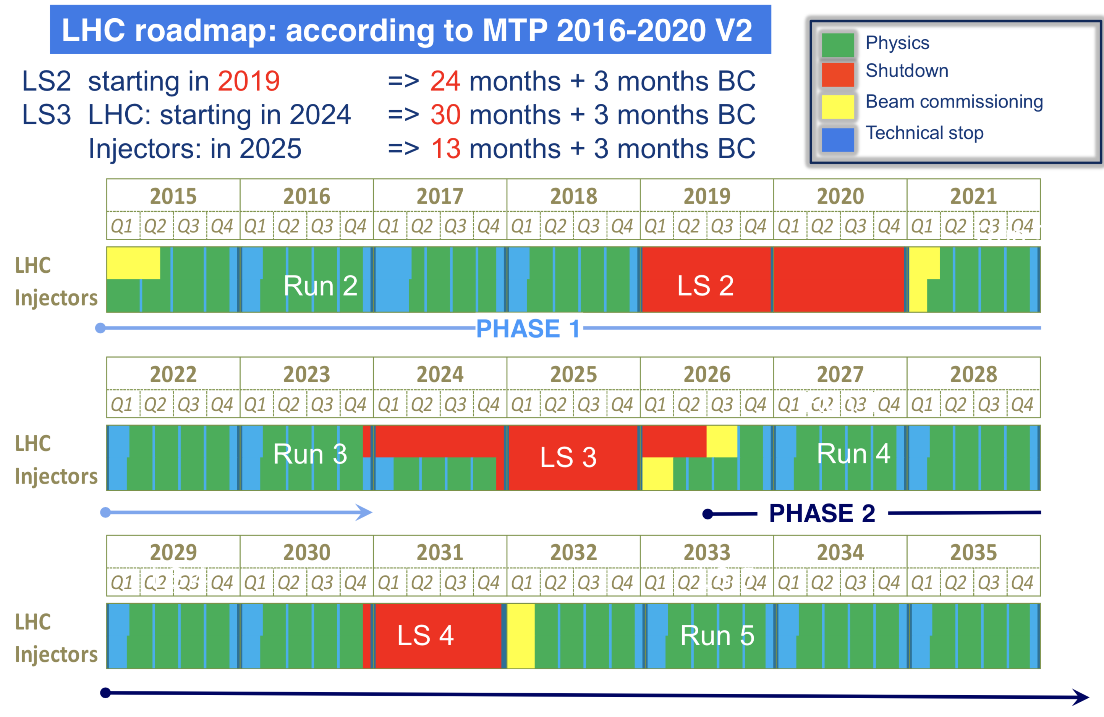
Primary electron beam facility at CERN

Slide 18
Towards a CDR this year

Slide 19
Concluding remarks
Important physics opportunities with e-beams at CERN
Based on previous usage of the CERN accelerator complex, and building on the accelerator R&D for CLIC, an electron beam facility would be a natural next step
  No show-stoppers have been found when exploring this option
  LDMX interest in pursuing this option as beam close to ideal
Will also provide many opportunities for important and strategic accelerator R&D at CERN – and opens the door to future electron facilities in general
- Thank you -
Primary electron beam facility at CERN
19

Slide 20
More information

Slide 21
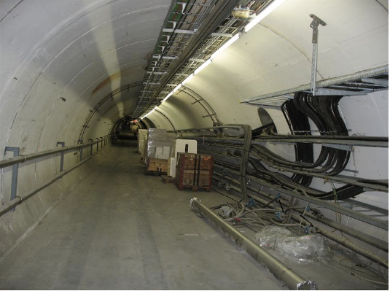
Transfer tunnel, TT60, from the Linac into the SPS
Injection into the SPS
Bunch to bucket injection in the 200MHz SPS longitudinal RF structure.
Total of 75 trains of 40 bunches
3000 bunches
10¹² electrons in the ring
Primary electron beam facility at CERN
9
Notes:
Up to 1.5E12
Discuss injection gap

Slide 22
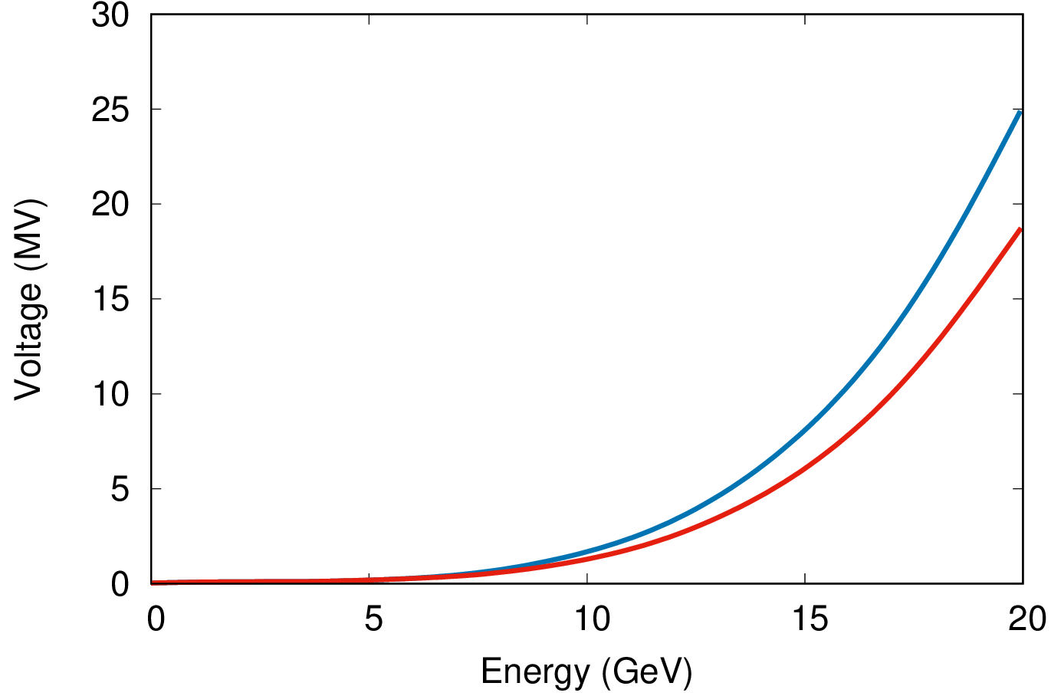
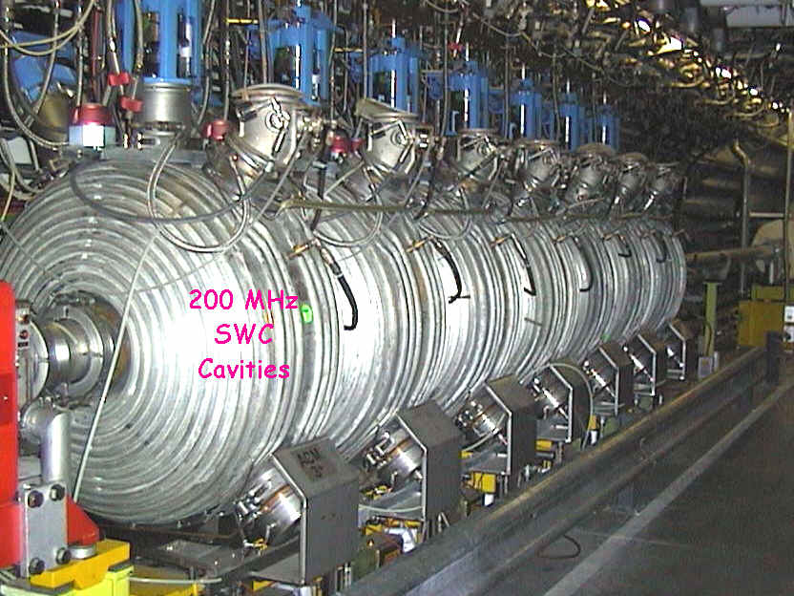
SPS RF system
Acceleration to 16 GeV can safely be
achieved
Existing 200 MHz cavities from LEP
era to be re-installed
  Need 10MV for 16GeV electrons
  (12 + 1) 200 MHz Standing
  Wave Cavities [1 MV per cavity] available
Space is available to install them
5ns, 10ns, … 40 ns longitudinal
structure is imposed by the available cavities
Trains of 200ns (linac) separated by 100ns gaps (injections kicker)
Voltage for 5min quantum lifetime
Energy loss per turn (MeV)
Courtesy J. Jowett
Primary electron beam facility at CERN
10

Slide 23
Slow extraction to experiments
Extraction
Primary electron beam facility at CERN
11

Slide 24
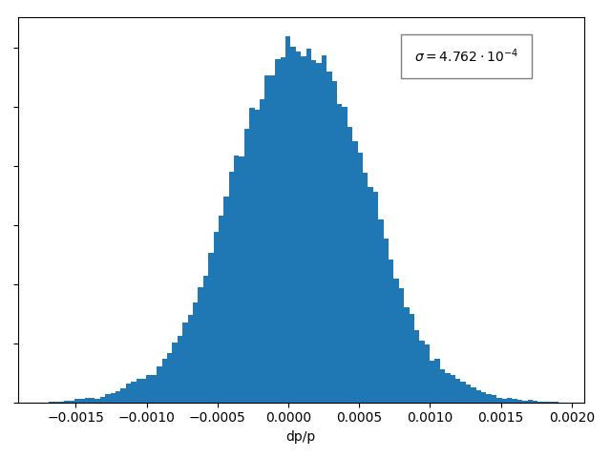
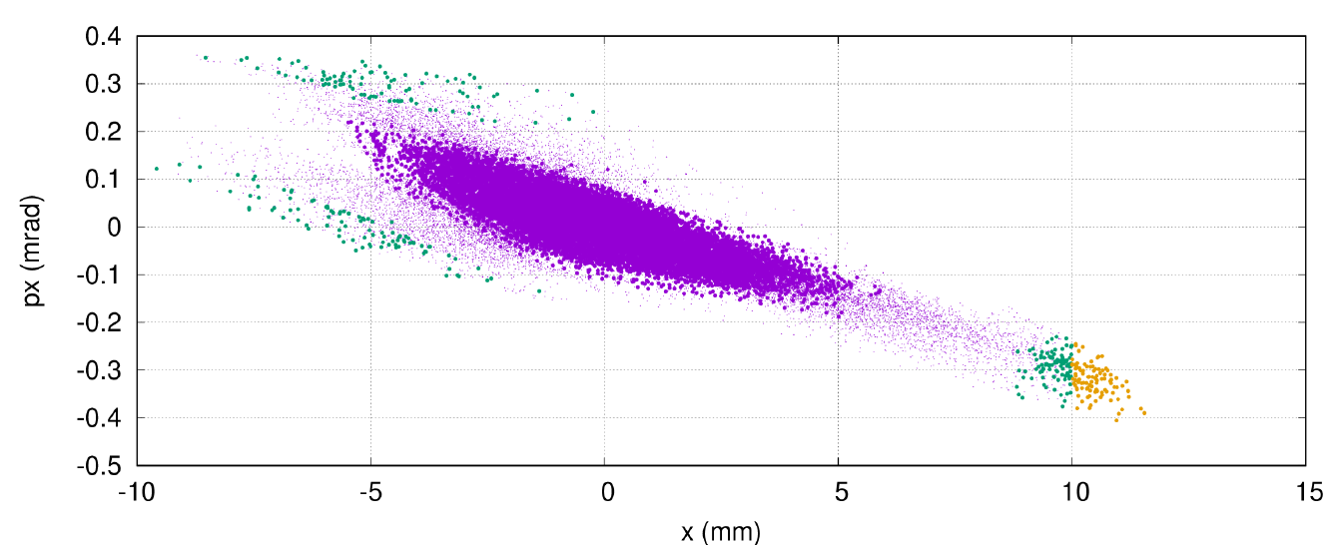
Slow extraction principle, in frequency space
Spread in oscillation frequency within the beam follows
  Transverse distribution
  Longitudinal distribution in presence of chromatic lattice
Position of the resonant condition is set by the machine
Synchrotron radiation constantly diffuse the particles to fill
the tail in the distribution
The extraction rate can be controlled by
changing the position of the resonant
condition
Resonant condition
extraction
diffusion
Electrostatic
Septum
Tune (frequency)
Extraction rate
Primary electron beam facility at CERN
12

Slide 25
Electron beam transfer line from the SPS to experiments
Uses existing TT10 line, designed to transport 10/20 GeV beams
Collimation in the line for control of beam distribution and intensity
  ~ Gaussian beam can be made almost flat by careful collimation
Beam size might be increased greatly at the target
  Size of beam-spot chosen to deliver number of
  electrons/cm²/bunch-crossing on target
  For instance a 2cm vertical and 20cm horizontal beam is feasible
  There is flexibility on the choice of both horizontal and vertical beam sizes
Primary electron beam facility at CERN
16
Notes:
TT10 was designed for 10 to 20 GeV

Slide 26
Instrumentation
Linac:
Position
  Re-use of CTF3 inductive pick-ups
  Simple button BPMs would also do the job
Beam Size
  OTR screens (can also be combined with streak camera for bunch length)
Intensity
  Re-use of CTF3 inductive pick-up or standard beam current transformers
SPS:
Position
  Standard orbit system (consolidated in LS2)
  Should be able to measure to 1e9 (limit ~5e8)
Beam Size
  Wirescanners
  Possible use of synchrotron radiation
Intensity
  DC Transformer OK for total current
  Fast BCT does not distinguish 5ns spaced bunches
  Could do batch by batch but at limit of resolution (tbc)
Extracted beam:
Position & Intensity
  Use of fibre monitors.
    Developed for new EHN1 (neutrino platform) secondary lines
    Scintillating (or Cherenkov) fibres
    Low material budget
    > 90% efficiency for single particles demonstrated
  R&D required to make them UHV compatible
The challenge of measuring very low intensity beam can be circumvented using a higher intensity for beam setup
Primary electron beam facility at CERN
17

Slide 27
Structure of extracted beam
up to 40 bunches
with 5ns spacing
Gap of 100ns with 0.5m injection kicker
Beam in the SPS
Energy
200 ns
100 ns
~1s
Beam on target
0s
10s
20s
30s
Flexibility
  Bunch spacing 5ns, 10ns, … 40ns
  Average electrons per bunch can be chosen from <1 to anything
  Transverse beam spot on target from very small up to hundred cm²
This flexibility can deliver the needs of LDMX
  Phase 1 : 10¹⁴ electrons
  Phase 2 : 10¹⁶ electrons
Primary electron beam facility at CERN
13

Slide 28
Beamdump experiments possible
After this beam has been delivered there is still a lot of electrons in the SPS
These can quickly be dumped into a separate beam line
  10¹² electrons within 23μs, possibly up to 4 times more
If there would be a high priority the dump can be repeated every 2 s
Beam in the SPS
Energy
…
~1s
Beam on target
Beam dumped
0s
10s
20s
30s
Primary electron beam facility at CERN
14

Slide 29
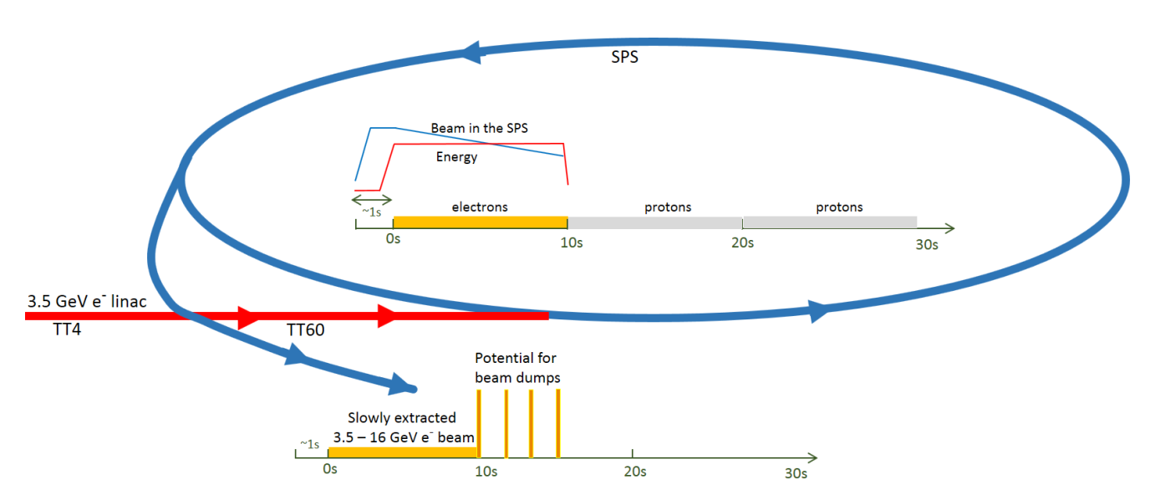
An Electron Beam Facility at CERN
Capability:
Extracting ~10 electrons per 5 ns means 10¹⁶ electrons in ~80 days
Including up-times and efficiencies: a dedicated ~year or a few years as part of super-cycle
Primary electron beam facility at CERN
15

