Slide 1
High-Quality LWFA-based electrons sources
Jurjen P. Couperus Cabadağ
Institute of Radiation Physics, Helmholtz-Zentrum Dresden - Rossendorf, Germany
3th ALEGRO workshop, CERN, March 2019

Slide 2
Title
Outline
  High quality beams: LWFA vs conventional acceleration
  Coupled parameters in LWFA
    Example case: Improving energy spread with Beam loading
  Injection mechanisms: crucial for high quality beams
    Bunch duration
    Energy spread
  Decoupling injection from acceleration
  Repetition rate & stability
  Conclusion

Slide 3
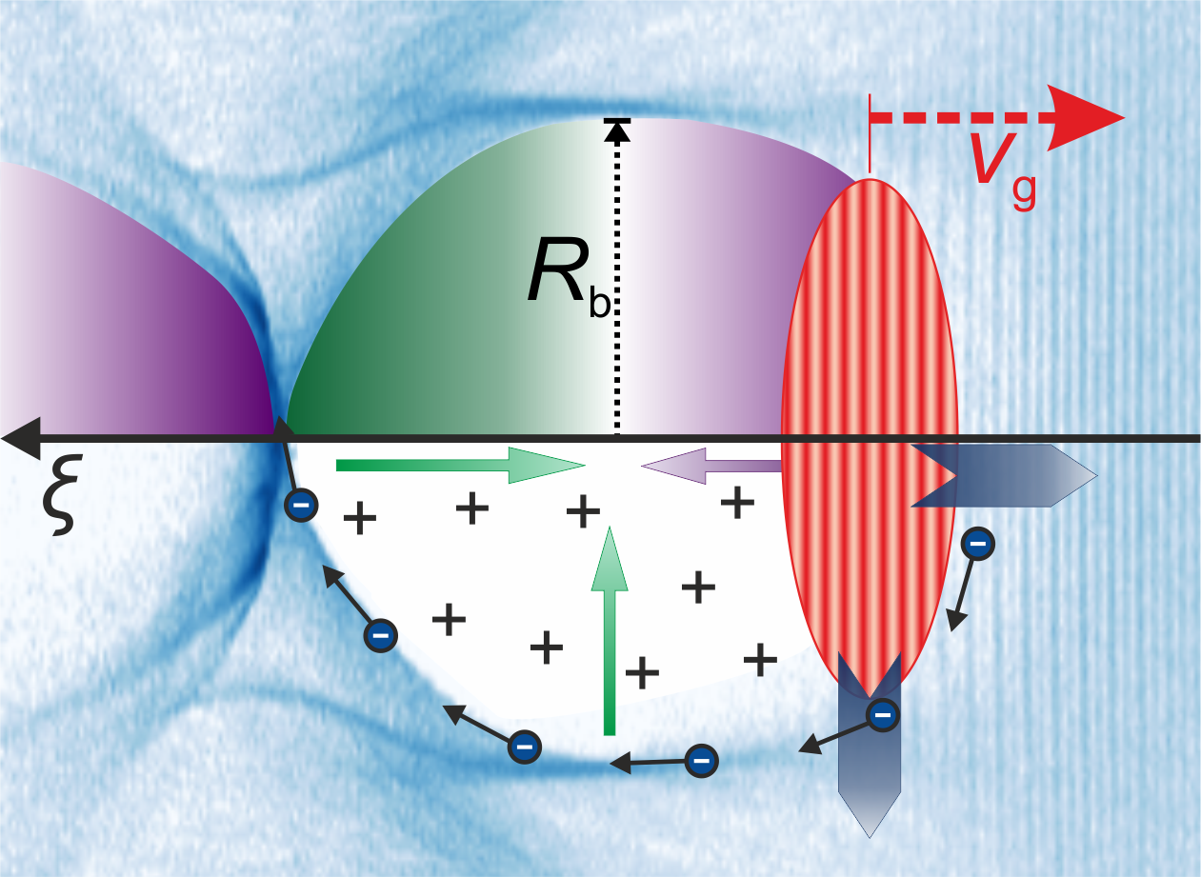

Most LPAs operate in the bubble regime
Laser pulse
Highly nonlinear regime (a₀>2)
  → (I > 8.5 x 10¹⁸ Wcm⁻²)
High accelerating gradients
  Wakefield structure and bunch charge balance each other
    Strong linear focusing fields
    Can contain and accelerate large charges
  Accelerating field is independent of transverse position
    reduces energy spread
Pukhov & Meyer-ter-Vehn, Appl. Phys. 74, (2002). Lu et al., PRSTAB 10, (2007), Downer et al., Rev. Mod. Phys 90, 035002 (2018).

Slide 4
LWFA: high quality?
  Strong points (compared to conv. acc.):
  Work in progress (compared to conv. acc.):
Property | Conventional acc. | Laser wakefield acc.
Acceleration gradient | < 100 MV/m | 100s GV/m
Bunch duration | ~100 fs – ns range | ~few fs
Beam size | > few µm | ~few µm at acc. exit
Peak current | few kA | 10s kA
Lundh et al., Nat. Phys. (2011)
Heigoldt et al., PRSTAB (2015)
Zhang et al., PRAB (2016)
Köhler et al., NIMA (2016)
Kneip et al., PRSTAB (2012)
Couperus et al., Nat. Comm. (2017)
Li et al., Phys. Plasmas (2017)
Property | Conventional acc. | Laser wakefield acc.
Energy spread | <<1% | 1 – 100% (typical ~10%)
Divergence | down to µrad | 1 mrad (typical ~few mrad)
Beam emittance | < mm mrad | 0.1 – 1 mm mrad
Repetition rate (average current) | kHz – MHz | ~1 Hz (limited by laser tech.)
Stability | sub-% | 1 – 10s %
Wang et al., PRL 124801 (2016)
Rechatin et al., PRL 164801 (2009)
Gallacher et al., Phys. Plasmas (2009)
Plateau et al., PRL (2012)
Curcio et al., PRAB (2017)
Barber et al., PRL (2017)
Laser wakefield acceleration is an attractive scheme, but does not (yet) deliver the same quality electron beams as found in conventional accelerators
M. Downer et al., Rev. Mod. Phys. 90, 035002

Slide 5
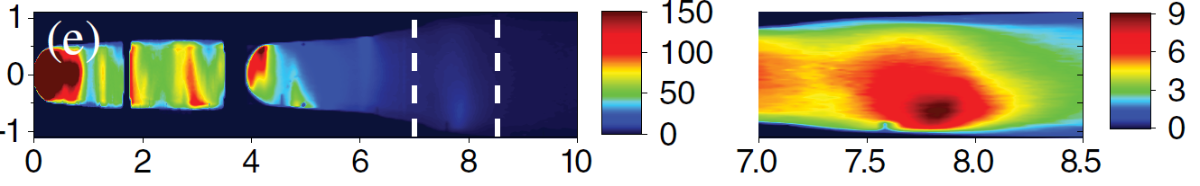
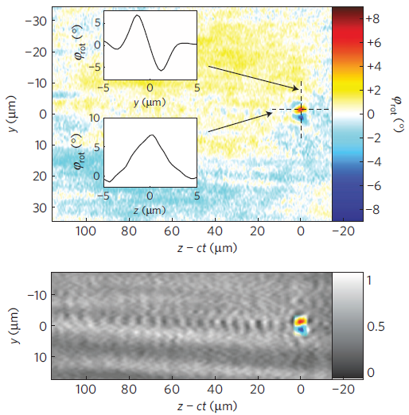
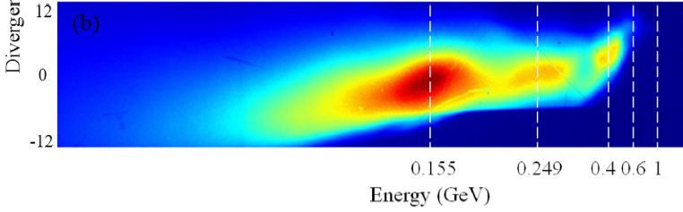
State-of-the-art results
Energy
Short bunch duration
angle (mrad)
Δ γ / γ ~ 6%
pC/mrad/
(GeV/c)
τ_{FWHM} = 5.8 fs
Buck et al., Nat. Phys. 7, 543(2011)
momentum (GeV/c)
~1 kA
7.8 GeV, 20 cm plasma medium, 5 pC
Gonsalves et al., Phys. Rev. Lett. 122, 084801 (2019)
Difficult to optimize all beam parameters at once:
High energy
High charge
Short pulse duration
Low energy spread
High charge / peak current
High peak current
80 TW, 3 mm plasma medium:
620 pC, 30 fs →20 kA
Li et al., Phys. Plasmas 24, 023108 (2017)

Slide 6
LWFA Electron beam properties
Difficult to optimize: many final beam parameters and/or accelerator properties are coupled
Energy
Energy spread
Injection Method
Plasma density
Bunch duration
Peak current
Transverse emittance
Repetition rate
Stability
Average current
Dephasing length
Laser energy
Acceleration length
Acceleration gradient
Charge

Slide 7
LWFA Electron beam properties
Difficult to optimize: many final beam parameters and/or accelerator properties are coupled
Energy
Energy spread
Injection Method
Plasma density
Bunch duration
Peak current
Transverse emittance
Repetition rate
Stability
Average current
Dephasing length
Laser energy
Acceleration length
Acceleration gradient
Charge

Slide 8
LWFA Electron beam properties
Difficult to optimize: many final beam parameters and/or accelerator properties are coupled
Energy
Energy spread
Injection Method
Plasma density
Bunch duration
Peak current
Transverse emittance
Repetition rate
Stability
Average current
Dephasing length
Laser energy
Acceleration length
Acceleration gradient
Charge
To reach high quality beams:
We have to decouple beam properties and/or scale key parameters without deteriorating others

Slide 9
LWFA Electron beam properties
Difficult to optimize: many final beam parameters and/or accelerator properties are coupled
Energy
Energy spread
Injection Method
Plasma density
Bunch duration
Peak current
Transverse emittance
Repetition rate
Stability
Average current
Dephasing length
Laser energy
Acceleration length
Acceleration gradient
Charge
Can the charge/current be scaled, while preserving a low energy spread?

Slide 10
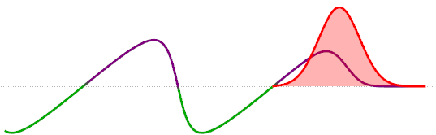
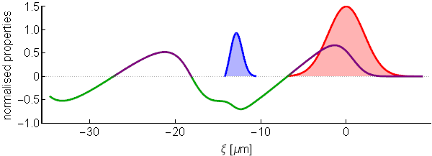

High charge induces beam loading
Self-fields of bunch reshape the accelerating wakefield
Laser driven acc. field
+
e⁻ beam self field
=
Beam loading
Beam loading effects
Reshaping plasma accelerating structure
Reduction of effective acceleration gradient
Degradation of the final beam quality:
maximum energy, energy spread
Rechatin et al., PRL 103, (2009)
Guillaume et al., PRSTAB 18 (2015)
Vafaei-Najafabadi et al., PRL, 112, (2014)

Slide 11
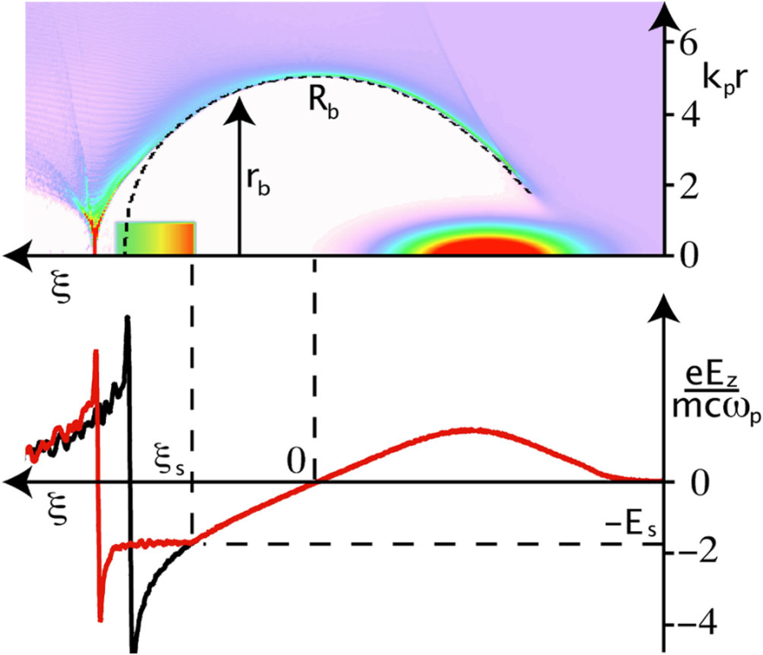

Optimal beam loading
BUT, one can optimize it :
  Injection of an optimum bunch shape in the nonlinear bubble regime with a specific charge Q_{s}
Charge scaling at the optimum loading condition
Requires ~0.3 nC of injected charge at 65 TW laser power
Tzoufras et al.,
Phys. Rev. Lett. 101, 145002 (2008)
Optimum beam loading
Accelerating gradient constant along the bunch
No extra addition of energy spread
S. van der Meer, CLIC note No. 3 (1985)
Katsouleas et al., Part. Acc. 22 (1987)

Slide 12
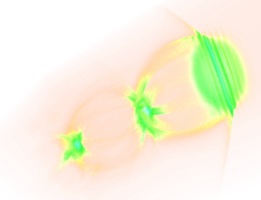
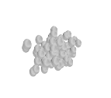

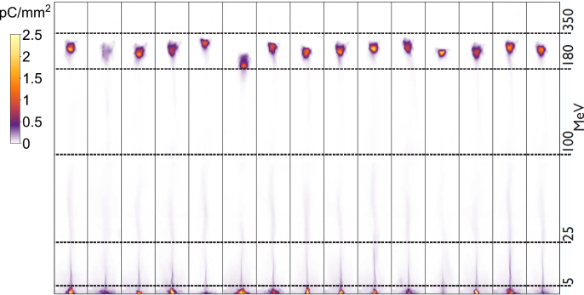
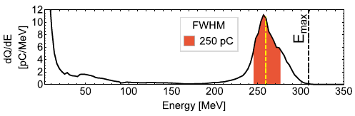
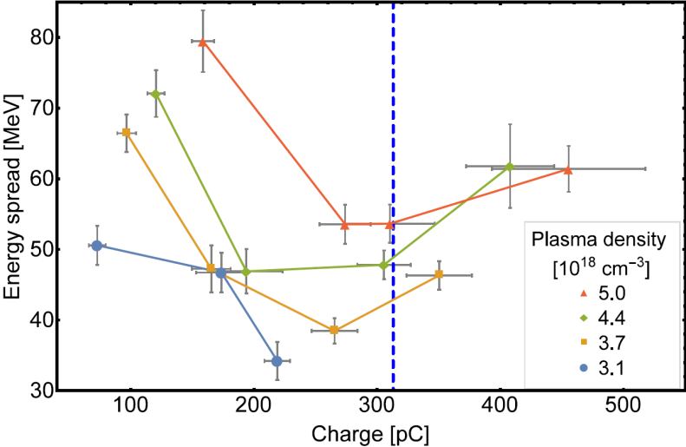
Optimal beam loading: minimizing energy spread
To minimise energy spread in a
plasma accelerator, the charge has to be increased for optimal beam loading
Controlled injection using self-truncated ionization injection (STII) of a large charge (0.1 up to 0.5 nC in FWHM) loads the wakefield.
Beam loading: At increased charge a minimum of energy spread occurs.
  Here the acceleration process no longer increases energy spread.
  The remaining energy spread originates from the injection process.
Theoretical prediction
At the optimal loading condition an unprecedented high peak current up to 20 kA at 15% energy spread is reached.
Couperus et al. Nat. Commun. 8, 487 (2017)

Slide 13
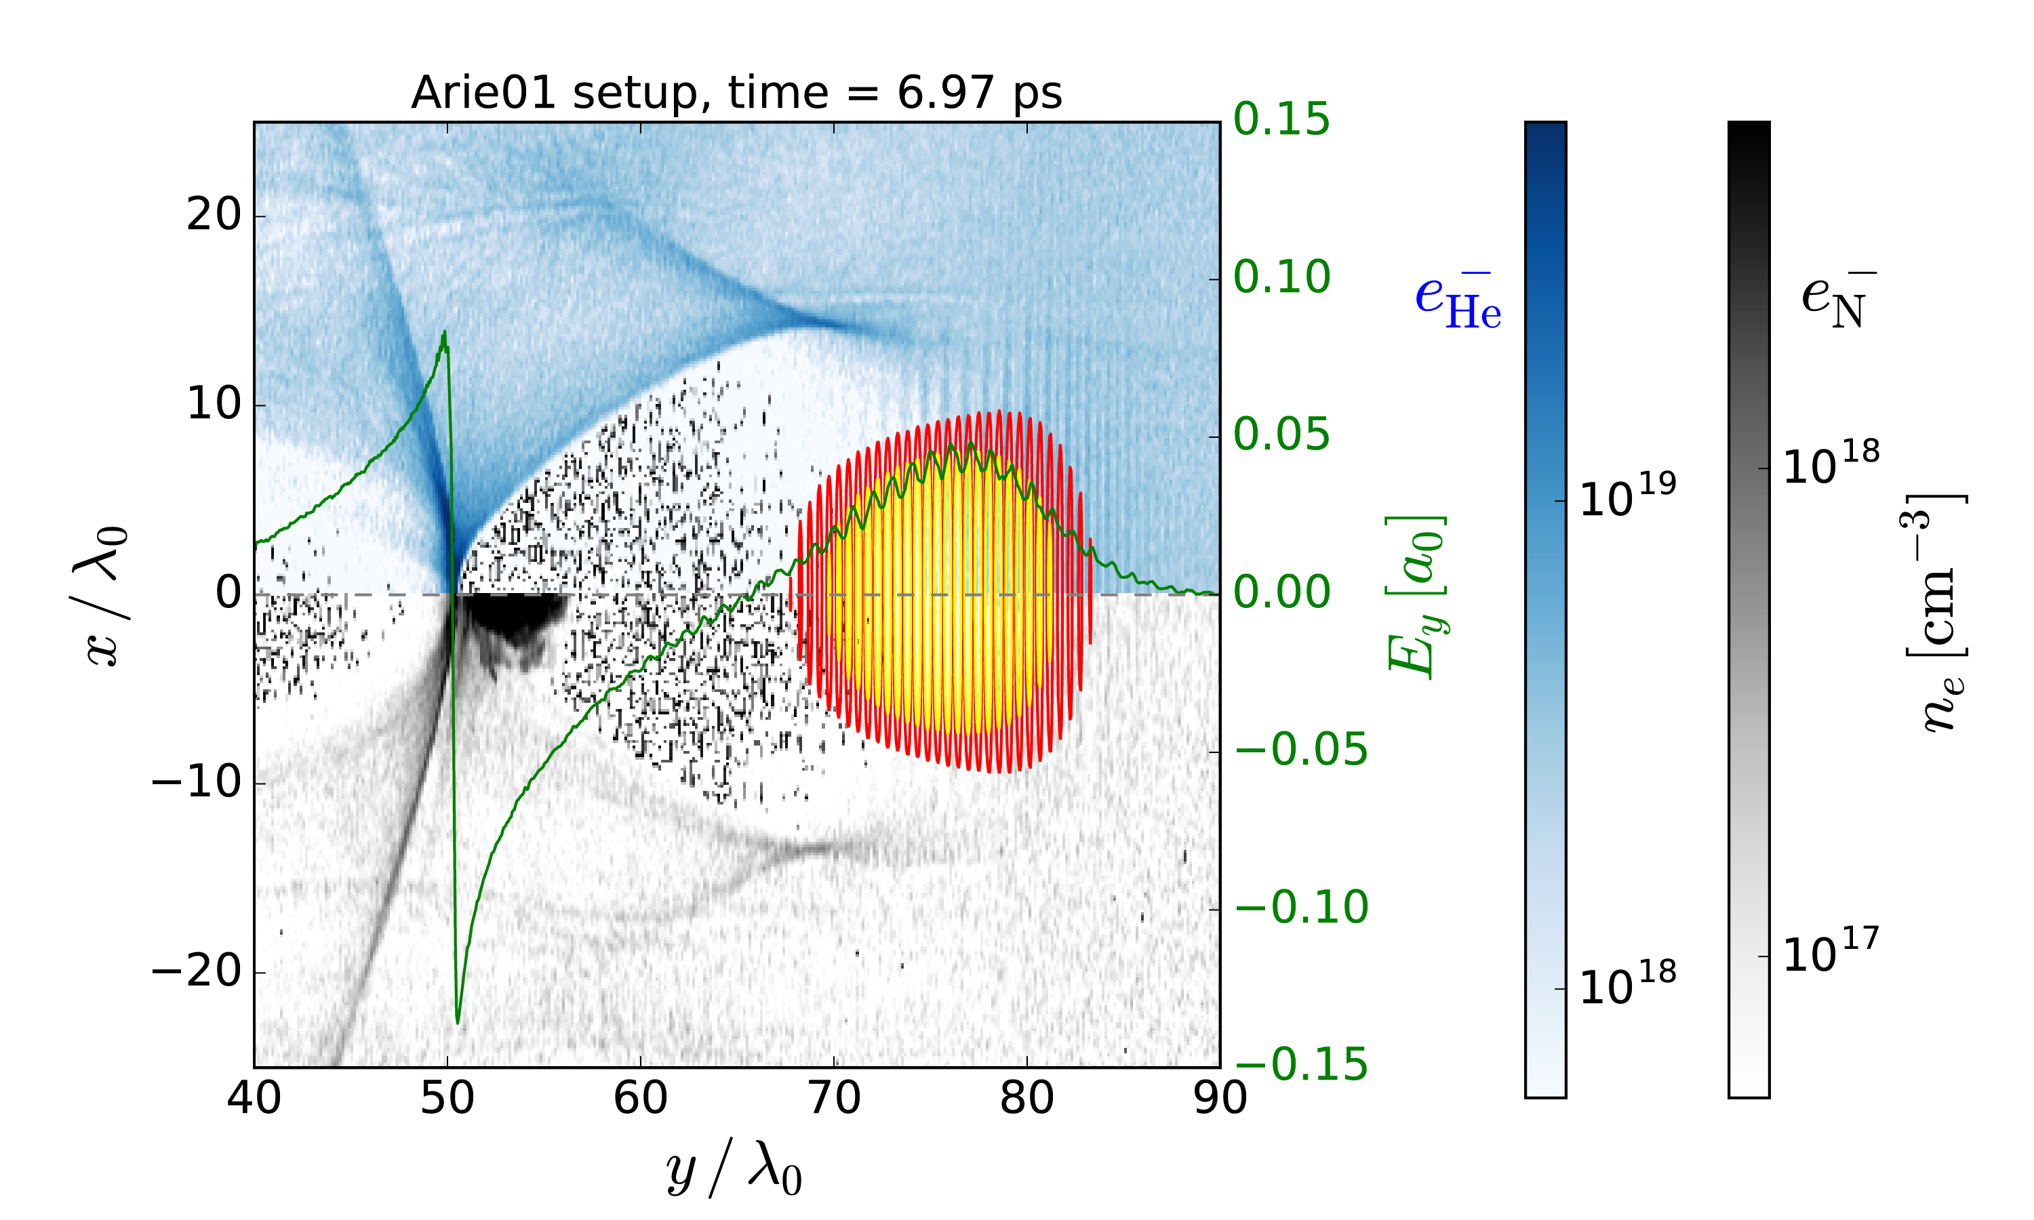
Ionisation injection
The accelerating medium is doped by a high-Z gas
Choosing the gas and laser energy such that inner shell electrons only ionize at the peak of the laser
Species | Ionisation energy (eV)
He¹⁺ | 24.6
He²⁺ | 54.4
N¹⁺ | 14.5
N²⁺ | 29.6
N³⁺ | 47.4
N⁴⁺ | 77.5
N⁵⁺ | 97.9
N⁶⁺ | 552
N⁷⁺ | 667
Injection volume phase-space constant
Charge is increased by increasing nitrogen doping
Ionised only near the
laser peak intensity

Slide 14
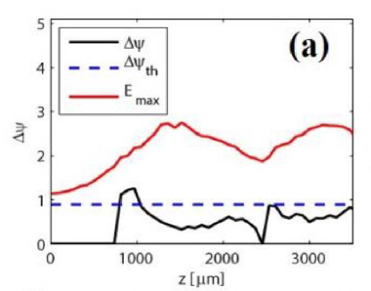
Self-truncated ionisation injection:
Stopping the injection for
mono-energetic beams
In order to restrict energy spread from injection, a limited injection time is required
In Self Truncated Ionisation Injection (STII) the laser driver and wakefield shape evolve during the interaction such that conditions for injection are fulfilled only in a limited region.
Injection only when:
  Laser max energy is high enough for ionisation
  pseudo-potential difference allows trapping
Zeng et al. Phys. Plasmas 21, 030701 (2014), Mirzaie et al. Sci. Rep. 5, 14659 (2015)

Slide 15
Electron beam properties: Injection
Energy
Energy spread
Injection Method
Plasma density
Bunch duration
Peak current
Transverse emittance
Repetition rate
Stability
Average current
Dephasing length
Laser energy
Acceleration length
Acceleration gradient
Charge
Self-truncated ionization injection is capable to inject high charges, but suffers from relative long injection time and related high energy spread.
Injection and acceleration is coupled

Slide 16
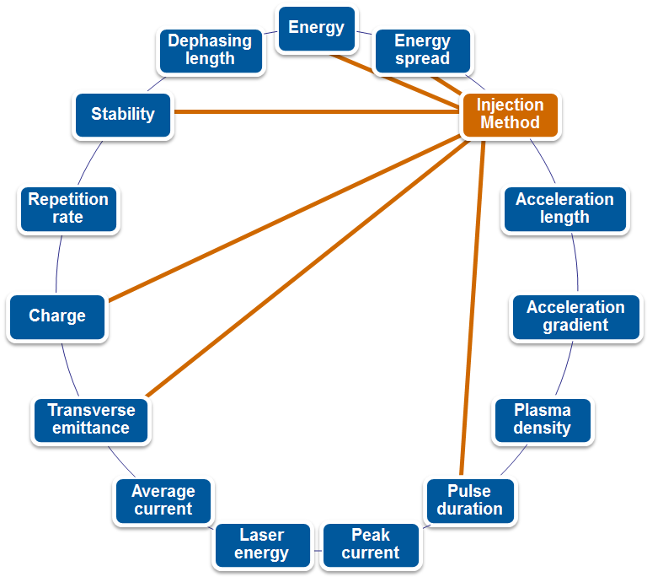
Injection mechanisms:
crucial for high quality beams
Controlling the injection is important as this influences:
  Final energy
  Energy spread
  Charge
  Divergence/emittance
  Bunch length

Slide 17
Injection: Pulse duration
CTR spectrometer technique to measure bunch durations
O. Zarini, A. Debus et al., in preparation
Self Truncated Ionization injection
Wave-breaking
O. Lundh et al., Nat. Phys. 7, 219–222 (2011), S.L. Bajlekov et al., PRSTAB 16, 040701 (2013), T. Maxwell et al., PRL. 111, 184801 (2013)
M. Heigoldt et al., PRSTAB 18 121302 (2015), B. Schmidt et al., arXiv:1803.00608 (2018), O. Zarini et al., IEEE AAC (2018)

Slide 18
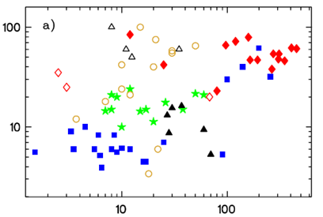
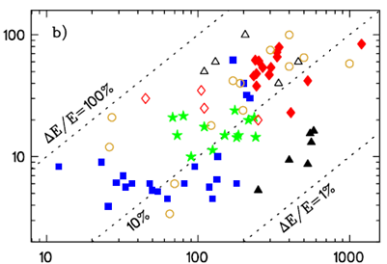
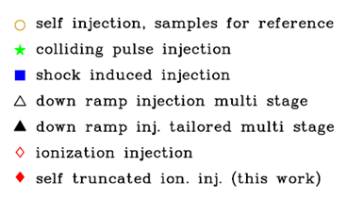
Injection: Energy spread & Charge
ΔE (FWHM, peaked distribution)
[MeV]
ΔE (FWHM, peaked distribution)
[MeV]
total charge (peaked distribution) [pC]
Mean energy (peaked distribution) [MeV]
J. Osterhoff et al., PRL (2008), S.P.D. Mangles et al., Nat. (2004), J. Faure et al., Nat (2004), W.P. Leemans et al., Nat. Phys. (2006), S. Kneip et al. PRL (2009), H.T. Kim et al., PRL (2013)
J. Faure et al., Nat. (2006), C. Rechatin et al., PRL (2009)
K. Schmid et al., PRSTAB (2010), A. Buck et al., PRL (2013), K.K. Swanson et al., PRAB (2017), K. Khrennikov et al., PRL (2015), S. Karsch et al., EAAC unpubl. (2017)
A.J. Gonsalves et al., Nat. Phys. (2011), B.B. Pollock et al., PRL (2011), W.T. Wang et al., PRL (2016)
C. McGuffey et al., PRL (2010), C.E. Clayton et al., PRL (2010), Y.F. Li et al., Phys. Plasmas (2017)
M. Mirzaie et al., Sci. Rep. (2015), J.P. Couperus et al., Nat. Comm. (2017)
A. Irman et al., Plasma Phys. Control. Fusion 60, 044015 (2018)

Slide 19

Injection: Coupled parameters with acceleration
In Self Truncated Ionisation Injection (STII) & wave-breaking injection the injector and accelerator are directly coupled
Injector + Accelerator
Partly decoupling injector and accelerator gives better control
  e.g. shock-front injection, colliding pulse injection
Injector
Accelerator
Ideally we would like to completely separate injection and acceleration parameters
  e.g. external injection
Injector
Accelerator
We still need to inject enough charge to reach the optimal loading condition

Slide 20
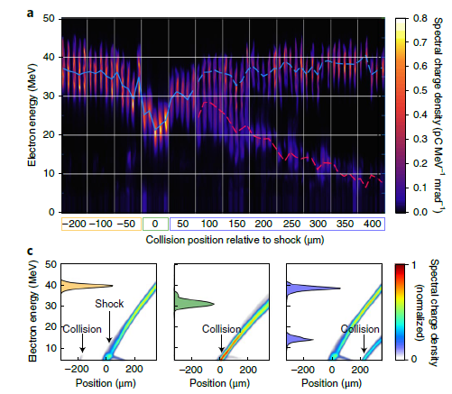
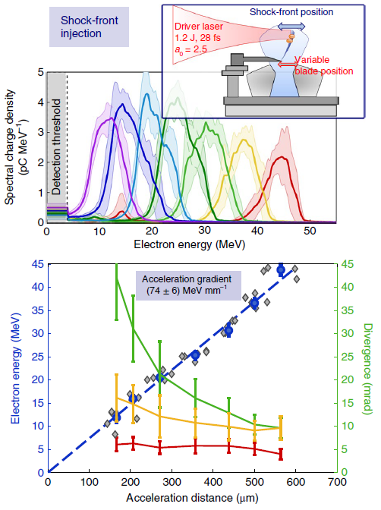
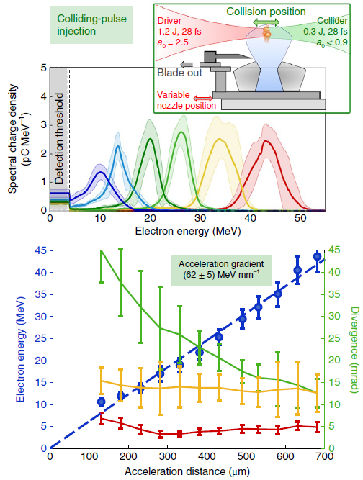


Injection: decoupling parameters
Improved control:
  Shock-front injection + Colliding pulse injection
shock-front
injection
optically assisted
shock-front injection
optical injection
J. Wenz et al., Nat. Photonics (2019)
A. Buck et al., PRL 110, 185006 (2013), K. Schmid, PRSTAB 13, 091301 (2010)
K.K Swanson et al, Phys. Rev. Acc. Beams 20, 051301 (2017). J. Faure et al., Nature 444, 737-739 (2006)

Slide 21
Injection: decoupling parameters
Stefan Karsch et al. (unpublished)
Reaches charge as required for the optimal loading condition!

Slide 22
Stability & Repetition rate
Talk this morning by Andreas Maier: Reliable laser operation
Talk this morning by Emily Link: High-average power laser for LWFA
Current high-power laser systems still suffer from shot-to-shot fluctuations
Talk yesterday by Lucas Schaper: High-repetition rate plasma sources
  Heat dissipation from laser/beam driver
  Plasma perturbations at high-repetition rate
Challenges
In how far can we further improve accelerator stability by improving laser stability?
&
Can we scale to high-repetition rate without sacrificing beam quality

Slide 23
Conclusion
Laser wakefield accelerators are attractive for their high accelerating gradient (compactness), their inherent short pulse duration (few fs) and high peak current (10s of kA).
Coupling of injector, accelerator and beam parameters makes improving beam quality in laser wakefield accelerators challenging.
Lot of recent progress in beam quality improvement:
  Optimal beam loading: Cancellation of the energy spread contribution from the acceleration process
  High peak currents, even at limited energy spread
  Measurement of bunch duration: sub-fs substructures & influence of different injection schemes
  Injection schemes: decoupling injector from accelerator. Further reducing energy spread & beam divergence/emittance (at high injected charge)
  Increased reproducibility & stability: from acceleration to accelerator.

Slide 24

Thank you for your attention!
HZDR, team electrons:
Arie Irman
Ulrich Schramm
Jurjen Couperus Cabadağ
Alexander Köhler
Omid Zarini
Vincent Chang
Thomas Kurz
Susanne Schöbel

