Slide 1
CLIC: Main Linac Beam Dynamics
ALEGRO Workshop
CERN
March 2019
Daniel Schulte

Slide 2

CLIC Introduction
CLIC: Compact LInear Collider
CLIC aims to provide multi-TeV electron-positron collisions with high luminosity at affordable cost and power consumption
2012 CDR:
Shows feasibility of 3 TeV design

Slide 3
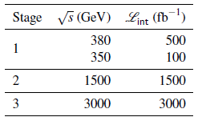
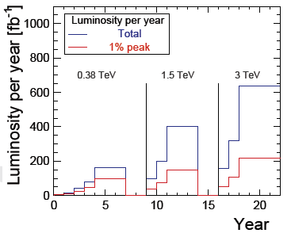
CLIC Staged Scenario
Plenty of physics at low centre-of-mass energies
Energy and luminosity targets from Physics Study Group
Top above threshold
Higgs via Zh and WW fusion
Study top at threshold
To be updated with more input from LHC and stage 1
Implementation in stages

Slide 4
CLIC at 380 GeV
Developed optimised first energy stage
Upgrade to higher energies included

Slide 5
Key Parameters
Very small emittances required to achieve the luminosity
Bunch charge and length at IP determined by main linac
Parameter | Symbol [unit] | CLIC | CLIC
Centre of mass energy | E_{cm} [GeV] | 380 | 3000
Luminosity | L [10³⁴cm⁻²s⁻¹] | 1.5 | 6
Luminosity in peak | L_{0.01} [10³⁴cm⁻²s⁻¹] | 0.9 | 2
Gradient | G [MV/m] | 72 | 72 / 100
Particles per bunch | N [10⁹] | 5.2 | 3.72
Bunch length | σ_{z} [μm] | 70 | 44
Collision beam size | σ_{x,y} [nm/nm] | 143 / 2.9 | 40 / 1
Emittance | ε_{x,y} [μm/nm] | 0.95 / 30 | 0.66 / 20
IP beta functions | β_{x,y} [mm/mm] | 8 / 0.1 | 6 / 0.07
Bunches per pulse | n_{b} | 352 | 312
Bunch distance | Δz [mm] | 0.5 | 0.5
Repetition rate | f_{r} [Hz] | 50 | 50

Slide 6
Luminosity and Parameter Drivers
Can re-write normal luminosity formula
Beam current
Luminosity
spectrum
Beam Quality
(+bunch length)
Need to ensure that we can achieve each parameter

Slide 7
Luminosity and Parameter Drivers
Can re-write normal luminosity formula
The limit is the beam stability in the main linac
Beam current
Luminosity
spectrum
Beam Quality
(+bunch length)
Need to ensure that we can achieve each parameter

Slide 8
Luminosity Drivers at High Energy
In the classical regime
In the quantum regime (high energy)

Slide 9
Luminosity and Beam Quality
Damping ring main source of horizontal emittance
But value is OK, as we will see
 | Δε_{x} [nm] | Δε_{y} [nm]
 | Total contribution | Design limits | Static imperf. | Dynamic imperf.
Damping ring exit | 700 | 5 | 0 | 0
End of RTML | 150 | 1 | 2 | 2
End of main linac | 50 | 0 | 5 | 5
Interaction point | 50 | 0 | 5 | 5
sum | 950 | 6 | 12 | 12
Imperfections are the main source of final vertical emittance
Require 90% likelihood to meet static emittance growth target
Luminosity
spectrum

Slide 10
Main Linac: Low Emittance Preservation
Beam stability
incoming beam can jitter (have small offsets) and become unstable
lattice design, choice of beam parameters
Static imperfections
errors of reference line, elements to reference line, elements. . .
excellent pre-alignment, beam-based alignment, beam-based tuning
Dynamic imperfections
Ground motion, cooling water induced jitter, RF jitter, electronic noise,. . .
lattice design, BNS damping, component stabilisation, feedback, re-tuning, re-alignment
Combination of dynamic and static imperfections can be severe
Lattice design needs to balance dynamic and static effects

Slide 11
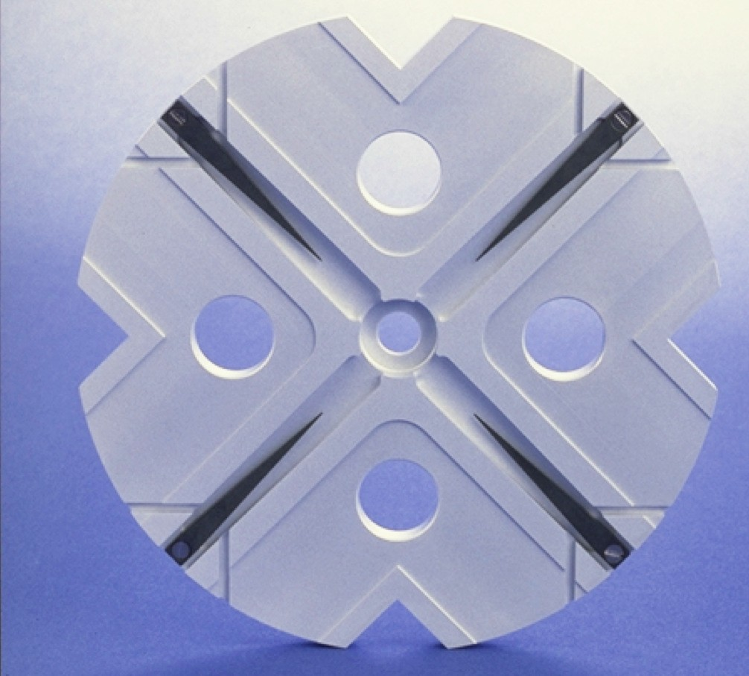
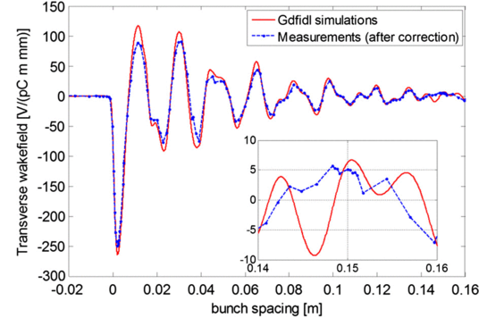
Wakefields and Beam Current
Two goals:
Maximise beam current
But maintain good beam quality
Maximise the current by
Maximising bunch charge
Minimising distance between bunches
Limit from main linac wakefields
Maximise beam quality
Main linac wakefields are important component
RF team loves small a
Less power
easier to reach gradient
Beam team hates small a
More wakefields
Beam less stable
2a
Will ignore multi-bunch wakefields solved by technical means in CLIC

Slide 12
Longitudinal Wakefield and Energy Spread
If a bunch extracts a large fraction of the energy in the structure the tail will gain much less energy
Z = time
Picture 1:
Particle extracts energy
Picture 2: Particle induces field
Limit arises from final focus system energy bandwidth
CLIC goal 0.35% RMS spread
Nominal particle
Lower energy particle
Focusing lens
Actually a doublet of quadrupoles
IP, i.e. focal point

Slide 13
Energy Spread and Bunchlength
Energy spread can be reduced by passing beam off-crest of the RF
Reasonable limit 12°
2% gradient loss
1.3 MV/m
1.5 MV/m
1.3 MV/m
This ties the bunch length to the charge for a given structure design
More charge requires longer bunches
The transverse wakefield effect roughly increases as length x charge

Slide 14
Transverse Wakefields
For short distances the wake-field rises linear
Coherent bunch offset (worst case)
The tail is deflected to the outside
Oscillation amplitude increases
Oscillation frequency decreases
First particle
Example equation of motion first particle
Second particle
Example equation of motion second particle

Slide 15
Tricks of the Beam Physics
Make the focus strong again
Use O(10%) of the linac for magnets
Leads to small beta-function
Makes the beam stable (strong spring for an oscillator)
For single bunch use BNS damping (Balakin, Novokhatsky and Smirnov)
Introduce energy chirp that compensates transverse wakefields

Slide 16


Beam Stability, With BNS
No BNS damping
With BNS damping
Offset beam centre at injection
Offset beam centre at injection
Direction of motion
Direction of motion

Slide 17
Beam Stability, With BNS
No BNS damping
With BNS damping
Tail still flaps a little bit
Tail and centre flap quite a lot
Direction of motion
Direction of motion
Simple betatron oscillation
Simple betatron oscillation
Centre of bunch is much more stable

Slide 18
Impact of Charge
If one increases the charge the beam stability will be compromised
30% more charge are still reasonable
But keep a bit away to as a margin
60% more charge leads to unstable beam

Slide 19
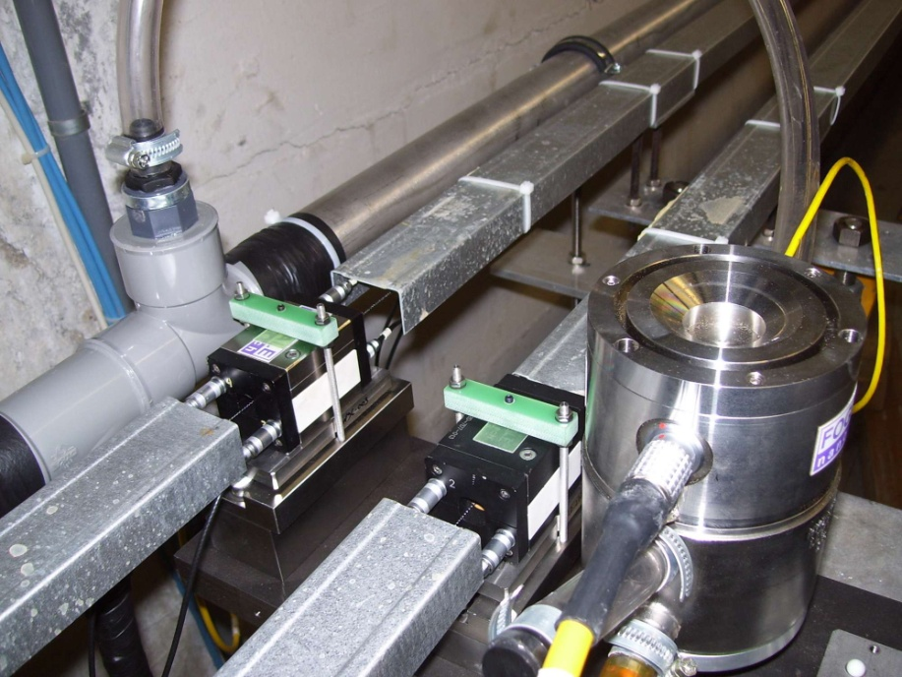

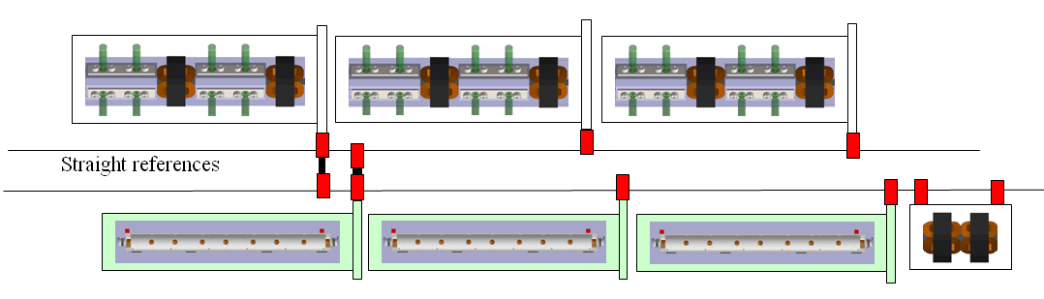
Static Imperfections: Main Linac Alignment
1) Align components accurately on the supporting girders
2) Establish reference system with overlapping wires, has some error but is not critical
3) Align modules remotely to the wires using their sensors and movers
The error for this is most critical misalignment of components is of the order O(10μm)
4) Use sophisticated beam-based alignment such as dispersion free steering (DFS, i.e. different energy beams) to align components
In particular to align BPMs

Slide 20
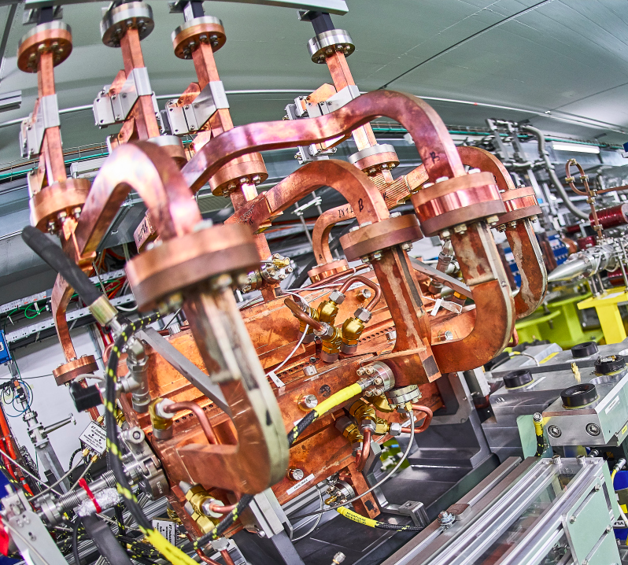
RF Alignment
Structures scattered on girder
Wakefield kick
5) Measure beam offset with wakefield monitor
Move girder to remove mean offset
No net wakefield kick
Limit mainly from
wakefield monitor accuracy (3.5 μm)
reproducibility of wakefield
tiny variation of betatron phase along girder
Wakefield monitor:
Measure wakefield in damping waveguide

Slide 21
Main Linac Emittance Growth (3 TeV)
imperfection | with respect to | symbol | value | emitt. growth
BPM offset | wire reference | σ_{BPM} | 14 µm | 0.367 nm
BPM resolution |  | σ_{res} | 0.1 µm | 0.04 nm
accelerating structure offset | girder axis | σ₄ | 10 µm | 0.03 nm
accelerating structure tilt | girder axis | σ_{t} | 200 µradian | 0.38 nm
articulation point offset | wire reference | σ₅ | 12 µm | 0.1 nm
girder end point | articulation point | σ₆ | 5 µm | 0.02 nm
wake monitor | structure centre | σ₇ | 3.5 µm | 0.54 nm
quadrupole roll | longitudinal axis | σ_{r} | 100 µradian | ≈ 0.12 nm
Emittance growth for different imperfections
Using sophisticated beam-based methods
Note: The tight tolerances are the price for the strong focusing,
Which allowed high beam current
Goal: less than 10% above Δε_{y} = 5 nm
Further improvement using tuning bumps
0 5 10
Δε_{y,0} [nm]

Slide 22
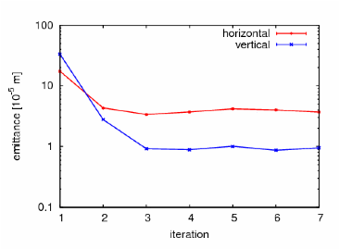
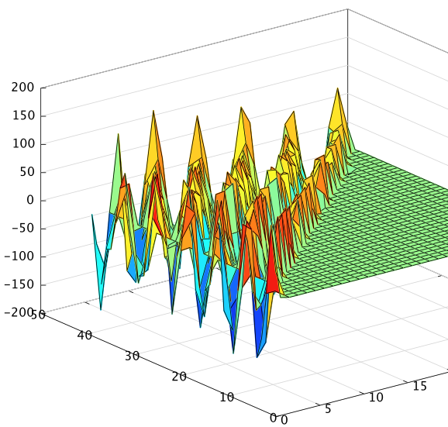
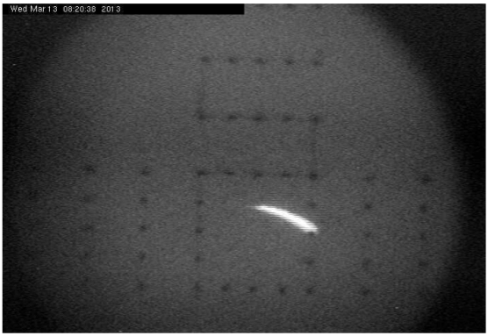
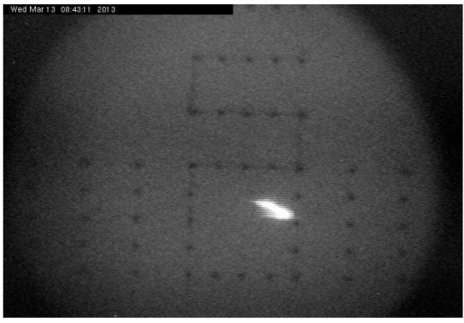
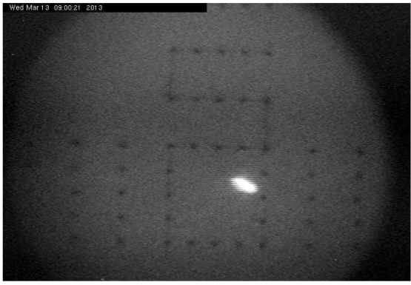
CLIC Beam-Based Alignment Tests at FACET
DFS applied to 500 meters of SLC linac
System identification algorithms to construct model
DFS correction with GUI
Emittance growth is measured
System model
Emittance [10⁻⁵ m ]
iteration
Initial beam
After 1 iteration
After 3 iterations

Slide 23
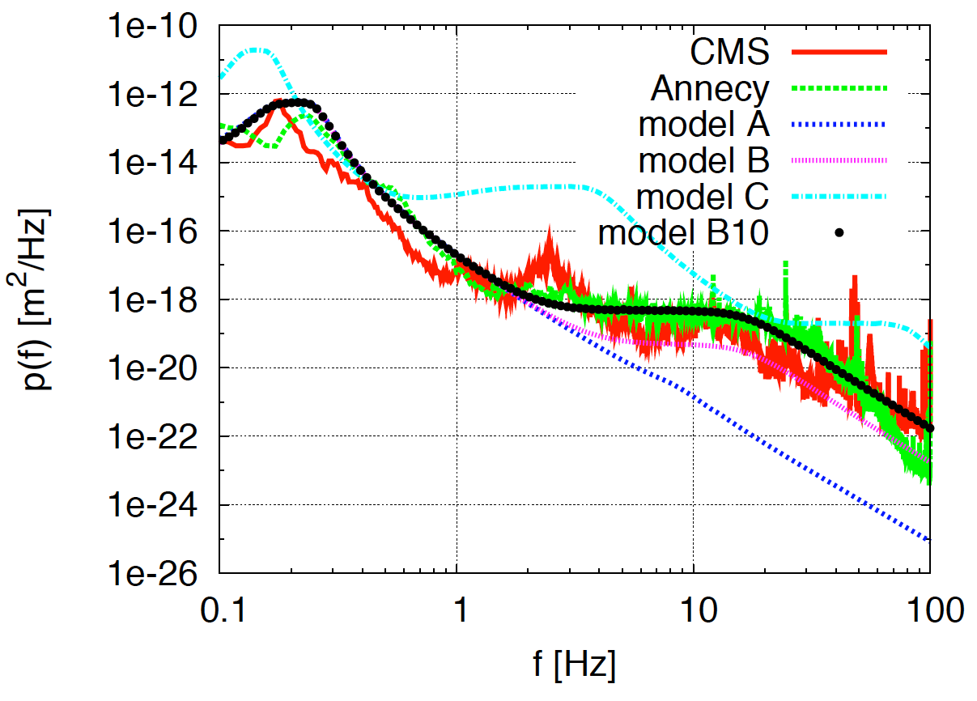
Dynamic Imperfection Example: Ground Motion
Beam-trajectory feedback corrects pulse-to-pulse (20 ms)
Cures low frequency ground motion
But not higher frequencies
Ground motion can impact beam trajectory
Beam-trajectory feedback:
Example transfer curve (recursive filter)
Amplification/demagnification
LEP tunnel
Want to be able to cope with this
(Model B10 similar to CMS hall)
0
5
10
15
20
25
demagnification
Frequency [Hz]

Slide 24
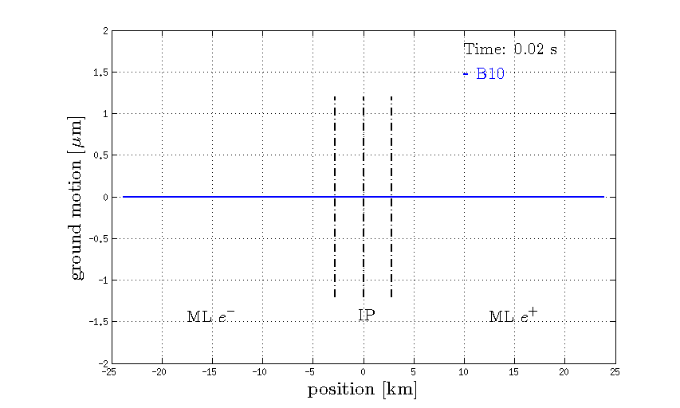
Ground Motion

Slide 25
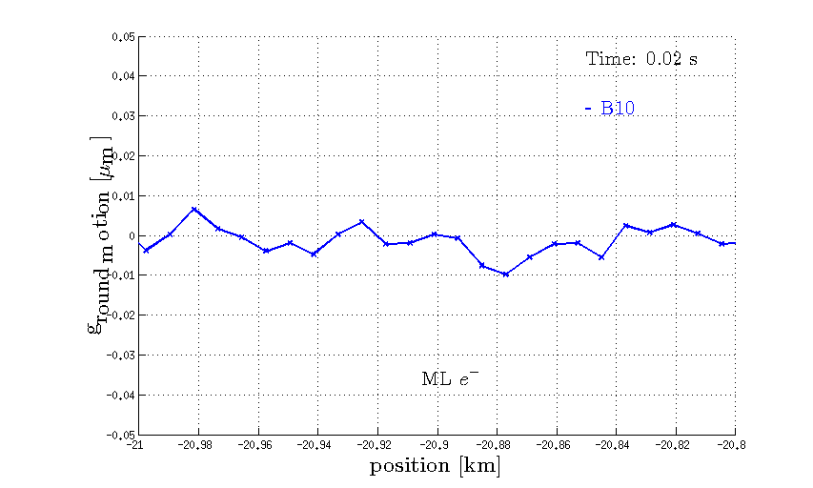
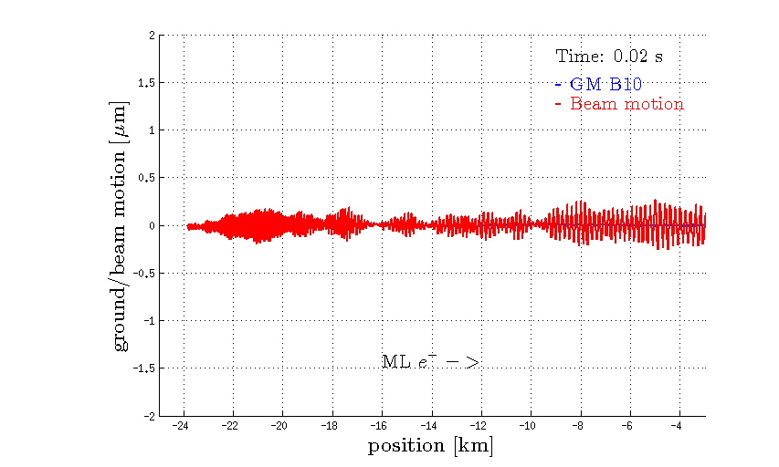
Beam Motion with Beam Feedback Only

Slide 26
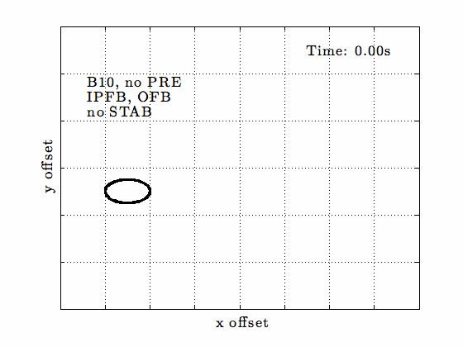
Jitter at IP

Slide 27
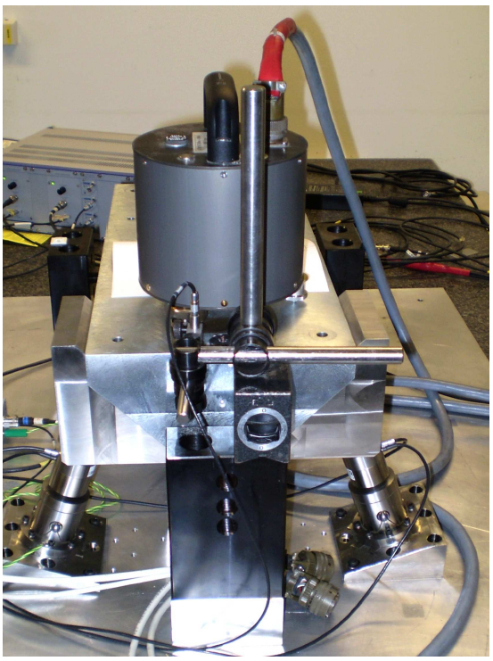
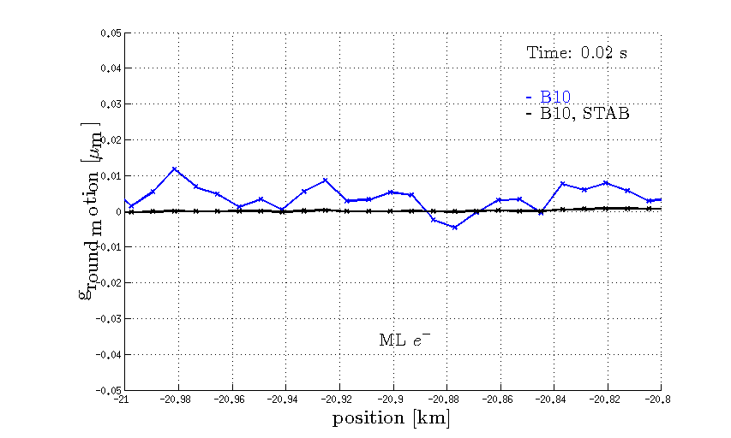
The Stabilisation System
K. Artoos et al.

Slide 28
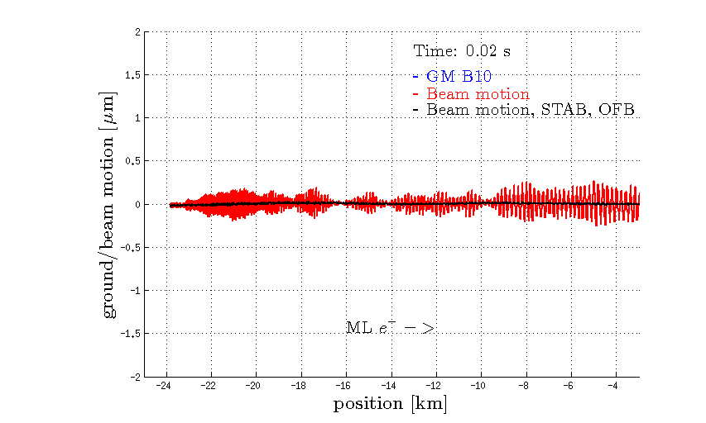
Beam Trajectory Jitter

Slide 29
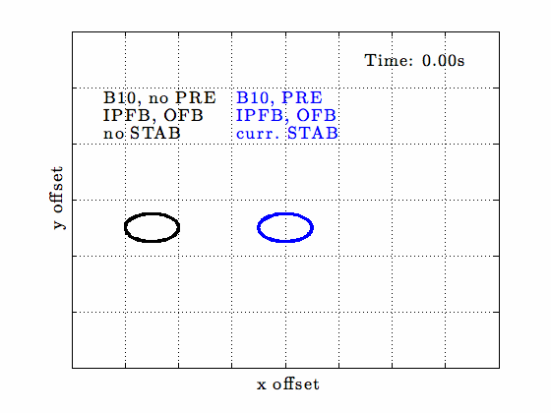
Beam Jitter at IP

Slide 30
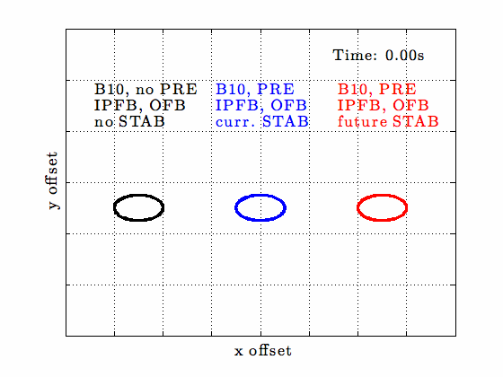
Beam Jitter at IP

Slide 31
Conclusion
The main linac beam dynamics is a key parameter driver in CLIC
It defines the charge and collision bunch length and impacts the vertical emittance
For each accelerating structure design there is an optimum beam parameter set
The highest charge that is acceptable in each bunch
Strong focusing is used to mitigate transverse wakefield effects
Imperfections and their mitigation are critical for the emittance growth and luminosity

Slide 32

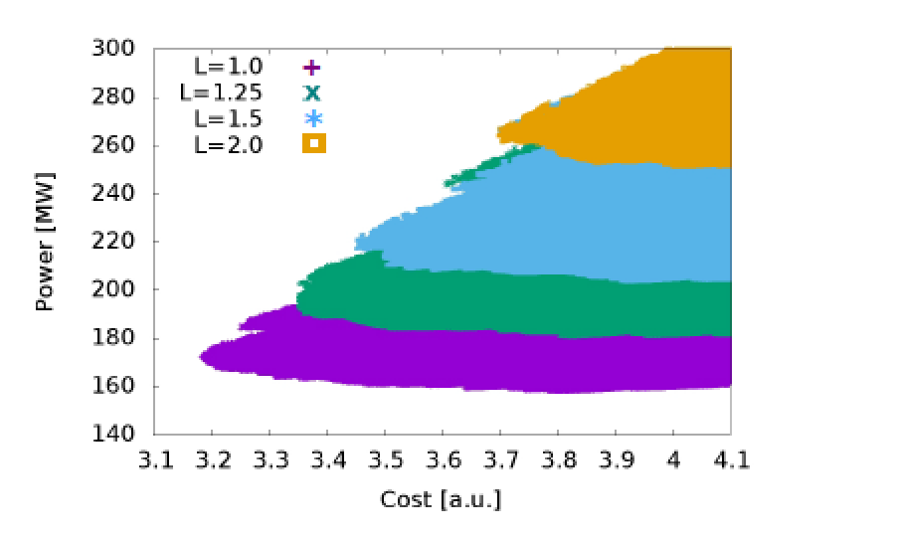
Note: CLIC Optimisation
Scan 1.7 billion cases:
Fix structure design parameters: a₁,a₂,d₁,d₂,N_{c},f,G
key beam parameters
Luminosity, cost and power (including other systems)
CERN-2016-004
Resulting designs:
Colors indicate luminosities
This is the one that we picked

Slide 33
Reserve

Slide 34
Damping ring makes flat beams
 | ε_{x} [nm] | ε_{y} [nm] | σ_{z} [μm] | N [10⁹] | E [GeV]
Damping ring exit | 700 | 5 | 1600 | 5.2 | 2.86
End of RTML | 850 | 10 | 70 | 5.2 | 9.0
End of main linac | 920 | 20 | 70 | 5.2 | 190.0
Interaction point | 950 | 30 | 70 | 5.2 | 190.0
Bunch energy defined by main linac
All systems contribute to vertical emittance
Final bunch length defined by main linac
Bunch charge defined by main linac

Slide 35
Main Linac: Dispersion-free Steering
Offset BPM produces bump
Method reduces dispersion
Use beams of different energy to identify offset BPMs
Compromise between offset and difference
Off-energy beam has different bump
DFS finds new solution with smaller bump
Adjust BPM reference to be on new trajectory
Dispersion:
Different energy particles take different trajectories

Slide 36
Pre-alignment Wavelength
Reference line error with given wavelength
Betatron wavelengths of the different sectors

Slide 37
Ground Motion Summary
Luminosity achieved/lost [%]
 | B10
No stab. | 53%/68%
Current stab. | 108%/13%
Future stab. | 118%/3%
Code
Machine model
Beam-based feedback
Close to/better than target

