Slide 1
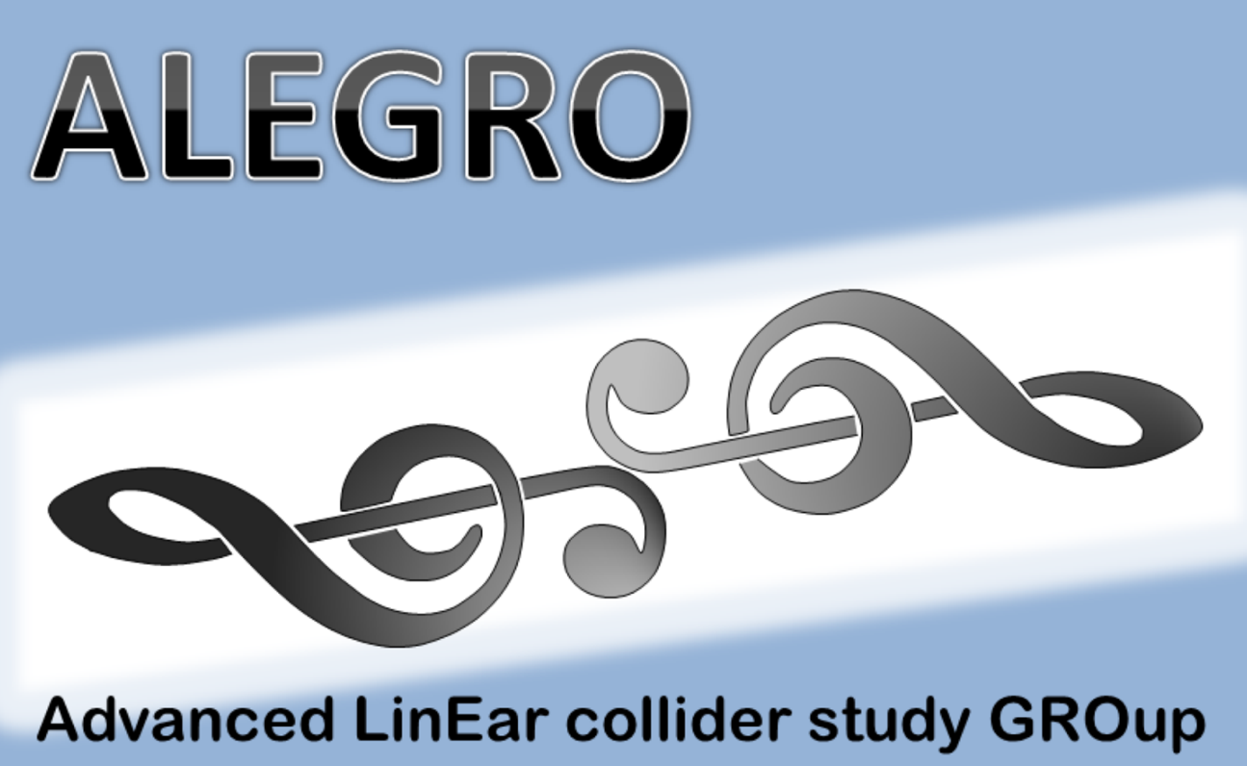
“Practical” Challenges with Positron Sources
Positron sources for Linear Colliders (CLIC and ILC)
Requirements for even more advanced colliders
Alternative positron sources
Conclusions

Slide 2
Typical requirements for a Positron Source for a collider for high energy physics
Delivers required intensity ~ 10⁹-10¹⁰ per bunch
Requires typically a yield of ~ > 1 if produced with primary electron beam
Extremely reliable and stable because the “complicated part” comes afterwards
Small energy spread before injection into damping ring ΔE/E ~ 1%
Extremely small emittance, needed for luminosity goals; implies flat beams
Requires in general one or two damping rings !
Synchronised with electron beam
Polarized beams preferred by physics
Low cost compared to collider total ( in reality a significant fraction)
Polarised electron beam (~80%) is “standard” for linear colliders

Slide 3
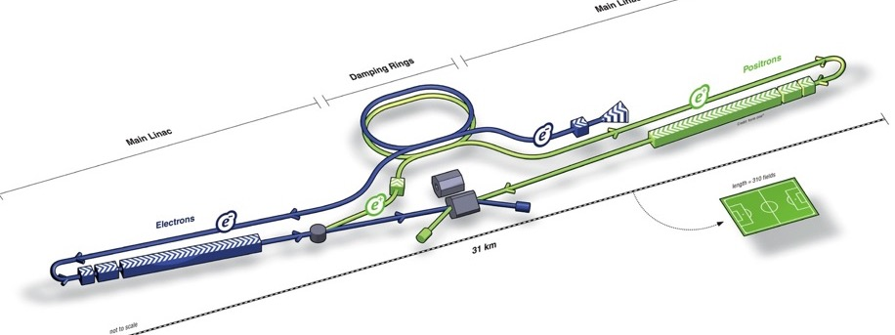
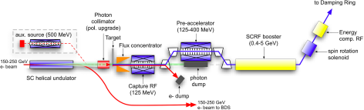
ILC positron source
~ 30% positron polarization

Slide 4
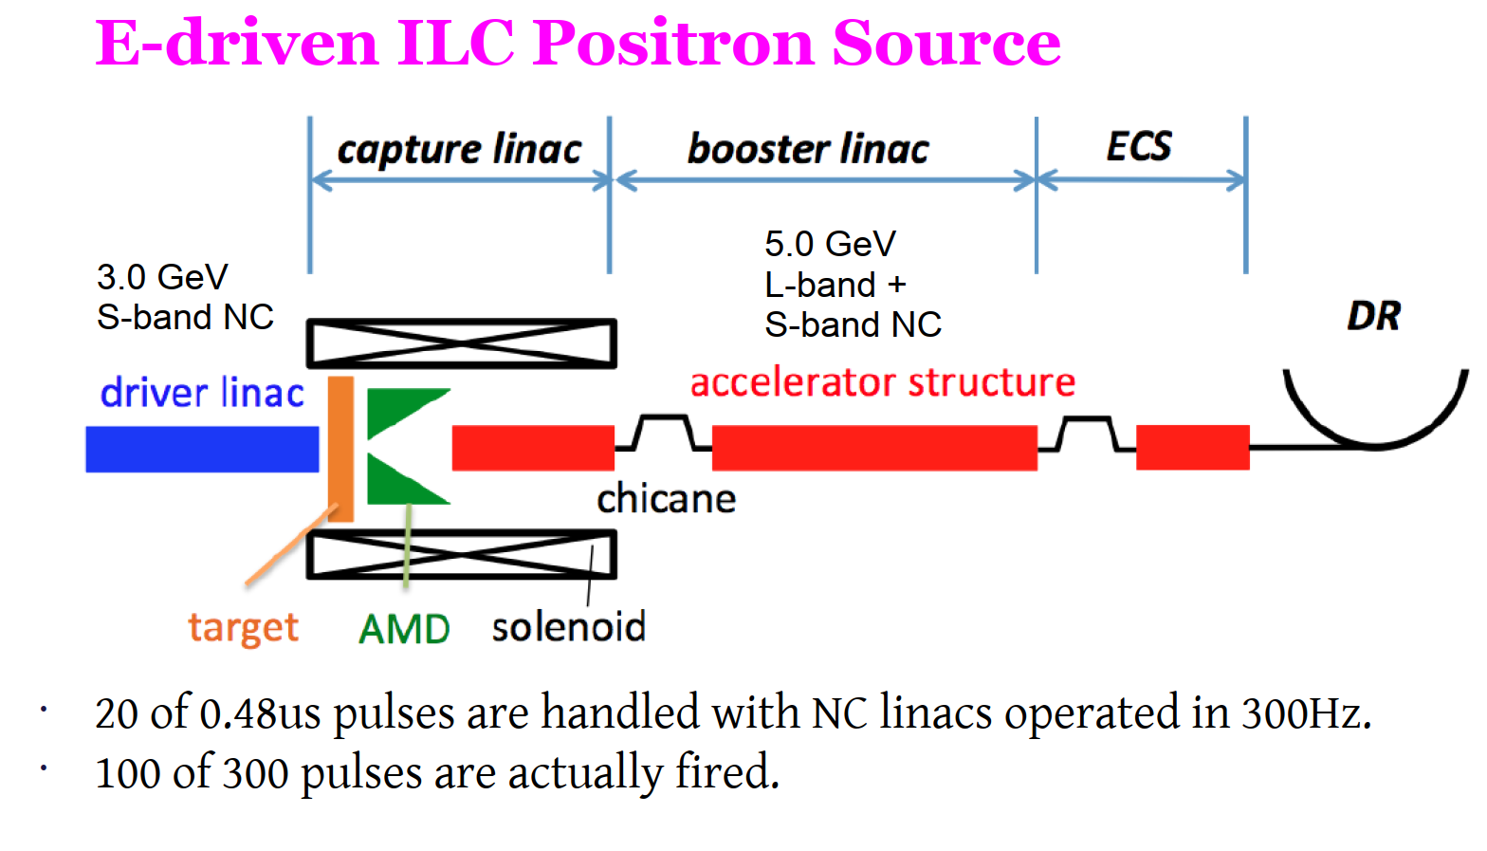
ILC positron source

Slide 5
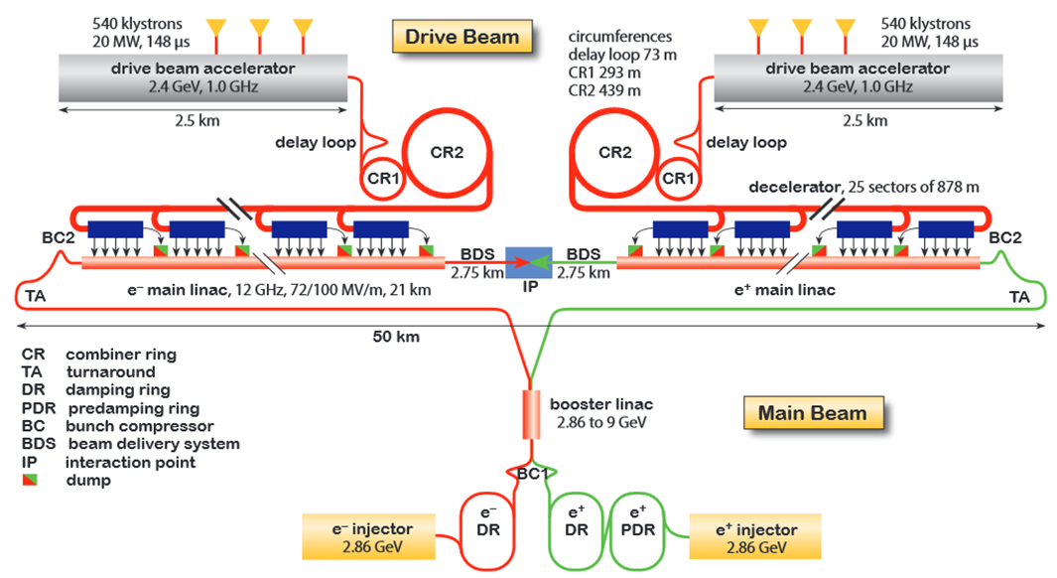
CLIC complex

Slide 6
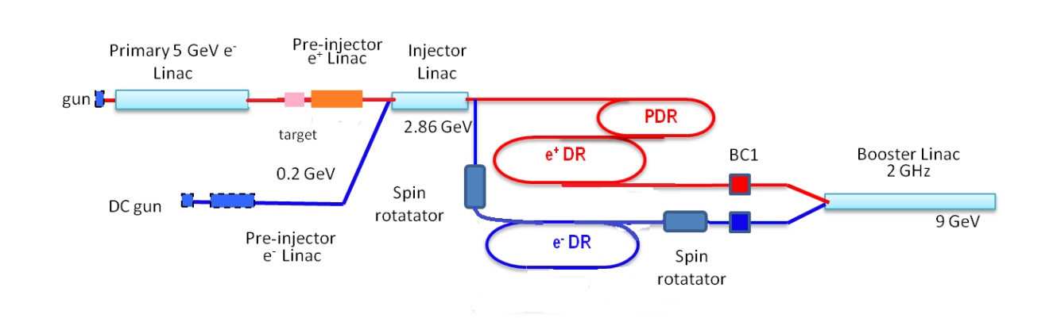
The CLIC Injector Complex
> 1 km
Pre-damping ring can be avoided if the beam emittance is
~ < 25 μm (norm)
Main damping ring; in: ε_{xn}/ε_{yn} = 65/10 μm
out: ε_{xn}/ε_{yn} = 472/5 nm
Bunch compressors needed after the rings for further acceleration

Slide 7
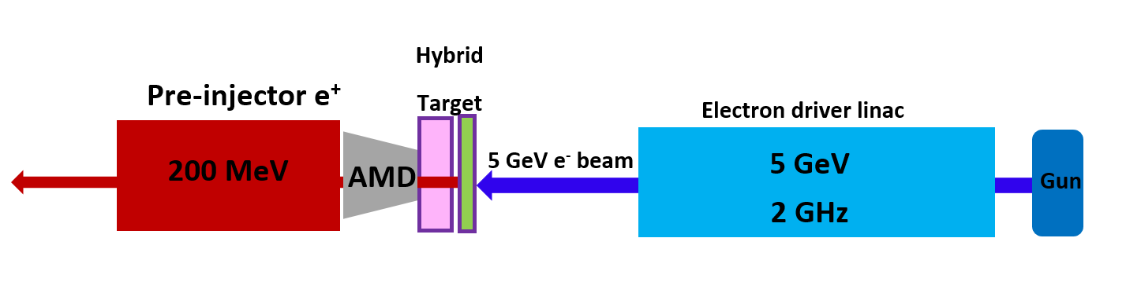
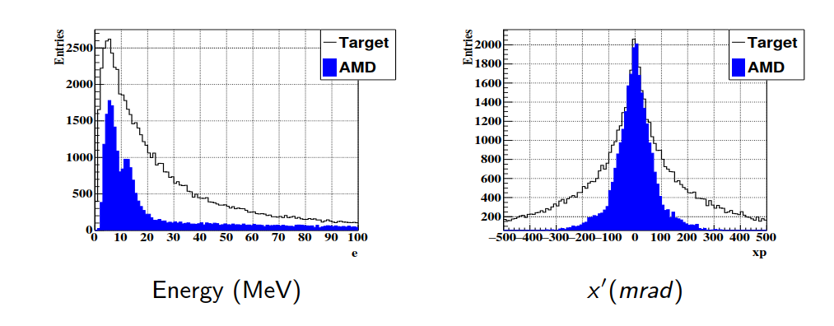
CLIC Positron Source
Generation of adequate photons (0-20 MeV) for pair production
Complex and lossy positron collection and capture system
Performance limited often by peak energy deposit density (PEDD < 35 J/g pulse)
Very high radiation area, constraints for operation and maintenance, engineering challenge
Long solenoidal field for guidance

Slide 8
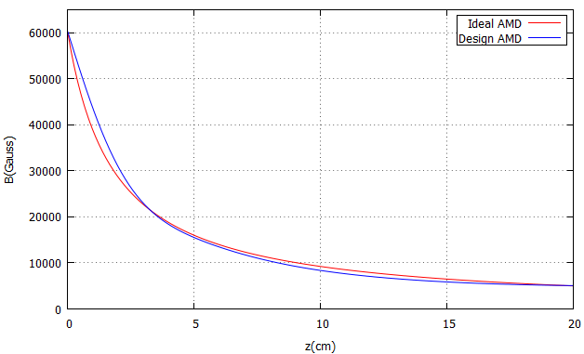
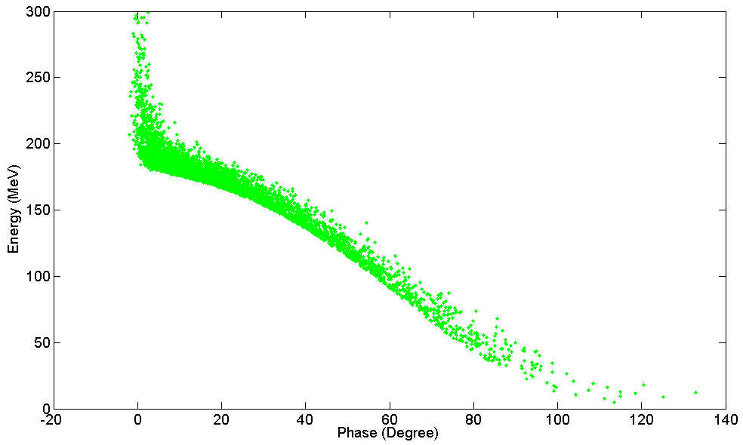
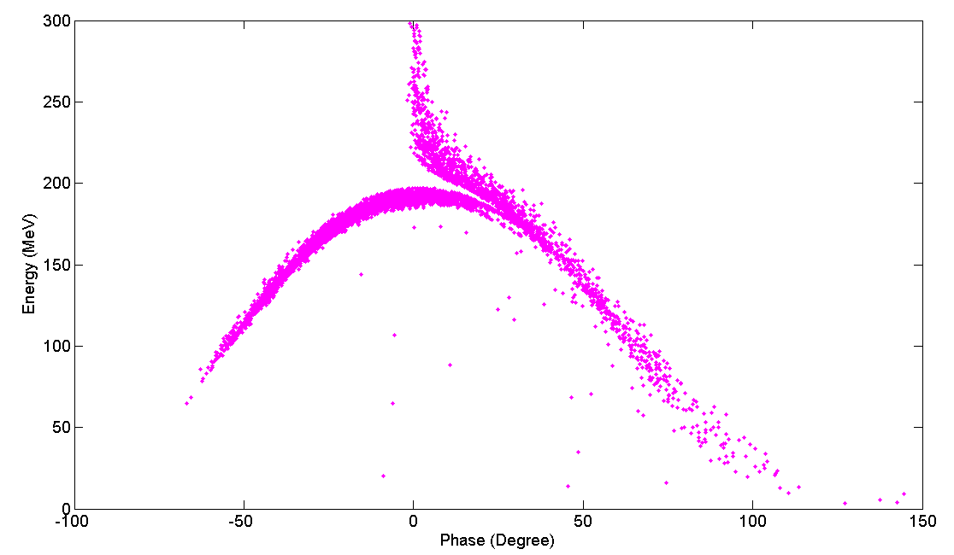
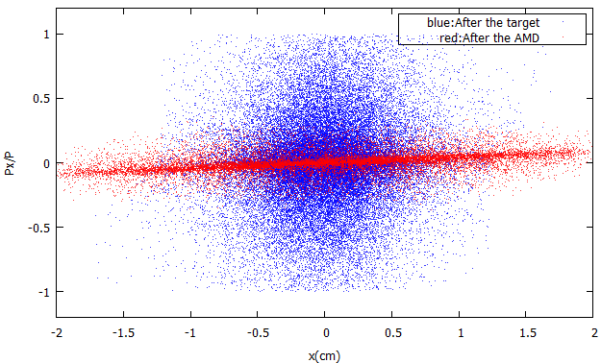
Previous studies: The Pre-Injector Linac
Aperture 20 mm !
The total yield: 8.0 e+/e- 2.8 e+/e- 1.09 e+/e- 0.98 e+/e- (effective)
e+
Target
AMD
Solenoid
TW Structures
The effective yield : (-20,20) degrees in phase and (150,250) MeV in energy
Total yield: 0.89 e+/e-
Effective yield: 0.50 e+/e-
Total yield: 0.93 e+/e-
Effective yield: 0.48 e+/e-
Parameters of the accelerating structures in the Pre-Injector linac
Acceleration
Deceleration
Parameters | Unit | Value
Cell length | cm | 5
Frequency | GHz | 2
Phase advance per cell | π | 2/3
Average axial electric field | MV/m | 15
C. Bayar

Slide 9
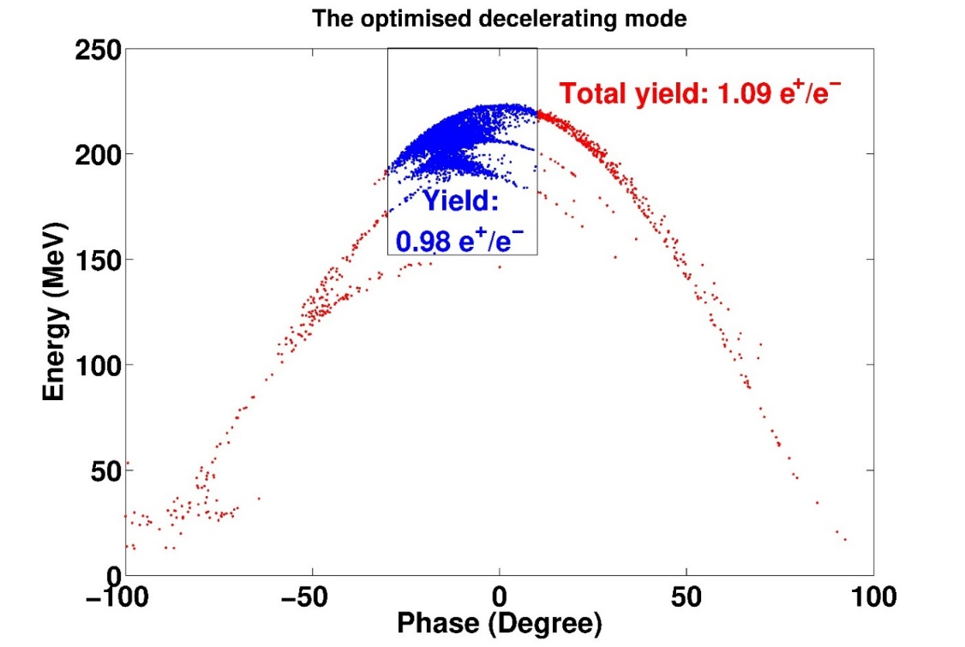
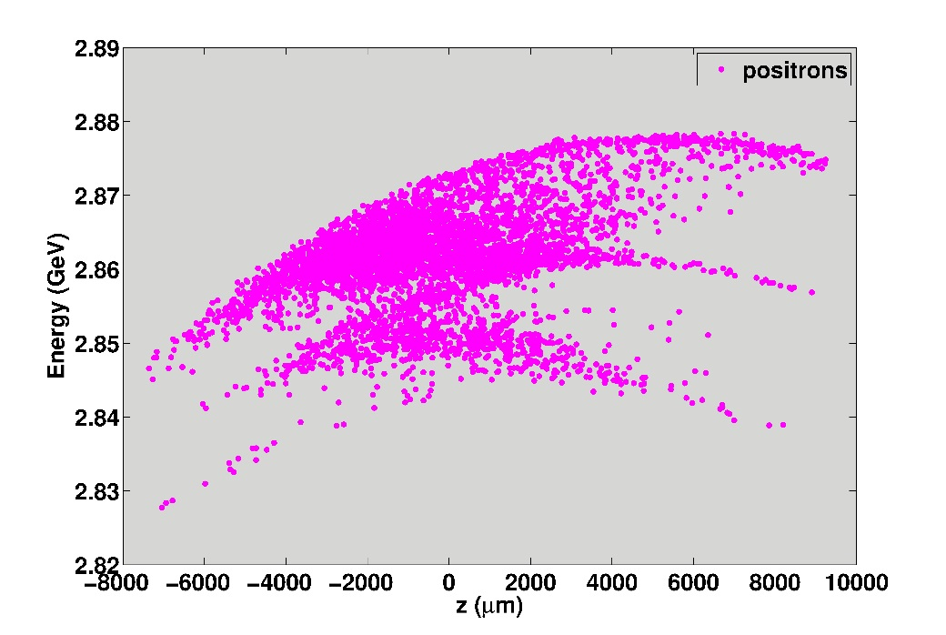
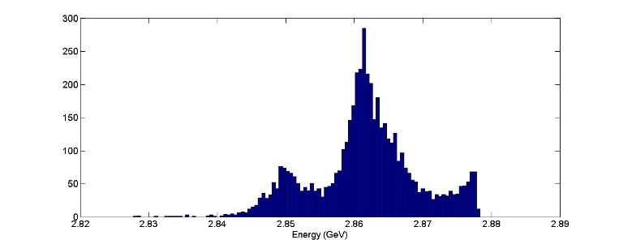
Injector Linac
Positron yield, 0.97 $e^{+}/e^{−}$
All positrons are within 1% acceptance window of the pre-damping ring.
The effective yield : (-20,20) degrees in phase and (150,250) MeV in energy
Energy (GeV) | Target exit (e⁺/e⁻) | AMD exit (e⁺/e⁻) | Total yield (e⁺/e⁻) | Effective yield (e⁺/e⁻)
5 (new) | 7.14 | 3.06 | 1.36 | 1.21
5 (previous) | 8.00 | 2.80 | 1.09 | 0.98
5 (CDR) | 8.00 | 2.10 | 0.95 | 0.38
C. Bayar

Slide 10
Positron requirements / beam parameters
D. Schulte, “Application of Advanced Accelerator Concepts for Colliders”, RAST, Vol 9, 2016
Parameter | Unit [] | ILC | CLIC | LPA | PWFA | DLA
CMS energy / Luminosity | [TeV] / 10³⁴ cm⁻²s⁻¹ | 0.25 1.8 | 3 6 | 3 10 | 3 6.3 | 3 3.2
Bunch charge | N [10⁹] | 20 | 3.72 | 1.2 | 10 | 0.0047
Bunch length | [μm] | 300 | 44 | 8 | 20 | 0.0028
Emittance norm | ε_{x}/ε_{y} [nm] | 10⁴/35 | 660/20 | 50/5 | 10⁴/35 | 0.1/0.1
Bunches per train | n | 1312 | 312 | 1 | 1 | 1
Repetition rate | [Hz] | 5 | 50 | 84 k | 10-15 k | 20 M
Particles /s | N [10¹⁴]/[s] | 1.3 | 0.58 | 1.0 | 1.5 | 0.94
Intensity probably OK with conventional technologies
Emittance and bunch length for DLA beyond todays reach
Emittance for LPA on the edge
Repetition rates > 1 kHz needs study

Slide 11
Example: Laser-driven Plasma Accelerator (LPA)
Parameters from
Conventional positron source might be as well
1 km long !
Here is the tricky part

Slide 12
Example: Beam-driven Plasma Accelerator (PWFA)
Assumes already
LC-type sources

Slide 13
Example: Dielectric Laser Collider (DLA)
R. J. England et al.
Not many details on sources yet
Positron source might be larger then the rest of the collider
Very challenging emittance and repetition rates

Slide 14
Key element damping ring, CLIC example
Injected Parameters | e⁻ | e⁺
Bunch population [10⁹] | 4.7 | 4.7
Repetition frequenzy [Hz] | 50 | 50
Bunch length [mm] | 1 | 9
Energy Spread [%] | 0.1 | 1
Long. emittance [eV.m] | 2000 | 257000
H/V norm. emittance [nm-rad] | 100 x 10³ | 7 x 10⁶
DR complex challenges
  Large injected emittances and energy spread →
  Requirement of large DA and MA
  Ultra low emittance at extraction
  Repetition time of 20 ms → Fast damping requirement
PDR → efficient injection of the large incoming beams
Main DR → ultra-low emittance generation
The positron beam needs at least 8 damping times to reach equilibrium (w/o taking into account injection, IBS, etc)
  → The positron PDR is necessary!
Extracted Parameters | PDR e⁻/e⁺ | DR e⁻/e⁺
Bunch population [10⁹] | 4.1-4.4 | 4.1
Bunch length [mm] | 10 | 1.4
Energy Spread [%] | 0.5 | 0.1
Long. emittance [eV.m] | 143000 | 5000
Hor. Norm. emittance [nm-rad] | 63000 | 500
Ver. Norm. emittance [nm-rad] | 1500 | 5
See for example: Y. Papaphilippou, “Reaching ultra-low emittance in the CLIC damping rings”

Slide 15
Damping Ring and Transverse Emittances
Can deliver O(10⁴) bunches/s
E.g. CLIC with 5ns kickers could cool 200 bunches at any time
Some beam dynamics issues but probably manageable
2008
Other solutions for electrons could be possible
But for positrons that are created in collisions?
LPA could be here
Depends on DR energy
DLA is down here
PWFA somewhere between CLIC and ILC
CLIC
ILC

Slide 16
“Exotic” / Advanced schemes for positron production
Positrons from Laser acceleration
Positrons from ultra high field laser interaction
Positrons from electro-static traps
Primary electron accelerator could be based on advanced accelerator technologies and used in a classical positron production scheme
Plasma lenses for matching, plasma based capturing section could be attractive

Slide 17
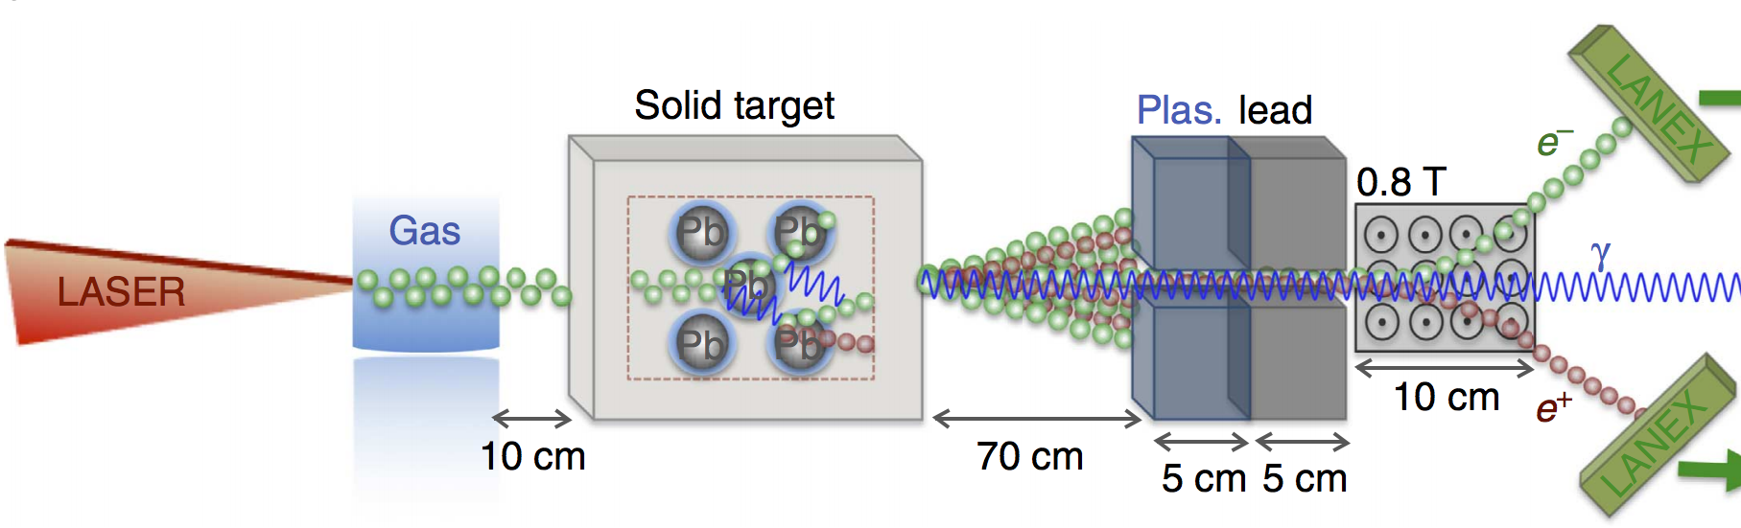

Positrons from laser wakefield acceleration
G. Sarri et al
High energy (600 MeV) from the source
High energy spread (50%)
Emittance (~ um), likely damping ring still needed
Possibly very short beams fs
Charge ~ 10⁸ total but small in reasonable bandwidth
Future example EuPRAXIA: 5 x10⁶ positrons at 1 GeV, 5% bandwidth, 190 μm emittance

Slide 18
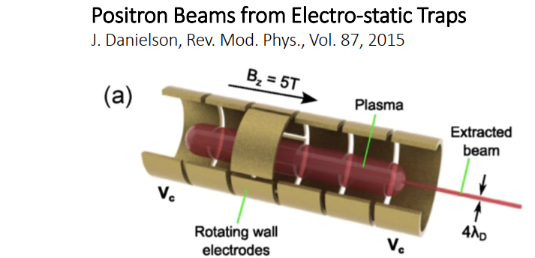
Positrons from electro-static traps
Excellent emittance, no need of damping ring ?
Very low energy ( keV) but low energy spread as well
Long bunch length (ns)
Low intensity and repetition rate (10⁷ and 0.1 Hz)

Slide 19
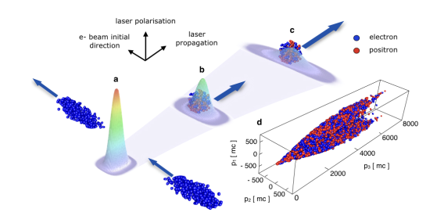
Positrons from very high field laser interaction
M. Vranic et al.
(see next talk)
High energy (>1 GeV) from the source
High energy spread (50%)
Emittance ?, likely damping ring still needed
Possibly short beams ?
Low intensity in useable bandwidth
High energy electron LINAC needed and high power laser needed

Slide 20
Conclusions
Positron sources are by no means trivial
Already very challenging for conventional linear colliders, may be considered as state of the art
For advanced colliders main limitation comes from beam quality requirements for further transport and acceleration; emittance, energy spread and bunch length
Very high repetition rate likely very costly and challenging
Alternative positron sources need to be considered.
Can we find a scheme which gets rite of the damping rings and provides equivalent or better beam quality
Without extremely stable and reliable source → no luminosity !!!

