Slide 1

Simulations for EuPRAXIA Accelerator Design
Phu Anh Phi NGHIEM (CEA-IRFU)

Slide 2











































EuPRAXIA Consortium
16 Participants
Private companies
25 Associated Partners

Slide 3
EuPRAXIA scope
From Acceleration to Accelerator
From Proof of principle to User’s Facility
Mission: Produce a Conceptual Design Report for the world's first
- high energy 1-5 GeV plasma-based electron accelerator
driven by laser or electron beam
- with “industrial quality”
24/7 user operation
high reliability, reproducibility
high repetition rate ≥ 10 Hz toward 100 Hz
- with high beam quality and high beam charge
- with user areas: FEL & HOPA
Simultaneously !
Simultaneously !

Slide 4
EuPRAXIA requirements
Critical parameters of the electron beam
required at Injection or Acceleration stages
OBJECTIVE:
- Providing beam at 5 GeV
meeting 'perfectly'
FEL and HOPA requirements
- Providing also beam at 1 GeV
'usable' for FEL and HOPA
as a 'commissioning' step
at the applications!

Slide 5
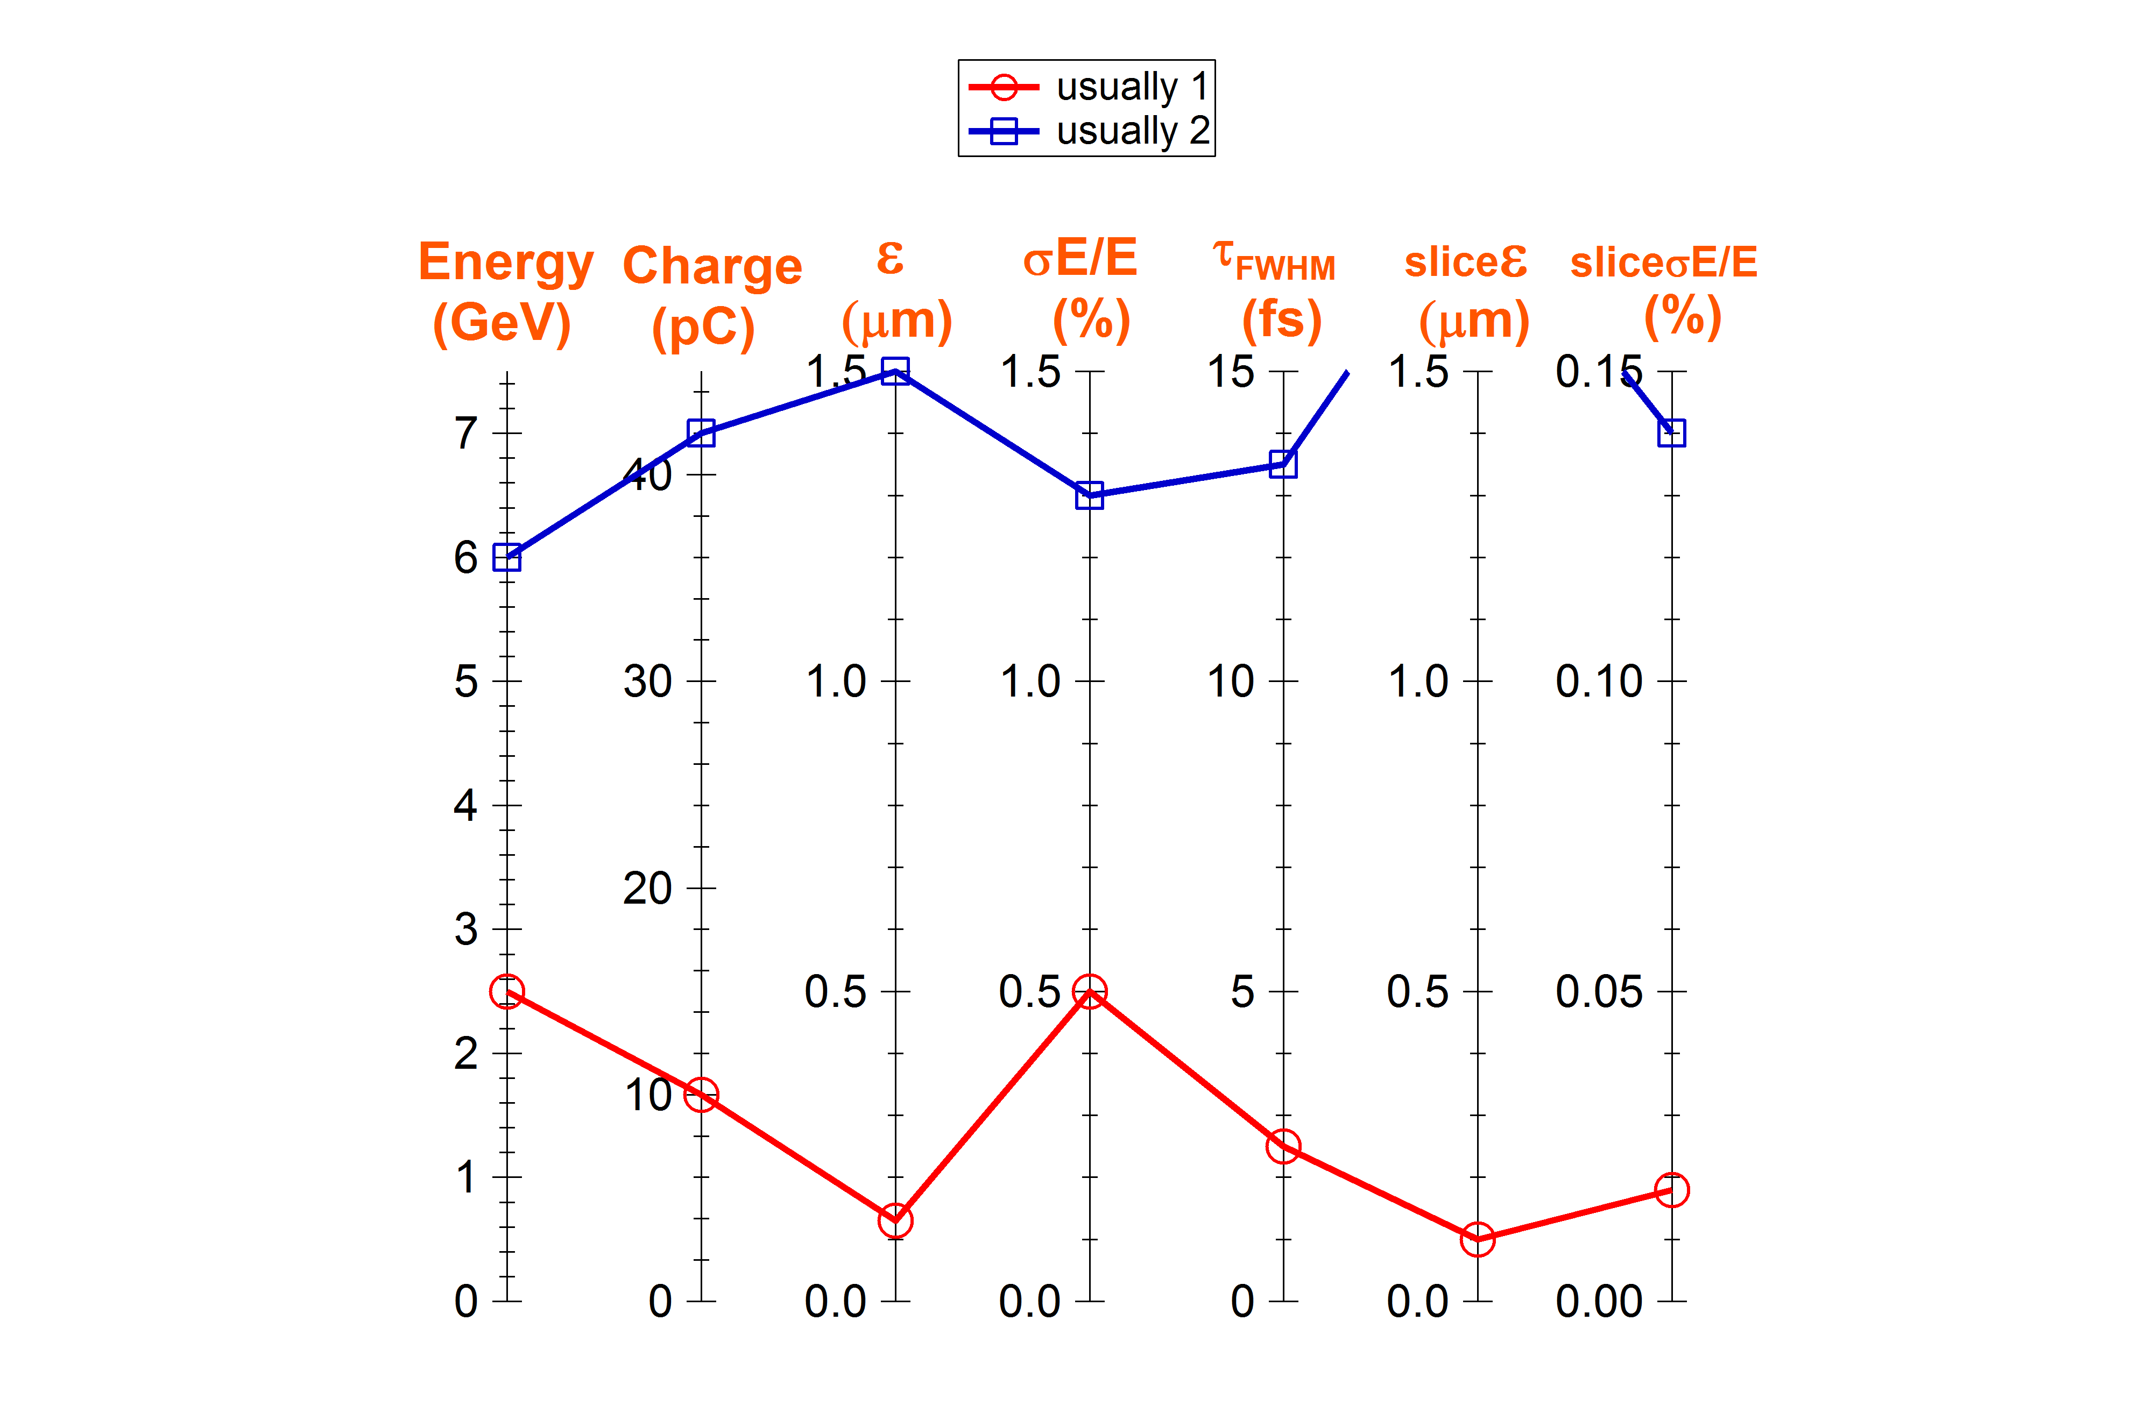
Beam parameters at 5 GeV
at the user's doorstep
Required value

Slide 6
"Accelerator" approach
"Physics experiment " approach : often built around a laser facility
"Accelerator" approach : like for a conventional accelerator
1. Definition of the desired beam parameters (TLR)
2. Large exploration (simulations) of inject./accelerat. configurations
3. Selection of the appropriate configurations
4. Determination of specifications for the laser and plasma systems
Issues : in plasma-based accelerator
- Simulations are very time consuming
- Many simulation codes → reliability, robustness ?

Slide 7
Inj. / Accel. schemes considered
1 GeV
5 GeV
5 GeV
LPI
LPAS
LPI
1A
1B
L
W
F
A
500 MeV
1 GeV
5 GeV
500 MeV
5 GeV
RFI
LPAS
LPAS
RFI
LPAS
2A
2B
150 MeV
1 GeV
5 GeV
150 MeV
5 GeV
LPI
LPAS
LPAS
LPI
LPAS
3A
3B
PWFA
500 MeV
1 GeV
500 MeV
5 GeV
RFI
PPAS
RFI
PPAS
4A
4B

Slide 8
Inj. / Accel. schemes studied
L
W
F
A
LETL
HETL
HETL
150 MeV
5 GeV
(1 GeV)
LPI
5 GeV
(1 GeV)
LPI
LPAS
250-500 MeV
HETL
240 MeV
2.5 GeV
HETL
RFI
LPAS
5 GeV
(1 GeV)
RFI
LPAS
LPAS
5 GeV
(1 GeV)
PWFA
HYBRID
500 MeV
HETL
3 GeV
HETL
RFI
PPAS
1 GeV
LPAS
PPAS
5 GeV
(1 GeV)

Slide 9
Inj. / Accel. schemes studied
A. Beck
A. Chancé
E. Chiadroni
A. Ferran Pousa
A. Giribono
B. Hidding
P. Lee
X. Li
A. Marocchino
A. Martinez de la Ossa
F. Massimo
G. Maynard
A. Mosnier
P.A.P. Nghiem
A.R. Rossi
T. Silva
E. Svystun
P. Tomassini
C. Vaccareza
J. Vieira
J. Zhu
L
W
F
A
CEA
CEA LETL
CEA
HETL
150 MeV
HETL
5 GeV
(1 GeV)
LPI
5 GeV
(1 GeV)
LPI
LPAS
CNR
IST, LLR
LPGP, CNR
CEA
DESY LNF
CEA
2.5 GeV
250-500 MeV
HETL
240 MeV
HETL
RFI
LPAS
5 GeV
(1 GeV)
RFI
LPAS
LPAS
5 GeV
(1 GeV)
DESY
INFN
DESY
PWFA
LNF LNF
CEA
HYBRID
500 MeV
HETL
3.5 GeV
HETL
RFI
PPAS
1 GeV
LPAS
PPAS
5 GeV
(1 GeV)
LNF
Strathclyde, DESY
11 European institutes
21 contributors

Slide 10
Inj. / Accel. techniques studied
RFI 240 MeV S-band, RF & Magn.compression
RFI 500 MeV S-band & X-band, Comb technique
LPI 150 MeV Wave-breaking injection and nonlinear regime
Shock-front injection and blow-out regime
Ionization injection and quasi-linear regime
Downramp injection and blow-out regime
Resonant Multiple Ionization Injection (ReMPI)
LPAS 5 GeV Quasi-linear regime, 1 LPAS
Blow-out regime, 2 LPAS + chicane
PPAS 1 GeV Weakly-nonlinear regime
LPAS-PPAS Trojan Horse Injection and blow-out regime
Wakefield Induced Ionization Injection and blow-out regime

Slide 11
Inj. / Accel. techniques studied
RFI 240 MeV S-band, RF & Magn.compression ASTRA
RFI 500 MeV S-band & X-band, Comb technique Tstep, Elegant
LPI 150 MeV Wave-breaking injection and nonlinear regime SMILEI
Shock-front injection and blow-out regime CALDER-C
Ionization injection and quasi-linear regime Warp
Downramp injection and blow-out regime OSIRIS
Resonant Multiple Ionization Injection (ReMPI) ALaDYN, QFluid
LPAS 5 GeV Quasi-linear regime, 1 LPAS FBPIC, QFluid, Warp
Blow-out regime, 2 LPAS + chicane FBPIC, ASTRA, CSRtrack
PPAS 1 GeV Weakly-nonlinear regime Architect
LPAS-PPAS Trojan Horse Injection and blow-out regime VSim
Wakefield Induce Ionization and blow-out regime OSIRIS

Slide 12
Published results
The resonant multi-pulse ionization injection, P. Tomassini, S. De Nicola, L. Labate, P. Londrillo, R. Fedele, D. Terzani, L. A. Gizzi, Physics of Plasmas, 24 , 10, 103120, doi: 10.1063/1.5000696 (2017).
Single-stage plasma-based correlated energy spread compensation for ultrahigh 6D brightness electron beams,
G.G. Manahan, A.F. Habib et al., Nat. Commun. 8, 15705 doi: 10.1038/ncomms15705 (2017).
Electron beam transfer line design for plasma driven Free Electron Lasers, M. Rossetti Conti, A. Bacci, A. Giribono, V. Petrillo, A.R. Rossi, L. Serafini, C. Vaccarezza, Nuclear Inst. and Methods in Physics Research A 909, 84-89 (2018).
Design of a 5 GeV Laser Plasma Accelerating Module in the Quasi-linear Regime, X. Li, A. Mosnier, P. A. P. Nghiem, Nuclear Inst. and Methods in Physics Research A 909, 49-53 (2018).
Toward Low Energy Spread in Plasma Accelerators in Quasi-linear Regime, X. Li, P. A. P. Nghiem, A. Mosnier, Phys. Rev. Accel. Beams, 21, 111301 (2018).
Plasma boosted electron beams for driving Free Electron Lasers, A. R. Rossi et al., Nuclear Inst. and Methods in Physics Research, A 909, 54 (2018).
Optimization of laser-plasma injector via beam loading effects using ionization-induced injection, P. Lee, G. Maynard, T. L. Audet, B. Cros, R. Lehe and J.-L. Vay, Phys. Rev. Accel. Beams, 21, 052802 (2018).
Preserving emittance by matching out and matching in plasma wakefield acceleration stage, X. Li, A. Chancé, P. A. P. Nghiem, Phys. Rev. Accel. Beams, 22, 021304 (2019).
Etc…………………………..

Slide 13
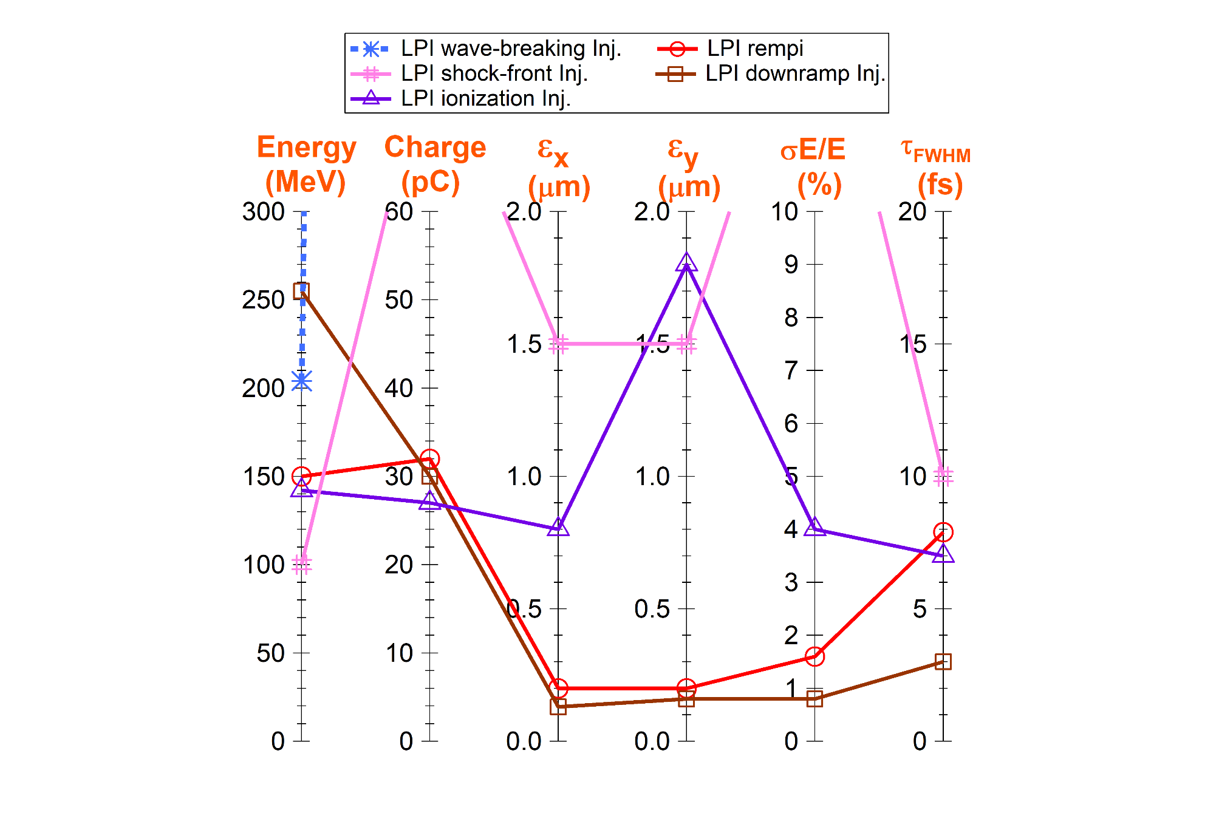
Beam parameters obtained at 150 MeV
All the configurations
Required value

Slide 14
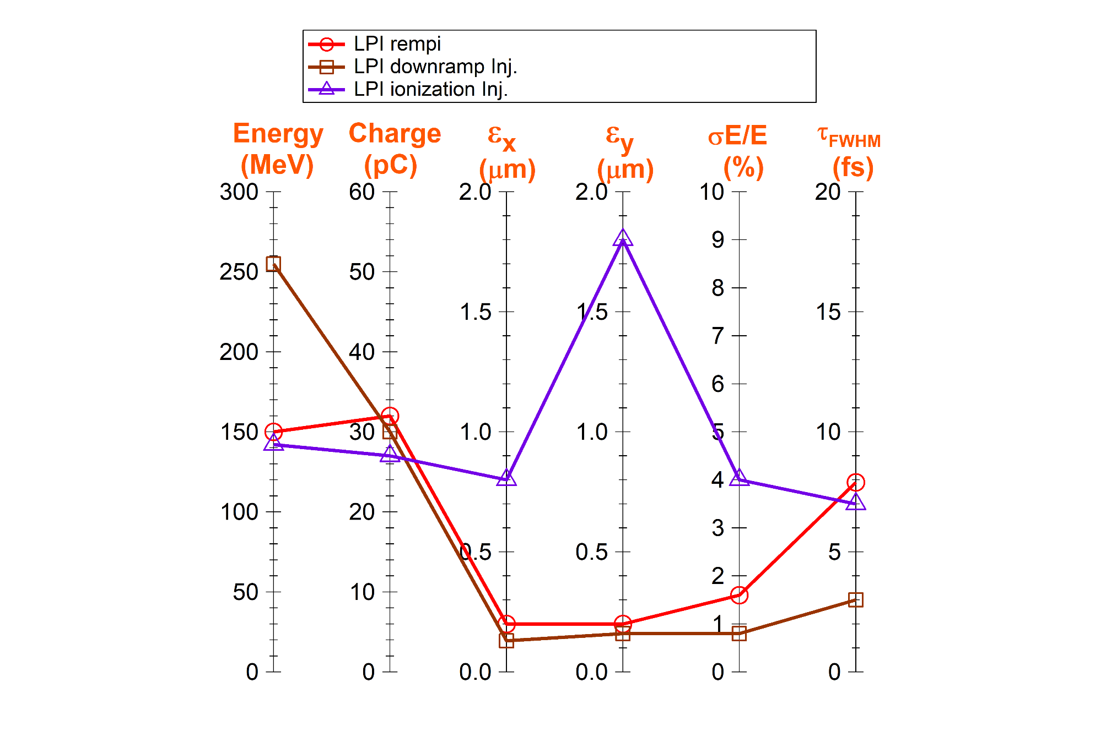
Beam parameters obtained at 150 MeV
Configurations closest to the requirements
Selected for start-to-end simulations
Required value

Slide 15
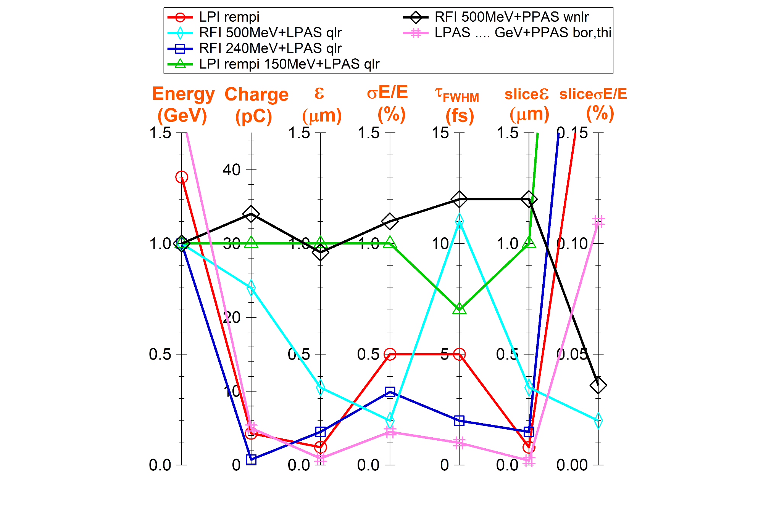
Beam parameters obtained at 1 GeV
All the configurations
Required value

Slide 16
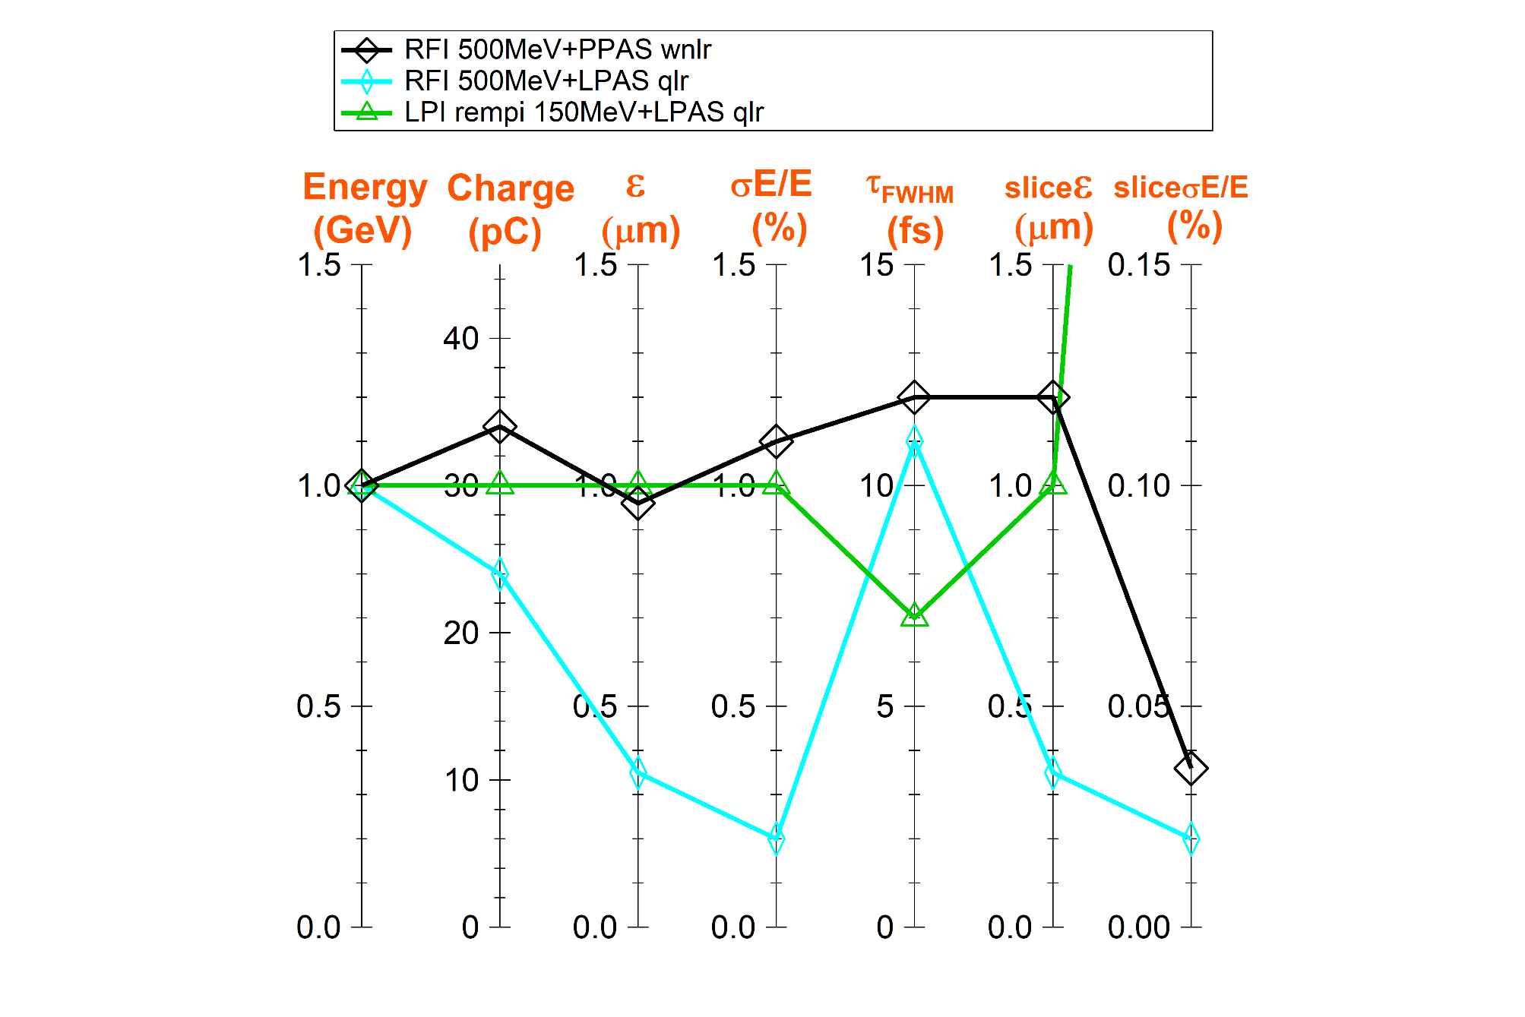
Beam parameters obtained at 1 GeV
Configurations closest to requirements
Selected for start-to-end simulations
Required value

Slide 17
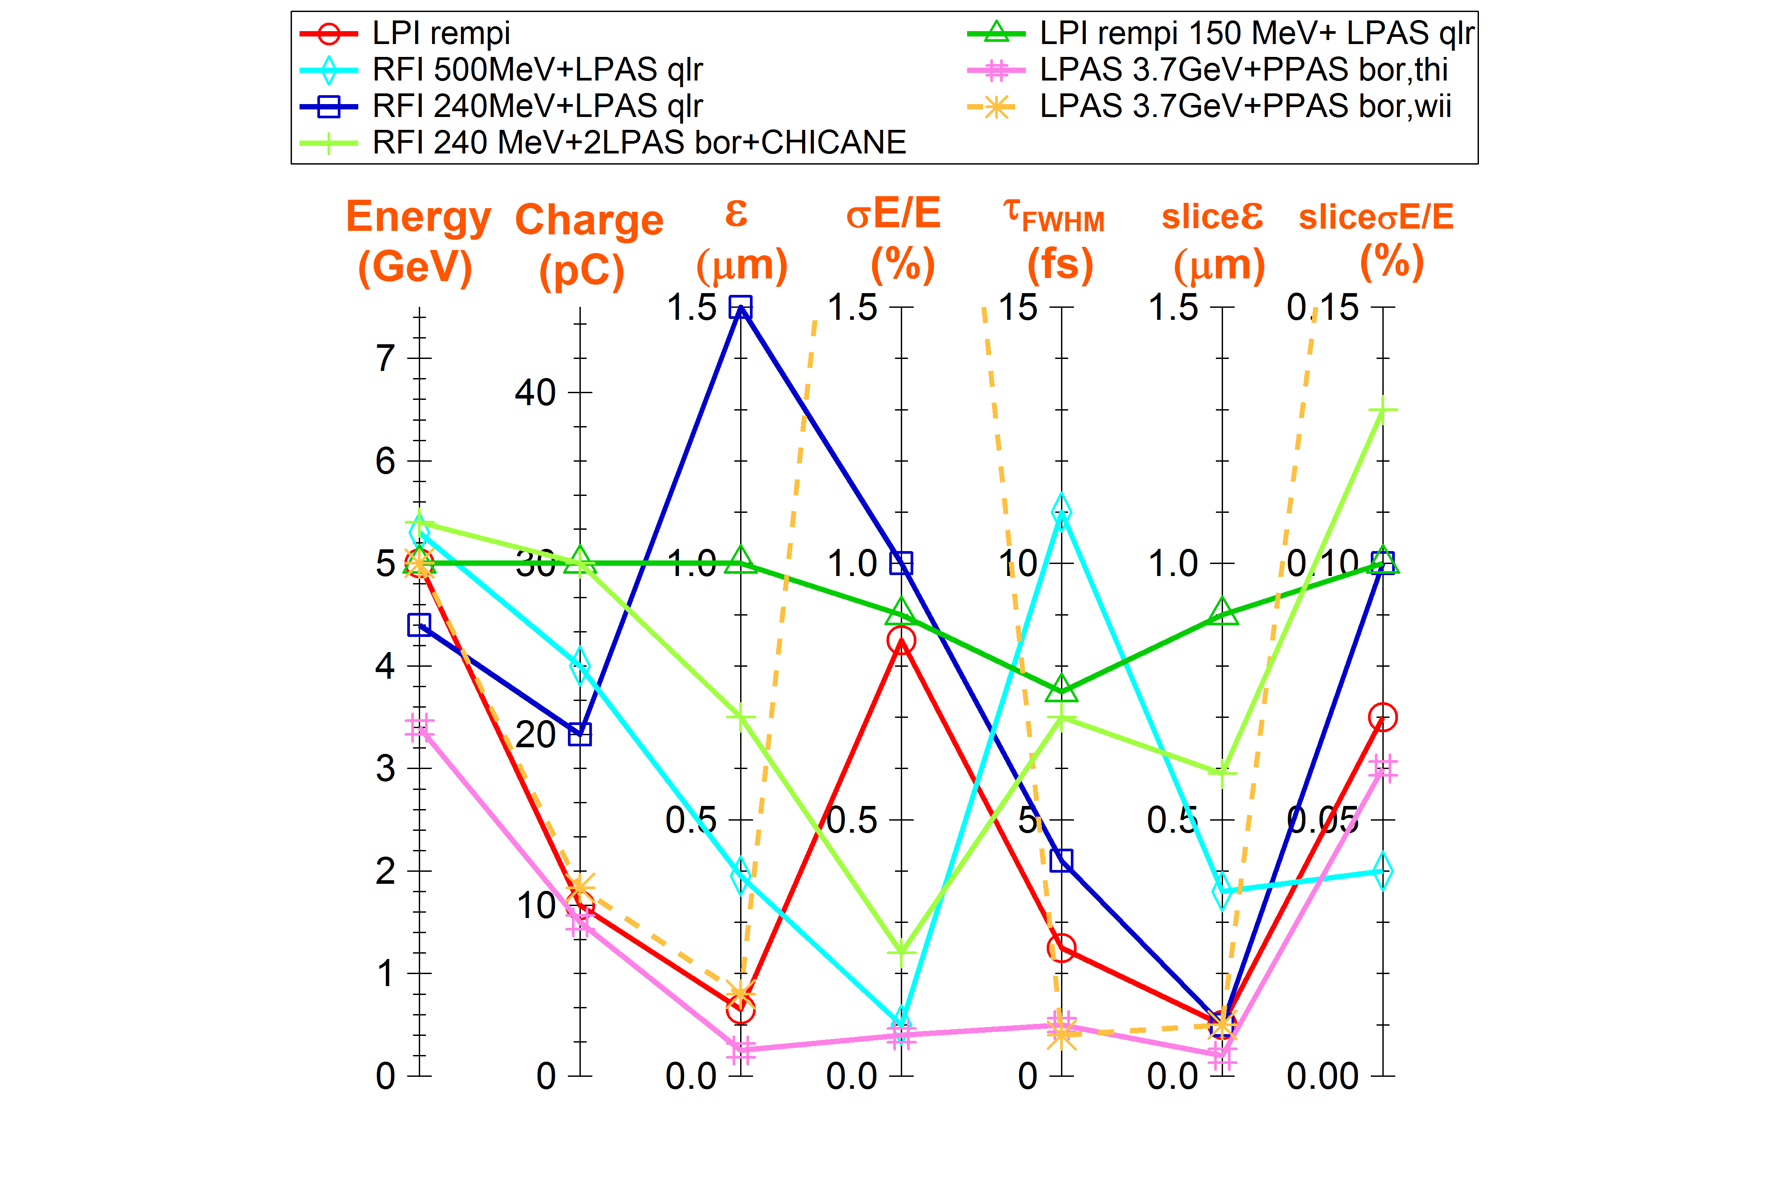
Beam parameters obtained at 5 GeV
All the configurations
Required value

Slide 18
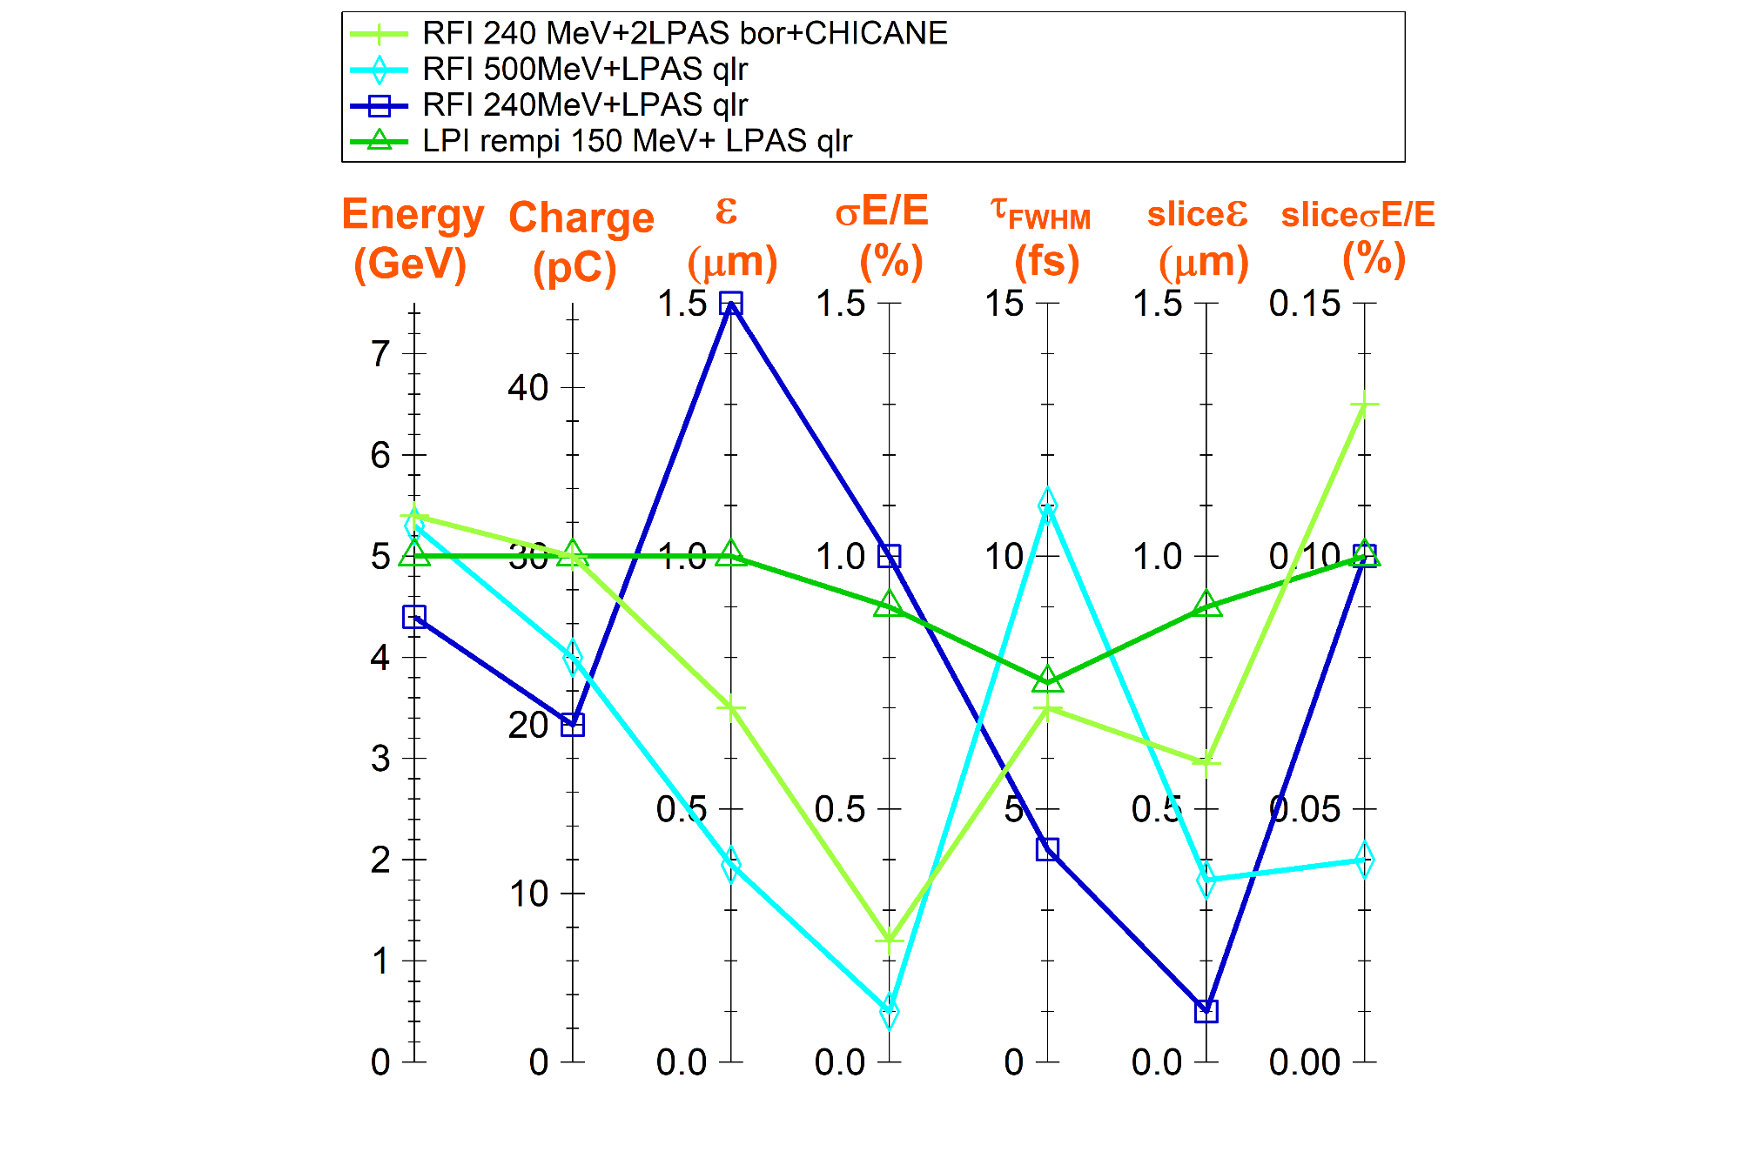
Beam parameters obtained at 5 GeV
Configurations closest to the requirements
Required value

Slide 19
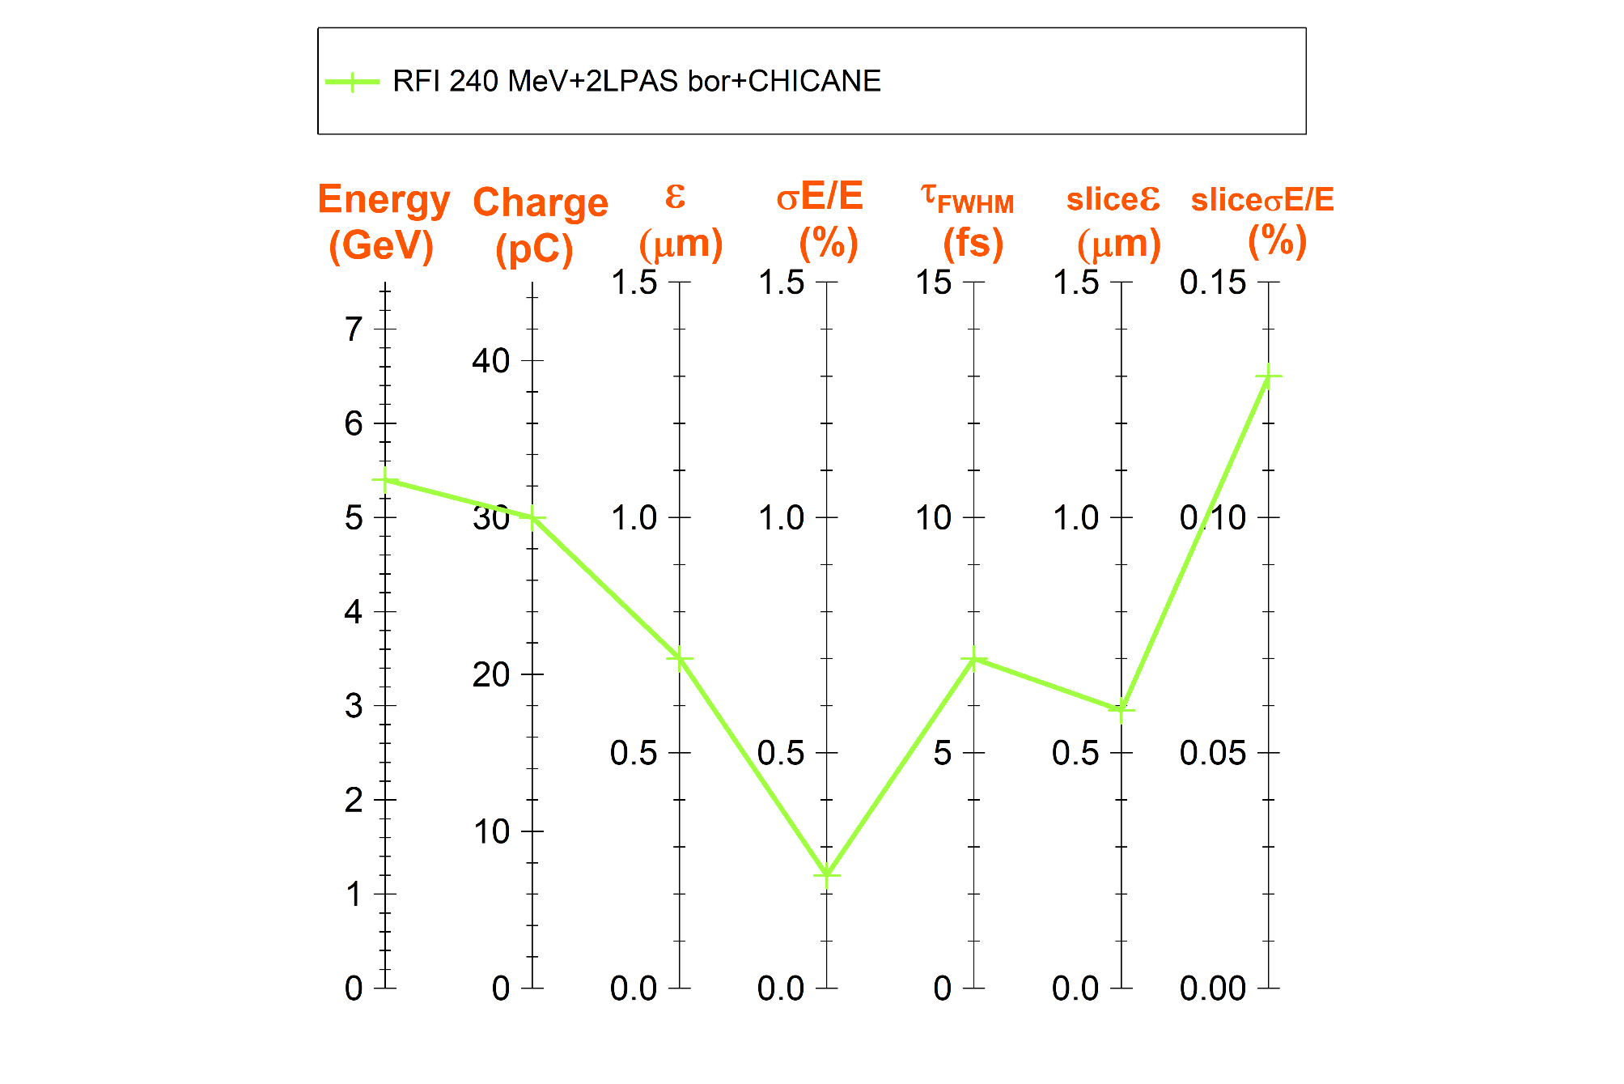
Beam parameters obtained at 5 GeV
2-LPAS configuration selected for S2E
Required value

Slide 20
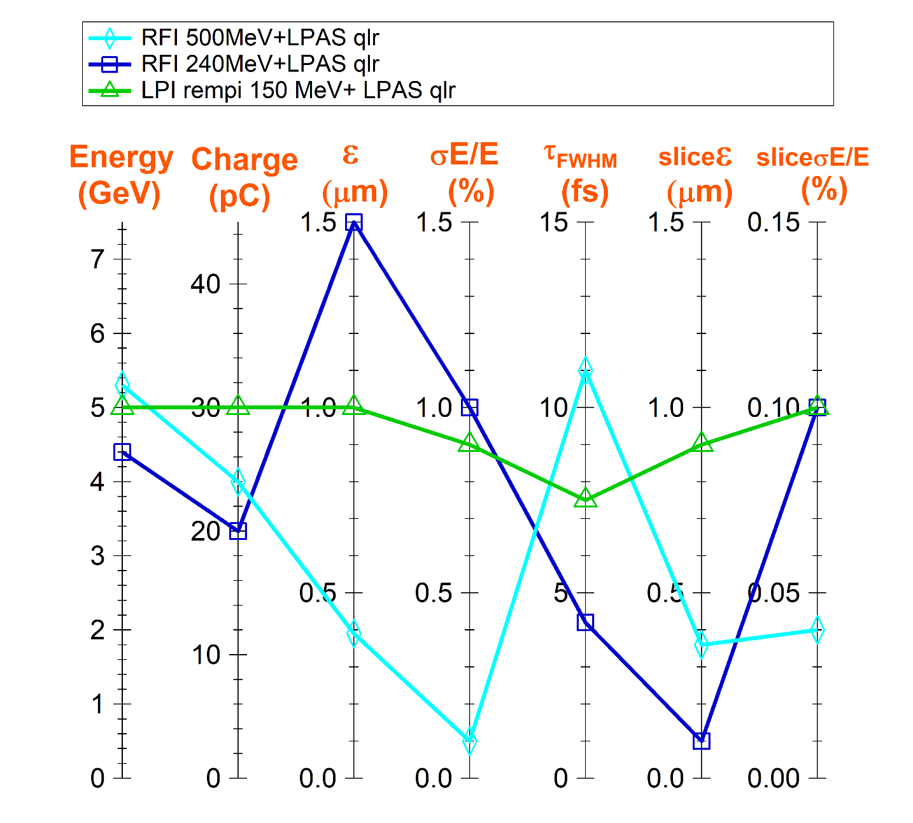
Beam parameters obtained at 5 GeV
1-LPAS configurations closest to the requirements
Required value
Three experts
Three institutes
Three codes used:
- Warp 3D
- QFluid ~3D
- FBPIC 3D
Three injectors:
LPI 150 MeV
RFI 240 MeV
RFI 540 MeV
Quasi linear regime
Close plasma,
laser parameters
⇒
Close results
Quasilinear regime with external injection: very robust !!!

Slide 21
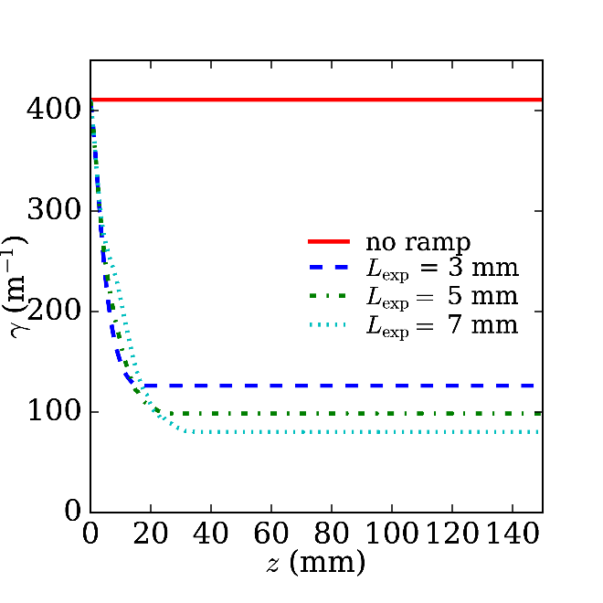
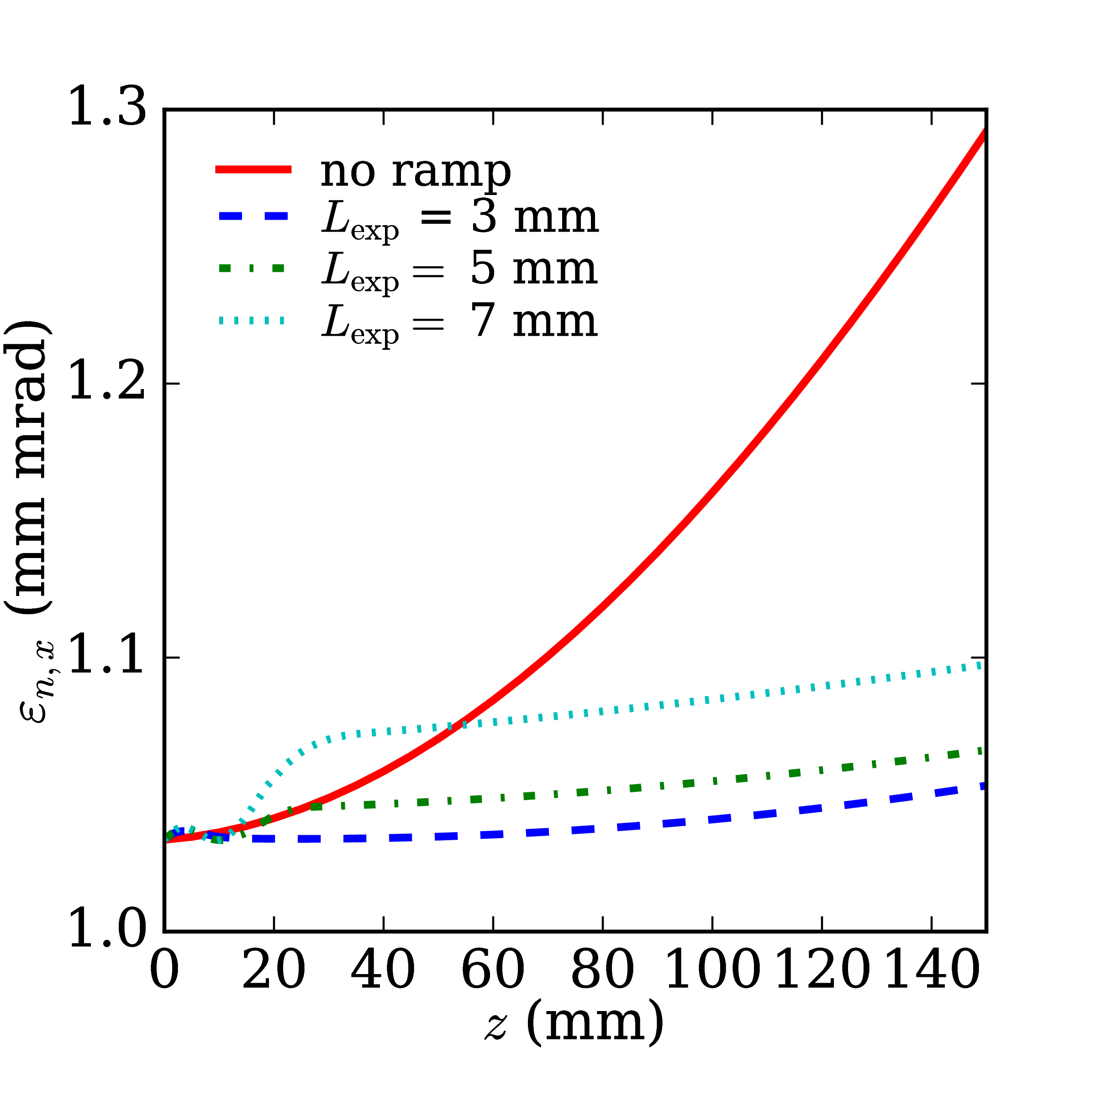
Beam Injection, Extraction & Transport
To minimize emittance growth, it is imperative to:
1
Tune the density ramp length, at entrance and exit (whatever its shape!)
2
Design transport lines where
number of quadrupoles = number of constraints (6, no more!)
LETL: 0.7 m, HETL: 4 m ➔ 20% emittance growth throughout a plasma stage

Slide 22
Selected Inj./Acc. Configurations
RFI 250-500MeV +
LPAS (quasilinear regime)
LPI 150 MeV (REMPI) + LPAS (quasilinear regime)
L
W
F
A
LETL
HETL
HETL
150 MeV
5 GeV
(1 GeV)
LPI
5 GeV
(1 GeV)
LPI
LPAS
250-500 MeV
HETL
240 MeV
2.5 GeV
HETL
RFI
LPAS
5 GeV
(1 GeV)
RFI
LPAS
LPAS
5 GeV
(1 GeV)
PWFA
HYBRID
500 MeV
HETL
3.5 GeV
HETL
RFI
PPAS
1 GeV
LPAS
PPAS
5 GeV
(1 GeV)
RFI 500 MeV +
PPAS (weakly-nonlinear regime)
RFI 240MeV +
2 LPAS (blow-out regime) +
CHICANE
Decouple injection from acceleration: two stages!
and also in the injection stage itself again!
Notice: a certain level of sophistication is necessary!!

Slide 23
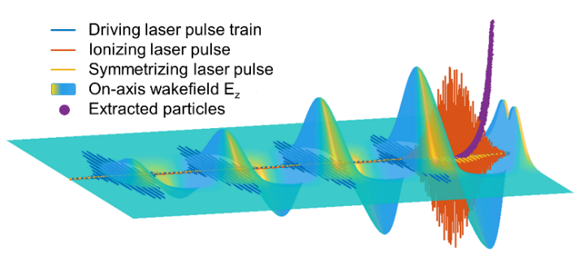
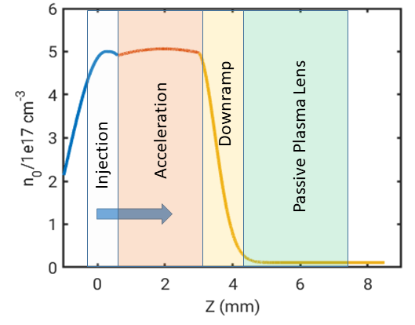
Specifications for laser & plasma at 150 MeV
"ReMPI"
Driving laser: decomposed in 4 subpulses, delay 160 fs
120 TW, 4 J, w₀ = 30 μm (a₀ = 1, τ_{FWHM} = 30 fs)
Ionizing laser: 3rd harmonic
1.0 TW, 0.07 J, w₀ = 3.8 μm (a₀ = 0.53, τ_{FWHM} = 45 fs)
Symmetrization laser: 3rd harmonic, delay 40 fs
0.7 TW, 0.02 J, w₀ = 11 μm (a₀ = 0.14, τ_{FWHM} = 25 fs)
Plasma: radially uniform, length 3.5 mm + 1 mm ramp
N preionized up to 5⁺, density n₀ = 5 10¹⁷ cm⁻³
+ 3 mm passive plasma lens, n₀ = 1.4 10¹⁶ cm⁻³
OR ELSE
"Downramp Injection"
Laser: 35 TW, 1.05 J, w₀ = 18 μm (a₀= 1.8, τ_{FWHM} = 30 fs)
(a₀ will be x 2 by self focusing)
Plasma: radially uniform, ~3.5 mm long
~1 mm upramp, ~0.1 mmm plateau at n₀ = 6 10¹⁸ cm⁻³
~0.15 mm downramp, 1.8 mm accelerating plateau at n₀ = 4 10¹⁸ cm⁻³
Exit ramp exponential L_{exp}=0.1 mm
+ passive plasma lens ~4mm at n₀ = 1 10¹⁶ cm⁻³

Slide 24
Spécifications for laser & plasma at 1 & 5 GeV
1 GeV
Laser: P = 200 TW, E = 30 J, w₀ = 30 μm ( a₀ = 2.57, τ_{FWHM} = 141 fs)
Bi gaussian
Plasma: parabolic in r, Δn/n_{c} = 1 to 0.6
unniform in z, 5 to 7 cm long, n₀ = 1 to 2 10¹⁷ cm⁻³
entrance and exit ramps ~2 cm
5 GeV
Laser: P = 400 TW, E = 60 J, w₀ = 45 μm ( a₀ = 2.42, τ_{FWHM} = 141 fs)
Bi gaussian
Plasma: parabolic in r, Δn/n_{c} = 1 to 0.3
unniform in z, 30 to 50 cm long, n₀ = 1 to 2 10¹⁷ cm⁻³
entrance and exit ramps ~2 cm

Slide 25
Summary
Tremendous simulations and optimizations have been performed by many contributors
→ Many results obtained on different injection/acceleration schemes and techniques
→ First down selection performed for S2E simulations
Issues of emittance growth addressed and solved
Thorough S2E simulations done
→ Beam parameters at user's doorstep very close to all the requirements
A certain level of sophistication is necessary
Solutions do exist, at least one is robust
Other schemes or techniques remain promising
Further progress is still possible
Next step: Errors and Tolerances studies

Slide 26
RESERVE

Slide 27
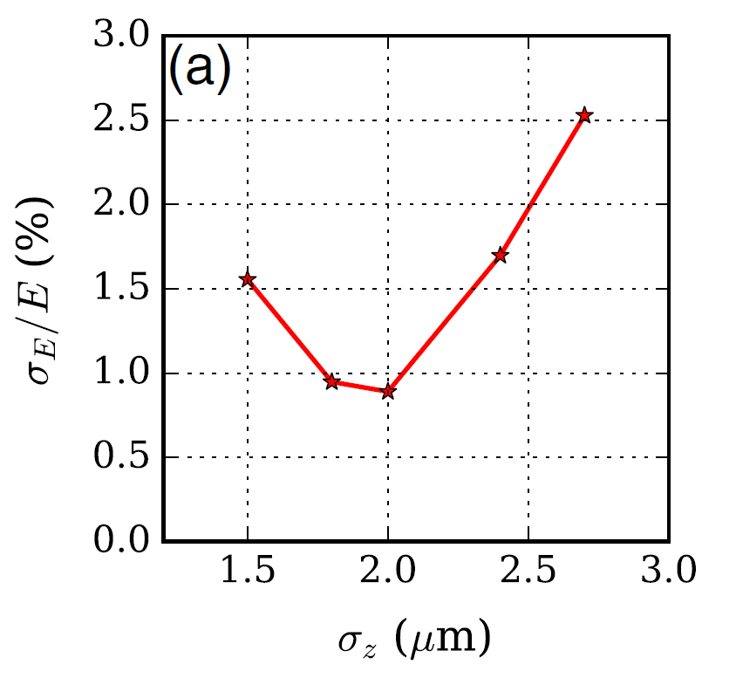
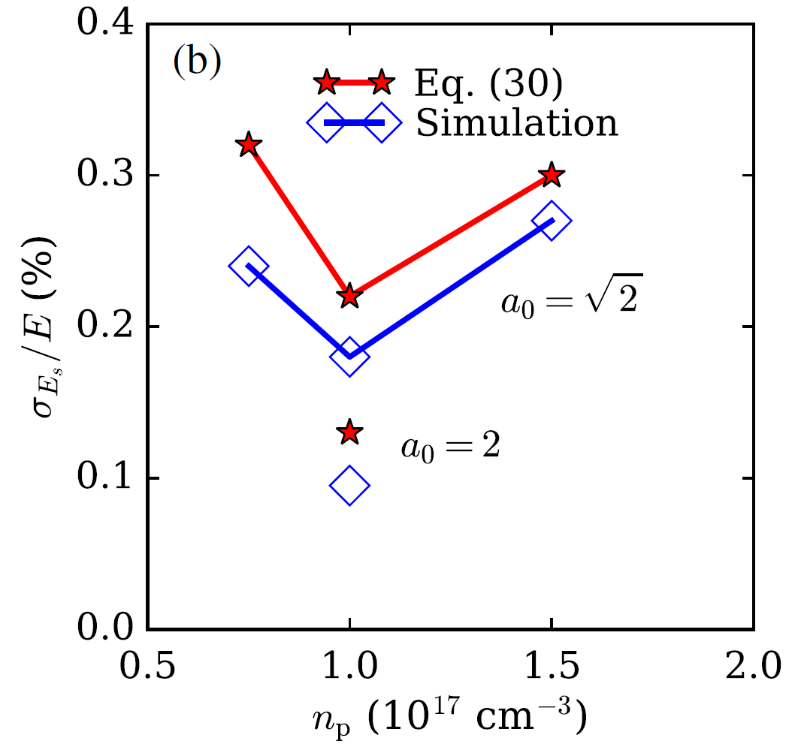
In the presence of significant beam loading
Optimizing energy spread
by optimizing the beam length
Optimizing slice energy spread
by optimizing jointly
the plasma density
and the laser rtength

